Slide 1



Slide 2


Slide 3
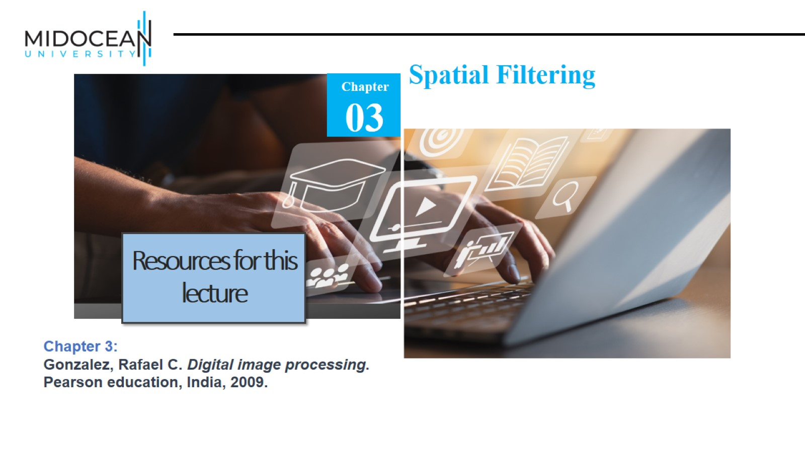

Slide 4
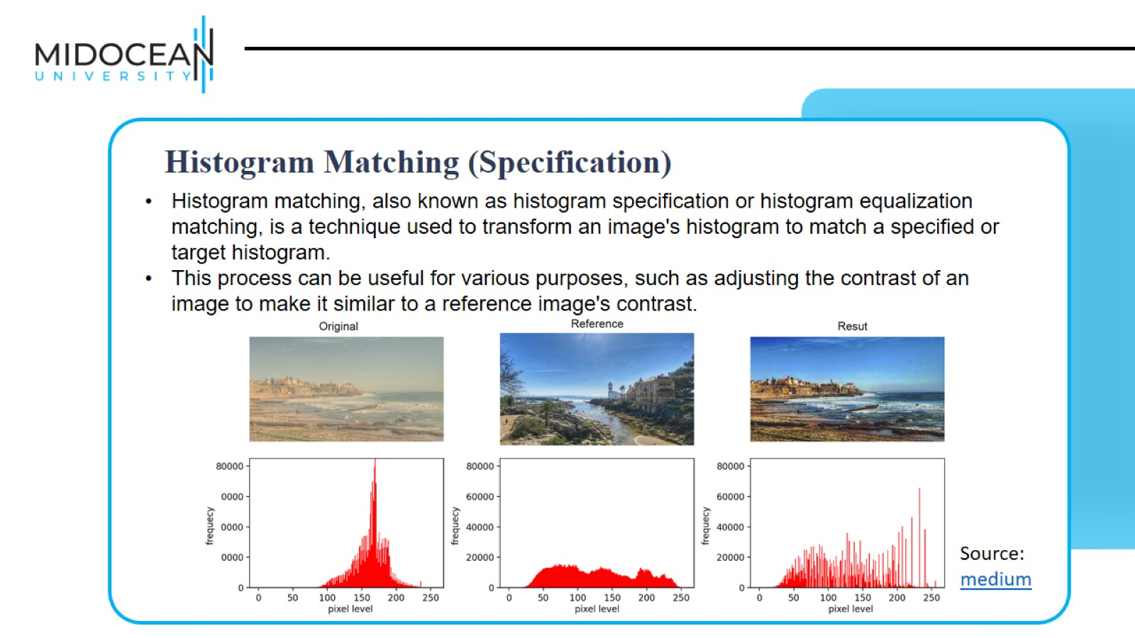

Slide 5
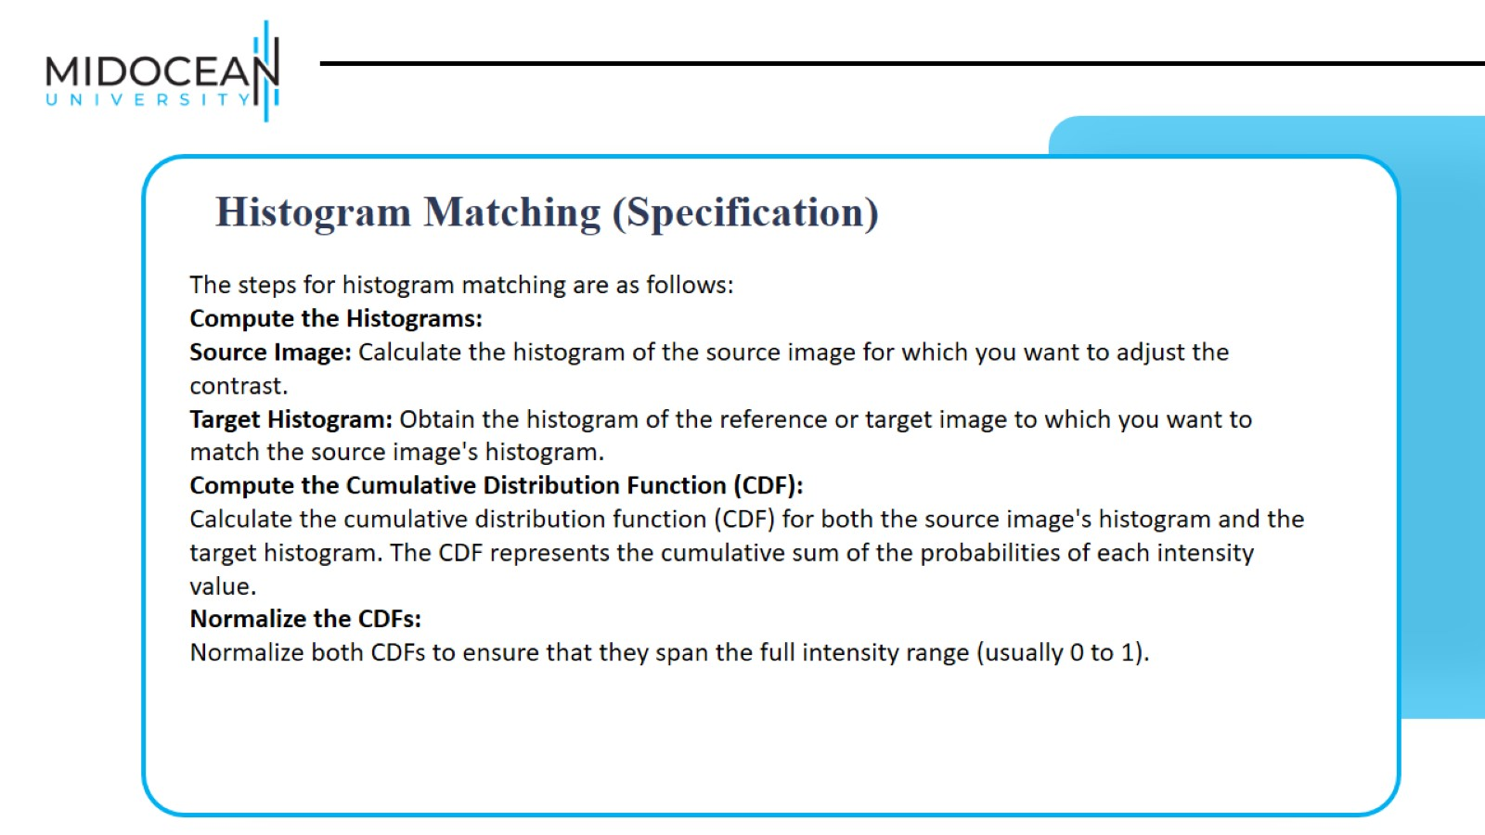

Slide 6
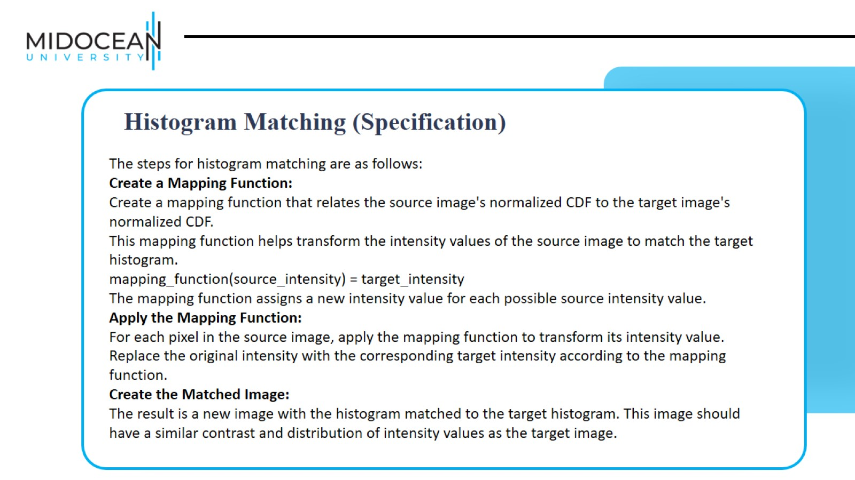

Slide 7
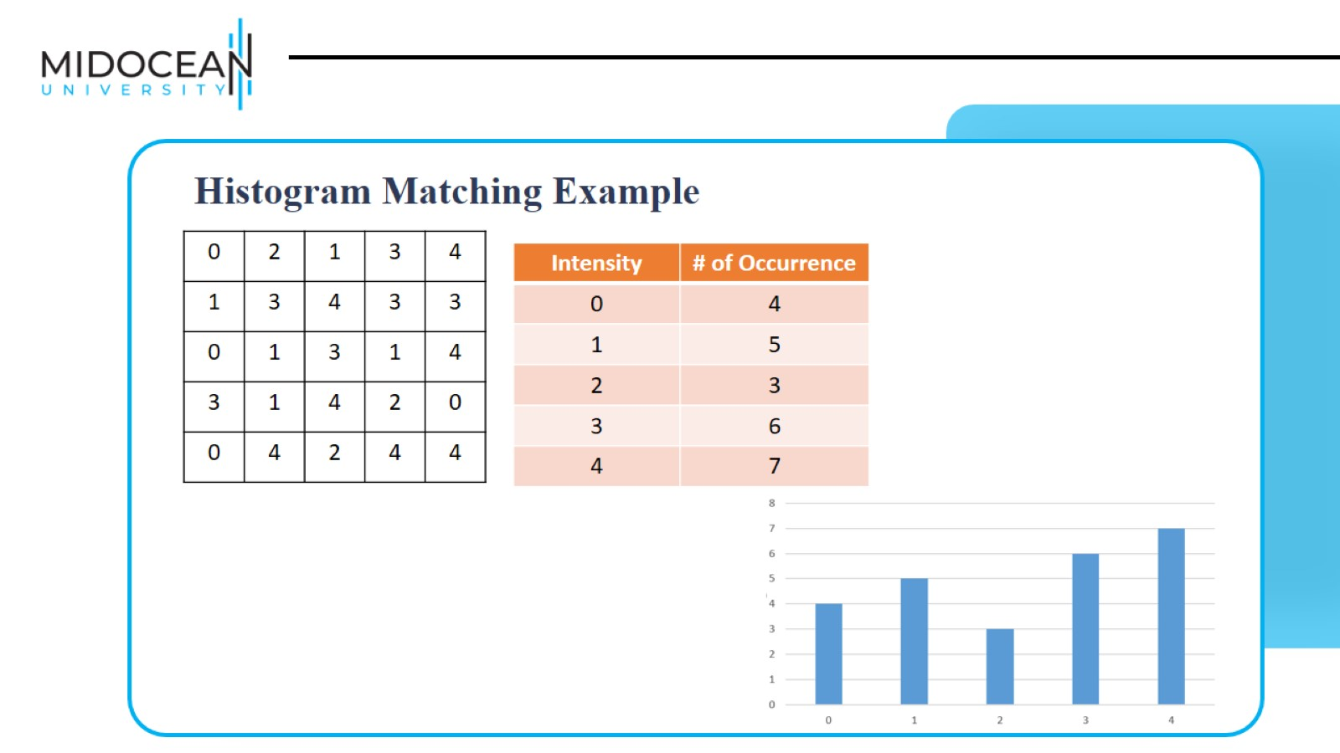

Slide 8
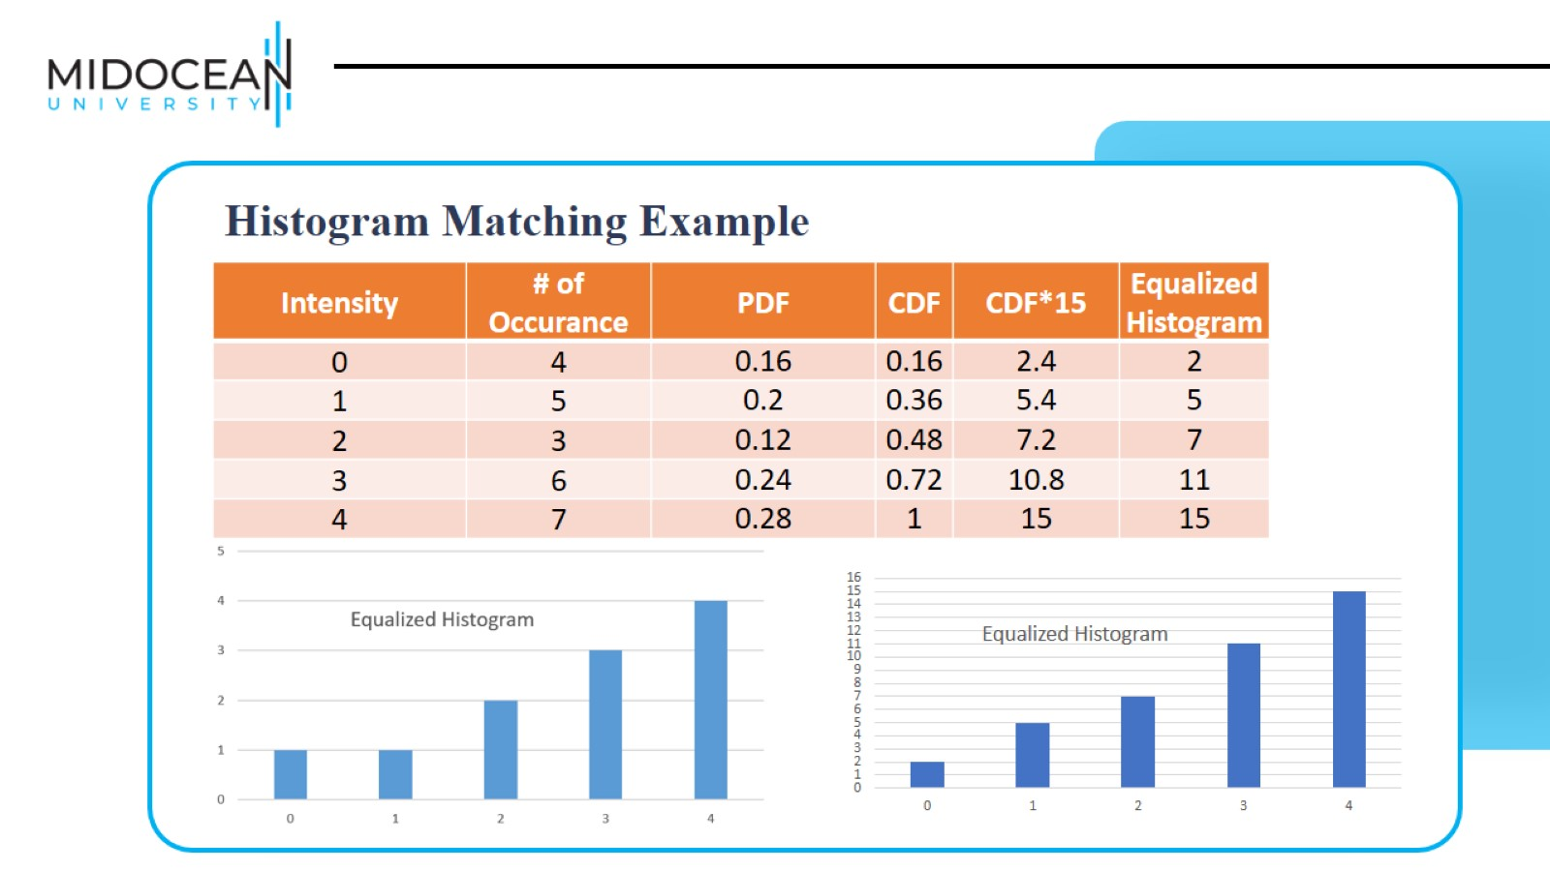

Slide 9
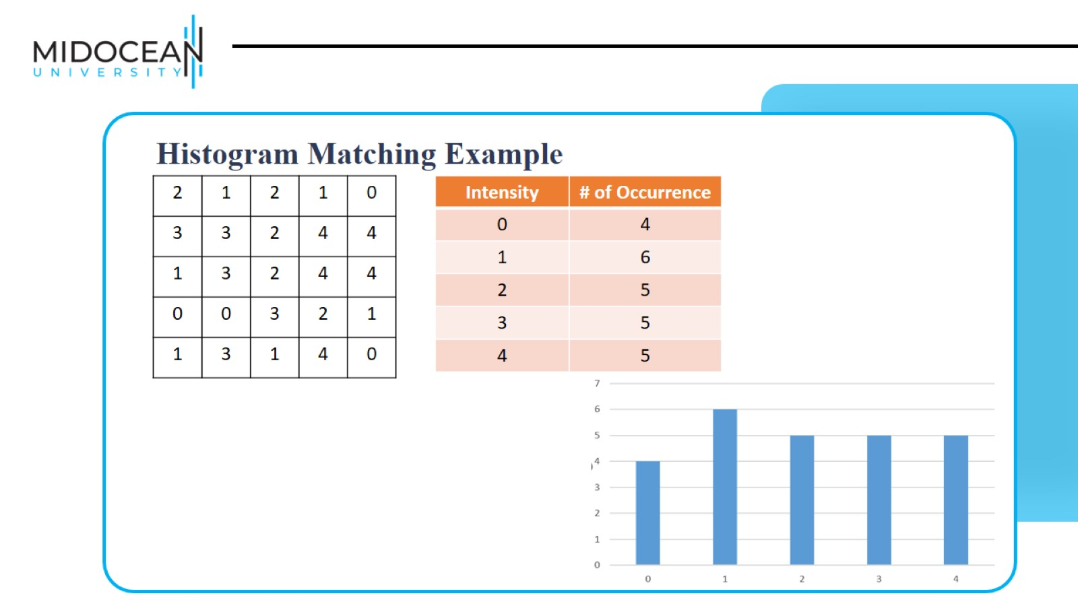

Slide 10
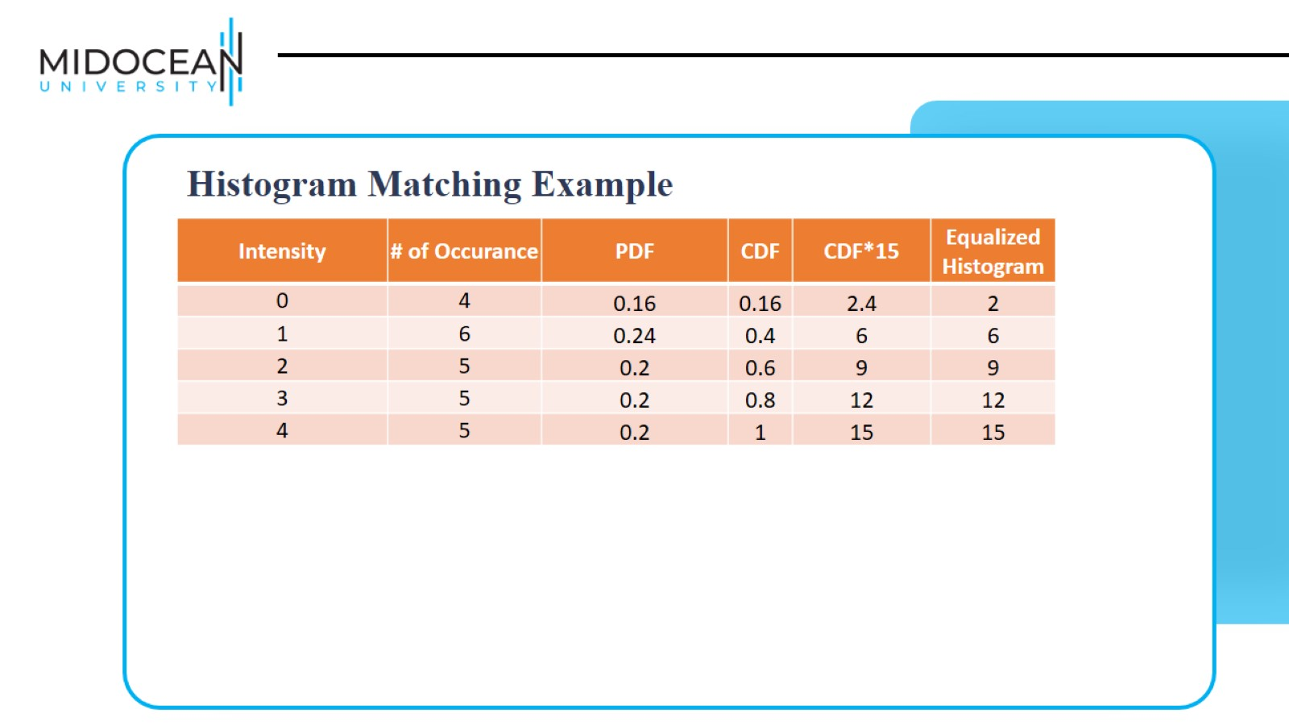

Slide 11
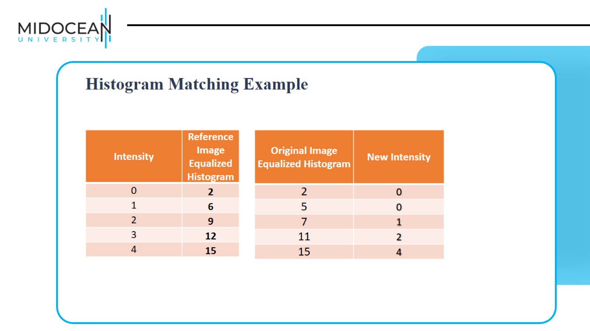

Slide 12
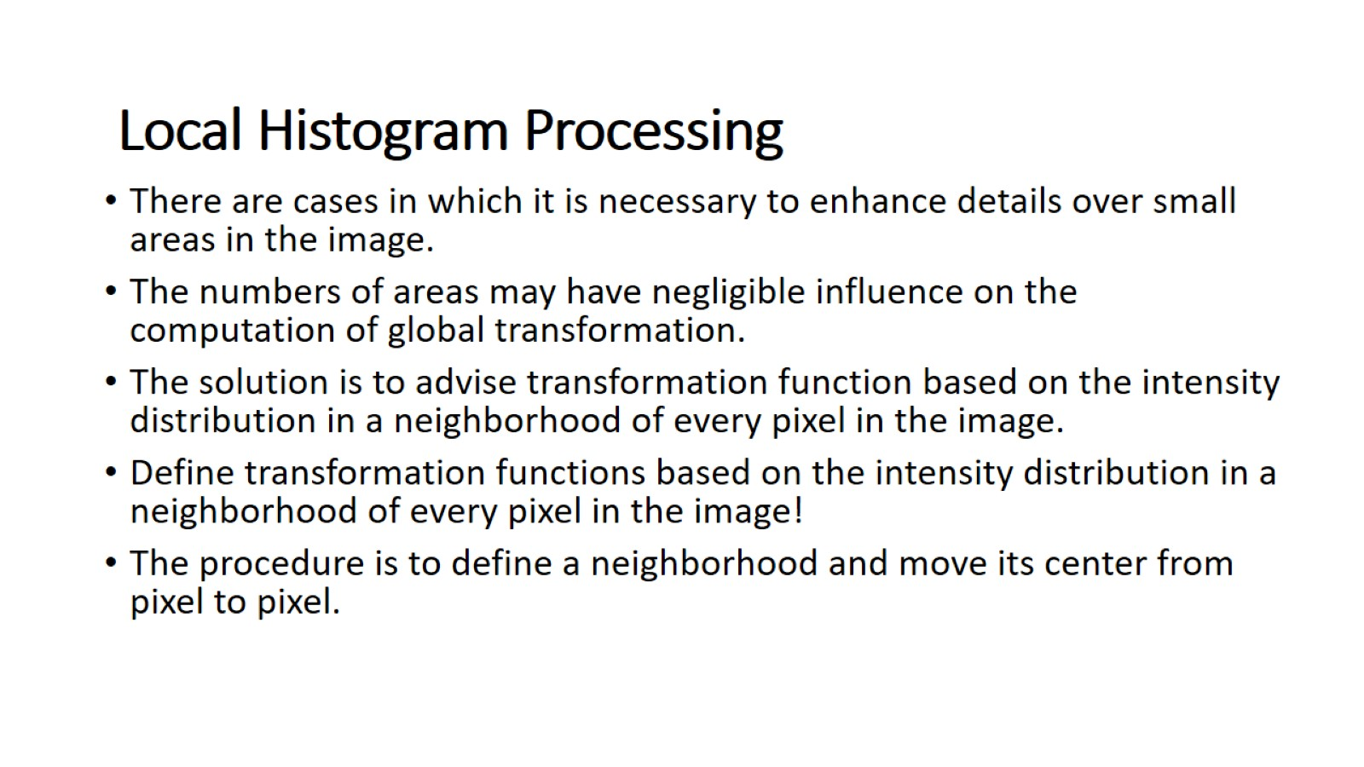
Local Histogram Processing

Slide 13
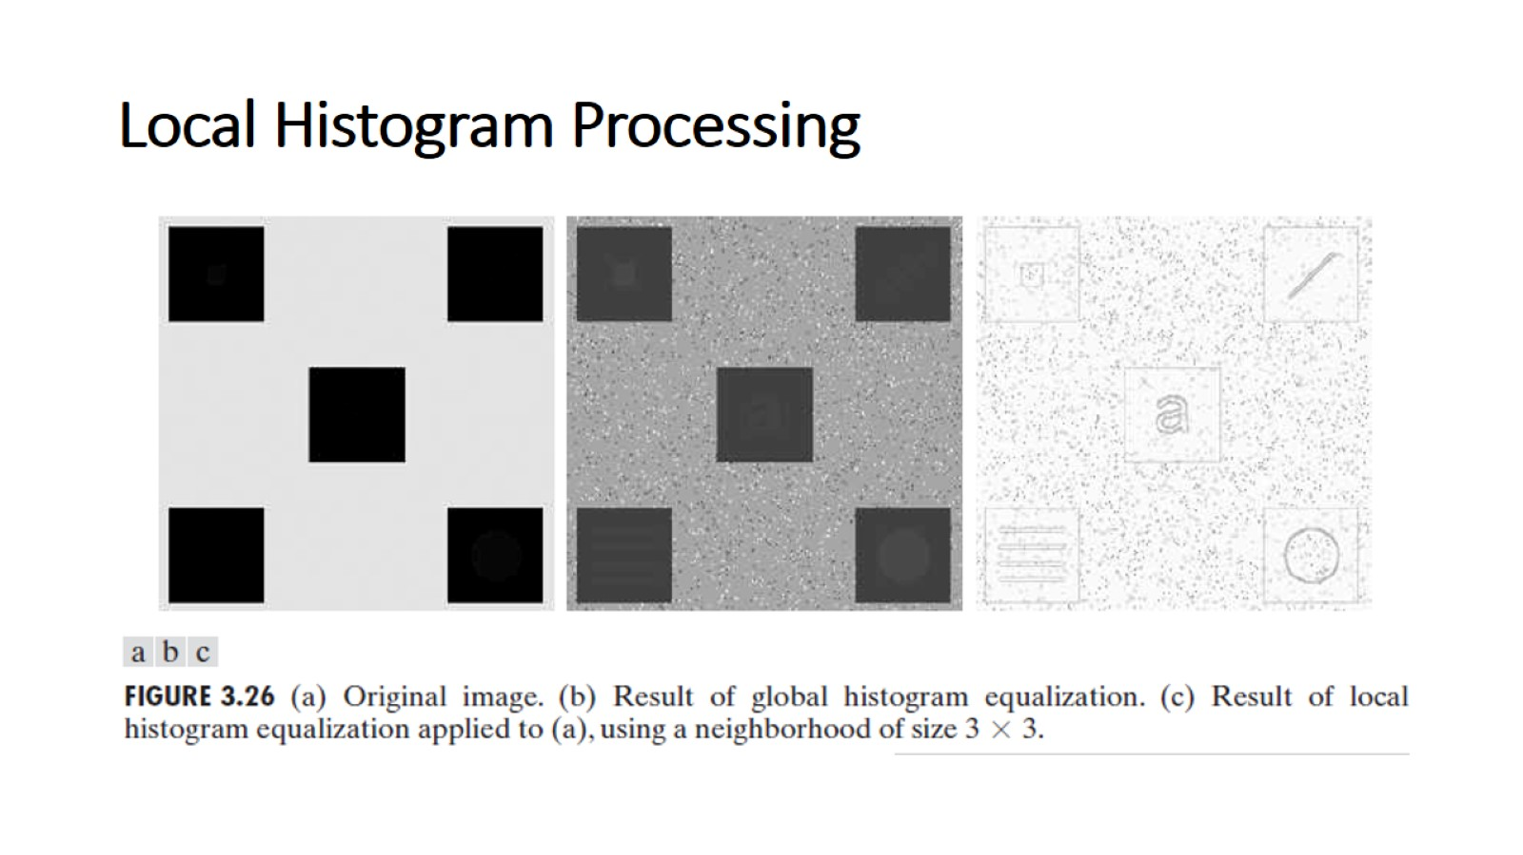
Local Histogram Processing

Slide 14
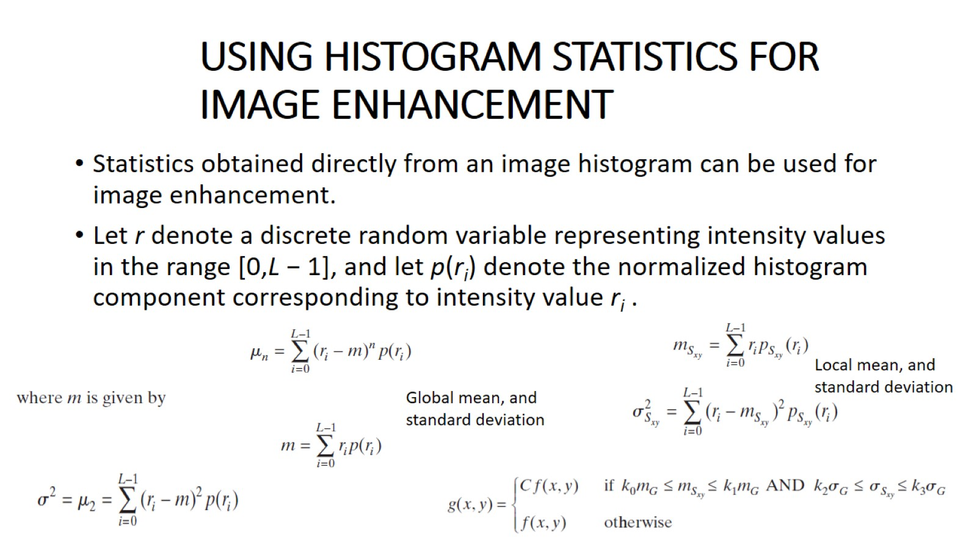
USING HISTOGRAM STATISTICS FOR IMAGE ENHANCEMENT

Slide 15
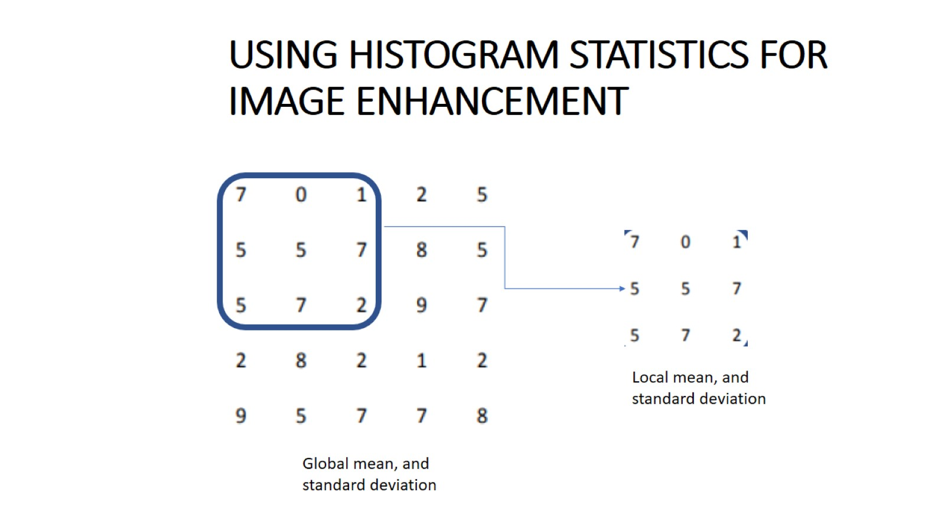
USING HISTOGRAM STATISTICS FOR IMAGE ENHANCEMENT

Slide 16
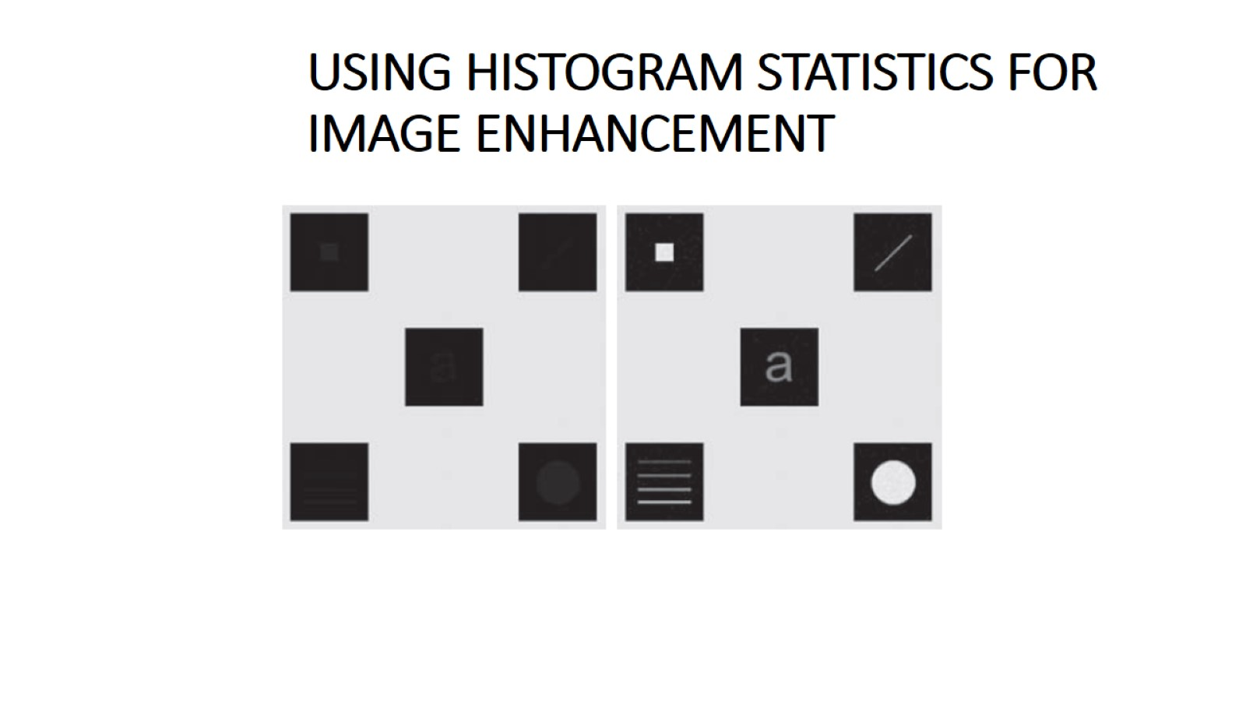
USING HISTOGRAM STATISTICS FOR IMAGE ENHANCEMENT

Slide 17
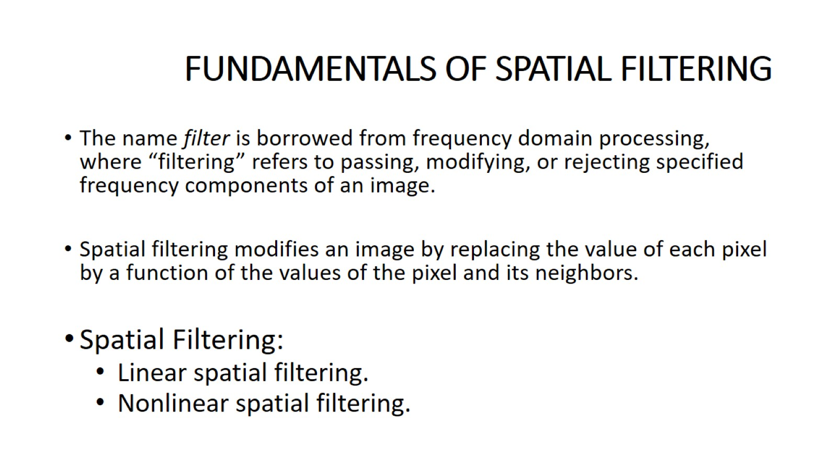
FUNDAMENTALS OF SPATIAL FILTERING

Slide 18
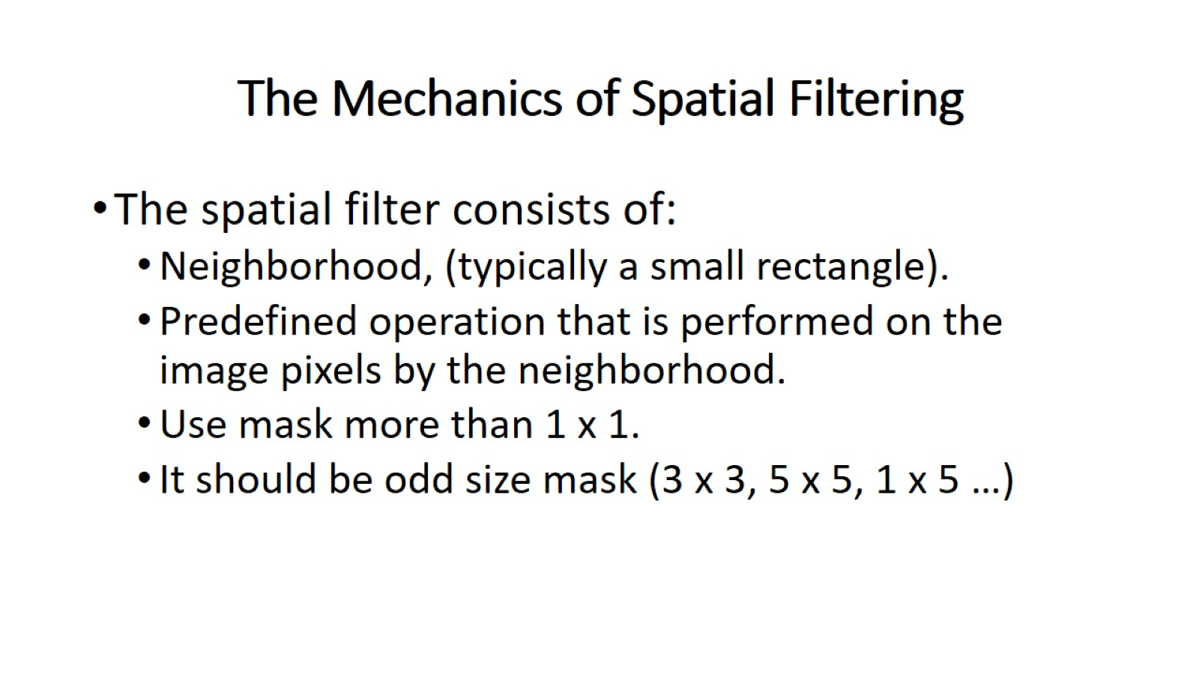
The Mechanics of Spatial Filtering

Slide 19
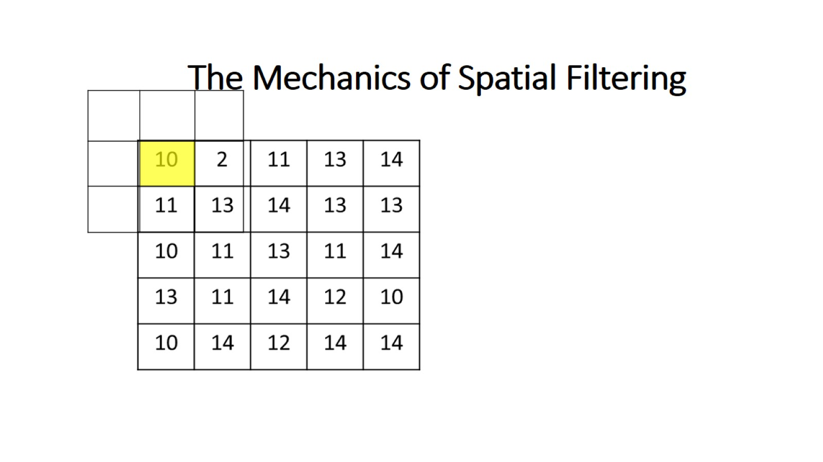

Slide 20
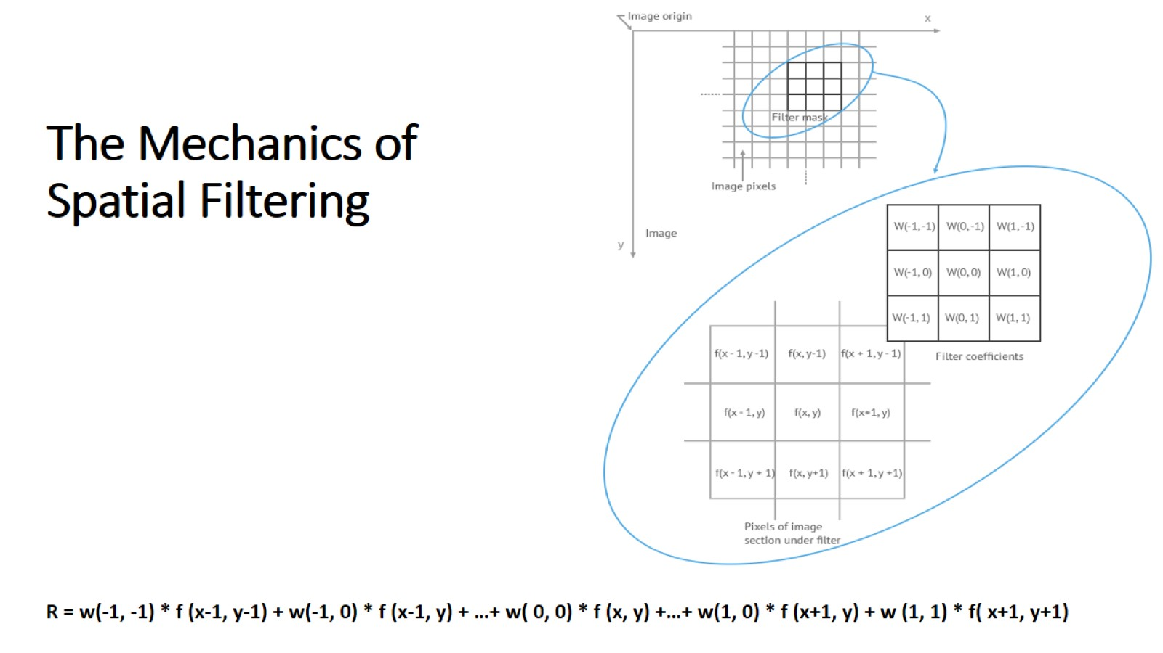
The Mechanics of Spatial Filtering

Slide 21
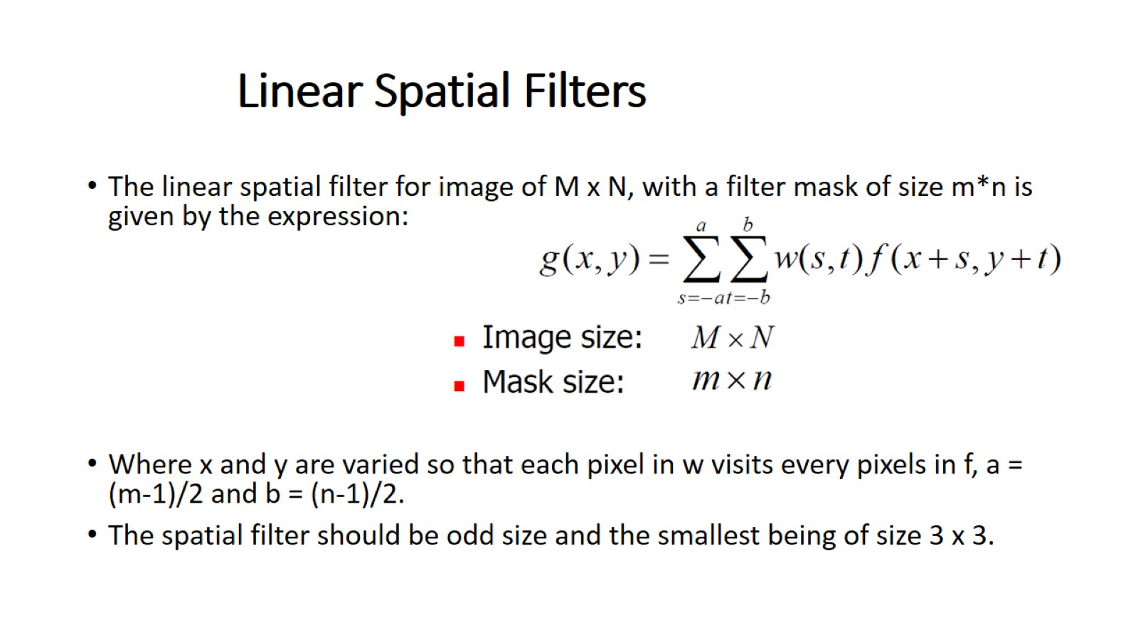
Linear Spatial Filters

Slide 22
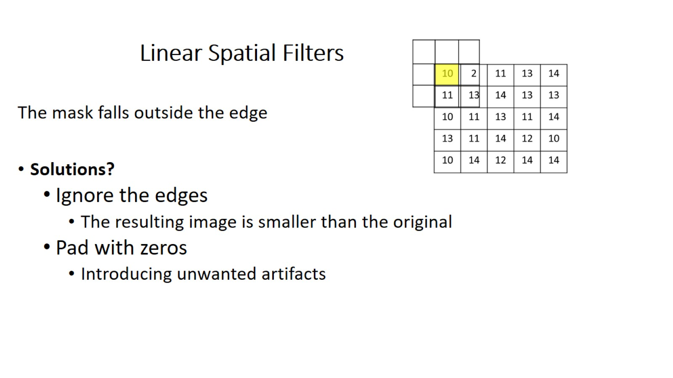

Slide 23
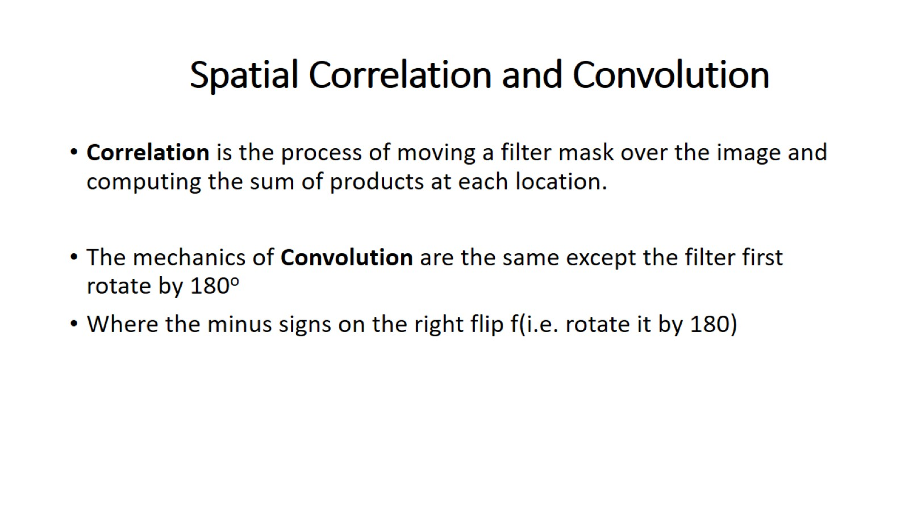
Spatial Correlation and Convolution

Slide 24
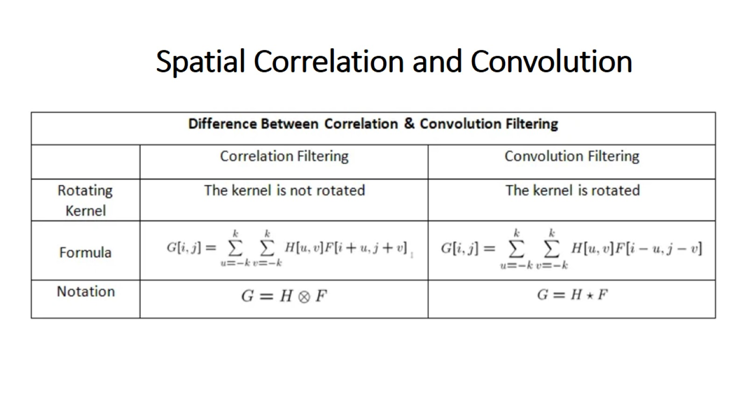

Slide 25
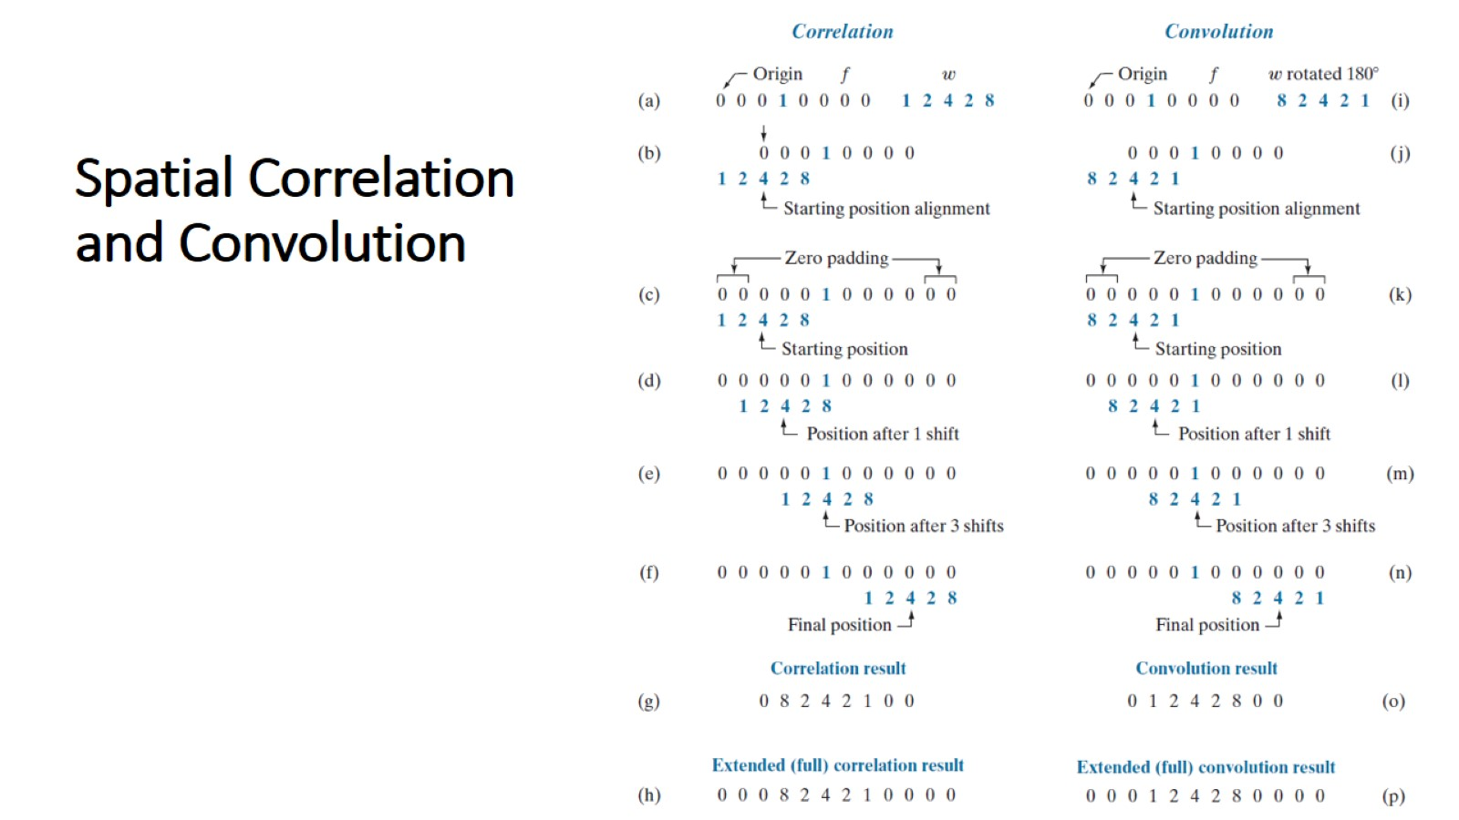
Spatial Correlation and Convolution

Slide 26
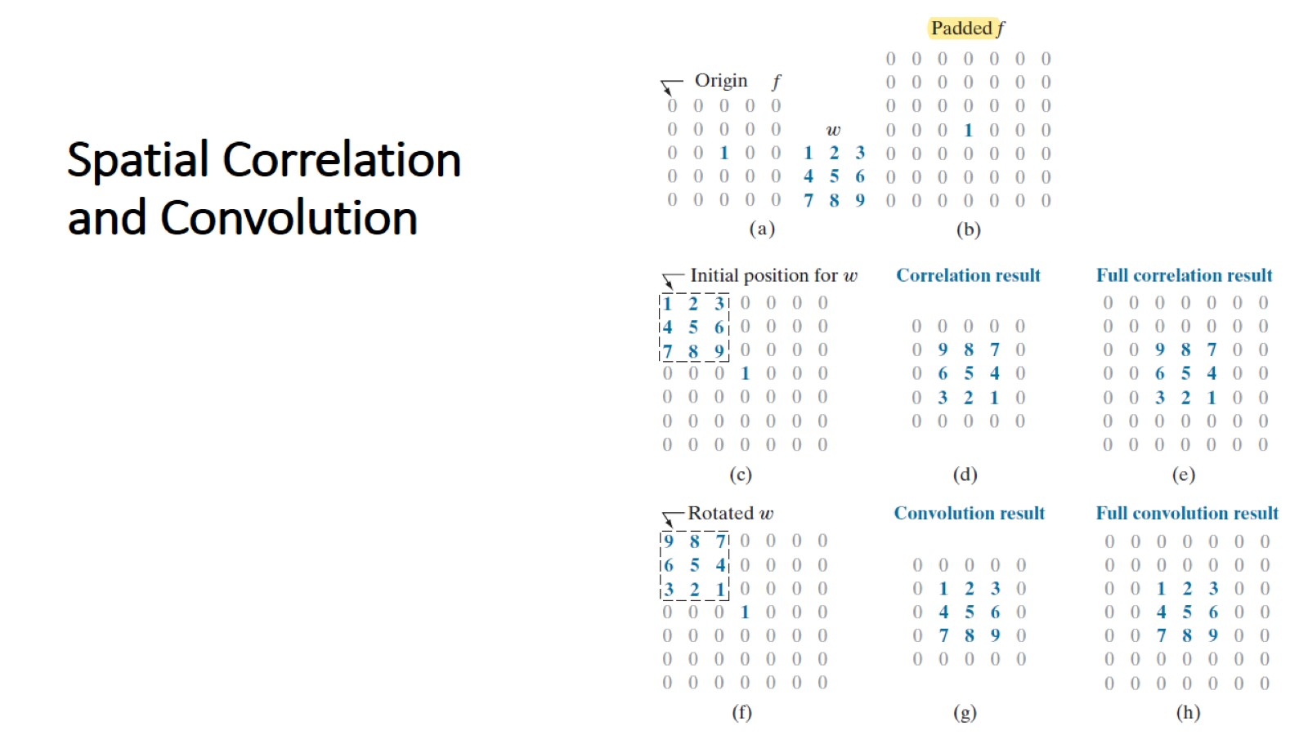

Slide 27
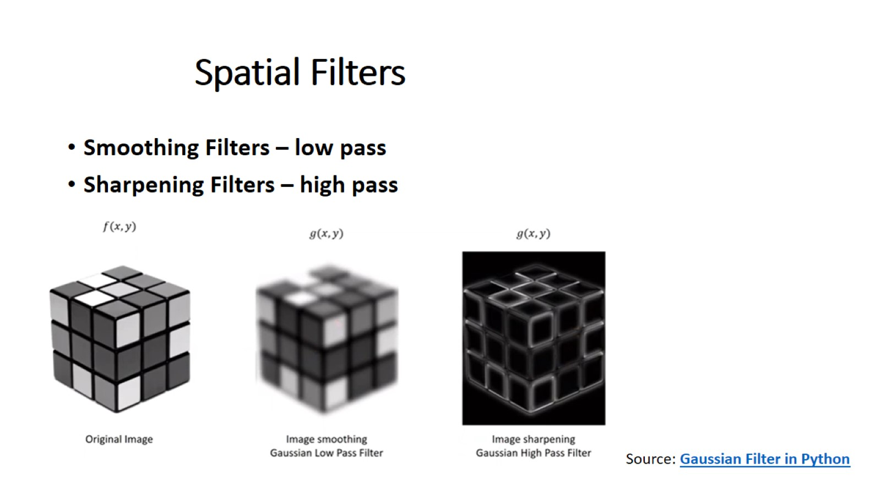
Spatial Filters

Slide 28
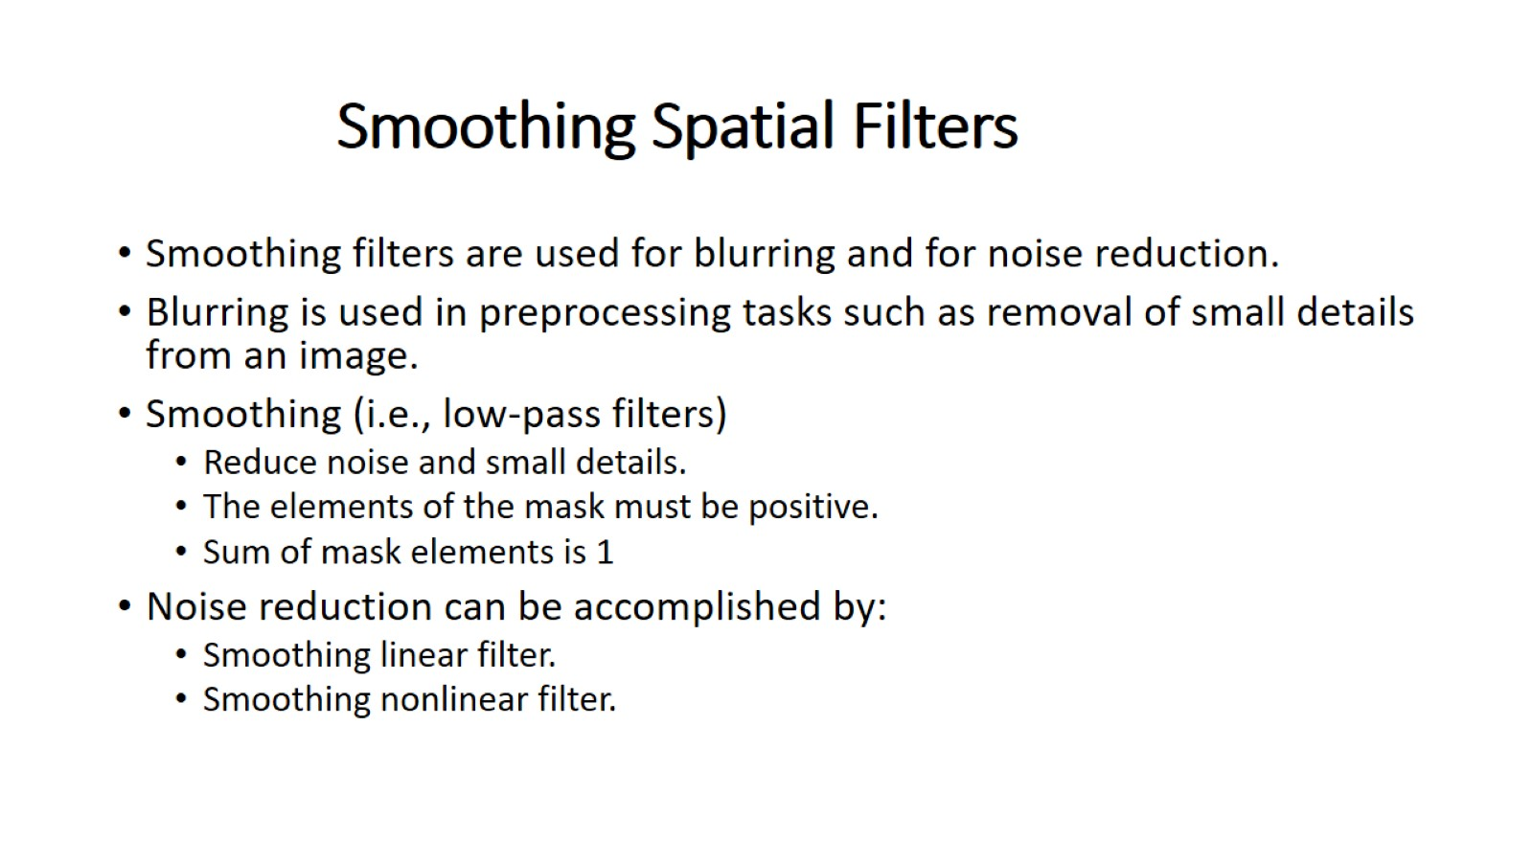
Smoothing Spatial Filters

Slide 29
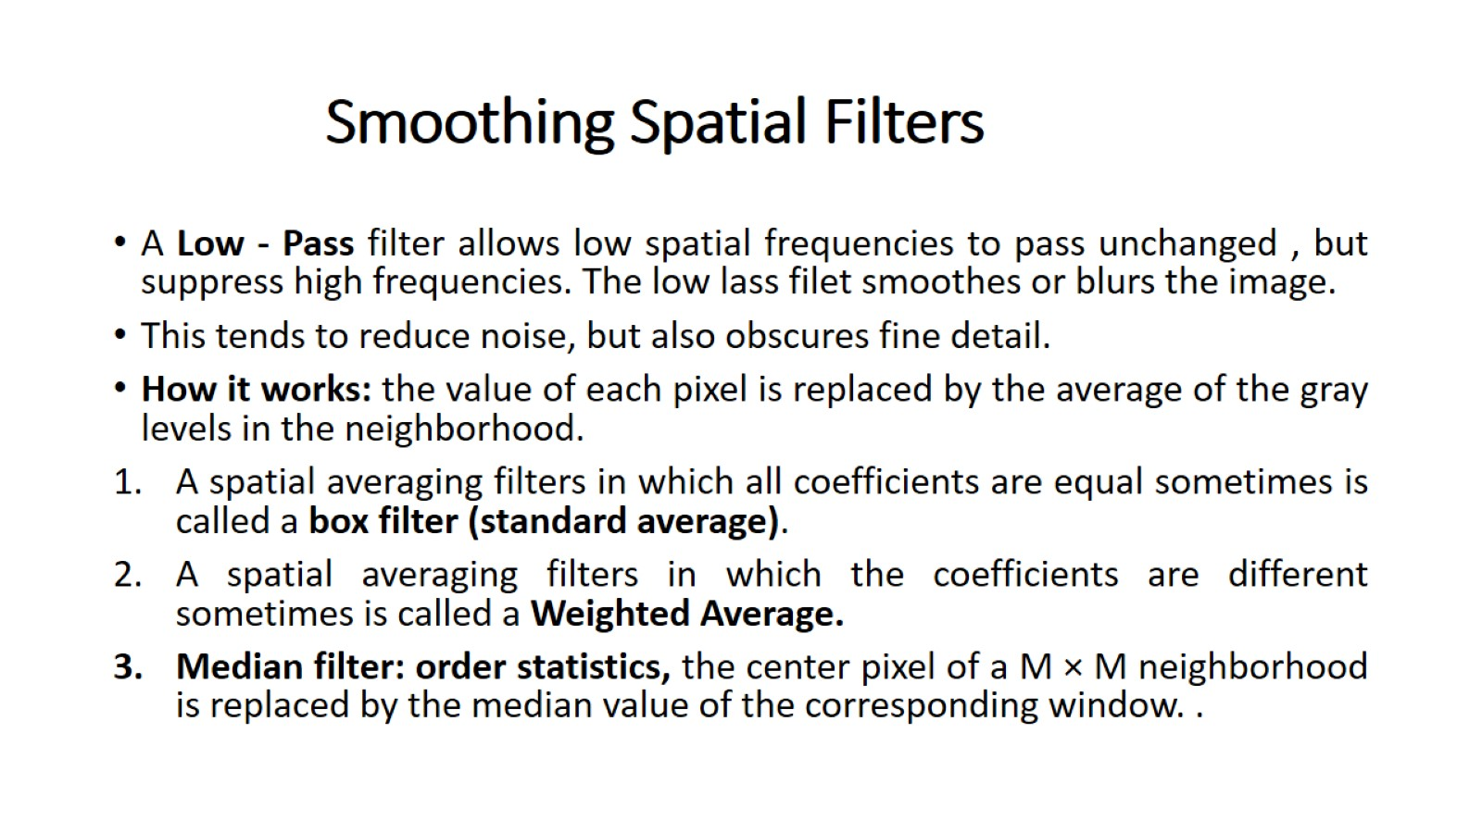
Smoothing Spatial Filters

Slide 30
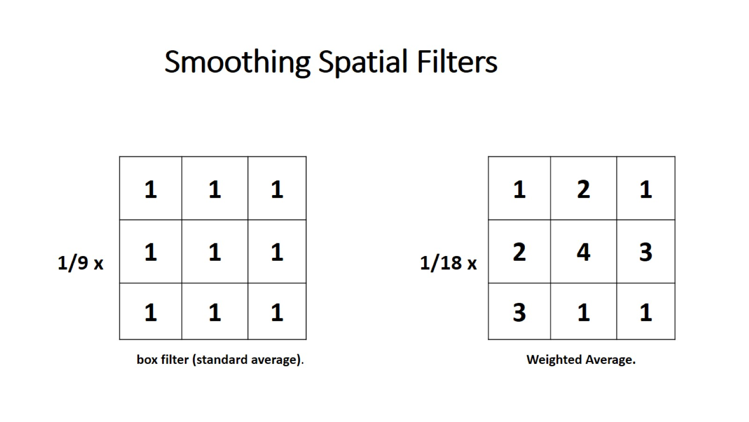
Smoothing Spatial Filters

Slide 31
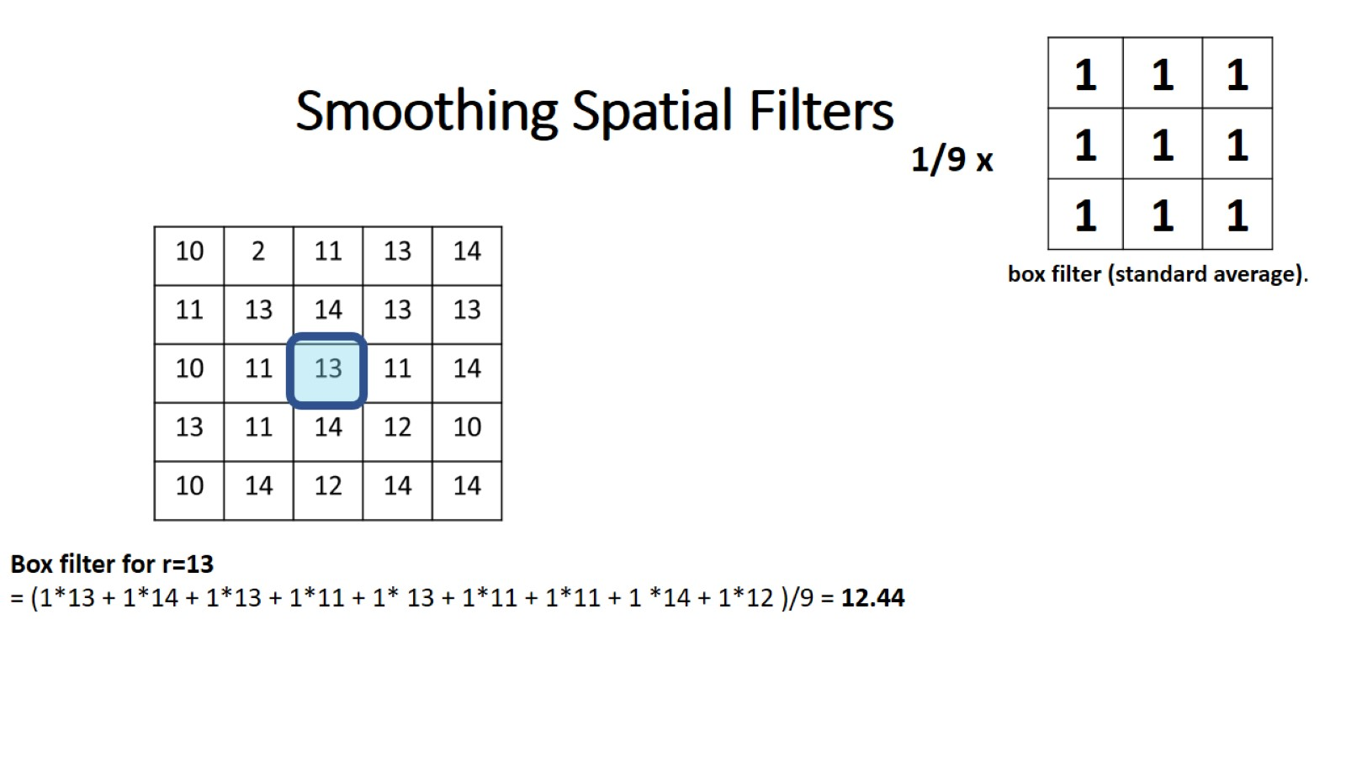
Smoothing Spatial Filters

Slide 32
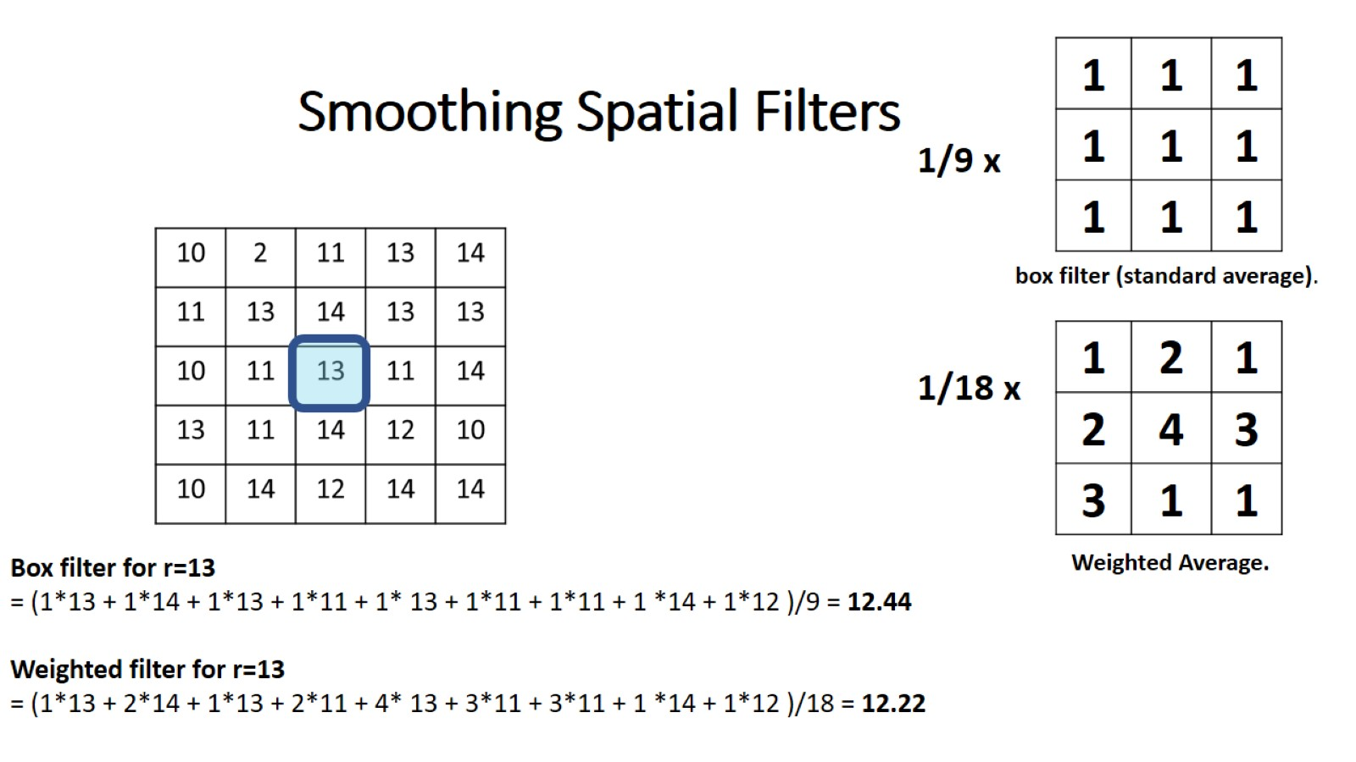
Smoothing Spatial Filters

Slide 33
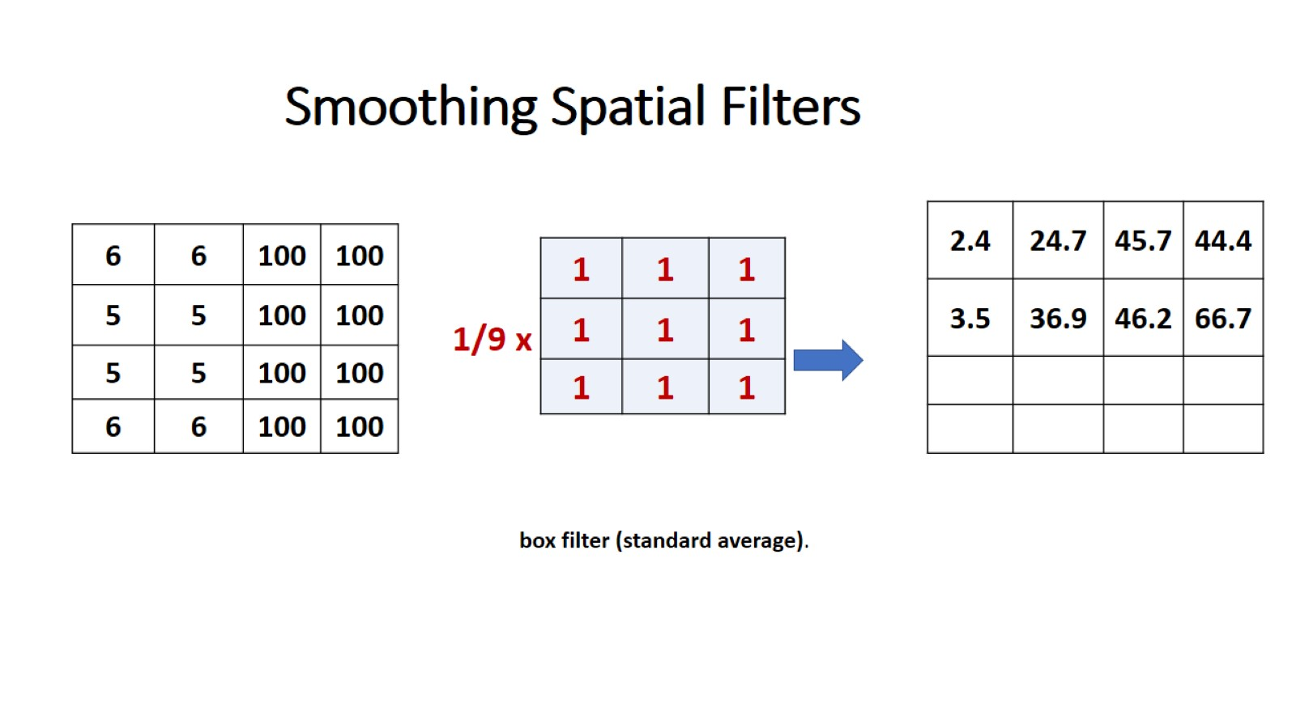
Smoothing Spatial Filters

Slide 34
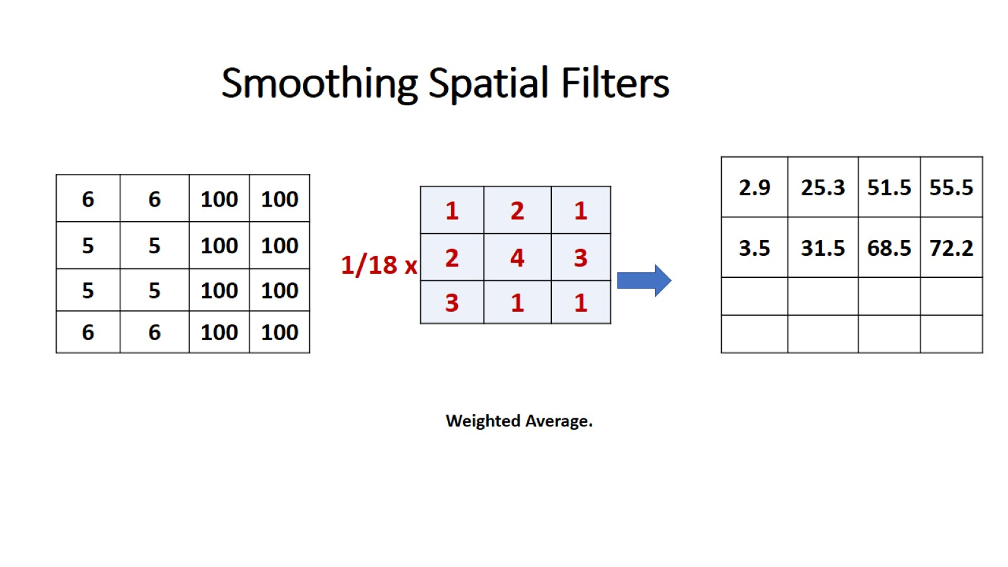
Smoothing Spatial Filters

Slide 35
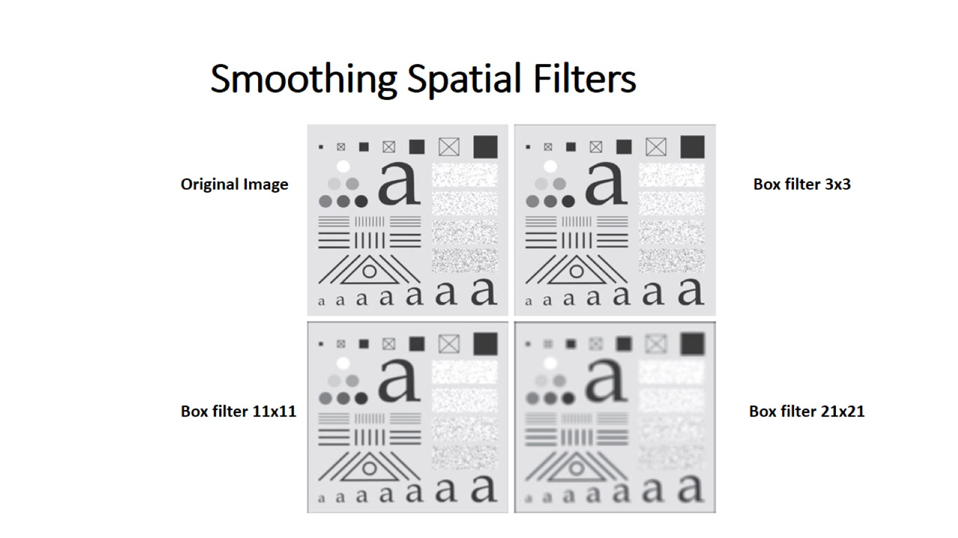
Smoothing Spatial Filters

Slide 36
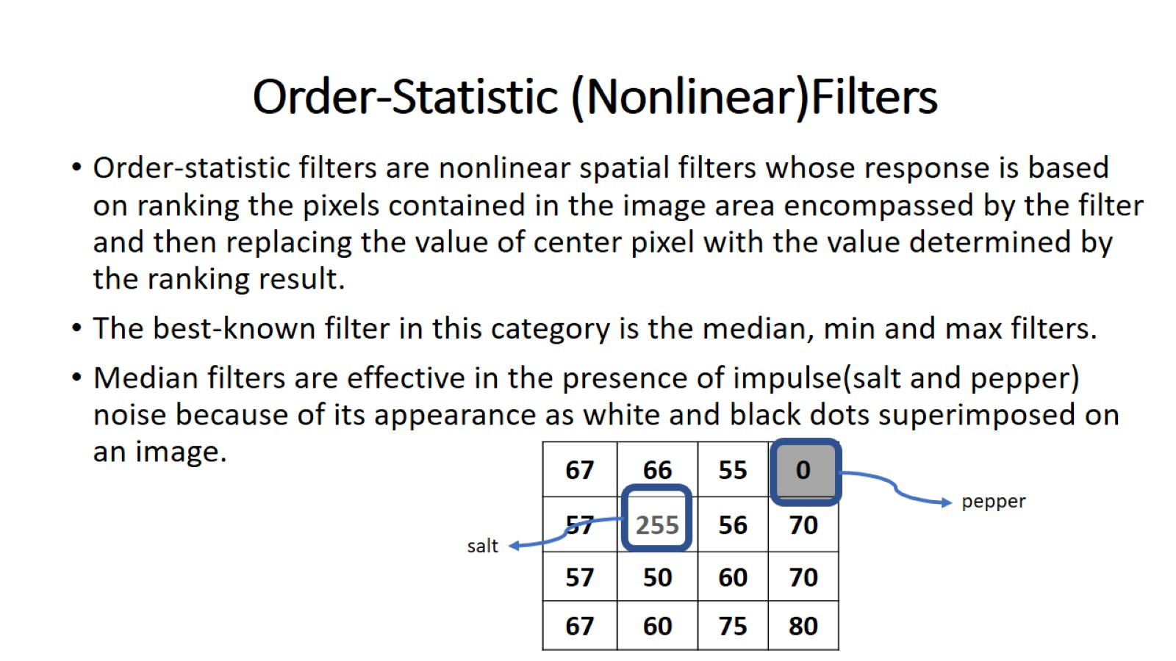
Order-Statistic (Nonlinear)Filters

Slide 37
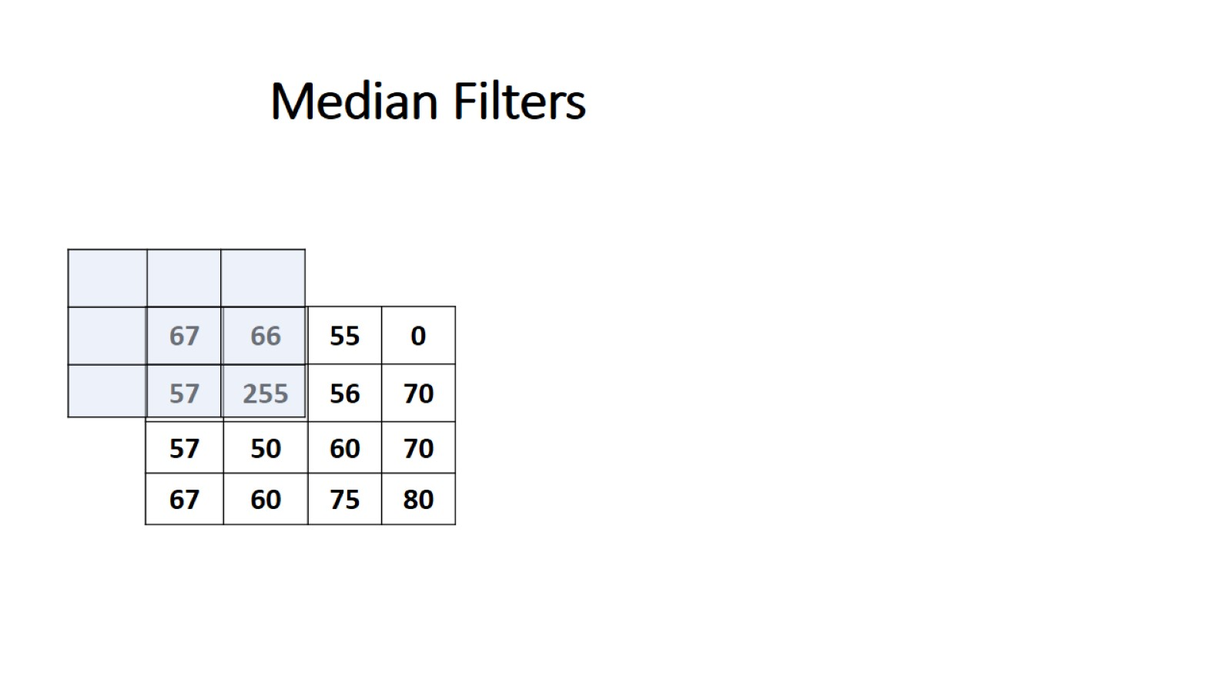
Median Filters

Slide 38
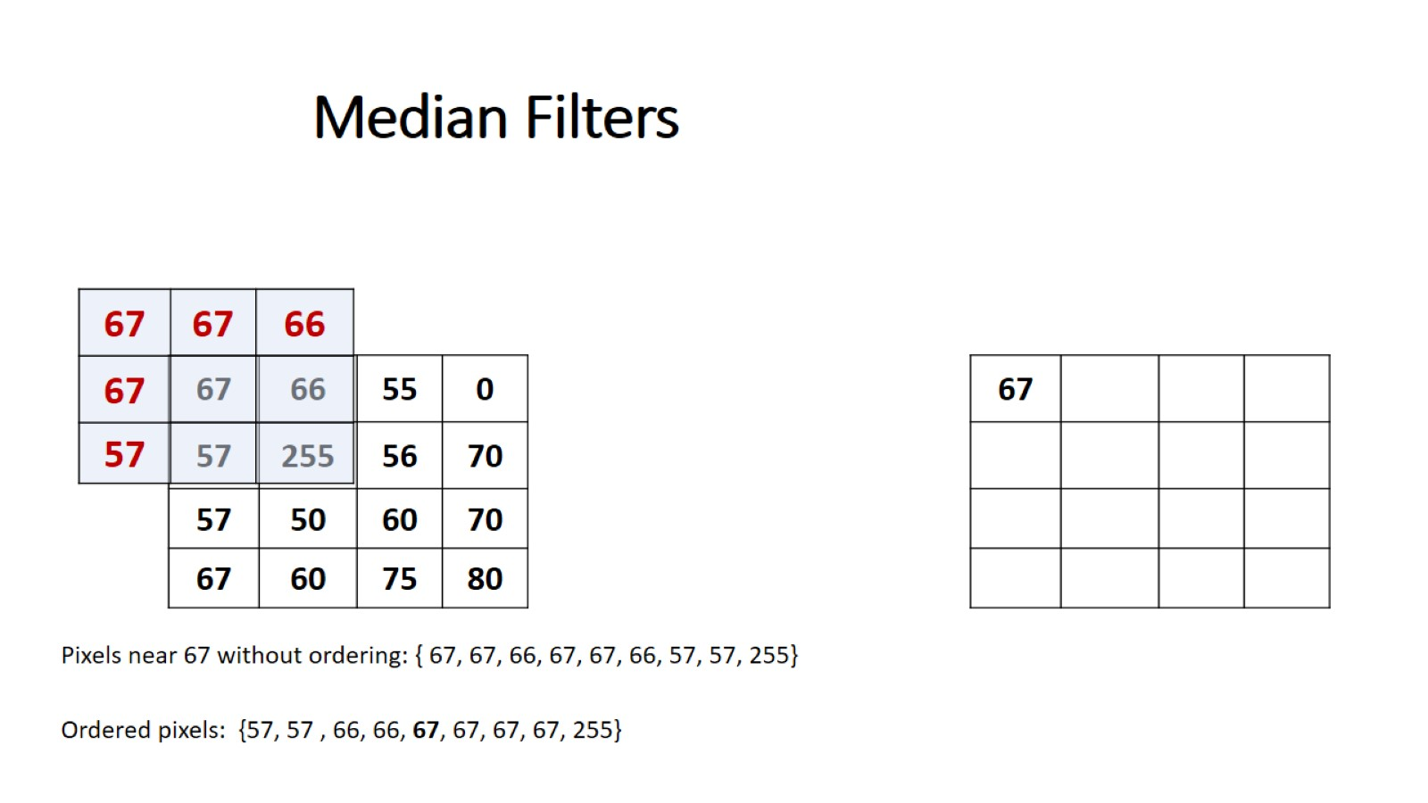
Median Filters

Slide 39
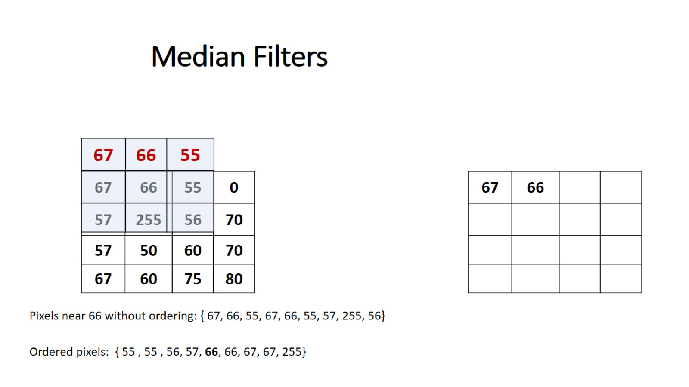
Median Filters

Slide 40
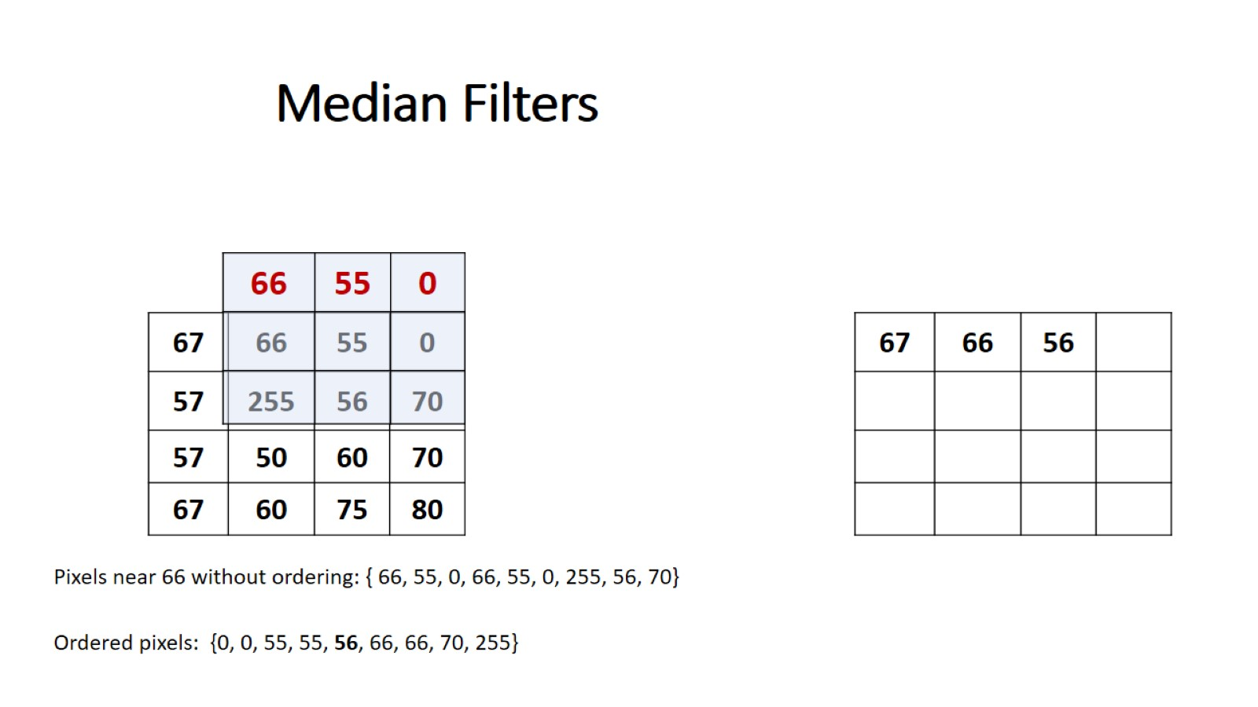
Median Filters

Slide 41
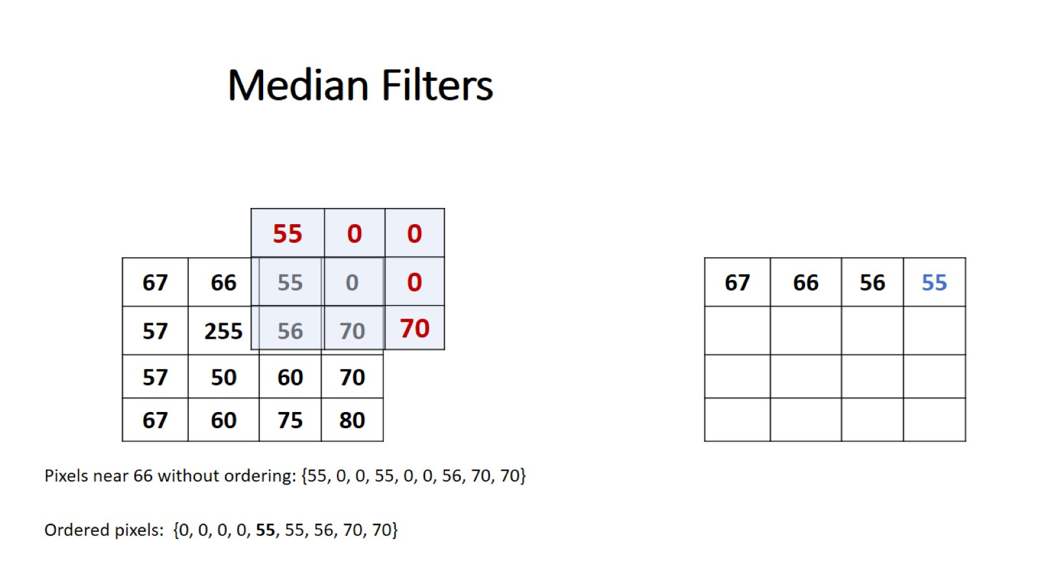
Median Filters

Slide 42
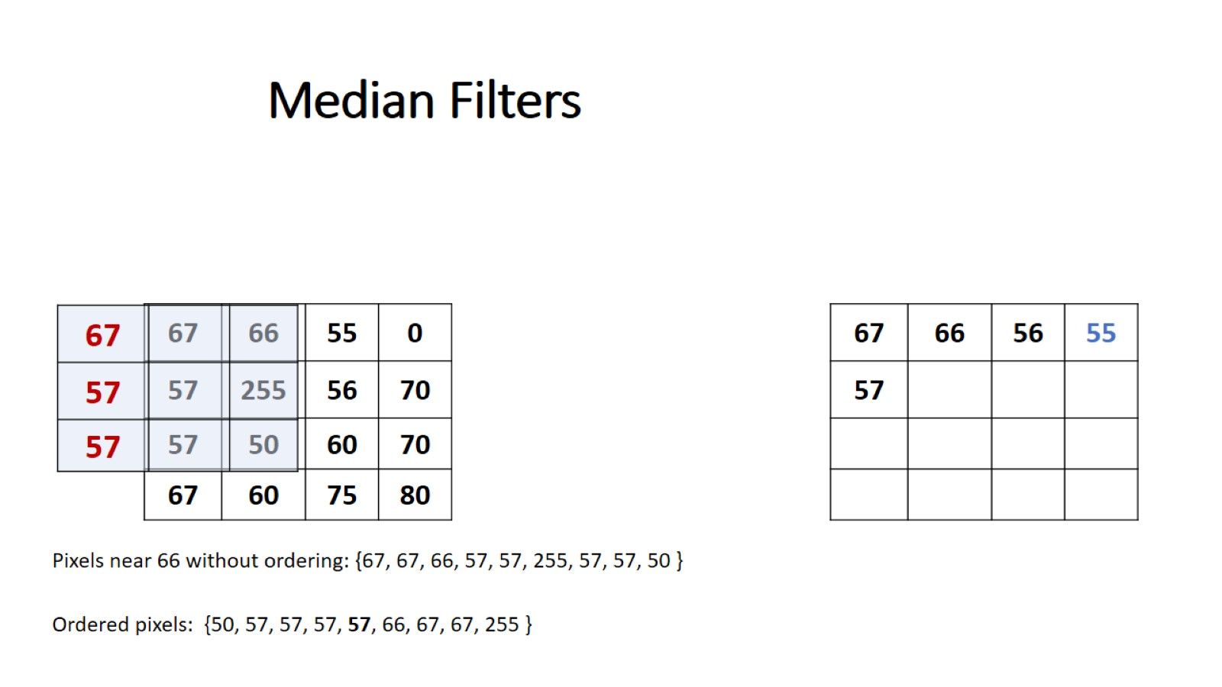
Median Filters

Slide 43
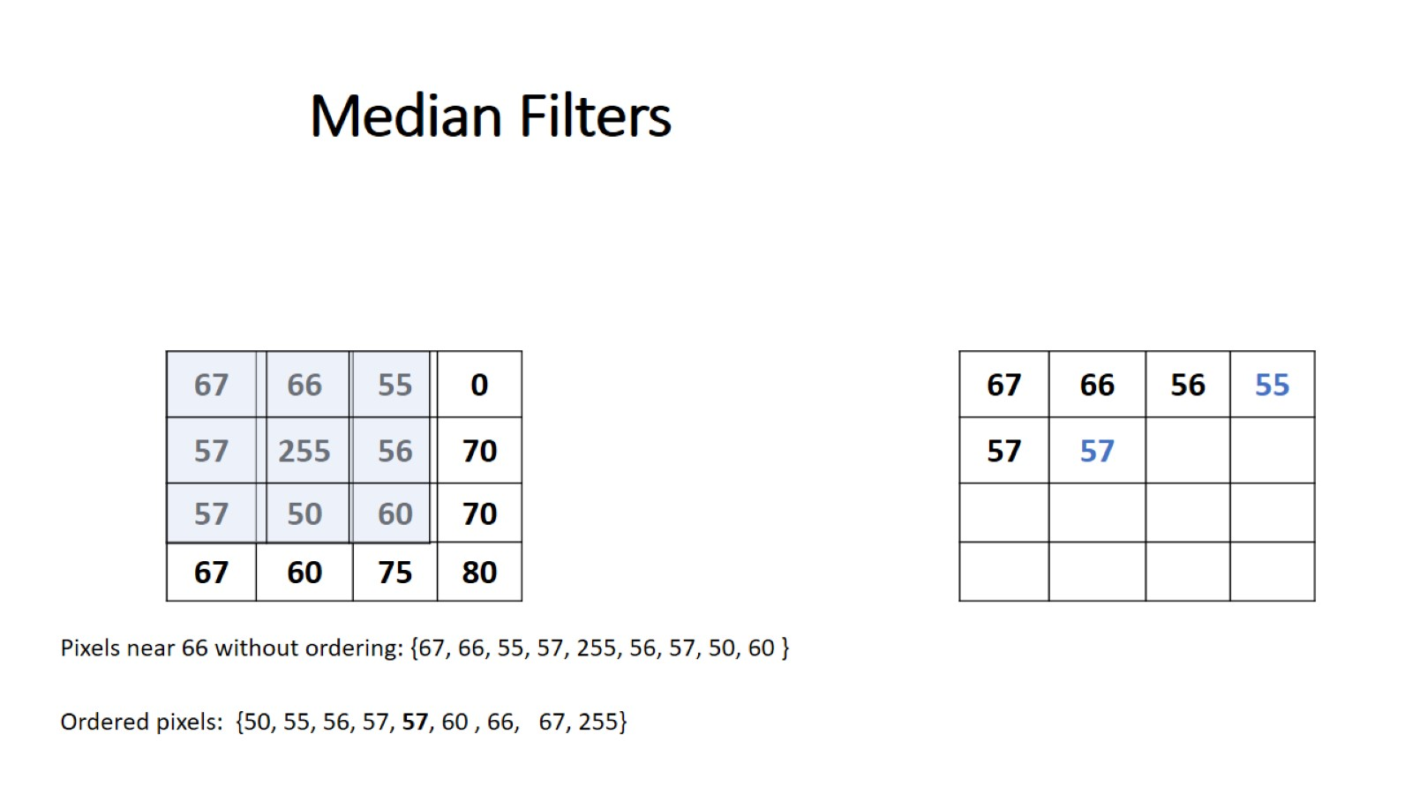
Median Filters

Slide 44
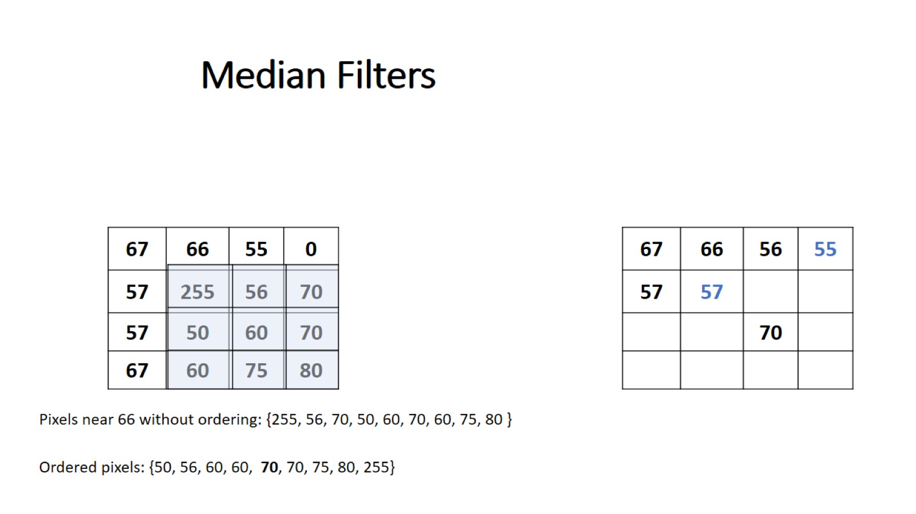
Median Filters

Slide 45
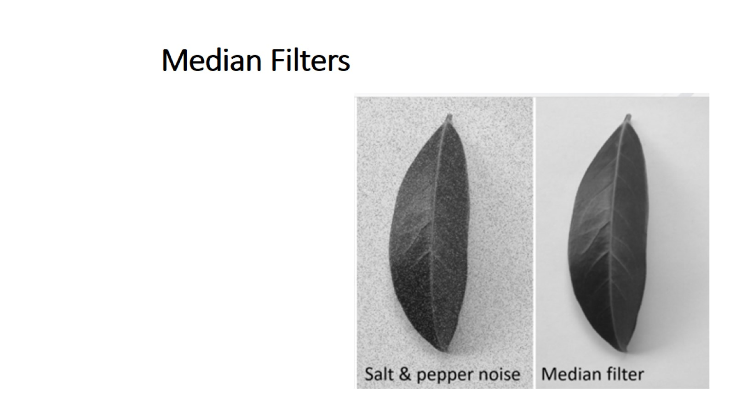
Median Filters

Slide 46
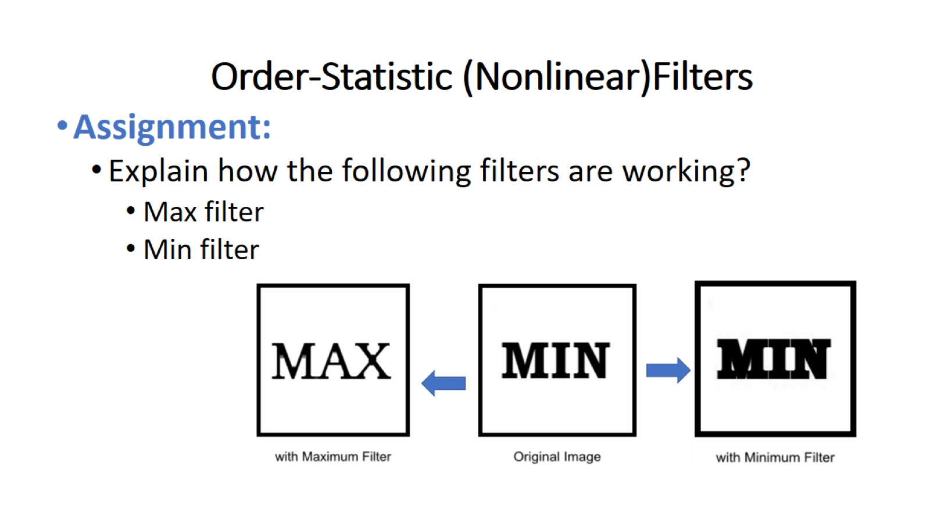
Order-Statistic (Nonlinear)Filters

Slide 47


