Slide 1


English Pronunciation Course
Prepared by
Ahmed Soliman

Slide 2



Lecture 3

Slide 3
Outline:
Final S Pronunciation

Slide 4
(Final S Pronunciation)

Slide 5
We pronounce the final S in three ways: /s/ - /z/ - /iz/
Watch the video in the next slide to know the rule

Slide 6


Slide 7
The Rule
voiceless + s /s/
/p/ - /t/ - /k/ - /f/
voiced + s /z/
/b/ - /d/ /g/ - /l/ - /m/ - /n/ - /r/ - /v/ - /w/
/ʃ/ (sh) - /tʃ/ (ch) - /dʒ/ - /s/ - /z/ + s /iz/

Slide 8
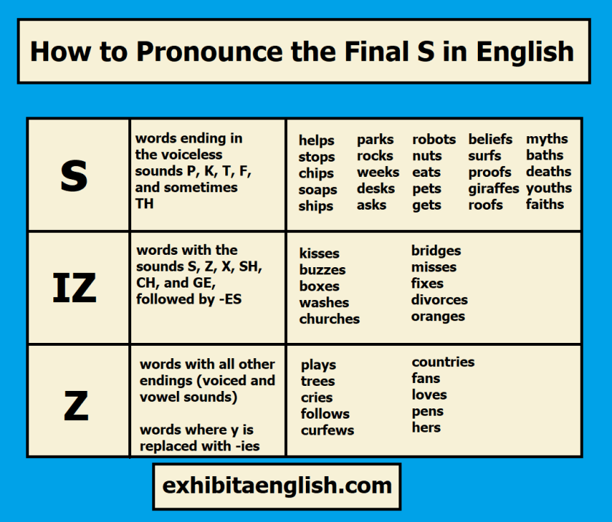

Slide 9
Practice
Exercise: Classify the words according to their pronunciation
jars- bags- graphs- prizes-friends - books- labs- kisses- dishes- laps-
things- gloves- buses- fans- watches
/s/ | /z/ | /iz/
Graphs – books – laps - | Jars – bags – friends – labs – things – gloves- fans - | Prizes – kisses – dishes – buses - watches

Slide 10
Practice
https://exhibitaenglish.com/pronunciation-the-final-s-in-english/

Slide 11



Thank You

