Slide 1

Risk management frameworks – Part 1
Lecture 7
Everyone’s Smart
University
MGM510
Risk Management

Slide 2


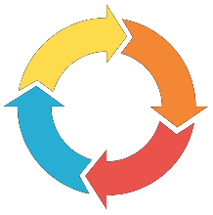
PMI-Risk Management framework
There are 5 domains and 6 processes in Project Risk Management. The first five processes belong to the planning process group, and the last process belongs to the monitor and control process group.
Domains
Processes
Risk strategy and planning (5 tasks)
Stakeholder engagement (9 tasks)
Risk process facilitation (7 tasks)
Risk monitoring and reporting (7tasks)
Perform specialized risk activities (3 tasks)
Plan risk management
Identify risks
Perform qualitative risk analysis
Perform quantitative risk analysis
Plan risk responses
Control risks

Slide 3
Domain 1—Risk Strategy and Planning
Risk Strategy and Planning domain contains activities related to developing policies, processes, and procedures; risk assessment, planning, and response. The tasks in this domain are the following:
Task:1 Develop risk assessment processes and tools.
Task:2 Update risk policies and procedures.
Task:3 Develop and recommend project risk strategy.
Task:4 Produce risk management plan for the project.
Task:5 Establish evaluation criteria for risk management processes.

Slide 4
Domain 2—Stakeholder Engagement
Stakeholder Engagement domain contains activities related to promoting the understanding of Project Risk Management for stakeholders and project team members, assessing stakeholder risk tolerance, prioritizing project risk, and promoting risk ownership. The tasks in this domain are the following:
Task: 1 | Promote common understanding of value of risk management.
Task: 2 | Train, coach, and educate stakeholders in risk principles and processes.
Task: 3 Task: 4 | Coach project team members.
 | Assess stakeholder’s risk tolerance.
Task: 5 Task: 6 Task: 7 Task: 8 Task: 9 | Identify stakeholder’s risk attitudes.
 | Engage stakeholders based on risk prioritization.
 | Provide risk-related recommendations to stakeholders.
 | Promote risk ownership by proactive communication.
 | Liaise with stakeholders of other projects.

Slide 5
Domain 3—Risk Process Facilitation
Risk Process Facilitation domain contains activities related to facilitating risk identification, evaluation, prioritization, and response among project team members. The tasks in this domain are the following:
Task: 1 | Apply risk assessment processes and tools.
Task: 2 | Facilitate risk identification.
Task: 3 | Facilitate project team’s evaluation of the identified risks attributes.
Task: 4 | Facilitate development of an aligned risk response strategy and actions.
Task: 5 | Facilitate the formulation of project contingency reserve.
Task: 6 | Provide risk data to cost and schedule analysts.
Task: 7 | Validate potential risk responses, key dependencies, and requirements.

Slide 6
Domain 4—Risk Monitoring and Reporting
Risk Monitoring and Reporting domain contains activities related to monitoring risk, evaluating risk response against established metrics, and communicating risk response performance to stakeholders and project team.
The tasks in this domain are the following:
Task: 1 Document and periodically update project risk information.
Task: 2 Coordinate with project manager.
Task: 3 Create periodic standard and custom reports.
Task: 4 Monitor risk response metrics.
Task: 5 Analyze risk process performance against metrics.
Task: 6 Update Project Risk Management plan.
Task: 7 Capture risk lessons learned.

Slide 7
Domain 5—Perform Specialized Risk Analyses
Perform Specialized Risk Analyses domain contains activities related to the specialized qualitative and quantitative tools and techniques used by Project Risk Management professionals. The tasks in this domain are the following:
Evaluate the attributes of identified risks.
Analyze risk data produced during the project.
Perform specialized risk analysis.

Slide 8
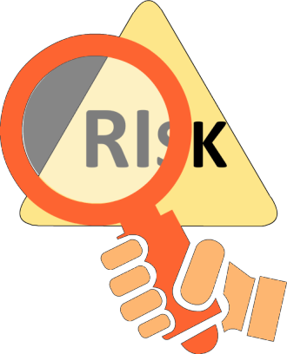
Individual and Overall Project Risks
The project risk is an uncertain event or a condition that has a positive or a negative effect on the project objectives. Project risk is classified into two levels:
Individual risk
Overall project risk
Understanding individual risk helps in overcoming the project-related risks and
increases the probability of project success.
The overall project risk represents the effect of uncertainty on the project as a whole.
The assessment of project risk helps in decision-making at strategic level and
in turn at program, portfolio, and project governance levels to decide priorities.
3

Slide 9
Stakeholder Risk Attitudes
It is important for a project or a risk manager to understand stakeholders’ risk attitudes. The risk attitudes of the project stakeholders determine the extent to which an individual risk or overall project risk matters.
It usually result in a desire for increased certainty in project outcomes and it may express a preference for one project objective over the other. Understanding stakeholders’ attitudes towards risk is an important component of risk management planning.
!
The priority of the risk depends upon the risk attitudes and tolerance levels of the stakeholders.
4

Slide 10



Stakeholder Risk Attitudes
Risk seeker
Risk neutral
Risk averse
Stakeholders are risk seeking in nature.
Risk seeker
Risk neutral
Risk averse
Stakeholders are neither risk averse nor risk seeking.
Risk seeker
Risk neutral
Risk averse
Stakeholders who does not take risks.
5

Slide 11

Risk Tolerance
Risk tolerance refers to the level of risk acceptability of a project manager or key stakeholder when the investment required for managing the risk is compared to the potential payoff.
The definition of probability and impact scales, and the definition of risk exposures on the probability and impact matrix are influenced by your understanding of the risk tolerance of stakeholders.
28

Slide 12
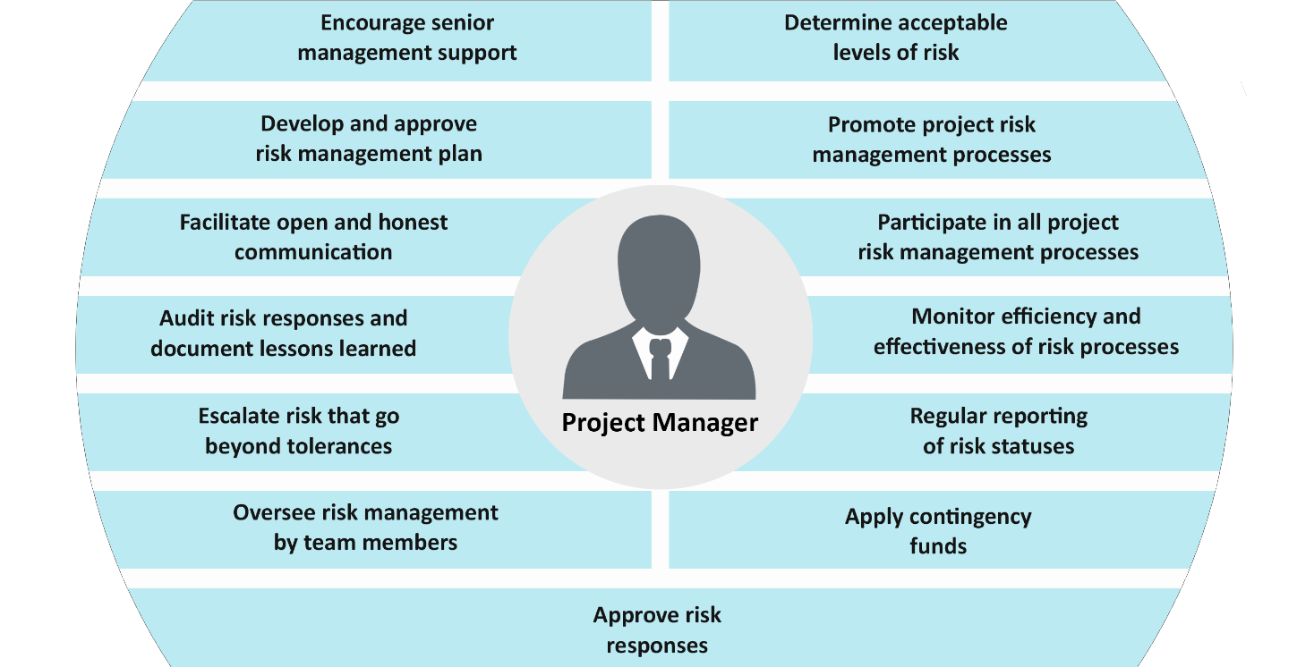
Project Manager Role
دعم و تشجيع الإدارة العليا
تحديد مستويات المخاطرة المقبولة
تطوير و الموافقة على خطة إدارة المخاطر للمشروع
تفعيل عملية ادارة المخاطر
تيسير التواصل المفتوح والصادق
يساهم في جميع عمليات إدارة مخاطر المشروع
تدقيق الاستجابة المخاطر وتوثيق الدروس المستفادة
مراقبة كفاءة وفعالية عملية الاستجابة للمخاطر
تصعيد المخاطر التي تتجاوز السماحية
مدير المشروع
التقارير المنتظمة عن حالة الخطر
يشرف على إدارة المخاطر من خلال أعضاء الفريق
يطبق الاعتمادات الطارئة
الموافقة على استجابات المخاطر

