Slide 1


Communication skills
CMM201
Prepared by Dr. Merna Emad
Presenting in the Workplace
Lecture 9

Slide 2

Section 2
Speech Design
Lecture
Section 1
Informing and Persuading

Slide 3
Section One

Slide 4
Informing and Persuading

Slide 5
Informing and Persuading
General rules
“As humans, we’re hard-wired to enjoy and learn from stories”.
Craft a 60- to 90-second narrative that launches your speech and compels your audience to listen to you.
Show a gripping photo. “Use photos instead of text, when possible,”. The old saying “A picture is worth a thousand words” is especially relevant when giving a presentation, and it can move your audience more than almost any words ever could.
A quality photo adds aesthetic appeal, increases comprehension, and makes your message more memorable.
www.midocean.ae

Slide 6
Informing and Persuading
General rules
Use a powerful quote. “Employ the wise words of a well-known person because the name allows you to tap into his or her credibility, likeability, and notoriety,”. However, make sure the quote is relevant to your message and can create meaning for the audience.
Play a short video. Unlike text and bullet points on a slide show, videos can evoke emotional responses from an audience as well as communicate your message quickly.
However, when using video, take care; you don’t want to spend so much time with a video that you leave yourself no time to speak.
www.midocean.ae

Slide 7
Informing and Persuading
The Importance of Presenting
Just as effective communication skills are essential to your professional success, effective oral communication skills are essential if you want to excel in leadership. Presentational excellence is important for the following reasons:
1) Product presentations, team huddles, meeting leadership, press conferences, special events, and other forms of oral communication reveal something about you as a professional;
www.midocean.ae

Slide 8
Informing and Persuading
The Importance of Presenting
Just as effective communication skills are essential to your professional success, effective oral communication skills are essential if you want to excel in leadership. Presentational excellence is important for the following reasons:
(2) presentations serve as a tool to motivate employees and to communicate effectively about business goals;
www.midocean.ae

Slide 9
Informing and Persuading
The Importance of Presenting
Just as effective communication skills are essential to your professional success, effective oral communication skills are essential if you want to excel in leadership. Presentational excellence is important for the following reasons:
3) presentational excellence is required to achieve professional excellence. To address these important topics, let’s take a look at ways to communicate excellence in presentations.
www.midocean.ae

Slide 10
Informing and Persuading
Identifying Presentation Opportunities and Purposes
The first step in the presentation process is identifying opportunities. Once you have identified the presentation opportunities, you can identify the purpose within them.
Presentation Opportunities
Two types of presentation opportunities are available to leaders. One is a formal presentation, which occurs in a traditional presentation setting. Presenting a sales pitch to clients and giving a progress report at the district meeting are examples of formal presentations.
www.midocean.ae

Slide 11
Informing and Persuading
Identifying Presentation Opportunities and Purposes
The first step in the presentation process is identifying opportunities. Once you have identified the presentation opportunities, you can identify the purpose within them.
Presentation Opportunities
Second type as the opportunity presentation. The opportunity presentation is identical in preparation and presentation to the formal presentation, but it occurs in a less traditional setting. For instance, many organizations have huddles, during which employees are pulled together to talk. This is not a traditional presentation setting, but it is still an opportunity. Meetings provide another possible setting for opportunity presentations. As a team leader, it will be your job to facilitate meetings.
www.midocean.ae

Slide 12
Informing and Persuading
Presentation Opportunities
Tips to opportunity presentation
Giving a small opening address to kick off a meeting is an example of an opportunity presentation.
As a leader, you must begin to identify presentation opportunities and present yourself with professional excellence at each opportunity.
You may consider preparing for presentations especially opportunity presentations, a waste of time.
www.midocean.ae

Slide 13
Informing and Persuading
General Purpose
Once you’ve identified your presentation opportunity, the next step is to determine your purpose. Presentations can have one of two general purposes: to inform or to persuade.
When speaking with an informative purpose, you present the facts.
Informative speakers act as teachers relaying information. When speaking with a persuasive purpose, you are acting as an advocate or making an argument. Your role is to advocate for or against something.
www.midocean.ae

Slide 14
Informing and Persuading
General Purpose
In some situations, you’ll be trying to persuade the audience simply to agree or disagree with an idea—this is known as passive agreement. In other situations, you’ll be trying to persuade the audience to take some sort of action—this is known as active agreement or a call to action.
Determining your purpose may seem like a simple enough task, but speakers with professional excellence always think carefully when determining their purpose.
www.midocean.ae

Slide 15
Informing and Persuading
General Purpose
For example, you may need to inform employees about a new policy in your organization. Ask yourself, “Am I merely informing them about the policy, or am I persuading them to follow the new policy?” In all likelihood, you will be persuading them. Although many presentation opportunities appear informative on the surface, a closer look reveals the need or opportunity to persuade.
www.midocean.ae

Slide 16
Informing and Persuading
Specific Purpose
Once you’ve identified the general purpose of your presentation, you’ll begin to formulate a specific purpose. The specific purpose is to an oral presentation what a thesis statement is to an essay. A specific purpose is a declarative sentence telling the listeners what you want them to understand, know, or believe by the end of your presentation.
The following are some examples of specific purposes:
I want my employees to understand and follow the new overtime rule.
I want the executive team to believe our department deserves a 10% budget increase.
I want Company X to select us as the health care provider for its employees.
I want my team to feel recognized and appreciated for their hard work.
www.midocean.ae

Slide 17
Informing and Persuading
Specific Purpose
Remember
Designing a presentation is not a linear process in which you move from one step to the next. Instead, designing a presentation is a fluid process. Thus, you may develop a tentative specific purpose and then change it after you have done some analysis and research. In fact, identifying the general and specific purposes for any presentation opportunity will require you to analyze the audience and the context.
www.midocean.ae

Slide 18
Informing and Persuading
Speaking to inform
As noted earlier, when speaking with an informative purpose, your goal is to present the facts. Informative speakers act as teachers relaying information, striving to be objective and not influenced or affected by emotions or their individual point of view.
According to Aristotle, a good persuasive speech includes three persuasive appeals: ethos, logos, and pathos. Although Aristotle discussed these appeals in relationship to persuasive presentations, we believe the first two appeals also are important for designing an effective informative presentation.
www.midocean.ae

Slide 19
Informing and Persuading
Ethos
Ethos refers to your credibility as a presenter as well as the credibility of the information delivered in your presentation.
To present with professional excellence, you must demonstrate credibility and help your audience believe you and the information or argument you are presenting.
How do you establish credibility?
According to Aristotle, presenters must demonstrate ethos or positive character by demonstrating competence, trustworthiness, and goodwill.
There are many ways to develop positive character within your presentation, but you must make sure the audience is aware of your expertise and knowledge on the subject matter.
In addition, you must conduct research and then cite your sources.
www.midocean.ae

Slide 20
Informing and Persuading
Logos
Logos is another type of appeal needed in effective presentations. Logos is a term that refers to the words of a presentation in the context of organizational structure and the supporting information. When developing an informative presentation, think of yourself as a teacher laying out information about a particular topic. After reviewing your research and analyzing the purpose, audience, and context, you will develop a clear organizational structure for your presentation. However, that structure can’t stand without support. The research that you’ve conducted will become that support. Together, the structure and the information will provide your audience with logical appeal.
www.midocean.ae

Slide 21
Informing and Persuading
Logos
What type of research should you include? Obviously, that will depend on the nature of your topic, your purpose, the audience, and the context. However, any or all of the following may have a place in your presentation: definitions, examples, statistics, and quotes. When it comes to selecting supporting material for your presentations, remember to include a variety.
www.midocean.ae

Slide 22
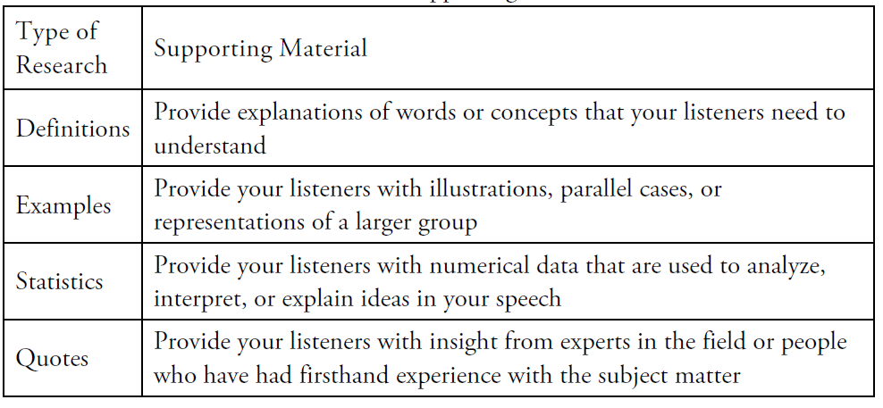
Informing and Persuading
Logos
www.midocean.ae

Slide 23
Informing and Persuading
Strategies for Informing With Excellence
Beyond the all-important basics of any successful speech, you need to take into account some additional variables when speaking to inform.
First, make certain that you are informing, not persuading. If you begin to incorporate your emotions and your point of view, you have stopped being objective. The range of topics for informative speeches is infinite. You can inform on people, places, things, new products, old products, history, events, process, corporate visions, governmental relations, and concepts from ancient religions to postmodernism. Some of these topics can be controversial. But remember, although your point of view on a controversial issue may be valuable and interesting, it should not be included in an informative speech.
www.midocean.ae

Slide 24
Informing and Persuading
Strategies for Informing With Excellence
Beyond the all-important basics of any successful speech, you need to take into account some additional variables when speaking to inform.
Second, pay careful attention to your audience’s level of knowledge and understanding when doing your audience analysis. You do not want to design a speech that informs them about things they already know. It is a waste of your time and their time. By the same token, if your audience has only a basic knowledge of information about a topic and you design your speech as if they are experts, they will not be able to comprehend the information.
www.midocean.ae

Slide 25
Informing and Persuading
Strategies for Informing With Excellence
Beyond the all-important basics of any successful speech, you need to take into account some additional variables when speaking to inform.
Third, Try to incorporate a variety of supporting material, such as definitions, examples, statistics, and quotes. This will make certain you appeal to all types of listeners and will make your speech more memorable.
www.midocean.ae

Slide 26
Informing and Persuading
Speaking to Persuade
When giving a persuasive speech, you are acting an as advocate or making an argument.
Your role is to advocate for or against something. As noted earlier, you will be trying to persuade the audience either simply to agree or disagree with an idea (passive agreement) or to take some sort of action (active agreement or a call to action).
The persuasive speaker is subjective, influenced, or affected by individual emotions, biases, or points of view.
Aristotle discussed the three persuasive appeals noted earlier in relationship to persuasive presentations. Let’s explore each in relationship to your persuasive speeches.
www.midocean.ae

Slide 27
Informing and Persuading
Speaking to Persuade
How do you establish credibility in a persuasive speech?
Just as you would in an informative speech, make certain the audience is aware of your expertise and knowledge on the subject matter. Additionally, cite your sources and make certain the sources are credible.
When persuading, it is also important to establish common ground with your audience. That is, show how you have a shared interest, concern, or background.
www.midocean.ae

Slide 28
Informing and Persuading
Speaking to Persuade
How do you establish credibility in a persuasive speech?
Logos, as you should recall, refers to the organizational structure and the supporting information found in your speeches. When developing a persuasive presentation, think of yourself as an attorney making an argument. You’re building a case with your presentation.
www.midocean.ae

Slide 29
Informing and Persuading
Types of Reasoning
In addition to these organizational patterns, effective persuasive speeches incorporate clear reasoning that guides the listener through the speaker’s argument. Types of reasoning include inductive, causal, deductive, analogical, and cognitive dissonance
www.midocean.ae

Slide 30
Informing and Persuading
Types of Reasoning
Inductive Reasoning
Inductive reasoning involves building an argument by using individual examples, pieces of information, or cases, and then pulling them together to make a generalization or come to a conclusion. For example, Bob got bad service at Store X. Juan got bad service at Store X.
Ming got bad service at Store X. The generalization or conclusion is that Store X gives bad service. The obvious question that you must ask yourself when using inductive reasoning is how many examples or cases are needed to make a generalization? Unfortunately, the answer is that it depends. Each situation must be considered individually. But if your audience does not think you have enough cases to support your generalization, you will not be able to persuade them.
www.midocean.ae

Slide 31
Informing and Persuading
Types of Reasoning
Casual Reasoning
Causal reasoning, more commonly known as the cause-and-effect relationship, is a type of inductive reasoning. When developing this type of argument, you must demonstrate that certain events or factors (causes) produced, or in some cases prevented, a certain result (the effect). When using causal reasoning, you must be certain that your causes do indeed produce the effect; therefore, your evidence must be credible. Furthermore, you must determine if the cause in your argument is the only cause. In most situations, it will not be the only cause. Therefore, you are wise to make mention of the other causes in your speech and explain why this cause, your cause, should be the focus.
www.midocean.ae

Slide 32
Informing and Persuading
Types of Reasoning
Deductive Reasoning
Deductive reasoning occurs when the speaker takes general information (premises) and draws a conclusion from that general information. Deductive reasoning is often set up as a syllogism.
www.midocean.ae

Slide 33
Informing and Persuading
Types of Reasoning
Cognitive Reasoning
Cognitive dissonance is another useful tool for persuading an audience. Although it is not one of the standard forms of reasoning, it is well worth mentioning. This theory, developed by researcher Leon Festinger (1957), states that when a person holds two ideas that contradict each other, it creates mental noise or cognitive dissonance in that person’s mind.
This results in a feeling of discomfort for the person, so he or she looks for ways to reduce the contradiction. If you develop an argument that creates cognitive dissonance and then offer a solution that reduces the contradiction, you are likely to have made a successful persuasive argument.
www.midocean.ae

Slide 34
Informing and Persuading
Pathos
The final type of persuasive appeal (after ethos and logos) is pathos—a term that refers to emotional appeal. Because informative speeches are objective, emotional appeals should not be present in informative speeches.
However, pathos is very powerful, and it does play an important role when persuading with professional excellence. But beware—a presentation that has strong pathos but lacks ethos and/or logos is not effective. Far too many presenters rely solely on emotional appeal. In the moment, they may move an audience, but in the long run, the lack of credibility and logic make for a poor presentation. To achieve professional excellence as a presenter, you must include all three appeals (ethos, logos, and pathos) in your presentations.
www.midocean.ae

Slide 35
Informing and Persuading
Pathos
How can I incorporate emotional appeal into my presentation?
One way is with the use of language. Selecting words that have a strong emotional connotation—or implied meaning—can be powerful. Incorporating into your presentation research that has strong emotional appeal is another tool.
Pathos also has a place in informative presentations. Selecting language and supporting material with emotional appeal can help an audience relate to the topic.
www.midocean.ae

Slide 36
Section Two

Slide 37
Speech Design

Slide 38
Speech Design
Speech design tips that can take your speech presentations to the next level:
Keep it simple. The most important thing for delivering a memorable speech is to make sure your message is understood by the audience. An audience can’t be moved if it doesn’t understand where it should be moved to.
Focus on the audience. What does the audience want to hear from you? What can you provide that is of value? It can be easy to focus on the message you want to get across, but great speakers keep in mind the needs and wants of their audience also.
www.midocean.ae

Slide 39
Speech Design
Speech design tips that can take your speech presentations to the next level:
Think in pictures. You can easily differentiate yourself from other speakers by replacing words with pictures wherever possible. People think in pictures, so it is important to use that to your advantage. People will focus on what you are saying instead of reading a presentation slide.
Get inspired and tell a story. Even if you’re presenting on something educational, you can transform it into an engaging story. Always try to speak about something personally important to you. Your passion can help evolve the storytelling process, and the audience will notice and feed off your energy.
www.midocean.ae

Slide 40
Speech Design
Analyzing the Audience
If you want to present with professional excellence, you must be audience centered. Don’t fall into the trap of so many mediocre presenters by focusing all your energy on your nerves or your PowerPoint slides. The best presenters, the best communicators in general, are aware of all the components involved in the communication process, and they pay particular attention to the audience.
Start by asking a series of questions designed to answer one all-important larger question: “Who is my audience?”
This audience analysis will frame your entire presentation, so it must be considered first, last, and during every stage in the design process.
www.midocean.ae

Slide 41
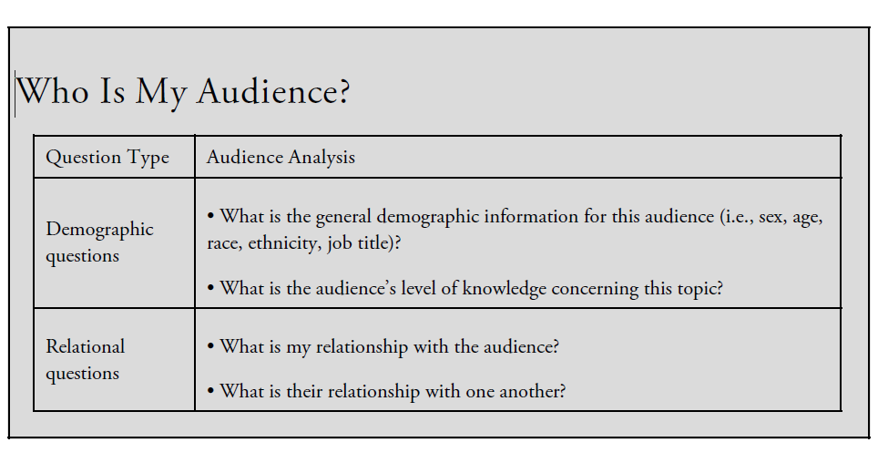
Speech Design
Analyzing the Audience
www.midocean.ae

Slide 42
Speech Design
Analyzing the Context
the context plays an important role in determining the purpose of the presentation. In addition, the context has a huge impact on the audience. Again, you must ask yourself a series of questions to analyze your context.
Once you’ve answered each of the questions about context, ask yourself, “How can I use this knowledge to improve my presentation?” For example, if you know the audience is required to be at your presentation, you may need to work harder to show them why the information is relevant to them. If the audience is standing, you must keep your remarks brief. If you have a large audience, no stage, and flat seating, you may need to rearrange the furniture to help the audience see you or you may need to walk around. Use the information you learn from your analysis to enhance your presentation.
www.midocean.ae

Slide 43
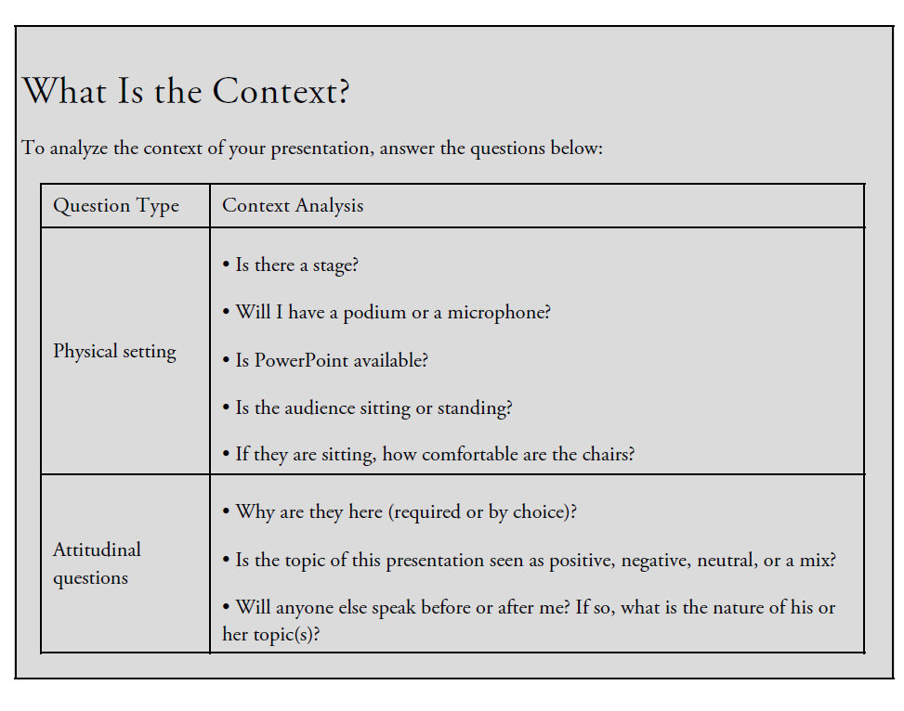
Speech Design
Analyzing the Context
www.midocean.ae

Slide 44
Speech Design
Researching
According to Hamilton (1996), poor presenters often make the mistake of either relying solely on their own knowledge or relying solely on the Internet.
Either way, a lack of research results in a poor presentation.
One of the many skills you will learn during your college experience is how to conduct research. research is the central skill used during the explorer phase of the creative process.
Research is also a central skill needed to present with professional excellence. Shortchanging the research process by limiting yourself to a quick Google search or to the report in hand will result in a poor presentation.
www.midocean.ae

Slide 45
Speech Design
Researching
Gathering Research
The research you need in order to develop and support your presentation can and should come from a variety of sources. Depending on the topic, you may use internal sources, external sources, or a combination of the two. Internal sources include information that comes from within the organization, such as reports, policies, or interviews with employees and/or customers. External sources include information that comes from outside the organization, such as from outside agencies, the competition, the government, and the media.
www.midocean.ae

Slide 46
Speech Design
Researching
Gathering Research
If you were giving a presentation on improving customer service within your organization, you could find supporting material in a variety of places. You might start with the new policy on customer service that created this presentation opportunity. You might then research past customer satisfaction scores within your organization, as well as data showing how your organization compares with the competition.
www.midocean.ae

Slide 47
Speech Design
Researching
Gathering Research
You might interview some executives about the importance of customer service or ask some employees with outstanding customer service their thoughts on the subject.
You might find some quotes or examples from organizations or leaders known for their customer service. Remember that you can’t begin and end your research with the new policy if you want to present with professional excellence.
www.midocean.ae

Slide 48
Speech Design
Organizing Your Presentation
Now that you’ve conducted your research and decided what to include, the time has come to get organized. Giving a presentation that’s well organized increases the likelihood that your audience will pay attention to, understand, and remember your message.
Organizing the Body
You must develop clear organization within the body of your presentation. Your typical, not-so-memorable speaker will take all the information available and lump it together as three main points. This is simply not acceptable.
www.midocean.ae

Slide 49
Speech Design
Organizing Your Presentation
Organizing the Body
. In the 21st century, it’s as easy as the click of a mouse to move information around as you develop the best organizational pattern for your presentation. It takes very little effort to develop a presentation that people can follow and remember. To excel as a speaker with professional excellence, make a commitment to solid organization. This is a relatively easy process—all you need to do is consider the various organizational formats until you find the one that best fits the presentation.
www.midocean.ae

Slide 50
Speech Design
Organizing Your Presentation
Organizing the Body
An organizational pattern often used to persuade in business and professional settings is Monroe’s Motivated Sequence. This five-step process, developed in 1935 by Purdue University professor Alan H. Monroe, includes the attention step,
the need step, the satisfaction step, the visualization step, and the action step.
The sequence begins with an attention step, in which the speaker engages the audience through the use of attention getting devices. In the needs step, the speaker establishes the problem and thereby the need for a change.
During the satisfaction step, the speaker provides a solution for the problem presented. The visualization step increases the audience’s desire for the solution by helping them visualize the benefits it will bring. Finally, the action step reinforces the solution with a specific, clear call to action.
www.midocean.ae

Slide 51
Speech Design
Organizing Your Presentation
Developing Transitions
Signposts could be used when discussing steps for protecting electronic equipment:
First, all data will be backed up on flash drives and taken to a secure location away from the storm.
Second, all electronic equipment will be unplugged and wrapped in plastic bags.
Third, all electronic equipment in exterior offices with windows will be moved to interior offices.
Fourth, all electronic equipment in interior offices will be taken off the floor and placed on desks or shelves.
www.midocean.ae

Slide 52
Speech Design
Organizing Your Presentation
Introductions
Well-developed introductions and conclusions are essential components of excellent presentations.
Presentations characterized by professional excellence always include a solid introduction— the part of the presentation in which you gain attention, introduce the topic, develop credibility, relate the topic to the audience, and preview your main points.
When you stand in front of an audience, you should imagine them sitting there with remote controls in their hands. If you don’t immediately capture their attention, they will mentally change the channel. Plus, if you don’t immediately pull them in, they will start daydreaming about winning the lottery, running through their to-do lists, or thinking about what they should have for lunch. You can never become an excellent speaker if the audience isn’t listening to you, so developing your attention getter is critical.
www.midocean.ae

Slide 53
Speech Design
Organizing Your Presentation
Tips for good introductions
Start off with something that captures the audience’s attention. You can start with a story, a quote, a statistic—anything that is going to spark interest. Once you have their attention, then you can introduce yourself and your topic. But in the first few seconds of your presentation, do something that will pull them in so that they won’t change the channel.
Similarly, introductions should always end with a preview of your main points. This will help the audience transition from the introduction to the body—and it will also reinforce your message.
www.midocean.ae

Slide 54
Speech Design
Organizing Your Presentation
Tips for good introductions
Therefore, in an introduction, gaining attention should occur first and the preview should occur last, but there is no formula for how the other three components should appear. When it comes to introducing the topic, making the topic relevant to the audience, and developing credibility, you have some flexibility.
By establishing credibility, you help the audience determine why they should trust you and the information you are presenting.
www.midocean.ae

Slide 55
Speech Design
Organizing Your Presentation
Conclusions
When you have completed your main points, it’s time to move into the conclusion. But keep in mind that if you have any additional points or information to cover, then you are not ready to conclude. Never create a false close—when a speaker signals to the audience that the presentation is concluding but then keeps going by introducing more information.
When you tell the audience that you’re concluding, you must summarize, drive the point home, and stop talking. If you say “in conclusion” and then continue on with new information and no clear end in sight, the audience will respond negatively. New information belongs in the body of the presentation.
www.midocean.ae

Slide 56
Speech Design
Organizing Your Presentation
Conclusions
A well-designed conclusion can elevate a presentation from average to excellent, whereas a poor conclusion can make an otherwise excellent presentation fall flat. By keeping a few simple steps in mind, you can easily design an excellent conclusion. These steps include stating that you are concluding, summarizing concisely, and ending with a strong impression.
End by leaving a strong impression. End with a quote or story, refer back to something you talked about in the beginning, or use a memorable statistic or something else that people will remember.
www.midocean.ae

Slide 57
Speech Design
Organizing Your Presentation
Conclusions
Never end with a statement such as, “Well, I guess that’s it.” Never begin packing up before the applause, and even if you’ll be taking questions, avoid ending with the statement “Does anyone have any questions?” Wait for the applause and then move into questions. Following these three simple steps will help you appear polished and will give the presentation a smooth close that will greatly enhance the audience’s perception of you as a speaker.
www.midocean.ae

Slide 58



Thank You

