Slide 1


Prepared by Eng. Eman Hamdy
Introduction to Information Systems – IT111
Numbering Systems
Lecture 2 (Practical)

Slide 2

lec
Numbering Systems
02
This course contains an introduction to information technology and computing systems.
The history and theory of information systems.
Practical application of technologies.
The student will be introduced to computer software, hardware, and networking technologies.
An introduction to the latest version of Microsoft Office.

Slide 3
lec
Numbering Systems
02
Points to cover
Decimal Numbering System
Binary Weights
Binary to Decimal Conversion
Decimal to Binary Conversion
Hexadecimal Numbers

Slide 4
lec
Numbering Systems
02
Decimal Numbering System
Base 10: explain why it is a base 10 system; there are numbers from
0 -9
Explain what are weights and give an example
102 101 100
567
5 x 100 + 6 x 10 + 7 x 1 è 500 + 60 + 7 è 567
Weight | Value
100 | 1
101 | 10
102 | 100
103 | 1000
104 | 10000

Slide 5

lec
Numbering Systems
02
Decimal Numbering System
Section Questions
Please answer these questions with them so they can answer the sheet
What is the weight of digit 6 in 1386? Answer: 100 = 1
Express 100 as a power of ten. Answer: 100 =

Slide 6
lec
Numbering Systems
02
Binary Numbering System
Base 2: Explain why it is a base 2 system; there are number s from
0 and 1
Explain the weights in a binary system and give an example
Binary Weights
Weight | Value
20 | 1
21 | 2
22 | 4
23 | 8
24 | 16
25 | 32
26 | 64
27 | 128

Slide 7
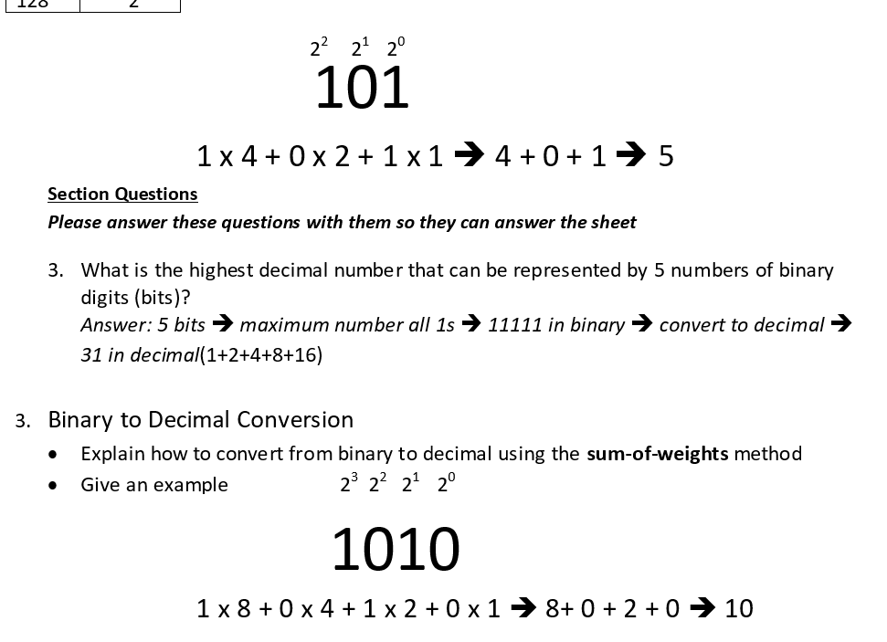
lec
Numbering Systems
02

Slide 8
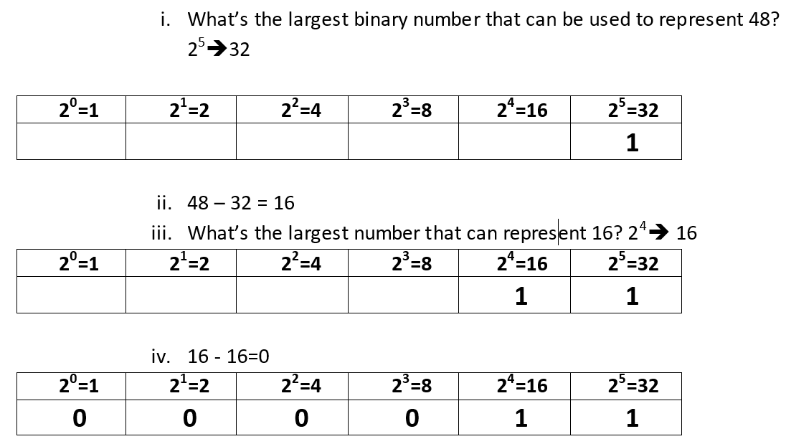
lec
Numbering Systems
02
Decimal to Binary Conversion
Explain how to convert from decimal to binary using the sum-of-weights method
Give an example
48

Slide 9
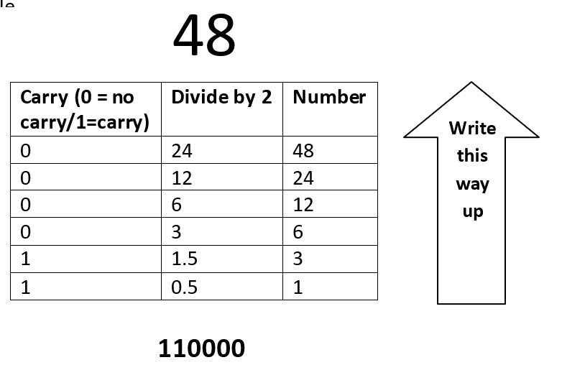
lec
Numbering Systems
02
Explain how to convert from decimal to binary using the divide-by-2 method
· Give an example

Slide 10
lec
Numbering Systems
02
Please answer these questions with them so they can answer the sheet
5. How many bits are required to represent 17?
Answer: Convert 17 to binary è 10001 ècount the bits è 5 bits

Slide 11
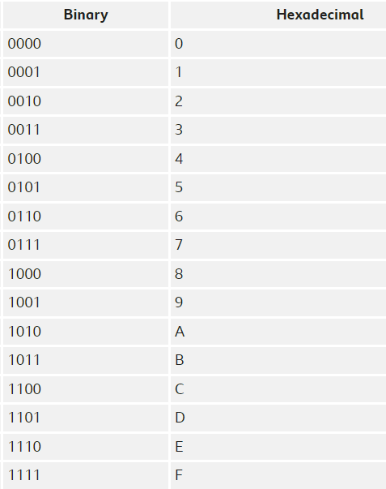
lec
Numbering Systems
02
Hexadecimal Numbers:
Hexa means 16. In the hexadecimal number system, it uses 16 digits. It consists of numbers and alphabets. It includes numbers 0, 1, 2, 3, 4, 5, 6, 7, 8, 9 and A, B, C, D, E, F; total 16 digits.
It is denoted by s16, where s is a hexadecimal number.
Examples: 1) A1₁₆ 2) EE9₁₆ 3) FD654₁₆

Slide 12
lec
Numbering Systems
02
Question 1: Convert A2B₁₆ to an equivalent binary number.
Solution: Given hexadecimal number = A2B₁₆
First, convert the given hexadecimal to the equivalent decimal number.
A2B₁₆ = (A × 16²) + (2 × 16¹) + (B × 16⁰)
= (A × 256) + (2 × 16) + (B × 1)
= (10 ×256) + 32 + 11
= 2560 + 43
= 2603(Decimal number)
Now we have to convert 2603₁₀ to binary
The binary number obtained is 101000101011₂
Hence, A2B₁₆ = 101000101011₂

Slide 13
lec
Numbering Systems
02
Question 2: Convert E₁₆ to an equivalent binary number.
Solution: Given, a hexadecimal number is E.
First, convert the given hexadecimal to the equivalent decimal number.
E₁₆ = E × 16⁰
= E × 1
= E
=14 (Decimal number)
Now we have to convert 14₁₀ to binary number.
The binary number obtained is 1110₂
Hence, E₁₆ = 1110_{2]}

Slide 14



Thank You

