Slide 1


Slide 2
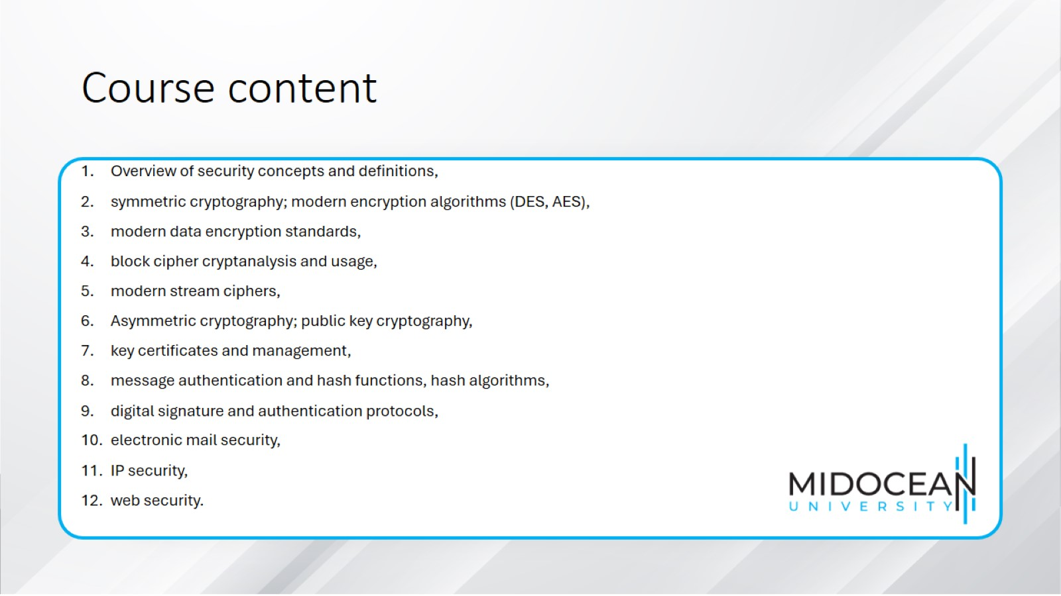
Course content

Slide 3


Slide 4

References

Slide 5


