Slide 1

Department of Cybersecurity
Orientation Lecture

Slide 2


Slide 3


Who Am I?
Name
Hamada Ibrahim AbdulWakel
B.Sc. degree
Faculty of Computers & Information, Minia University, Minia, Egypt.
M.Sc. & Ph.D. degrees
In Computer Science from Faculty of Computers and Artificial Intelligence, Cairo University.
Semantic web & Social networking
Internet of Things

Slide 4
Who Am I?
Jobs
Lecturer at Faculty of Computers & Information, Minia University, Minia, Egypt.
Lecturer at Elsadat Academy.

Slide 5



Who Am I?
Google Scholar
Publons
ORCID

Slide 6

Your Turn

Slide 7
Prerequisite Core Term: Course Details
Course Code
CYB550
Course Name
Programming Foundations In Python
Coordinating Unit
Cybersecurity department, Everyone's Smart University.

Slide 8
Course Contact
ESU email:
  hamada@esu.ac.ae
  (Subject name: "Python Foundations Course: Question")

Slide 9
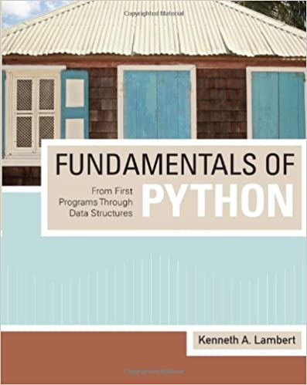

Course Materials
The main contents:
"Fundamentals of Python From First Programs
Through Data Structures", by Kenneth A. Lambert
Recorded lectures available on course moodle page.

Slide 10

Learning Objectives of this Course
What you'll learn?
New programming language "Python".
Problem-solving techniques.
Application development and prototyping.
Best practice in software development.

Slide 11

Topics Covered in this Course
The main contents:
Introduction to computer programming and Python.
Data types and basic input output operations.
Conditional and loop instructions.
Lists and dictionaries data processing.

Slide 12
Topics Covered in this Course
The main contents:
Functions, modules, and packages.
Object-oriented programming.
Graphical user interface.

Slide 13
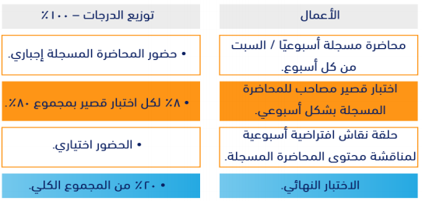
Course Assessment

Slide 14
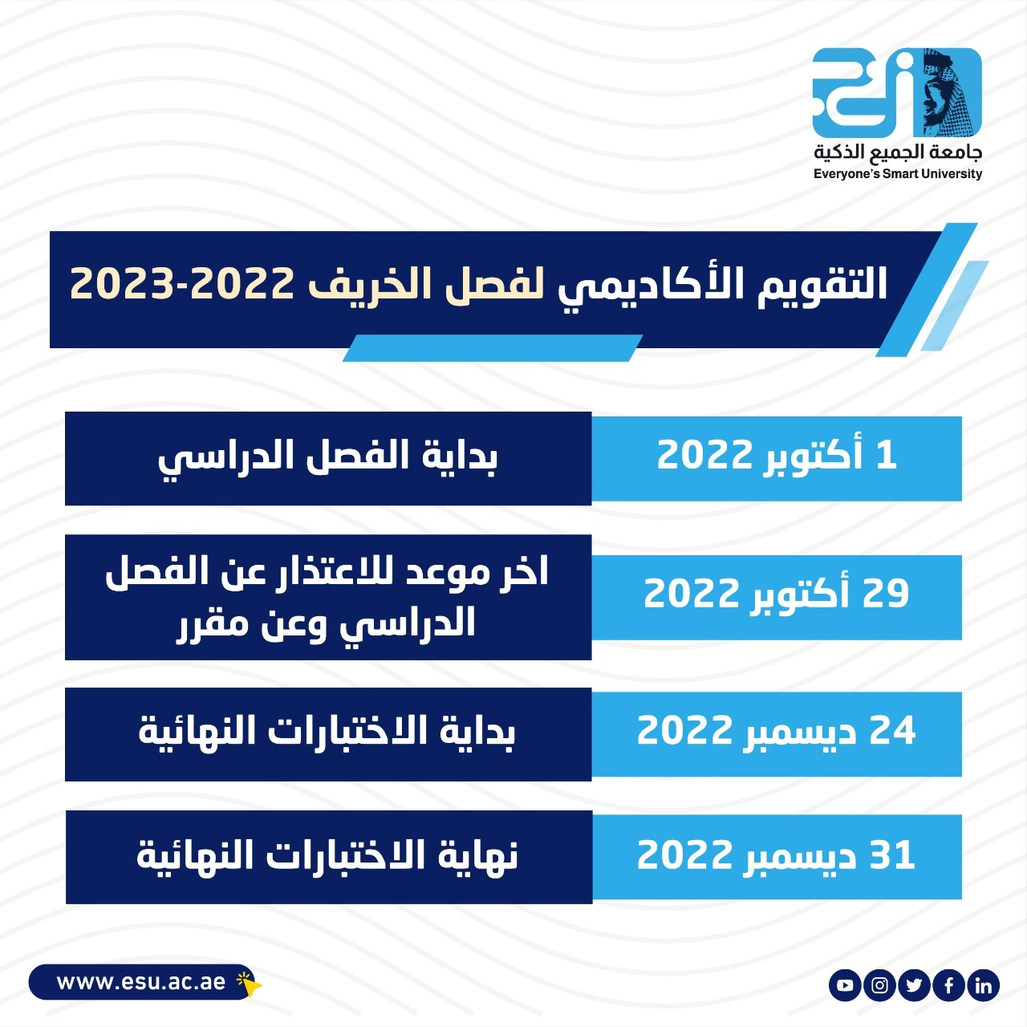
Academic Calendar

Slide 15
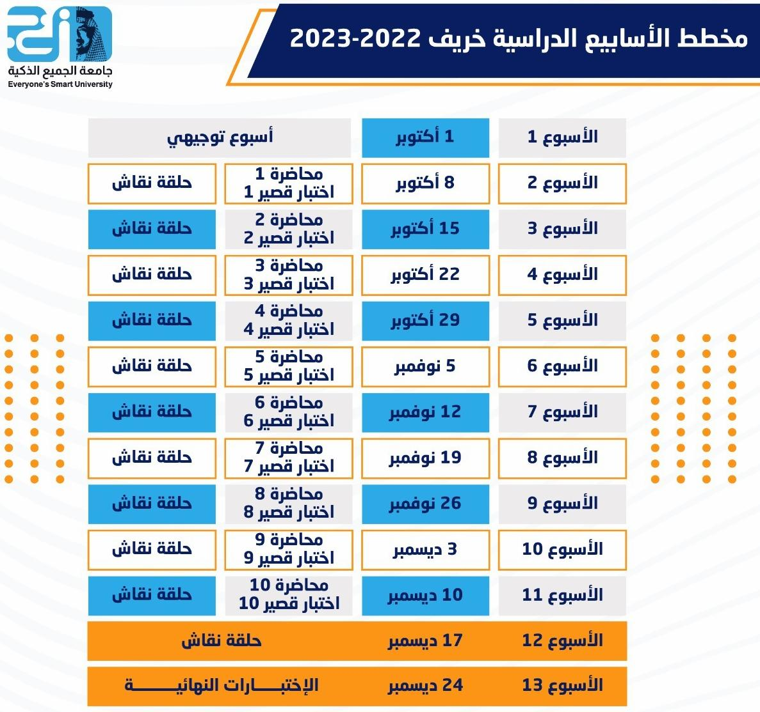
Academic Calendar

Slide 16
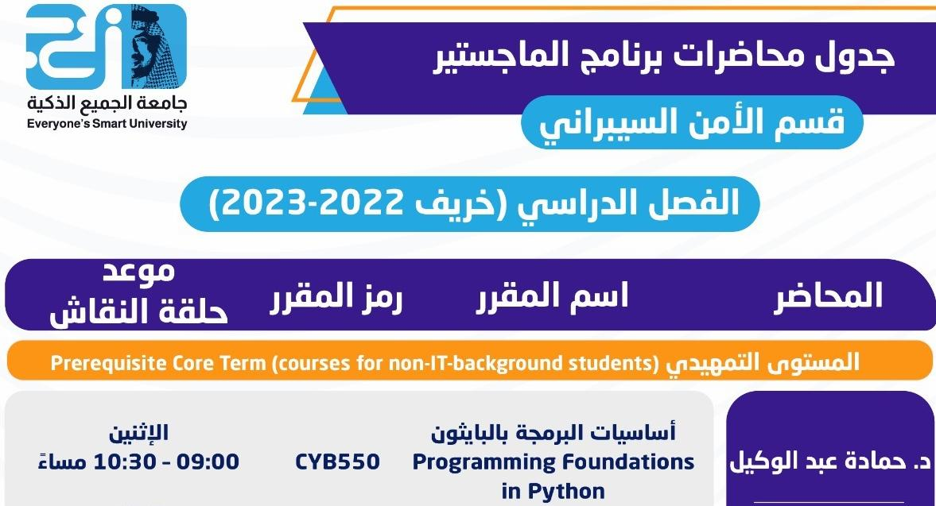
Academic Calendar

Slide 17


Course Exams
Exam rules:
Exam password: agree.
Eight must answer questions/exam.
One-Try exam.
24 min/exam.
You must be sure of your selected answer before pass to the next question.

Slide 18
Course Exams
Exam rules:
Exam begins on Saturday 10:00 PM
to next Saturday 9:00 PM.
Exam question types are Multiple-choice
and T/F questions.

Slide 19


Slide 20


