Slide 1

CCNA (200-301) Cisco Certified Network Associate
Prepared by Eng. Taghreed Elsayed
Lecture 2
Internet Protocol version4
& ARP protocol

Slide 2

Chapter
01
Internet Protocol version 4
Objectives
What is IPv4?
What is Sub netting?
What is ARP ?
Ethernet what does it mean ?

Slide 3
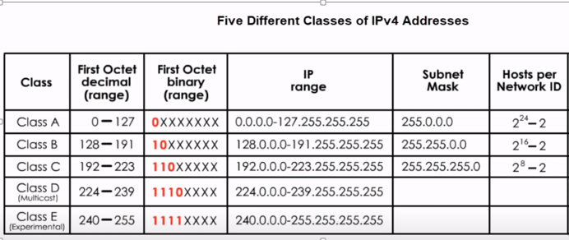
Chapter
01
Internet Protocol version 4

Slide 4
Chapter
01
Internet Protocol version 4
For example : 10. 1.1.1
Class A
network bits =8 bits 3.host bits = 24 bits
173.16.30.1
Class B
network bits =16 bits 6.host bits = 16 bits

Slide 5
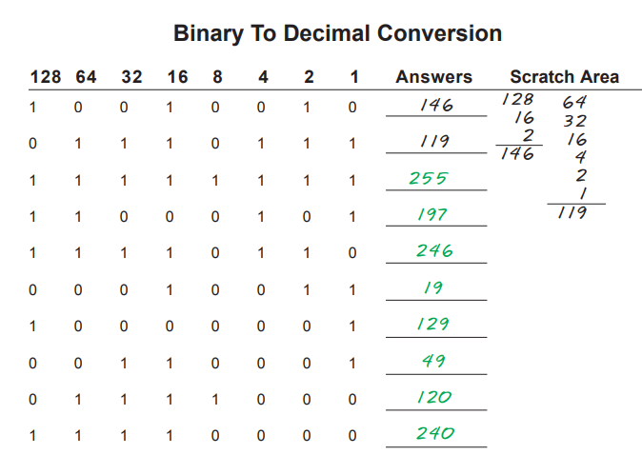
Chapter
01
Internet Protocol version 4

Slide 6
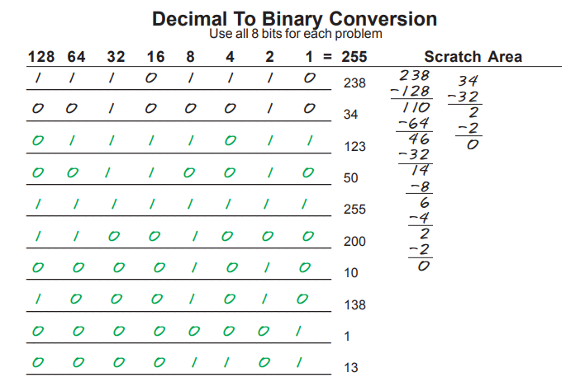
Chapter
01
Internet Protocol version 4

Slide 7
Chapter
01
Internet Protocol version 4
Determine : network Id , broadcast IP
193. 30.11.1
class c no of network bits = 24bits
no of host bits =32-24 =8 bits
Network id =193.30.11.0
First ip =193.30.11.1
Last ip =193.30.11.254
Broadcast ip =193.30.11.255

Slide 8
Chapter
01
Internet Protocol version 4
ANDING With Default subnet masks
Every IP address must be accompanied by a subnet mask. By now you should be able to look at an IP address and tell what class it is. Unfortunately your computer doesn’t think that way. For your computer to determine the network and subnet portion of an IP address it must “AND” the IP address with the subnet mask.
Default Subnet Masks: Class A 255.0.0.0
Class B 255.255.0.0
Class C 255.255.255.0
ANDING Equations: 1 AND 1 = 1 1 AND 0 = 0 0 AND 1 = 0 0 AND 0 =

Slide 9
Chapter
01
Internet Protocol version 4
For example: 192.168.1.1 class c /24 prefix
Network address o network ip
192.168.1.1 = 192 . 168 . 1 . 1
AND = 192.168.1.0
255.255.255.0 = 1111 . 1111 . 1111 . 0
Last ip address =192.168.1.254 broadcast ip =192.168.1.255
No of hosts = 2^{H} - 2

Slide 10
Chapter
01
Internet Protocol version 4
Sub netting
Sub netting means making subnet from network
Sub netting is done by taking some bits from host bits and add it to
network bits
N-bits
H-bits
Network
Host
N-bits
S-bits H-bits
Network
subnet
Host

Slide 11
Chapter
01
Internet Protocol version 4
For example: 172.16.0.0 /16
Calculate the subnet mask required to make :
200 subnet
200 host /subnet
Solution :
To get no of bits required to make 200 subnets
2^{s} >=200 s=8bits prefix= n-bits + s-bits =16+8=24 /24
Subnet mask = 255.255.255.0
H-bits= 8bits No of hosts = 2^{s} -2 = 254

Slide 12
Chapter
01
Internet Protocol version 4
Design example1: 192.168.1.0 /24
If we need to make 4 subnets
Calculate the ranges of ip addresses
No of s- bits = 2^{s} >=4 s=2bits
2. 192.168.1. xx 00 0000
1st 192.168.1. 0 /26
2nd 192.168.1.64 /26
3rd 192.168.1.128 /26
4th 192.168.1.192 /26
Sol:

Slide 13
Chapter
01
Internet Protocol version 4
For the first subnet , the range of ip addresses :
192.168.1.0 /26
First ip 192.168.1.1
Last ip 192.168.1.62
Broadcast ip 192.168.1.63

Slide 14
Chapter
01
Internet Protocol version 4
Design example2: 193.168.30.207 /29
Get network Id, First ip , Last ip , Broadcast ip
1.Subnet mask 255.255.255. 248
255.255.255. 1111 1000
2.Network id 193.168.30 . 1100 1111 =207
255.255.255. 1111 1000 =248
193.168.30.
Sol:
1100 1000= 200

Slide 15
Chapter
01
Internet Protocol version 4
Network ip address = 193.168.30.200
First ip 193.168.30.201
Last ip 193.168.30.206
Broadcast ip 193.168.30 .xxxx x 111=
193.168.30.1100 1 111 = 193.168.30.207

Slide 16
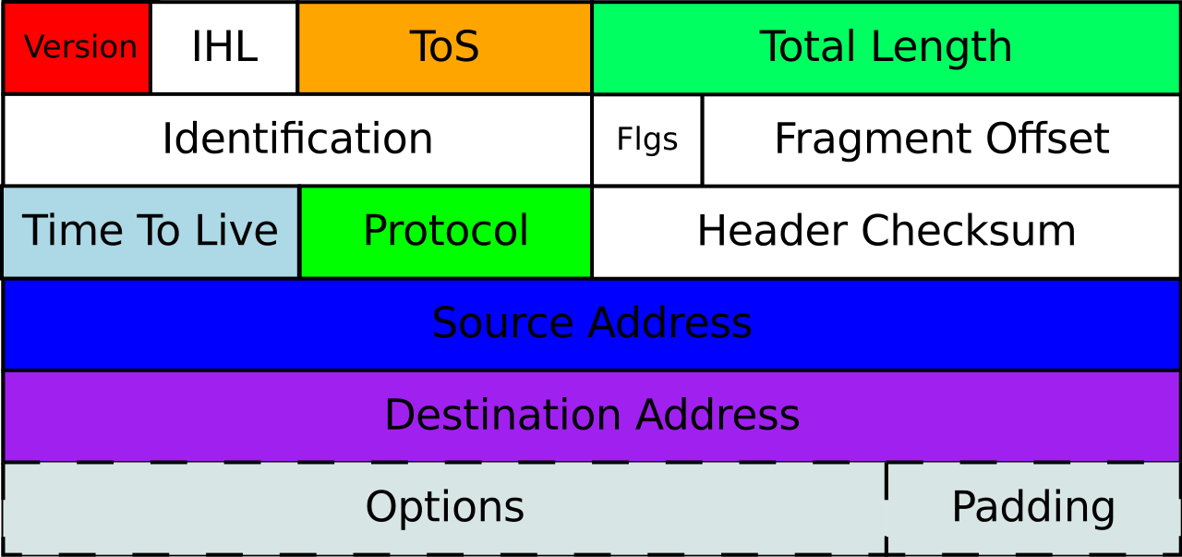
Chapter
01
Internet Protocol version 4
IPv4 Header

Slide 17
Chapter
01
Internet Protocol version 4
VERSION: Version of the IP protocol (4 bits), which is 4 for IPv4
HLEN: IP header length (4 bits), which is the number of 32 bit words in the header. The minimum value for this field is 5 and the maximum is 15.
Type of service: Low Delay, High Throughput, Reliability (8 bits)
Total Length: Length of header + Data (16 bits), which has a minimum value 20 bytes and the maximum is 65,535 bytes.
Identification: Unique Packet Id for identifying the group of fragments of a single IP datagram (16 bits)

Slide 18
Chapter
01
Internet Protocol version 4
Flags: 3 flags of 1 bit each : reserved bit (must be zero), do not fragment flag, more fragments flag (same order)
Fragment Offset: Represents the number of Data Bytes ahead of the particular fragment in the particular Datagram. Specified in terms of number of 8 bytes, which has the maximum value of 65,528 bytes.
Time to live: Datagram’s lifetime (8 bits), It prevents the datagram to loop through the network by restricting the number of Hops taken by a Packet before delivering to the Destination.
Protocol: Name of the protocol to which the data is to be passed (8 bits)

Slide 19
Chapter
01
Internet Protocol version 4
Header Checksum: 16 bits header checksum for checking errors in the datagram header
Source IP address: 32 bits IP address of the sender.
Destination IP address: 32 bits IP address of the receiver.
Option: Optional information such as source route, record route.
Used by the Network administrator to check whether a path is working or not.

Slide 20
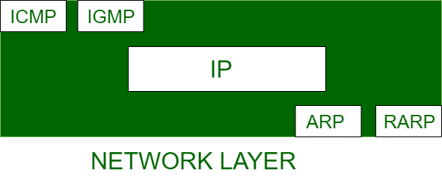
Chapter
01
ARP Protocol
Address Resolution Protocol (ARP) which is one of the most important protocols of the Network layer in the OSI model.
Note: ARP finds the hardware address, also known as Media Access Control (MAC) address, of a host from its known IP address.

Slide 21
Chapter
01
ARP Protocol
ARP Cache Timeout: It indicates the time for which the MAC address in the ARP cache can reside
ARP request: This is nothing but broadcasting a packet over the network to validate whether we came across the destination MAC address or not.
  The physical address of the sender.
  The IP address of the sender.
  The physical address of the receiver is FF:FF:FF:FF:FF:FF or 1’s.
  The IP address of the receiver
ARP response/reply: It is the MAC address response that the source receives from the destination which aids in further communication of the data

Slide 22
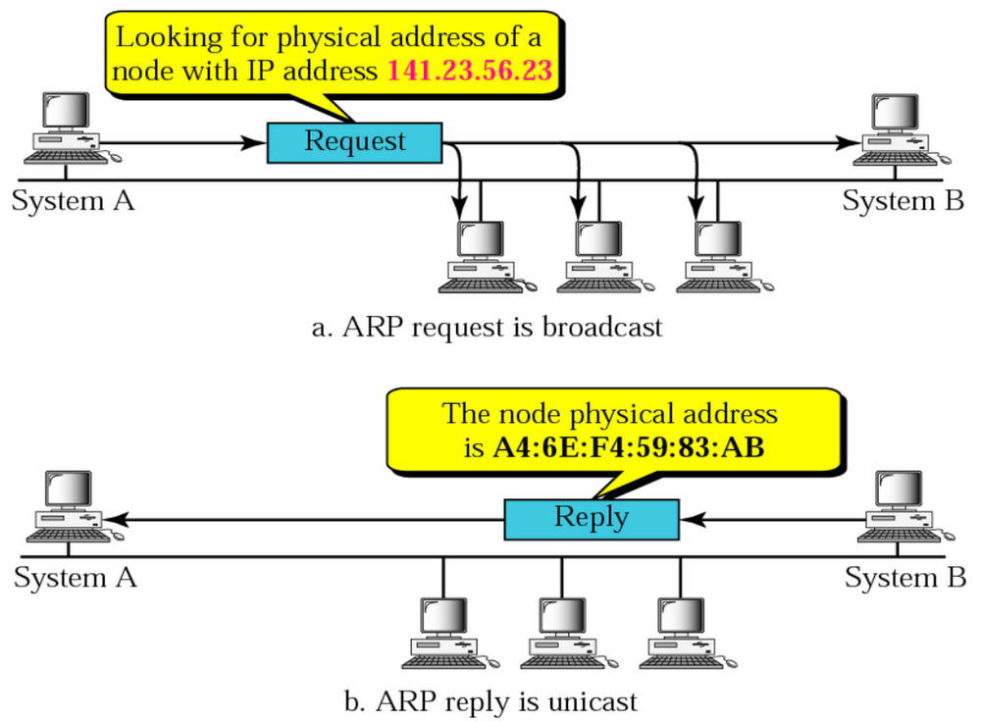
Chapter
01
ARP Protocol
CASE-1: The sender is a host and
wants to send a packet to another
host on the same network.
Use ARP to find another host’s
physical address

Slide 23
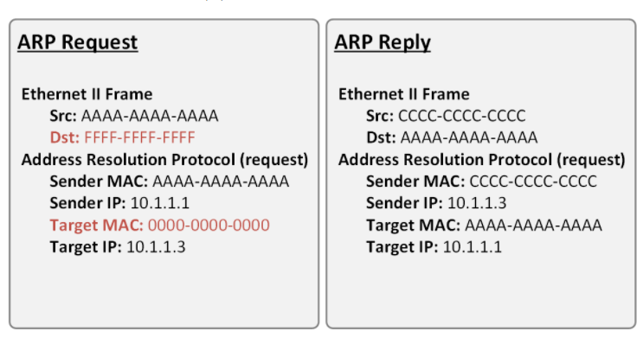
Chapter
01
ARP Protocol
Header
h
Data

Slide 24
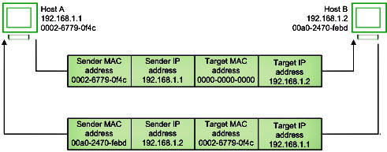
Chapter
01
ARP Protocol
ARP request (broadcast)
Header :
Src MAC=MAC A
Dec MAC=FFFF.FFFF.FFFF

Slide 25
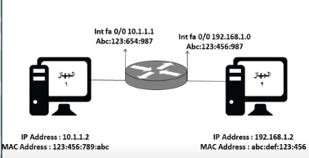
Chapter
01
ARP Protocol
CASE-2: The sender is a host and
wants to send a packet to
another host on another network.
Find the IP address of the next-hop
(router) for this destination.
Use ARP to find the router’s
physical address

Slide 26
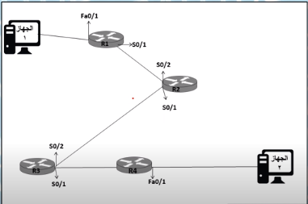
Chapter
01
ARP Protocol
CASE-3: the sender is a router and
received
a datagram destined for a host on
another network.
  The router checks its routing table.
  Find the IP address of the next router.
  Use ARP to find the next router’s
  physical address.
  Use ARP to find this host’s physical address.
NOTE: An ARP request is a broadcast, and an
ARP response is a Unicast.

Slide 27
Chapter
01
Ethernet
Ethernet is the traditional technology for connecting devices in a wired local area network (LAN) or wide area network (WAN).
It enables devices to communicate with each other via a protocol, which is a set of rules or common network language.
Ethernet describes how network devices format and transmit data so other devices on the same LAN or campus network can recognize, receive and process the information.
An Ethernet cable is the physical, encased wiring over which the data travels.
Connected devices that use cables to access a geographically localized network -- instead of a wireless connection -- likely use Ethernet. From businesses to gamers, diverse end users rely on the benefits of Ethernet connectivity, which include reliability and security.

Slide 28
Chapter
01
Ethernet
How Ethernet works
IEEE specifies in the family of standards called IEEE 802.3 that the Ethernet protocol touches both Layer 1 (physical layer) and Layer 2 (data link layer) on the Open Systems Interconnection (OSI) model.
Ethernet defines two units of transmission: packet and frame. The frame includes the payload of data being transmitted as well as the following:
the physical media access control (MAC) addresses of both the sender and receiver;
Each frame is wrapped in a packet that contains several bytes of information to establish the connection and mark where the frame starts.

Slide 29
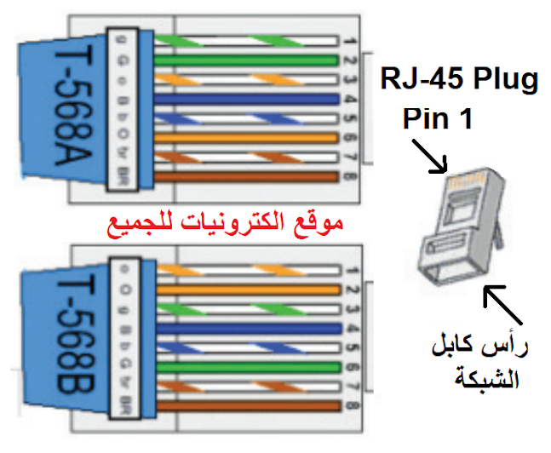
Chapter
01
Etherenet
When you connect two devices of different types together, you use a straight through cable. When you connect two devices of the same type together, you use a crossover cable. All cables are straight through if you insert a network device between two devices of the same kind

Slide 30
Chapter
01
Etherenet
MDI and MDI-X
Away from the CCNA exams, there is one more complication to take into account when you are buying network cables. If your device implements MDI and MDI-X, you don’t need to worry about crossover cables. MDI is the Medium Dependent Interface standard and it operates inside the socket of a NIC. It can detect which wire transmissions arrive on rather than doggedly listening on pins 3 and 6. MDI-X stands for Medium Dependent Interface – Crossover. So, if your computer, printer, switch, router or modem has MDI printed on the box, you only need to buy a straight through cable.

Slide 31
Chapter
01
Etherenet
Crossover cables
A crossover cable does exactly as its name suggests, it crosses over the wire from pin 1 at one end to pin 3 at the other connector. The wire that is crimped to pin 2 at one end is attached to pin 6 at the other end and the pins 3 and 6 wires go to pins 1 and 2 respectively in the other connector. The crossover cable follows both EIA-568A and EIA-568B. It is A at one end and B at the other. So those conflicting standards did end up being useful.
To pass your CCNA exams, you just need to know that the pin that the striped orange wire connects to on the left of the diagram takes the striped green wire on the right of the diagram. The pin that takes the solid green wire on the left, takes the solid orange wire on the right. You could also write down orange left and green right and you would still get full marks.

Slide 32
Chapter
01
Etherenet
What Is Straight Through Cable?
A straight through cable is a type of twisted pair cable that is used in local area networks to connect a computer to a network hub such as a router. This type of cable is also sometimes called a patch cable and is an alternative to wireless connections where one or more computers access a router through a wireless signal. On a straight through cable, the wired pins match. Straight through cable use one wiring standard: both ends use T568A wiring standard or both ends use T568B wiring standard.
The Main Differences-Straight Through and Crossover Cable
Straight through and crossover cables are wired differently from each other. One easy way to tell what you have is to look at the order of the colored wires inside the RJ45 connector. If the order of the wires is the same on both ends, then you have a straight through cable. If not, then it’s most likely a crossover cable or was wired wrong.

Slide 33
Chapter
01
Etherenet
What Are the Various Types of Ethernet Networks?
Fiber optic media converters connect an Ethernet device with CAT5/CAT6 copper cables to a fiber optic cable. An Ethernet network usually is active in a 10-km periphery. This extension to fiber optic cable significantly increases the distance covered by the network. Here are some types of Ethernet networks:
Fast Ethernet: As the term suggests, this is quite a high-speed internet, and can transmit or receive data at about 100 Mbps. This type of network is usually supported by a twisted pair or CAT5 cable. If a laptop, camera, or any other device is connected to a network, they operate at 10/100Base Ethernet and 100Base on the fiber side of the link.
Gigabit Ethernet: This type of network transfers data at an even higher speed of about 1000 Mbps or 1Gbps. Gigabit speed is an upgrade from Fast Ethernet which is slowly being phased out. In this type of network, all the four pairs in the twisted pair cable contribute to the data transfer speed. This network type finds a large application in video calling systems which use CAT5e or other advanced cables. For extended networks, the distance of up to 500m, 1000Base SX fiber cables may be used for multimode,

Slide 34
Chapter
01
Etherenet
This network type finds a large application in video calling systems which use CAT5e or other advanced cables. For extended networks, the distance of up to 500m, 1000Base SX fiber cables may be used for multimode, as well as 1000Base LX for single mode systems. VERSITRON manufactures Gigabit Ethernet Media Converters that can handle 10/100/1000Base speeds on the Ethernet side and 1000Base Gigabit speed on the fiber side by using Fiber SFP modules.
10-Gigabit Ethernet: This is an even more advanced and high speed network type with a data transfer rate of 10 Gigabit/second. It is supported by CAT6a or CAT7 twisted pair cables, as well as fiber optic cables. By using a fiber optic cable, this network area can be extended up to around 10,000 meters.

Slide 35
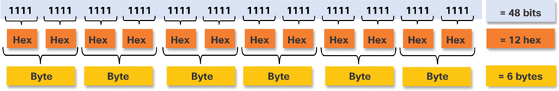
Chapter
01
Etherenet
Ethernet MAC Address (7.2.2)
In an Ethernet LAN, every network device is connected to the same shared medium. The MAC address is used to identify the physical source and destination devices (NICs) on the local network segment. MAC addressing provides a method for device identification at the data link layer of the OSI model.
An Ethernet MAC address is a 48-bit address expressed using 12 hexadecimal digits, as shown in Figure. Because 1 byte equals 8 bits, we can also say that a MAC address is 6 bytes in length.

Slide 36

Chapter
01
Etherenet
All MAC addresses must be unique to the Ethernet device or Ethernet interface. To ensure uniqueness, every vendor that sells Ethernet devices must register with the IEEE to obtain a unique 6-digit hexadecimal (that is, 24-bit or 3-byte) code called an organizationally unique identifier (OUI).
When a vendor assigns a MAC address to a device or to an Ethernet interface, the
vendor must do as follows:
Use its assigned OUI as the first 6 hexadecimal digits.
Assign a unique value in the last 6 hexadecimal digits.
Therefore, an Ethernet MAC address consists of a 6-digit hexadecimal vendor OUI code followed by a 6-digit hexadecimal vendor-assigned value, as shown in Figure .

Slide 37
Chapter
01
Etherenet
When the computer boots up, the NIC copies its MAC address from ROM into RAM. When a device is forwarding a message to an Ethernet network
the Ethernet header includes the following:
Source MAC address: This is the MAC address of the source device NIC.
Destination MAC address: This is the MAC address of the destination device NIC.

Slide 38
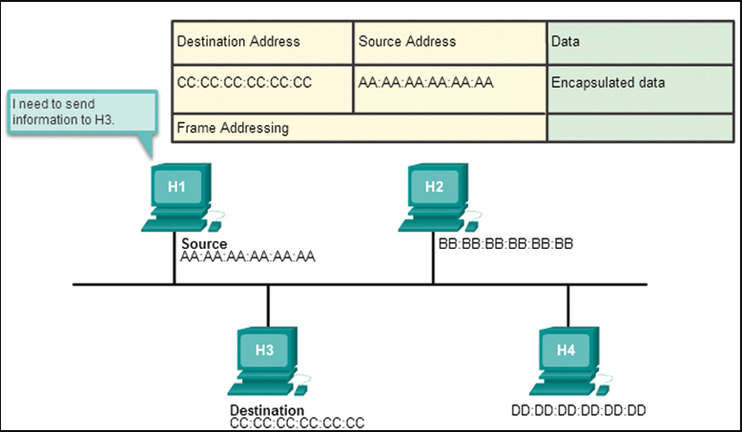
Chapter
01
Etherenet

Slide 39
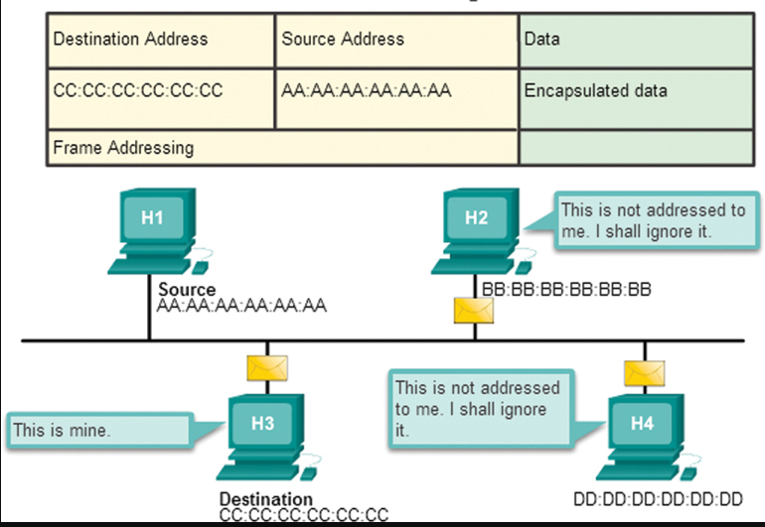
Chapter
01
Etherenet

