Slide 1


Database Management System
IT 261
Bachelor of Information Technology
Prepared by Dr. Khaled Eskaf
Lecture 2

Slide 2

Week | Topic | Objective | MySQL Practical Activities
1 | Introduction to Database Concepts | Understand basic database concepts. | Install MySQL, explore the interface, create a basic database.
2 | Relational Data Model | Learn about the relational data model. | Create relational tables in MySQL.
3 | Relational Integrity Rules | Understand relational integrity constraints. | Implement primary and foreign key constraints in MySQL.
4 | Relational Algebra and Basic SQL | Explore relational algebra and basic SQL commands. | Use basic SQL queries in MySQL.
5 | Advanced SQL Queries | Delve into complex SQL operations. | Execute advanced SQL commands in MySQL.
6 | Introduction to Database Normalization | Begin learning database normalization principles. | Apply the first normal form (1NF) in MySQL.
7 | Advanced Database Normalization | Explore advanced normalization techniques. | Normalize a database in MySQL to 2NF and 3NF.
8 | Data Modeling and ER Diagrams | Understand data modeling and ER diagrams. | Create an ER diagram and implement it in MySQL.
9 | Database Design for Real-World Apps | Apply database design to real-world scenarios. | Develop a database schema based on a real-world example.
10 | Project and Review | Apply all learned concepts in a comprehensive project. | Complete a project in MySQL incorporating all learned skills.
www.midocean.ae

Slide 3
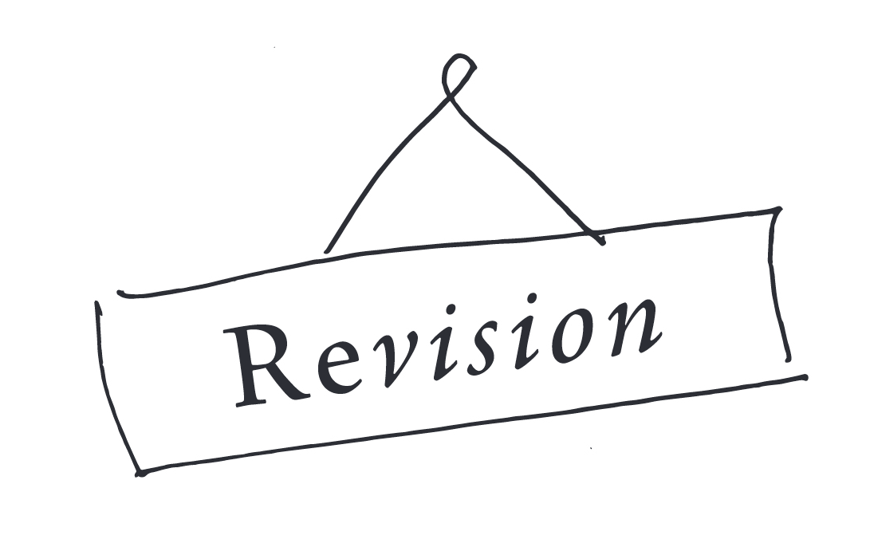
www.midocean.ae

Slide 4
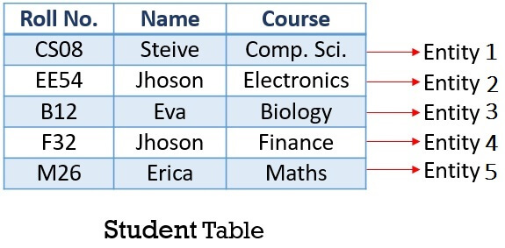
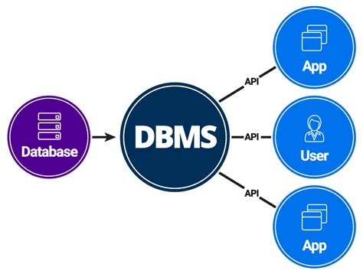
Definitions
Database:
A very large, integrated collection of data.
Models real-world:
Entities (e.g., students, courses),
Relationships (Ex., Eva is taking Biology)
Database Management System (DBMS (
a software package designed to store and manage databases.
Examples of Database Applications(Banking)
www.midocean.ae

Slide 5

Purpose of Database Systems
In the early days, database applications were built directly on top of file systems
Drawbacks of using file systems to store data:
  Data redundancy and inconsistency
  Multiple file formats, duplication of information in different files
  Difficulty in accessing data
  Need to write a new program to carry out each new task.
  Data isolation — multiple files and formats
www.midocean.ae

Slide 6

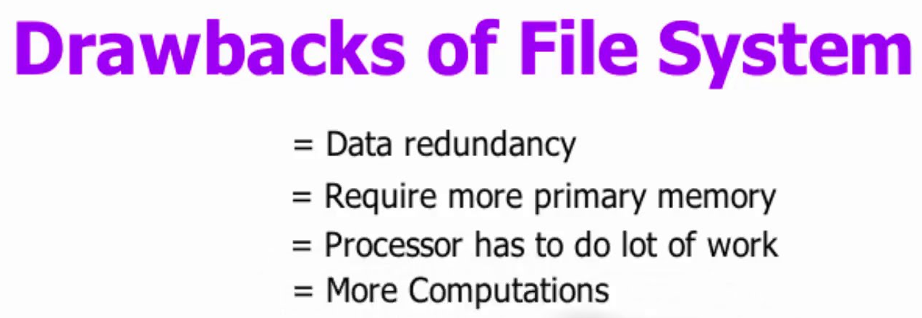
www.midocean.ae

Slide 7

Why Use a DBMS?
Separation of the Data definition and the Program Abstraction into a simple model Data independence and efficient access. Reduced application development time – ad-hoc queries Data integrity and security. Uniform data administration. Concurrent access, recovery from crashes. Support for multiple different views
www.midocean.ae

Slide 8

Why Study Databases?
Shift from computation to information: -at the “low end”: scramble to webspace (a mess!) -at the “high end”: scientific applications Datasets increasing in diversity and volume. -Digital libraries, interactive video, Human Genome project, EOS project. -... need for DBMS exploding DBMS encompasses most of CS -OS, languages, theory, “AI”, multimedia, logic
www.midocean.ae

Slide 9
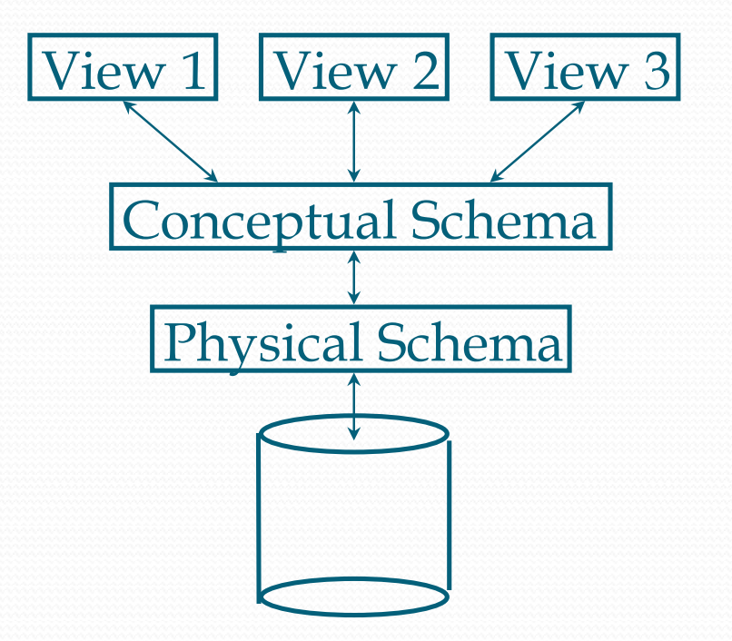
Levels of Abstraction
Many views, single conceptual (logical) schema and physical schema.
 Views describe how users see the data.
 Conceptual schema defines logical structure. Sometime we separate between conceptual level and logical level
 Physical schema describes the files and indexes used
Schemas are defined using DDL (Data Definition Language)
data is modified/queried using DML (Data Manipulation Language)
www.midocean.ae
Notes:
مستويات التجريد في قواعد البيانات تتضمن عدة طبقات:
المستوى المفاهيمي: يحدد البنية المنطقية لقاعدة البيانات بأكملها. يُظهر النظام بأكمله كوحدة واحدة دون الخوض في التفاصيل الفنية.
المستوى المنطقي (مخطط منطقي): يصف كيف يرى المستخدمون البيانات. يحدد أنواع البيانات والعلاقات بينها.
المستوى الفيزيائي (مخطط فيزيائي): يصف البيانات في مستوى أكثر تفصيلاً مثل الملفات والفهارس المستخدمة في تخزين البيانات.
لغات قواعد البيانات تشمل:
DDL (لغة تعريف البيانات): تستخدم لتعريف وتعديل البنية الأساسية لقاعدة البيانات.
DML (لغة معالجة البيانات): تستخدم للاستعلام وتعديل البيانات ضمن قاعدة البيانات.
هذه المستويات تسمح بفهم وتصميم قاعدة البيانات بطريقة منظمة وفعالة.

Slide 10




www.midocean.ae

Slide 11
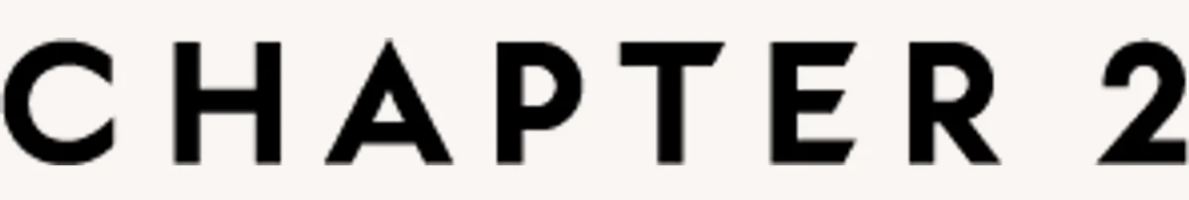
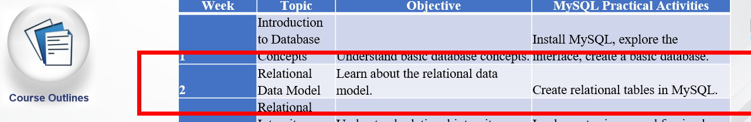
The Entity-Relationship Model
www.midocean.ae

Slide 12
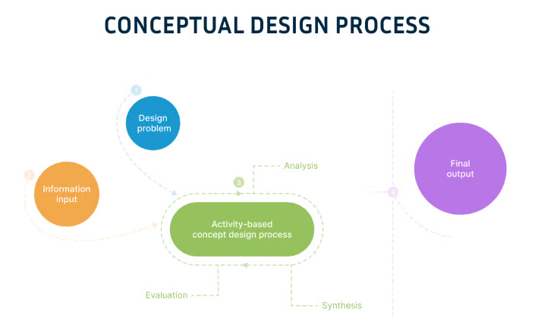
Overview of Database Design
Conceptual design: (ER Model is used at this stage.)
  What are the entities and relationships in the enterprise?
  What information about these entities and relationships should we store in the database?
  What are the integrity constraints or business rules that hold?
  A database `schema’ in the ER Model can be represented pictorially (ER diagrams).
  Can map an ER diagram into a relational schema.
www.midocean.ae
Notes:
التصميم النظري

Slide 13
ER Model Basics
name
ssn
lot
Entity: Real-world object distinguishable from other objects. An entity is described (in DB) using a set of attributes.
Entity Set: A collection of similar entities. E.g., all employees.
  All entities in an entity set have the same set of attributes. (Until we consider ISA hierarchies, anyway!)
  Each entity set has a key.
  Each attribute has a domain.
Employees
www.midocean.ae
Notes:
الكيان: كائن في العالم الحقيقي يمكن تمييزه عن الكائنات الأخرى. يتم وصف الكيان (في قاعدة البيانات) باستخدام مجموعة من السمات.
مجموعة الكيانات: مجموعة من الكيانات المتشابهة. على سبيل المثال، جميع الموظفين.
جميع الكيانات في مجموعة الكيانات لها نفس مجموعة السمات. (حتى نأخذ بعين الاعتبار التسلسل الهرمي لـ ISA، على أي حال!)
كل مجموعة كيان لديها مفتاح.
كل سمة لها مجال.

Slide 14
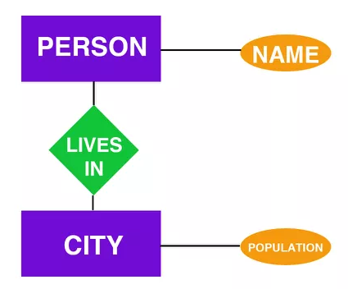
What is an ER Diagram?
Definition: An ER Diagram (Entity-Relationship Diagram) is a graphical representation of an ER model. It uses symbols and notation to visualize the entities, attributes, and relationships defined in the model. ER diagrams are tools that help to detail and communicate the design based on the ER model.
Components: ER diagrams consist of rectangles (representing entities), ovals (representing attributes), diamonds (representing relationships), and lines connecting these shapes (indicating the nature of the relationship between entities).
Purpose: The main goal of an ER diagram is to provide a visual tool for examining and communicating the database's logical structure, making it easier for stakeholders to understand the design and for developers to implement the database schema.
www.midocean.ae

Slide 15
What is an ER Model?
Definition: The Entity-Relationship (ER) Model is a conceptual tool for modeling data in a structured way. It is used to represent the data architecture and its components at a high level, without getting into the details of physical storage. The ER model provides a way to describe the data types, relationships, and constraints that should be applied to the data.
Components: The ER model includes entities (which represent real-world objects or concepts), attributes (which describe properties of entities), and relationships (which define how entities are connected to each other).
Purpose: Its primary purpose is to establish a clear and comprehensive blueprint for the logical structure of the database. It helps in understanding the data requirements of an organization and how different data elements interact with one another.
www.midocean.ae

Slide 16
Feature | ER Model | ER Diagram
What is it? | A plan for how to organize data. | A picture showing the plan.
Purpose | To think about what data you need and how it fits together. | To show others your data plan in an easy-to-understand way.
Contains | Ideas about data, like what information you're keeping track of and how it's linked. | Shapes and lines that represent your data ideas.
Use | To make a clear plan for your database's structure. | To help people see and understand your data plan.
Level | Thinking about what data is needed. | Showing the plan with pictures.
For Who? | People making the database plan. | People making the database and others who need to understand the plan.
Result | A detailed plan for your data. | A drawing that shows your data plan.

Slide 17

The following diagram showcases two entities - Student and Course, and their relationship.
The relationship described between student and course is many-to-many, as a course can be opted by several students, and a student can opt for more than one course.
Student entity possesses attributes - Stu_Id, Stu_Name & Stu_Age.
The course entity has attributes such as Cou_ID & Cou_Name.
www.midocean.ae

Slide 18
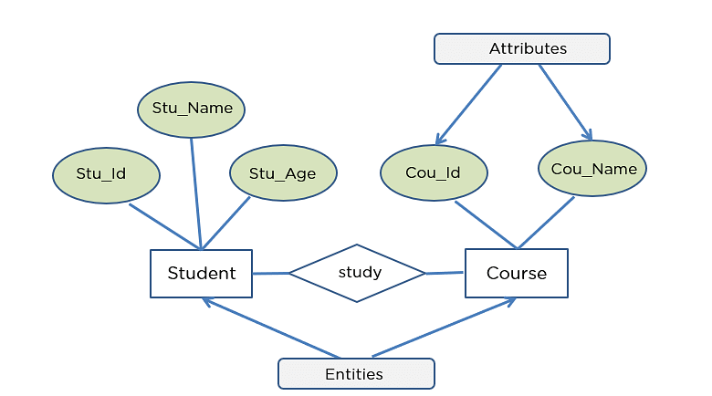
www.midocean.ae

Slide 19
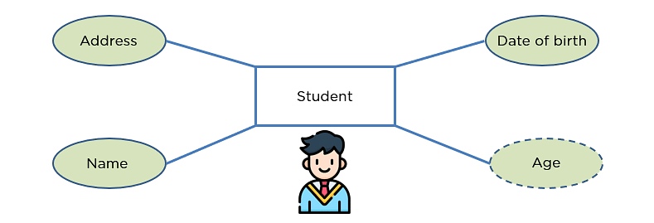
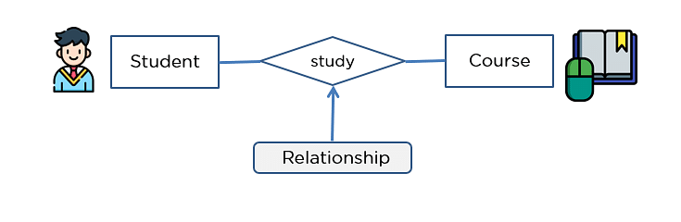
www.midocean.ae

Slide 20
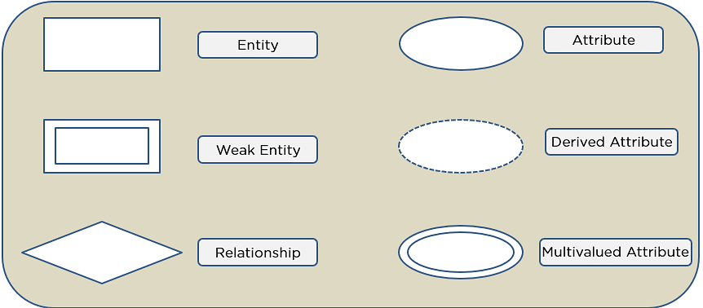
Symbols Used in ER Diagrams
Rectangles: This Entity Relationship Diagram symbol represents entity types
Ellipses: This symbol represents attributes
Diamonds: This symbol represents relationship types
Lines: It links attributes to entity types and entity types with other relationship types
Primary key: Here, it underlines the attributes
Double Ellipses: Represents multi-valued attributes
www.midocean.ae

Slide 21
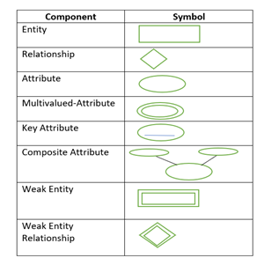
Components of ER Diagram
You base an ER Diagram on three basic concepts:
Entities
Attributes
  Key Attribute
  Composite Attribute
  Multivalued Attribute
  Derived Attribute
Relationships
  One-to-One Relationships
  One-to-Many Relationships
  Many-to-One Relationships
  Many-to-Many Relationships
www.midocean.ae

Slide 22
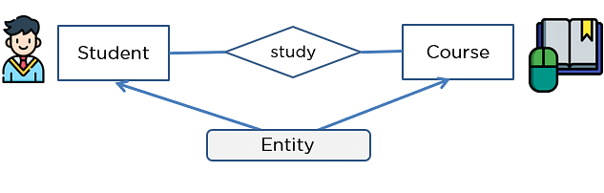
Entities
An entity can be either a living or non-living component.
It showcases an entity as a rectangle in an ER diagram.
For example, in a student study course, both the student and the course are entities.
www.midocean.ae

Slide 23
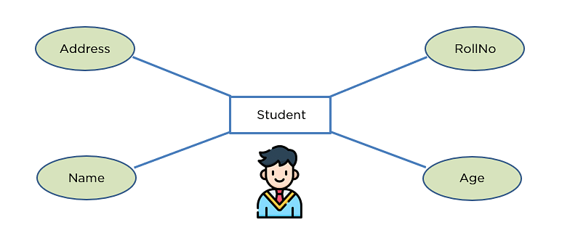
Attribute
An attribute exhibits the properties of an entity.
You can illustrate an attribute with an oval shape in an ER diagram.
www.midocean.ae

Slide 24
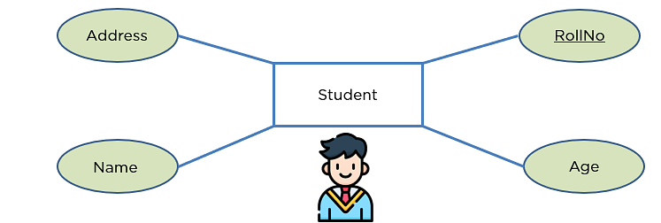
Key Attribute
Key attribute uniquely identifies an entity from an entity set.
It underlines the text of a key attribute.
For example: For a student entity, the roll number can uniquely identify a student from a set of students.
www.midocean.ae

Slide 25
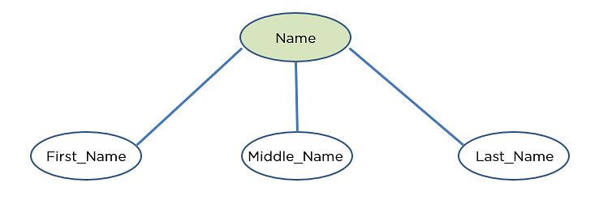
Composite Attribute
An attribute that is composed of several other attributes is known as a composite attribute.
An oval showcases the composite attribute, and the composite attribute oval is further connected with other ovals.
www.midocean.ae

Slide 26
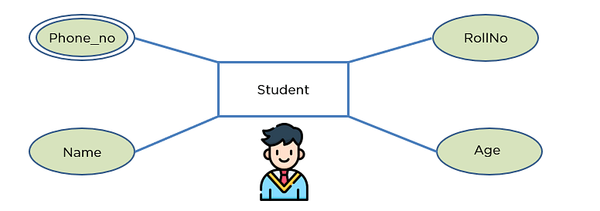
Multivalued Attribute
Some attributes can possess over one value, those attributes are called multivalued attributes.
The double oval shape is used to represent a multivalued attribute.
www.midocean.ae

Slide 27
Derived Attribute
An attribute that can be derived from other attributes of the entity is known as a derived attribute.
In the ER diagram, the dashed oval represents the derived attribute.
www.midocean.ae

Slide 28
Relationship
The diamond shape showcases a relationship in the ER diagram.
It depicts the relationship between two entities.
In the example below, both the student and the course are entities, and study is the relationship between them.
www.midocean.ae

Slide 29

One-to-One Relationship
When a single element of an entity is associated with a single element of another entity, it is called a one-to-one relationship.
For example, a student has only one identification card and an identification card is given to one person.
www.midocean.ae

Slide 30

One-to-Many Relationship
When a single element of an entity is associated with more than one element of another entity, it is called a one-to-many relationship
For example, a customer can place many orders, but an order cannot be placed by many customers.
www.midocean.ae

Slide 31

Many-to-One Relationship
When more than one element of an entity is related to a single element of another entity, then it is called a many-to-one relationship.
For example, students have to opt for a single course, but a course can have many students.
www.midocean.ae

Slide 32

Many-to-Many Relationship
When more than one element of an entity is associated with more than one element of another entity, this is called a many-to-many relationship.
For example, you can assign an employee to many projects and a project can have many employees.
www.midocean.ae

Slide 33
How to Create an ER Diagram
Before you design a relational database, it makes sense to create an ER diagram. You may have software that is equipped to handle this process. If not, Put pen (or pencil) to paper, or find a software program that can handle the charting requirements.
To create an ER diagram by hand:
Create a rectangular box for each entity or concept relevant to your model.
Draw lines to connect related entities to model the relationships. Label the relationships using verbs inside diamond shapes.
Identify the relevant attributes for each entity, beginning with the most important attributes, and enter them in ovals in the diagram. Later, you can make the attribute lists more detailed.
www.midocean.ae

Slide 34
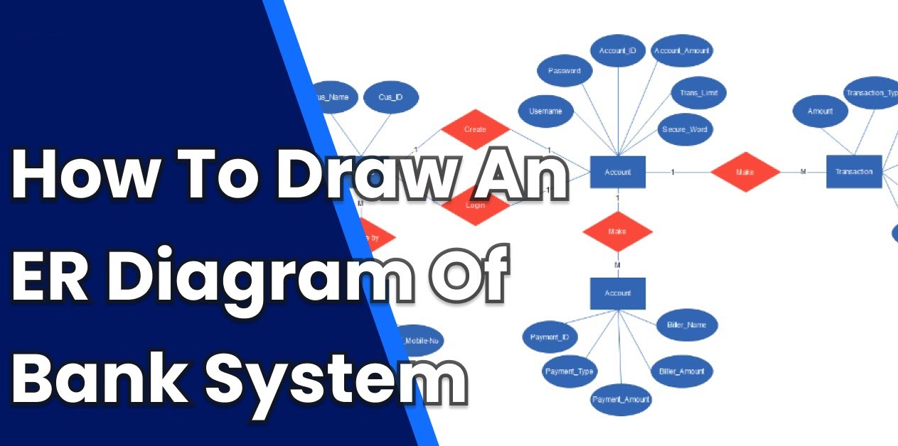
Creating an Entity-Relationship (ER) Diagram for a simple bank system involving customers and their bank accounts can be a great way to understand how ER diagrams work.
www.midocean.ae

Slide 35

ER Diagram for Bank Database:
In an ER diagram for a Banking System, we will have to keep in my mind the following points while making the diagram:
There are going to be a number of entities, namely customers, banks, bank accounts, and transactions.
The various entities in our diagram will have many different attributes like the Customer has First Name and Last Name.
There are going to be varying relationships between the various entities like the Bank account, and the Customer will have a relationship called owned by, where we show that the account is being held by the Customer.
www.midocean.ae

Slide 36
Let's start with making our ER diagram:
Deciding Entities
We first decide the entities that we are going to have in our diagram :
Bank
Bank Account
Transaction
Customer
www.midocean.ae

Slide 37
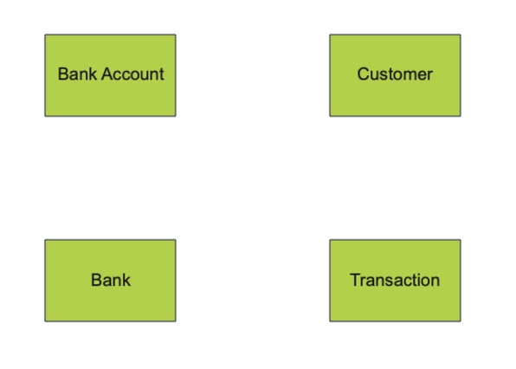
Bank
Bank Account
Transaction
Customer
www.midocean.ae

Slide 38
Deciding Attributes :
We then decide what attributes are associated with these entities:
Bank: Name, City
Bank Account: Balance, Account holder, Bank
Customer: First Name, Last Name, Phone Number
Transaction: Deposit Account, Withdrawal Account, Timestamp, Currency, Amount
www.midocean.ae

Slide 39
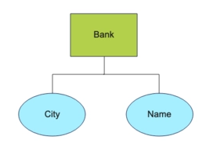
Bank: Name, City
www.midocean.ae

Slide 40
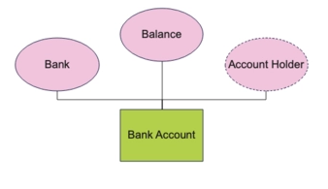
Bank Account: Balance, Account holder, Bank
www.midocean.ae

Slide 41
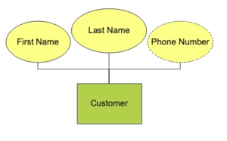
Customer: First Name, Last Name, Phone Number
www.midocean.ae

Slide 42
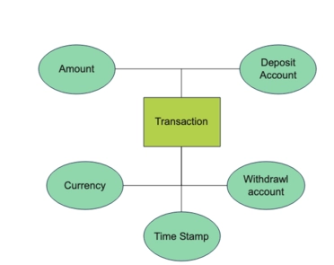
Transaction: Deposit Account, Withdrawal Account, Timestamp, Currency, Amount
www.midocean.ae

Slide 43
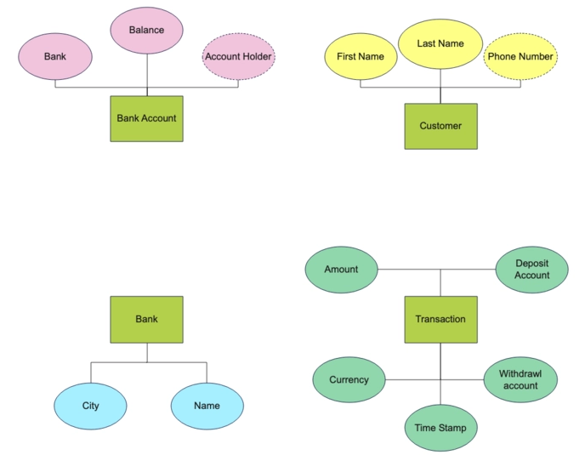
Bank: Name, City
Bank Account: Balance, Account holder, Bank
Customer: First Name, Last Name, Phone Number
Transaction: Deposit Account, Withdrawal Account, Timestamp, Currency, Amount
www.midocean.ae

Slide 44
Deciding Relationships :
We then decide the relationships between the various entities:
A Bank Account is owned by a Customer.
A Bank has a Bank Account.
A Transaction is linked to the Bank Account.
The relationship between Bank Account and Customer is many to one because a Customer can have many Bank Accounts.
The relationship between Bank and Bank Account is one too many as a Bank has many bank accounts.
The Transaction to bank account relationship is many to one because multiple transitions can be linked to one bank account.
www.midocean.ae

Slide 45
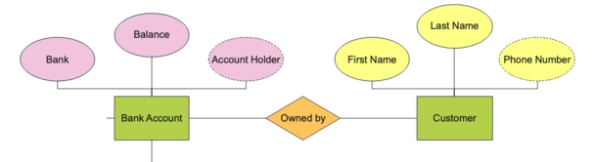
A Bank Account is owned by a Customer.
www.midocean.ae

Slide 46
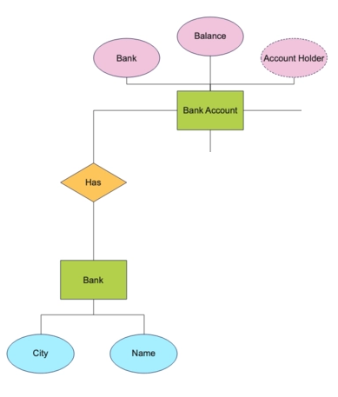
A Bank has a Bank Account.
www.midocean.ae

Slide 47
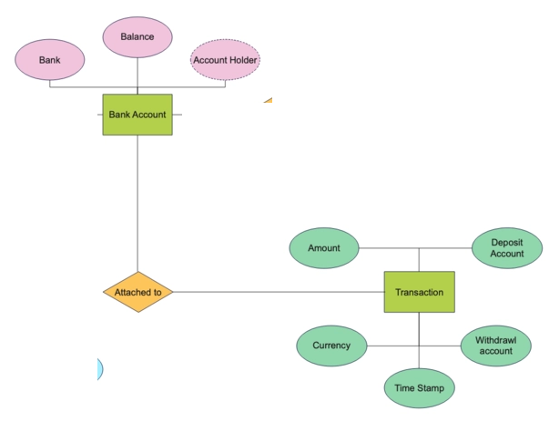
A Transaction is linked to the Bank Account
www.midocean.ae

Slide 48
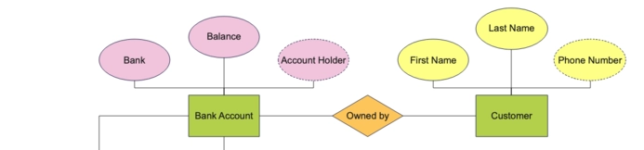
The relationship between Bank Account and Customer is many to one because a Customer can have many Bank Accounts.
www.midocean.ae

Slide 49


The relationship between Bank and Bank Account is one too many as a Bank has many bank accounts.
www.midocean.ae

Slide 50
The Transaction to bank account relationship is many to one because multiple transitions can be linked to one bank account.
www.midocean.ae

Slide 51
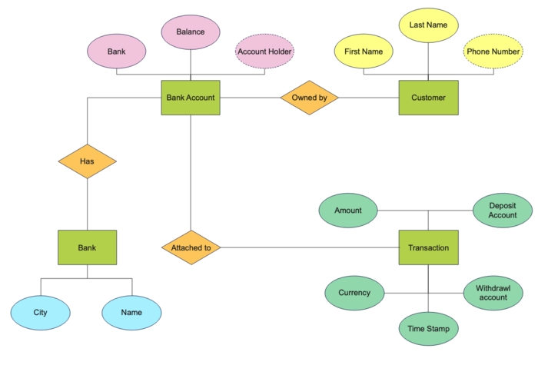
www.midocean.ae

Slide 52
Advantages of Banking ER diagrams:
Let's discuss the advantages of using an ER model for designing your banking database.
Conceptually, it is very simple: ER models are very simple because if we know the relationship between entities and attributes, then we can easily draw an ER diagram. These help us easily understand the system.
Effective communication tool: It is an effective communication tool for database designers
Increased efficiency: By using an ER diagram, designers can identify inefficiencies and redundancies in the system, allowing them to streamline processes and reduce costs. This can result in a more efficient system that is easier to maintain and operate.
Easier maintenance and updates: By having a clear understanding of the system's components and relationships, designers can more easily make updates and modifications to the system as needed. ER diagrams can help to ensure that updates and modifications are made in a consistent and efficient manner, which can help to minimize errors and downtime.
www.midocean.ae

Slide 53



Thank You

