Slide 1

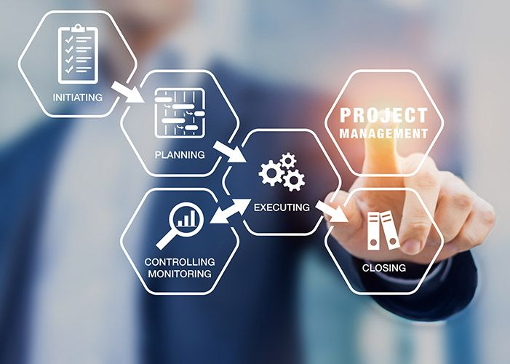
Project Management Technologies
PMG 312
Project management in a nutshell (Cont.)
Prepared by Dr. Majid Saad
Lecture 2

Slide 2



Project Management Technologies
PMG 312
Lecture 2
Prepared by
Dr. Prepared by Dr. Majid Saad

Slide 3
AGENDA
Project requirements definition​
Workshop​
Brainstorming​
Decision logic table​
RACI charting​
Understanding the project business case​

Slide 4

Project requirements definition
One of the major issues in starting the project is getting good requirements!
Project requirements are the further breakdown of the client’s deliverables that are described in detail.

Slide 5

Project requirements definition​
This process cannot be done in a vacuum, and the requirements collecting process is mostly the client’s or shareholder’s responsibility.
It is the responsibility of the PM to facilitate this requirements collecting process and there are many techniques (or combination of) for doing this.

Slide 6

Workshop
The PM could have designed workshops with the stakeholders and subject matter experts to gather the detailed requirements, which usually enhance user participation, expediting development and improving the quality of the specifications.

Slide 7

Workshop
These workshops have a set of detailed agenda to eliminate uncertainties between parties and help improve communication between all parties.

Slide 8

Workshop
A popular workshop process is joint application design (JAD), which is a group meeting-based process for requirements collection
JAD is usually more effective in small, clearly defined projects and less effective in large complex projects.

Slide 9
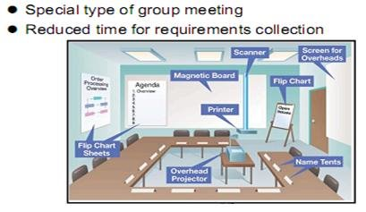
Workshop

Slide 10
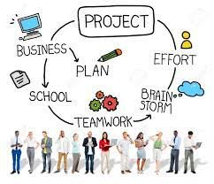
Brainstorming
A requirement gathering is a group brainstorming exercise that needs to be facilitated by the PM.
The group consists mostly of the clients or shareholders.

Slide 11
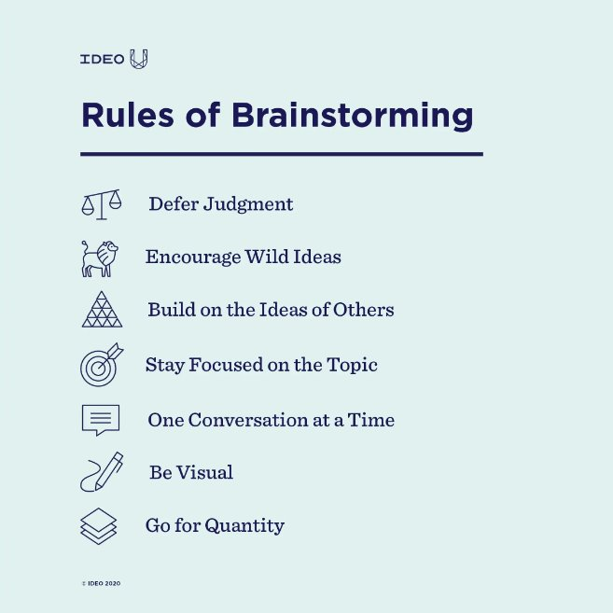
Brainstorming

Slide 12
Brainstorming
It is always smart if the PM sends surveys along with the project’s charter to key stakeholders to list their requirements or have individual interviews with the key stakeholders before the brainstorming session(s) begins to save time and have a more effective meeting.

Slide 13
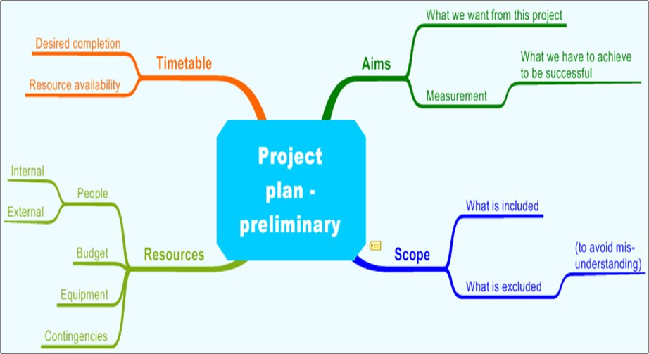
Brainstorming

Slide 14
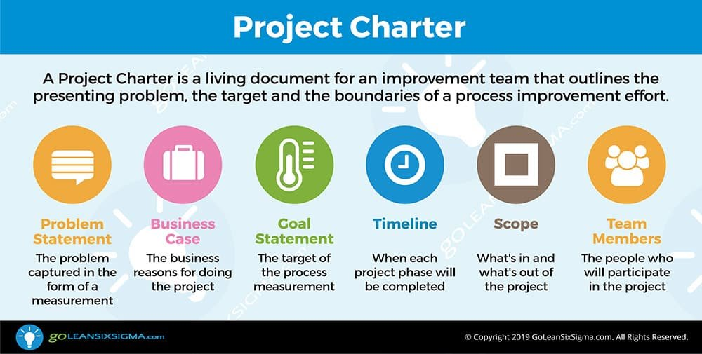
Brainstorming

Slide 15
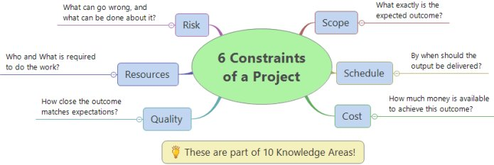
Brainstorming
Brainstorming should also include the areas of assumptions, constraints, and potential risks.
As for risk identification, the group could look at risks from past projects.

Slide 16
Brainstorming
The following are some techniques that could be used during the brainstorming session:
Brown paper
Process chart

Slide 17
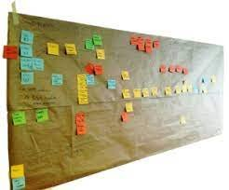
A- Brown paper
Brown paper is a form of flow-charting used to capture a complete process for evaluation (e.g., finding ways to streamline the system)
Including highlights of key activities, interfaces, documentation, data sources, strengths, and problems.

Slide 18
A- Brown paper
Brown papers are generally used in the “as-is” and “to-be” model definition phases of a project.
They can also be used to develop “should-be” and “could-be” models for evaluation.

Slide 19
A- Brown paper (Advantage)
It is important to gather the right people to develop a model of the process or system under evaluation.
Another advantage in having the users involved in this exercise is that you usually will get “buy in” and support from them on changing the process.
A feeling of ownership is important to users!

Slide 20
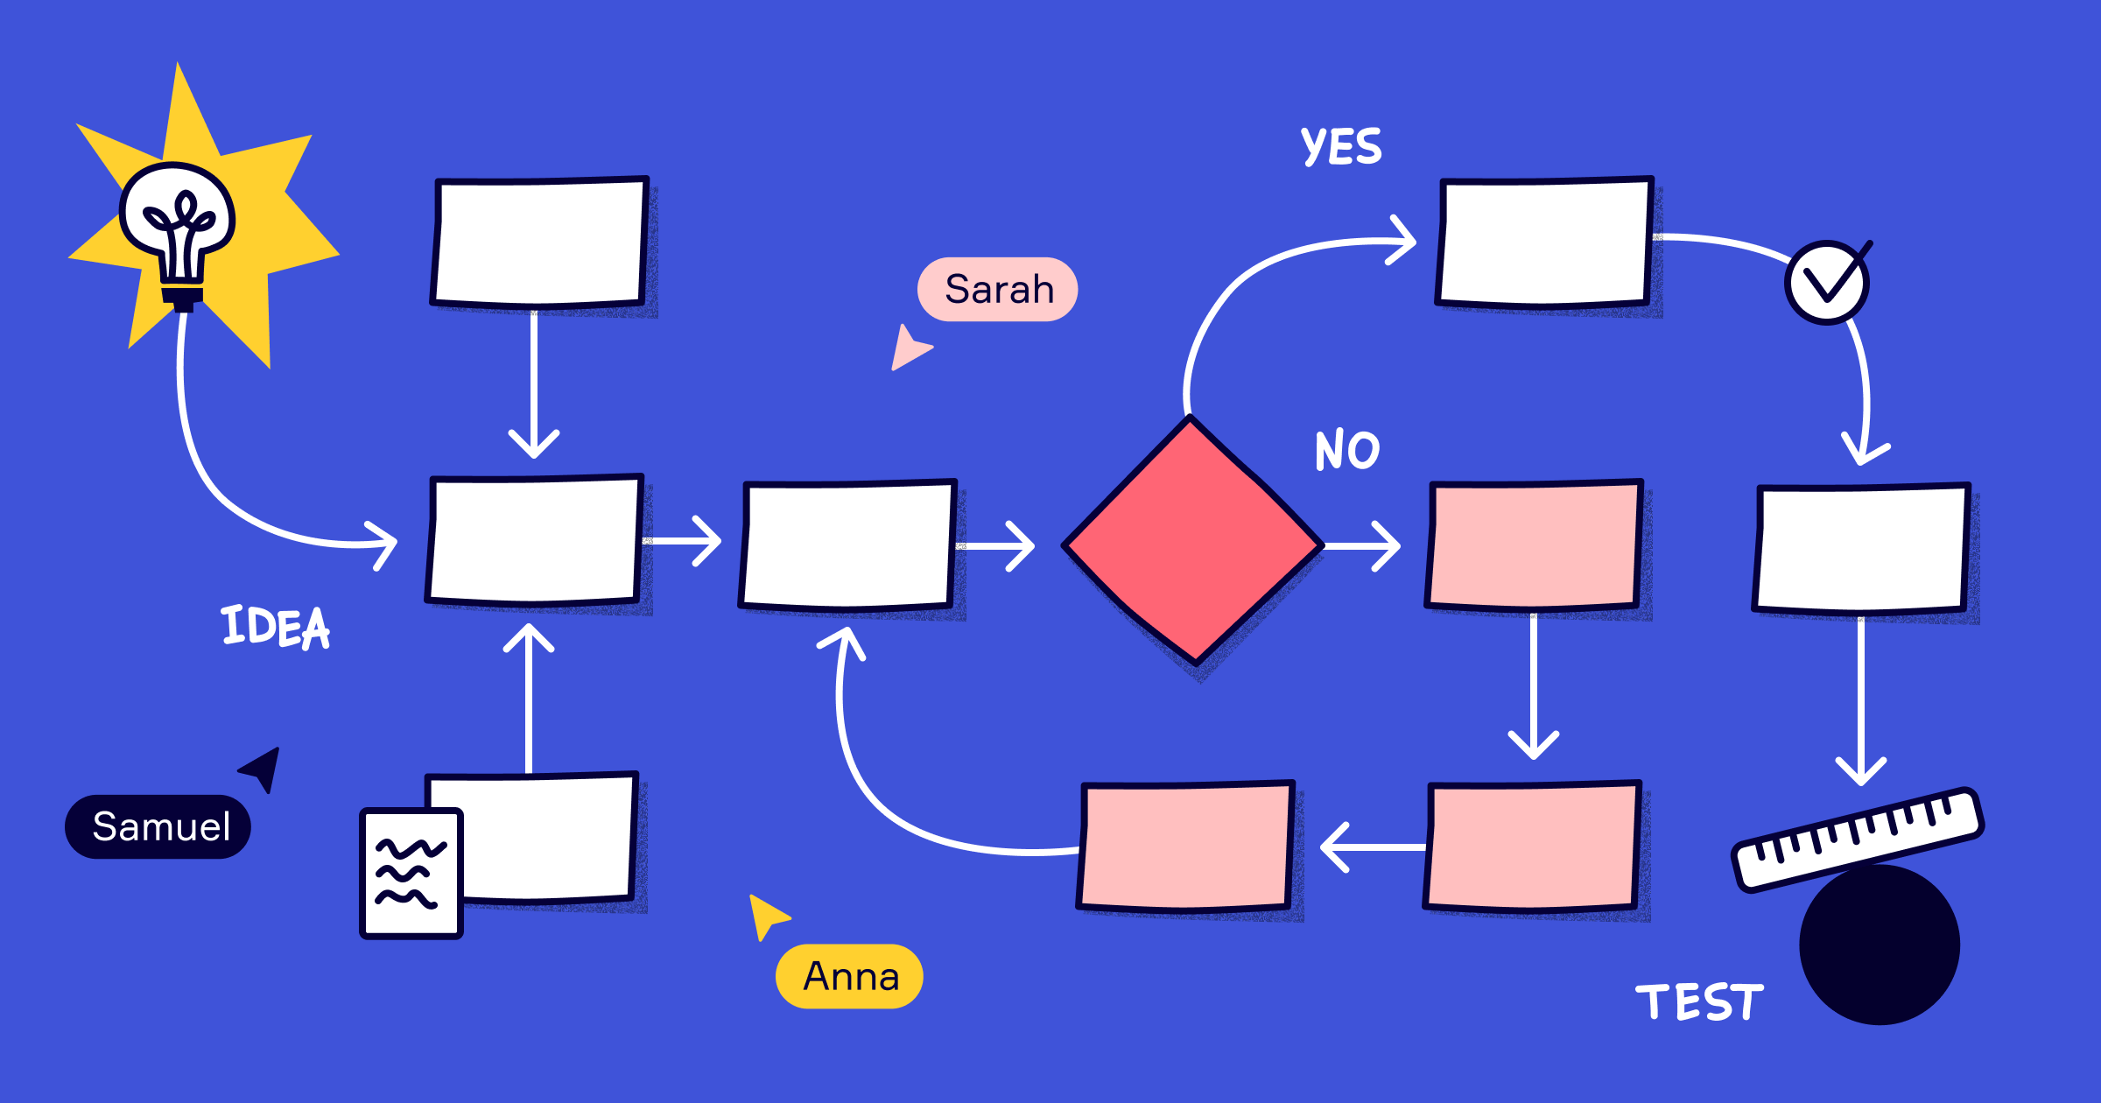
B- Process chart
If you want to learn in detail what happens in a situation involving a document, request, material, or even the actions of a person, consider using a process chart.

Slide 21
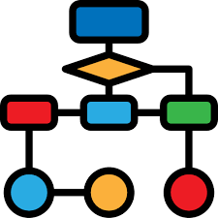
B- Process chart
The process chart documents the detailed steps of the flow and categorizes the type of action taken.

Slide 22
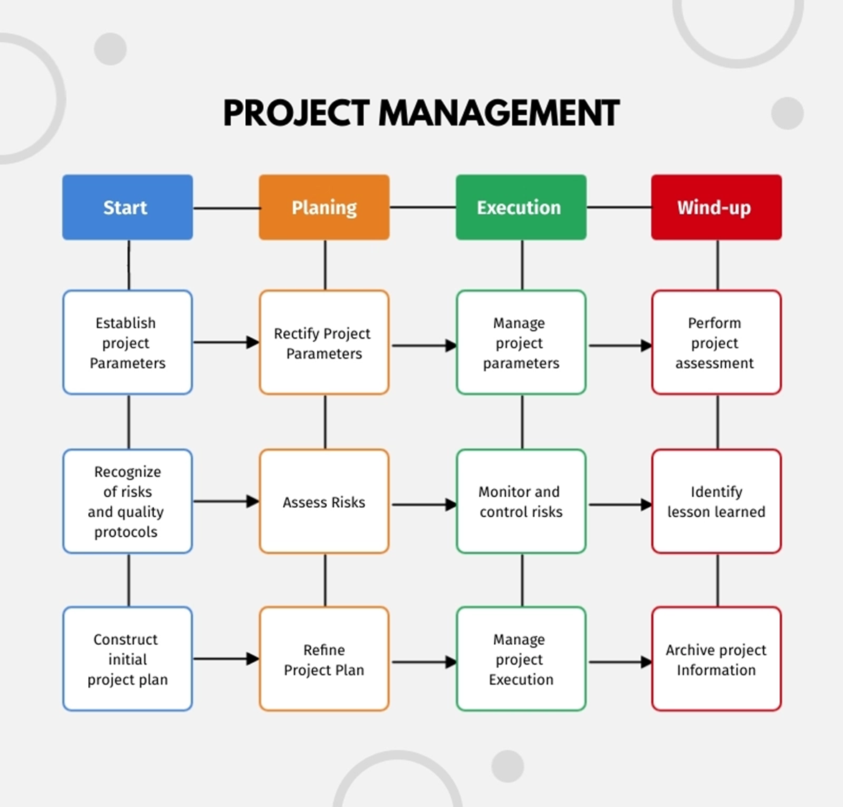
B- Process chart

Slide 23
B- Process chart
The Process Flow chart provides a visual representation of the steps in a process.
Flow charts are also referred to as Process Mapping or Flow Diagrams.

Slide 24
B- Process chart
Constructing a flow chart is often one of the first activities of a process improvement effort, because of the following benefits:
Gives everyone a clear understanding of the process
Helps to identify non-value-added operations
Facilitates teamwork and communication
Keeps everyone on the same page

Slide 25
B- Process chart
With this information, you can analyze the process for potential improvements.
To add value, you should try to reduce a complex process to its lowest common denominator to a series of simple steps to save time and reduce costs.
.

Slide 26
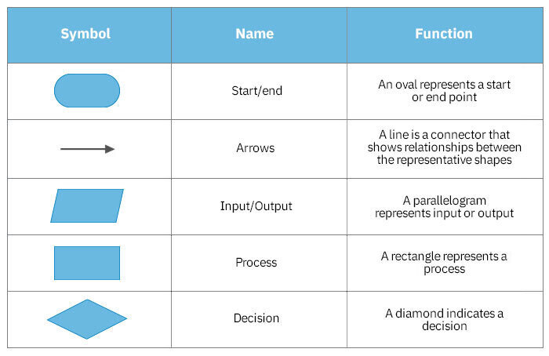
B- Process chart
There are many symbols used to construct a process chart; the more common symbols are shown below:

Slide 27
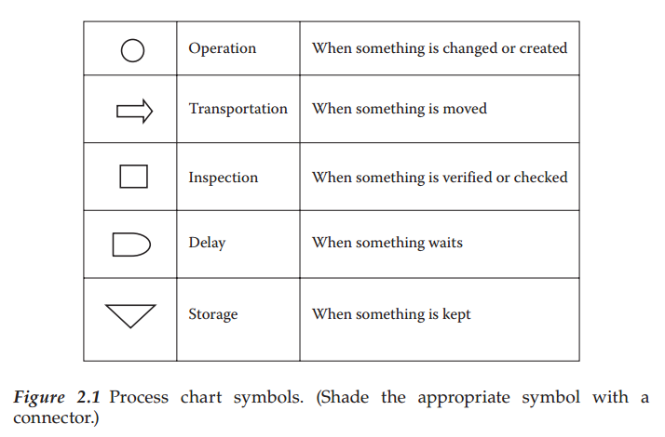
B- Process chart
www.midocean.ae

Slide 28
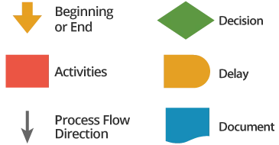
B- Process chart (Example 2)
There are many other symbols used to construct a process chart;

Slide 29
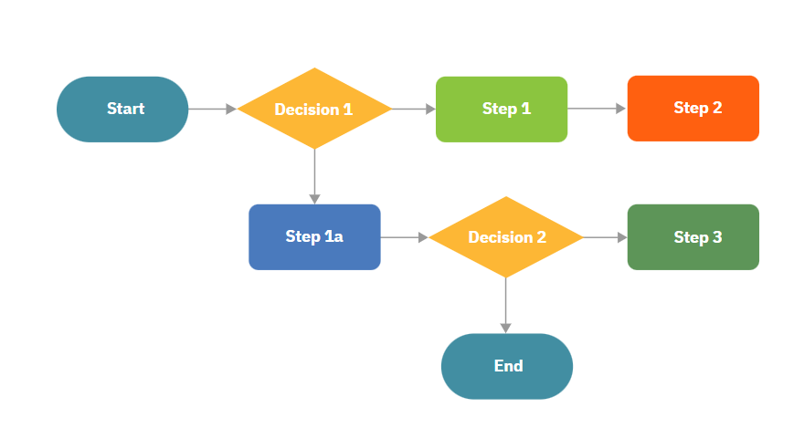
B- Process chart (Example 2)
The following is an example of a very simple flow chart for the process

Slide 30

Decision logic table
A decision logic table (DLT) is a documentation technique that can display an entire situation visually, with all alternatives shown side by side.
If you do not use a DLT, you may miss some alternatives that you never thought of which could sink your project.

Slide 31
Decision logic table
A decision table lists the various values for all the factors that influence some aspect of a system’s behavior and indicates the expected system actions in response to each combination of factors.

Slide 32
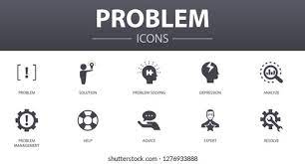

Decision logic table
The following describes the characteristics of a DLT, which increases team communication:
Displays all the elements of a problem.
Shows all the conditions affecting the solution.
Reveals all the relationships that exist among the defined conditions.
Indicates which action is appropriate for each set of circumstances.
Illustrates the IF (condition) and THEN (conclusion or action) concept.

Slide 33

Decision logic table
These factors can be shown either as statements with possible answers of true or false, as questions with possible answers of yes or no, or as conditions that can have two or more possible values.

Slide 34
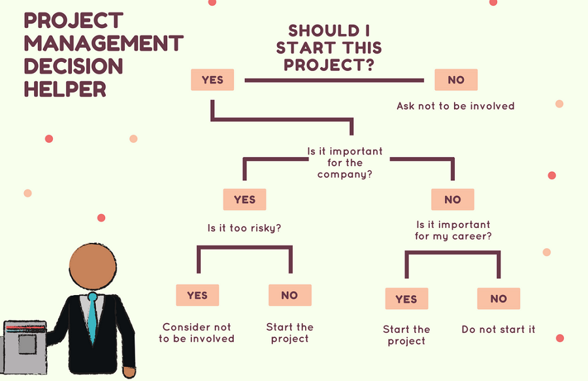
Decision Tree (Example)

Slide 35
RACI charting
Responsible, Accountable, Consult and Inform (RACI) charting is an effective means of analyzing and assigning roles and responsibilities.
It correlates functional roles or individuals to their level of participation in an activity by assigning codes for responsibility, accountability, and communication interfaces.

Slide 36
RACI charting
Establishing participation for each activity, for all roles, by assigning codes as described below:
R (responsible)—The individual working on the activity (the doer)
A (accountable)—The individual with yes/no authority; approval or veto power (Note: If two or more A’s exist, this could be a sign of problems.)
C (consult)—The individual must be consulted prior to action; two-way communication occurs
I (inform)—The individual receives one-way communication and will use the information or take subsequent action

Slide 37
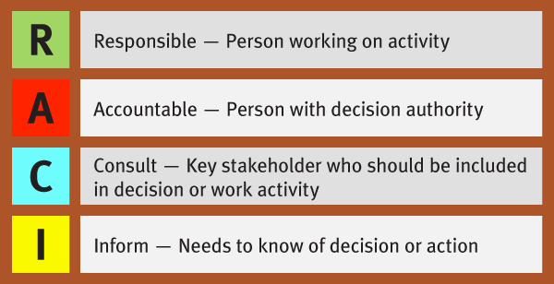
RACI charting

Slide 38
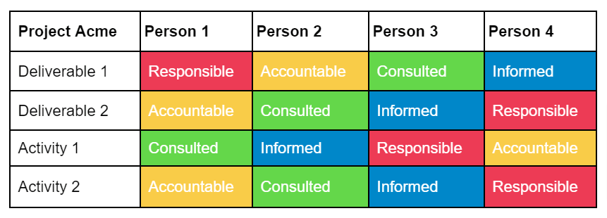
RACI charting

Slide 39
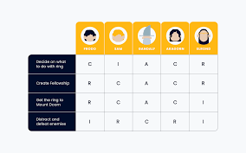
RACI charting
It is a quick means of bringing redundancies and misunderstandings to light, so that better communication can occur.

Slide 40
Traditional RACI charting
Steps to complete a chart include (Traditional RACI Matrix):
Selecting a business process to be analyzed.
Listing all of the activities associated with that process in the lefthand column of the chart.
Identifying all functional roles associated with the process and listing them in the top row on the chart.

Slide 41

RACI charting
Step 2: Identify Project Tasks
Review the project and break it down into clear tasks and deliverables.
Put these down the left-hand column of your chart.

Slide 42
RACI charting
Step 3: Assign The RACI To Each Role And Task
Work through each task and think about the different roles and what they should be responsible for.
Every task or deliverable should have Responsible and Accountable at least.
Make sure there is only one role or name assigned to Accountable—this is really important.
Think carefully about who should be Consulted whilst the task is ongoing, and who should be Informed once the task is complete.

Slide 43
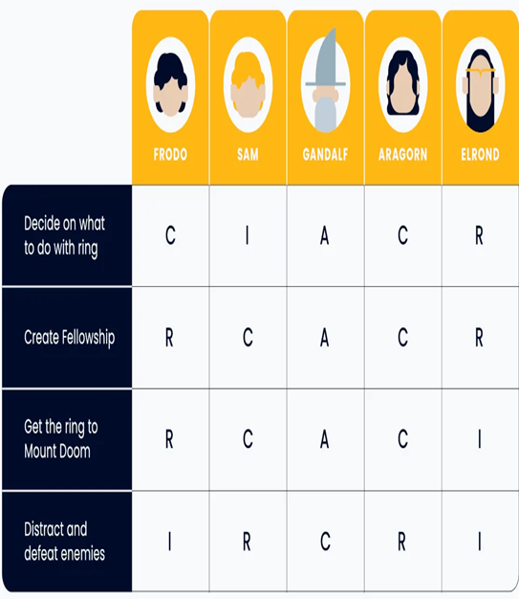
RACI charting
Step 4: Agree on This With Your Team
Step 5: Agree on This With The Core Project Stakeholders
Step 6: Make It Useful Throughout The Life Of The Project

Slide 44
Understanding the project business case
From many recent studies, the major reason for project failures is not the specifics of what went wrong, but rather the lack of procedures, methodology, and standards for managing the project.
The PM who is asked to manage a project with no methodology, standards, procedures, and processes will have a difficult time keeping the project under control and has a high probability of being unsuccessful.

Slide 45
Understanding the project business case
Also keep in mind that technical oriented projects have unusually high degrees of uncertainty for the following reasons:
Technology is changing every 6–12 months—new programming languages, new interface mechanisms, hardware platforms, tools, and version compatibility issues
Immature methodologies

Slide 46
Understanding the project business case
Resource turnover is high—new teams for each project
No standard benchmarks for abilities/skill levels of resources
Dependencies on customer for good requirements and project plan task completions
Fast-changing business environment

Slide 47
Understanding the project business case
Unfortunately, most projects have no linkage to corporate strategy (i.e., a set of short- and long-range goals), which remains revolutionary thinking in many corporations today.
So, in ranking a new project request, you should ask: does this project have any linkage to your corporate strategy? If it does, there is a high probability that you want to execute this project.
Also, if the new project request has nothing to do with your corporate strategy, there is a much lower probability that you would execute the project.

Slide 48
Understanding the project business case
Going this way shows maturity in your project management process and adds more overall long-term value to your organization.
Another advantage of linking projects to your corporate strategy is having more executive support in gaining resources and needed budget monies.
In summary, projects need to have more of a business focus that is aligned to strategic business goals!

Slide 49
Conclusion
The goal of Project Management is to deliver an Information System that is acceptable to Users and is developed on time and within budget
A good methodology encompasses standard policies, processes, and procedures that incorporate a suite of tools and techniques to help guide the process through its life cycle in an efficient, consistent, and repeatable manner.
Project requirements are the further breakdown of the client’s deliverables that are described in detail.
This process cannot be done in a vacuum, and the requirements' collecting process is mostly the client’s or shareholder’s responsibility.
It is the responsibility of the PM to facilitate this requirements collecting process and there are many techniques (or combination of) for doing this.
Projects need to have more of a business focus that is aligned to strategic business goals!

Slide 50



Thank You

