Slide 1

Prepared by
Dr. Hamada I. AbdulWakel
Lecture 9
CYB615
Network Programming

Slide 2
Module9: Handling E-mails

Slide 3


Lecture 9
Agenda
Email Protocols.
Sending Emails.
Securing Emails.
Retrieving Emails.

Slide 4
Lecture 9
Email Protocols
Simple Mail Transfer Protocol (SMTP): It can only be used by the MTA for sending e-mails from one host to another.
Post Office Protocol 3 (POP3): It provides a simple and standardized way for the users to gain access to the mailboxes and then download the messages.
Internet Message Access Protocol (IMAP): It provides a simple and standardized way for accessing your e-mail. It requires only a small data transfer; this scheme works well even over a slow connection.

Slide 5
Lecture 9
Email Modules in Python
Python has three modules:
  smtplib for SMTP protocol.
  poplib for POP3 protocol.
  imaplib for IMAP protocol.
Each module has options for transmitting the information securely by using the Transport Layer Security (TLS) protocol.
Each protocol also uses some form of authentication for ensuring the confidentiality of the data.

Slide 6
Lecture 9
smtplib Module Basic Methods
smtplib has these methods:
  SMTP(): returns an object of SMTP class.
  ehlo(): identifies the server. An extended hello message will be sent by the client to the server.
  starttls(): starts TLS mode.
  login(): takes username and password arguments to login to SMTP server.
  sendmail(): performs an entire mail transaction.
  quit(): terminates SMTP session.

Slide 7
Lecture 9
Checking Email Client Running
import smtplib
session = smtplib.SMTP('localhost', 1025)
subject = 'Test'
body = "A test message to check the email sending using STMP"
msg = f"Subject: {subject} \n\n{body}"
session.sendemail("hamada@esu.ae.ac", "hamada_mbsoft@yahoo.com", msg)

Slide 8
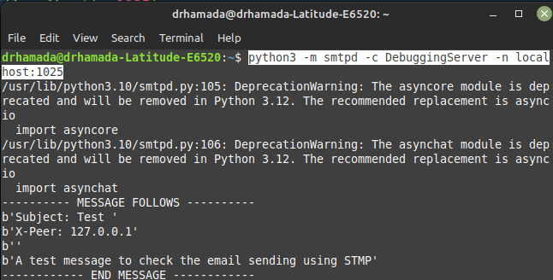
Lecture 9
Checking Email Client Running
Cont'd

Slide 9
Lecture 9
Simple Email Client Example
import smtplib, imghdr
from email.message import EmailMessage
from email.utils import make_msgid
sender = input("Enter sender email address: ")
recipient = input("Enter recipient email address: ")
msg = EmailMessage()
msg['subject'] = 'A new message with attachment'
msg['from'] = sender
msg['to'] = recipient
msg['Message-ID'] = make_msgid()
msg.set_content("Image attached ...")

Slide 10
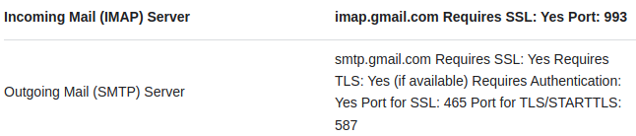
Lecture 9
Simple Email Client Example
Cont'd
with open('image.jpg', 'rb') as f:
file = f.read()
fileType = imghdr.what(f.name); print(fileType)
fileName = f.name
msg.add_attachment(file, maintype='image', subtype=fileType, filename = fileName)
mailserver = 'smtp.gmail.com'; mailport = 587
session = smtplib.SMTP(mailserver, mailport)
session.ehlo()
session.sendmail(sender, recipient, msg.as_string())
print(f"You email is sent to {recipient}.")
session.quit()

Slide 11
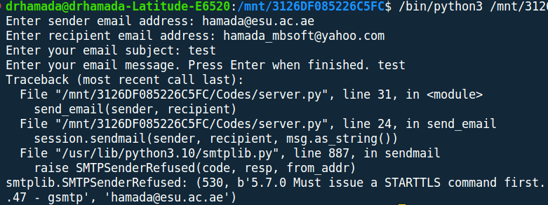
Lecture 9
Simple Email Client Example
Cont'd

Slide 12
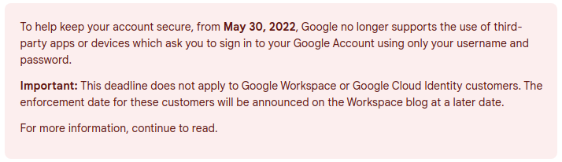
Lecture 9
Less Secure Apps
https://support.google.com/accounts/answer/6010255?hl=en

Slide 13
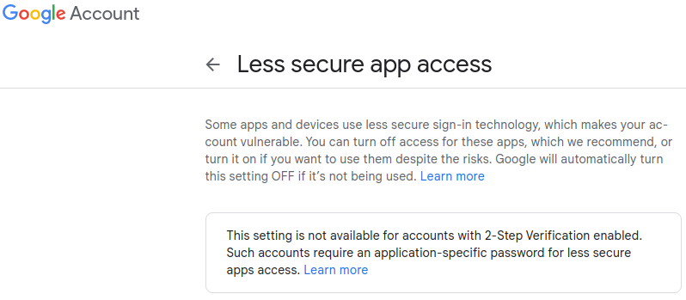
Lecture 9
Less Secure Apps
Cont'd

Slide 14
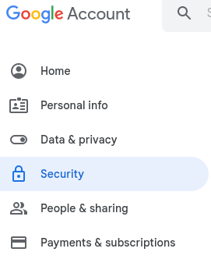
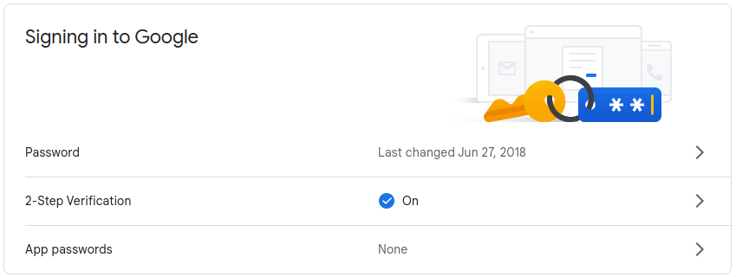
Lecture 9
Less Secure Apps
Cont'd

Slide 15
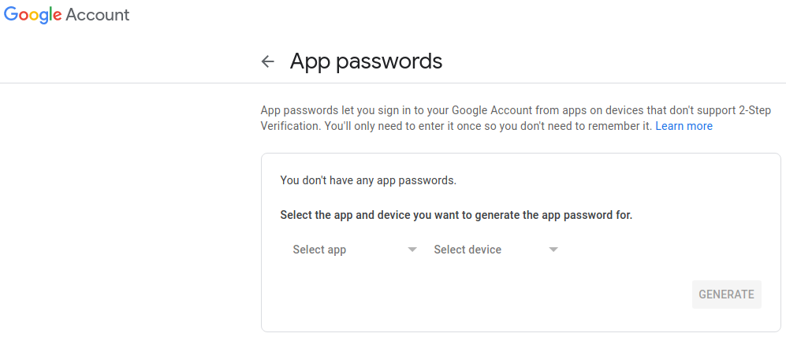
Lecture 9
Less Secure Apps
Cont'd

Slide 16
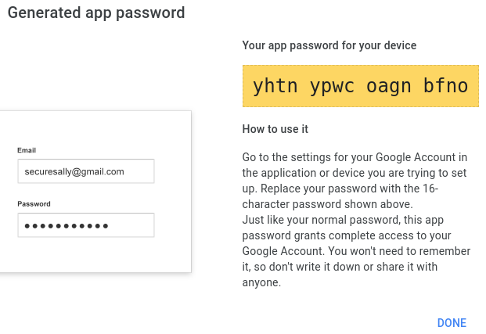
Lecture 9
Less Secure Apps
Cont'd

Slide 17
Lecture 9
Secured Connection in Email Client
import getpass
session = smtplib.SMTP(mailserver, mailport)
session.ehlo()
session.starttls() #to encrypt the traffic
session.ehlo() # re-identify themselves as encrypted connection
# "yhtnypwcoagnbfno"
password = getpass.getpass(prompt="Enter you email password: ")
session.login(sender, password)

Slide 18
Lecture 9
Retrieving E-mails Using POP3
poplib has these methods:
  POP3(): creates a POP3 object.
  POP3_SSL(): creates a secured POP3 object.
  user(): sets the username to get the mailbox.
  pass_(): sets the password for the username.
  stat(): returns mailbox status in a tuple format (message count, mailbox size).
  list(): retrieves a list of messages in the tuple format (responsecode, msglist, sizeofresponse).
  retr(): retrieves a single message in the form of a tuple (responsecode, lines, size) and marks it as read.

Slide 19
Lecture 9
Retrieving E-mails Using POP3
Cont'd
import getpass, poplib
GPOP3SERVER = 'pop.gmail.com'
POP3PORT = 995
username = input("Enter your email user ID: ")
password = getpass.getpass(prompt="Enter your email password: ")
mailbox = poplib.POP3_SSL(GPOP3SERVER, POP3PORT)
mailbox.user(username)
mailbox.pass_(password)
num_messages = len(mailbox.list()[1])
print(f"Total emails: {num_messages}")
print("Getting last message")
for msg in mailbox.retr(num_messages)[1]:
print(msg)
mailbox.quit()

Slide 20
Lecture 9
Retrieving E-mails Using IMAP
imaplib has these methods:
  IMAP4_SSL(): creates a secure IMAP object.
  login(): logins to the server.
  list(): lists the folders present in mailbox. Returns a tuple of ('Ok', [list])
  select(): selects a specific mail folder to get messages from it. Returns a tuple of ('Ok', [list of one item specify number of emails in this folder])
  fetch(): returns a particular message. Its 1st argu. Is the number of message, the second is the parsing format. Return a tuple of ('Ok', [list of message header]).

Slide 21
Lecture 9
Retrieving E-mails Using IMAP
Cont'd
import imaplib, email
imapServer = 'imap.gmail.com'
sender = 'hamada.mbsoft@gmail.com'
password = 'yhtnypwcoagnbfno' #Invalid credentials
conn = imaplib.IMAP4_SSL(imapServer)
conn.login(sender, password)
print(conn.list())
print(conn.select('INBOX'))
conn.select('INBOX')
typ, data = conn.fetch(b'6433','(RFC822)')
print(data[0])
print(data[0][1])

Slide 22
Lecture 9
Retrieving E-mails Using IMAP
Cont'd
…......
# convert data into email message object
msg = email.message_from_string(data[0][1].decode('utf-8'))
print("To:", msg['to'])
print("From:", msg['from'])
print("Subject: ", msg['subject'])
# use walk() to get message parts and check its content type
for p in msg.walk():
if p.get_content_type() == 'text/plain':
body = p.get_payload()
print(body)

Slide 23
Lecture 9
Sheet
Exercise 1:
Create your own Mail Client and use it to send e-mail to "hamada@esu.ac.ae".

Slide 24
THANK YOU

