Slide 1



Network
Programming
in Python
Prepared by Dr. Hamada I. AbdulWakel
Lecture 5

Slide 2



Socket Programming
Using Python – Part II
Lecture 5
Prepared by
Dr. Hamada I. AbdulWakel
www.midocean.ae

Slide 3
Lecture
RECAP: LECTURE 4
05
The Client/Server Programming.
The Communication Protocols.
TCP and UDP Programming in Python.
www.midocean.ae

Slide 4
Lecture
05
LECTURE MAIN POINTS
Sockets and concurrency.
The threading programming.
Programming the multiple client/server model.
The casting/communication types.
www.midocean.ae

Slide 5
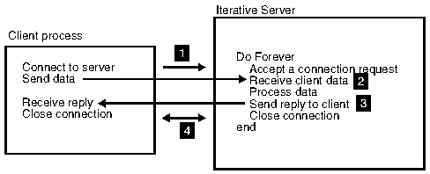
Lecture
05
THE ITERATIVE SERVER
www.midocean.ae

Slide 6
Lecture
05
THE ITERATIVE SERVER
Cont'd
An iterative server iterates through each client, handling it one at a time.
The following list describes the iterative server socket process.
  When a connection request arrives, it accepts the connection, receives the client data and does whatever has to be done to build a reply.
  The server sends the data back to the client.
  The server closes the socket and waits for the next connection request from the network.
www.midocean.ae

Slide 7
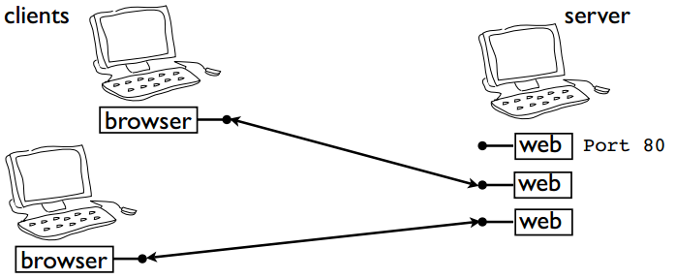
Lecture
05
SOCKETS AND CONCURRENCY
Servers usually handle multiple clients.
www.midocean.ae

Slide 8
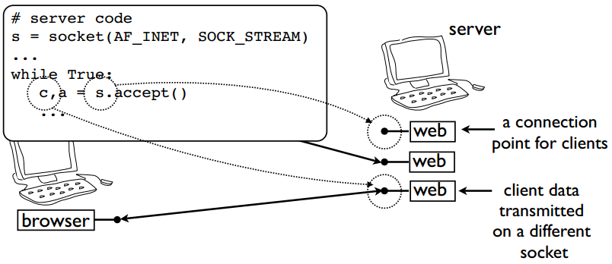
Lecture
05
SOCKETS AND CONCURRENCY
Cont'd
Each client gets its own socket on server.
www.midocean.ae

Slide 9
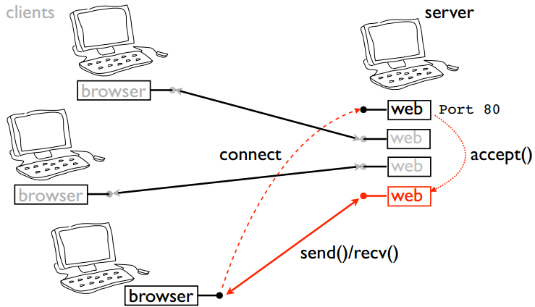
Lecture
05
SOCKETS AND CONCURRENCY
Cont'd
New connections make a new socket.
www.midocean.ae

Slide 10
Lecture
05
SOCKETS AND CONCURRENCY
Cont'd
A concurrent server accepts a client connection, delegates the connection to a child process of some kind, and immediately signals its availability to receive the next client connection.
The following list describes the concurrent server process:
  When a connection request arrives, it schedules a child process and forwards the connection to the child process.
  The child process takes the connection from the main process.
  The child process receives the client request and processes it.
  The connection is closed, and the child process signals to the main process that it is available for a new connection.
www.midocean.ae

Slide 11
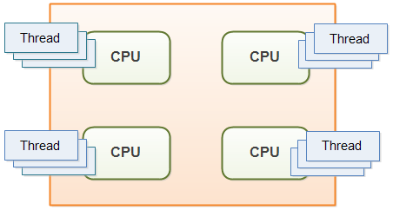
Lecture
05
THE THREADING PROGRAMMING
A thread is defined in computer science as the smallest unit that can be scheduled in an operating system.
The ability of a process to execute
multiple threads parallelly is called
Multithreading.
www.midocean.ae

Slide 12
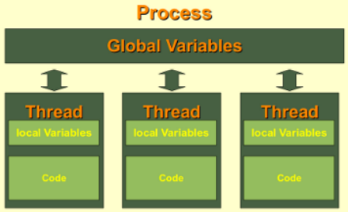
Lecture
05
THE THREADING PROGRAMMING
Cont'd
Advantages:
  Significantly improve the performance
  of any program.
  A program can remain responsive while
  one thread waits for input.
  All the threads of a process have access
  to its global variables.
www.midocean.ae

Slide 13
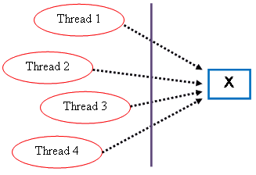
Lecture
05
THE THREADING PROGRAMMING
Cont'd
Disadvantages:
  On 1-CPU system, multithreading would not hit
  the speed of computation.
  Synchronization for preventing mutual exclusion
  of shared resources.
  Increases the complexity of the program.
  Thread safe problem.
www.midocean.ae

Slide 14
THREADING IN PYTHON USING FUNCTIONS
Lecture
05
A function is a set of instructions that could be performed n times according to function calling in the code.
def myFun1(a, b):
c = a + b
print(c)
myFun1(1, 2)
www.midocean.ae

Slide 15
THREADING IN PYTHON USING FUNCTIONS
Lecture
05
Cont'd
Performing/calling a function using threads using the threading module in Python.
import threading
def myFun1(a, b):
c = a + b
print(c)
thread1 = threading.Thread(target = myFun1, args = (12, 10))
thread1.start()
www.midocean.ae

Slide 16
THREADING IN PYTHON USING FUNCTIONS
Lecture
05
Cont'd
Code:
import threading, time
def myFun1(a, b):
time.sleep(1) #seconds
c = a + b
print(c)
def myFun2(a):
c = a * 2
print(c)
www.midocean.ae

Slide 17
THREADING IN PYTHON USING FUNCTIONS
Lecture
05
Cont'd
Code:
thread1 = threading.Thread(target = myFun1, args = (12, 10))
thread1.start()
thread2 = threading.Thread(target = myFun2, args = (10,))
thread2.start()
print("Total number of threads", threading.active_count() - 1)
www.midocean.ae

Slide 18
Lecture
05
THREADING METHODS
Thread(): creates a thread object. It takes two argument as following:
  target: refers to the function name assigned to the created thread.
  args: a tuple represents the function inputs.
start(): starts the execution of the thread in the operating system.
active_count(): counts the number of the threads in the whole program.
  The program itself is counted as a thread, so we subtract 1 from the number returned from this method.
www.midocean.ae

Slide 19
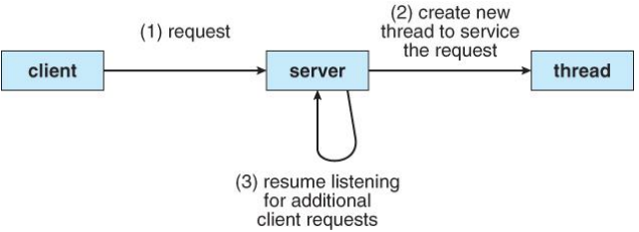
THREADING FOR THE CLIENT/SERVER MODEL
Lecture
05
Thread-1: listen and accept connections from other clients.
Thread-N: send commands to an already connected clients.
www.midocean.ae

Slide 20
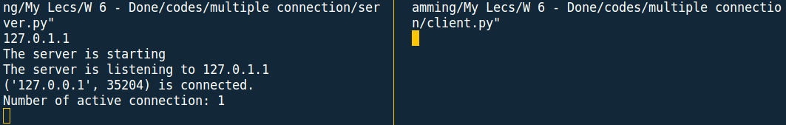
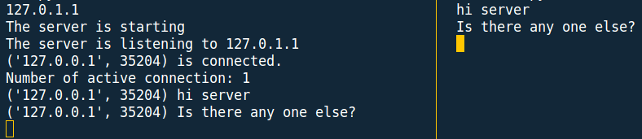
THREADING FOR THE CLIENT/SERVER MODEL
Lecture
05
Cont'd
www.midocean.ae

Slide 21
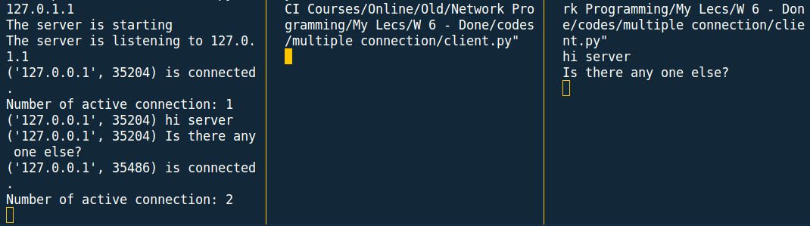
THREADING FOR THE CLIENT/SERVER MODEL
Lecture
05
Cont'd
www.midocean.ae

Slide 22
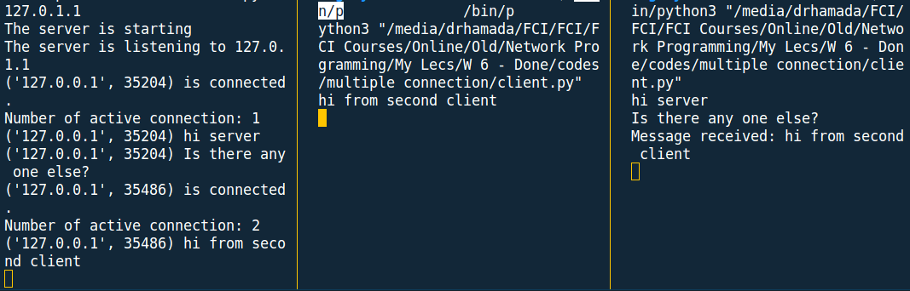
THREADING FOR THE CLIENT/SERVER MODEL
Lecture
05
Cont'd
www.midocean.ae

Slide 23
THREADING FOR THE CLIENT/SERVER MODEL
Lecture
05
Cont'd
Code: 1- the server
import socket, threading
Port = 5050
Server = socket.gethostbyname(socket.gethostname())
Addr = (Server, Port)
server = socket.socket(socket.AF_INET, socket.SOCK_STREAM)
server.bind(Addr)
def send(msg, client):
client.send(msg.encode("utf-8"))
www.midocean.ae

Slide 24
THREADING FOR THE CLIENT/SERVER MODEL
Lecture
05
Cont'd
Code: 1- the server
def client(conn, addr, clients):
print(addr, "is connected.")
connected = True
while connected:
msg = conn.recv(1024).decode("utf-8")
if msg == "DES":
connected = False
continue
print(addr, msg)
www.midocean.ae

Slide 25
THREADING FOR THE CLIENT/SERVER MODEL
Lecture
05
Cont'd
Code: 1- the server
def client(conn, addr, clients):
…....
while connected:
…...
msg = f"Message received: {msg}"
for client in clients:
if client != conn:
send(msg, client)
conn.close()
www.midocean.ae

Slide 26
THREADING FOR THE CLIENT/SERVER MODEL
Lecture
05
Cont'd
Code: 1- the server
def start():
clients = []
server.listen()
print("The server is listening to", Server)
while True:
conn, addr = server.accept()
clients.append(conn)
www.midocean.ae

Slide 27
THREADING FOR THE CLIENT/SERVER MODEL
Lecture
05
Cont'd
Code: 1- the server
def start():
…....
while True:
…...
thread = threading.Thread(target=client, args=(conn, addr, clients))
thread.start()
print("Number of active connection:", threading.active_count() - 1)
print("The server is starting")
start()
www.midocean.ae

Slide 28
THREADING FOR THE CLIENT/SERVER MODEL
Lecture
05
Cont'd
Code: 2- the client
import threading, socket
Port = 5050
Server = socket.gethostbyname(socket.gethostname())
Addr = (Server, Port)
client = socket.socket(socket.AF_INET, socket.SOCK_STREAM)
client.connect(Addr)
def read():
msg = client.recv(1024).decode("utf-8")
print(msg)
www.midocean.ae

Slide 29
THREADING FOR THE CLIENT/SERVER MODEL
Lecture
05
Cont'd
Code: 2- the client
def send():
connect = True
while connect:
msg = input(); client.send(msg.encode("utf-8"))
if msg == "DES": connect = False
else:
thread = threading.Thread(target=read); thread.start()
continue
send()
www.midocean.ae

Slide 30
Lecture
05
CASTING
Many applications transmit the same data at one time to multiple receivers:
  Broadcasts of Radio or Video.
  Video conferencing.
  Shared applications.
The cast term signifies some data (stream of packets) is being transmitted to the client(s) from a server over the communication channel.
www.midocean.ae

Slide 31
CASTING/COMMUNICATION TYPES
Lecture
05
There are three casting types:
  Unicasting.
  Multicasting.
  Broadcasting.
www.midocean.ae

Slide 32
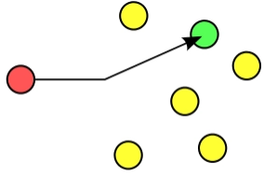
CASTING/COMMUNICATION TYPES
Lecture
05
Cont'd
Unicasting.
  A type of information transfer and it is used when there is a participation of single sender and single recipient.
  Represents the one-to-one communication.
  Example:
    Browsing a website.
    Downloading a file from a FTP server
www.midocean.ae

Slide 33
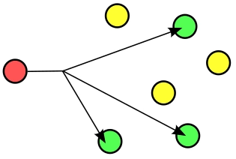
CASTING/COMMUNICATION TYPES
Lecture
05
Cont'd
Multicasting.
  A type of information transfer and it is used when there is a participation of single sender and multiple recipient.
  Represents the one-to-many communication.
  The multiple recipient must join to that a multicast group to receive data.
  Only supported by UDP.
  Example:
      Sending an email to a mailing list.
www.midocean.ae

Slide 34
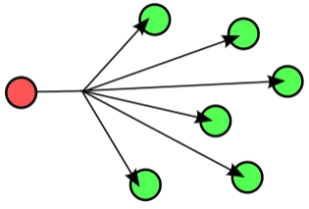
CASTING/COMMUNICATION TYPES
Lecture
05
Cont'd
Broadcasting.
  A type of information transfer and it is used when there is a participation of single sender and all recipient.
  Represents the one-to-all communication.
  The recipients should be in a local network.
  Example:
      Video and audio broadcasting.
www.midocean.ae

Slide 35
Lecture
05
QUESTIONS FOR ONLINE DISCUSSION
Write a program to simulate an arithmetic competition, where any client can ask other clients to solve a simple arithmetic equation, and they can send their results. The client who send the question then say the client's address with the correct answer.
www.midocean.ae

Slide 36


Thank You

