Slide 1

Secure Operating systems
by Dr. Hesham Abou Elfetouh
Lecture 8

Slide 2

08 Introduction
In Previous Lecture you learned:
Password Selection Criteria
One-Time Passwords
Challenge-response Authentication
Attacks on Passwords
In the user authentication:

Slide 3
Lecture
8
Lecture 8 TOPICS
This chapter covers the following topics and concepts:
Biometrics
Why Biometrics?
Problems with Biometrics
Biometrics Usage
Phases of Biometric System
Authentication in distributed systems
Databases Security
Basic database terminology and concepts
Security requirements for databases
Implementing access controls in databases
Protecting sensitive data
Data mining and big data

Slide 4
08 Lecture 8 GOALS
When you complete this chapter, you will be able to:
Describe Why we use biometrics
Explain the phases of biometric system
Describe the Authentication in distributed systems
Explain the token-based authentication

Slide 5
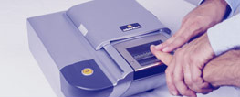

Biometrics
Use a person’s physical characteristics
  fingerprint, voice, face, keyboard timing, …
Advantages
  Cannot be disclosed, lost, forgotten
Disadvantages
  Cost, installation, maintenance
  Reliability of comparison algorithms
    False positive: Allow access to unauthorized person
    False negative: Disallow access to authorized person
  Privacy?
  If forged, how do you revoke?

Slide 6
Biometrics
A biometric should be
  Universal: The ideal biometric should apply to virtually everyone.
  Distinguishing: The ideal biometric should distinguish with virtual certainty.
  Permanent: The physical characteristic being measured should never change.
  Collectible: The physical characteristic should be easy to collect without any potential to cause harm to the subject.
  Reliable, robust, and user-friendly

Slide 7
Identification versus Authentication
Biometrics are very reliable for Identification but much less effective for authentication
The difference is between a system that looks at a hand geometry and says "this is Captain Hook" (identification) versus a man who says "I am, Captain Hook, presenting my hand to prove who I am" and the system confirms "this hand matches Captain Hook's template" (authentication).

Slide 8
Identification versus Authentication
Identification:
  Identify the subject from a list of many possible subjects.
  E.g., a suspicious fingerprint from a crime scene is sent to the FBI fingerprint database for comparison with all records on file. In this case, the comparison is one to many.
Authentication:
  The comparison is one to one
  E.g., if someone claiming to be Alice uses a thumbprint mouse biometric, the captured thumbprint image is only compared with the stored thumbprint of Alice.

Slide 9
Why Biometrics?
More secure replacement for passwords
Cheap and reliable biometrics needed
  An active area of research
Biometrics used in security are :
  Thumbprint mouse
  Palm print for secure entry
  Fingerprint to unlock car door, etc.
But biometrics not too popular
  Has not lived up to its promise (yet?)

Slide 10
Problems with Biometrics
Biometric recognition devices are costly
All biometric readers use sampling and establish a threshold for when a match is close enough to accept.
Biometrics can become a single point of failure.
although equipment is improving, there are still false readings
The speed at which a recognition must be done limits accuracy.
Although we like to think of biometrics as unique parts of an individual, forgeries are possible.

Slide 11

Biometrics
Common uses
  Specialized situations, physical security Combine :
    Multiple biometrics
    Biometric and PIN
    Biometric and token

Slide 12
Phases of Biometric System
The Enrollment Phase:
subjects have their biometric information entered into a database.
The Recognition Phase:
subjects have their biometric information compared with that stored in the database.

Slide 13
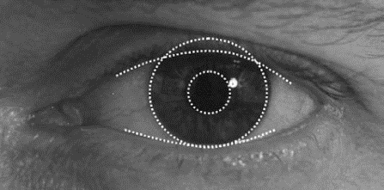
Biometric Examples
Fingerprints
Hand Geometry
Iris Scan

Slide 14
Biometric Error Rates
For fingerprint biometric systems, the error rate is about 5%
hand geometry has an equal error rate of about 10⁻³

Slide 15
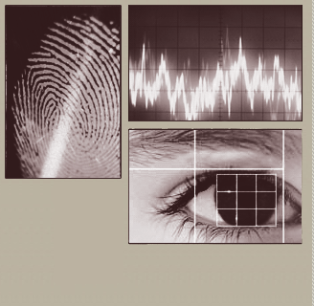
Biometrics: Authentication Not Using Passwords
Biometrics are biological authenticators, based on some physical characteristics of the human body.
Now there are devices to recognize the following biometrics:
  fingerprints
  hand geometry (shape and size of fingers)
  retina and iris (parts of the eye)
  voice
  handwriting
  blood vessels in the finger
  face.

Slide 16
Biometrics: Authentication Not Using Passwords
Authentication with biometrics has advantages over passwords because:
  a biometric cannot be lost,
  stolen,
  forgotten,
  lent,
  or forged and is
  always available,
  always at hand.

Slide 17
Authentication in distributed systems
  Single sign-on, Microsoft Passport
  Trusted Intermediaries

Slide 18
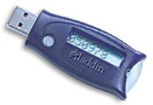
Token-based Authentication
Smart Card
With embedded CPU and memory
  Carries conversation with a small card reader
Various forms
  PIN protected memory card
    Enter PIN to get the password
  Cryptographic challenge/response cards
    A cryptographic key in memory
    Computer create a random challenge
    Enter PIN to encrypt/decrypt the challenge with the card
  Cryptographic Calculator (readerless smart card)
    Simulating a smartcard: user enter the encrypted result

Slide 19
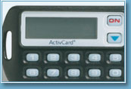
Smart Card Example
Initial data
Time
Challenge
Time
Some complications
  Initial data shared with server
    Need to set this up securely
    Shared database for many sites
  Clock skew
function

Slide 20
Microsoft Passport
Launched 1999
  Claim > 200 million accounts in 2002
  Over 3.5 billion authentications each month
  Microsoft Passport is a two-factor authentication (2FA) system that combines a PIN or biometrics (via Windows Hello) with encrypted keys from a user's device to provide two-factor authentication.
  If you sign into Windows with fingerprint or face recognition, then you are already using Windows Hello.
  What does Microsoft Passport service do?
  It allows you to log in to Windows using your Active Directory and replace passwords, smartcards, and virtual smart cards.

Slide 21
Microsoft Passport
How do I get a Microsoft Passport?
Creating Passport: Upon first login to their device the user is prompted to create a gesture. After they create the gesture, Windows creates a private-public key pair and registers the user's public key while the private key is protected by encrypted with a locally derived secret.

Slide 22
Microsoft Passport
Log in to many websites using one account
  Used by MS services Hotmail, MSN Messenger or MSN subscriptions; also Radio Shack, etc.
  Hotmail or MSN users automatically have Microsoft Passport accounts set up
The Passport may continue to evolve; bugs have been uncovered

Slide 23
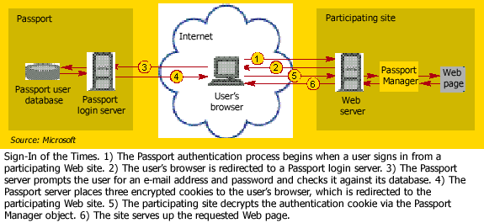
Passport log-in

Slide 24
Trusted Intermediaries
Symmetric key problem:
How do two entities establish a shared
secret key over the network?
Solution:
trusted key distribution center (KDC)
acting as intermediary between entities
Public key problem:
When Alice obtains Bob’s public key (from web site, e-mail, flash memory), how does she know it is Bob’s public key, not a spy?
Solution:
trusted certification authority (CA)

Slide 25



Key Distribution Center (KDC)
Alice, Bob need shared symmetric key.
KDC: server shares a different secret key with each registered user (many users)
Alice, Bob know own symmetric keys, K_{A-KDC} K_{B-KDC} , for communicating with KDC.
KDC
K_{B-KDC}
K_{A-KDC}
K_{P-KDC}
K_{X-KDC}
K_{P-KDC}
K_{Y-KDC}
K_{A-KDC}
K_{Z-KDC}
K_{B-KDC}

Slide 26
Key Distribution Center (KDC)
Q: How does KDC allow Bob, Alice to determine shared symmetric secret key to communicate with each other?
KDC generates R1
K_{A-KDC}(A,B)
Alice
knows R1
Bob knows to use R1 to communicate with Alice
K_{A-KDC}(R1, K_{B-KDC}(A,R1) )
K_{B-KDC}(A,R1)
Alice and Bob communicate: using R1 as
session key for shared symmetric encryption

Slide 27
Ticket
In K_{A-KDC}(R1, K_{B-KDC}(A,R1) ), the K_{B-KDC}(A,R1) is also known as a ticket
Comes with expiration time

Slide 28
Certification Authorities
Certification authority (CA): binds a public key to a particular entity, E.
E (person, router) registers its public key with CA.
  E provides “proof of identity” to CA.
  CA creates certificate binding E to its public key.
  Certificate containing E’s public key digitally
  signed by CA – CA says “this is E’s public key”
Bob’s
public
key
+
K
+
Digital signature
(encrypt)
B
K
B
Bob’s
identifying information
certificate for Bob’s public key, signed by CA
CA
private
key
-
K
CA

Slide 29
Certification Authorities
When Alice wants Bob’s public key:
  gets Bob’s certificate (Bob or elsewhere).
  apply CA’s public key to Bob’s certificate, get Bob’s public key
+
digital
signature
(decrypt)
Bob’s
public
key
K
B
+
K
B
CA
public
key
+
K
CA

Slide 30
Single KDC/CA
Problems
  Single administration trusted by all principals
  Single point of failure
  Scalability
Solutions: break into multiple domains
  Each domain has a trusted administration

Slide 31
Multiple KDC/CA Domains
Secret keys:
KDCs share pairwise key
topology of KDC: tree with shortcuts
Public keys:
cross-certification of CAs
example: Alice with CA_{A}, Boris with CA_{B}
  Alice gets CA_{B}’s certificate (public key p₁), signed by CA_{A}
  Alice gets Boris’ certificate (its public key p₂), signed by CA_{B} (p₁)

Slide 32
Summary
This part explained :
Biometrics Usage
Phases of Biometric System
Authentication in distributed systems
  Smart Card
  Microsoft Passport
  Key Distribution Center (KDC)
  Certification Authorities) (CA)

Slide 33
Databases Security

Slide 34
Database Terms
Database administrator
Database management system (DBMS)
Record
Field/element
Schema
Subschema
Attribute
Relation

Slide 35
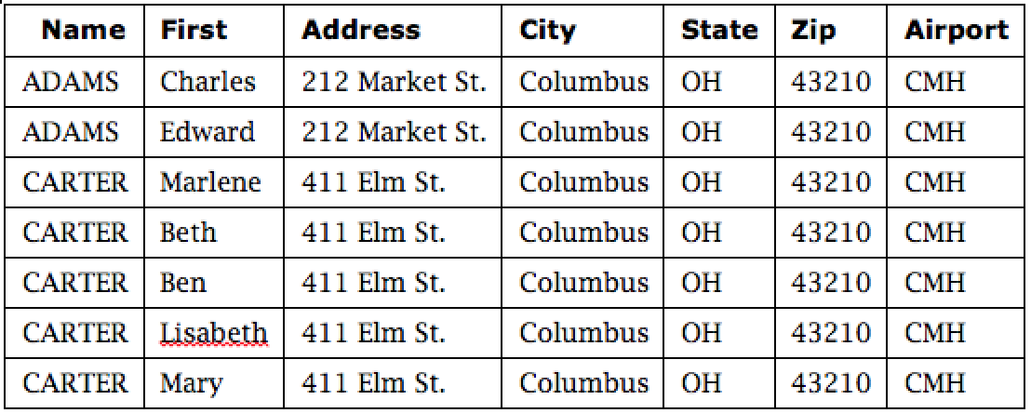
Example SQL Query
SELECT ZIP=‘43210’

Slide 36
Reliability and Integrity
Reliability: in the context of databases, reliability is the ability to run for long periods without failing
Database integrity: concern that the database as a whole is protected against damage
Element integrity: concern that the value of a specific data element is written or changed only by authorized users
Element accuracy: concern that only correct values are written into the elements of a database

Slide 37
Two-Phase Update
Phase 1: Intent
  DBMS does everything it can, other than making changes to the database, to prepare for the update
    Collects records, opens files, locks out users, makes calculations
  DBMS commits by writing a commit flag to the database
Phase 2: Write
  DBMS completes all write operations
  DBMS removes the commit flag
If the DBMS fails during either phase 1 or phase 2, it can be restarted and repeat that phase without causing harm

Slide 38
Other Database Security Concerns
Error detection and correction codes to protect data integrity
For recovery purposes, a database can maintain a change log, allowing it to repeat changes as necessary when recovering from failure
Databases use locks and atomic operations to maintain consistency
  Writes are treated as atomic operations
  Records are locked during write so they cannot be read in a partially updated state

Slide 39
Types of Disclosures
Keeping records from being dumped out of the database is not sufficient to actually prevent disclosure.
There are many ways to deduce the content of a database.
Apply the appropriate protection mechanisms to protect sensitive database information.

Slide 40
Preventing Disclosure
Suppress obviously sensitive information
Keep track of what each user knows based on past queries
Disguise the data

Slide 41
Security vs. Precision

Slide 42
Data Mining
Data mining uses statistics, machine learning, mathematical models, pattern recognition, and other techniques to discover patterns and relations on large datasets
The size and value of the datasets present an important security and privacy challenge, as the consequences of disclosure are naturally high

Slide 43
Data Mining Challenges
Correcting mistakes in data
Preserving privacy
Secure data storage
Transaction logs
Real-time security monitoring

Slide 44
Summary
This part explained :
Database security requirements include.
Reliability and Integrity
Two-Phase Update
There are many subtle ways for sensitive data to be inadvertently disclosed, and there is no single answer for prevention
Data mining and big data have numerous open security and privacy challenges

