Slide 1


Probability and
Statistics
Prepared by Dr. Alfaisal Hasan
STA 201
Probability and Statistics
Lecture NO 2

Slide 2



Probability and
Statistics
Lecture NO 2
STA 201
Probability and Statistics
Prepared by
Dr. Alfaisal Hasan
www.midocean.ae

Slide 3

Chapter
Topics
Chapter 1: Introduction To Statistics
Chapter 2: Descriptive Statistics
Chapter 3: Probability
Chapter 4: Discrete Probability Distributions
Chapter 5: Normal Probability Distributions
Chapter 6: Confidence Intervals
Chapter 7: Hypothesis Testing with One Sample
Chapter 8: Hypothesis Testing with Two Samples
Chapter 9: Correlation And Regression
Chapter 10: Chi-Square Tests and The F-Distribution
www.midocean.ae

Slide 4
Chapter
Descriptive Statistics
1- Frequency Distributions and Their Graphs
2- More Graphs and Displays
3- Measures of Central Tendency
4- Measures of Variation
5- Measures of Position
www.midocean.ae

Slide 5
Chapter
Frequency Distributions and their Graphs
1- Frequency Distributions
2- Graphs of Frequency Distributions
www.midocean.ae

Slide 6
Chapter
Frequency Distributions and their Graphs
A frequency distribution is a table that shows classes or intervals of data entries with a count of the number of entries in each class. The frequency f of a class is the number of data entries in the class.
To Draw the frequency table, determine the three items:
1- number of classes
2- Range
3- Class Width
www.midocean.ae

Slide 7
Chapter
Example 1
The following sample data set lists the prices (in dollars) of 30 portable global positioning system (GPS) navigators. Construct a frequency distribution that has seven classes.
Construct a Frequency Distribution from a Data Set
90 | 130 | 200 | 400 | 350 | 70 | 325 | 250 | 150 | 250
275 | 270 | 150 | 130 | 59 | 200 | 160 | 450 | 300 | 130
220 | 100 | 200 | 400 | 200 | 250 | 95 | 180 | 170 | 150
www.midocean.ae

Slide 8
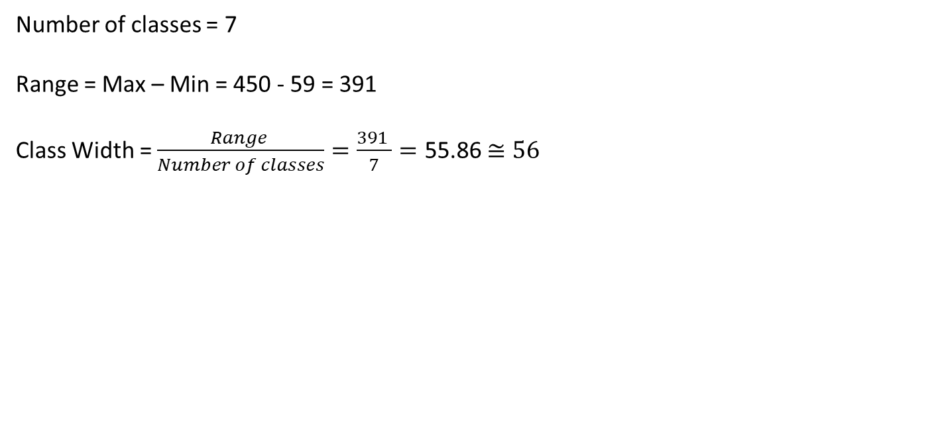
Chapter
Solution of Example 1
Number of classes = 7
Range = Max – Min = 450 - 59 = 391
Class Width = $\frac{Range }{Number of classes}=\frac{391 }{7}=\text{55.86}$ $≅56$
90 | 130 | 200 | 400 | 350 | 70 | 325 | 250 | 150 | 250
275 | 270 | 150 | 130 | 59 | 200 | 160 | 450 | 300 | 130
220 | 100 | 200 | 400 | 200 | 250 | 95 | 180 | 170 | 150
59
450
www.midocean.ae

Slide 9
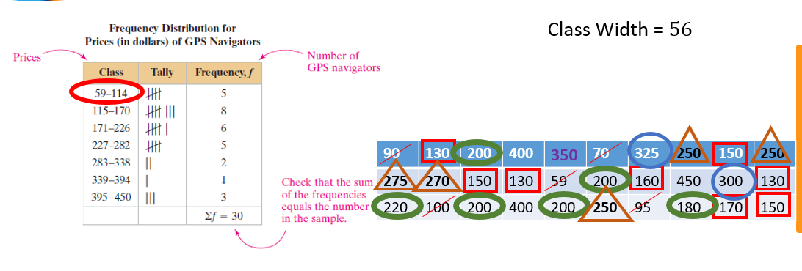
Chapter
Frequency Distributions and their Graphs
www.midocean.ae

Slide 10
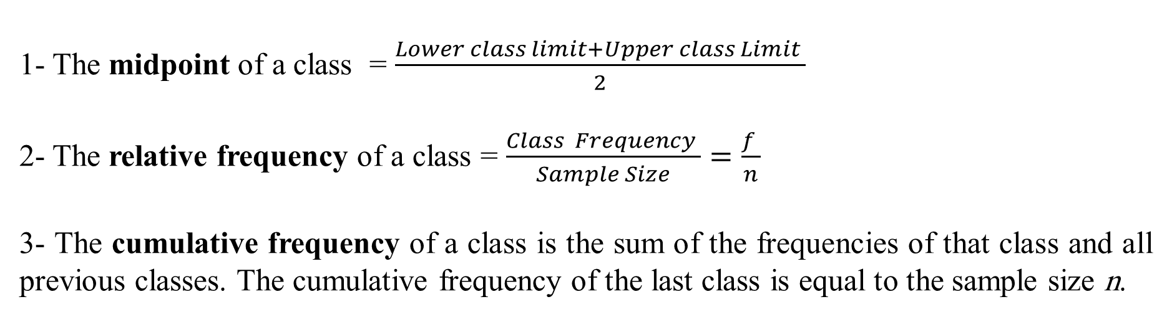
Chapter
Cumulative Frequency Distributions
1- The midpoint of a class = $\frac{Lower class limit+Upper class Limit }{2}$
2- The relative frequency of a class = $\frac{Class Frequency }{Sample Size}=\frac{f }{n}$
3- The cumulative frequency of a class is the sum of the frequencies of that class and all previous classes. The cumulative frequency of the last class is equal to the sample size n.
www.midocean.ae

Slide 11
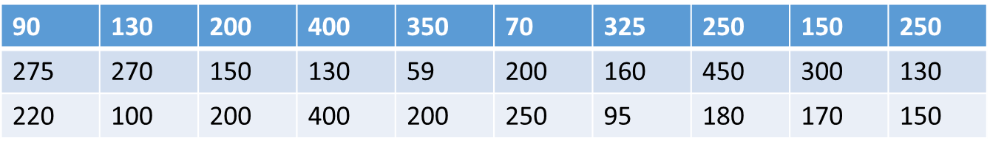
Chapter
Example 2
The following sample data set lists the prices (in dollars) of 30 portable global positioning system (GPS) navigators. Construct a frequency distribution that has seven classes.
Find the mid point, Relative frequency and a Cumulative Frequency Distribution from a Data Set above
www.midocean.ae

Slide 12
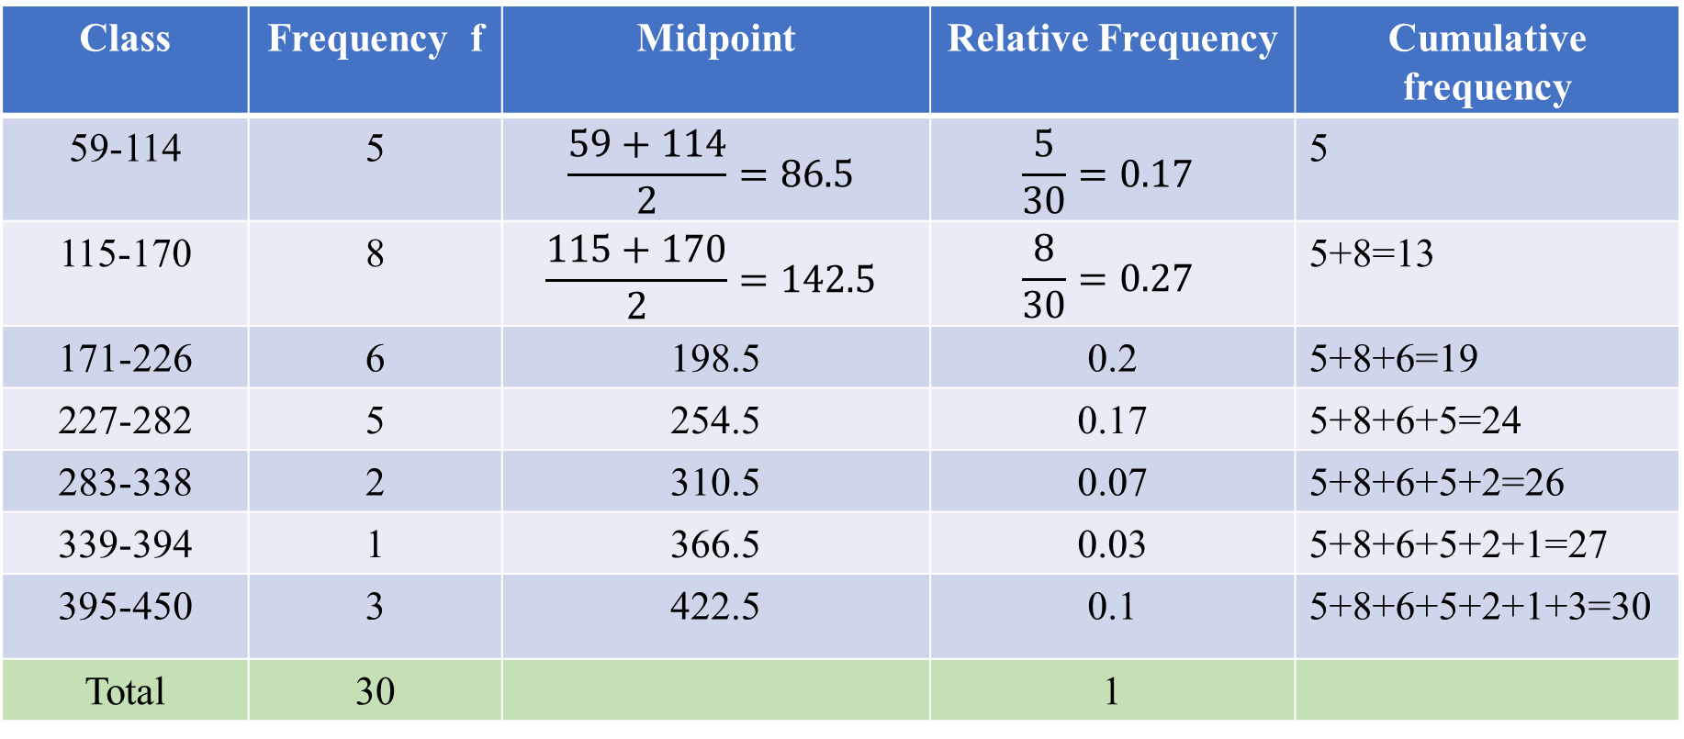
Solution of Example 2
Chapter
Class | Frequency f | Midpoint | Relative Frequency | Cumulative frequency
59-114 | 5 | $$\frac{59+114}{2}=86.5$$ | $$\frac{5}{30}=0.17$$ | 5
115-170 | 8 | $$\frac{115+170}{2}=142.5$$ | $$\frac{8}{30}=0.27$$ | 5+8=13
171-226 | 6 | 198.5 | 0.2 | 5+8+6=19
227-282 | 5 | 254.5 | 0.17 | 5+8+6+5=24
283-338 | 2 | 310.5 | 0.07 | 5+8+6+5+2=26
339-394 | 1 | 366.5 | 0.03 | 5+8+6+5+2+1=27
395-450 | 3 | 422.5 | 0.1 | 5+8+6+5+2+1+3=30
Total | 30 |  | 1
www.midocean.ae

Slide 13
Graphs of Frequency Distributions
1- Frequency Histogram
2- Frequency Polygon
3- Relative Frequency Histogram
www.midocean.ae

Slide 14
Chapter
Frequency Histogram
Frequency histogram is a bar graph that represents the frequency distribution of a data set. A histogram has the following properties.
1. The horizontal scale is quantitative and measures the data values.
2. The vertical scale measures the frequencies of the classes.
3. Consecutive bars must touch.
www.midocean.ae

Slide 15
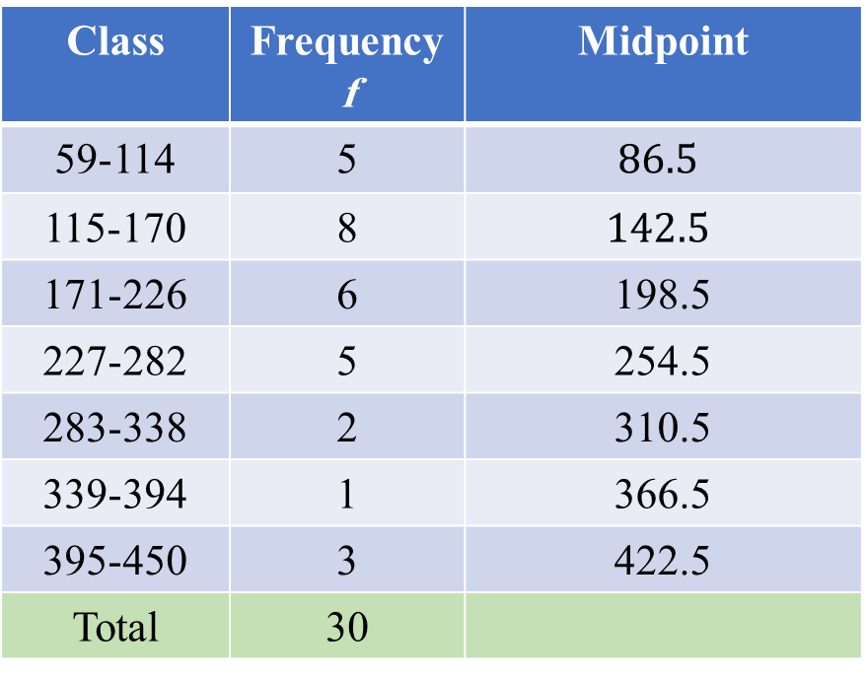
Chapter
Example 3
Draw the frequency Histogram based on the data in the below table:
Class | Frequency f | Midpoint
59-114 | 5 | $$86.5$$
115-170 | 8 | $$142.5$$
171-226 | 6 | 198.5
227-282 | 5 | 254.5
283-338 | 2 | 310.5
339-394 | 1 | 366.5
395-450 | 3 | 422.5
Total | 30
www.midocean.ae

Slide 16
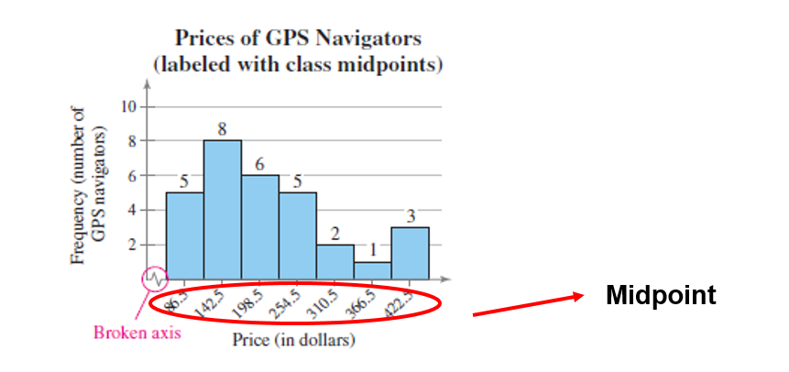
Chapter
Frequency Histogram
www.midocean.ae

Slide 17
Chapter
Frequency Polygon
A frequency polygon is a line graph that emphasizes the continuous change in frequencies.
www.midocean.ae

Slide 18
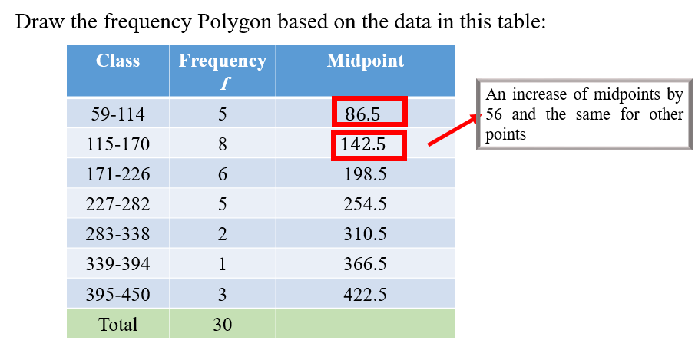
Chapter
Example 4
www.midocean.ae

Slide 19
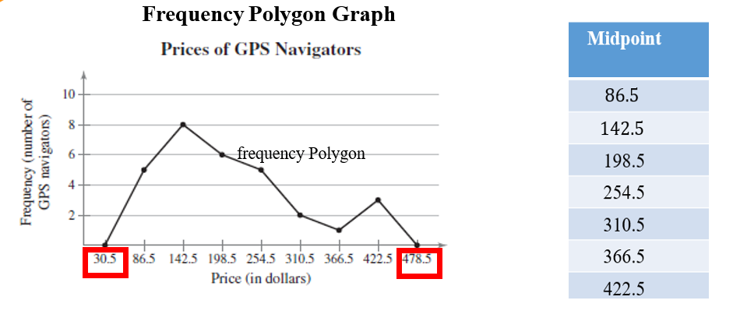
Chapter
Solution of Example 4
www.midocean.ae

Slide 20
Chapter
Relative Frequency Histogram
A relative frequency histogram has the same shape and the same horizontal scale as the corresponding frequency histogram. The difference is that the vertical scale measures the relative frequencies, not frequencies.
www.midocean.ae

Slide 21
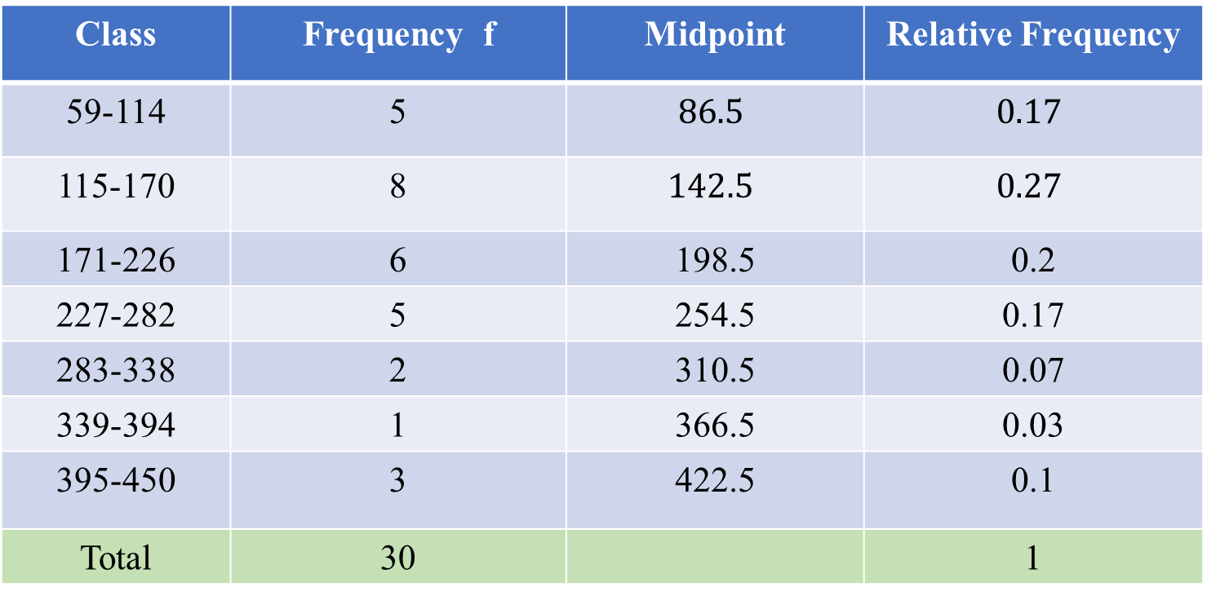
Example 5
Chapter
Draw the relative frequency Histogram based on the data in this table:
Class | Frequency f | Midpoint | Relative Frequency
59-114 | 5 | $$86.5$$ | $$0.17$$
115-170 | 8 | $$142.5$$ | $$0.27$$
171-226 | 6 | 198.5 | 0.2
227-282 | 5 | 254.5 | 0.17
283-338 | 2 | 310.5 | 0.07
339-394 | 1 | 366.5 | 0.03
395-450 | 3 | 422.5 | 0.1
Total | 30 |  | 1
www.midocean.ae

Slide 22
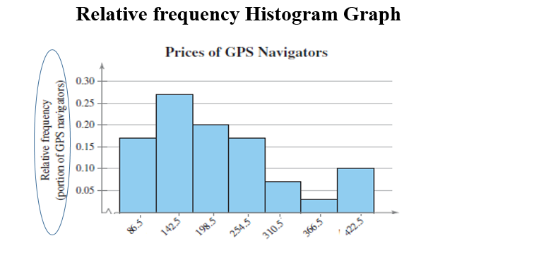
Chapter
Solution of Example 5
www.midocean.ae

Slide 23
Chapter
Frequency Distributions and their Graphs
1- Frequency Distributions and Their Graphs
2- More Graphs and Displays
3- Measures of Central Tendency
4- Measures of Variation
5- Measures of Position
www.midocean.ae

Slide 24
Chapter
Measures of Central Tendency
We have three measures of Central Tendency:
1- Mean
2- Median
3- Mode
www.midocean.ae

Slide 25
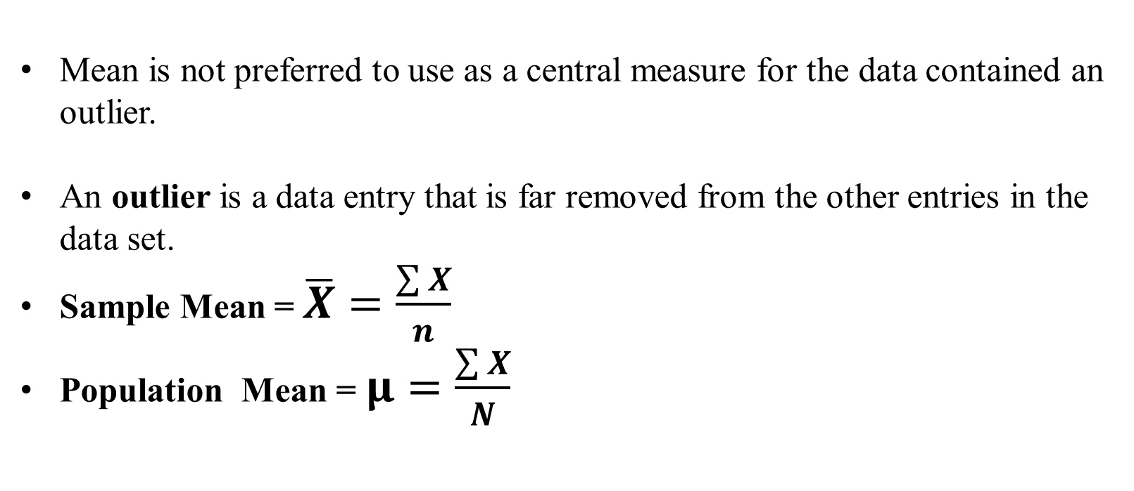
Chapter
Important Notes
Mean is not preferred to use as a central measure for the data contained an outlier.
An outlier is a data entry that is far removed from the other entries in the data set.
Sample Mean = $\overline{X}=\frac{\sum{X}}{n}$
Population Mean = $μ=\frac{\sum{X}}{N}$
www.midocean.ae

Slide 26
Chapter
Example 6
Given the following Macroeconomics exam grades for a sample of 6 students:
81 75 66 16 90 90
Calculate the central tendency measures and state the best central measure for this data.
www.midocean.ae

Slide 27
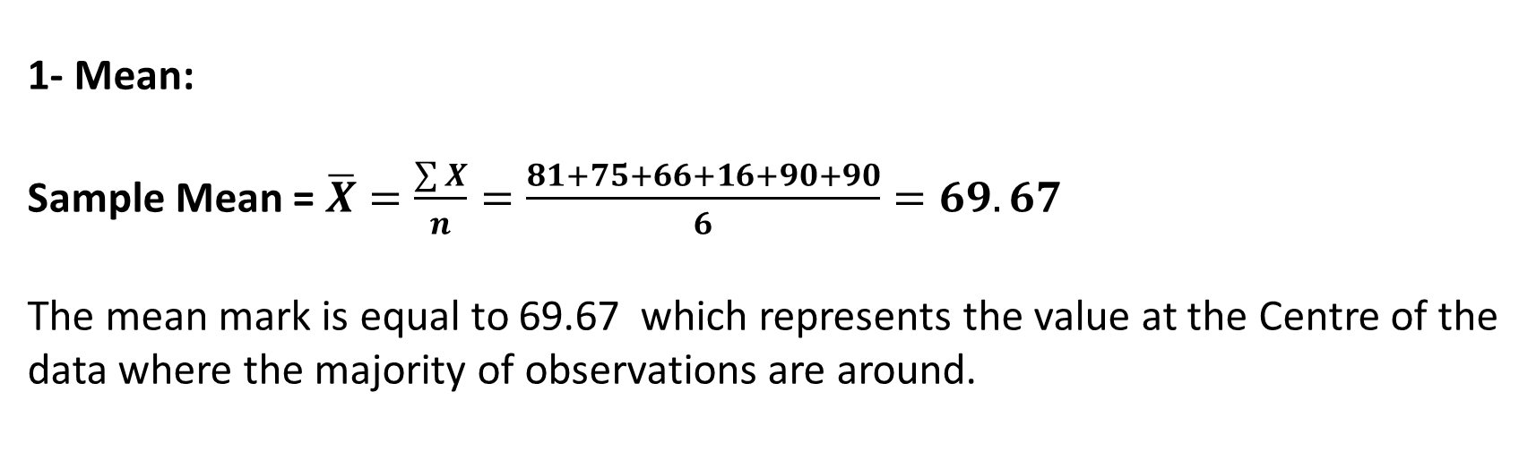
Chapter
Solution of Example 6
1- Mean:
Sample Mean = $\overline{X}=\frac{\sum{X}}{n}=\frac{81+75+66+16+90+90}{6}=69.67$
The mean mark is equal to 69.67 which represents the value at the Centre of the data where the majority of observations are around.
www.midocean.ae

Slide 28
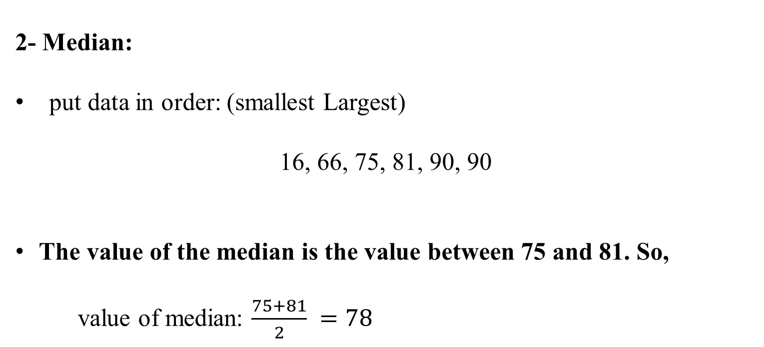
Chapter
Solution of Example 6
2- Median:
put data in order: (smallest Largest)
16, 66, 75, 81, 90, 90
The value of the median is the value between 75 and 81. So,
value of median: $\frac{75+81}{2} =78$
www.midocean.ae

Slide 29
Chapter
Solution of Example 6
3- Mode:
The most repeated number in the data. So,
Mode = 90
Since there is an outlier which is (16). Therefore, the best central measure is the median NOT the mean.
www.midocean.ae

Slide 30
Chapter
Example 7
Given the following Macroeconomics exam grades for a sample of 7 students:
5 6 9 10 14 11 12
Calculate the central tendency measures and state the best central measure for this data.
www.midocean.ae

Slide 31
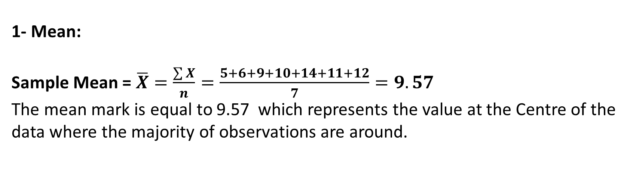
Chapter
Solution of Example 7
1- Mean:
Sample Mean = $\overline{X}=\frac{\sum{X}}{n}=\frac{5+6+9+10+14+11+12}{7}=9.57$
The mean mark is equal to 9.57 which represents the value at the Centre of the data where the majority of observations are around.
www.midocean.ae

Slide 32
Chapter
Solution of Example 7
2- Median:
put data in order: (smallest Largest)
5, 6, 9, 10, 11, 12, 14
The value of the median is the value 10
www.midocean.ae

Slide 33
Chapter
Solution of Example 7
3- Mode: 5 6 9 10 14 11 12
The most repeated number in the data. So,
The data has No mode
www.midocean.ae

Slide 34
Chapter
Example 8
In the following three groups, it is required to calculate the mean, median, and mode:
Group 1: 2 – 4 – 4 – 6
Group 2: -2 – 4 – 4 - 10
Group 3: -70 – 4 – 4 - 78
www.midocean.ae

Slide 35
Chapter
Solution of Example 8
Mode | Median | Mean | Group
4 | 4 | 4 | 1
4 | 4 | 4 | 2
4 | 4 | 4 | 3
www.midocean.ae

Slide 36
Chapter
Measures of Variation
We have three measures of Variations:
1- Range
2- Variance
3- Standard deviation
www.midocean.ae

Slide 37
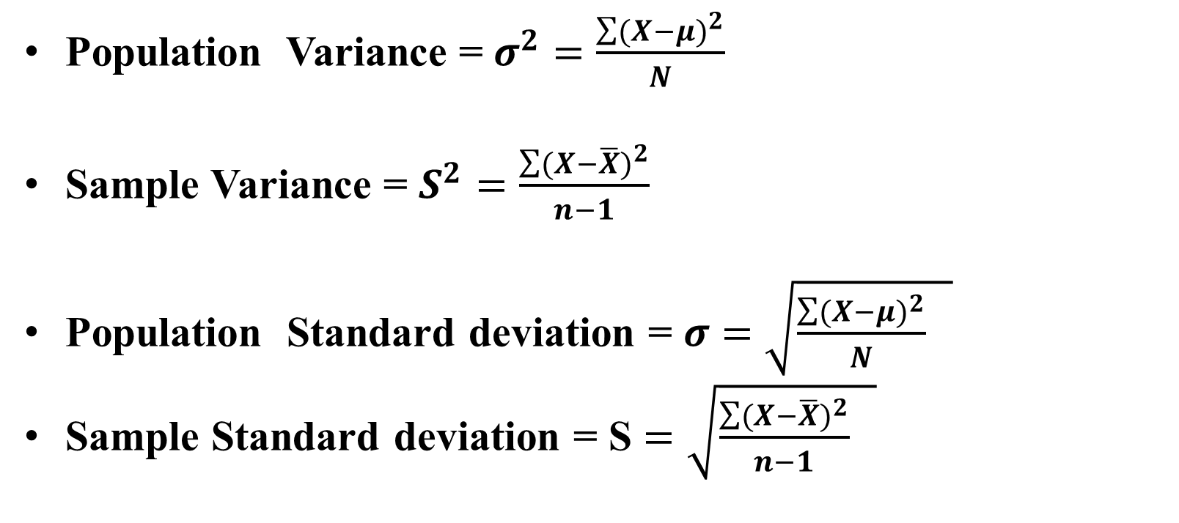
Important Notes
Chapter
Population Variance = $σ^{2}=\frac{\sum{{(X−μ)}^{2}}}{N}$
Sample Variance = $S^{2}=\frac{\sum{{(X−\overline{X})}^{2}}}{n−1}$
Population Standard deviation = $σ$ $=\sqrt{\frac{\sum{{(X−μ)}^{2}}}{N} }$
Sample Standard deviation = S $=\sqrt{\frac{\sum{{(X−\overline{X})}^{2}}}{n−1} }$
www.midocean.ae

Slide 38
Chapter
Example 9
Given the following Mathematics exam grades for a sample of 5 students.
8 12 20 7 3
Calculate the dispersion measures for the above data
www.midocean.ae

Slide 39
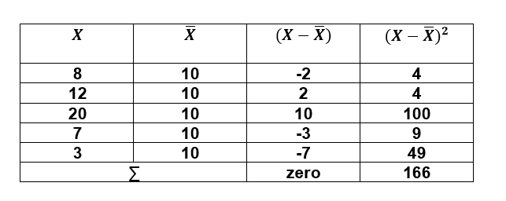
Chapter
Solution of Example 9
1- Range = Max – Min = 20- 3 = 17
2- Sample Variance = $S^{2}=\frac{\sum{{(X−\overline{X})}^{2}}}{n−1}$
www.midocean.ae

Slide 40
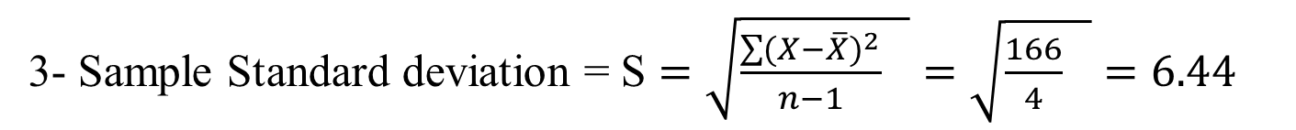
Solution of Example 9
1- Range = Max – Min = 20- 3 = 17
Chapter
2- Sample Variance = $S^{2}=\frac{\sum{{(X−\overline{X})}^{2}}}{n−1}$
3- Sample Standard deviation = S $=\sqrt{\frac{\sum{{(X−\overline{X})}^{2}}}{n−1} }=\sqrt{\frac{166}{4} }=6.44$
www.midocean.ae

Slide 41
Chapter
Example 10
Given the following Macroeconomics exam grades for a sample of 5 students.
81 75 66 84 96
Calculate the dispersion measures for the above data
www.midocean.ae

Slide 42
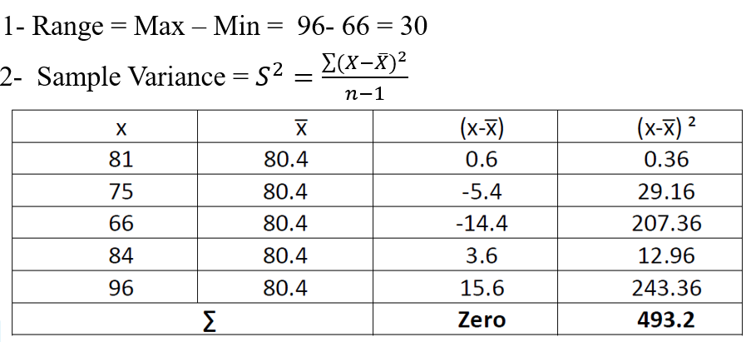
Solution of Example 10
www.midocean.ae

Slide 43
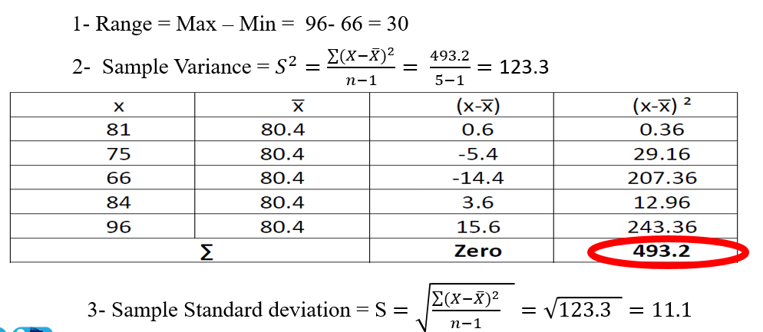
Chapter
Solution of Example 10
www.midocean.ae

Slide 44
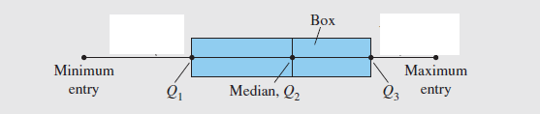
Measures of Position
Chapter
Q1 is the first Quartile
Q2 is the Second Quartile ( Median )
Q3 is the third Quartile
Interquartile range IQR = Q3 - Q1
Box Plot
www.midocean.ae

Slide 45
Chapter
Example 11
The number of nuclear power plants in the top 15 nuclear power-producing
countries in the world are listed.
Find the first, second, and third quartiles of the data set.
Calculate IQR
Draw the Box plot
www.midocean.ae

Slide 46
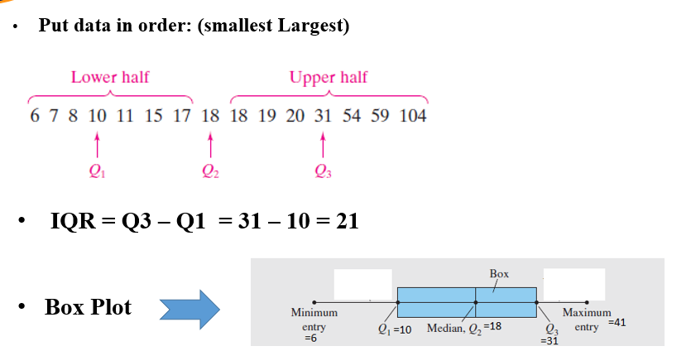
Chapter
Solution of Example 11
www.midocean.ae

Slide 47
Chapter Summary
Chapter
Measures of Central Tendency:
1- Mean
2- Median
3- Mode
Measures of Position:
1- First Quartile
2- Second Quartile
3- Third Quartile
4- IQR
5- Box Plot
Frequency Distributions
Graphs and Displays:
1- Frequency Histogram
2- Frequency Polygon
3- Relative Frequency Histogram
Measures of Variation:
1- Range
2- Variance
3- Standard deviation
www.midocean.ae

Slide 48
Un Solved Examples
Chapter
Given the following data
11 25 30 24 22 10 12
Find Mean – Median – Mode - Range
www.midocean.ae

Slide 49
Un Solved Examples
Chapter
The value of Q1 for the values [12,10,33,49,18,90,100]
www.midocean.ae

Slide 50
Un Solved Examples
Chapter
The value of Q3 for the values [12,10,33,49,18,90,100]
www.midocean.ae

Slide 51
Un Solved Examples
Chapter
The value of Q2 for the values [12,10,33,49,18,90,100]
www.midocean.ae

Slide 52
Un Solved Examples
Chapter
The value of IQR for the values [12,10,33,49,18,90,100]
www.midocean.ae

Slide 53


Thank You

