Slide 1


Managing People and Organizations
Prepared by Dr. Usama Al-Fendi
MGM603
Managing People and Organizations
Lecture 4

Slide 2

Lecture
Outcomes of the chapter:
4
Discuss different kinds of intelligence that affect behavior in organizations.
Describe different learning styles that influence how people process information and that affect behavior in organizations.
Discuss how attitudes are formed, describe the meaning of cognitive dissonance, and identify and describe three important work-related attitudes.
Describe the role and importance of values and emotions in organizational behavior.
www.midocean.ae

Slide 3
Lecture
Individual Differences
4
Intelligence:
In addition to personality and personality traits, another important set of individual differences is intelligence. There are many types of intelligence, or mental abilities, including
general mental ability,
information processing capacity,
verbal ability, and
emotional intelligence.
www.midocean.ae

Slide 4
Lecture
Individual Differences
4
1- General Mental Ability:
General mental ability is the capacity to rapidly and fluidly acquire, process, and apply information. It involves reasoning, remembering, understanding, and problem solving. It is associated with the increased ability to acquire, process, and synthesize information and has been defined simply as the ability to learn.
Research has supported the idea that mental ability is most important in complex jobs, when individuals are new to the job, and when there are changes in the workplace that require workers to learn new ways of performing their jobs. Some companies, particularly technology companies including Google, prefer to hire for general mental ability rather than experience
www.midocean.ae

Slide 5
Lecture
Individual Differences
4
2- Information processing capacity:
Information processing capacity involves the way individuals process and organize information. Information processing capacity also helps explain differences between experts and novices on task learning and performance, as experts process and organize information more efficiently and accurately than novices.
General mental ability influences information processing capacity. Age also explains differences in information processing capacity. Relative to younger adults, older adults tend to have access to a wider amount and variety of information, although they are less able to process novel information quickly
www.midocean.ae

Slide 6
Lecture
Individual Differences
4
2- Information processing capacity:
There are many different types of mental ability tests, including the Wonderlic Personnel Test, Raven’s Progressive Matrices, the Kaufman Brief Intelligence Test, and the Wechsler Abbreviated Scale of Intelligence..
Because hiring discrimination can be legally problematic when using mental ability tests, it is best to evaluate the effect of mental ability tests on protected groups before using them on job candidates Many organizations use mental ability tests, including the National Football League.
www.midocean.ae

Slide 7
Lecture
Individual Differences
4
3- Multiple Intelligences:
Researchers and scholars are realizing that there is more than one way to be smart. Gardner’s theory of multiple intelligences suggests that there are several distinct forms of intelligence that everyone possesses in varying degrees:
Linguistic: words and language
Logical–mathematical: logic and numbers
Musical: music, rhythm, and sound
Bodily–kinesthetic: body movement and control
Spatial–visual: images and space
Interpersonal: other people’s feelings
Intrapersonal: self-awareness
www.midocean.ae

Slide 8
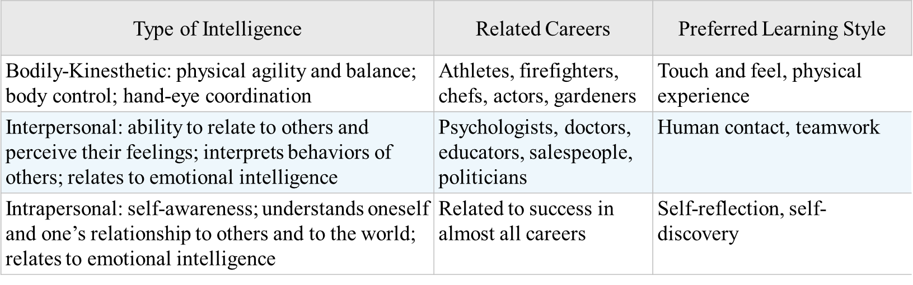
Lecture
4
Individual Differences
3- Multiple Intelligences:
Matching Intelligence Types with Career Choices
www.midocean.ae

Slide 9
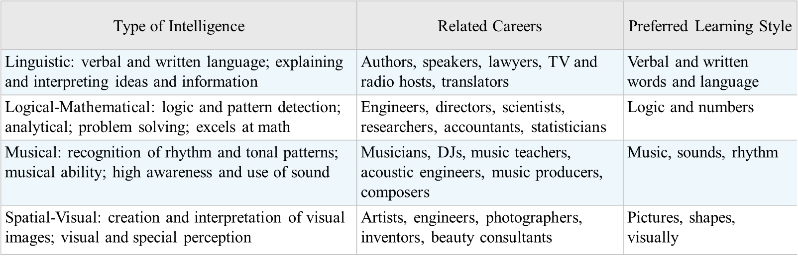
Lecture
4
Individual Differences
3- Multiple Intelligences:
Matching Intelligence Types with Career Choices
www.midocean.ae

Slide 10
Lecture
Individual Differences
4
4- Emotional Intelligence:
Emotional intelligence (EI) is an interpersonal capability that includes the ability to perceive and express emotions, to understand and use them, and to manage emotions in oneself and other people
Expert Daniel Goleman defines emotional intelligence as “the capacity for recognizing our own feelings and those of others, for motivating ourselves, and for managing emotions well in ourselves and in our relationships.”
He describes five dimensions of EI that include three personal competencies (self-awareness, self-regulation, and motivation) and two social competencies (empathy and social skills). Emotional capabilities may operate at multiple levels to influence change in organizations
www.midocean.ae

Slide 11
Lecture
Individual Differences
4
4- Emotional Intelligence:
The five dimensions comprising emotional intelligence are:
Self-awareness: being aware of what you are feeling
Self-motivation: persisting in the face of obstacles, setbacks, and failures
Self-management: managing your own emotions and impulses
Empathy: sensing how others are feeling
Social skills: effectively handling the emotions of others
You can get a rough estimate of your EI by taking the EI self-assessment from About.com at:
http://psychology.about.com/library/quiz/bl_eq_quiz.htm.
www.midocean.ae

Slide 12
Lecture
4
Individual Differences
Learning Styles:
Learning style refers to individual differences and preferences in how we process information while problem solving, learning, or engaging in similar activities.
There are several of the most popular approaches to learning styles:
1- A sensory modality is a system that interacts with the environment through one of the basic senses. The most important sensory modalities are:
Visual: learning by seeing
Auditory: learning by hearing
Tactile: learning by touching
Kinesthetic: learning by doing
according to researchers, about 20–30 percent of American students are auditory; about 40 percent are visual; and the remaining 30–40 percent are either tactile/kinesthetic, visual/tactile, or some combinations of the above major senses.
www.midocean.ae

Slide 13
Lecture
Individual Differences
4
Learning Styles:
Learning Style Inventory
2- The Kolb Learning Style Inventory, is one of the more dominant approaches to categorizing cognitive styles. According to David Kolb, the four basic learning modes are active experimentation, reflective observation, concrete experience, and abstract conceptualization.
Kolb suggests that there are four basic learning styles:
1- Convergers: depend primarily on active experimentation and abstract conceptualization to learn. People with this style are superior in technical tasks and problems and inferior in interpersonal learning settings.
2- Divergers: depend primarily on concrete experience and reflective observation. People with this style tend to organize concrete situations from different perspectives and structure their relationships into a meaningful whole. They are superior in generating alternative hypotheses and ideas and tend to be imaginative and people- or feeling-oriented.
www.midocean.ae

Slide 14
Lecture
Individual Differences
4
Learning Styles:
3- Assimilators: depend on abstract conceptualization and reflective observation. These individuals tend to be more concerned about abstract concepts and ideas than about people. They also tend to focus on the logical soundness and preciseness of ideas, rather than the ideas’ practical values; they tend to work in research and planning units.
4- Accommodators: rely mainly on active experimentation and concrete experiences and focus on risk taking, opportunity seeking, and action. Accommodators tend to deal with people easily and specialize in action-oriented jobs, such as marketing and sales.
www.midocean.ae

Slide 15
Lecture
Individual Differences
4
Learning Styles:
3- Learning style orientations predict preferences for instructional methods beyond the Big Five personality traits. They identified five key factors:
Discovery learning: an inclination for exploration during learning. Discovery learners prefer subjective assessments, interactional activities, informational methods, and active-reflective activities.
Experiential learning: a desire for hands-on approaches to instruction. Experiential learning is positively related to a preference for action activities.
Observational learning: a preference for external stimuli such as demonstrations and diagrams to help facilitate learning. Observational learning is positively related to preference for informational methods and active-reflective methods.
www.midocean.ae

Slide 16
Lecture
Individual Differences
4
Learning Styles:
3- Learning style orientations
4. Structured learning: a preference for processing strategies such as taking notes, writing down task steps, and so forth. Structured learning is related to preferences for subjective assessments.
5. Group learning: a preference to work with others while learning. Group learning is related to preferences for action and interactional learning
www.midocean.ae

Slide 17
Lecture
Individual Values, Perceptions, and Reactions
4
Attitudes in Organizations
www.midocean.ae

Slide 18
Lecture
Individual Values, Perceptions, and Reactions
4
Real-World Challenge :
Attitude Is a Choice at Pike Place Fish Market
John Yokoyama did not plan on owning Seattle’s Pike Place Fish Market.
But when the owner of the business decided to get out, Yokoyama decided to buy the business instead of losing his job.
He emulated the previous owner’s negative attitudes, anger, and fear-based management style. No one working there was having fun, including Yokoyama.
As his business struggled, employee turnover was high and morale was low.
Yokoyama knew he was not getting the best from his employees and
finally recognized that he needed to change his managerial values and style to save his business.
Yokoyama asks you for advice on improving his employees’ attitudes.
www.midocean.ae

Slide 19

Lecture
Individual Values, Perceptions, and Reactions
4
Real-World Challenge :
Attitude Is a Choice at Pike Place Fish Market
www.midocean.ae

Slide 20
Lecture
Individual Values, Perceptions, and Reactions
4
1- Attitudes in Organizations:
Attitudes
Defined as A person’s complexes of beliefs and feelings about specific ideas, situations, or other people.
Attitudes Important
Attitudes are important because they are the mechanism through which most people express their feelings.
How Attitudes Are Formed
Attitudes are formed by a variety of forces, including our personal values, our experiences, and our personalities.
www.midocean.ae

Slide 21

Lecture
Individual Values, Perceptions, and Reactions
4
1- Attitudes in Organizations:
Attitudes are our beliefs and feelings about things. For example, soccer fans develop positive attitudes toward their favorite team and then support it by cheering for it to win, wearing shirts and caps with its logo, and bragging about its accomplishments to their friends. They also root for other teams to lose because this helps their own team. Their attitudes may be developed on the basis of where they live, who plays on the team, or myriad other factors
www.midocean.ae

Slide 22
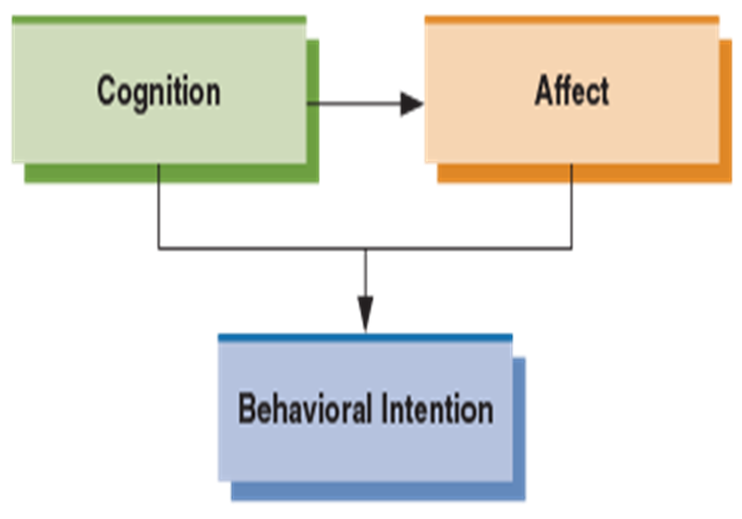
Lecture
Individual Values, Perceptions, and Reactions
4
1- Attitudes in Organizations:
How Attitudes Are Formed:
Attitudes are generally formed around a sequence of cognition, affect, and behavioral intention.
That is, we come to know something that we believe to be true (cognition). This knowledge triggers a feeling (affect).
Cognition and affect then together influence how we intend to behave in the future
www.midocean.ae

Slide 23
Lecture
Individual Values, Perceptions, and Reactions
4
1- Attitudes in Organizations:
How Attitudes Are Formed:
1- Cognition
Defined as the knowledge a person presumes to have about something
Ex. You may believe you like a class because the textbook is excellent, the class meets at your favorite time, the instructor is outstanding, and the workload is reasonable. This “knowledge” may be true, partially true, or totally false.
Cognitions are based on perceptions of truth and reality, and, perceptions agree with reality to varying degrees.
www.midocean.ae

Slide 24
Lecture
Individual Values, Perceptions, and Reactions
4
1- Attitudes in Organizations:
How Attitudes Are Formed:
2- A person’s affect
A person’s feeling toward something.
In many ways, affect is similar to emotion — it is something over which we have little or no conscious control.
Ex. you may like one of your classes, dislike another, and be indifferent toward a third. If the class you dislike is an elective, you may not be particularly concerned. But if it is the first course in your chosen major, your affective reaction may cause you considerable anxiety.
www.midocean.ae

Slide 25
Lecture
Individual Values, Perceptions, and Reactions
4
1- Attitudes in Organizations:
How Attitudes Are Formed:
3- behavioral Intention
Component of an attitude that guides a person’s behavior
Ex. If you like your instructor, you may intend to take another class from him or her next semester. Intentions are not always translated into actual behavior, however. If the instructor’s course next semester is scheduled for 8:00 a.m., you may decide that another instructor is just as good.
Some attitudes, and their corresponding intentions, are much more central and significant to an individual than others. You may intend to do one thing (take a particular class) but later alter your intentions because of a more significant and central attitude (fondness for sleeping late).
www.midocean.ae

Slide 26
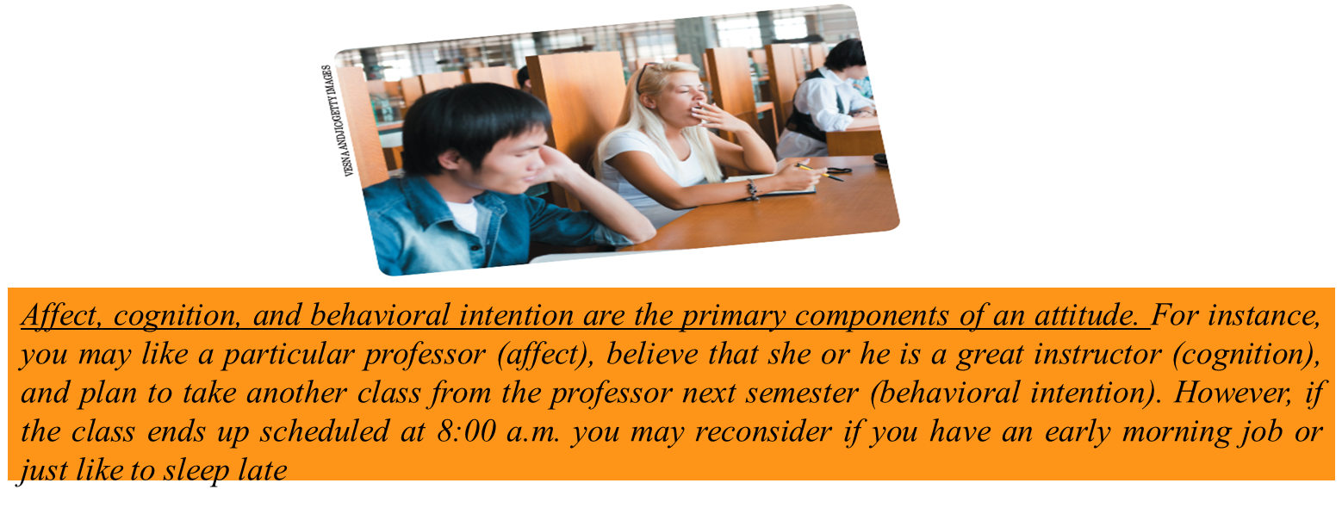
Lecture
Individual Values, Perceptions, and Reactions
4
1- Attitudes in Organizations:
How Attitudes Are Formed:
www.midocean.ae

Slide 27
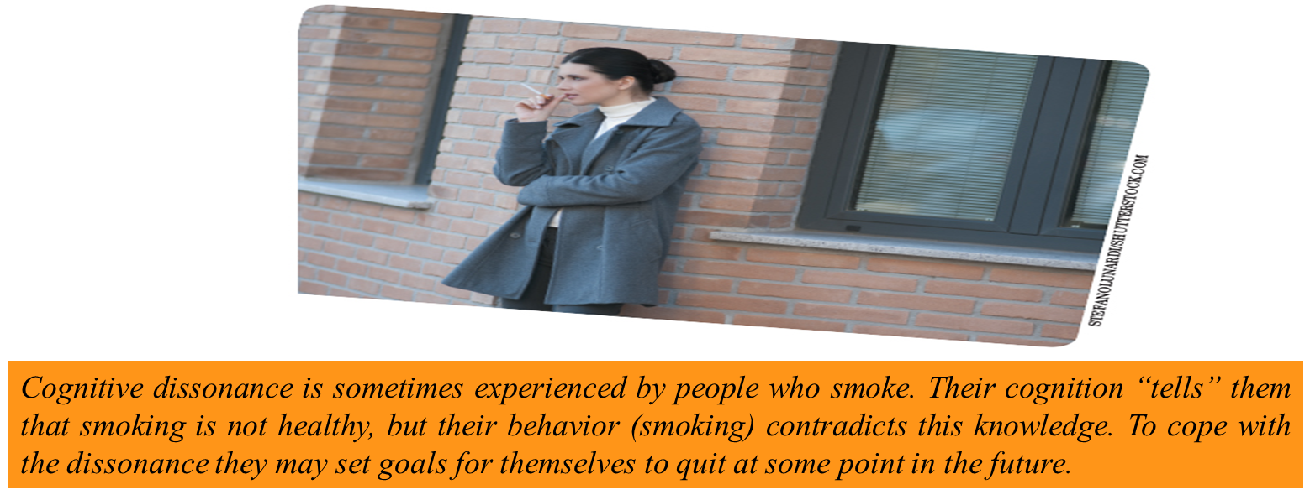
Lecture
Individual Values, Perceptions, and Reactions
4
1- Attitudes in Organizations:
Cognitive dissonance :
www.midocean.ae

Slide 28
Lecture
Individual Values, Perceptions, and Reactions
4
1- Attitudes in Organizations:
Cognitive dissonance :
Cognitive dissonance is an incompatibility or conflict between behavior and an attitude or between two different attitudes.
Ex. suppose that you strongly believe that all companies need to be both profitable and environmentally responsible and that you are the new CEO of a company that is a terrible polluter. You learn that reducing your company’s carbon emissions would be so expensive that the company would no longer be profitable. What would you do? The gap between your environmentally responsible attitude and your attitude that your responsibility is to run a profitable company creates what is called cognitive dissonance.
www.midocean.ae

Slide 29
Lecture
Individual Values, Perceptions, and Reactions
4
1- Attitudes in Organizations:
Cognitive dissonance :
When people experience dissonance, they often use one of four approaches to cope with it. Using the scenario mentioned in the pervious ex., these would include:
You can change your behavior and reduce the company’s carbon emissions.
You can reduce the felt dissonance by reasoning that the pollution is not so important when compared to the goal of running a profitable company.
You can change your attitude toward pollution to decrease your belief that pollution is bad.
You can seek additional information to better reason that the benefits to society of manufacturing the products outweigh the societal costs of polluting.
www.midocean.ae

Slide 30
Lecture
Individual Values, Perceptions, and Reactions
4
1- Attitudes in Organizations:
Cognitive dissonance :
sometimes people are aware of their dissonance but make a conscious decision to not reduce it. This decision would be influenced by the following three things:
Your perception of the importance of the elements that are creating the dissonance.
The amount of influence you feel you have over these elements
The rewards involved in the dissonance
www.midocean.ae

Slide 31
Lecture
Individual Values, Perceptions, and Reactions
4
1- Attitudes in Organizations:
Attitude Change:
Attitudes are not as stable as personality attributes.
Attitudes can also change when the object of the attitude becomes less important or less relevant to the person.
individuals may change their attitudes as a way to reduce cognitive dissonance.
Deeply rooted attitudes that have a long history are, of course, resistant to change.
www.midocean.ae

Slide 32

Lecture
Individual Values, Perceptions, and Reactions
4
1- Attitudes in Organizations:
Attitudes play an important role in organizations, especially attitudes like job satisfaction, organizational commitment, and employee engagement. Take this team of designers, for example. They seem to enjoy working together and appear to all be satisfied with what they are doing. In all likelihood, then, they will be productive and help the organization remain effective and successful.
www.midocean.ae

Slide 33
Lecture
Individual Values, Perceptions, and Reactions
4
1- Attitudes in Organizations:
Key Work-Related Attitudes
People in an organization form attitudes about many different things.
Employees are likely to have attitudes about their salary, their promotion possibilities, their boss, employee benefits, ………
Some of these attitudes are more important than others. Especially important attitudes are:
Job satisfaction,
Organizational commitment, and
Employee engagement.
www.midocean.ae

Slide 34
Lecture
Individual Values, Perceptions, and Reactions
4
1- Attitudes in Organizations:
Key Work-Related Attitudes
Job satisfaction, The work itself, | Job satisfaction reflects our attitudes and feelings about our job The factors that have the greatest influence on job satisfaction are; The work itself, Attitudes, Values, and Personality. Satisfaction with the nature of the work itself is the largest influence on job satisfaction. Challenging work, autonomy, variety, and job scope also increase job satisfaction.
www.midocean.ae

Slide 35
Lecture
Individual Values, Perceptions, and Reactions
4
1- Attitudes in Organizations:
Key Work-Related Attitudes (Job satisfaction)
The work itself, Attitudes | As a manager, if you want to increase your subordinates’ job satisfaction, focus first on improving the nature of the work they do. Coworkers, bosses, and subordinates attitudes and perceptions can be contagious, especially for new hires forming impressions about the job and company. If coworkers are unhappy and dissatisfied with their jobs, new hires are more likely to be dissatisfied than if they regularly interact with happy and satisfied coworkers.
www.midocean.ae

Slide 36
Lecture
Individual Values, Perceptions, and Reactions
4
1- Attitudes in Organizations:
Key Work-Related Attitudes (Job satisfaction)
Value Personality | Employees who find intrinsic value in their work are doing what is important to them. Some people are rarely satisfied with their jobs, and others tend to be satisfied no matter what job they have. Research evidence suggests that differences in job satisfaction are due in part to differences in employees’ genetics and personality. In particular, core self-evaluation, extroversion, and conscientiousness influence job satisfaction. Accordingly, selecting extroverted, conscientious people who are a good fit with the job and who have high core self-evaluations (a broad, general, positive self-regard) can enhance employees’ job satisfaction.
www.midocean.ae

Slide 37
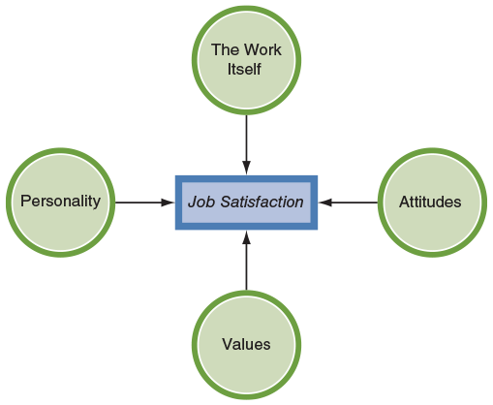
Lecture
Individual Values, Perceptions, and Reactions
4
1- Attitudes in Organizations:
Key Work-Related Attitudes (Job satisfaction)
Job satisfaction is one of the most important job-related attitudes in organizations.
It reflects both our attitudes and our feelings about our job.
Job satisfaction is strongly influenced by our personality, values, other attitudes, and the work itself.
www.midocean.ae

Slide 38
Lecture
Individual Values, Perceptions, and Reactions
4
1- Attitudes in Organizations:
Key Work-Related Attitudes (Job satisfaction)
2) Organizational Commitment | Organizational commitment reflects the degree to which an employee identifies with the organization and its goals and wants to stay with the organization. There are three ways we can feel committed to an employer: 1- Affective commitment: positive emotional attachment to the organization and strong identification with its values and goals. 2- Normative commitment: feeling obliged to stay with an organization for moral or ethical reasons. 3- Continuance commitment: staying with an organization because of perceived high economic (i.e., taking another job would mean losing valuable stock options)
www.midocean.ae

Slide 39
Lecture
Individual Values, Perceptions, and Reactions
4
1- Attitudes in Organizations:
Key Work-Related Attitudes (Job satisfaction)
3) Employee Engagement | Employee engagement is “a heightened emotional and intellectual connection that an employee has for his/her job, organization, manager, or coworkers that, in turn, influences him/her to apply additional discretionary effort to his/her work.” Engagement is enhanced when employees: Have clear goals. And Have the resources needed to do a good job. Get meaningful feedback on their performance. Are able to use their talents. Are recognized for doing a good job. Have positive relationships with coworkers. Have opportunities to learn and grow., Have supportive leadership.
www.midocean.ae

Slide 40
Lecture
Individual Values, Perceptions, and Reactions
4
2- Values and Emotions in Organizations:
Values | Values are ways of behaving or end-states that are desirable to a person or to a group. Values can be conscious or unconscious. A company leader’s personal values affect the firm’s business strategy and all aspects of organizational behavior including staffing, reward systems, manager–subordinate relationships, communication, conflict management styles, and negotiation approaches Our personal values combine with organizational influences like company culture to generate decisions that can be significantly different from those made based solely on our personal values. Strong company cultures help to guide us when making these ambiguous choices.
www.midocean.ae

Slide 41
Lecture
Individual Values, Perceptions, and Reactions
4
2- Values and Emotions in Organizations:
Types of Values (Terminal and Instrumental Values):
Types of Values 1- Terminal Values | Values can be described as terminal or instrumental and as intrinsic or extrinsic. Terminal values reflect our long-term life goals and may include prosperity, happiness, a secure family, and a sense of accomplishment. Terminal values can change over time depending on our experiences and accomplishments. When a career-oriented person sells his or her business for a lot of money, his or her prosperity goals may be reached and family may then become most important.
www.midocean.ae

Slide 42
Lecture
Individual Values, Perceptions, and Reactions
4
2- Values and Emotions in Organizations:
Types of Values (Terminal and Instrumental Values):
2- Instrumental values | Instrumental values are our preferred means of achieving our terminal values or our preferred ways of behaving. Terminal values influence what we want to accomplish; instrumental values influence how we get there. Honesty, ambition, and independence are examples of instrumental values that guide our behavior in pursuit of our terminal goals. People who value honesty behave more ethically in pursuing the terminal value of prosperity and a sense of accomplishment than do people with a lower honesty instrumental value.
www.midocean.ae

Slide 43
Lecture
Individual Values, Perceptions, and Reactions
4
2- Values and Emotions in Organizations:
Types of Values (Intrinsic and Extrinsic Values):
3- Intrinsic work values 4- Extrinsic work values | Intrinsic work values relate to the work itself For example, some employees want challenging jobs with a lot of variety that require them to continually learn new things, whereas others prefer simpler jobs they can perform in the same way every day. Extrinsic work values are related to the outcomes of doing work. For Example, employees who work to earn money or to have health benefits are satisfying extrinsic work values. Having high status in the company, getting recognized for quality work, and having job security are extrinsic work values.
www.midocean.ae

Slide 44
Lecture
Individual Values, Perceptions, and Reactions
4
2- Values and Emotions in Organizations:
Conflicts among Values:
Conflicts among Values: 1- Intrapersonal value | Intrapersonal, interpersonal, and individual–organization value conflicts all influence employee attitudes, retention, job satisfaction, and job performance. When highly ranked instrumental and terminal values conflict and both cannot be met, we experience inner conflict and stress. intrapersonal value conflict between the instrumental value of ambition and the terminal value of happiness If being happy pulls us to spend quality time with our family or pursuing a hobby we love, but personal ambition pulls us to work longer hours and pursue promotions, we feel conflicted.
www.midocean.ae

Slide 45
Lecture
Individual Values, Perceptions, and Reactions
4
2- Values and Emotions in Organizations:
Conflicts among Values:
2- Interpersonal value 3- Individual–organization value conflicts | interpersonal value: conflicts occur when two different people hold conflicting values. Interpersonal value conflicts are often the cause of personality clashes and other disagreements. If one coworker values individual rewards and the other values group recognition, the two may clash over how to approach a new project Employee’s values can conflict with the values of the organization, creating individual–organization value conflict. Lower individual–organization value conflict leads to greater job satisfaction, higher performance, lower stress, and greater job commitment
www.midocean.ae

Slide 46
Lecture
Individual Values, Perceptions, and Reactions
4
2- Values and Emotions in Organizations:
How Values Differ around the World:
How Values Differ around the World: | Global differences in values can also lead to different managerial behaviors. For example, Latin Americans tend to highly value family loyalty, which leads them to hire competent family members whenever possible Managers in the United States tend to strongly value individual achievement, which leads them to emphasize a candidate’s previous performance and skill assessments rather than family ties.
www.midocean.ae

Slide 47
Lecture
4
Individual Values, Perceptions, and Reactions
2- Values and Emotions in Organizations:
How Values Differ around the World:
How Values Differ around the World: | Values are influenced by culture. Research has found that a large number of basic values can be condensed into two major dimensions that vary across cultures:. traditional/secular–rational values and survival/self-expression values Traditional/secular-rational values reflect the contrast between societies in which religion is very important and those in which it is not More traditional societies emphasize the importance of parent–child ties and deference to authority, which is reflected in high levels of national pride and a nationalistic outlook. secular-rational values societies have the opposite characteristics.
www.midocean.ae

Slide 48
Lecture
Individual Values, Perceptions, and Reactions
4
2- Values and Emotions in Organizations:
How Values Differ around the World:
How Values Differ around the World: | Survival values emphasize economic and physical security. Self-expression values emphasize subjective well-being, self-expression, and quality of life, giving high priority to environmental protection, diversity tolerance, and participation in decision making. Societies that rank high on self-expression values also tend to have higher interpersonal trust and tolerance and value individual freedom and self-expression
www.midocean.ae

Slide 49
Lecture
Individual Values, Perceptions, and Reactions
4
2- Values and Emotions in Organizations:
The Role of Emotions in Behavior:
Emotions | Emotions: are intense, short-term physiological, behavioral, and psychological reactions to a specific object, person, or event that prepare us to respond to it. The definition can be divided into its four important elements: Emotions are short events or episodes. Emotions are relatively short-lived. Emotions are directed at something or someone. This differentiates emotions from moods, which are short-term emotional states that are not directed toward anything in particular. Emotions are experienced. They involve involuntary changes in heart rate, blood pressure, facial expressions, animation, and vocal tone. We feel emotion.
www.midocean.ae

Slide 50
Lecture
Individual Values, Perceptions, and Reactions
4
2- Values and Emotions in Organizations:
The Role of Emotions in Behavior:
Emotions Why is understanding the role of emotions important to organizations? | 4- Emotions create a state of physical readiness through physiological reactions. Increased heart rate, adrenaline, and eye movements prepare our bodies to take action. First, because effective employees and managers know how to positively influence their own emotions and the emotions of others Second, emotions influence both the creation and maintenance of our motivation to engage or to not engage in certain behaviors. Third, research has found that emotion can influence turnover, decision making, leadership, helping behaviors, and teamwork behaviors.
www.midocean.ae

Slide 51

Lecture
Individual Values, Perceptions, and Reactions
4
2- Values and Emotions in Organizations:
Affect and Mood
Affect and mood play important roles in how we perform our jobs and how others perceive us. These two Starbucks baristas, for example, are happy and engaging. Their positive mood and affect, in turn, can make their customers feel good as well.
www.midocean.ae

Slide 52
Lecture
Individual Values, Perceptions, and Reactions
4
2- Values and Emotions in Organizations:
Affect and Mood
Affectivity | Affectivity represents our tendency to experience a particular mood or to react to things with certain emotions Researchers have identified two types of affectivity: positive and negative Positive affect, which reflects a combination of high energy and positive evaluation characterized by emotions like elation. Negative affect, which comprises feelings of being upset, fearful, and distressed.
www.midocean.ae

Slide 53

Lecture
Individual Values, Perceptions, and Reactions
4
2- Values and Emotions in Organizations:
Affect and Mood
Affect can vary anywhere along a continuum ranging from positive affect to negative affect. As illustrated here, it is also possible to fall in between these extremes and reflect neither positive nor negative affect.
www.midocean.ae

Slide 54



Thank You

