Slide 1


Real-Time Arabic sign language Translation
2025
Midocean University
Informatics College
Master of Artificial Intelligence
Prepared by: Ahmed Yousef Abdelrahman ID:(243001651)
Supervisor: Dr Khalied Esakf

Slide 2
Introduction
Sign language is the primary communication method for the deaf and hard-of-hearing community.
This community faces major challenges in integrating with society due to language barriers.
The project aims to facilitate communication by developing an intelligent system that translates Arabic Sign Language into text automatically.
This project helps make communication easier and supports social inclusion.

Slide 3
Problem Statement
Most research focuses on global sign languages such as ASL or BSL, while Arabic Sign Language remains underexplored.
Available solutions do not fully meet users’ needs(for Arabic sign ).
There is a clear gap in developing efficient systems that can be used daily by the deaf and hard-of-hearing community for direct communication

Slide 4
Objective
  Develop a real-time Arabic Sign Language recognition system using deep learning techniques.
  Use MobileNetV2 to get important features from images.
  Integrate LSTM to process sequences of signs and convert them into text.
  Improve model accuracy using techniques such as Data Augmentation.

Slide 5
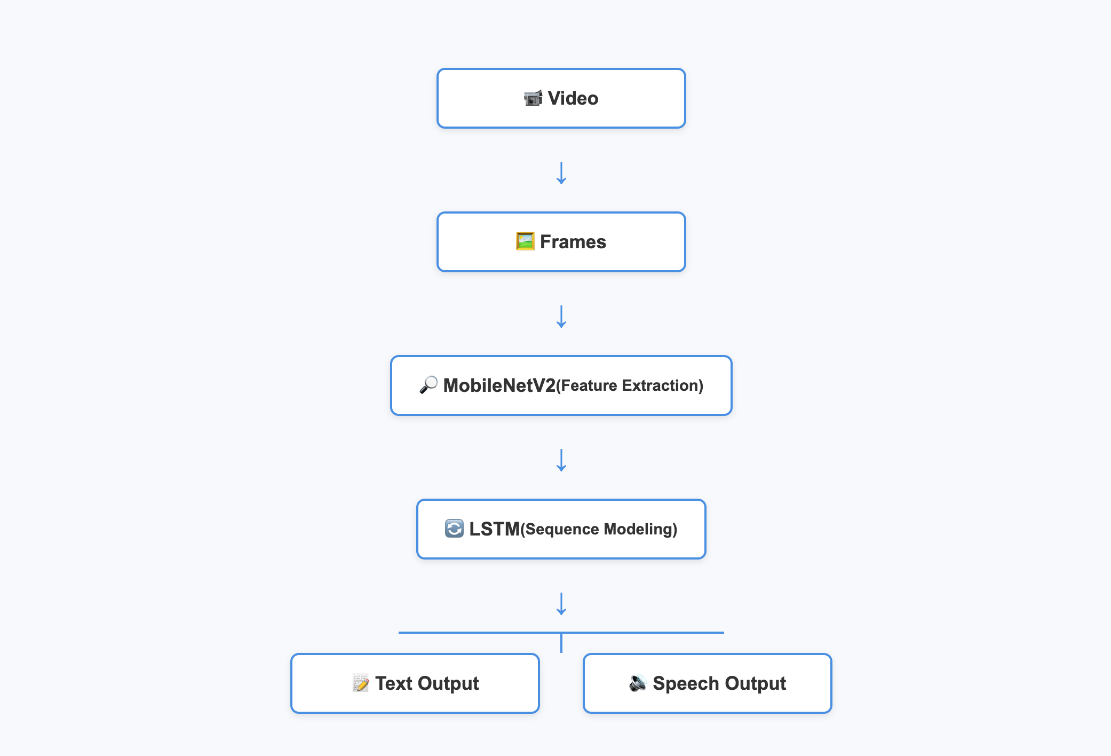
(Methodology / Architecture)
Input a video containing hand signs.
Split the video into frames.
Use MobileNetV2 to extract features from images.
Feed these features into LSTM to process the sequence.
Output the result as text .

Slide 6
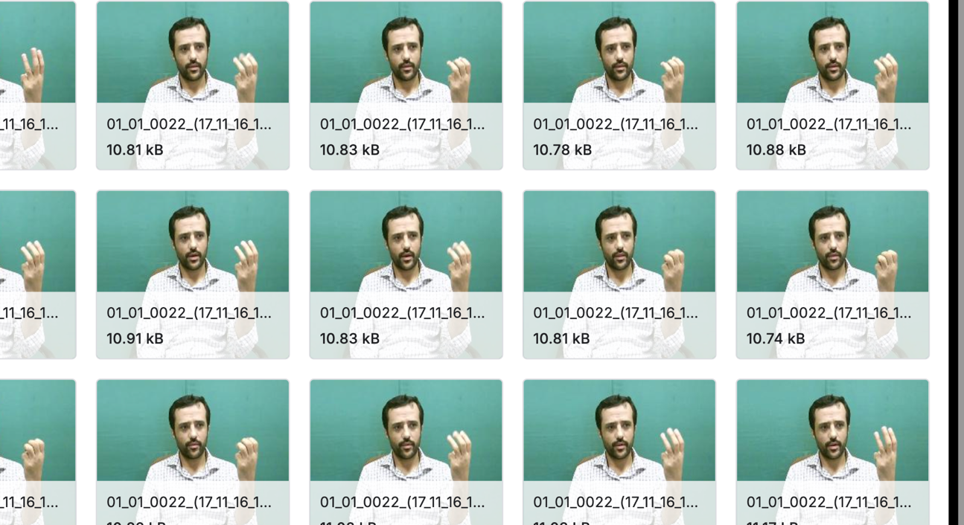
Dataset
Dataset Source: KArSL-502 from Kaggle.
Total number of classes: 502 classes.
Only 23 classes were used for actual training due to limitations (training time / data size).
Each class contains sequences of images representing Arabic Sign Language gestures.
Dataset examples:

Slide 7
Pre-processing
Resize:
All images were resized to a fixed dimension (e.g., ‎224×224‎) to meet the model requirements.
Data Augmentation:
  Applied techniques such as rotation, flipping, and scaling to increase dataset diversity and enhance model generalization.

Slide 8
Model
MobileNetV2 for feature extraction.
LSTM for sequence processing.

Slide 9
Experiments
Training setup: 20 Epochs, Batch Size = 8, Adam Optimizer, number of sequences 32
Environment: Google Colab, GPU(L4 GPU).

Slide 10
Results
Accuracy.(97 %)
Comparison with previous studies.
Paper | Architecture | Dataset | Target | Accuracy | Key Contribution
A Real-Time Arabic Sign Language Alphabets (ArSLA) Recognition Model Using Deep Learning | AlexNet | ArSLA dataset | Alphabet recognition | 94.81% | Real-time ArSLA recognition
Signer-Independent Arabic Sign Language Recognition Using Deep Learning | MobileNetV2-LSTM-SelfMLP | Raw & segmented videos | Signer-independent gestures | 87.69% | Region-based segmentation + SelfMLP for generalization
An Automatic Arabic Sign Language Recognition System Based on Deep CNN | Deep CNN | 50,000 images | ArSL gestures | 97.6% | Large dataset & hyperparameter optimization
An Automatic Arabic Sign Language Recognition System Based on Deep CNN | CNN-LSTM-SelfMLP (Transfer Learning) | Raw & segmented videos | Gesture recognition | ~88-90% | Transfer learning + region-based segmentation
A Comparative Study Using 2D CNN and Transfer Learning to Detect and Classify Arabic-Script-Based Sign Language | CNN | dataset of 54,049 images across 32 Arabic sign alphabet classes | Gesture recognition | 94 %
Arabic Sign Language Recognition using Lightweight CNN-based Architecture | EfficientNet-Lite |  |  | 94&

Slide 11
Conclusion
A model for Arabic Sign Language recognition was developed using MobileNetV2 + LSTM.
Results showed that the model can recognize selected signs with good accuracy.
The project has practical importance in facilitating communication between the deaf community and society.

Slide 12
Future Work
Extend the model to recognize full sentences instead of individual signs.
Expand the dataset to include more classes and gestures.
Develop a mobile application for practical system usage.

Slide 13

Demo

Slide 14
Acknowledgment
Special thanks to the project supervisor.(Dr.khalied eskaf).
Thanks to the university and faculty for their support.

