Slide 1


Foundations of Project
Management
PMG 101
Managing Risk
Part 2
Lecture 9

Slide 2
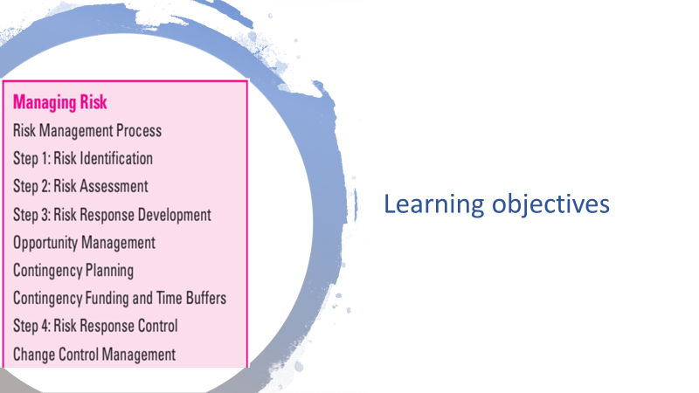
Chapter
09
www.midocean.ae

Slide 3
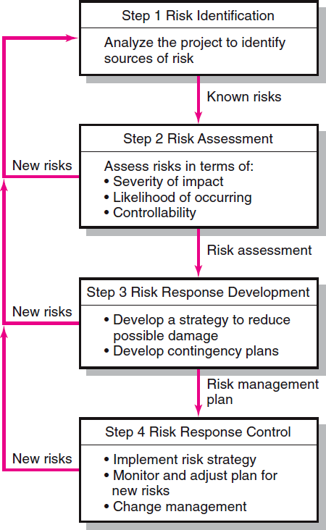

Chapter
09
FIGURE 7.2
www.midocean.ae

Slide 4
Chapter
09
Contingency plan
A contingency plan is an alternative plan that will be used if a possible foreseen risk event becomes a reality. The contingency plan represents actions that will reduce or mitigate the negative impact of the risk event. Like all plans, the contingency plan answers the questions of what, where, when, and how much action will take place.
A key distinction between a risk response and a contingency plan is that a response is part of the actual implementation plan and action is taken before the risk can materialize, while a contingency plan is not part of the initial implementation plan and only goes into effect after the risk is recognized.
www.midocean.ae

Slide 5
Chapter
09
Importance of Contingency plan
The absence of a contingency plan, when a risk event occurs, can cause a manager to delay or postpone the decision to implement a remedy. This postponement can lead to panic, and acceptance of the first remedy suggested. Such after-the-event decision making under pressure can be potentially dangerous and costly.
Contingency planning evaluates alternative remedies for possible foreseen events before the risk event occurs and selects the best plan among alternatives. This early contingency planning facilitates a smooth transition to the remedy or work-around plan.
The availability of a contingency plan can significantly increase the chances for project success.
www.midocean.ae

Slide 6
Chapter
09
An example on contingency plan
A high-tech niche computer company intends to introduce a new “platform” product at a very specific target date. The project’s 47 teams all agree delays will not be acceptable. Their contingency plans for two large component suppliers demonstrate how seriously risk management is viewed. One supplier’s plant sits on the San Andreas Fault, which is prone to earthquakes.
The contingency plan has an alternative supplier, who is constantly updated, producing a replica of the component in another plant. Another key supplier in Toronto, Canada, presents a delivery risk on their due date because of potential bad weather.
This contingency plan calls for a chartered plane (already contracted to be on standby) if overland transportation presents a delay problem. To outsiders these plans must seem a bit extreme, but in high-tech industries where time to market is king, risks of identified events are taken seriously.
www.midocean.ae

Slide 7
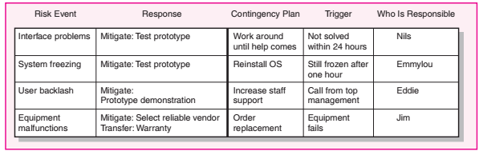
Chapter
09
Risk response matrices such as the one shown in Figure 7.8 are useful for summarizing how the project team plans to manage risks that have been identified.
FIGURE 7.8 Risk Response Matrix
www.midocean.ae

Slide 8
Chapter
09
Steps to mange risk:
1- The team has to identify whether to reduce, share, transfer, or accept the risk.
2- The next step is to identify contingency plans in case the risk still occurs.
3- The team also needs to discuss and agree what would “trigger” implementation of the contingency plan.
4- Finally, the individual responsible for monitoring the potential risk and initiating the contingency plan needs to be assigned.
Smart project managers establish protocols for contingency responses before they are needed.
www.midocean.ae

Slide 9

Chapter
09
Risks during the project/idea initiation phase:
  Unavailable subject matter experts
  Poor definition of problem or project
  No feasibility study
  No or unclear objectives
www.midocean.ae

Slide 10
Chapter
09
Taking….cont’d
Risks during the project planning phase:
  No risk management plan
  Spotty planning
  Underdeveloped requirements and specifications
  Unclear statement of work
  No management or stakeholder support
  Poor role definition
  Inexperienced team
  Definite lack of skills
www.midocean.ae

Slide 11
Chapter
09
….cont’d
Risks during the project execution phase
  Changes in schedule
  No control systems in place
  Unskilled labour
  Material availability or poor quality material
  Unreliable suppliers
  Unexpected price increase (not budget for it)
  Strikes
  Weather
  Regulatory requirements
www.midocean.ae

Slide 12
Chapter
09
….cont’d
Risks during the project close-out / termination phase:
  Unacceptable to customer
  Poor quality product/project
  Budget problems
  Penalties to be paid for exceeding the time parameter of the project
www.midocean.ae

Slide 13
Chapter
09
Opportunity management
An opportunity is an event that can have a positive impact on project objectives. For example, unusually favorable weather can accelerate construction work, or a drop in fuel prices may create savings that could be used to add value to a project.
Essentially the same process that is used to manage negative risks is applied to positive risks. Opportunities are identified, assessed in terms of likelihood and impact, responses are determined, and even contingency plans and funds can be established to take advantage of the opportunity if it occurs. The major exception between managing negative risks and opportunity is in the responses.
www.midocean.ae

Slide 14
Chapter
09
Four different types of response to an opportunity:
Exploit. This tactic seeks to eliminate the uncertainty associated with an opportunity to ensure that it definitely happens. Examples include assigning your best personnel to a critical burst activity to reduce the time to completion or revising a design to enable a component to be purchased rather than developed internally.
Share. This strategy involves allocating some or all of the ownership of an opportunity to another party who is best able to capture the opportunity for the benefit of the project. Examples include establishing continuous improvement incentives for external contractors or joint ventures.
Enhance. Enhance is the opposite of mitigation in that action is taken to increase the probability and/or the positive impact of an opportunity. Examples include choosing site location based on favorable weather patterns or choosing raw materials that are likely to decline in price.
Accept. Accepting an opportunity is being willing to take advantage of it if it occurs, but not taking action to pursue it.
www.midocean.ae

Slide 15







Chapter
09
Exploit
Share
Enhance
Acceptance
Avoid
Transfer
Mitigate
Acceptance (Retain)
www.midocean.ae

Slide 16
Chapter
09
FIGURE 7.2
www.midocean.ae

Slide 17
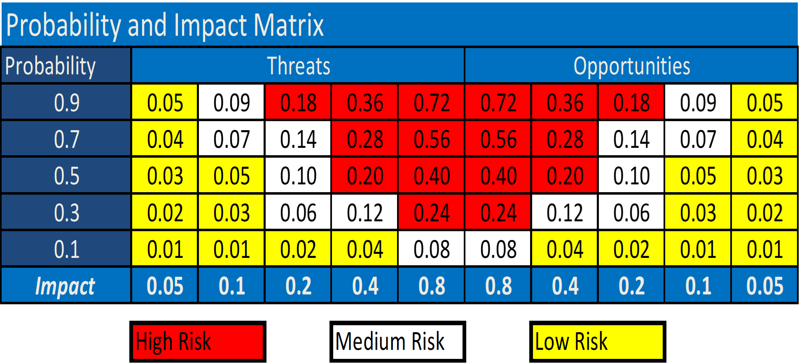
Chapter
09
www.midocean.ae

Slide 18
Chapter
09
Contingency funding
Contingency funds are established to cover project risks that are identified and unknown. When, where, and how much money will be spent is not known until the risk event occurs.
Project “owners” are often reluctant to set up project contingency funds that seem to imply the project plan might be a poor one. Some perceive the contingency fund as an add-on slush fund. Others say they will face the risk when it materializes. Usually, such reluctance to establish contingency reserves can be overcome with documented risk identification, assessment, contingency plans, and plans for when and how funds will be disbursed.
www.midocean.ae

Slide 19
Chapter
09
Contingency funding
Contingency funds are established to cover project risks that are identified and unknown. When, where, and how much money will be spent is not known until the risk event occurs.
Project “owners” are often reluctant to set up project contingency funds that seem to imply the project plan might be a poor one. Some perceive the contingency fund as an add-on slush fund. Others say they will face the risk when it materializes. Usually, such reluctance to establish contingency reserves can be overcome with documented risk identification, assessment, contingency plans, and plans for when and how funds will be disbursed.
www.midocean.ae

Slide 20
Chapter
09
Contingency funding
In practice, contingencies run from 1 to 10 percent in projects similar to past projects. However, in unique and high-technology projects it is not uncommon to find contingencies running in the 20 to 60 percent range. Use and rate of consumption of reserves must be closely monitored and controlled.
In practice, the contingency reserve fund is typically divided into budget and management reserve funds for control purposes. Budget reserves are set up to cover identified risks; these reserves are those allocated to specific segments or deliverables of the project. Management reserves are set up to cover unidentified risks and are allocated to risks associated with the total project.
www.midocean.ae

Slide 21
Chapter
09
Contingency funding
1. Budget reserves
These reserves are identified for specific work packages or segments of a project found in the baseline budget or work breakdown structure. For example, a reserve amount might be added to “computer coding” to cover the risk of “testing” showing a coding problem.
The budget reserve should be communicated to the project team. This openness suggests trust and encourages good cost performance. However, distributing budget reserves should be the responsibility of both the project manager and the team members responsible for implementing the specific segment of the project. If the risk does not materialize, the funds are removed from the budget reserve. Thus, budget reserves decrease as the project progresses.
www.midocean.ae

Slide 22
Chapter
09
Contingency funding
2. Management Reserves
These reserve funds are needed to cover major unforeseen risks and, hence, are applied to the total project. For example, a major scope change may appear necessary midway in the project. Because this change was not anticipated or identified, it is covered from the management reserve. Management reserves are established after budget reserves are identified and funds established.
These reserves are independent of budget reserves and are controlled by the project manager and the “owner” of the project. The “owner” can be internal (top management) or external to the project organization. Most management reserves are set using historical data and judgments concerning the uniqueness and complexity of the project.
www.midocean.ae

Slide 23
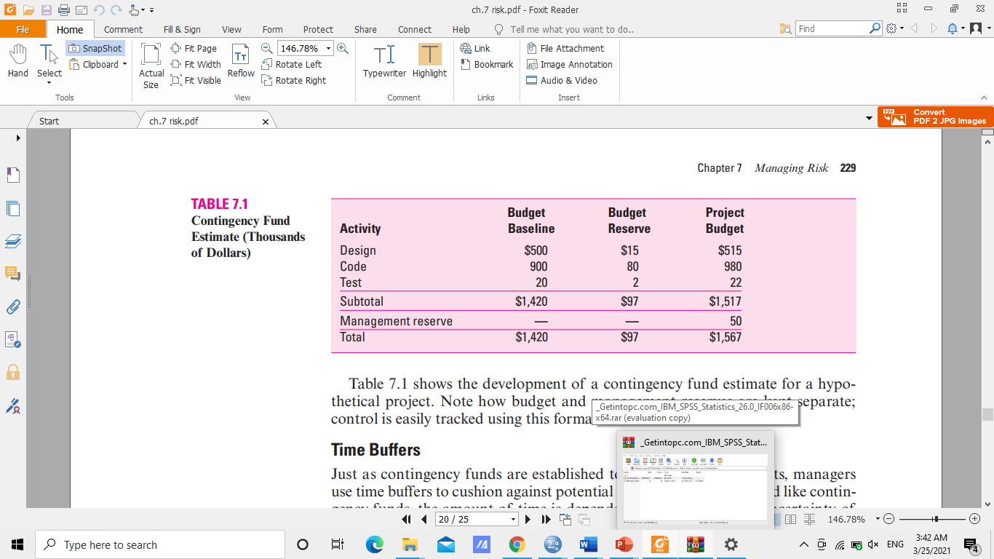
Chapter
09
Table 7.1 shows the development of a contingency fund estimate for a hypothetical project. Note how budget and management reserves are kept separate; control is easily tracked using this format.
www.midocean.ae

Slide 24
Chapter
09
Time Buffer
Just as contingency funds are established to absorb unplanned costs, managers use time buffers to cushion against potential delays in the project. And like contingency funds, the amount of time is dependent upon the inherent uncertainty of the project. The more uncertain the project the more time should be reserved for the schedule. The strategy is to assign extra time at critical moments in the project. Like management reserves, this buffer typically requires the authorization of top management.
www.midocean.ae

Slide 25
Chapter
09
FIGURE 7.2
www.midocean.ae

Slide 26
Chapter
09
Step 4: Risk response control
Typically, the results of the first three steps of the risk management process are summarized in a formal document often called the risk register. A risk register details all identified risks, including descriptions, category, and probability of occur- ring, impact, responses, contingency plans, owners, and current status. The register is the backbone for the last step in the risk management process: risk control.
Risk control involves executing the risk response strategy, monitoring triggering events, initiating contingency plans, and watching for new risks. Establishing a change management system to deal with events that require formal changes in the scope, budget, and/or schedule of the project is an essential element of risk control.
www.midocean.ae

Slide 27
Chapter
09
Step 4: Risk response control
A key for controlling the cost of risks is documenting responsibility. This can be problematic in projects involving multiple organizations and contractors. Responsibility for risk is frequently passed on to others with the statement, “That is not my worry.” This mentality is dangerous. Each identified risk should be assigned (or shared) by mutual agreement of the owner, project manager, and the contractor or person having line responsibility for the work package or segment of the project.
It is best to have the line person responsible approve the use of budget reserve funds and monitor their rate of usage. If management reserve funds are required, the line person should play an active role in estimating additional costs and funds needed to complete the project. Having line personnel participate in the process focuses attention on the management reserve, control of its rate of usage, and early warning of potential risk events.
www.midocean.ae

Slide 28
Chapter
09
www.midocean.ae

Slide 29

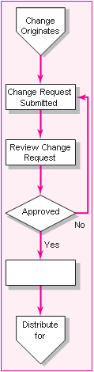
Chapter
09
Step 4: Risk response control
Change control management
A major element of the risk control process is change management. Every detail of a project plan will not materialize as expected. Coping with and controlling project changes present a formidable challenge for most project managers.
Changes come from many sources such as the project customer, owner, project manager, team members, and occurrence of risk events.
www.midocean.ae

Slide 30
Chapter
09
Step 4: Risk response control
Change control management
Most changes easily fall into three categories:
1- Scope changes in the form of design or additions represent big changes; for example, customer requests for a new feature or a redesign that will improve the product.
2- Implementation of contingency plans, when risk events occur, represent changes in baseline costs and schedules.
3- Improvement changes suggested by project team members represent another category.
Because change is inevitable, a well-defined change review and control process should be set up early in the project planning cycle.
www.midocean.ae

Slide 31
Chapter
09
Step 4: Risk response control
Change management systems involve reporting, controlling, and recording changes to the project baseline. In practice most change management systems are designed to accomplish the following:
Identify proposed changes.
List expected effects of proposed change(s) on schedule and budget.
Review, evaluate, and approve or disapprove changes formally.
Negotiate and resolve conflicts of change, conditions, and cost.
Communicate changes to parties affected.
Assign responsibility for implementing change.
Adjust master schedule and budget.
Track all changes that are to be implemented.
www.midocean.ae

Slide 32
Chapter
09
Step 4: Risk response control
Organizations use change request forms and logs to track proposed changes. An example of a simplified change request form is depicted in Figure 7.10. Typically change request forms include a description of the change, the impact of not approving the change, the impact of the change on project scope/schedule/cost, and defined signature paths for review as well as a tracking log number.
These logs are used to monitor change requests. They typically summarize the status of all outstanding change requests and include such useful information as source and date of the change, document codes for related information, cost estimates, and the current status of the request.
www.midocean.ae

Slide 33
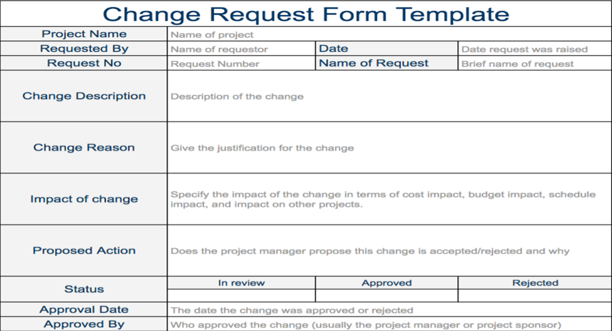
Chapter
09
www.midocean.ae

Slide 34
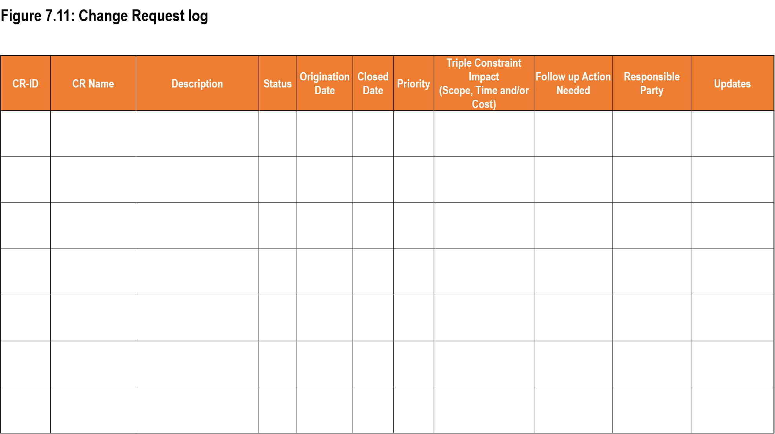
Chapter
09
www.midocean.ae

Slide 35
Chapter
09
The benefits derived from change control systems are the following:
  1- Inconsequential changes are discouraged by the formal process.
  2- Costs of changes are maintained in a log.
  3- Integrity of the WBS and performance measures is maintained.
  4- Allocation and use of budget and management reserve funds are tracked.
  5- Responsibility for implementation is clarified.
  6- Effect of changes is visible to all parties involved.
  7- Implementation of change is monitored.
  8- Scope changes will be quickly reflected in baseline and performance measures
www.midocean.ae

Slide 36
Chapter
09
Balancing the Portfolio for Risks and Types of Projects
A major responsibility of the priority team is to balance projects by type, risk, and resource demand. This requires a total organization perspective. Hence, a proposed project that ranks high on most criteria may not be selected because the organization portfolio already includes too many projects with the same characteristics— e.g., project risk level, use of key resources, high cost, nonrevenue producing, long durations.
Balancing the portfolio of projects is as important as project selection. Organizations need to evaluate each new project in terms of what it adds to the project mix. Short-term needs need to be balanced with long-term potential. Resource usage needs to be optimized across all projects, not just the most important project.
Two types of risk are associated with projects. First are risks associated with the total portfolio of projects, which should reflect the organization’s risk profile. Second are specific project risks that can inhibit the execution of a project.
www.midocean.ae

Slide 37

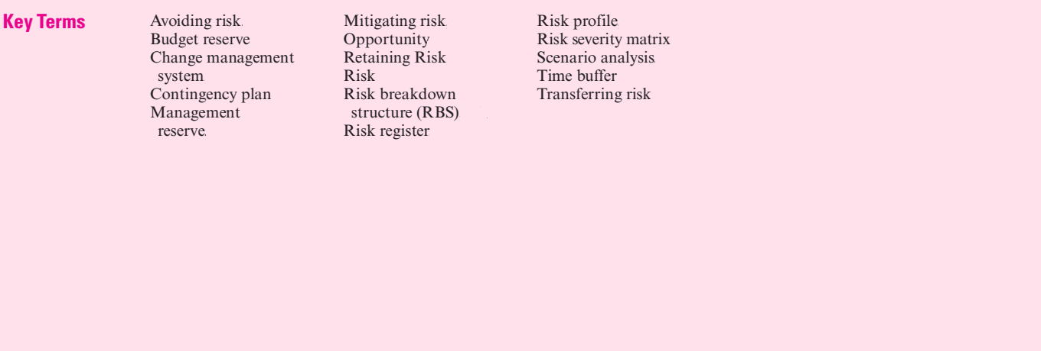
Chapter
09
www.midocean.ae

Slide 38



Thank You

