Slide 1




Mathematics 3 – MAT132
Dr. Israa Lewaa
Lecture 2 - Differential Equations: Part 2

Slide 2

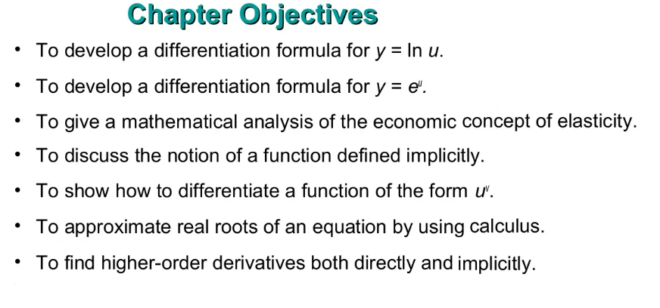


Lecture Objective
Lecture
05
Chapter Objectives
Lecture 2 Dr. Israa Lewaa Mathematics 3

Slide 3
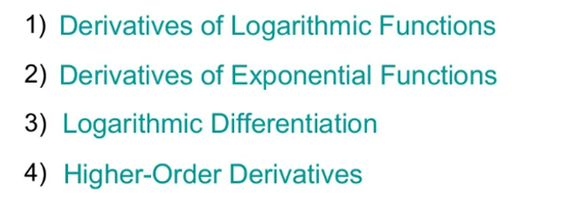
Lecture Outline
Lecture
05
Chapter Outline

Slide 4
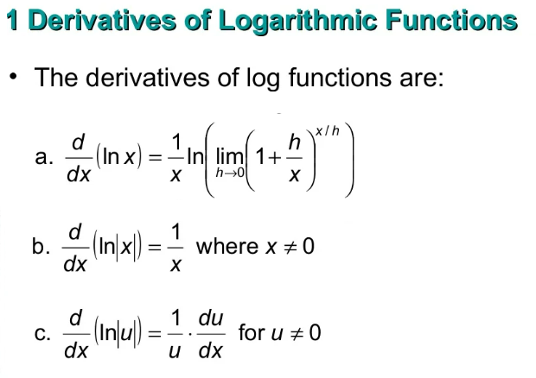
Lecture
05
1- Derivatives of Logarithmic Functions
1-

Slide 5
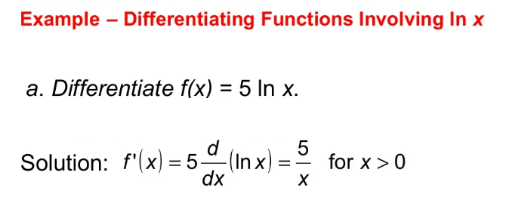
Lecture
05
Example
Example

Slide 6
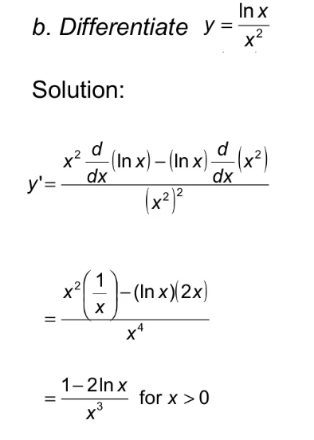
Lecture
05
Example
Example

Slide 7
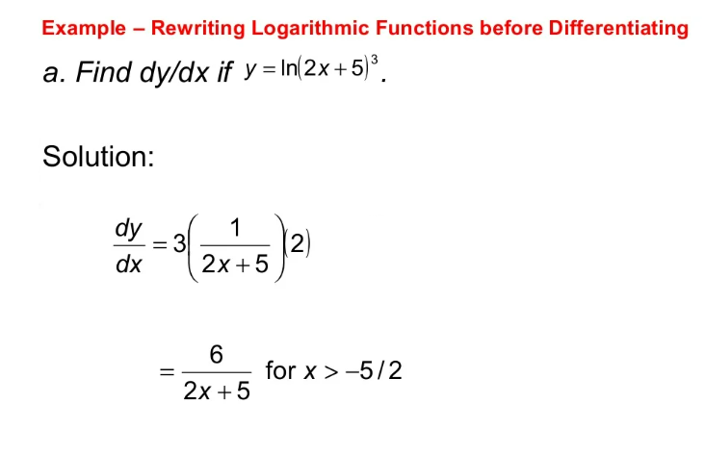
Lecture
05
Example
Example

Slide 8
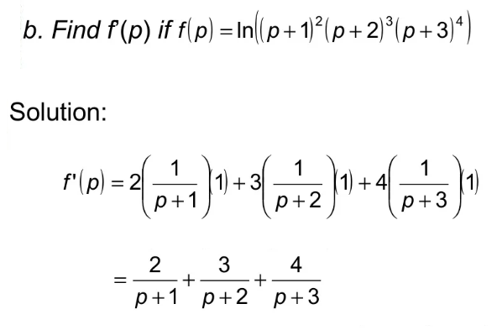
Example
Lecture
05
Example

Slide 9
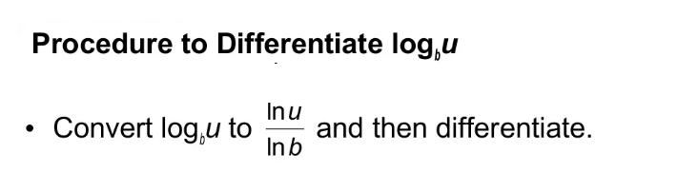

Lecture
05
Procedure to Differentiate ${\text{log}}_{b}$

Slide 10
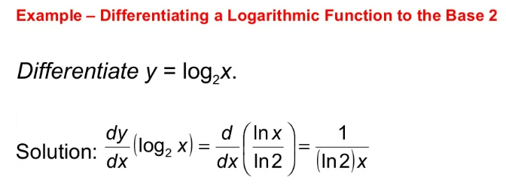
Lecture
05
Example
Example

Slide 11
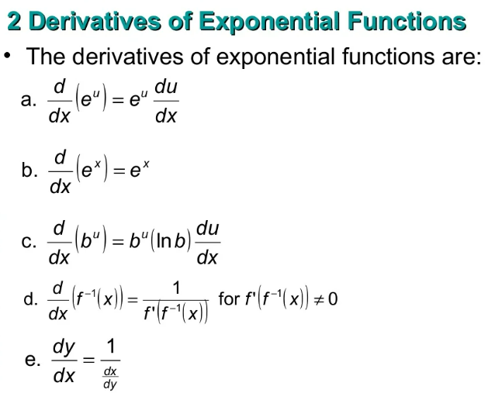
Derivatives of Exponential Functions
Lecture
05

Slide 12
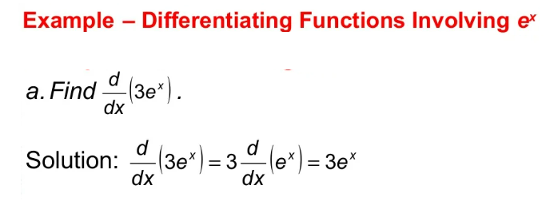
Lecture
05
Example
Example

Slide 13
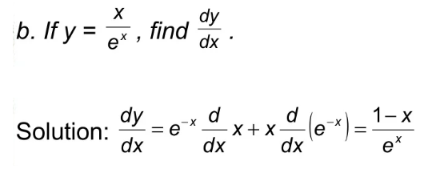
Example
Lecture
05
Example

Slide 14
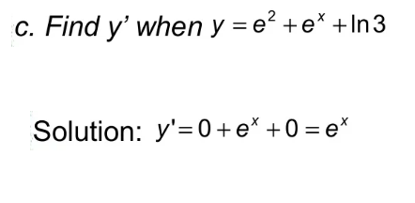
Example
Lecture
05
Example

Slide 15
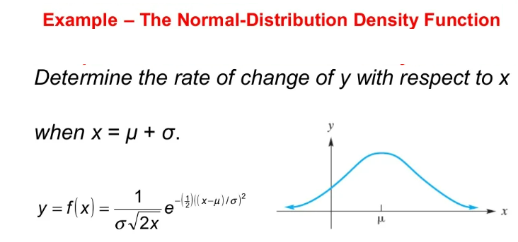
Lecture
05
Example
Example

Slide 16
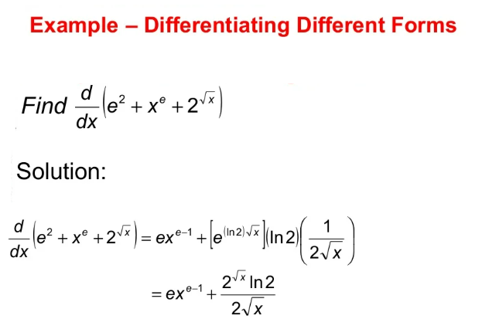
Lecture
05
Example
Example

Slide 17
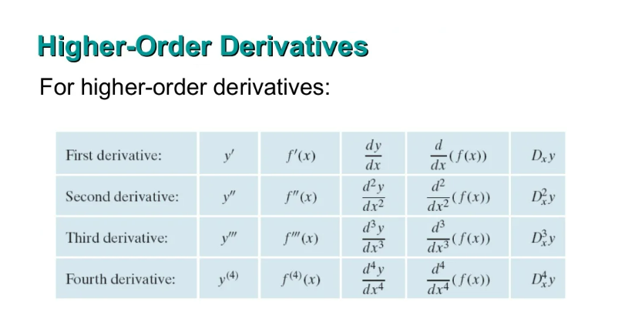
Lecture
05
Higher-Order Derivatives
Higher-Order Derivatives

Slide 18
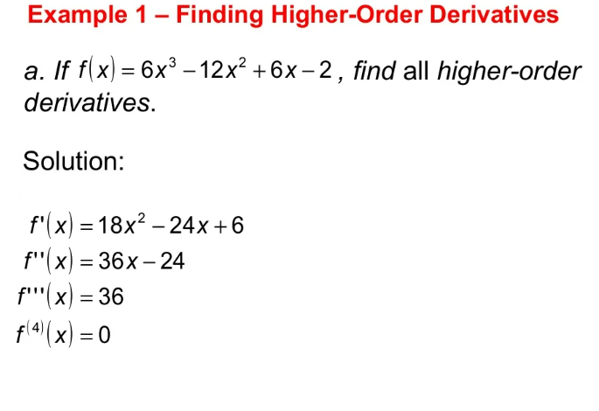
Lecture
05
Example
Example

Slide 19
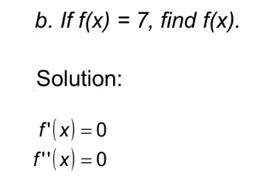
Lecture
05
Example
Example

Slide 20
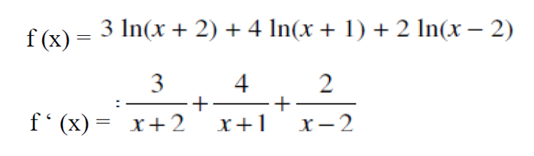
Extra Practice – Example 1
Lecture
05
Extra Practice -- Example

Slide 21
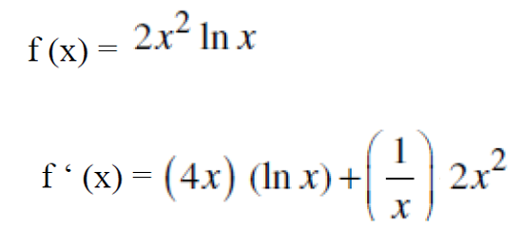
Extra Practice – Example 2
Lecture
05
Extra Practice -- Example

Slide 22
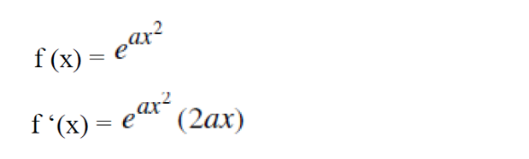
Extra Practice – Example 3
Lecture
05
Example
Differentiate the following functions:

Slide 23
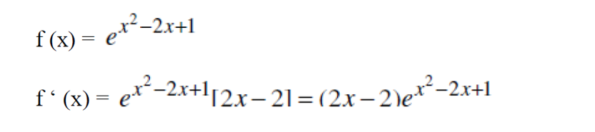
Extra Practice – Example 4
Lecture
05
Example
Differentiate the following functions:

Slide 24
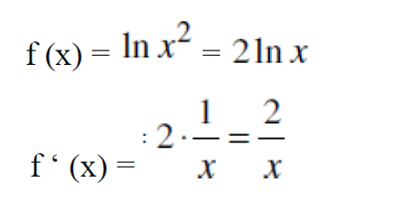
Extra Practice – Example 5
Lecture
05
Example

Slide 25
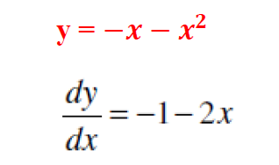
Extra Practice – Example 6
Lecture
05
Example

Slide 26
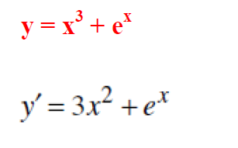
Extra Practice – Example 7
Lecture
05
Example

Slide 27
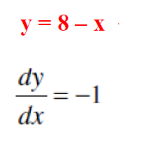
Extra Practice – Example 8
Lecture
05
Example

Slide 28
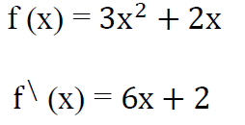
Extra Practice – Example 9
Lecture
05
Example

Slide 29
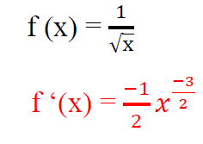
Extra Practice – Example 10
Lecture
05
Example

Slide 30
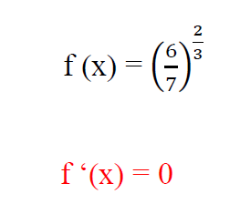
Extra Practice – Example 11
Lecture
05
Example

Slide 31
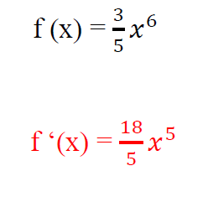
Extra Practice – Example 12
Lecture
05
Example

Slide 32
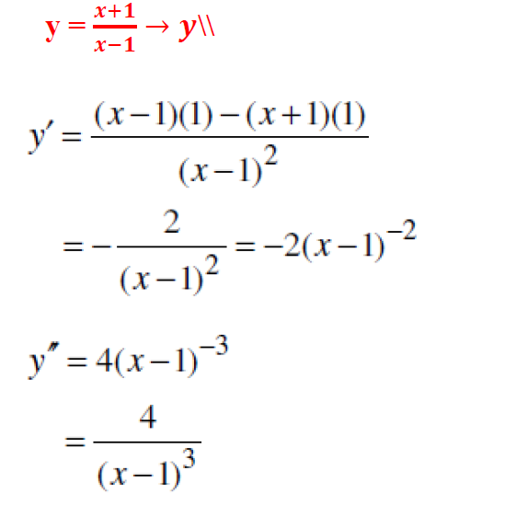
Extra Practice – Example 13
Lecture
05
Example

Slide 33
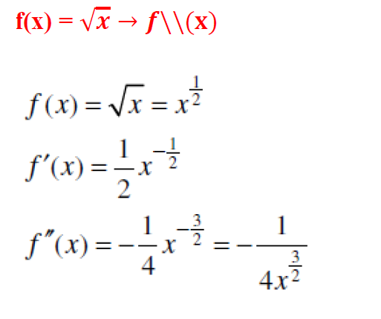
Extra Practice – Example 14
Lecture
05
Example

Slide 34
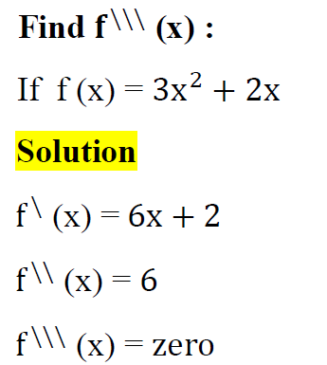
Extra Practice – Example 15
Lecture
05
Example

Slide 35
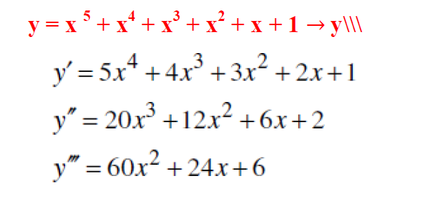
Extra Practice – Example 16
Lecture
05
Example

Slide 36
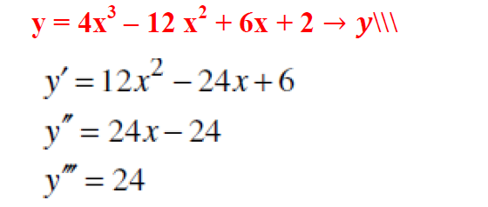
Extra Practice – Example 17
Lecture
05
Example

Slide 37
Lecture Summary
Lecture
05
Lecture Summary

