Slide 1

Risk Management
Prepared by Dr. Dalia Hosni
Lecture4
MGM 510
Risk Management

Slide 2

Lecture 4
Commonly Used Risk Management Examples
Risk Avoidance
Customer Credit Risk Management
Industry-Specific Strategy
Elimination of Contract Risk
Compliance Risks
Market Risk
Safety Risks
Information Security Risk
Risk Transfer

Slide 3
Lecture 3
Lecture 4
Commonly Used Risk Management Examples
Risk Avoidance
The best way to explain risk avoidance would be to take the example of an investor trying to manage his/her risk in the company that they invested in. If the company they have invested in is going through losses and decide to sell their investment (stock) in the company, they can exclude it from their list of investments, it is considered risk avoidance.

Slide 4
Lecture 4
Commonly Used Risk Management Examples
Customer Credit Risk Management
When it comes to the retail industry, there is always a risk because of the external factors involved. One such external factor is customer credit, which can really impact the profits of the company. If companies conduct a customer credit risk analysis and find that things are not going so well, they can manage their risk. This can be done by stopping the extensions on invoices to the customers the company views as high risk so that it can eliminate further risk.

Slide 5
Lecture 4
Lecture 4
Commonly Used Risk Management Examples
Industry-Specific Strategy
Take the manufacturing industry as an example. One organization wants to manufacture a new product. Before they can start production for the same, they have to conduct a thorough risk analysis to understand the level of risk the company can face. Then they can decide if the benefits of manufacturing the new product can outweigh the risks that come with it or not.

Slide 6
Lecture 4
Commonly Used Risk Management Examples
Elimination of Contract Risk
When investors make investments overseas, there can be external risks to the company. The foreign exchange rates can fall, which can lead to losses, which is considered to be a big threat to the investor. To deal with this risk, the investor can make the contracts in USD and keep themselves safe.

Slide 7
Lecture 4
Commonly Used Risk Management Examples
Compliance Risks
Maintaining regulatory compliance is a really important aspect of any institution, which can, in turn, become a huge risk. Companies need to ensure they have controls in place to monitor their organizations’ compliance on a regular basis. They need to monitor all their existing processes, procedures, and technologies and stay compliant. This can be effectively done with a risk management system.

Slide 8
Lecture 4
Commonly Used Risk Management Examples
Safety Risks
There can be a risk to the safety of the operations within the company. This needs to be analyzed and taken care of regularly as well. All maintenance processes need to be audited regularly to check for latent human error in the processes. This can also be handled very efficiently if companies implement a risk management system.

Slide 9
Lecture 4
Commonly Used Risk Management Examples
Information Security Risk
This is a part of cybersecurity. Any business’s data is one of its most valuable assets, and it needs to be protected. There are different ways in which data can be stolen, and data theft is a major risk to any organization. One of the many ways to combat this risk is to have controls in place for all incoming communications such as emails. They need to be scanned to make sure no suspicious ones are coming to the company, and even if they are, they are taken care of immediately.

Slide 10
Lecture 4
Commonly Used Risk Management Examples
Market Risk
Market risk is a common risk among nearly all industries. There is no guarantee that the product or service a company provides is going to be priced at the same value in the future. A lot of companies manage this risk by getting into early and long-term contracts with various investors so that their future is secured to some extent, regardless of the market conditions.

Slide 11
Lecture 4
Commonly Used Risk Management Examples
Risk Transfer
When companies aren’t well versed in all aspects of their risk, but they would still like to mitigate it, they transfer the risk. For example, a retail brand may not be fully equipped to manage all cybersecurity risks to the company, but the threat still exists. To manage it more efficiently, they can outsource all their information technology capabilities to a third party, holding them accountable, and thereby transferring their risk.

Slide 12
Lecture 4
Commonly Used Risk Management Examples
Risk management is a complex process because there are hundreds of different types of risks that companies need to be aware of. Many training and certification programs will impart knowledge for enterprise teams, which will help companies successfully mitigate risks and help the organization improve all its processes and generate more revenue.

Slide 13
Lecture 4
Project Risk Topics
Plan Risk Management
Identify Risks
Perform Qualitative Risk Analysis
Perform Quantitative Risk Analysis
Plan Risk Responses
Monitor and Control Risks

Slide 14
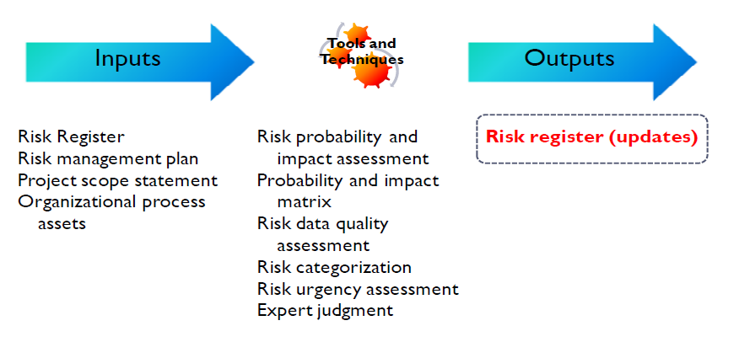
Lecture 4
Perform Qualitative Risk Analysis
The only output to the qualitative risk analysis process is updates to the risk register.
To perform these updates, we use a battery of tools and techniques to help us perform qualitative risk analysis.

Slide 15
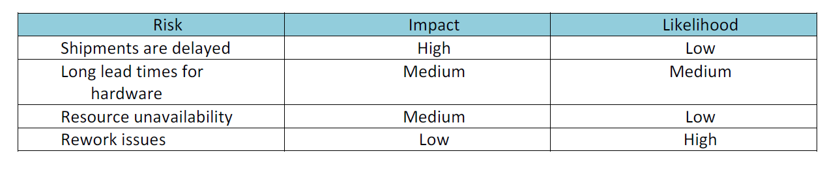
Lecture 4
Perform Qualitative Risk Analysis
Qualitative Risk Assessment Matrix
The qualitative risk assessment matrix offers a summary level of the potential impact of the risk, based on approximate percentages. Notice that this matrix shows general percentages that are not tied to specific dollar amounts or timelines. Another way of showing a qualitative impact is to rank the probabilities as high, medium or low:

Slide 16
Lecture 4
Perform Qualitative Risk Analysis
Risk Register Updates
Partial List of Risk Register Updates:
Ranking and prioritization of project risks
Grouping risks by categories
Risks requiring near-term response
Risks requiring additional analysis and response
Low priority risks to monitor
Look for trends in results – regression analysis or trend charts

Slide 17
Lecture 4
Perform Qualitative Risk Analysis
Risk Register Updates
Risk register updates will generally include the outcome of risk assessments, risk audits, and periodic risk reviews. This can include identification of new risk events or updates to risk probability, risk impact, risk priority and risk response plans
An important use of the risk register is to view the actual outcomes of the project risks and risk responses against anticipated risks. This data can help project managers plan for risk as the project moves forward

Slide 18

Lecture 4
Perform Qualitative Risk Analysis
Risk Register Updates
Risk Register updates are an output of Perform Qualitative Risk Analysis, Perform Quantitative Risk Analysis, Plan Risk Responses and Monitor & Control Risks.

Slide 19
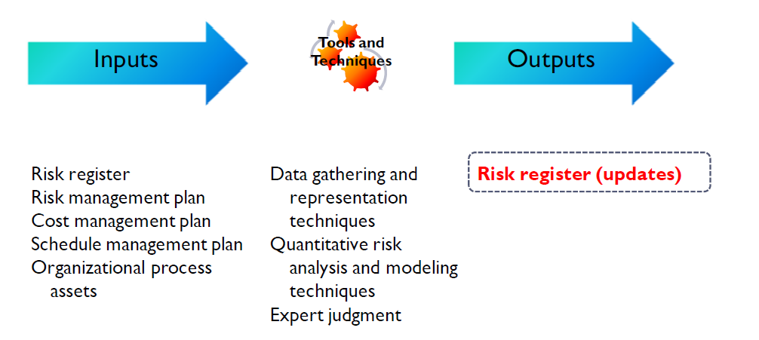
Lecture 4
Perform Quantitative Risk Analysis

Slide 20
Lecture 4
Perform Quantitative Risk Analysis
Quantitative risk analysis involves the numerical quantification and measurement of the effects of identified risks on the project. It frequently involves the use of sophisticated mathematical modeling techniques to create forecasts and trend analysis.

Slide 21
Lecture 4
Perform Quantitative Risk Analysis
One of the more common analysis and
modeling techniques is the sensitivity
analysis, which is used to identify the
risks with the largest potential impact
on the project. The tornado diagram is
frequently used to display the
sensitivity analysis. The example
shown is from the US Department of
Transportation

Slide 22
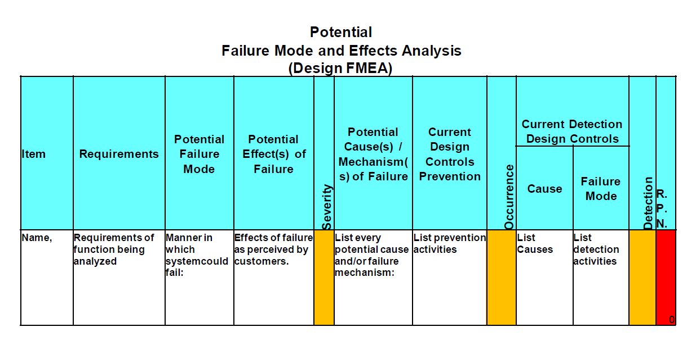
Lecture 4
قابلية الكشف
Perform Quantitative Risk Analysis
Failure Modes Effects Analysis (FMEA)
احتمالية الحدوث
شدة الخطر

Slide 23
Lecture 4
Perform Quantitative Risk Analysis
FMEA: Failure Modes Effects Analysis. The FMEA is useful for manufactured product or where risk may be undetectable:
Utilizes three measures: 1) Severity, 2) Occurrence, 3) Detectability to produce the Risk Priority Number (RPN) : The higher the RPN, the greater the risk

Slide 24
Lecture 4
Perform Quantitative Risk Analysis
A key aspect of the failure modes and effects analysis, or FMEA, is that it uses three measures to determine the Risk Priority Number:
Severity
Probability
Detectability
Severity of the risk - represented on a numeric scale from 1 to 10, 1 representing no effect, to 10 representing a high hazard (unsafe without warning)
Probability of occurrence – 1 representing the current probability of less than .0007%, to 10 representing a probability of 20% (almost continuous failure) or greater
Probability of occurrence – 1 representing the current probability of less than .0007%, to 10 representing a probability of 20% (almost continuous failure) or greater
Detectability of the risk – 1 representing a risk that is highly detectable, to 10 representing a risk that is completely undetectable (failure without warning
Detectability of the risk – 1 representing a risk that is highly detectable, to 10 representing a risk that is completely undetectable (failure without warning
Notes
The three numbers are multiplied together to produce the RPN (Risk Priority Number)

Slide 25


Lecture 4
Perform Quantitative Risk Analysis
The three numbers are multiplied together to produce the RPN (Risk Priority Number)
This risk register type is particularly effective for manufactured products or for software products in which the software controls mechanical devices that could potentially cause serious injury or loss of life if the software (and therefore the device itself) were to fail.

Slide 26
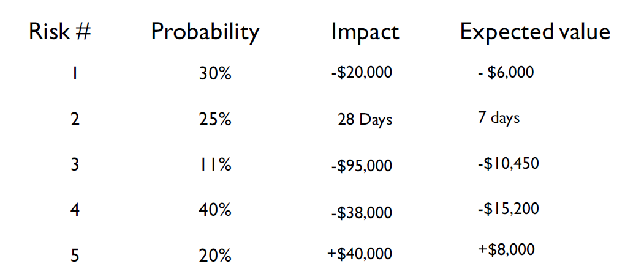
Lecture 4
Perform Quantitative Risk Analysis
Expected Value/ Expected Monetary Value
Expected value or Expected Monetary Value (EMV) is computed by multiplying the probability of an event by its impact. Examples appear below:
المخاطره
الاحتمال
التأثير
القيمة المتوقعة

Slide 27
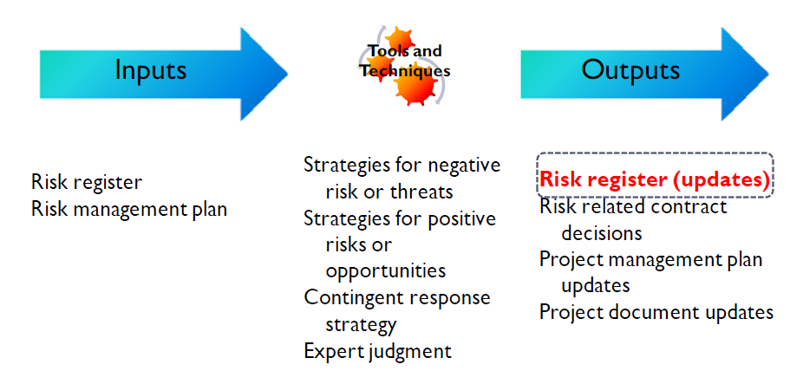
Lecture 4
Plan Risk Responses
سجل المخاطر
خطة إدارة المخاطر

Slide 28
Lecture 4
Plan Risk Responses
After risks are identified and evaluated from a qualitative and quantitative perspective, we can plan our responses to risk, and either to enhance opportunities, or reduce threats for the project.

Slide 29
Lecture 4
Plan Risk Responses
There are a number of risk response strategies that can be employed on a project, however, all of the responses fall into the following basic categories:
Implementing actions to prevent the risk from occurring
Implementing actions in response to a risk occurrence
Implementing actions to mitigate or reduce the risk occurrence
Implementing actions to promote opportunities
Implementing fallback or contingent responses, in the event risk response plans do not work

Slide 30

Lecture 4
Plan Risk Responses
Examples of Risk Strategies – Negative Risks
Avoid Elimination of the potential threat. For example, you are dealing with a
vendor and there is the threat of a potential major strike. Your avoidance strategy would be to switch vendors to an organization that does not have unions at all.

Slide 31

Lecture 4
Plan Risk Responses
Transfer----- This involves shifting some or all of the negative impact of a threat, along with the ownership of the response, to a third party. Examples include purchasing insurance, performance bonds, warranties, or other forms of guarantee.

Slide 32

Lecture 4
Plan Risk Responses
Mitigate______ – this involves a reduction in the probability or impact of the risk. Designing fault tolerance into a system is a risk mitigation strategy. Instead of shouldering the full cost of the development of a new high risk product, you find three or four partners who can share the expense of development. In case of failure, your exposure to loss has been cut by 75-80%

Slide 33

Lecture 4
Plan Risk Responses
Accept – Acceptance means that you cannot eliminate, transfer, or mitigate a threat, and there is no other suitable response strategy. You can actively or passively accept the threat:
        Passive acceptance means you take no action and deal with the risk if it occurs
        Active acceptance commonly means you have set aside contingency reserves to deal with any potential risks

Slide 34
Lecture 4
Plan Risk Responses
Examples of Risk Strategies – Positive Risks
Exploit------is used when the organization wants to ensure an opportunity is realized. Saving funds by using existing equipment or facilities is an exploit strategy

Slide 35
Lecture 4
Plan Risk Responses
Examples of Risk Strategies – Positive Risks
Exploit------is used when the organization wants to ensure an opportunity is realized. Saving funds by using existing equipment or facilities is an exploit strategy

Slide 36

Lecture 4
Plan Risk Responses
Examples of Risk Strategies – Positive Risks
Share_____ occurs when the organization transfers ownership of the opportunity, in part or altogether to a third party to ensure the opportunity occurs. Engaging a sub-contractor with specialized skill sets not available in your organization can help you capture an opportunity that may have been out of reach otherwise.

Slide 37

Lecture 4
Plan Risk Responses
Examples of Risk Strategies – Positive Risks
Enhance___ – used to increase the impact or probability of an opportunity. Ending a project early by using highly experienced resources, or utilizing specific schedule compression echniques, is an enhancement opportunity.

Slide 38

Lecture 4
Plan Risk Responses
Examples of Risk Strategies – Positive Risks
Accept – willing to take advantage of an opportunity without actively pursuing it.

