Slide 1



Project Leadership
PMG 511
Lecture 3
Ch3 - Understanding Leadership
Prepared by
Dr Hakem Sharari
www.midocean.ae

Slide 2
Learning Outcomes
The leader’s title.
Leadership styles: describe 7 basic leadership styles.
Who we lead: define 'stakeholder' in the context of a project effort.
Matching leadership with culture: define ‘culture’ in the context of a project, team, and organization.
Summary and conclusions.
Self assessment.

Slide 3

The Leader’s Title
Leader can have many titles, he can be a manager, supervisor, boss, CEO, Expert, Foreman, Monitor.
Understand that title isn't synonymous with the need or authority to engage in leadership.
It is a sit of words that supposed all correlated to actual duties of jobs.
The actual title can affect perceptions.

Slide 4
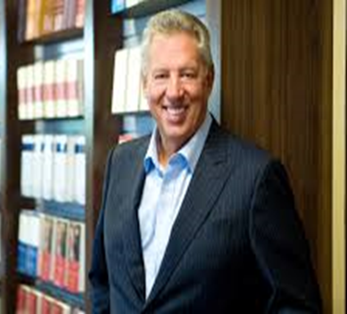
“Leadership is not about titles, positions or flowcharts. It is about one life influencing another.” - John C. Maxwell

Slide 5
Team Leadership
The idea of team leadership is broken down into its digestible components:
Leadership styles.
Leadership theories.
Influences.
Motivators.
Influences on organizational team performance.
Culture.
Understanding of who is being led.

Slide 6
Early Studies of Leadership
Researchers began studying leadership in the early part of the twentieth century and focused on:
The person - leader trait theories.
The behaviors - how the leader interacted with his or her group members (behavior theories).
Early leadership theories focused on what qualities distinguished between leaders and followers, while subsequent theories looked at other variables such as situational factors and skill level.

Slide 7
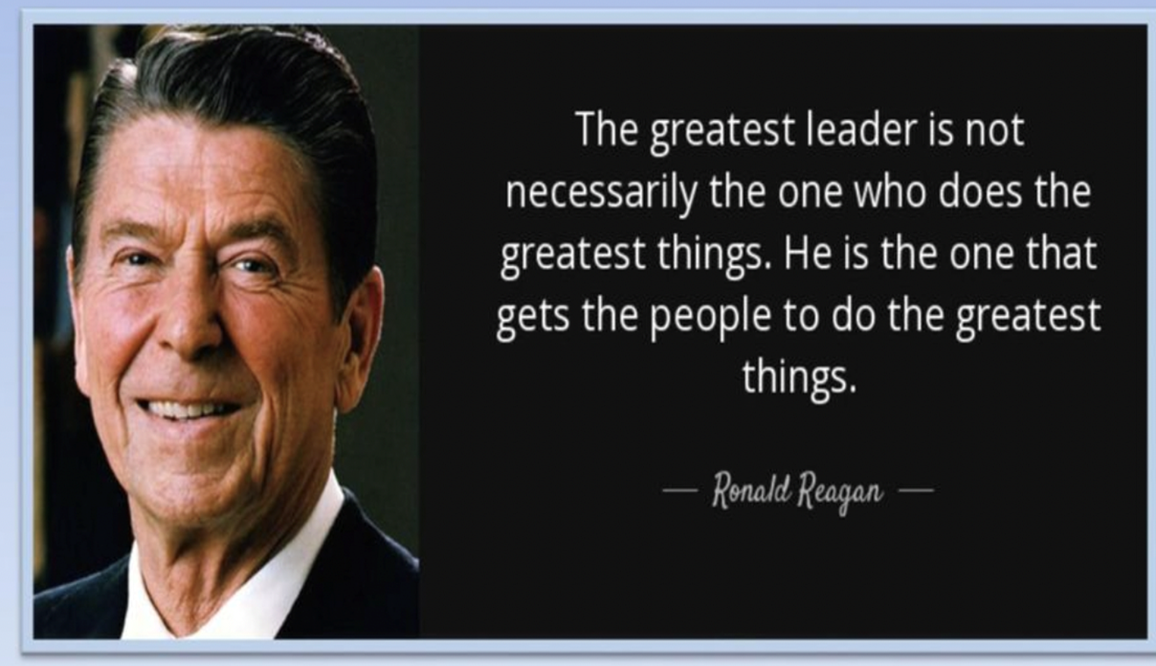

Slide 8
Leadership Styles
People as a leader adopt different styles.
Leadership style should be chosen based on the team’s features, what they are trying to achieve.
Leaders have a ‘default’ style they prefer:
This may not be appropriate for their team.
Stress or circumstances can cause leaders to choose or revert to the wrong style.
There are (7 main styles covered here).

Slide 9

Affiliative Leadership Style
In the affiliative leadership style, people come first.
This leadership style is one of 7 styles of Emotional leadership and promotes positivity, a harmonious workplace and team-building.
It focuses on conflict resolution and creating personal connections between employees and their managers to build a sense of community and trust.

Slide 10
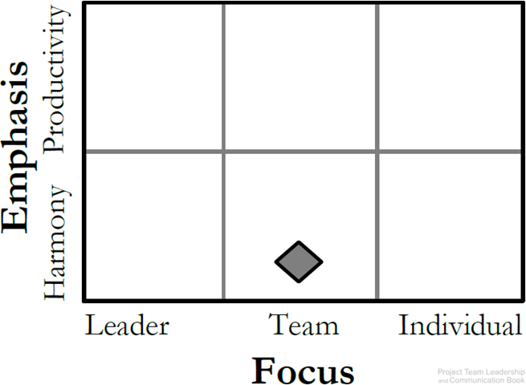
Affiliative Leadership Style
The type of leadership a manager chooses to affect the emotional, mental and physical health of his team. Whether this effect is positive or negative.
Affiliative leadership is one of many styles of leadership that positively impacts employees.
It is Good for teams in need of a morale boost (team need to repair).

Slide 11

Affiliative Leadership Style
Pros:
This style Emphasizes connection, harmony, and conflict resolution.
It is Good for teams in need of a morale boost (team need to repair).
Creates effective teams.
It Increase employee morale.
It Builds employee trust.
It Provides guidance during crises.
It Resolves conflicts more efficiently.
It Reduces workplace stress.

Slide 12

Affiliative Leadership Style
Cons:
Can be abused. (too much Affiliative Style can become the disease-to-please).
Stuff may not receive enough advice.
Allow under-performers to go unchecked.
Ineffective when faced with complex challenge.
“Affiliative is really about letting people get to know you, and you making an effort to get to know them.”

Slide 13
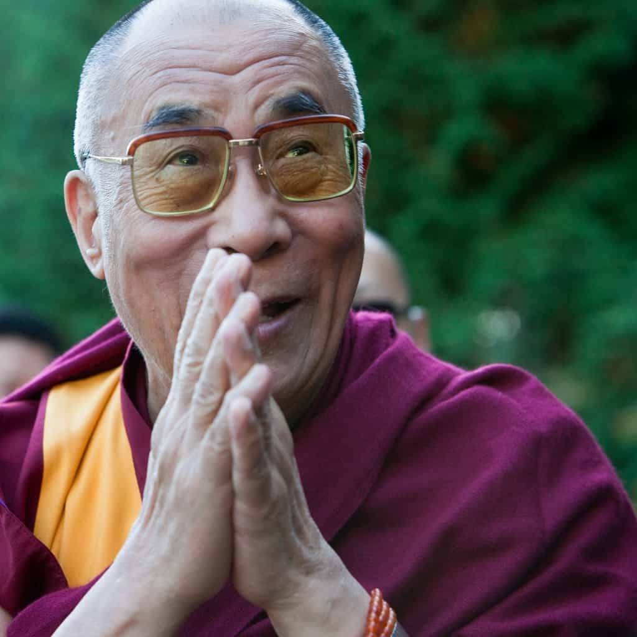
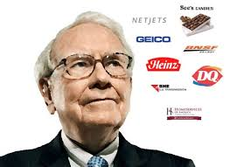
Dalai Lama
Warren Buffett

Slide 14

Authoritarian Leadership Style
Authoritarian /Commanding /The Boss/Autocratic Leadership Style.
It is centered on the boss. the leader holds all authority and responsibility.
The leader centralizing decision making, and limiting participation.
leaders make decisions on their own without consulting subordinates. They reach decisions, communicate them to subordinates and expect prompt implementation.
One of the famous examples for an authoritarian is of Napoleon Bonaparte and Hitler.

Slide 15
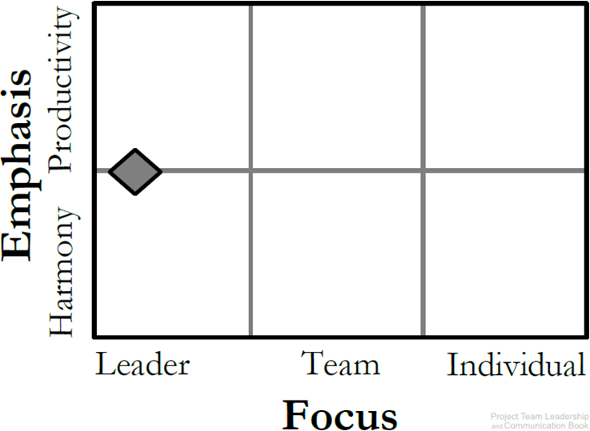
Authoritarian Leadership Style
Leaders like this can achieve results and productivity quickly.
Best applied to situations where there is little time for group decision-making or where the leader is the most knowledgeable member in the group.

Slide 16
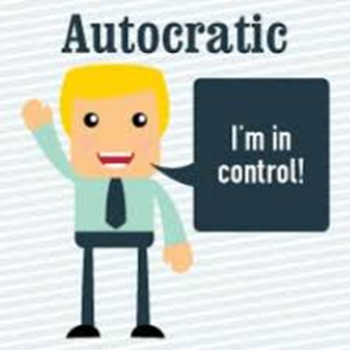
Authoritarian Leadership Style
Pros:
Leaders like this can achieve results quickly.
Quick decision-making.
Focused target.
Close supervision.
Maintain order and disciple.
Good for emergencies/crisis situations.

Slide 17
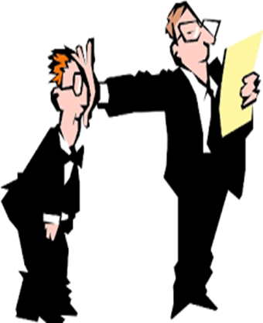
Authoritarian Leadership Style
Cons:
Classic’ leadership structure.
Strong, dominating leader(s).
Can cause poor morale if teams aren’t used to it.
High stress, members feel stressed due to high expectation.
Group doesn't pick up from innovativeness and information of individuals, so benefits of collaboration are lost.

Slide 18
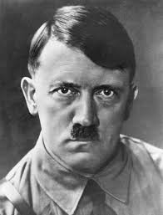

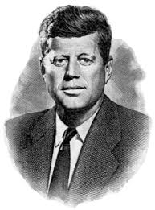
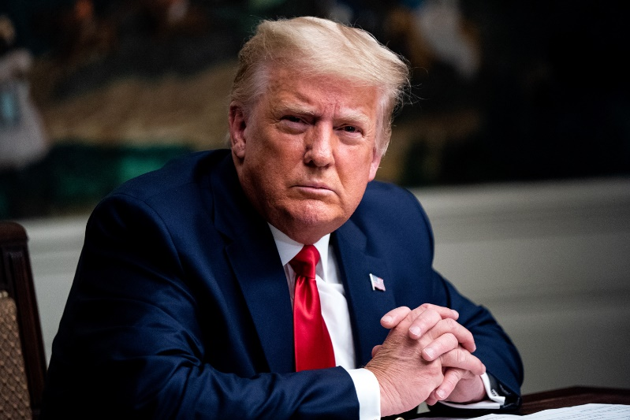

Slide 19
Coaching Leadership Style
Coaching leadership involves teaching and supervising followers.
A coaching leader is highly operational in setting where results/ performance require improvement.
Basically, in this kind of leadership, followers are helped to improve their skills.
Coaching leadership does the following: motivates followers, inspires followers and encourages followers.
A coaching leader is a great mentor is a pioneer who also has a remarkable ability to instruct and train.
They prep individuals to enhance both information and skills. (build the skills of others).

Slide 20
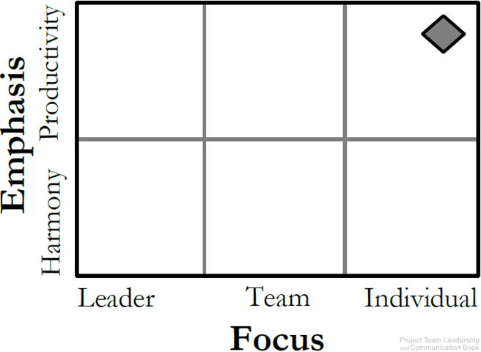
Coaching Leadership Style
About connecting the goals and productivity of the team/project with individuals.
Best for teams who have the desire to succeed and are motivated.

Slide 21

Coaching Leadership Style
Pros:
Leaders like this create very positive workplace.
Cons:
Results take time to achieve.
Work well if the leader has stuff already self motivated.

Slide 22

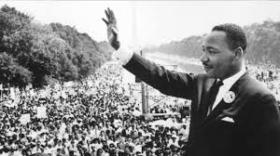

Slide 23

Democratic Leadership Style
In this leadership style, subordinates are involved in making decisions. Unlike autocratic.
This leadership is centered on subordinates’ contributions.
The democratic leader holds final responsibility, but he or she is known to delegate authority to other people, who determine work projects.
His style of authority depends on the group been counseled and their feelings being esteemed.

Slide 24
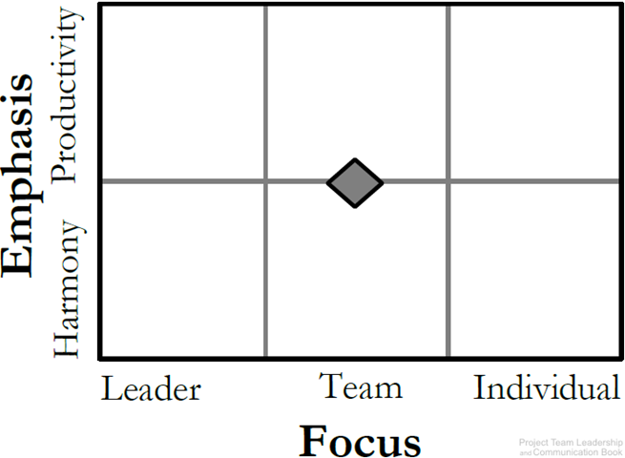
Democratic Leadership Style
Relies on the skills and knowledge of team members.
Group makes decisions collectively.

Slide 25

Democratic Leadership Style
Pros:
Higher quality work.
Allow follower to say any decision.
Create a well collaborative workplace.
Cons:
The leader depend on the followers level of knowledge.
Leader spend too much time listening.
Can be time consuming (Collaboration may take time.)
difficult for indecisive teams.

Slide 26
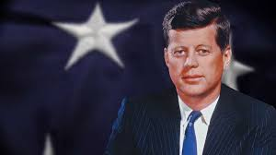
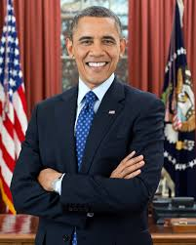
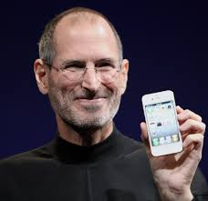
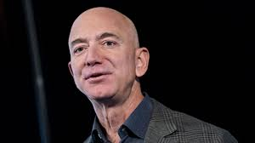

Slide 27

Laissez-faire Leadership Style
Laissez-faire leadership gives authority to employees (LEAVE IT BE).
Subordinates are allowed to work as they choose, with complete freedom to make decision. with minimal or no interference.
This kind of leadership has been always found to be the least satisfying and least effective management style.

Slide 28
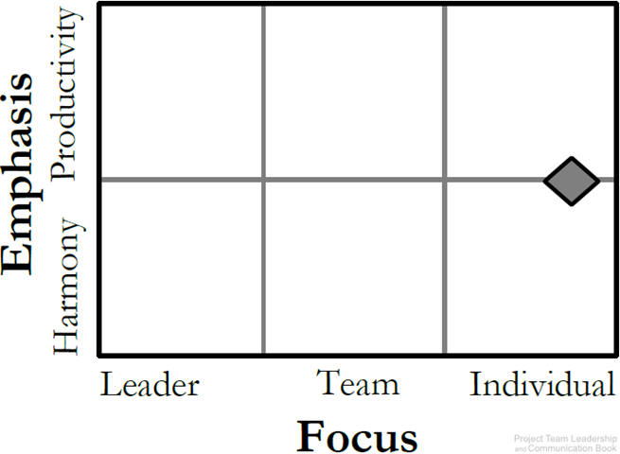
Laissez-faire Leadership Style
The ‘hands-off’ approach.
Management trusts the team members to make decisions and meaningful progress.
Leaders support rather than control.
style is frequently connected when the group is extremely fit, very much inspired and composed.

Slide 29

Laissez-faire Leadership Style
Pros:
Can promote creativity.
Easy management style to administer.
Complete empowerment for the followers.
Cons:
The leader plays the least role.
Requires self-motivated, hard-working, honest team members
Poor decision making may result.

Slide 30
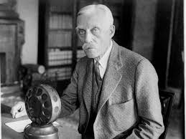
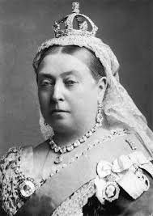
Warren Buffett
Andrew Mellon
Queen Victoria

Slide 31

Pacesetting Leadership Style
Pacesetting leadership is when the leader sets an example of high performance, high pace and high quality.
Team members are expected to follow suit, and the pacesetting leader values results more than anything.

Slide 32
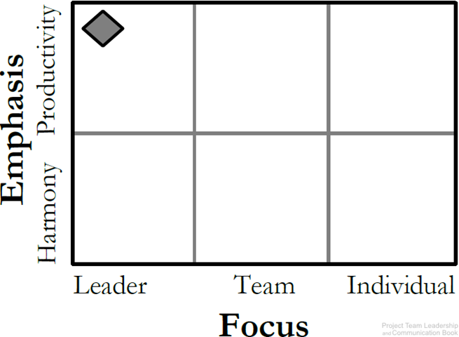
Pacesetting Leadership Style
This is ‘lead by example’ (do as I do, now).
Leader is highly focused on performance and expects the same of the team.
Works best with teams that already perform at a high level.
Role model, high standards.

Slide 33

Pacesetting Leadership Style
Pros:
This leadership style can be good to reach short term results.
Ability to achieve results quickly.
Outstanding performance of the team.
Cons:
Can be detrimental for employee engagement and motivation in the long run.
Team can be overwhelmed by the demand on them.
Team members can feel as they’ll never ‘measure up,’ lowering morale.

Slide 34
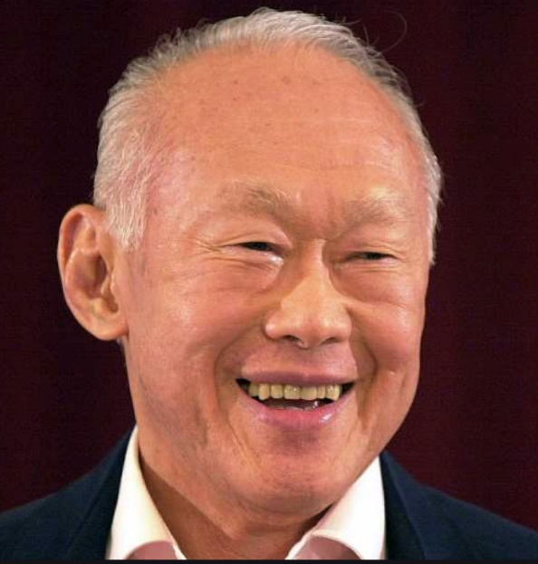
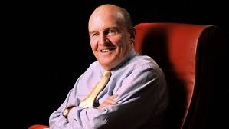
Jack Welch
Lee Kuan Yew

Slide 35

Transformational/Visionary Leadership Style
The transformational leadership style is one of the most implemented styles.
It has integrity, defines clear goals, encourages clear steps to communication and expressive.
This type of leader inspires their team to work together towards a common target.
Transformational leaders combine the best practices and are leaders who are trusted and can motivate others.

Slide 36

Transformational/Visionary Leadership Style
The transformational style requires a number of different skills, and its primary focus is to make change happen in our self, others, groups, and organizations.

Slide 37
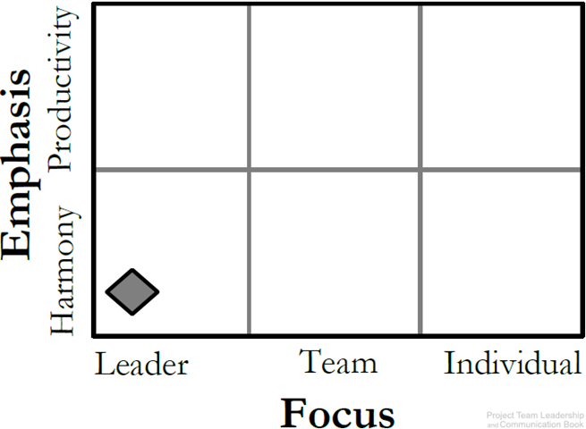
Transformational/Visionary Leadership Style
The leader focuses on setting a positive vision for the future.
Team members are infused with a sense of purpose and excitement.
leaders who stimulate and inspire (transform) followers to achieve extraordinary outcomes.

Slide 38
Organizational Values and Needs
Pros:
This style of leadership encourages, motivates and supports employees, often involves recognizing and rewarding people for their good work.
Enhance innovation.
Good for teams that have recently experienced failure.
Cons:
Can become unrealistic and overly optimistic.
Conflicts if other strong individual in the organization with competing vision.

Slide 39

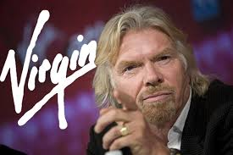
Richard Branson

Slide 40

Charismatic Leadership Style
In this leadership, the charismatic leader shows his or her revolutionary power.
Charisma does not mean sheer behavioral change. It actually involves a transformation of followers’ values and beliefs.

Slide 41
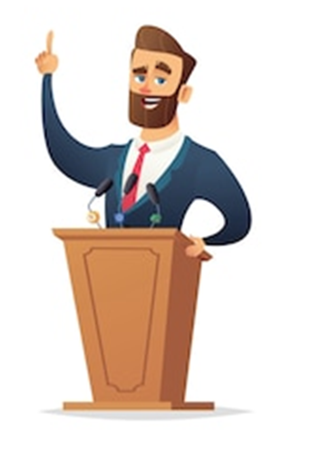
Charismatic Leadership Style
A charismatic leader is an enthusiastic, self-confident leader whose personality and actions influence people to behave in certain ways. The most comprehensive analysis of charismatic leaders identified the following personal characteristics they share:
They have a vision.
The have the ability to articulate that vision.
They are willing to take risks to achieve that vision.
They demonstrate behaviors that are out of the ordinary.

Slide 42

Charismatic Leadership Style
Pros:
Create a vision that make everyone believes that the future will be better.
Cons:
Too connected to the leader’s personality.
Leader can get out of control.

Slide 43
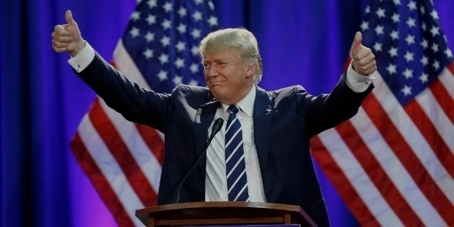



Slide 44

Who We Lead?

Slide 45
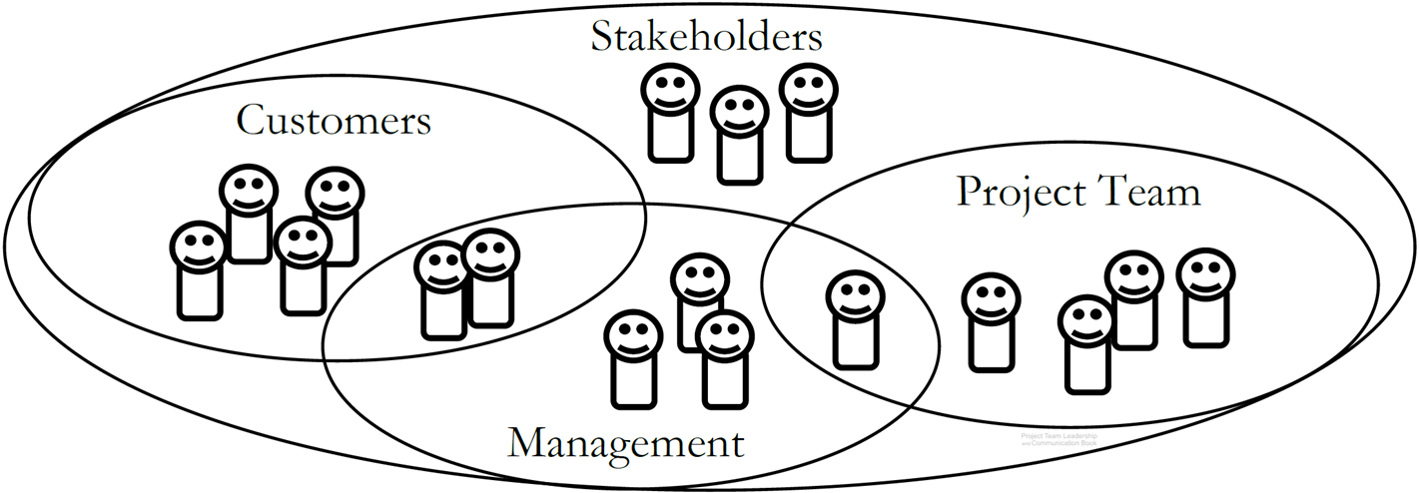
Stakeholders
Stakeholders are people who can affect or are affected by the execution or outcome of a project.

Slide 46

Matching Leadership with Culture

Slide 47
Organizational Culture
The set of behaviors or beliefs that determine how an organization or team interacts or carries out work.
Awareness of culture and different circumstances/attitudes is key.
Influenced by:
The industry, environment, customers, organizational practices.
Personalities, values, principles, etc. of the organization, leader, and team.
Influences:
Decision making, risk tolerance, decisiveness, orderliness, competitiveness .
Level of attention to detail, amount of process, emphasis on achievement.
Supportiveness, reward/punishment, team vs. individual contribution.

Slide 48
Summary and Conclusion
A leader’s title can be everything.
Leaders adopt different leadership styles.
Culture influences every aspect of the organization and team.
Stakeholders are key to any project effort, and comprise multiple groups.

Slide 49
Assignment
For each of the following situations, which leadership style or styles might be appropriate?
A team has recently suffered a rather demoralizing project failure.
A team considers themselves to be high-performance, and morale is at its highest when they’re achieving at that level.
A group of equals, the team loves the empowerment of making their own decisions.
A recent crisis and some disagreement within their ranks means has created a situation where someone needs to ‘take control’ in order to meet their objectives.

Slide 50
Thank You For Listening

Slide 51


Reference

