Slide 1




AWS Cloud Security Foundations– AWS-CSF
Dr. Ibrahim Gomaa
Lecture 4 – AWS foundational services – Storage and Database

Slide 2



Lecture
Course Outline
4
Lecture 4: AWS Foundational Services – Storage and Database
Topics
  Amazon Elastic Block Store (Amazon EBS)
  Amazon Simple Storage Service (Amazon S3)
  Amazon Elastic File System (Amazon EFS)
  Amazon Simple Storage Service Glacier
Amazon Relational Database Service (Amazon RDS)
Amazon DynamoDB
Amazon Redshift
Amazon Aurora
Activities
Storage solution case study
Database case studies
Demo
Amazon EBS console
Amazon RDS console
Lab
Working with Amazon EBS
Build Your DB Server and Interact with Your DB Using an App
Knowledge check
AWS Cloud Security Foundations– AWS-CSF
Lecture 4 – AWS Foundational Services – Storage and Database
Dr. Ibrahim Gomaa

Slide 3
Lecture
AWS Foundational Services – Storage and Database
4
Amazon Elastic Block Store (Amazon EBS)
AWS Cloud Security Foundations– AWS-CSF
Lecture 4 – AWS Foundational Services – Storage and Database
Dr. Ibrahim Gomaa

Slide 4

Lecture
Amazon Elastic Block Store
4
Amazon Elastic Block Store (Amazon EBS)
Amazon EBS (non-volatile storage) is:
persistent (retains data after power off), mountable storage that can be mounted as a device to an Amazon EC2 instance.
Amazon EBS can be mounted to an Amazon EC2 instance only within the same Availability Zone. Only one Amazon EC2 instance at a time can mount an Amazon EBS volume.
automatically replicated within its Availability Zone to protect you from component failure. (designed for high availability and durability, consistent and low-latency performance to run your workloads).
can scale your usage up or down within minutes, while paying a low price for only what you provision.
AWS Cloud Security Foundations– AWS-CSF
Lecture 4 – AWS Foundational Services – Storage and Database
Dr. Ibrahim Gomaa

Slide 5

Lecture
Amazon Elastic Block Store
4
AWS storage options: Block storage versus object storage
What if you want to change one character in a 1-GB file?
  Block storage
  Object storage
  Change one block (piece of the file)
  that contains the character
  Entire file must be updated
Block storage solutions are typically faster and use less bandwidth, but they can cost more than object-level storage.
AWS Cloud Security Foundations– AWS-CSF
Lecture 4 – AWS Foundational Services – Storage and Database
Dr. Ibrahim Gomaa

Slide 6
Lecture
Amazon Elastic Block Store
4
AWS storage options: Block storage versus object storage
What if you want to change one character in a 1-GB file?
  Block storage
  Object storage
  Change one block (piece of the file)
  that contains the character
  Entire file must be updated
Block storage solutions are typically faster and use less bandwidth, but they can cost more than object-level storage.
AWS Cloud Security Foundations– AWS-CSF
Lecture 4 – AWS Foundational Services – Storage and Database
Dr. Ibrahim Gomaa

Slide 7
Lecture
Amazon Elastic Block Store
4
  Amazon EBS enables you to create individual storage volumes and attach them to an Amazon EC2 instance:
  Amazon EBS offers block-level storage.
  Volumes are automatically replicated within its Availability Zone.
  It can be backed up automatically to Amazon S3 through snapshots (The first snapshot is called the baseline snapshot).
  Uses include –
    Boot volumes and storage for Amazon EC2 instances
    Data storage with a file system
    Database hosts
    Enterprise applications
AWS Cloud Security Foundations– AWS-CSF
Lecture 4 – AWS Foundational Services – Storage and Database
Dr. Ibrahim Gomaa

Slide 8
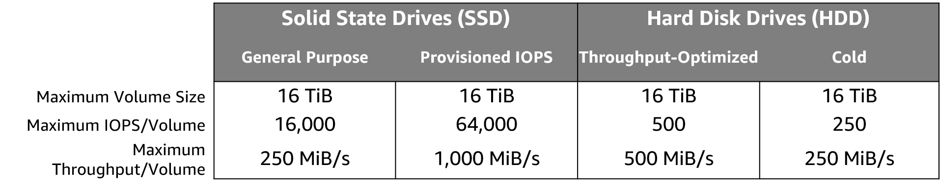
Lecture
Amazon Elastic Block Store
4
  Amazon EBS volume types
Matching the correct technology to your workload is a best practice for reducing storage costs.
Only SSDs can be used as boot volumes for EC2 instances.
The lower-cost options might be a solution for additional storage or use cases other than boot volumes.
AWS Cloud Security Foundations– AWS-CSF
Lecture 4 – AWS Foundational Services – Storage and Database
Dr. Ibrahim Gomaa

Slide 9



Lecture
Amazon Elastic Block Store
4
  Amazon EBS features
Snapshots –
  Point-in-time snapshots
  Recreate a new volume at any time
Encryption –
  Encrypted Amazon EBS volumes
  No additional cost
Elasticity –
  Increase capacity
  Change to different types
AWS Cloud Security Foundations– AWS-CSF
Lecture 4 – AWS Foundational Services – Storage and Database
Dr. Ibrahim Gomaa

Slide 10
Lecture
Amazon Elastic Block Store
4
  Amazon EBS features
Snapshots –
  Point-in-time snapshots
  Recreate a new volume at any time
Encryption –
  Encrypted Amazon EBS volumes
  No additional cost
Elasticity –
  Increase capacity
  Change to different types
AWS Cloud Security Foundations– AWS-CSF
Lecture 4 – AWS Foundational Services – Storage and Database
Dr. Ibrahim Gomaa

Slide 11
Lecture
AWS Foundational Services – Storage and Database
4
Amazon Simple Storage Service (Amazon S3)
AWS Cloud Security Foundations– AWS-CSF
Lecture 4 – AWS Foundational Services – Storage and Database
Dr. Ibrahim Gomaa

Slide 12

Lecture
4
Amazon Simple Storage Service
Amazon Simple Storage Service (Amazon S3)
Amazon S3 is:
persistent storage where each file becomes an object and is available through a Uniform Resource Locator (URL); it can be accessed from anywhere.
object-level storage, which means that if you want to change a part of a file, you must make the change and then re-upload the entire modified file.
stores data as objects within resources that are called buckets.
AWS Cloud Security Foundations– AWS-CSF
Lecture 4 – AWS Foundational Services – Storage and Database
Dr. Ibrahim Gomaa

Slide 13


Lecture
4
Amazon Simple Storage Service
Amazon S3 overview
Data is stored as objects in buckets
Bucket names are universal and must be unique across all existing bucket names in Amazon S3
Virtually unlimited storage
  Single object is limited to 5 TB
Designed for 11 9s of durability
Granular access to bucket and objects
AWS Cloud Security Foundations– AWS-CSF
Lecture 4 – AWS Foundational Services – Storage and Database
Dr. Ibrahim Gomaa

Slide 14
Lecture
4
Amazon Simple Storage Service
Amazon S3 storage classes
  Amazon S3 offers a range of object-level storage classes that are designed for different use cases:
    Amazon S3 Standard (high durability, availability, performance, low latency and high throughput, use cases: cloud applications, dynamic websites, content distribution, mobile and gaming applications, and big data analytics)
    Amazon S3 Intelligent-Tiering (optimize costs by automatically moving data to the most cost-effective access tier, without performance impact or operational overhead. Ex: objects that have not been accessed for 30 consecutive days to the infrequent access tier)
    Amazon S3 Standard-Infrequent Access (Amazon S3 Standard-IA) (low cost and high performance makes Amazon S3 Standard-IA good for long-term storage and backups, and as a data store for disaster recovery files)
    Amazon S3 One Zone-Infrequent Access (Amazon S3 One Zone-IA) (Unlike other Amazon S3 storage classes, which store data in a minimum of three AZ, it stores data in a single AZ and it costs less than Amazon S3 Standard-IA. Use cases storing secondary backup copies of on-premises and cost-effective storage for data that is replicated from another AWS Region by using Amazon S3 Cross-Region Replication.)
    Amazon S3 Glacier (secure, durable, and low-cost storage class for data archiving. costs are competitive with—or cheaper than—on-premises solutions. To keep costs low yet suitable for varying needs, Amazon S3 Glacier provides three retrieval options that range from a few minutes to hours)
    Amazon S3 Glacier Deep Archive (the lowest-cost storage class for Amazon S3. It supports long-term retention and digital preservation for data that might be accessed once or twice in a year. All objects that are stored in Amazon S3 Glacier Deep Archive are replicated and stored across at least three geographically dispersed Availability Zones, and these objects can be restored within 12 hours)
AWS Cloud Security Foundations– AWS-CSF
Lecture 4 – AWS Foundational Services – Storage and Database
Dr. Ibrahim Gomaa

Slide 15


Lecture
4
Amazon Simple Storage Service
Amazon S3 bucket URLs (two styles)
  To upload your data:
  Create a bucket in an AWS Region.
  Upload almost any number of objects to the bucket.
Amazon S3
Bucket path-style URL endpoint:
https://s3.ap-northeast-1.amazonaws.com/bucket-name
[bucket name]
Region code
Bucket name
Bucket virtual hosted-style URL endpoint:
https:// bucket-name.s3-ap-northeast-1.amazonaws.com
Preview2.mp4
Tokyo Region (ap-northeast-1)
Bucket name
Region code
AWS Cloud Security Foundations– AWS-CSF
Lecture 4 – AWS Foundational Services – Storage and Database
Dr. Ibrahim Gomaa

Slide 16

Lecture
4
Amazon Simple Storage Service
Common use cases
Storing application assets
Static web hosting
Backup and disaster recovery (DR)
Staging area for big data
Many more….
AWS Cloud Security Foundations– AWS-CSF
Lecture 4 – AWS Foundational Services – Storage and Database
Dr. Ibrahim Gomaa

Slide 17





Lecture
4
Amazon Simple Storage Service
Amazon S3 common scenarios
Backup and storage
Application hosting
Media hosting
Software delivery
Amazon S3 buckets
Amazon EC2
instances
AWS Cloud Security Foundations– AWS-CSF
Lecture 4 – AWS Foundational Services – Storage and Database
Dr. Ibrahim Gomaa

Slide 18
Lecture
4
Amazon Simple Storage Service
Amazon S3 pricing
Pay only for what you use, including –
  GBs per month
  Transfer OUT to other Regions
  PUT, COPY, POST, LIST, and GET requests
You do not pay for –
  Transfers IN to Amazon S3
  Transfers OUT from Amazon S3 to Amazon CloudFront or Amazon EC2 in the same Region
AWS Cloud Security Foundations– AWS-CSF
Lecture 4 – AWS Foundational Services – Storage and Database
Dr. Ibrahim Gomaa

Slide 19
Lecture
4
Amazon Simple Storage Service
Amazon S3: Storage pricing
To estimate Amazon S3 costs, consider the following:
Storage class type –
  Standard storage is designed for:
    11 9s of durability
    Four 9s of availability
  S3 Standard-Infrequent Access (S-IA) is designed for:
    11 9s of durability
    Three 9s of availability
Amount of storage –
  The number and size of objects
AWS Cloud Security Foundations– AWS-CSF
Lecture 4 – AWS Foundational Services – Storage and Database
Dr. Ibrahim Gomaa

Slide 20
Lecture
4
Amazon Simple Storage Service
Amazon S3: Storage pricing
Requests –
  The number and type of requests (GET, PUT, COPY)
  Type of requests:
    Different rates for GET requests than other requests.
Data transfer –
  Pricing is based on the amount of data that is transferred out of the Amazon S3 Region
    Data transfer in is free, but you incur charges for data that is transferred out.
AWS Cloud Security Foundations– AWS-CSF
Lecture 4 – AWS Foundational Services – Storage and Database
Dr. Ibrahim Gomaa

Slide 21
Lecture
AWS Foundational Services – Storage and Database
4
Amazon Elastic File System (Amazon EFS)
AWS Cloud Security Foundations– AWS-CSF
Lecture 4 – AWS Foundational Services – Storage and Database
Dr. Ibrahim Gomaa

Slide 22

Lecture
4
Amazon Simple Storage Service
Amazon Elastic File System (Amazon EFS)
Amazon EFS is
a shared file system that multiple Amazon EC2 instances can mount at the same time.
simple, scalable, elastic file storage for use with AWS services and on-premises resources.
dynamically scale on demand without disrupting applications—it will grow and shrink automatically as you add and remove files.
  It is designed so that your applications have the storage they need, when they need it.
AWS Cloud Security Foundations– AWS-CSF
Lecture 4 – AWS Foundational Services – Storage and Database
Dr. Ibrahim Gomaa

Slide 23
Lecture
4
Amazon Simple Storage Service
Amazon EFS features
File storage in the AWS Cloud
Works well for big data and analytics, media processing workflows, content management, web serving, and home directories
Petabyte-scale, low-latency file system
Shared storage
Elastic capacity
Supports Network File System (NFS) versions 4.0 and 4.1 (NFSv4)
Compatible with all Linux-based AMIs for Amazon EC2
AWS Cloud Security Foundations– AWS-CSF
Lecture 4 – AWS Foundational Services – Storage and Database
Dr. Ibrahim Gomaa

Slide 24


Lecture
4
Amazon Simple Storage Service
Amazon EFS architecture
VPC
Availability Zone A
Availability Zone B
Availability Zone C
Private subnet
Private subnet
Private subnet
Network Interface
Network Interface
Network Interface
Private subnet
Network Interface
Network Interface
Network Interface
Mount target
Mount target
Mount target
Elastic File System
AWS Cloud Security Foundations– AWS-CSF
Lecture 4 – AWS Foundational Services – Storage and Database
Dr. Ibrahim Gomaa

Slide 25
Lecture
AWS Foundational Services – Storage and Database
4
Amazon S3 Glacier
AWS Cloud Security Foundations– AWS-CSF
Lecture 4 – AWS Foundational Services – Storage and Database
Dr. Ibrahim Gomaa

Slide 26

Lecture
4
Amazon S3 Glacier
Amazon S3 Glacier
Amazon S3 Glacier is:
for cold storage for data that is not accessed frequently
for example,
(when you need long-term data storage for archival or compliance reasons).
AWS Cloud Security Foundations– AWS-CSF
Lecture 4 – AWS Foundational Services – Storage and Database
Dr. Ibrahim Gomaa

Slide 27
Lecture
4
Amazon S3 Glacier
Amazon S3 Glacier review
Amazon S3 Glacier is a data archiving service that is designed for security, durability, and an extremely low cost.
  Amazon S3 Glacier is designed to provide 11 9s of durability for objects.
Three key Amazon S3 Glacier terms:
Archive: Any object such as a photo, video, file, or document that you store in Amazon S3 Glacier. It is the base unit of storage in Amazon S3 Glacier. Each archive has its own unique ID and can also have a description.
Vault: A container for storing archives. When you create a vault, you specify the vault name and the region in which you would like to locate the vault.
Vault Access Policy: Determine who can and cannot access the data stored in the vault and what operations users can and cannot perform. One vault access policy can be created for each vault to manage access permissions for that vault. You can also use a vault lock policy to make sure a vault cannot be altered. Each vault can have one vault access policy and one vault lock policy that is attached to it.
  The Vault Lock feature enforces compliance through a policy.
AWS Cloud Security Foundations– AWS-CSF
Lecture 4 – AWS Foundational Services – Storage and Database
Dr. Ibrahim Gomaa

Slide 28


Lecture
4
Amazon S3 Glacier
Extremely low-cost design works well for long-term archiving.
Provides three options for access to archives— expedited, standard, and bulk —retrieval times range from a few minutes to several hours.
Storage service for low-cost data archiving and long-term backup
You can configure lifecycle archiving of Amazon S3 content to Amazon S3 Glacier
Retrieval options –
  Standard: 3–5 hours
  Bulk: 5–12 hours
  Expedited: 1–5 minutes
Archive after 30 days
Delete after 5 years
Amazon S3 bucket
Amazon S3 Glacier Archive
AWS Cloud Security Foundations– AWS-CSF
Lecture 4 – AWS Foundational Services – Storage and Database
Dr. Ibrahim Gomaa

Slide 29






Lecture
4
Amazon S3 Glacier
Amazon S3 Glacier use cases
Media asset archiving
Healthcare information archiving
Regulatory and compliance archiving
Scientific data archiving
Digital preservation
Magnetic tape replacement
AWS Cloud Security Foundations– AWS-CSF
Lecture 4 – AWS Foundational Services – Storage and Database
Dr. Ibrahim Gomaa

Slide 30


Lecture
4
Amazon S3 Glacier
Lifecycle policies
Amazon S3 lifecycle policies enable you to delete or move objects based on age.
Amazon S3 Standard
Amazon S3 Standard - Infrequent Access
Amazon
S3 Glacier
Delete
30 days
60 days
365 days
Preview2.mp4
Preview2.mp4
Preview2.mp4
AWS Cloud Security Foundations– AWS-CSF
Lecture 4 – AWS Foundational Services – Storage and Database
Dr. Ibrahim Gomaa

Slide 31
Lecture
4
Amazon S3 Glacier
Storage comparison
 | Amazon S3 | Amazon S3 Glacier
Data Volume | No limit | No limit
Average Latency | ms | minutes/hours
Item Size | 5 TB maximum | 40 TB maximum
Cost/GB per Month | Higher cost | Lower cost
Billed Requests | PUT, COPY, POST, LIST, and GET | UPLOAD and retrieval
Retrieval Pricing | ¢ Per request | ¢¢ Per request and per GB
AWS Cloud Security Foundations– AWS-CSF
Lecture 4 – AWS Foundational Services – Storage and Database
Dr. Ibrahim Gomaa

Slide 32

Lecture
4
Amazon S3 Glacier
Security with Amazon S3 Glacier
Control access with IAM
Amazon S3 Glacier encrypts your data with AES-256
Amazon S3 Glacier
Amazon S3 Glacier manages your keys for you
AWS Cloud Security Foundations– AWS-CSF
Lecture 4 – AWS Foundational Services – Storage and Database
Dr. Ibrahim Gomaa

Slide 33
Lecture
AWS Foundational Services – Storage and Database
4
Amazon Relational Database Service
AWS Cloud Security Foundations– AWS-CSF
Lecture 4 – AWS Foundational Services – Storage and Database
Dr. Ibrahim Gomaa

Slide 34

Lecture
4
Amazon Relational Database Service
Amazon RDS is a fully managed relational database service that creates and operates a relational database in the cloud
Amazon Relational Database Service
(Amazon RDS)
AWS Cloud Security Foundations– AWS-CSF
Lecture 4 – AWS Foundational Services – Storage and Database
Dr. Ibrahim Gomaa

Slide 35



Lecture
4
Amazon Relational Database Service
Unmanaged versus managed services
Unmanaged:
Managed:
Scaling, fault tolerance, and availability are managed by you.
Scaling, fault tolerance, and availability are typically built in to the service.
AWS Cloud Security Foundations– AWS-CSF
Lecture 4 – AWS Foundational Services – Storage and Database
Dr. Ibrahim Gomaa

Slide 36
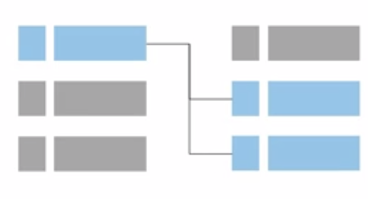
Lecture
4
Amazon Relational Database Service
Challenges of relational databases
When you run your own relational database, you are responsible for:
Server maintenance and energy footprint
Software installation and patches
Database backups and high availability
Limits on scalability
Data security
Operating system (OS) installation and patches
AWS Cloud Security Foundations– AWS-CSF
Lecture 4 – AWS Foundational Services – Storage and Database
Dr. Ibrahim Gomaa

Slide 37

Lecture
4
Amazon Relational Database Service
From on-premises databases to Amazon RDS
Database in Amazon Elastic Compute Cloud (Amazon EC2)
Database in Amazon RDS or Amazon Aurora
On-premises database
Application optimization
Scaling
High Availability
Database backups
Database software patches
Database software installs
Operation system patches
Operating system install
Server maintenance
Rack and stack servers
Power, HVAC, network
Application optimization
Scaling
High Availability
Database backups
Database software patches
Database software installs
Operation system patches
Operating system install
Server maintenance
Rack and stack servers
Power, HVAC, network
Application optimization
Scaling
High Availability
Database backups
Database software patches
Database software installs
Operation system patches
Operating system install
Server maintenance
Rack and stack servers
Power, HVAC, network
AWS
provides
AWS
provides
AWS Cloud Security Foundations– AWS-CSF
Lecture 4 – AWS Foundational Services – Storage and Database
Dr. Ibrahim Gomaa

Slide 38

Lecture
4
Amazon Relational Database Service
Managed services responsibilities
You manage:
Application optimization
AWS manages:
OS installation and patches
Database software installation and patches
Database backups
High availability
Scaling
Power and racking and stacking servers
Server maintenance
Amazon RDS
AWS Cloud Security Foundations– AWS-CSF
Lecture 4 – AWS Foundational Services – Storage and Database
Dr. Ibrahim Gomaa

Slide 39





Lecture
4
Amazon Relational Database Service
Amazon RDS read replicas
AWS Cloud
Features
Offers asynchronous replication
Can be promoted to primary if needed
can be created in a different Region than the primary database. (DR or reduce latency)
Functionality
Use for read-heavy database workloads
Offload read queries
Availability Zone
VPC
Public subnet
Amazon EC2
Application
Private subnet
P
R
Amazon RDS
primary instance
Read replica
instance
AWS Cloud Security Foundations– AWS-CSF
Lecture 4 – AWS Foundational Services – Storage and Database
Dr. Ibrahim Gomaa

Slide 40
Lecture
4
Amazon Relational Database Service
When to Use Amazon RDS
Use Amazon RDS when your application requires:
Do not use Amazon RDS when your application requires:
Complex transactions or complex queries
A medium to high query or write rate – Up to 30,000 IOPS (15,000 reads + 15,000 writes)
No more than a single worker node or shard
High durability
Massive read/write rates (for example, 150,000 write/second)
Sharding due to high data size or throughput demands
Simple GET or PUT requests and queries that a NoSQL database can handle
Relational database management system (RDBMS) customization
AWS Cloud Security Foundations– AWS-CSF
Lecture 4 – AWS Foundational Services – Storage and Database
Dr. Ibrahim Gomaa

Slide 41
Lecture
4
Amazon Relational Database Service
When to Use Amazon RDS
Use Amazon RDS when your application requires:
Do not use Amazon RDS when your application requires:
Complex transactions or complex queries
A medium to high query or write rate – Up to 30,000 IOPS (15,000 reads + 15,000 writes)
No more than a single worker node or shard
High durability
Massive read/write rates (for example, 150,000 write/second)
Sharding due to high data size or throughput demands
Simple GET or PUT requests and queries that a NoSQL database can handle
Relational database management system (RDBMS) customization
AWS Cloud Security Foundations– AWS-CSF
Lecture 4 – AWS Foundational Services – Storage and Database
Dr. Ibrahim Gomaa

Slide 42
Lecture
AWS Foundational Services – Storage and Database
4
Amazon DynamoDB
AWS Cloud Security Foundations– AWS-CSF
Lecture 4 – AWS Foundational Services – Storage and Database
Dr. Ibrahim Gomaa

Slide 43

Lecture
4
Amazon Relational Database Service
What is Amazon DynamoDB?
Fast and flexible NoSQL database service for any scale
NoSQL database tables
Virtually unlimited storage
Items can have differing attributes
Low-latency queries
Scalable read/write throughput
Amazon DynamoDB
AWS Cloud Security Foundations– AWS-CSF
Lecture 4 – AWS Foundational Services – Storage and Database
Dr. Ibrahim Gomaa

Slide 44
Lecture
4
Amazon Relational Database Service
Relational versus non-relational databases
 | Relational (SQL) | Non-Relational
Data Storage | Rows and columns | Key-value, document, graph
Schemas | Fixed | Dynamic
Querying | Uses SQL | Focuses on collection of documents
Scalability | Vertical | Horizontal
Example
ISBN | Title | Author | Format
3111111223439 | Withering Depths | Jackson, Mateo | Paperback
3122222223439 | Wily Willy | Wang, Xiulan | Ebook
{
ISBN: 3111111223439,
Title: “Withering Depths”,
Author: ”Jackson, Mateo”,
Format: “Paperback”
}
AWS Cloud Security Foundations– AWS-CSF
Lecture 4 – AWS Foundational Services – Storage and Database
Dr. Ibrahim Gomaa

Slide 45
Lecture
4
Amazon Relational Database Service
Amazon DynamoDB core components
Tables, items, and attributes are the core DynamoDB components
  A table is a collection of data.
  Items are a group of attributes that is uniquely identifiable among all the other items.
  Attributes are a fundamental data element, something that does not need to be broken down any further.
DynamoDB supports two different kinds of primary keys:
  The partition key is a simple primary key, which is composed of one attribute called the sort key.
  The partition key and sort key are also known as the composite primary key, which is composed of two attributes.
AWS Cloud Security Foundations– AWS-CSF
Lecture 4 – AWS Foundational Services – Storage and Database
Dr. Ibrahim Gomaa

Slide 46
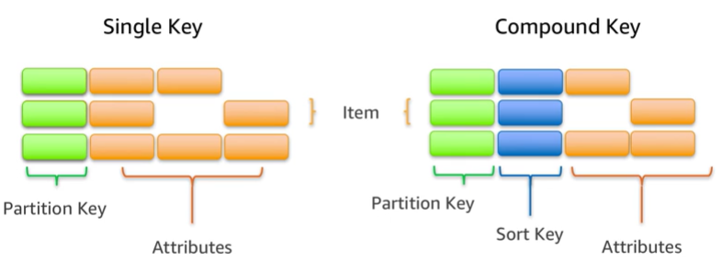
Lecture
4
Amazon Relational Database Service
Items in a table must have a key
AWS Cloud Security Foundations– AWS-CSF
Lecture 4 – AWS Foundational Services – Storage and Database
Dr. Ibrahim Gomaa

Slide 47
Lecture
AWS Foundational Services – Storage and Database
4
Amazon Redshift
AWS Cloud Security Foundations– AWS-CSF
Lecture 4 – AWS Foundational Services – Storage and Database
Dr. Ibrahim Gomaa

Slide 48

Lecture
4
Amazon Redshift
Amazon Redshift is a fast, fully managed data warehouse that makes it simple and cost-effective to analyze all your data by using standard SQL and your existing business intelligence (BI) tools
Amazon Redshift
AWS Cloud Security Foundations– AWS-CSF
Lecture 4 – AWS Foundational Services – Storage and Database
Dr. Ibrahim Gomaa

Slide 49
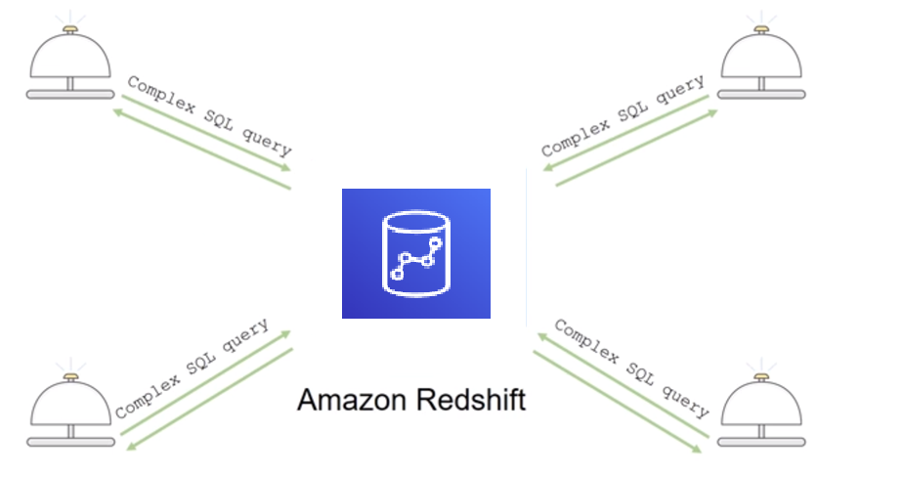
Lecture
4
Amazon Redshift
Introduction to Amazon Redshift
Amazon Redshift is a fast and powerful, fully managed data warehouse that is simple and cost-effective to set up, use, and scale.
It enables you to run complex analytic queries against petabytes of structured data
Most results come back in seconds
AWS Cloud Security Foundations– AWS-CSF
Lecture 4 – AWS Foundational Services – Storage and Database
Dr. Ibrahim Gomaa

Slide 50


Lecture
4
Amazon Redshift
Parallel processing architecture
The leader node manages communications with client programs and all communication with compute nodes.
The leader node compiles code for individual elements of the plan and assigns the code to individual compute nodes. The compute nodes run the compiled code and send intermediate results back to the leader node for final aggregation.
SQL Clients/BI tools
Amazon Redshift
Leader node
Dense compute
node
Dense compute nodes
Virtual Core
RAM
Local disk
Amazon DynamoDB
Amazon S3
AWS Cloud Security Foundations– AWS-CSF
Lecture 4 – AWS Foundational Services – Storage and Database
Dr. Ibrahim Gomaa

Slide 51
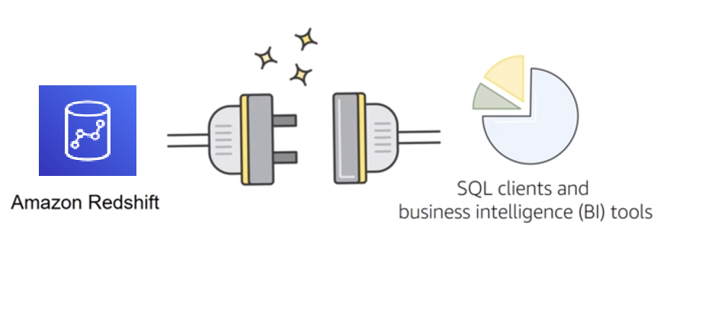
Lecture
4
Amazon Redshift
Compatibility
Amazon Redshift supports standard SQL.
It also provides high-performance Java Database Connectivity (JDBC) and Open Database Connectivity (ODBC) connectors, which enable you to use the SQL clients and BI tools of your choice
AWS Cloud Security Foundations– AWS-CSF
Lecture 4 – AWS Foundational Services – Storage and Database
Dr. Ibrahim Gomaa

Slide 52

Lecture
4
Amazon Redshift
Amazon Redshift use cases
  Enterprise data warehouse (EDW)
    Migrate at a pace that customers are comfortable with
    Experiment without large upfront cost or commitment
    Respond faster to business needs
  Big data
    Low price point for small customers
    Managed service for ease of deployment and maintenance
    Focus more on data and less on database management
AWS Cloud Security Foundations– AWS-CSF
Lecture 4 – AWS Foundational Services – Storage and Database
Dr. Ibrahim Gomaa

Slide 53
Lecture
AWS Foundational Services – Storage and Database
4
Amazon Aurora
AWS Cloud Security Foundations– AWS-CSF
Lecture 4 – AWS Foundational Services – Storage and Database
Dr. Ibrahim Gomaa

Slide 54

Lecture
4
Amazon Aurora
Enterprise-class relational database
Compatible with MySQL or PostgreSQL
Automate time-consuming tasks (such as provisioning, patching, backup, recovery, failure detection, and repair).
Amazon Aurora
AWS Cloud Security Foundations– AWS-CSF
Lecture 4 – AWS Foundational Services – Storage and Database
Dr. Ibrahim Gomaa

Slide 55
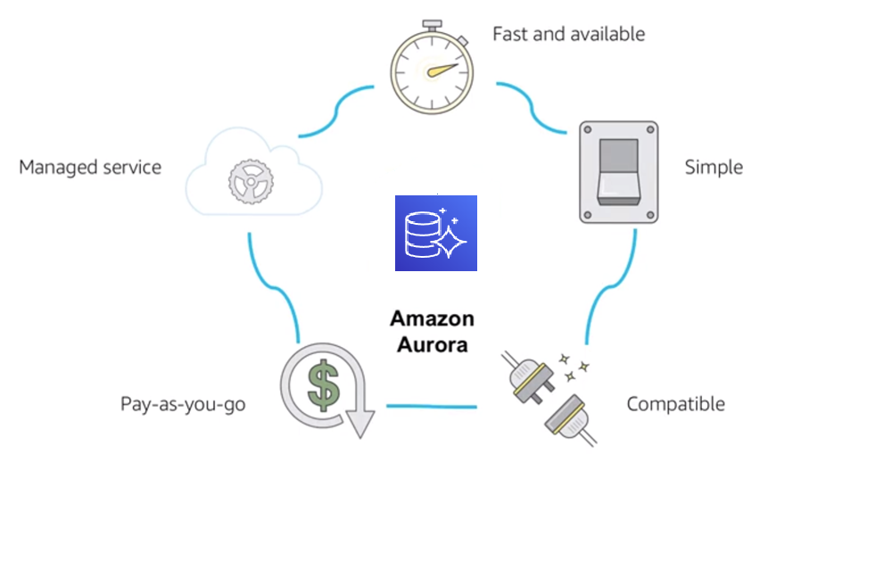
Lecture
4
Amazon Aurora
Amazon Aurora service benefits
AWS Cloud Security Foundations– AWS-CSF
Lecture 4 – AWS Foundational Services – Storage and Database
Dr. Ibrahim Gomaa

Slide 56
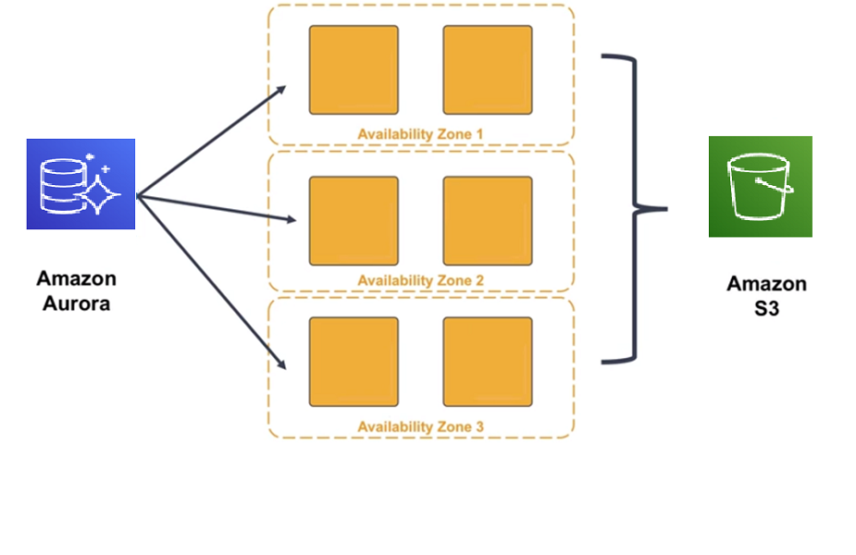
Lecture
4
Amazon Aurora
High availability
Amazon Aurora is designed to be highly available:
It stores multiple copies of your data across multiple Availability Zones with continuous backups to Amazon S3.
It can use up to 15 read replicas can be used
to reduce the possibility of losing your data.
It is designed for instant crash recovery if your
primary database becomes unhealthy.
AWS Cloud Security Foundations– AWS-CSF
Lecture 4 – AWS Foundational Services – Storage and Database
Dr. Ibrahim Gomaa

Slide 57
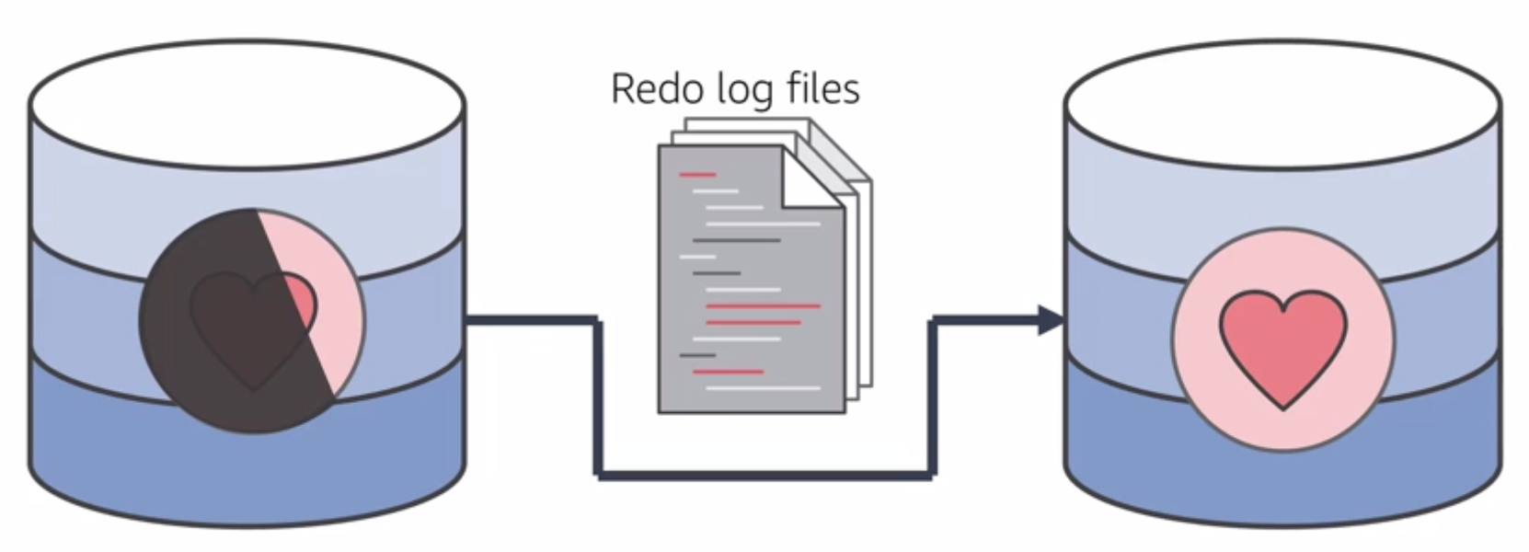
Lecture
4
Amazon Aurora
Resilient design
After a database crash, Amazon Aurora does not need to replay the redo log from the last database checkpoint. Instead, it performs this on every read operation. This reduces the restart time after a database crash to less than 60 seconds in most cases.
AWS Cloud Security Foundations– AWS-CSF
Lecture 4 – AWS Foundational Services – Storage and Database
Dr. Ibrahim Gomaa

Slide 58
Lecture
4
Amazon Aurora
The right tool for the right job
What are my requirements?
Enterprise-class relational database | Amazon RDS
Fast and flexible NoSQL database service for any scale | Amazon DynamoDB
Operating system access or application features that are not supported by AWS database services | Databases on Amazon EC2
Specific case-driven requirements (machine learning, data warehouse, graphs) | AWS purpose-built database services
AWS Cloud Security Foundations– AWS-CSF
Lecture 4 – AWS Foundational Services – Storage and Database
Dr. Ibrahim Gomaa

Slide 59


Lecture
AWS Foundational Services – Storage and Database
4
Storage case study activity
A collaboration software company processes email for enterprise customers. They have more than 250 enterprise customers and more than half a million users. They must store petabytes of data for their customers. The following diagram illustrates their architecture.
Elastic Load Balancing
Corporate data center
Storage ??
Amazon EC2 instances
AWS Cloud Security Foundations– AWS-CSF
Lecture 4 – AWS Foundational Services – Storage and Database
Dr. Ibrahim Gomaa

Slide 60





Lecture
AWS Foundational Services – Storage and Database
4
Database case study activity
An online payment processing company that processes over1 million transactions per day. They must provide services to ecommerce customers who offer flash sales (sales that offer greatly reduced prices for a limited time), where demand can increase by 30 times in a short time period. They use IAM and AWS KMS to authenticate transactions with financial institutions. They need high throughput for these peak loads. The following diagram illustrates their architecture.
AWS Cloud
Database
???
AWS Identity and Access Management (IAM)
Elastic Load Balancing
Internet
Banks
AWS SDK
AWS Key Management Service (AWS KMS)
Amazon EC2 instances
Read replicas
AWS Cloud Security Foundations– AWS-CSF
Lecture 4 – AWS Foundational Services – Storage and Database
Dr. Ibrahim Gomaa

Slide 61
Lecture
AWS Foundational Services – Storage and Database
4
Thanks
AWS Cloud Security Foundations– AWS-CSF
Lecture 4 – AWS Foundational Services – Storage and Database
Dr. Ibrahim Gomaa

