Slide 1


Slide 2


Slide 3

Dynamic Programming

Slide 4

The objectives of this lecture is to:

Slide 5
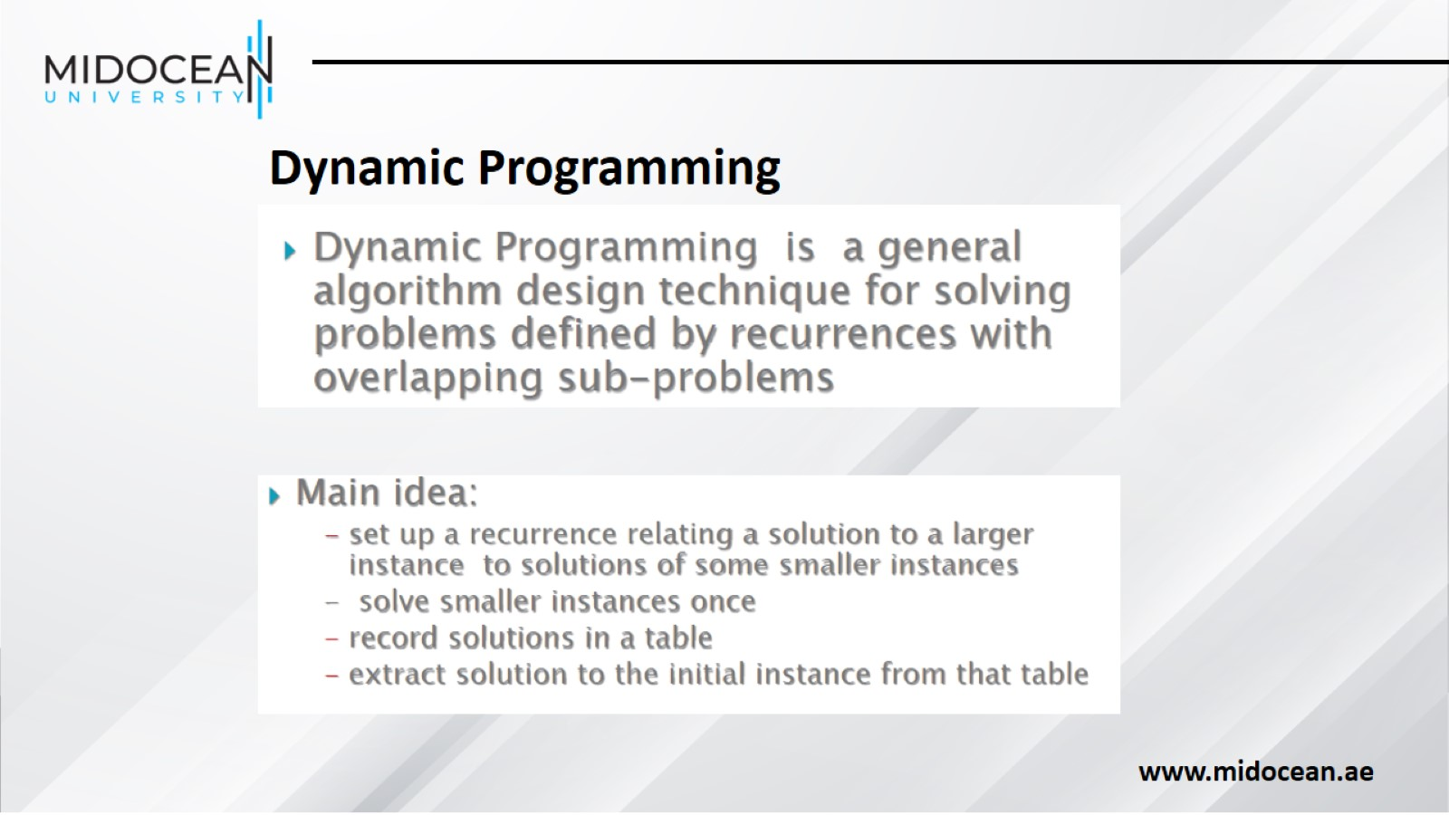

Slide 6
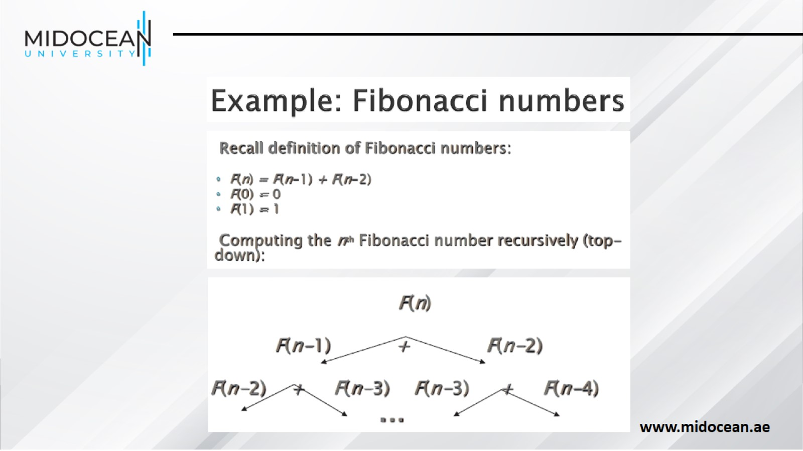

Slide 7
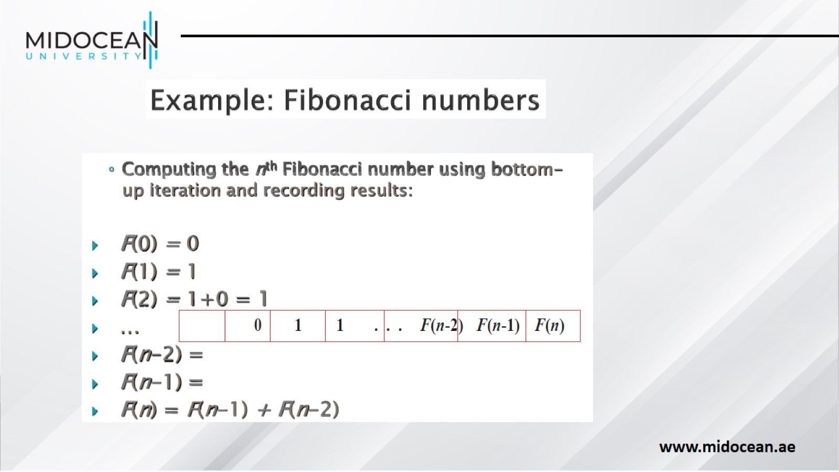

Slide 8
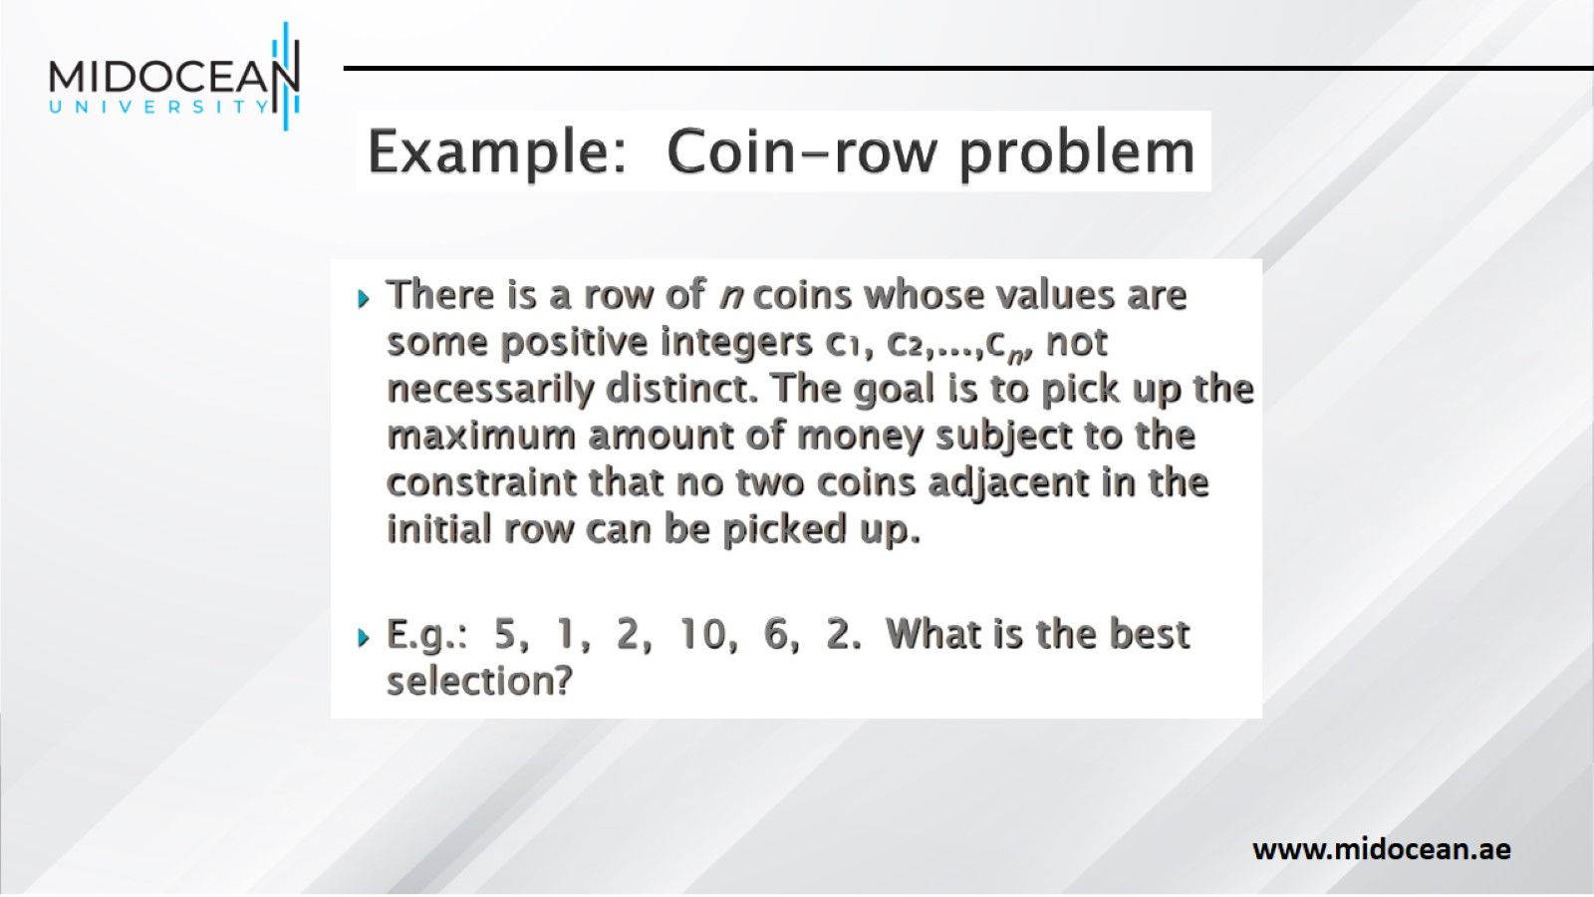

Slide 9
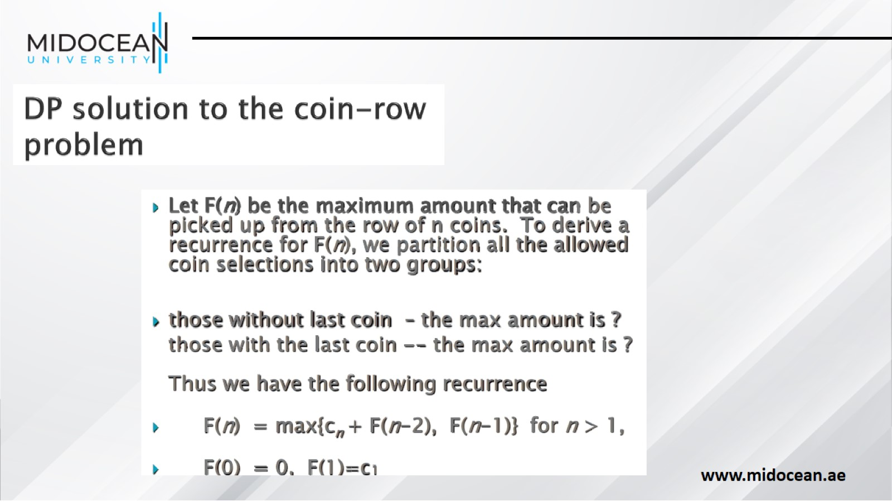

Slide 10
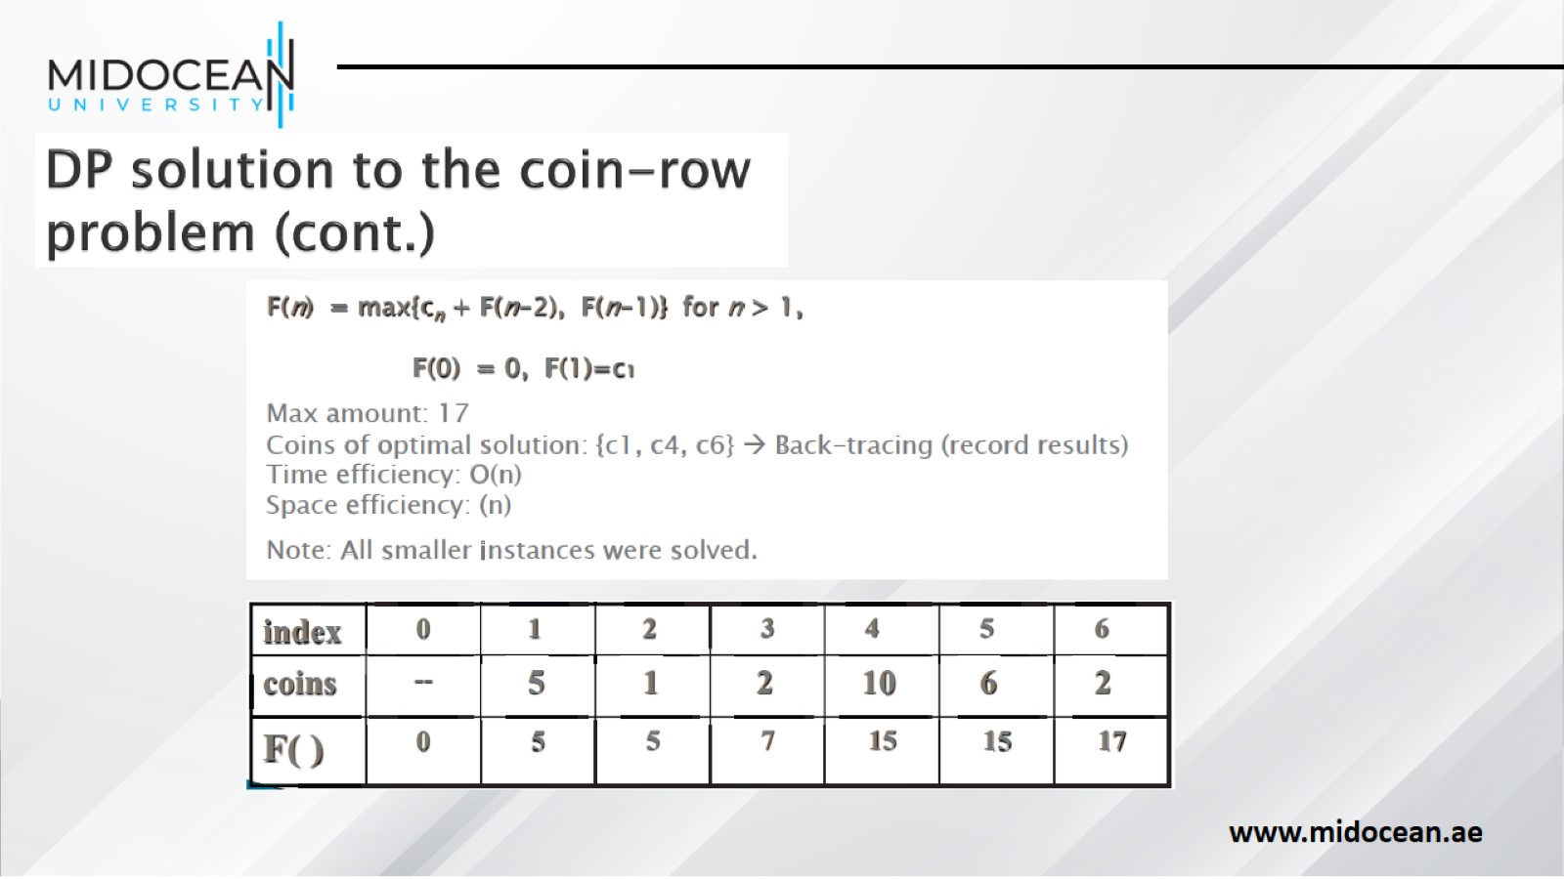

Slide 11
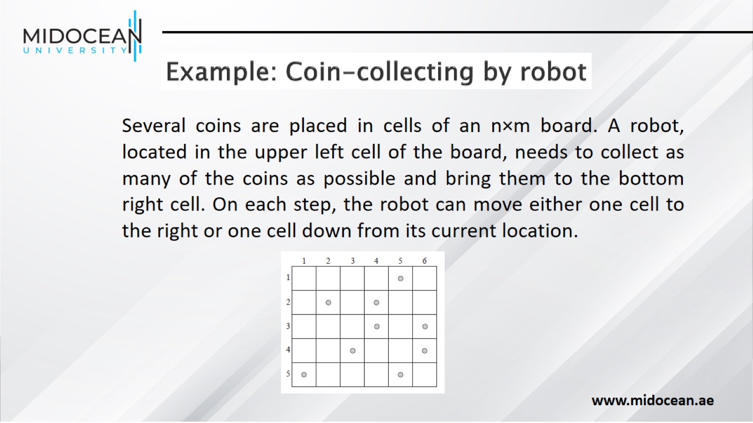

Slide 12
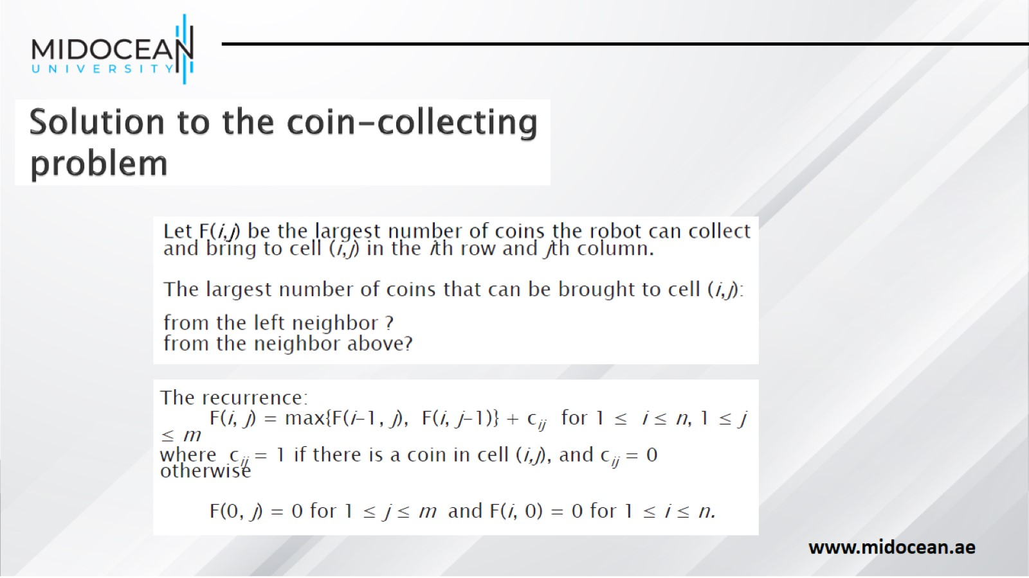

Slide 13
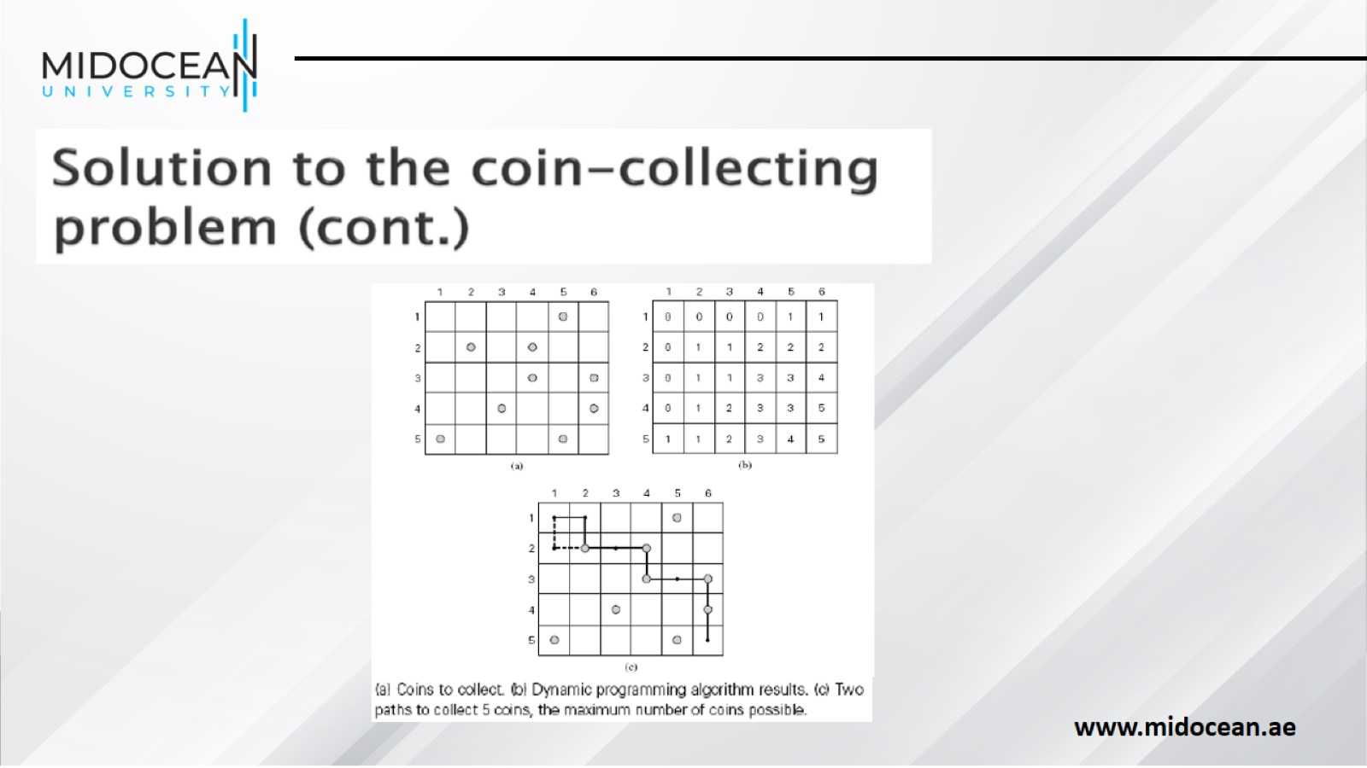

Slide 14
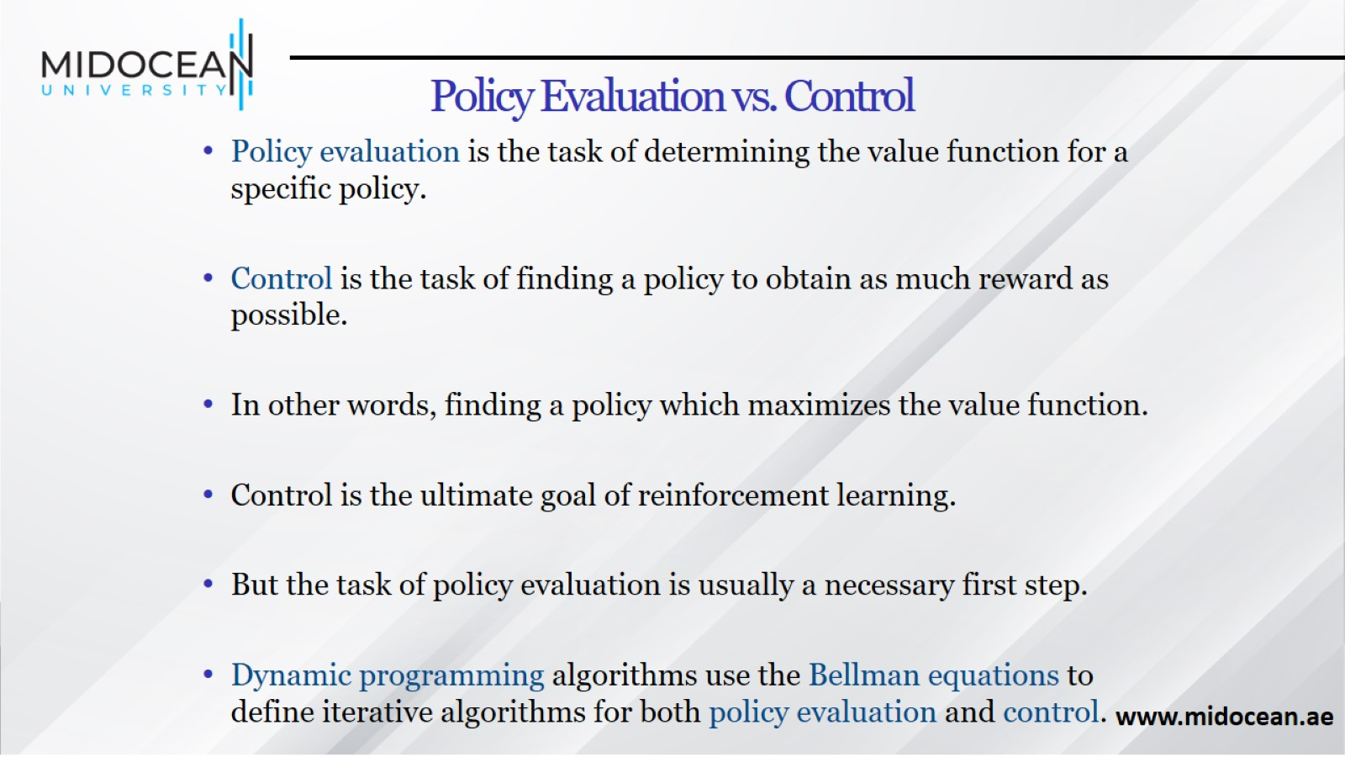
Policy Evaluation vs. Control

Slide 15
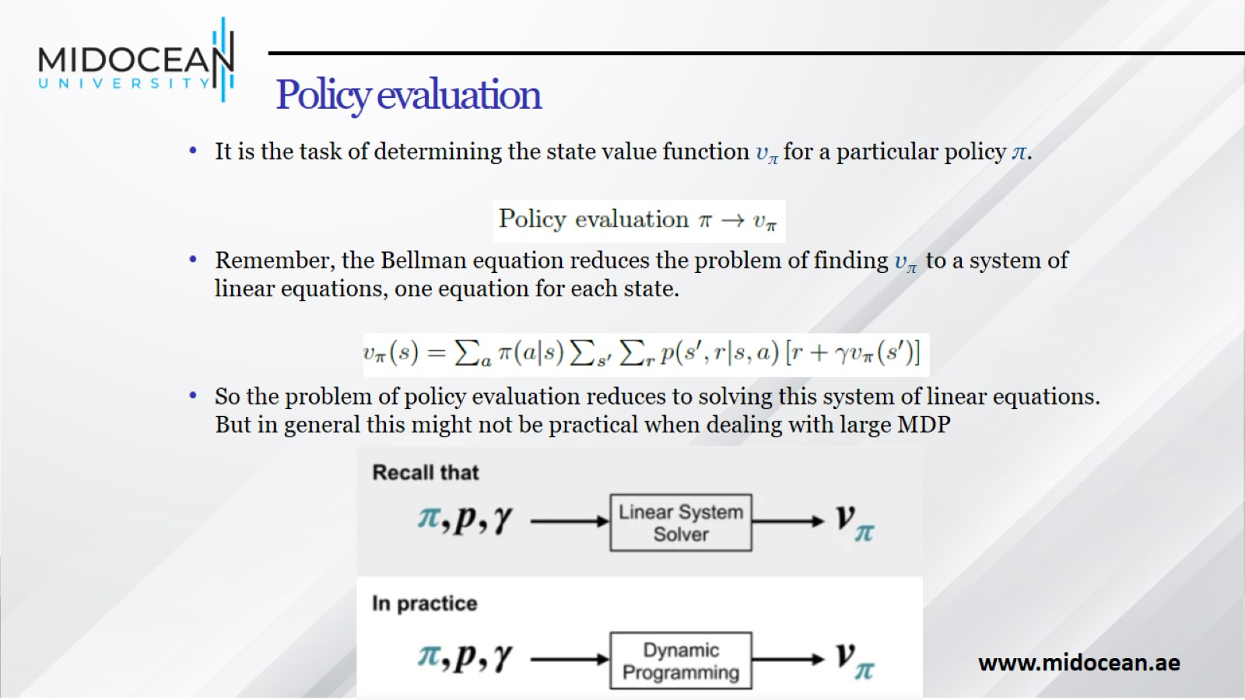
Policy evaluation

Slide 16
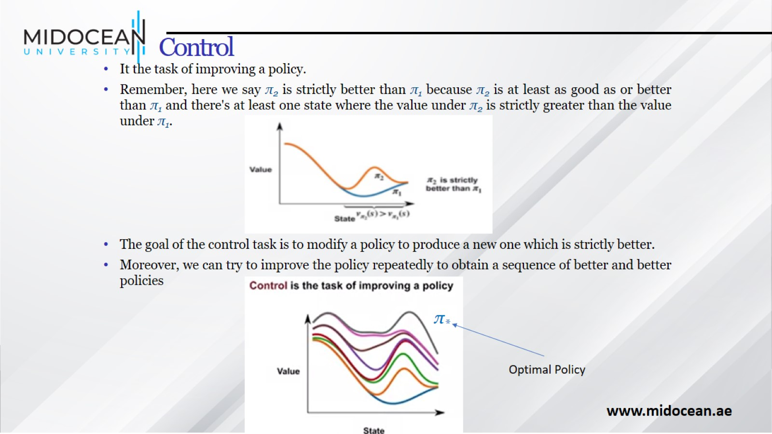
Control

Slide 17
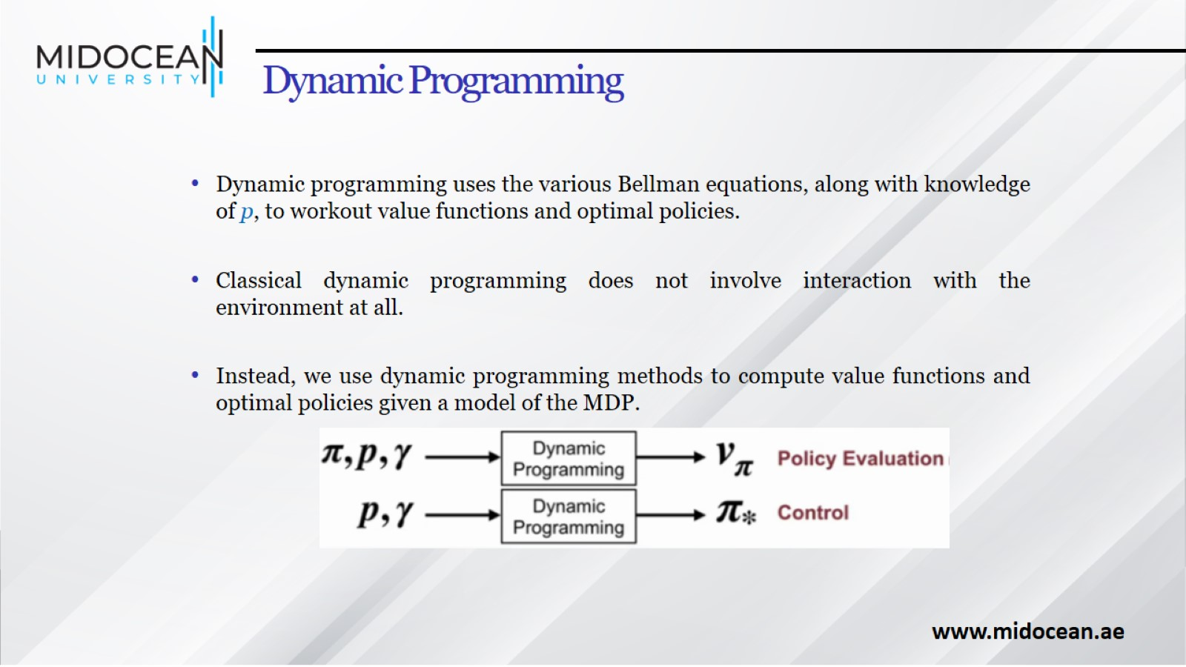
Dynamic Programming

Slide 18
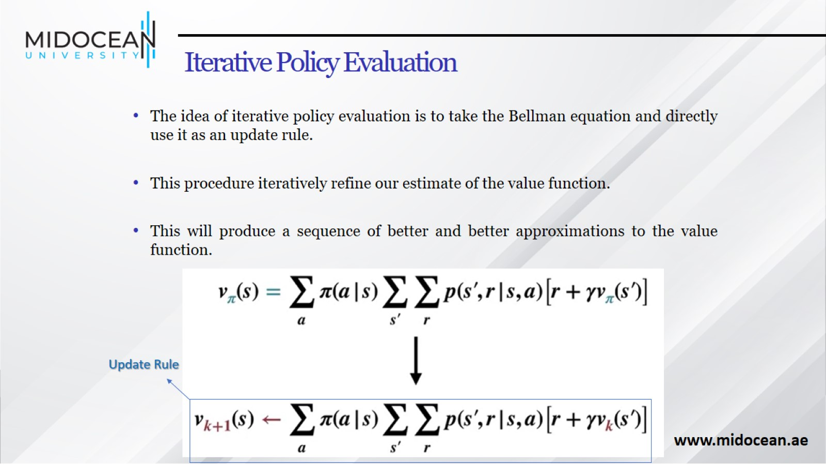
Iterative Policy Evaluation

Slide 19
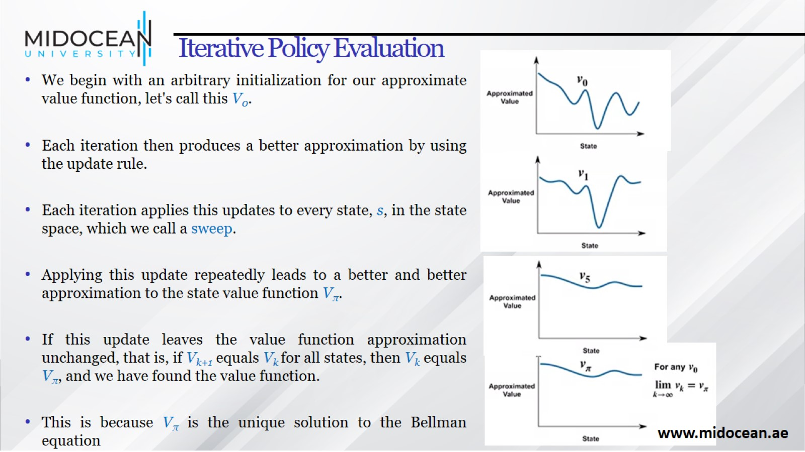
Iterative Policy Evaluation

Slide 20
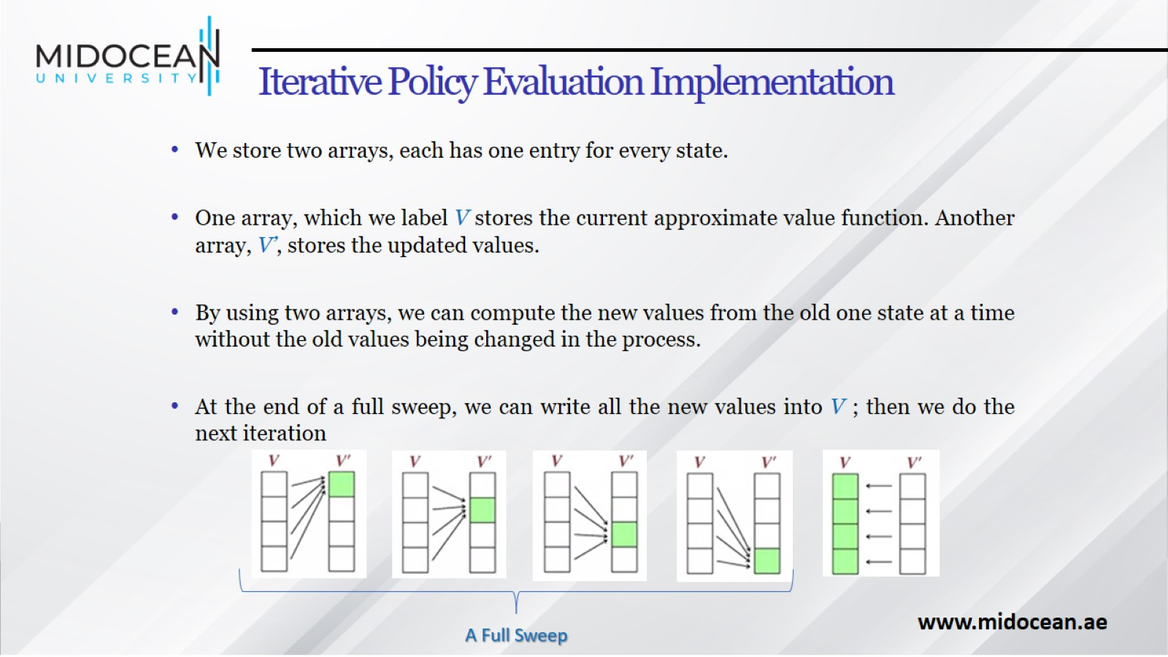
Iterative Policy Evaluation Implementation

Slide 21
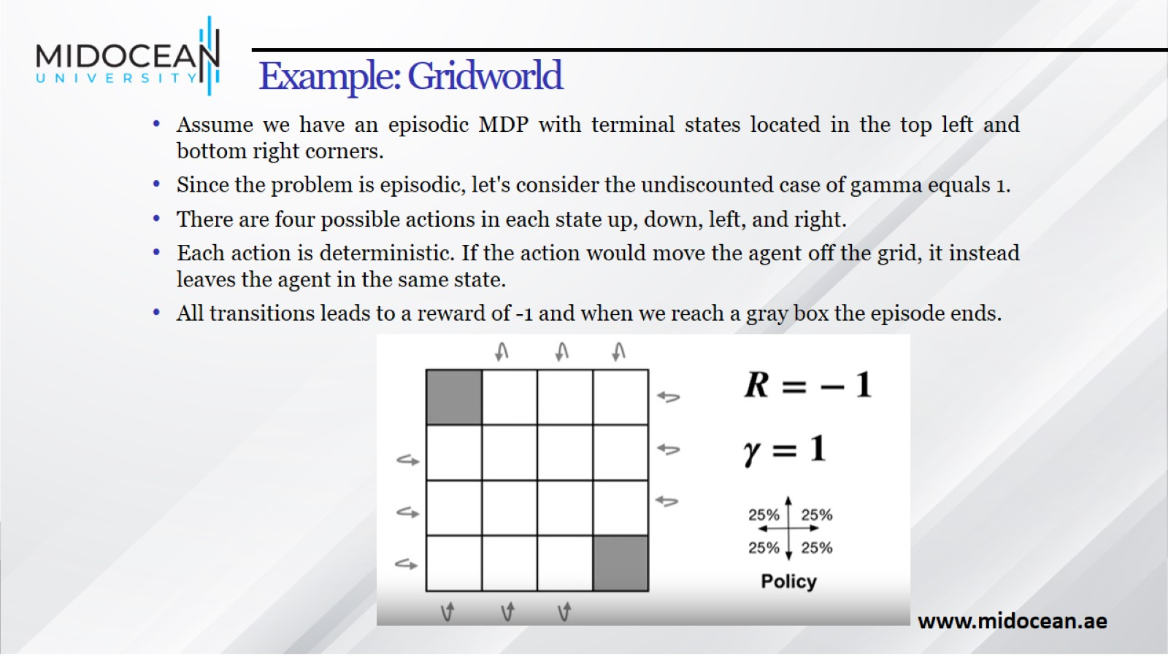
Example: Gridworld

Slide 22
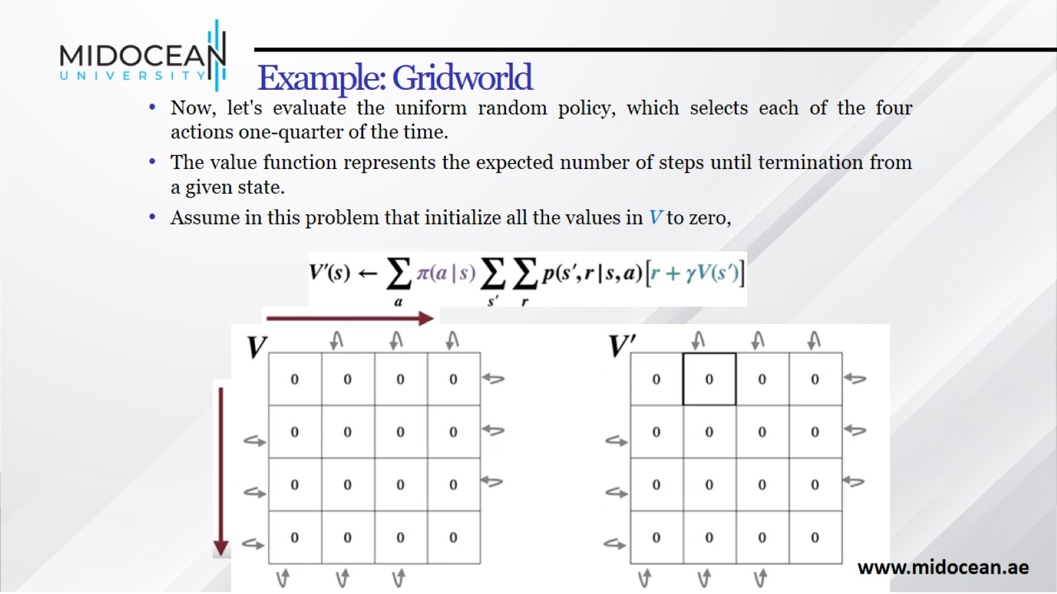
Example: Gridworld

Slide 23
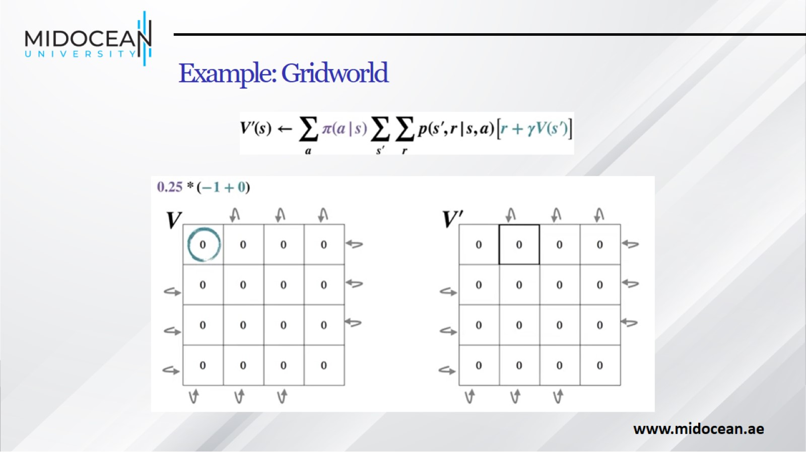
Example: Gridworld

Slide 24
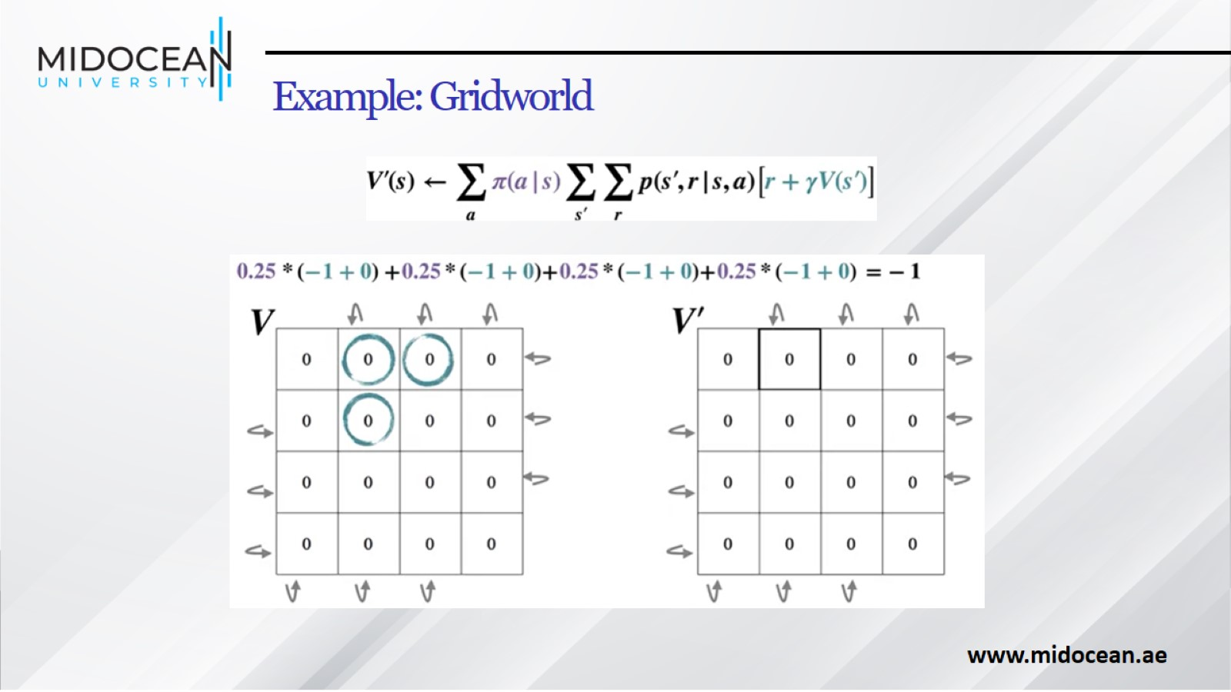
Example: Gridworld

Slide 25
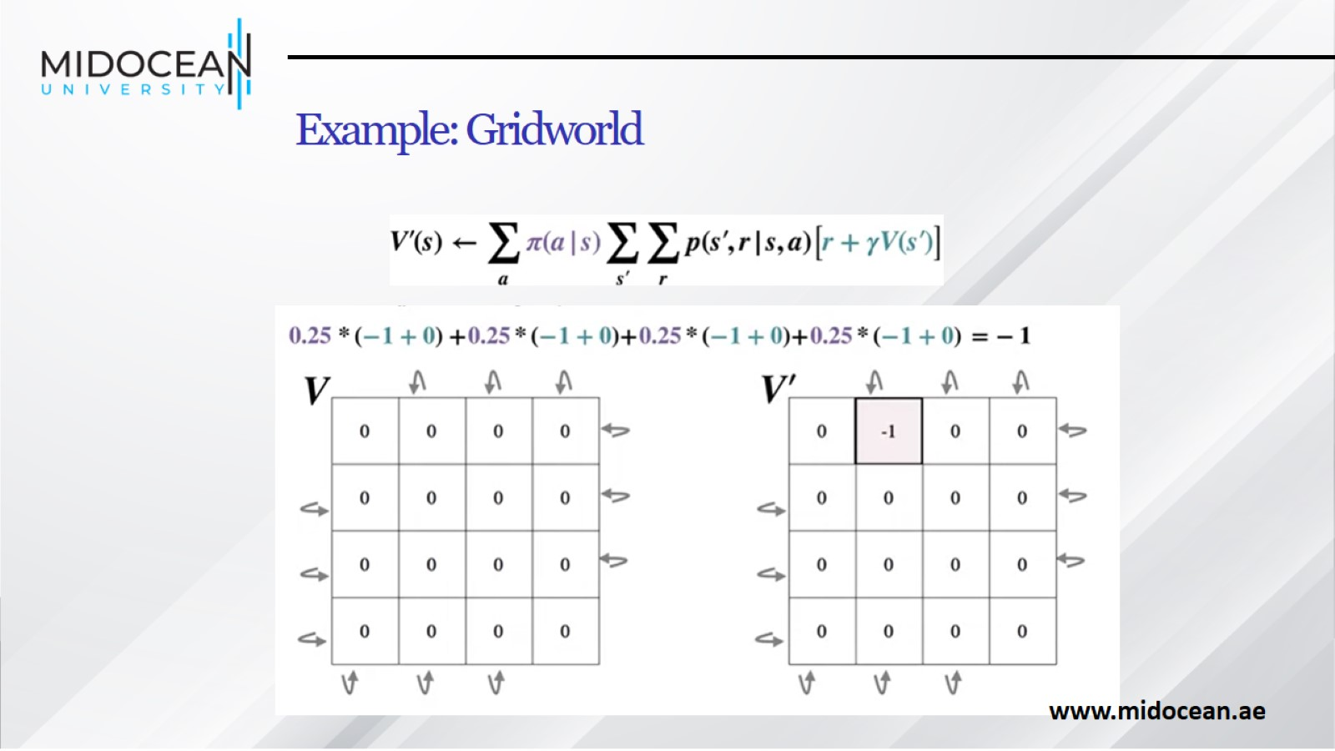
Example: Gridworld

Slide 26
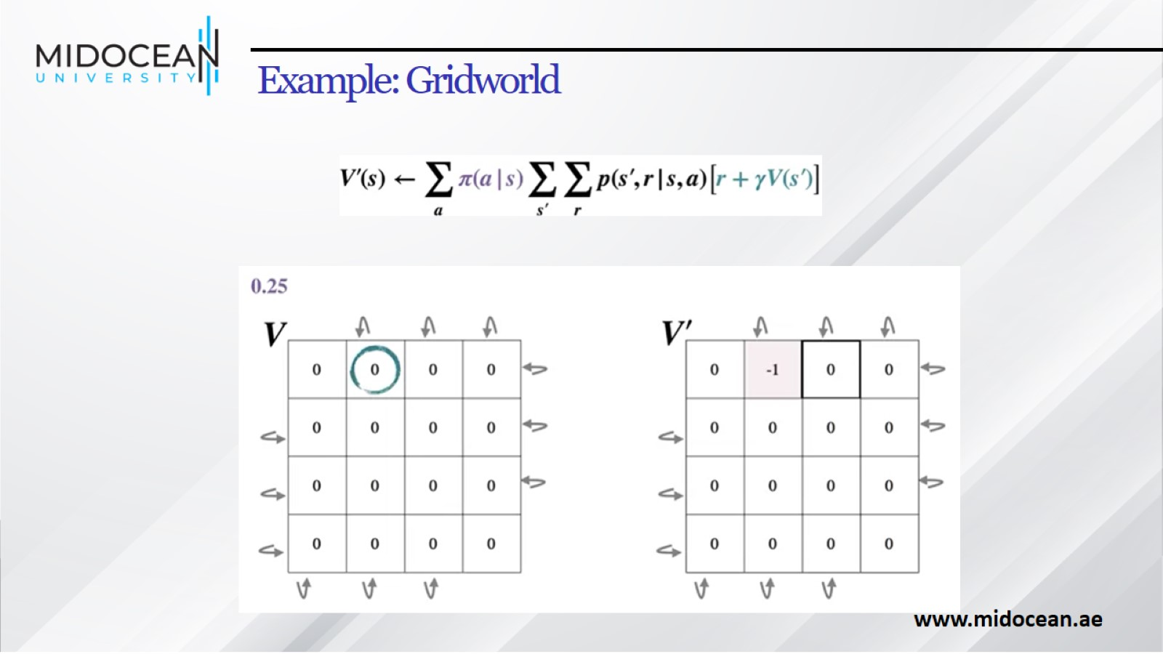
Example: Gridworld

Slide 27
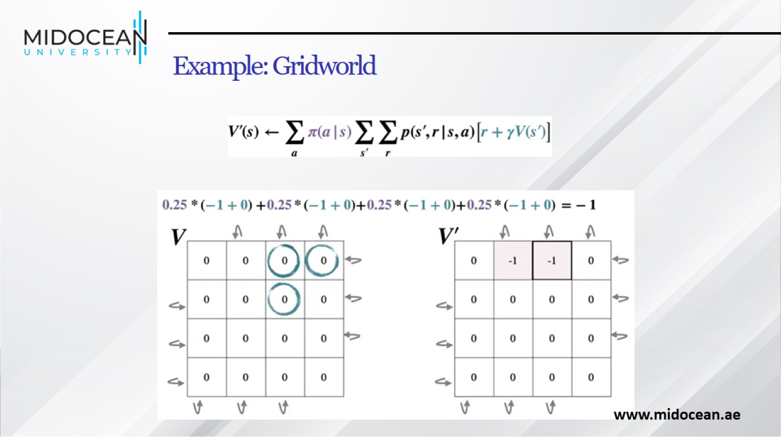
Example: Gridworld

Slide 28
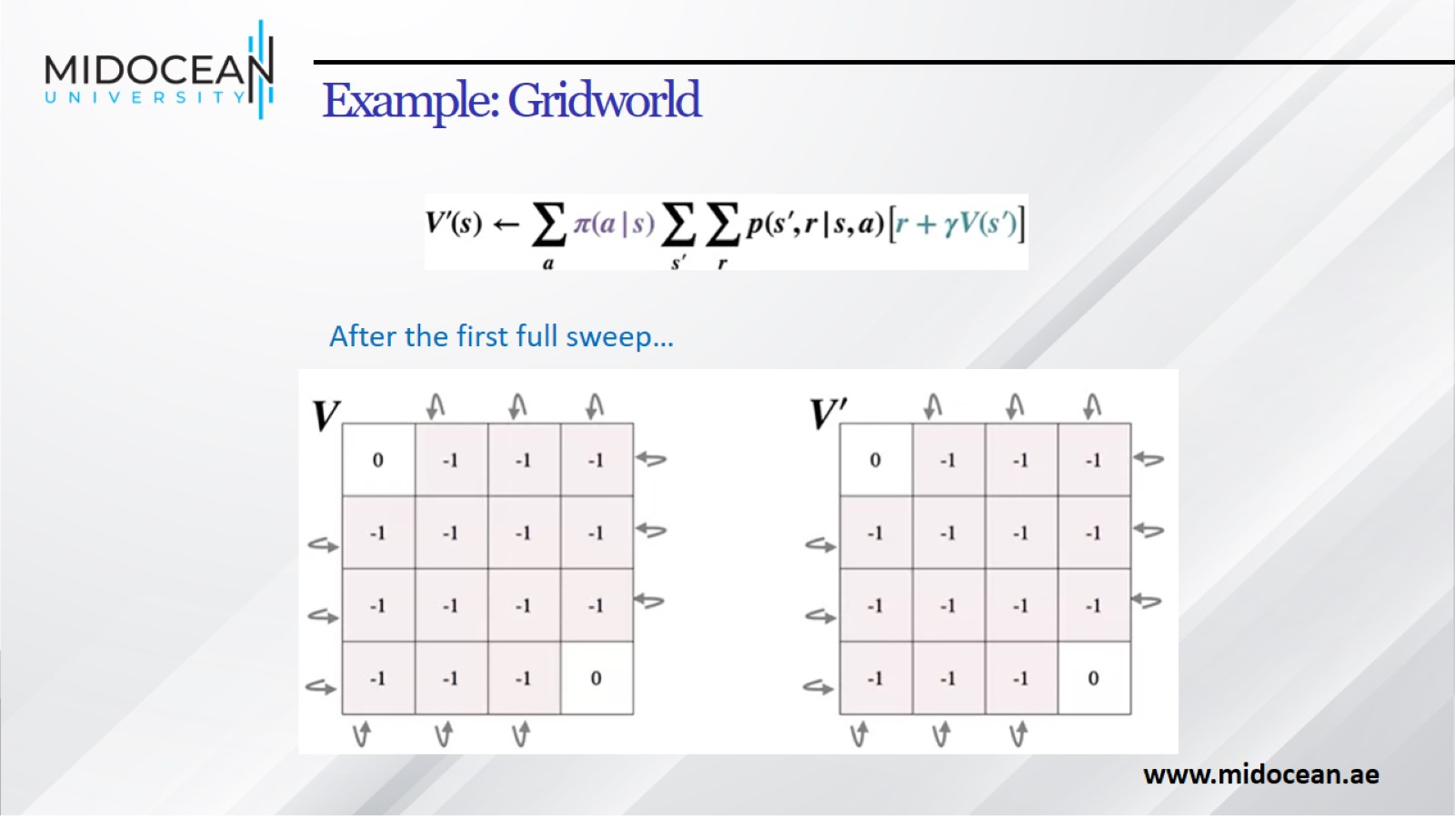
Example: Gridworld

Slide 29
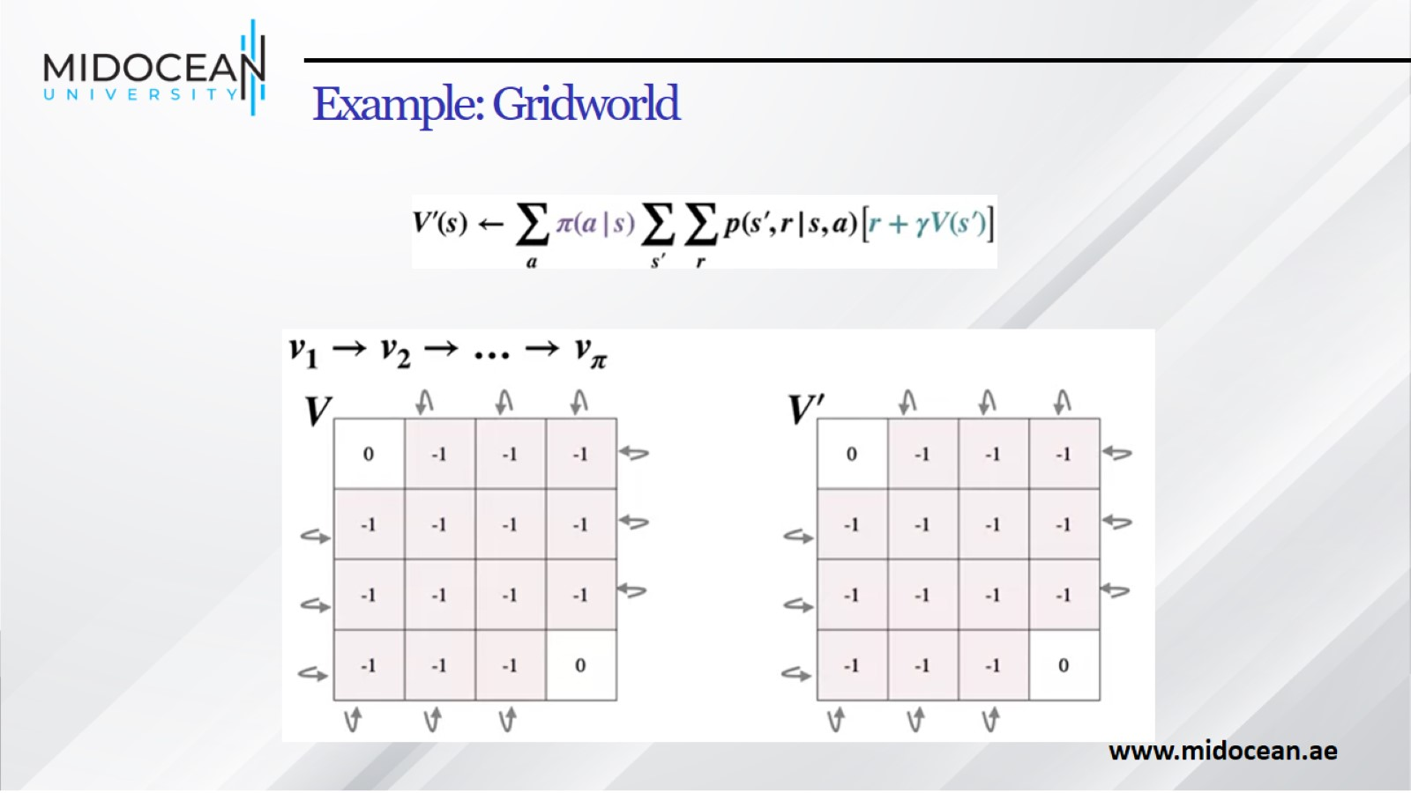
Example: Gridworld

Slide 30
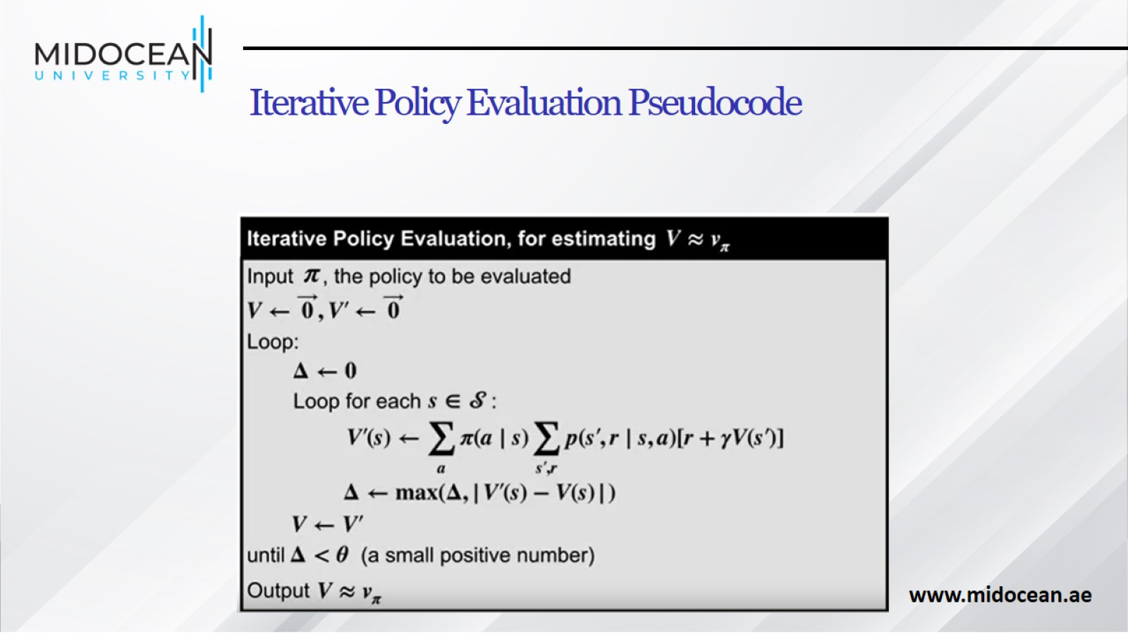
Iterative Policy Evaluation Pseudocode

Slide 31
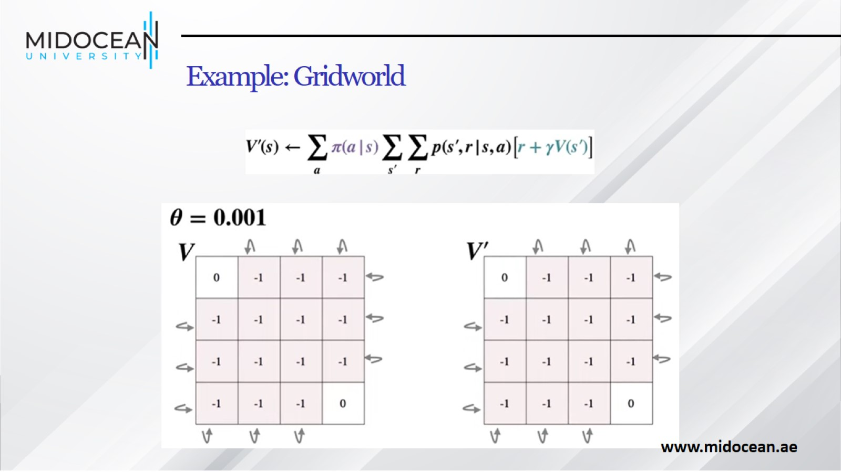
Example: Gridworld

Slide 32
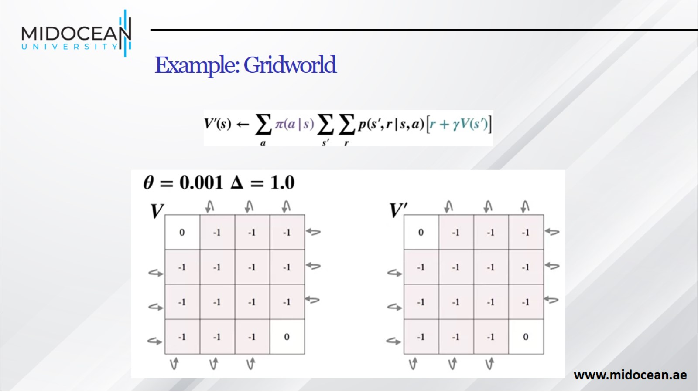
Example: Gridworld

Slide 33
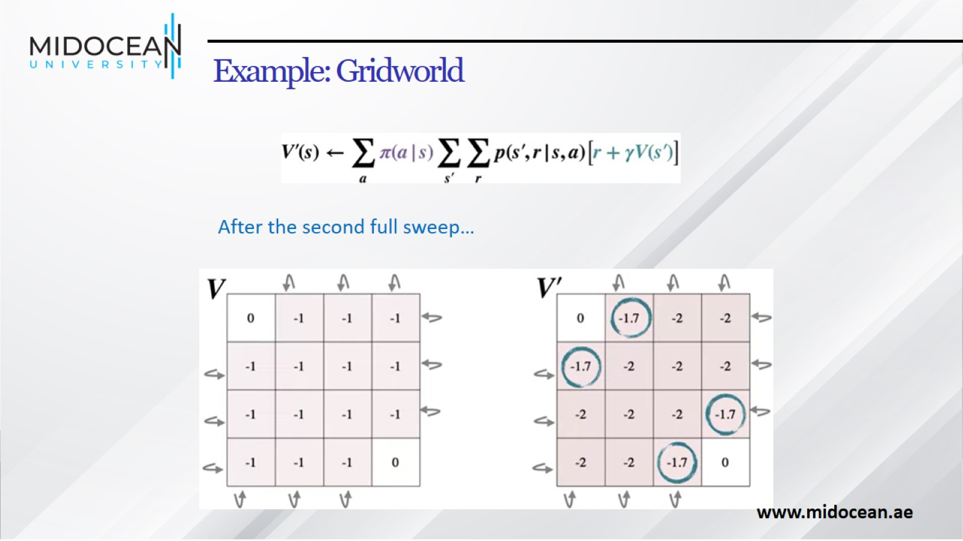
Example: Gridworld

Slide 34
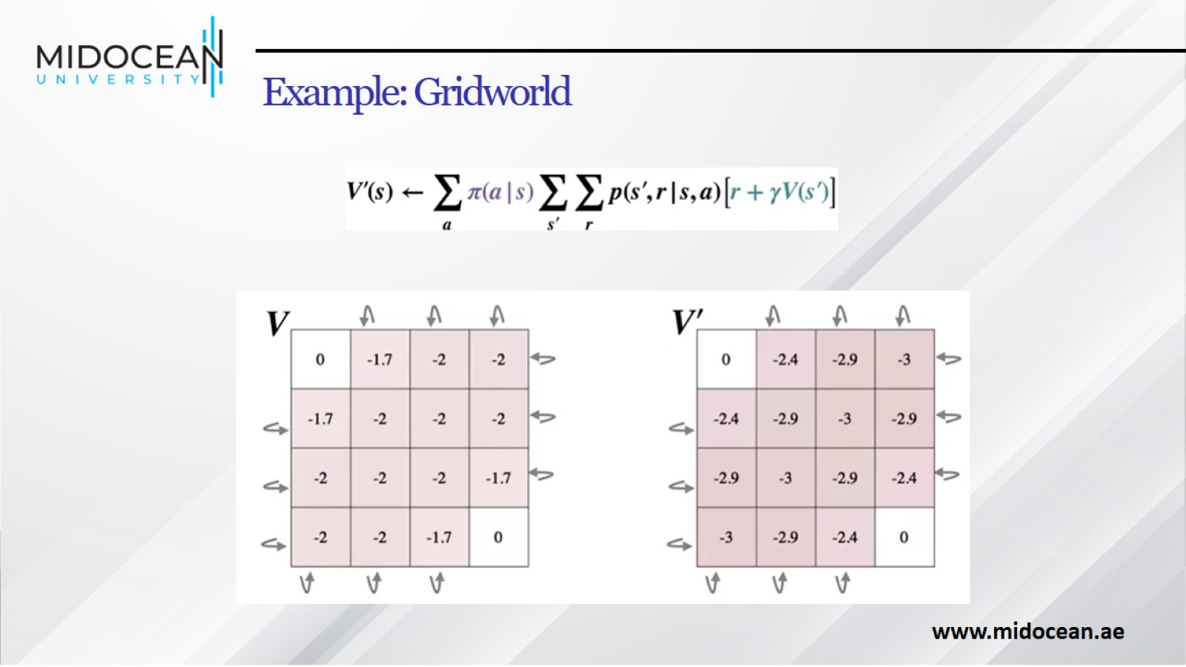
Example: Gridworld

Slide 35
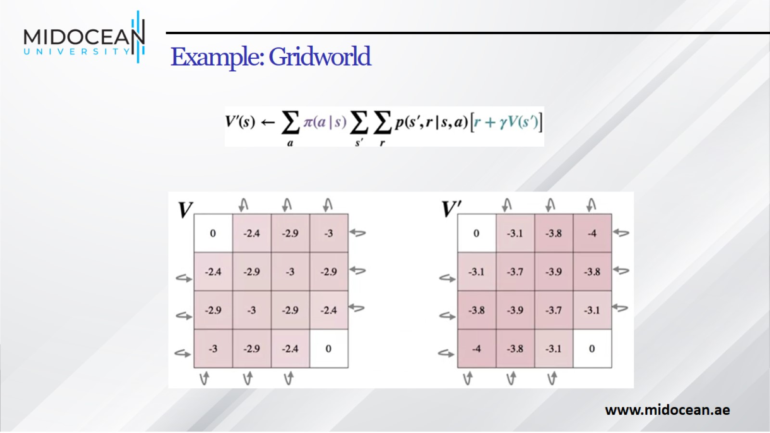
Example: Gridworld

Slide 36
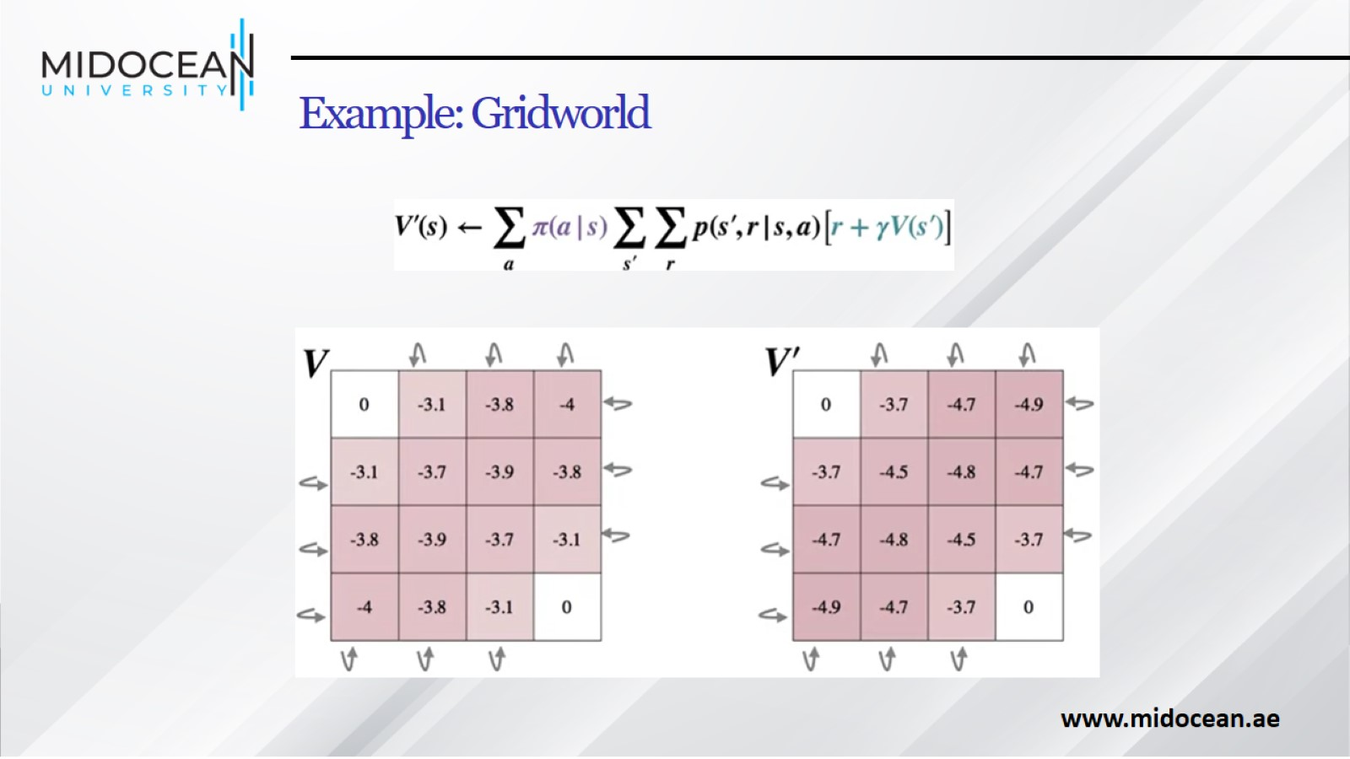
Example: Gridworld

Slide 37
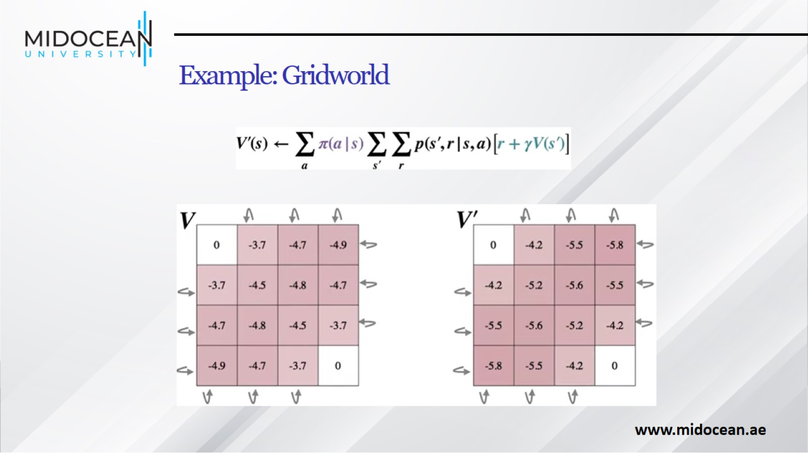
Example: Gridworld

Slide 38
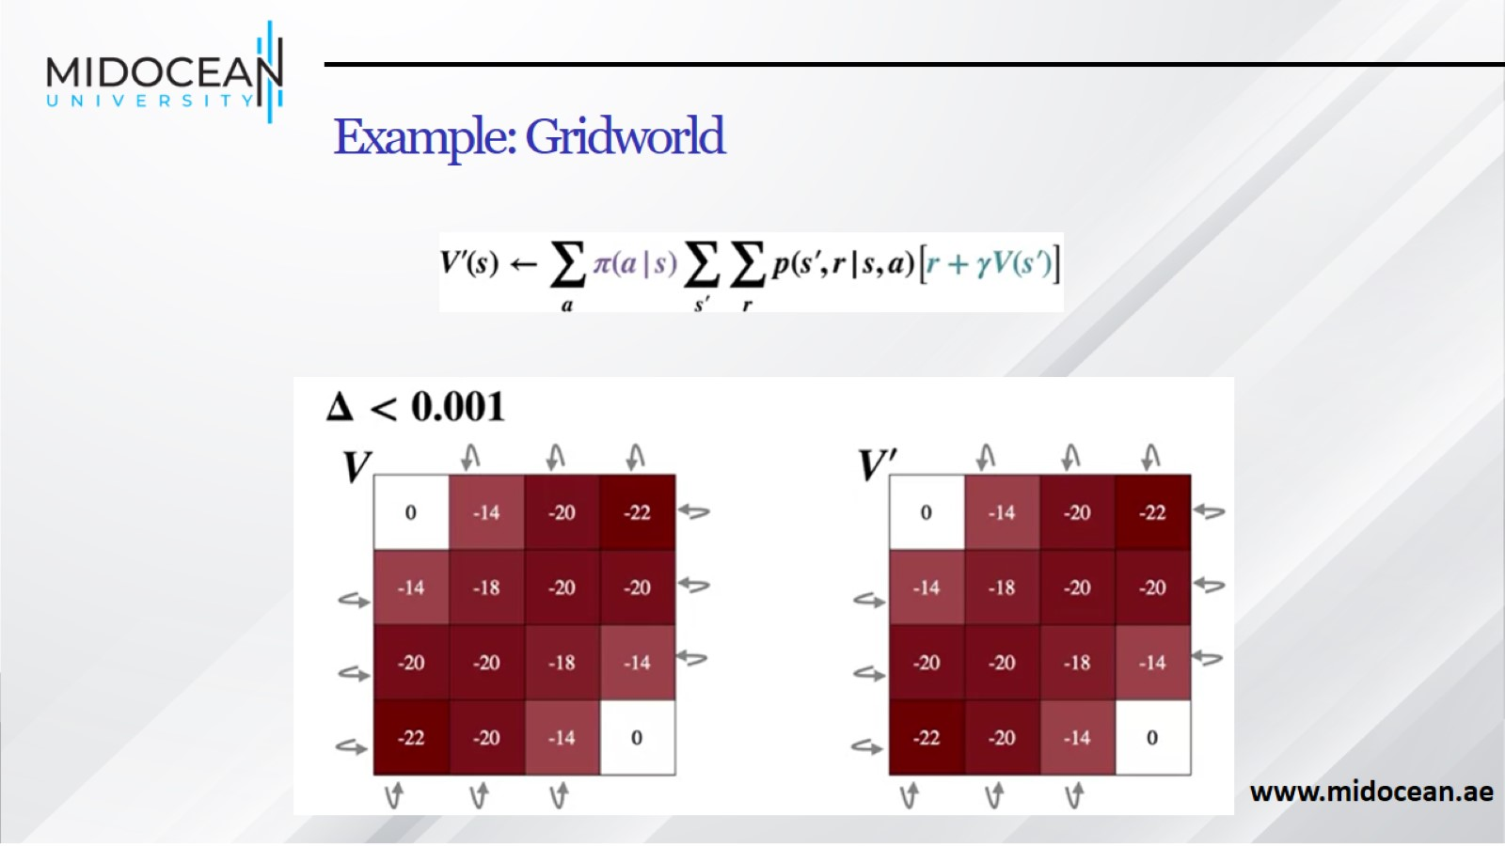
Example: Gridworld

Slide 39
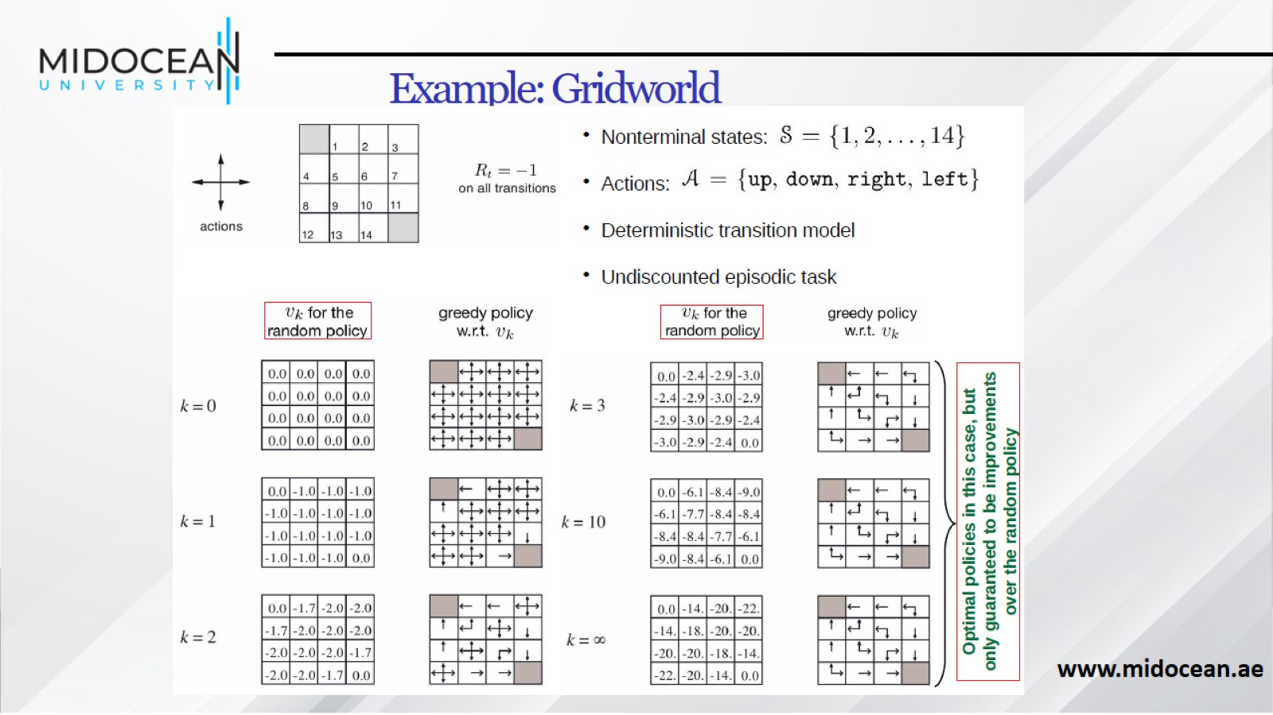
Example: Gridworld

Slide 40
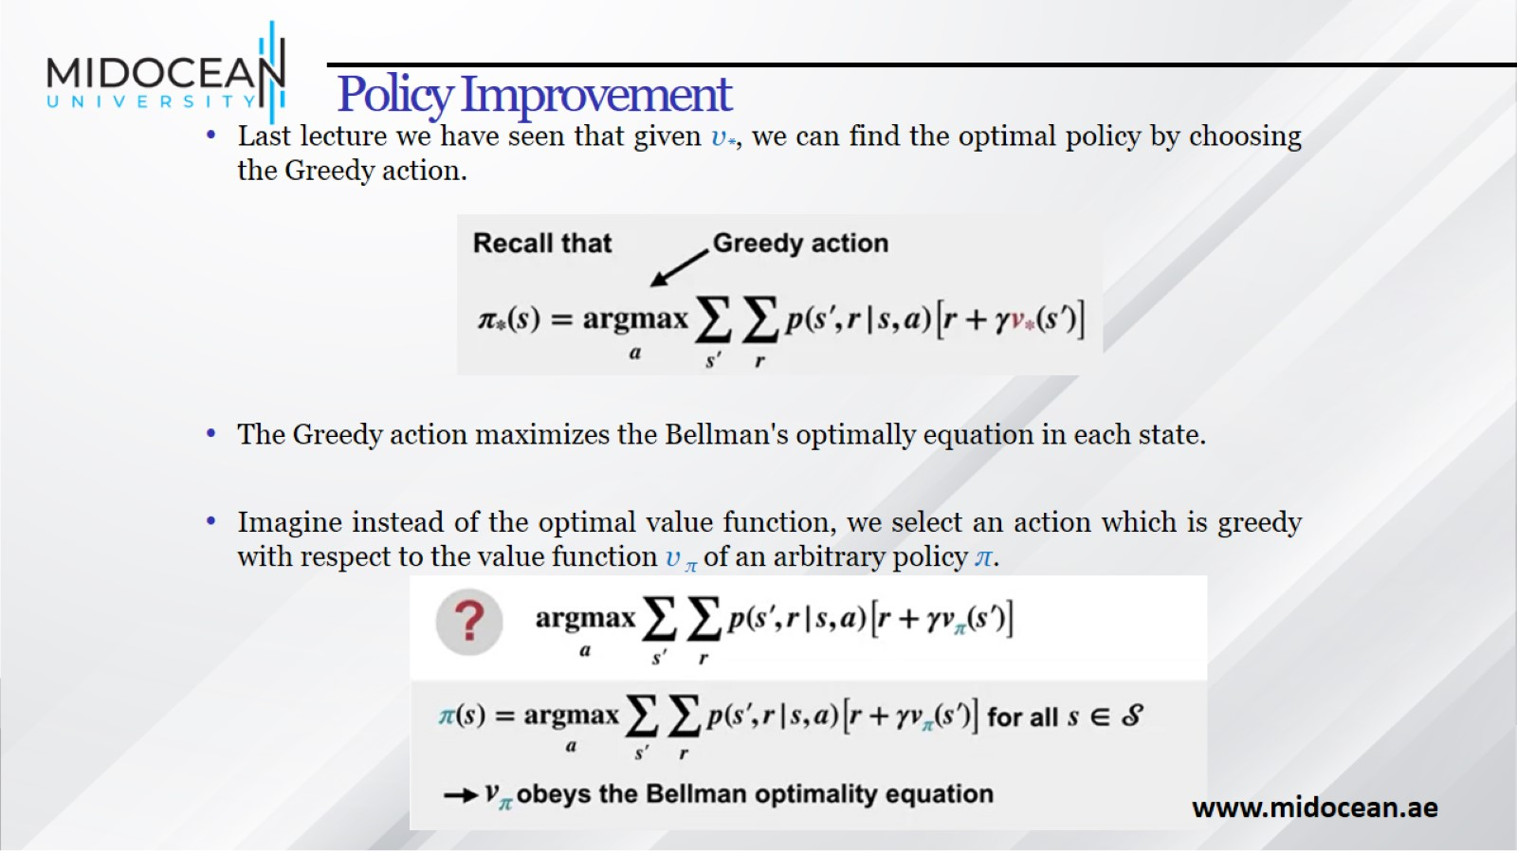
Policy Improvement

Slide 41
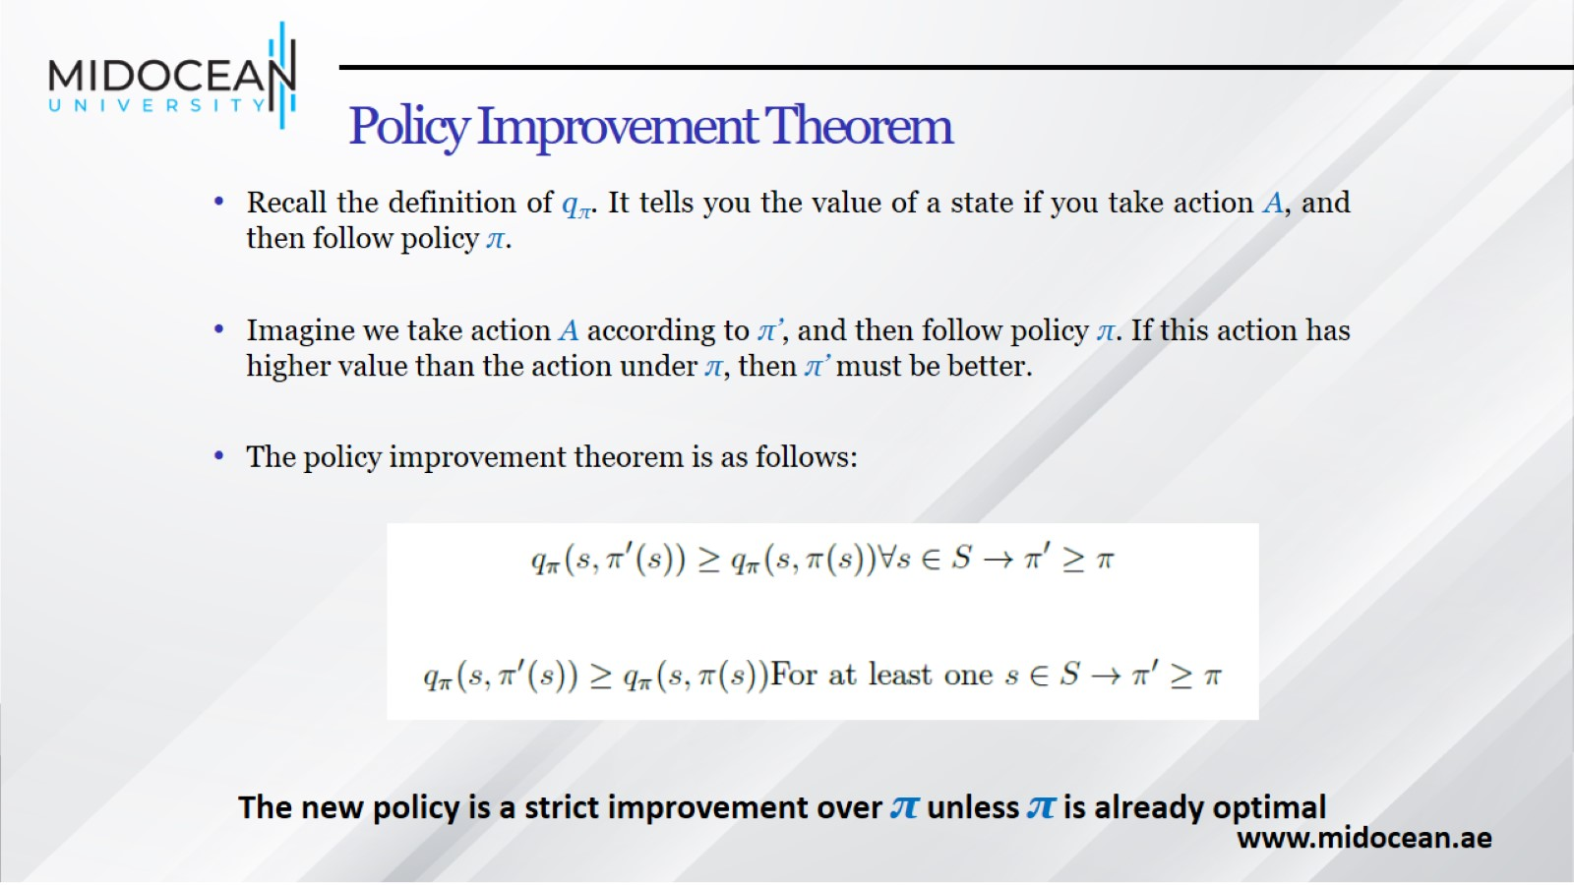
Policy Improvement Theorem

Slide 42
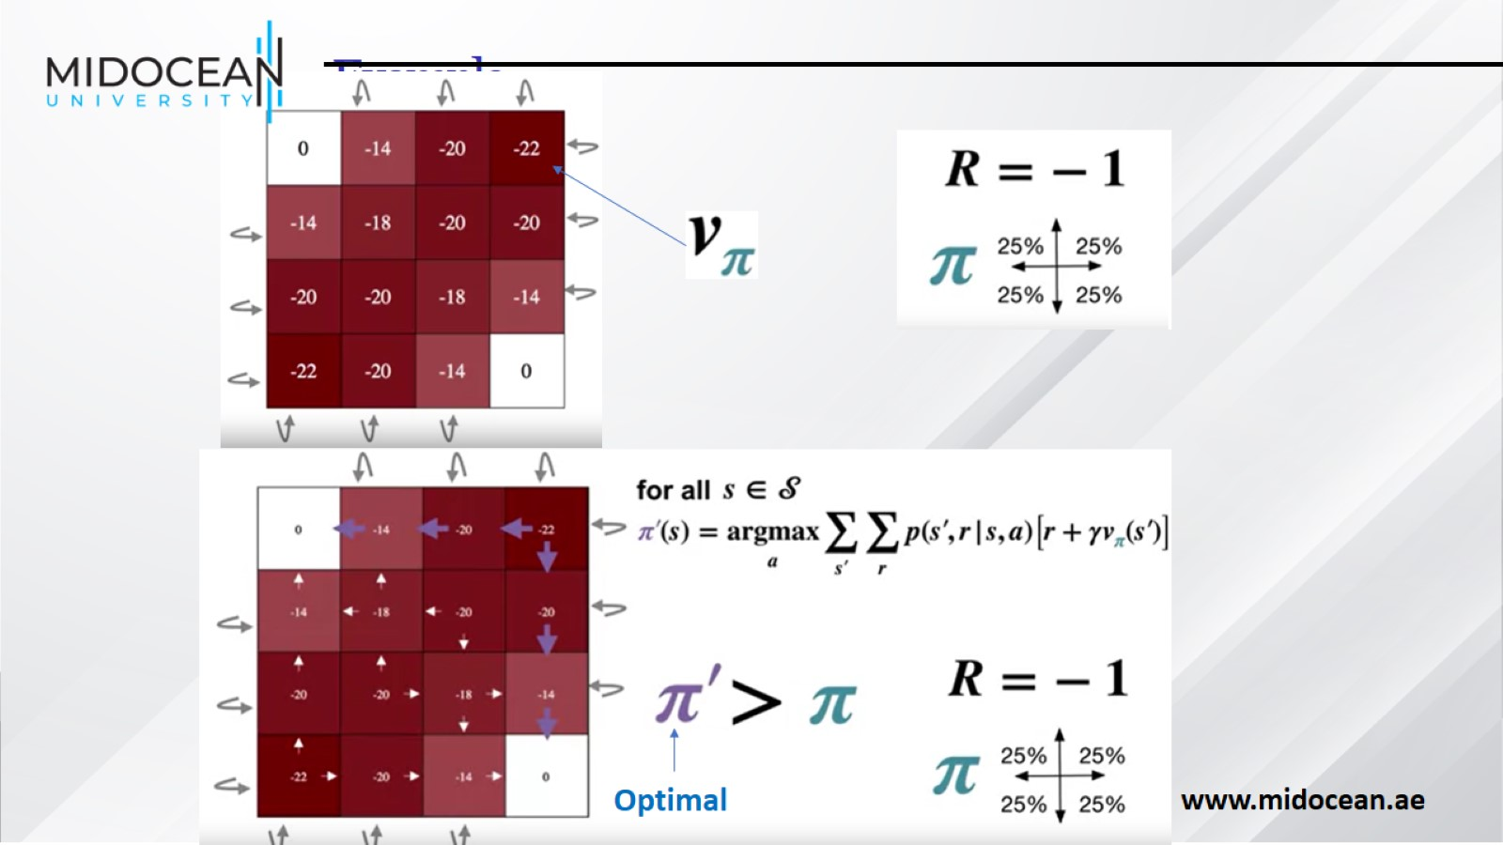
Example

Slide 43
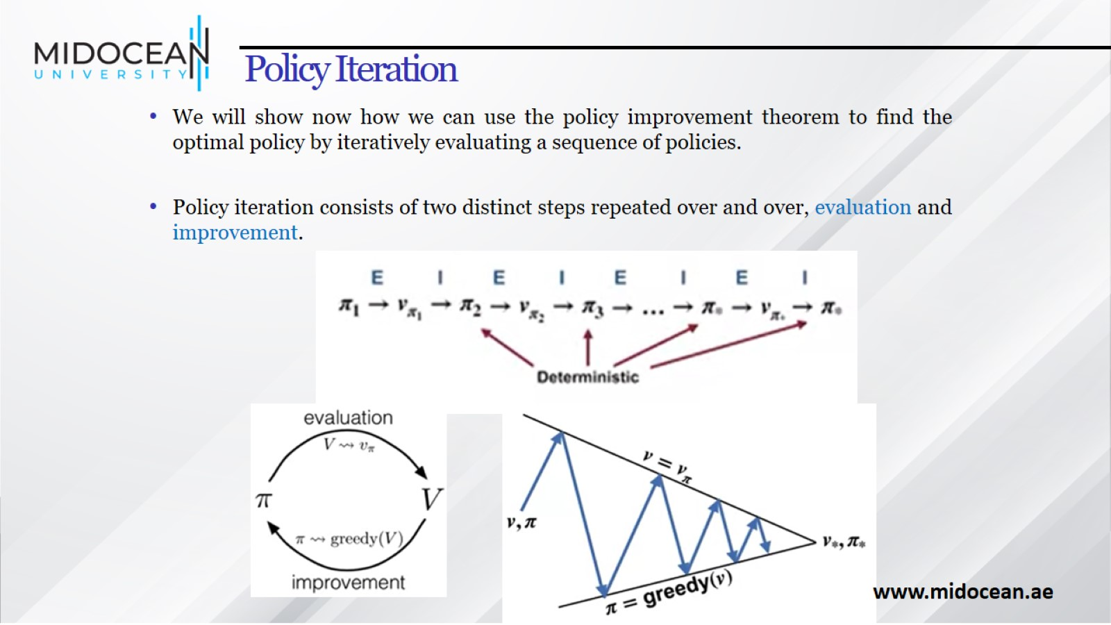
Policy Iteration

Slide 44
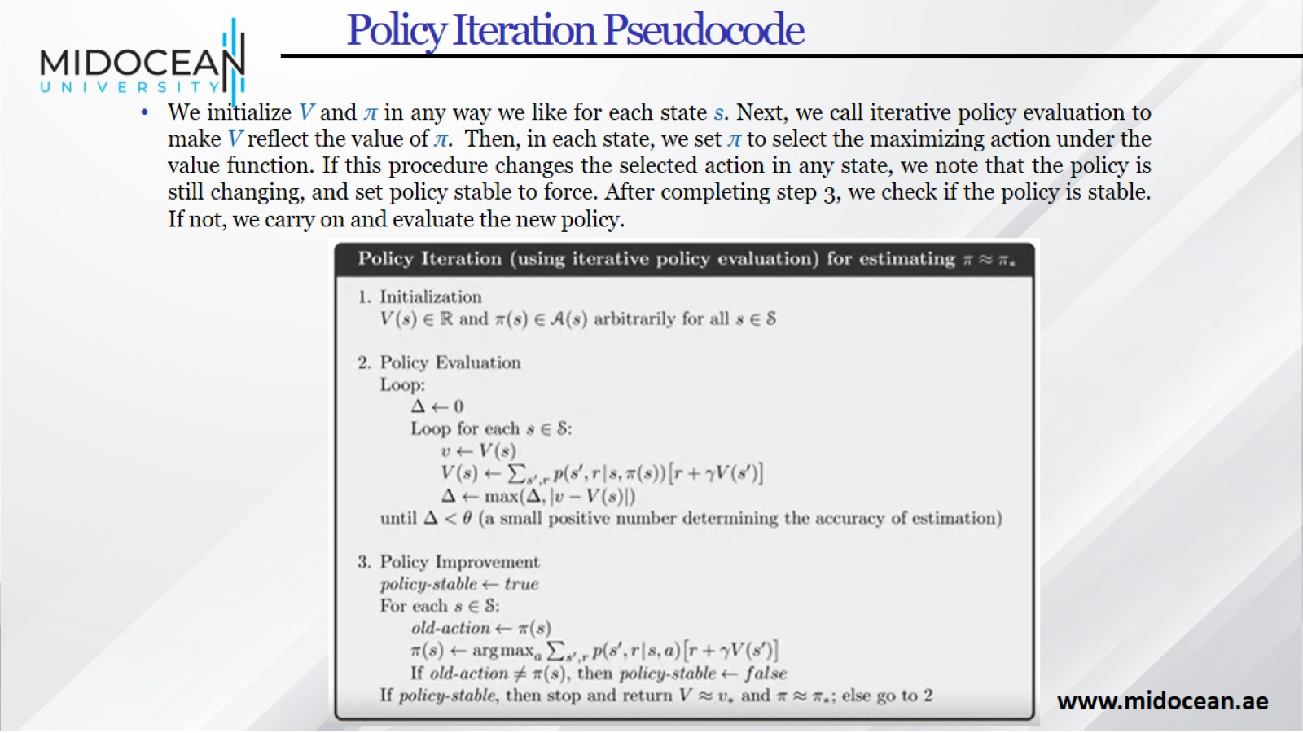
Policy Iteration Pseudocode

Slide 45
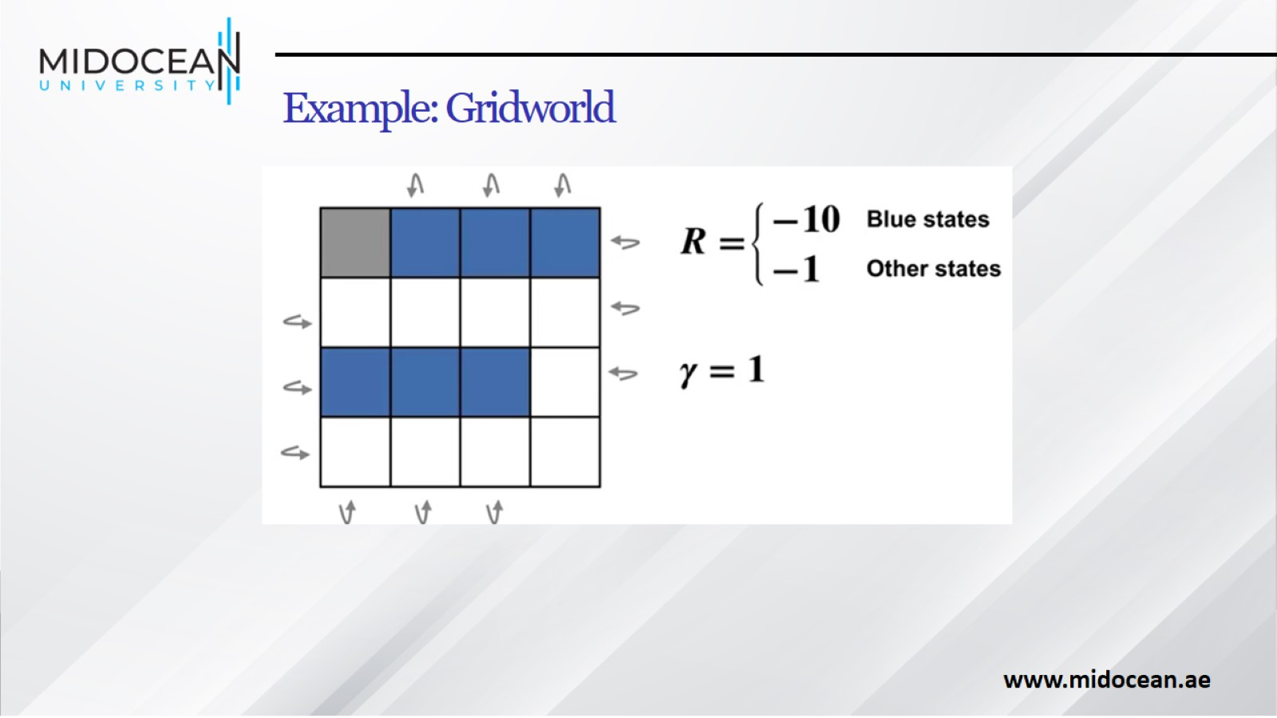
Example: Gridworld

Slide 46
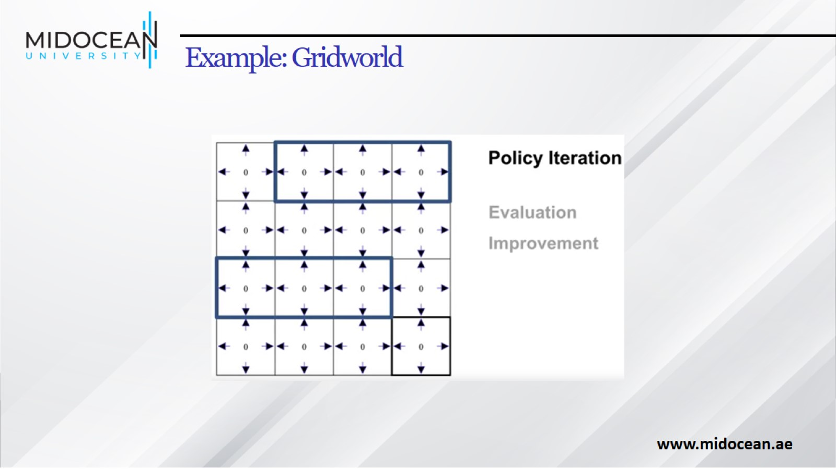
Example: Gridworld

Slide 47
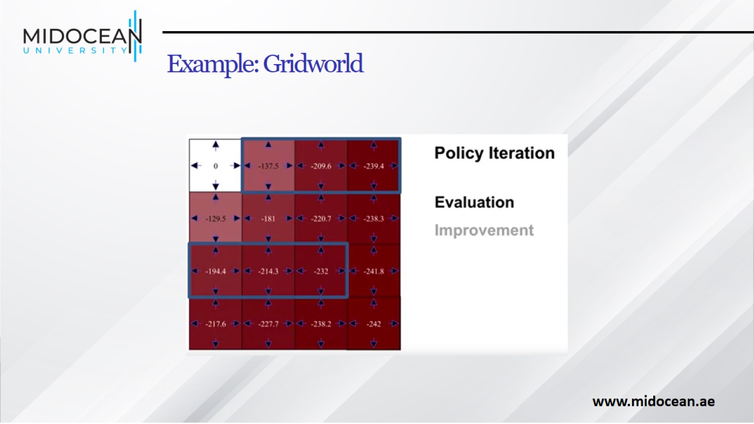
Example: Gridworld

Slide 48
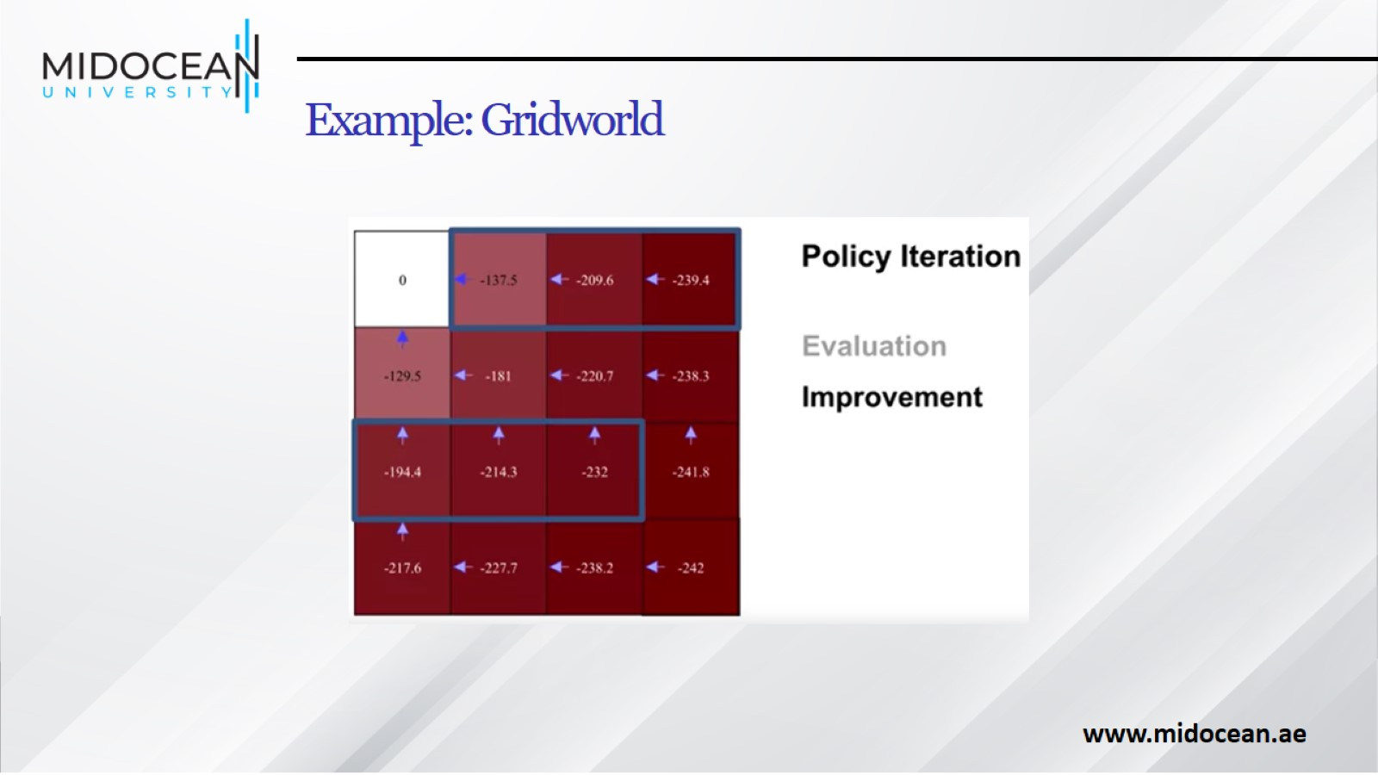
Example: Gridworld

Slide 49
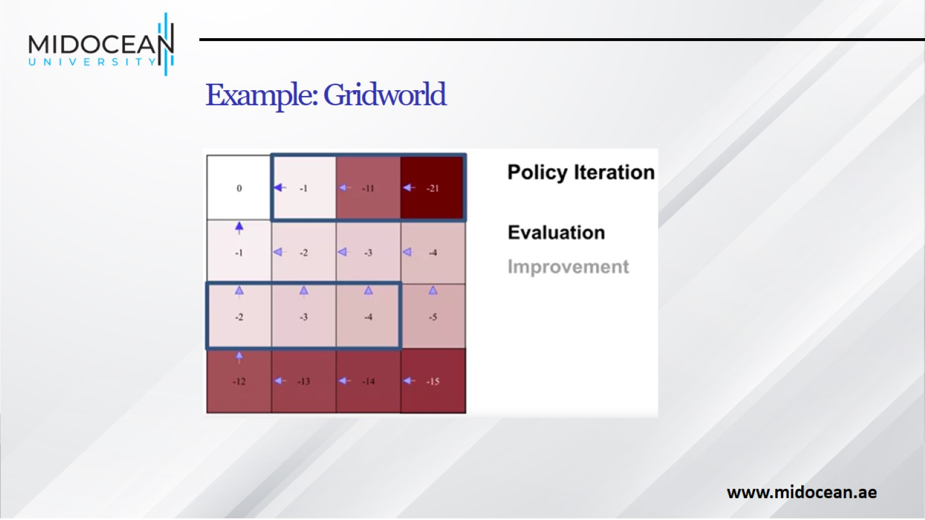
Example: Gridworld

Slide 50
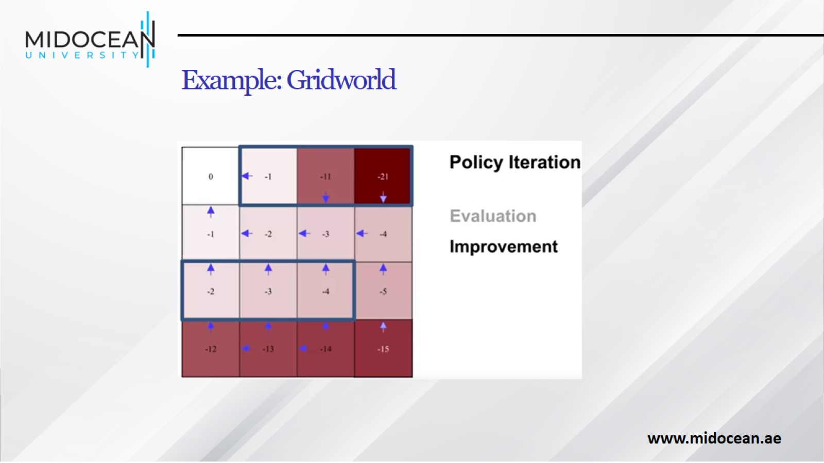
Example: Gridworld

Slide 51
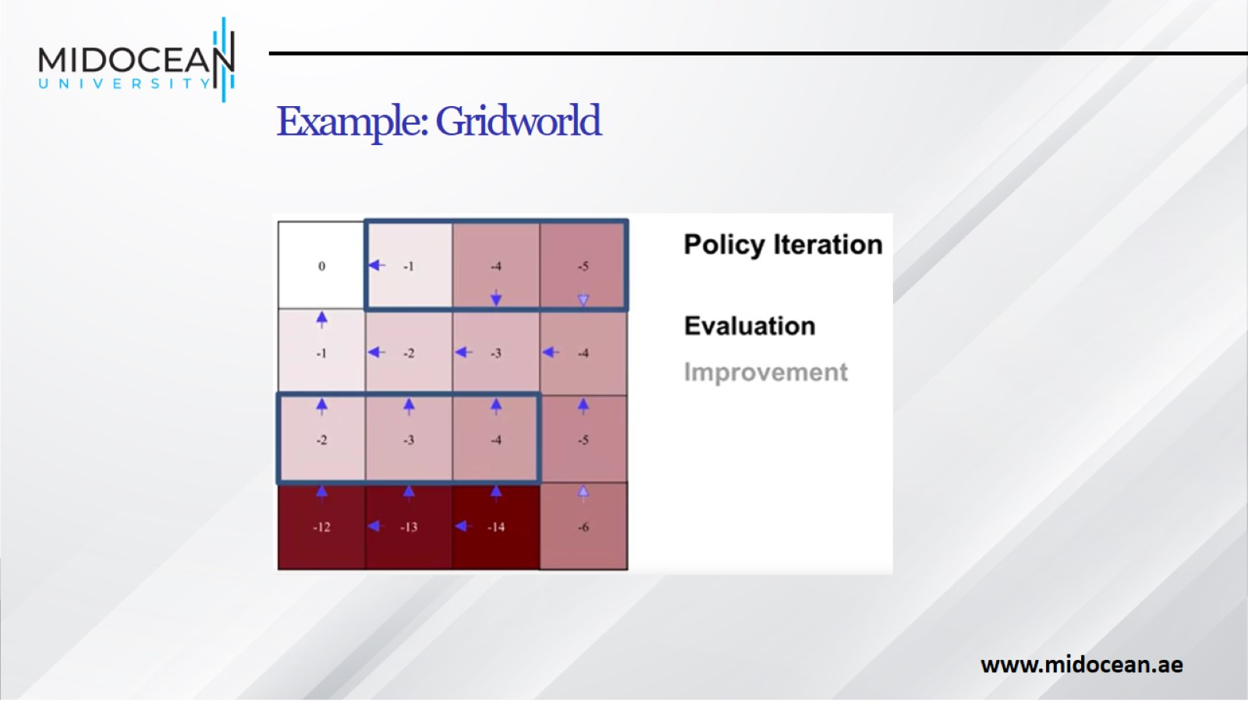
Example: Gridworld

Slide 52
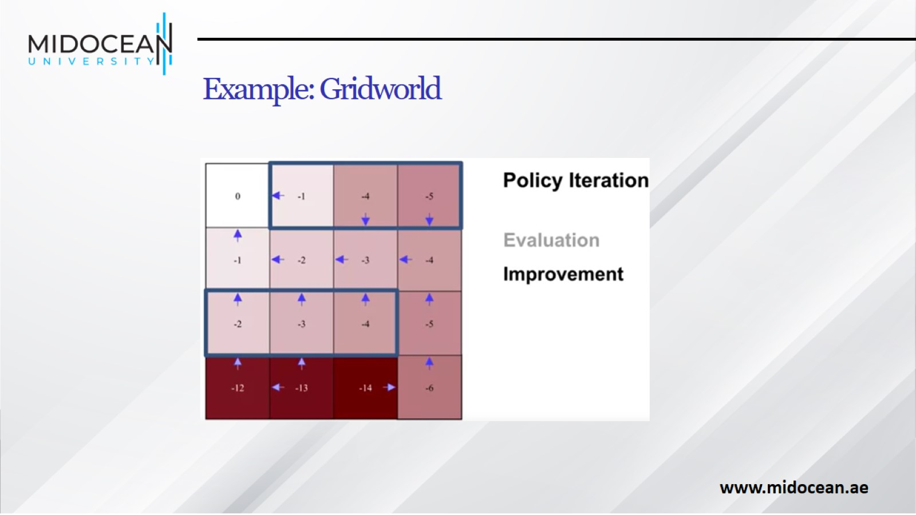
Example: Gridworld

Slide 53
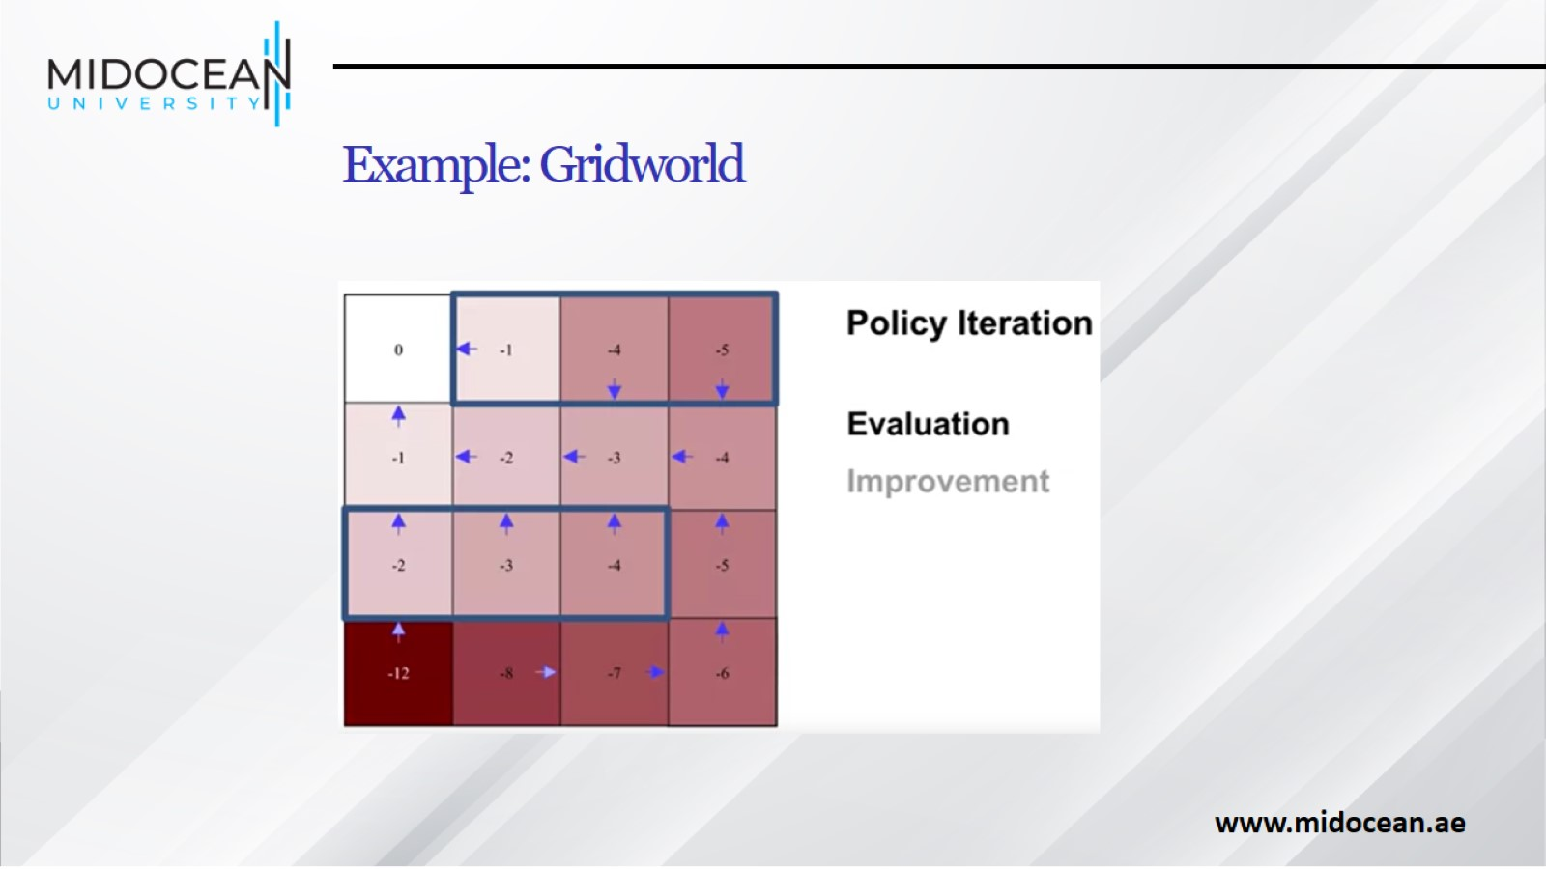
Example: Gridworld

Slide 54
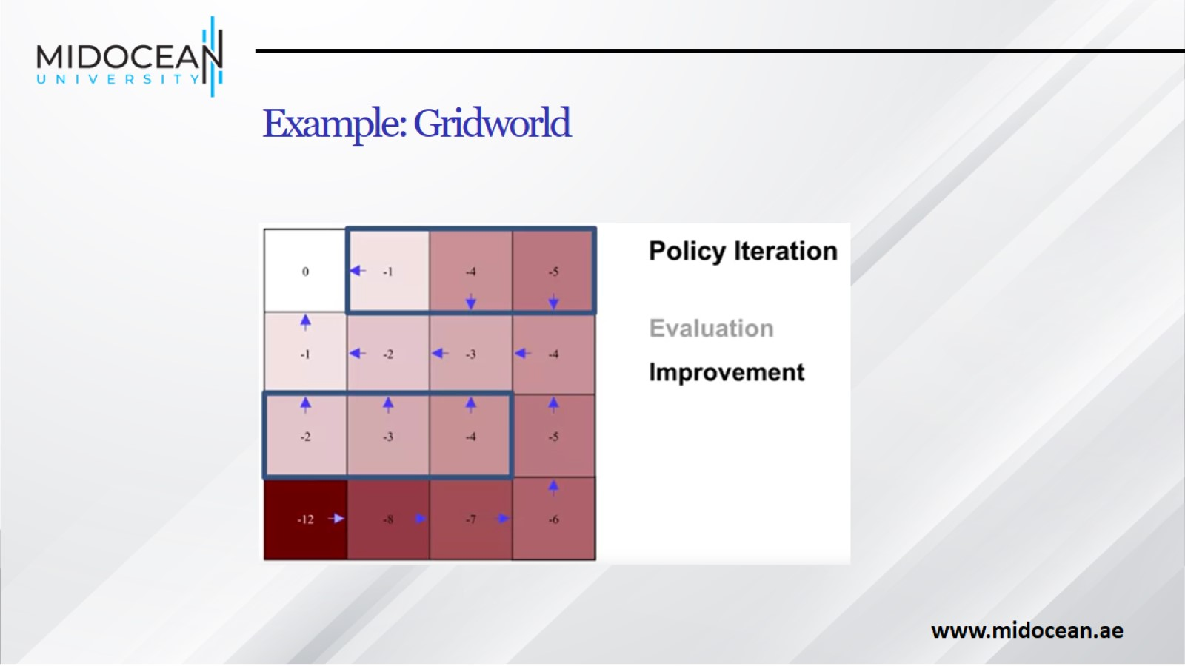
Example: Gridworld

Slide 55

Example: Gridworld

Slide 56

Example: Gridworld

Slide 57

Flexibility of the Policy Iteration Framework

Slide 58

Generalized Policy Iteration

Slide 59


