Slide 1


Slide 2


Slide 3
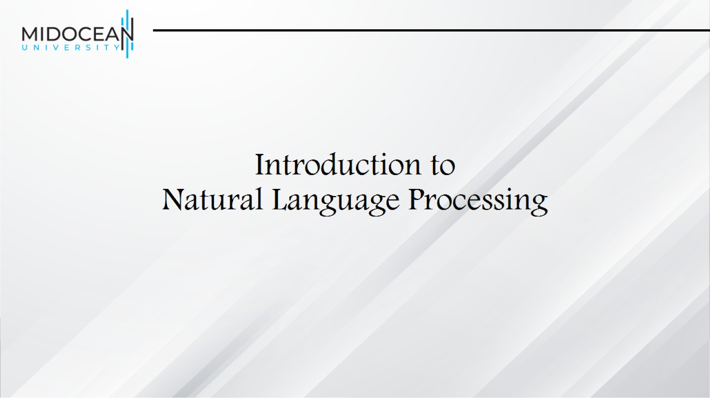
Introduction to
Natural Language Processing

Slide 4
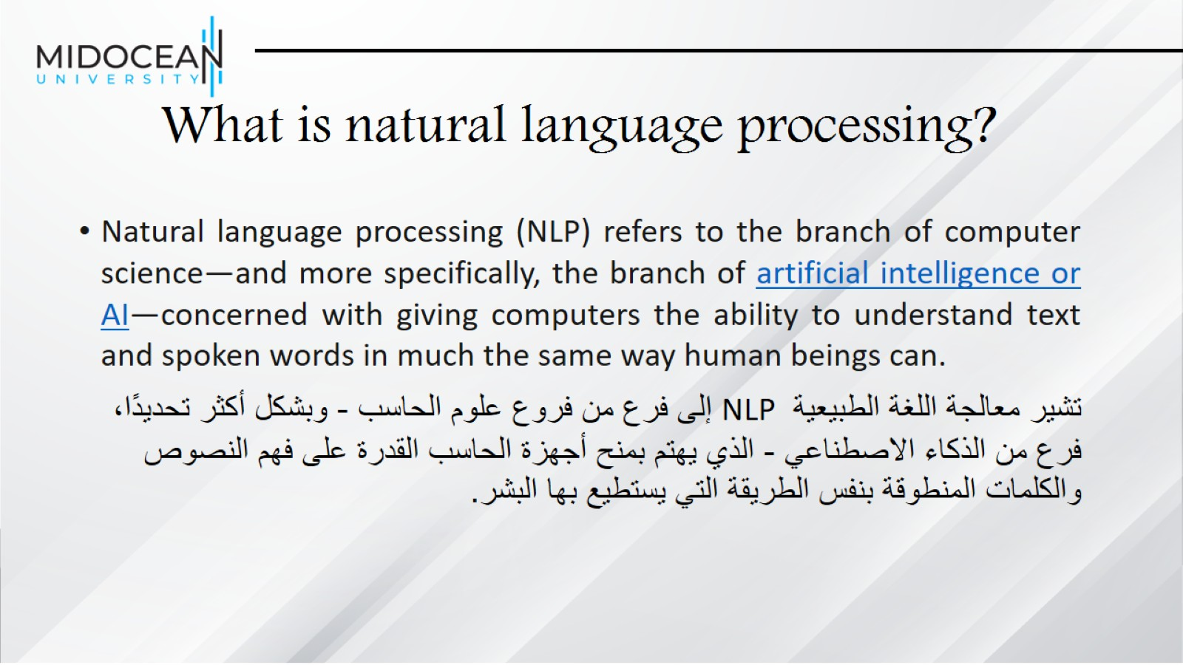
What is natural language processing?

Slide 5
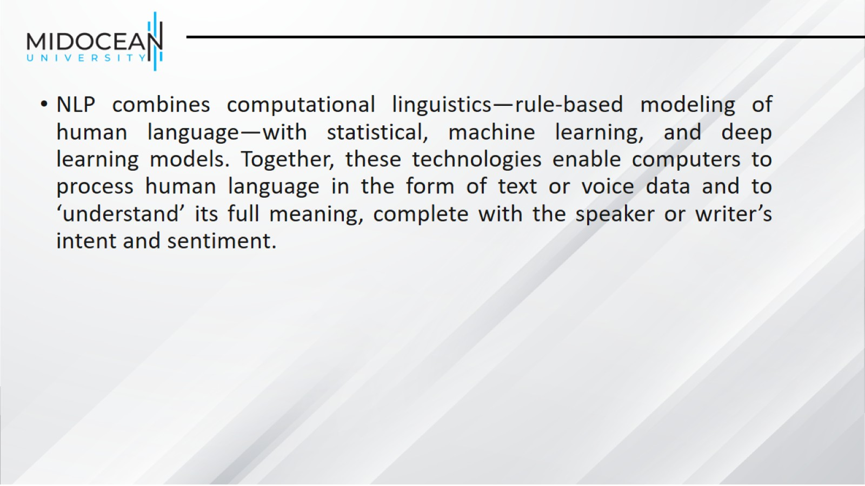

Slide 6
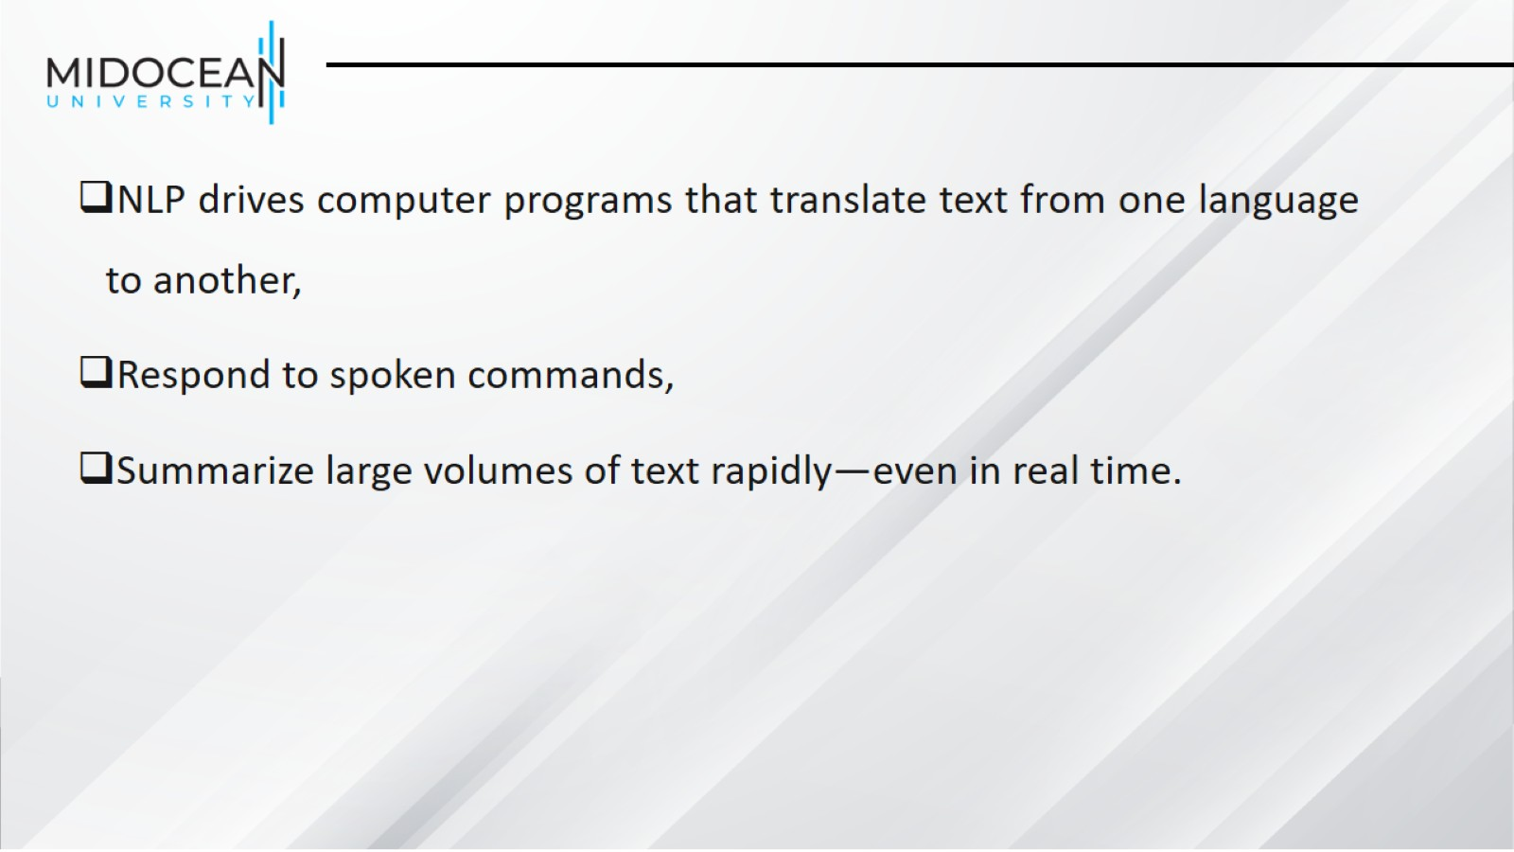

Slide 7
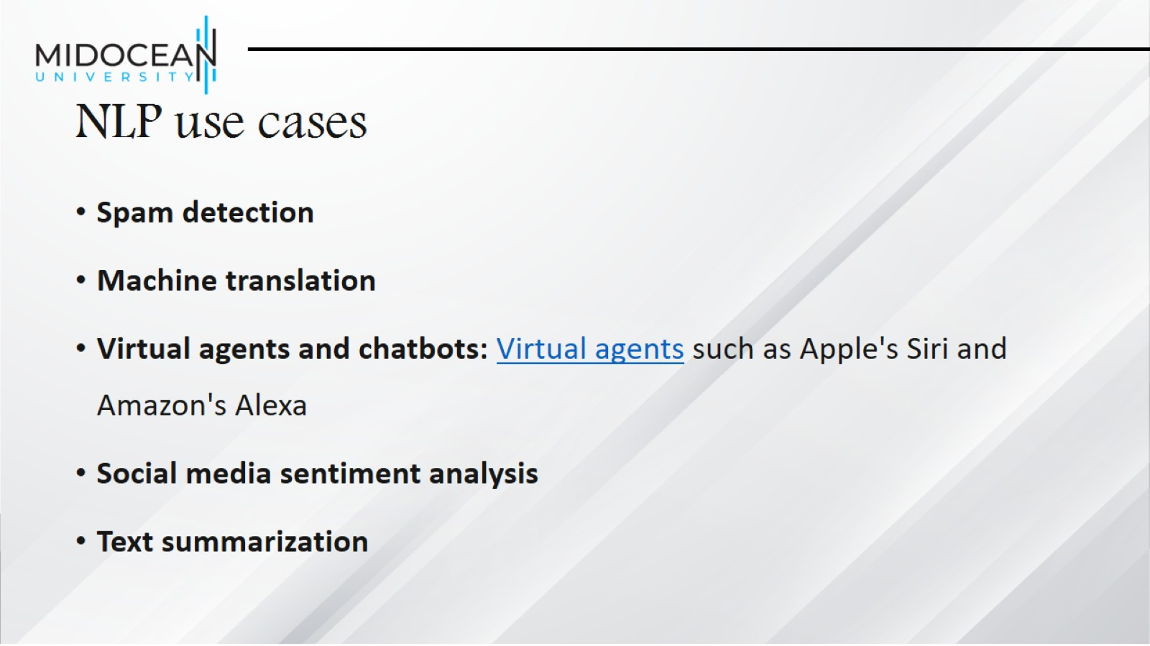
NLP use cases

Slide 8
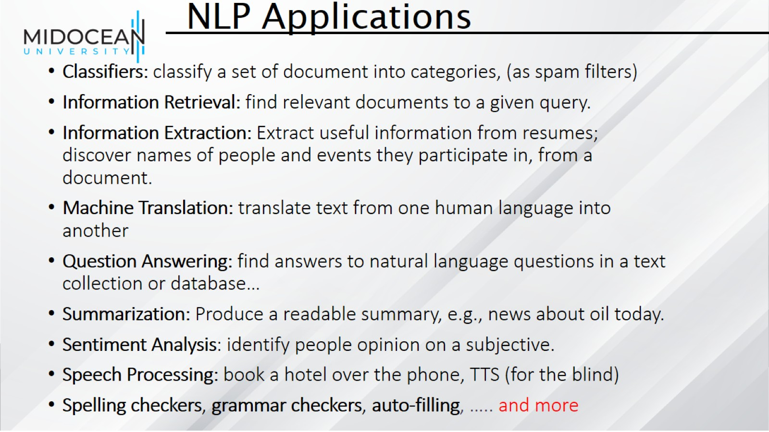

Slide 9
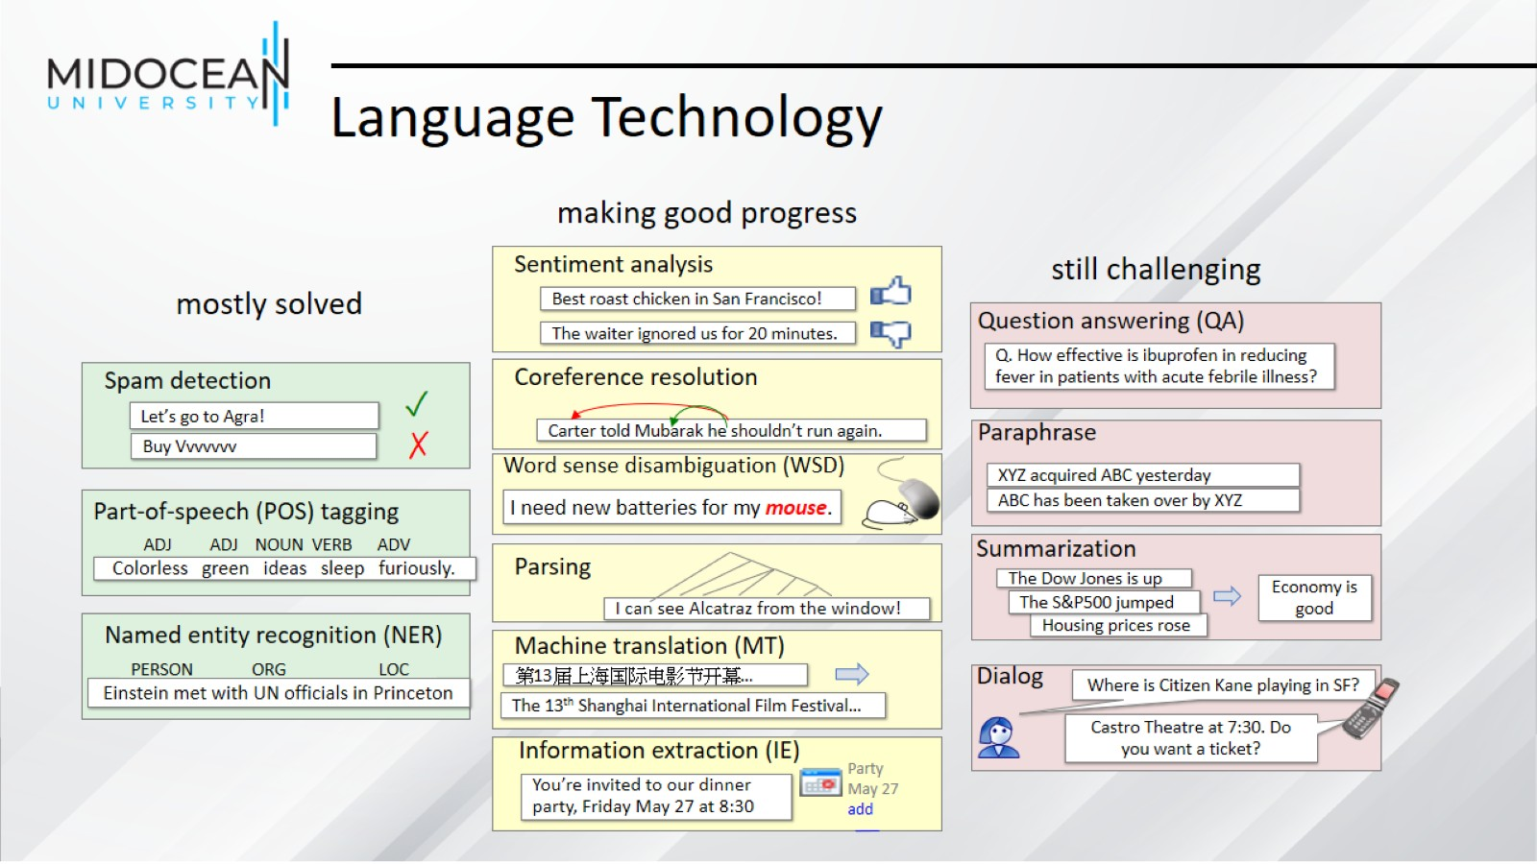
Language Technology

Slide 10
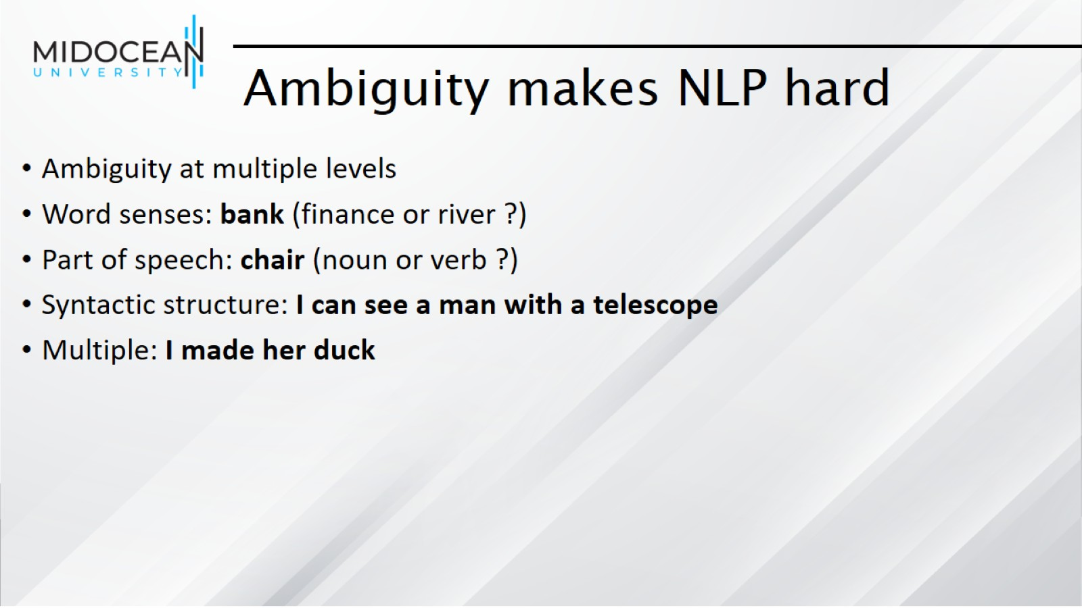
Ambiguity makes NLP hard

Slide 11
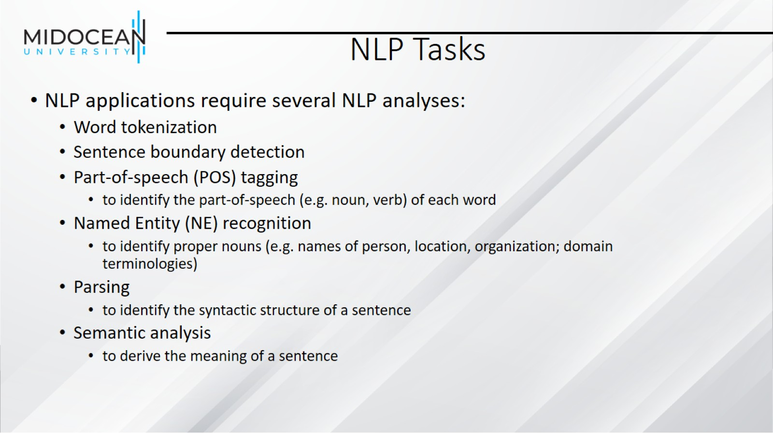
NLP Tasks

Slide 12
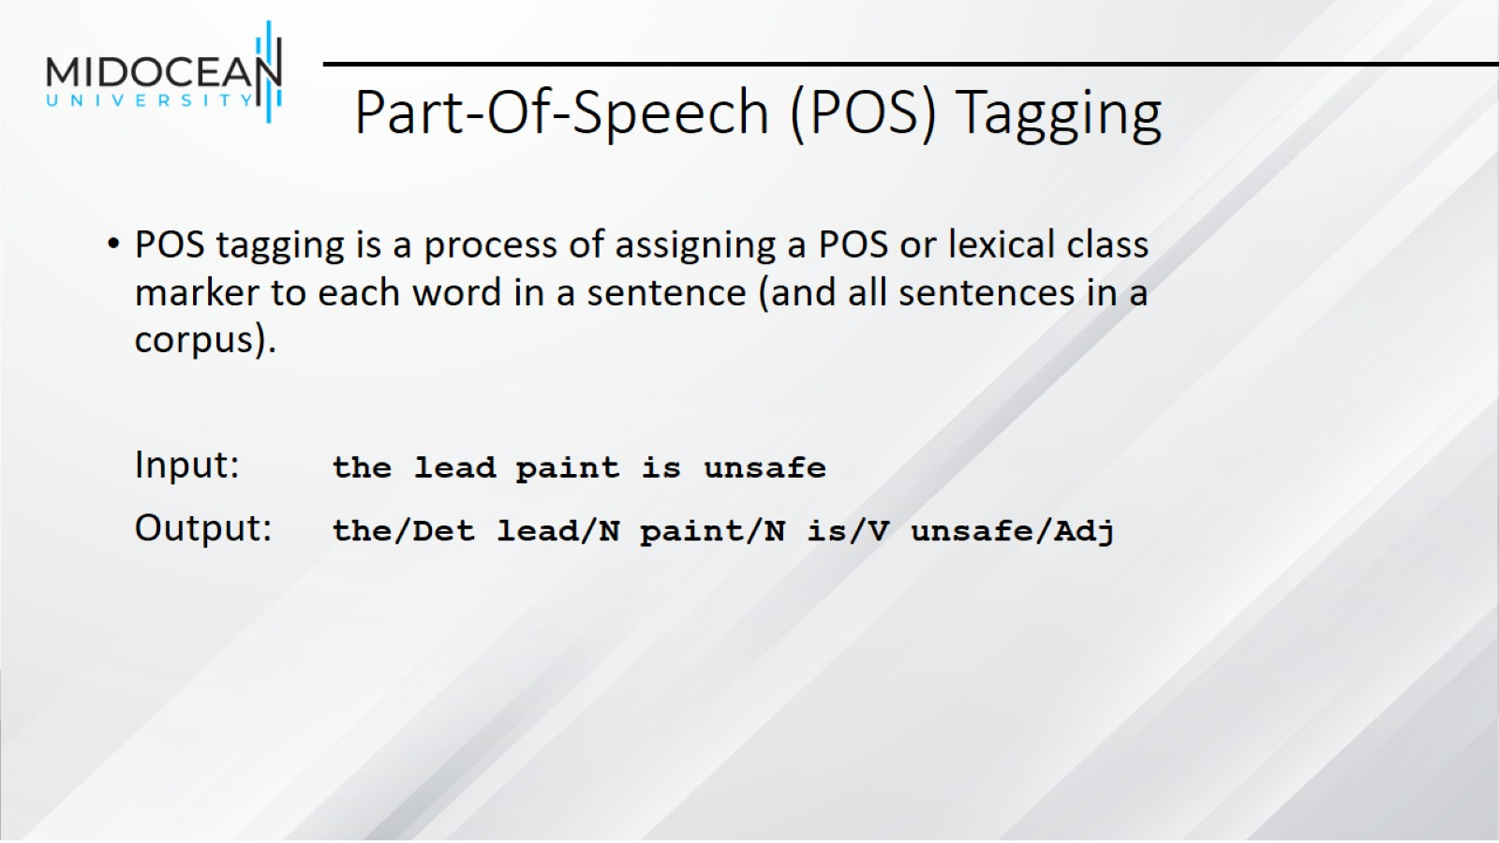
Part-Of-Speech (POS) Tagging

Slide 13
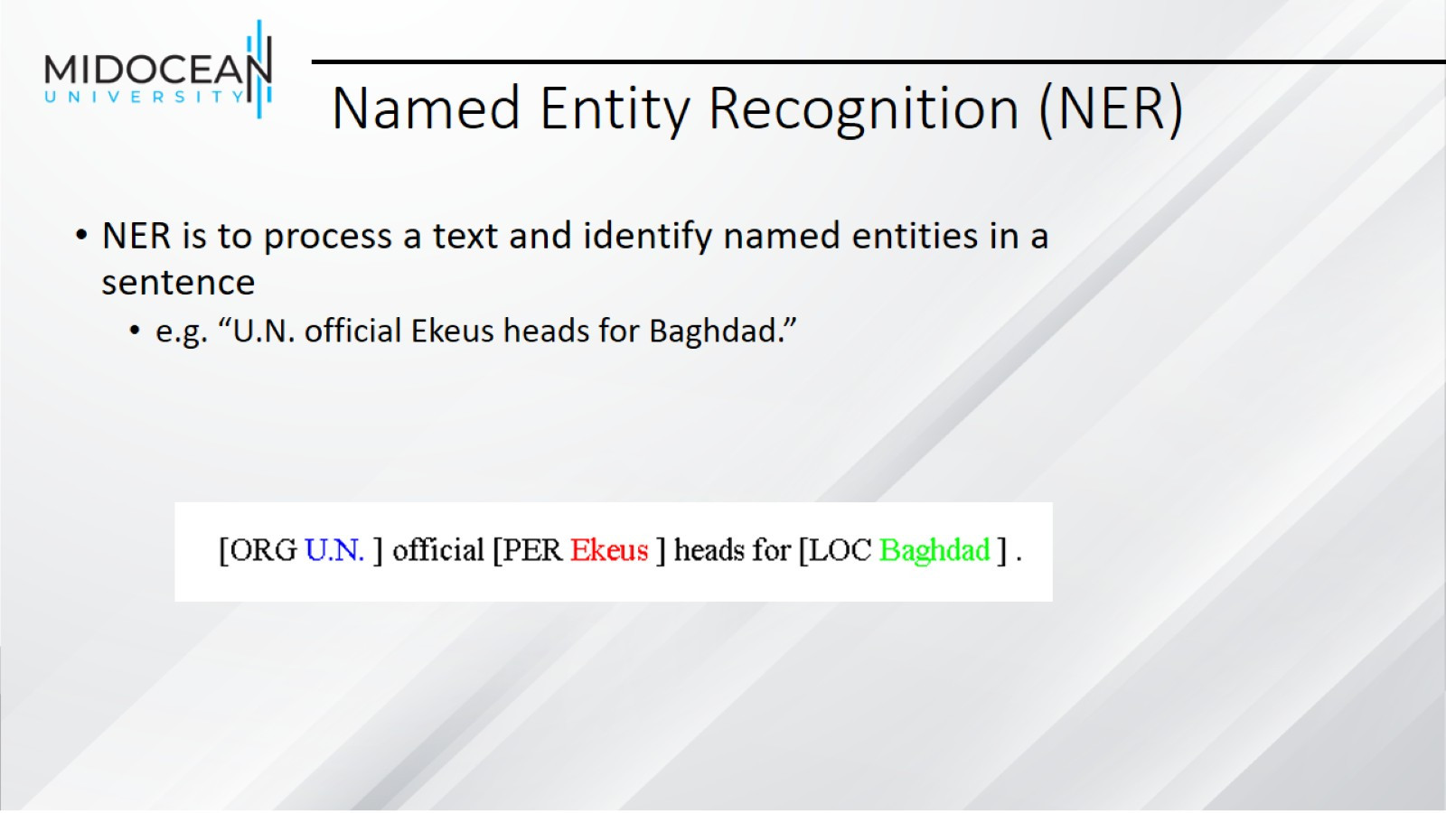
Named Entity Recognition (NER)

Slide 14
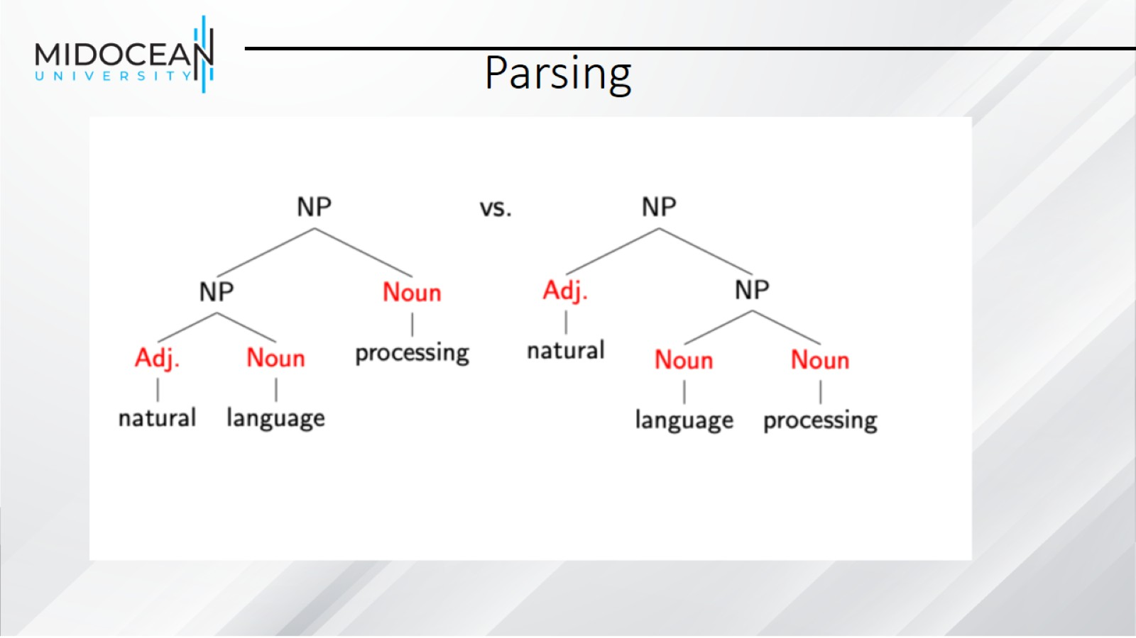
Parsing

Slide 15
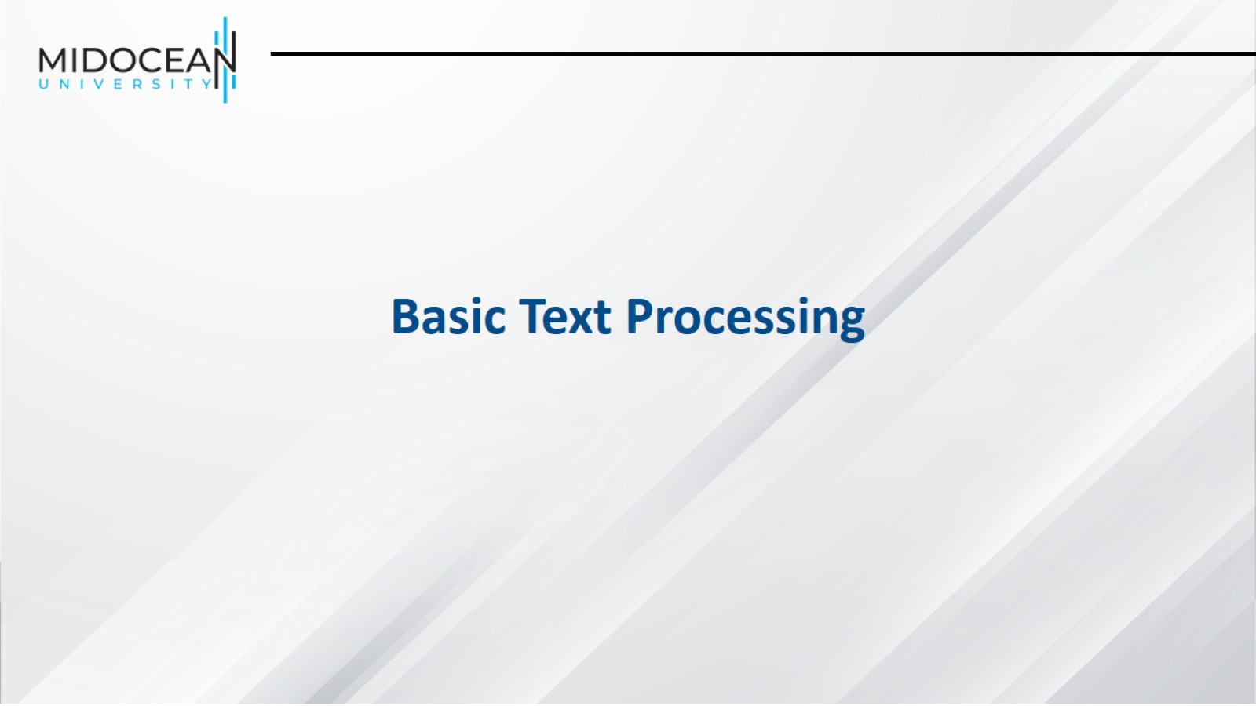

Slide 16
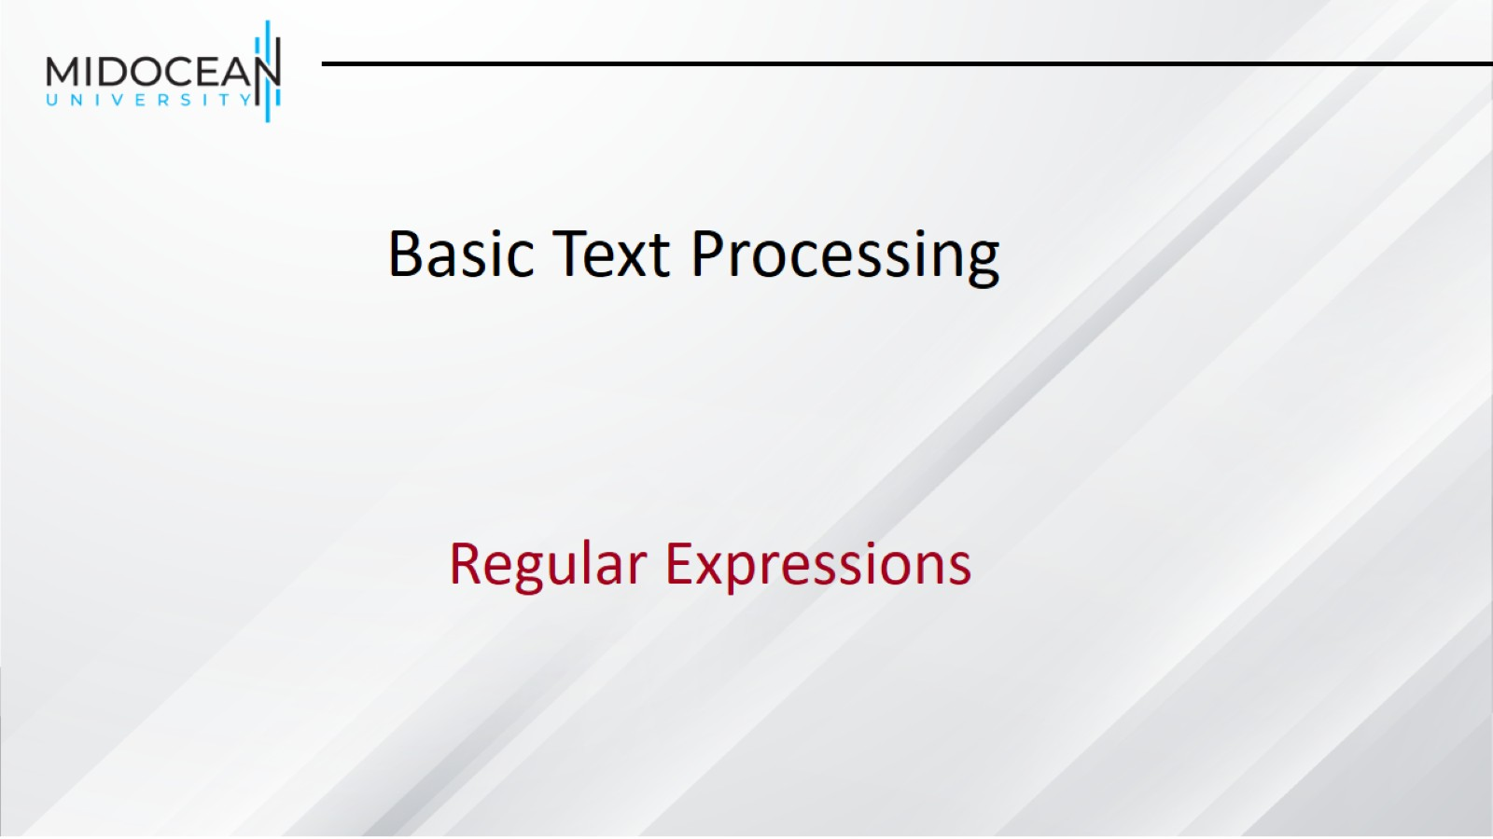

Slide 17
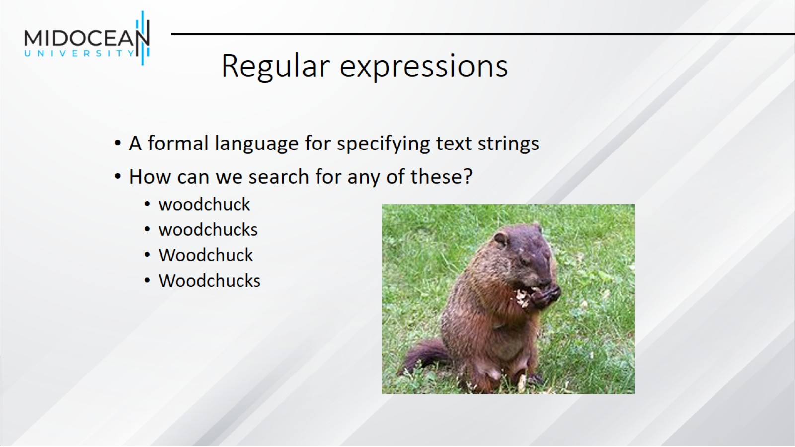
Regular expressions

Slide 18
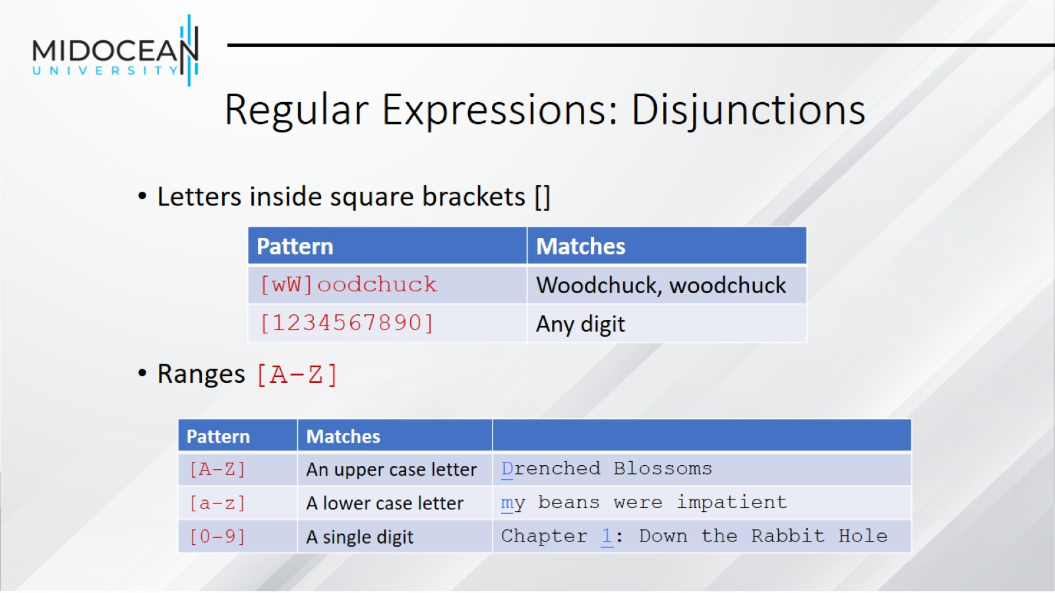
Regular Expressions: Disjunctions

Slide 19
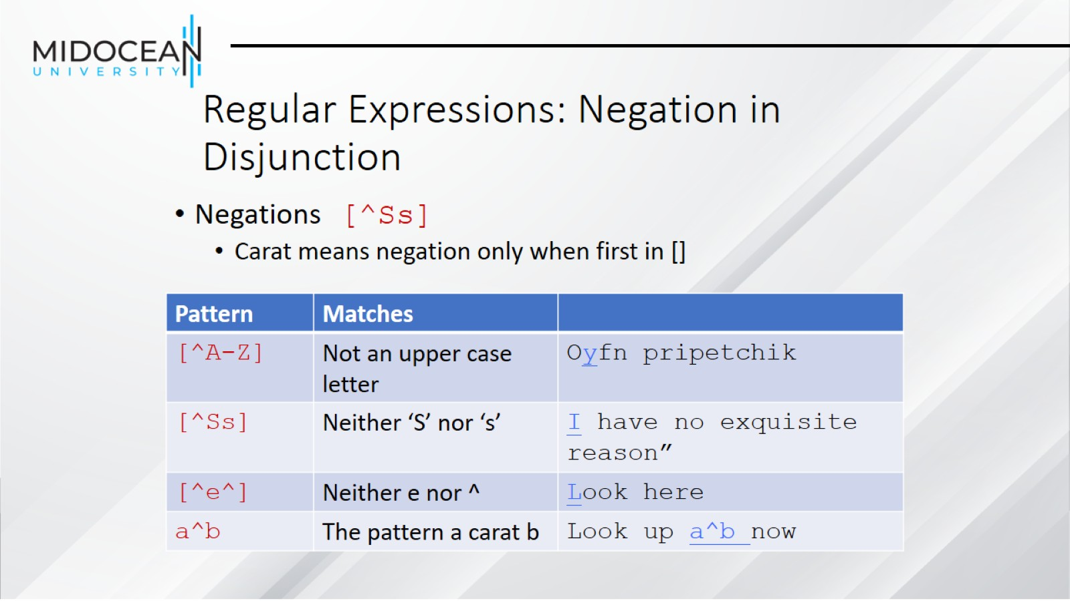
Regular Expressions: Negation in Disjunction

Slide 20
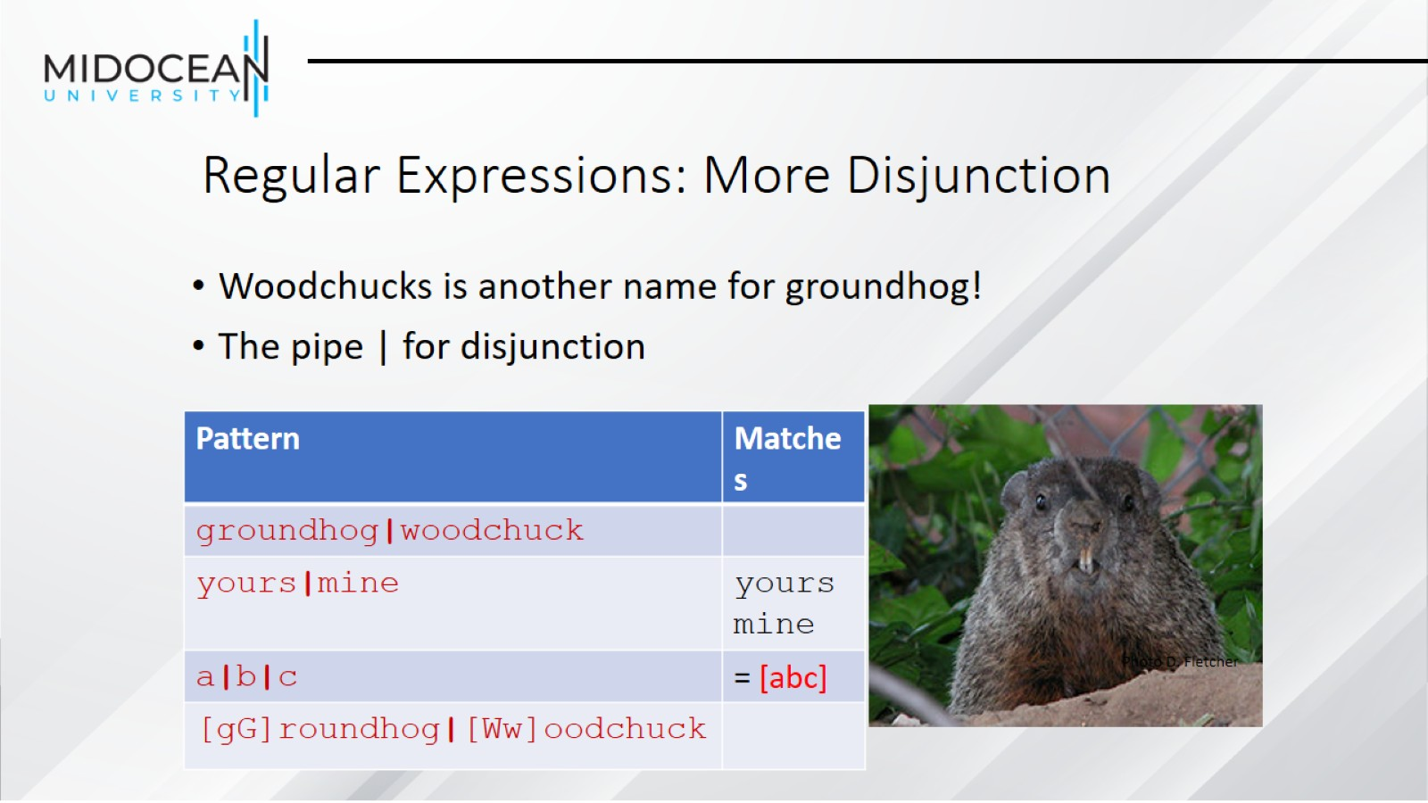
Regular Expressions: More Disjunction

Slide 21
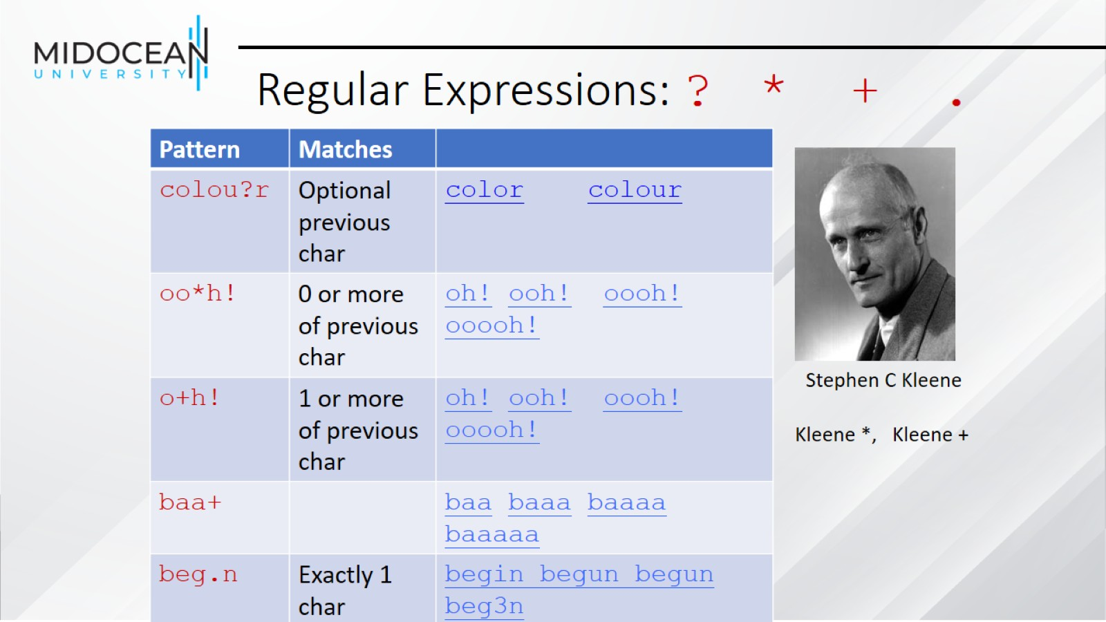
Regular Expressions: ? * + .

Slide 22
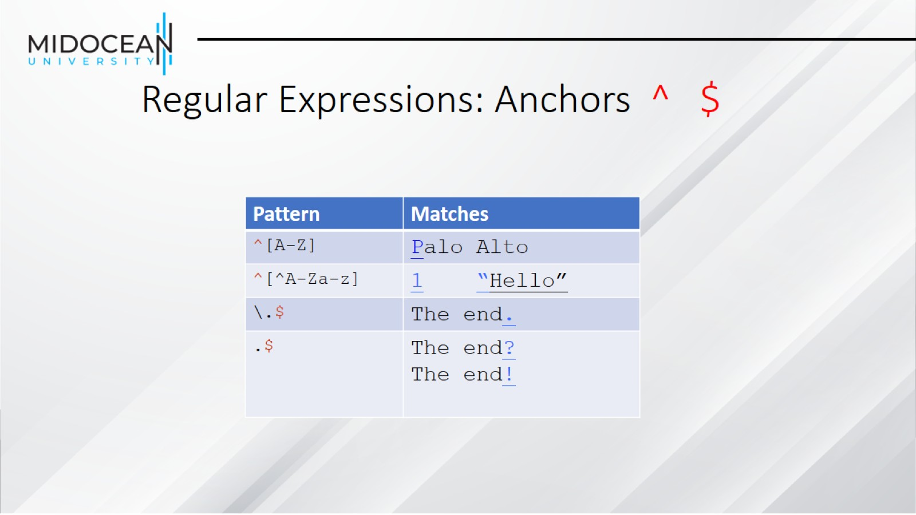
Regular Expressions: Anchors ^ $

Slide 23
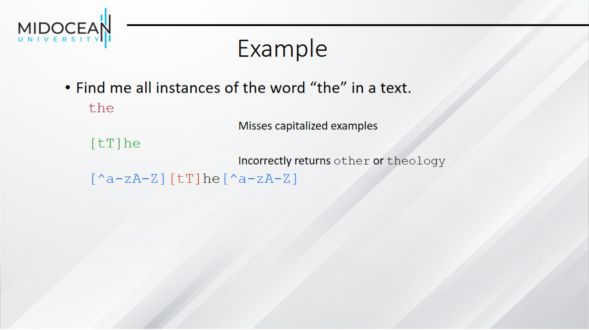
Example

Slide 24
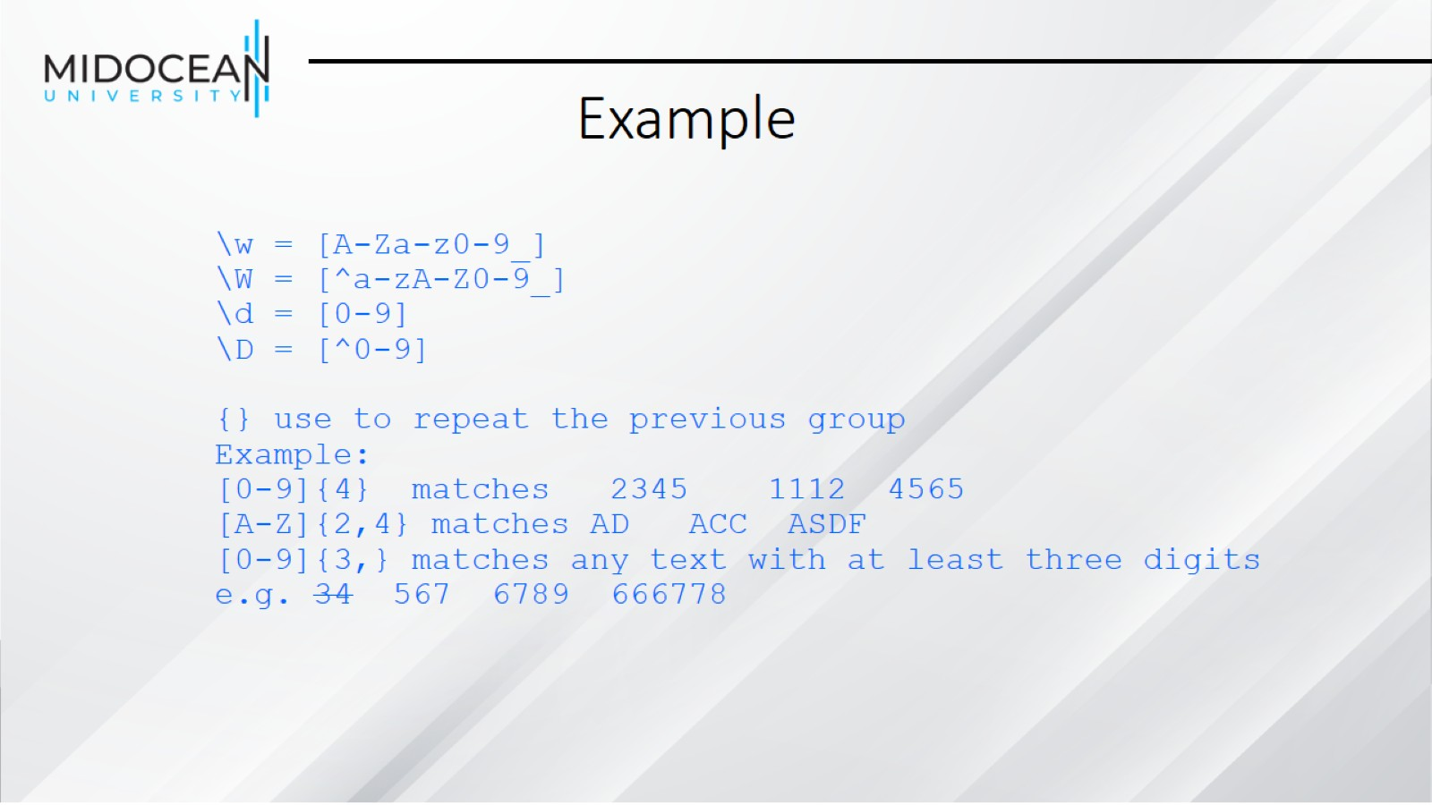
Example

Slide 25
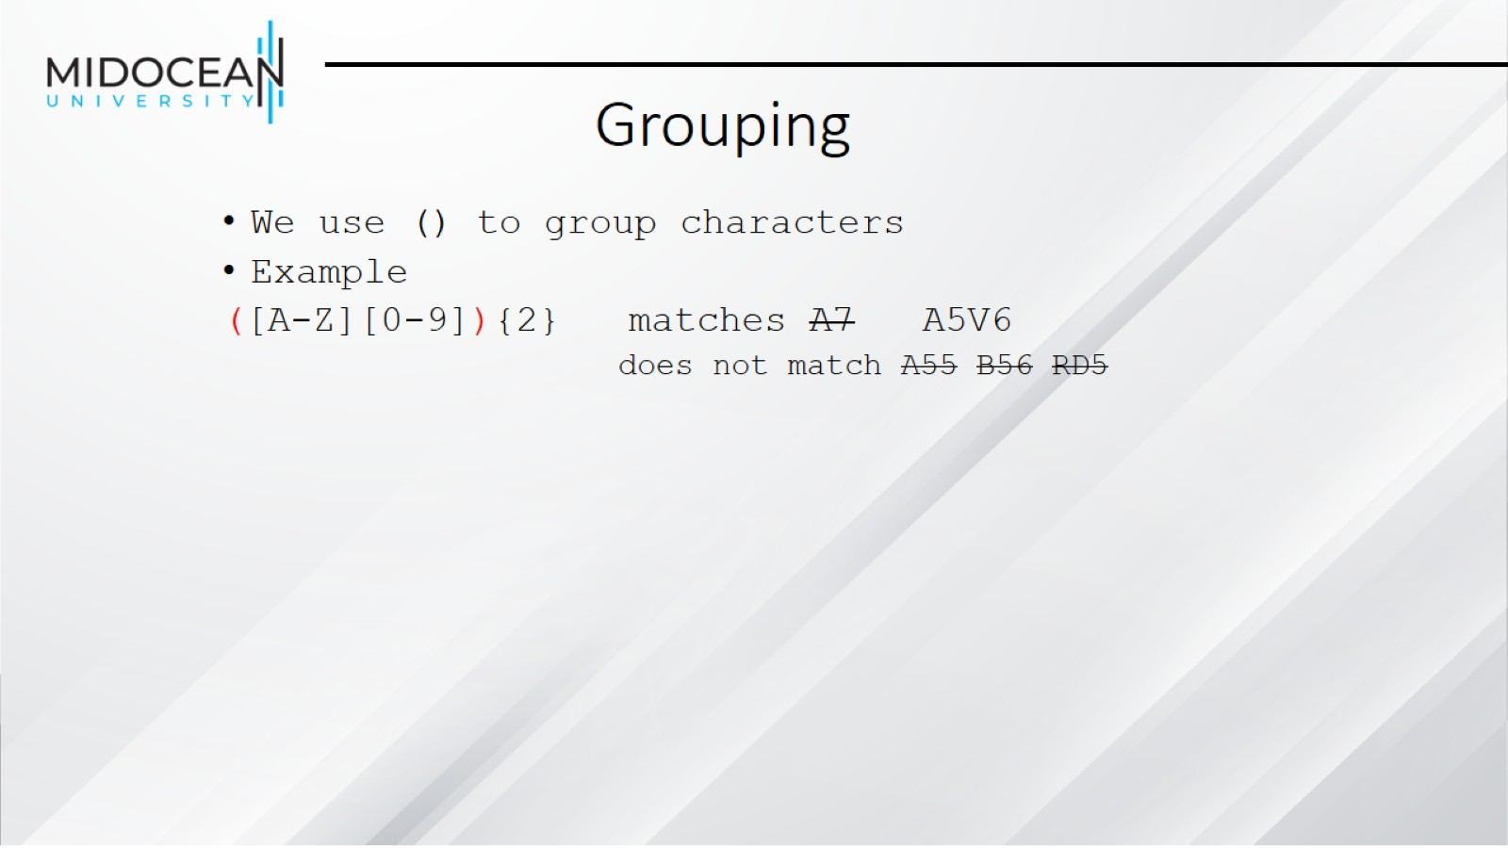
Grouping

Slide 26
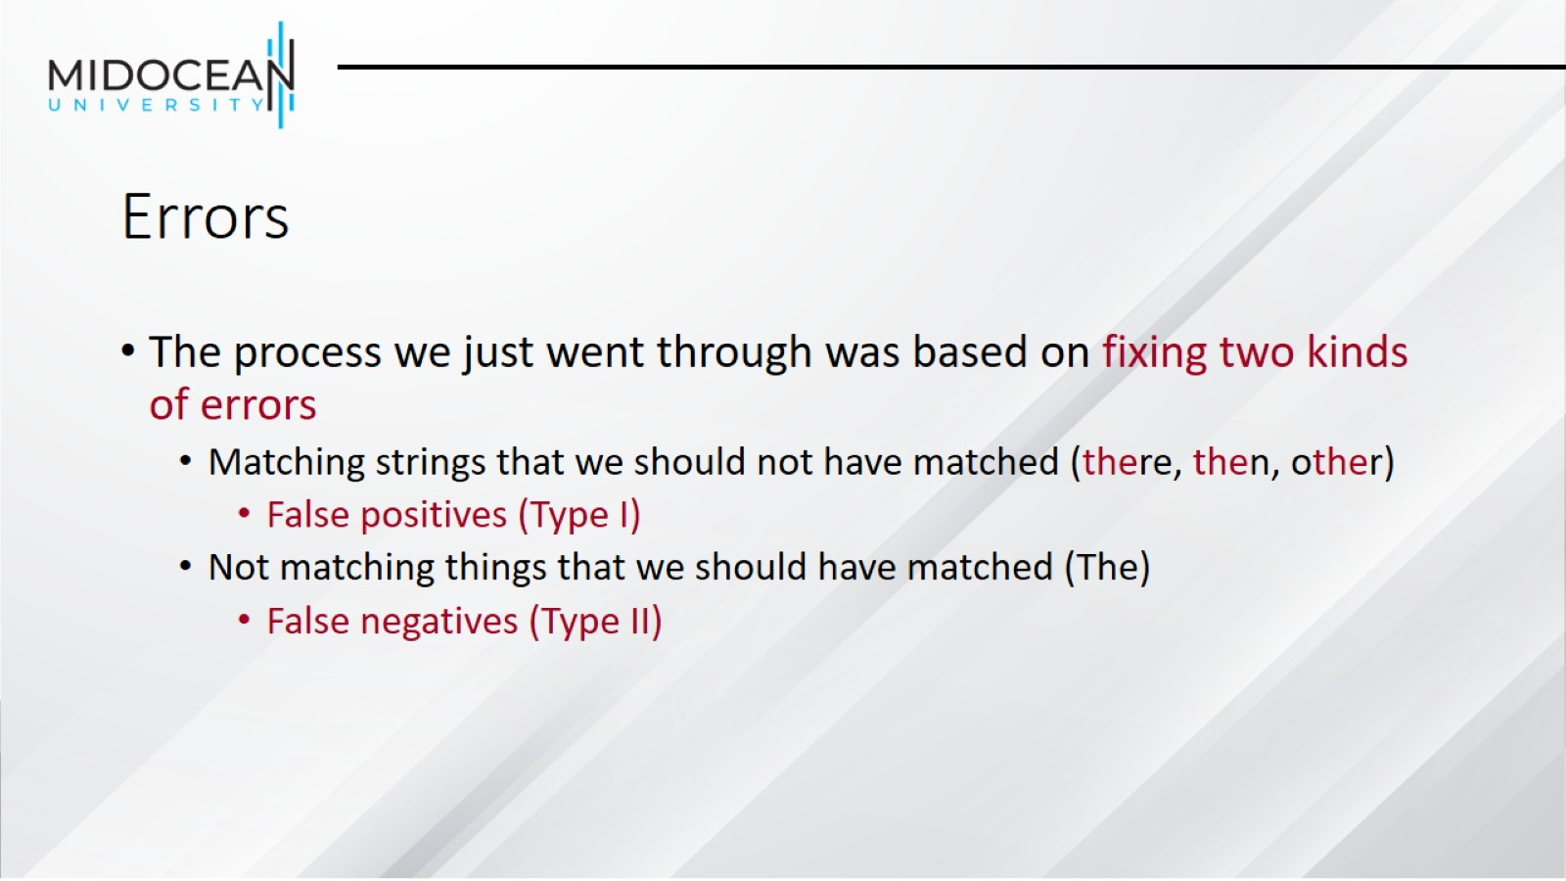
Errors

Slide 27
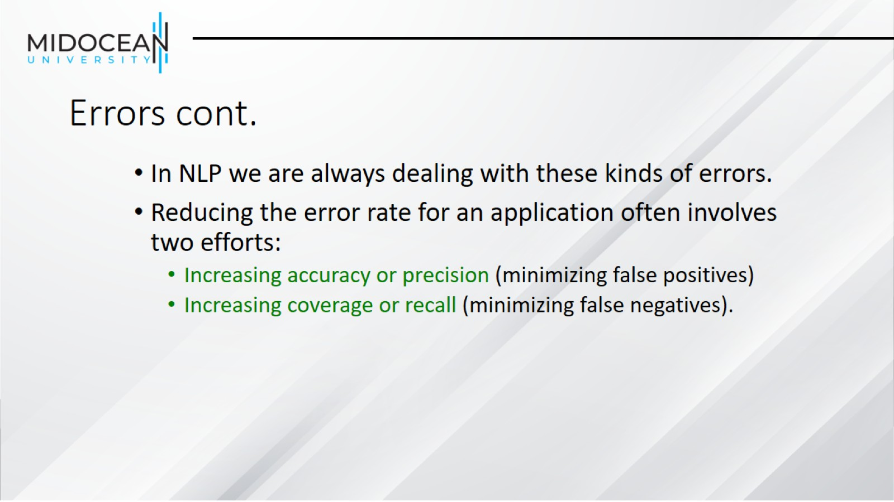
Errors cont.

Slide 28
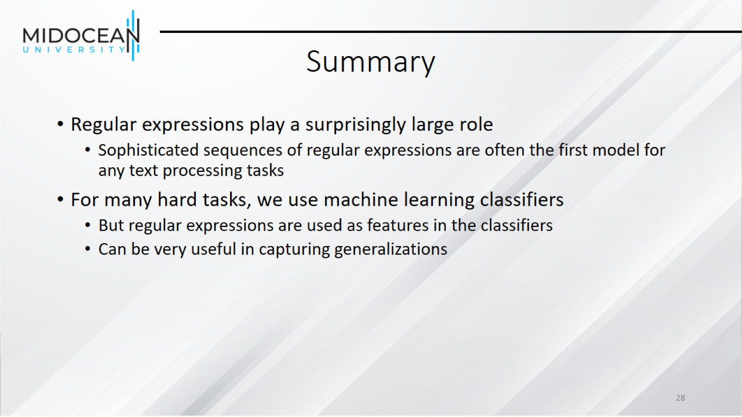
Summary

Slide 29
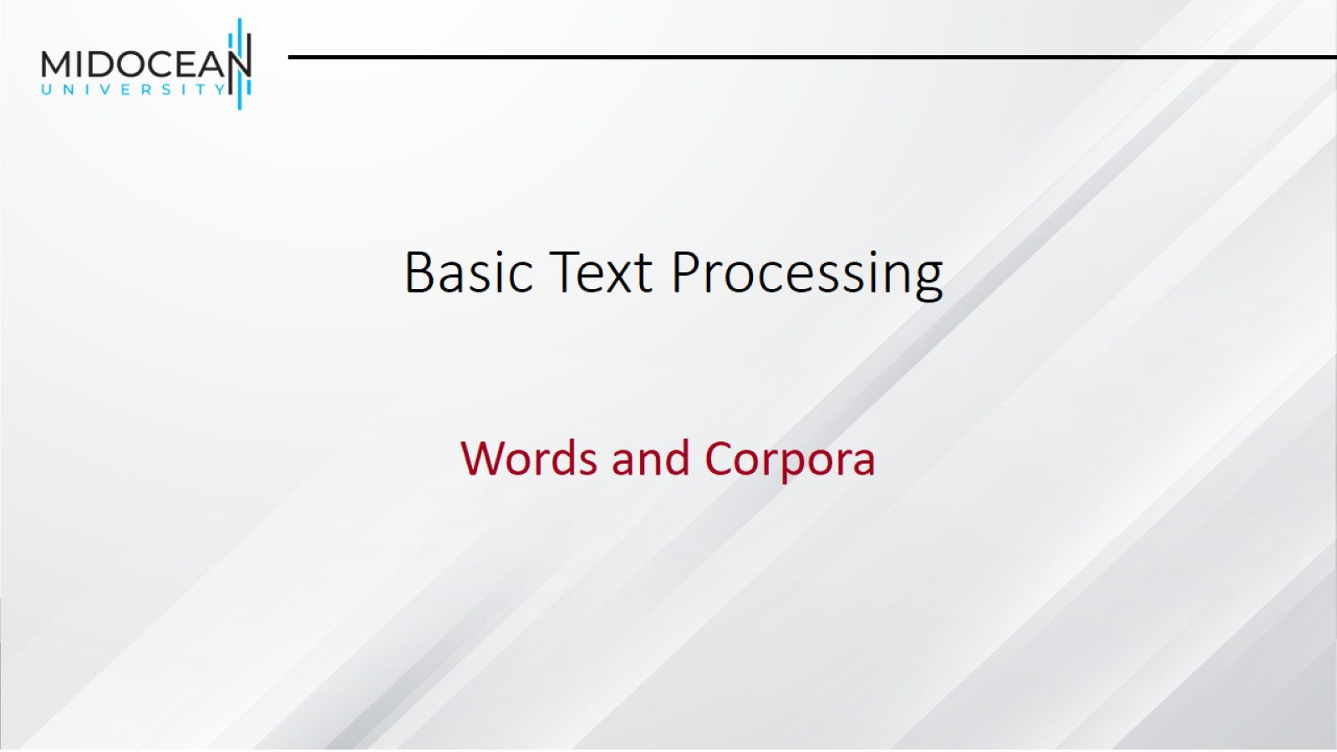
Basic Text Processing

Slide 30
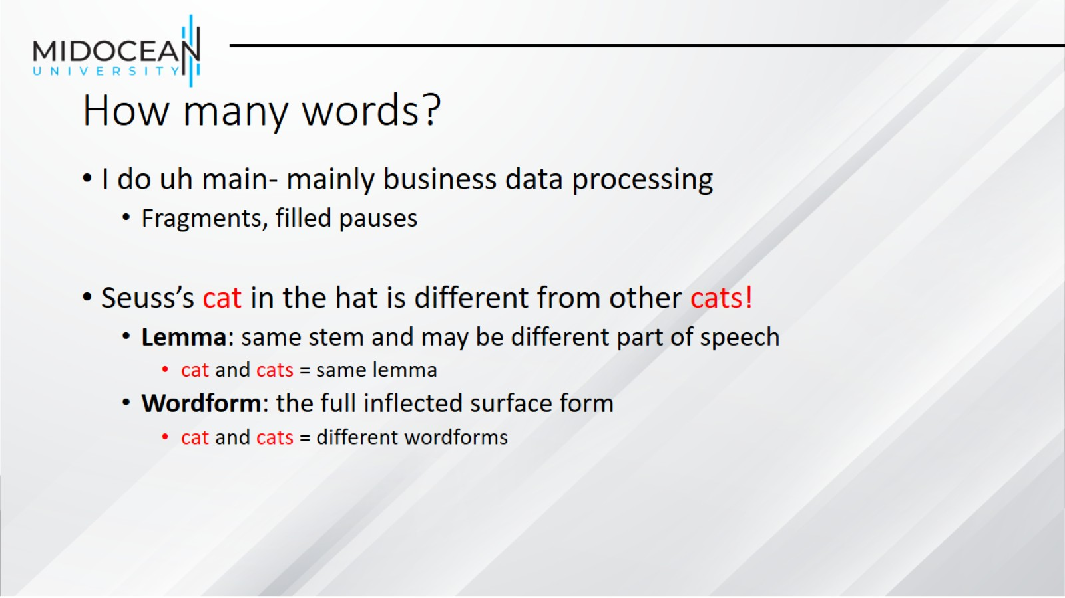
How many words?

Slide 31
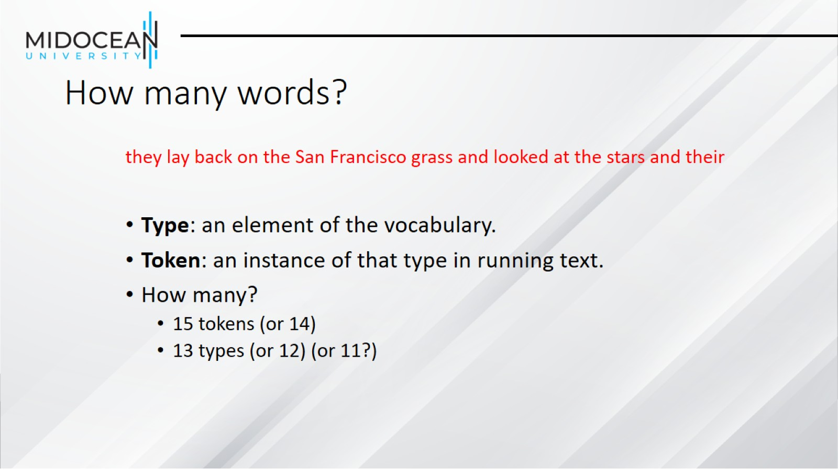
How many words?

Slide 32
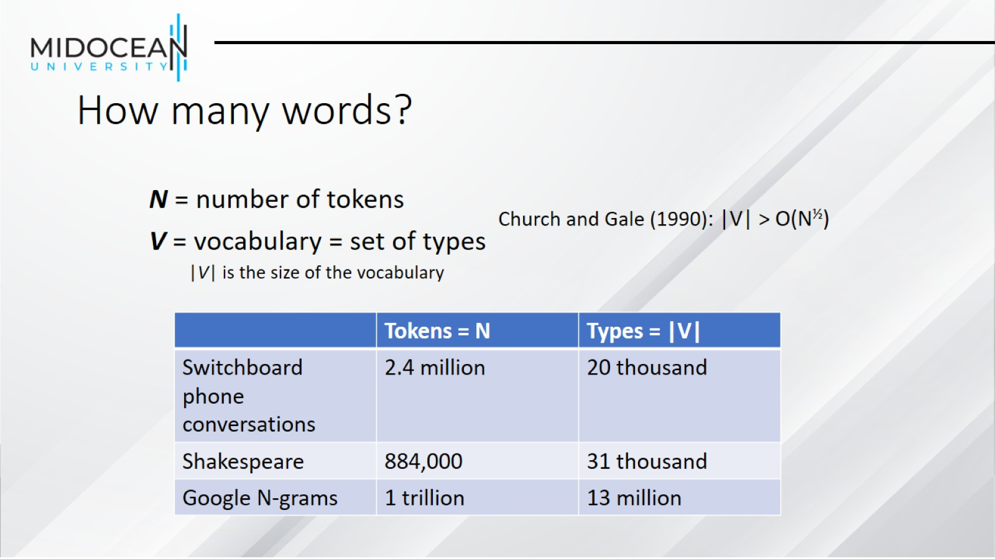
How many words?

Slide 33
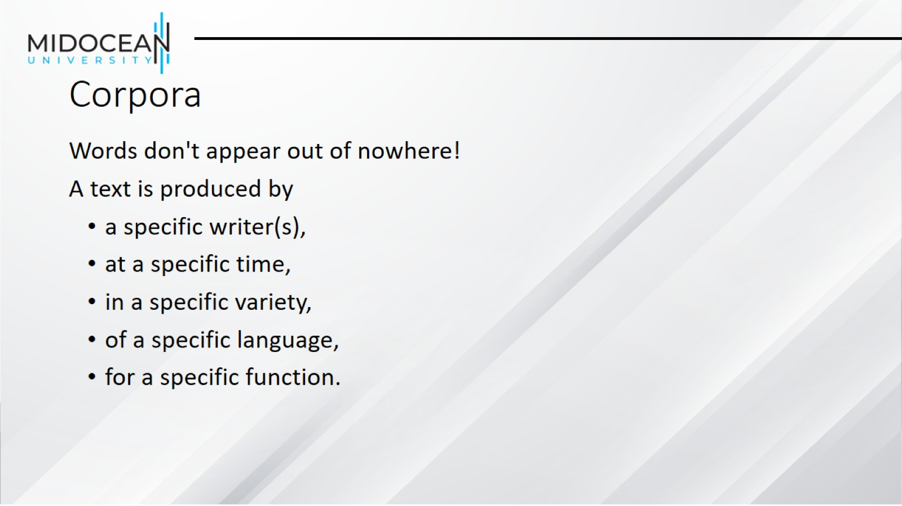
Corpora

Slide 34
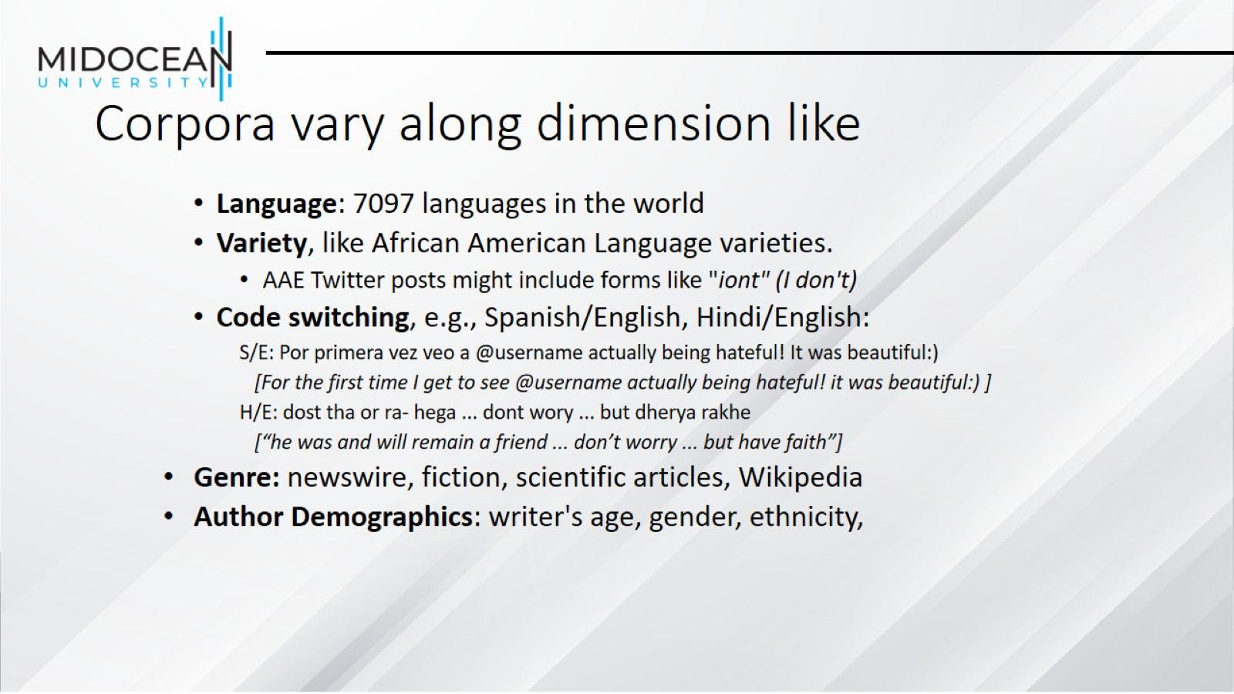
Corpora vary along dimension like

Slide 35
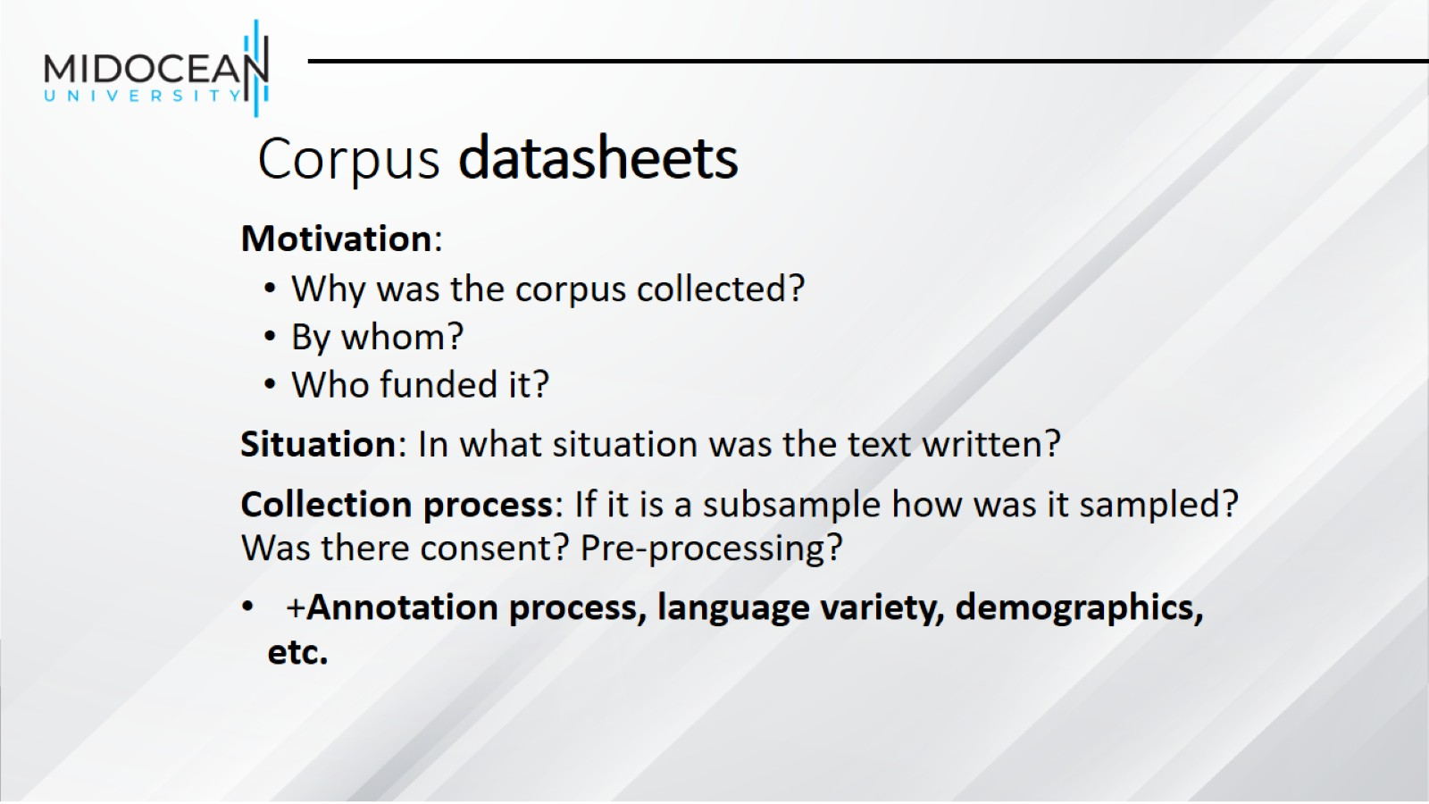
Corpus datasheets

Slide 36
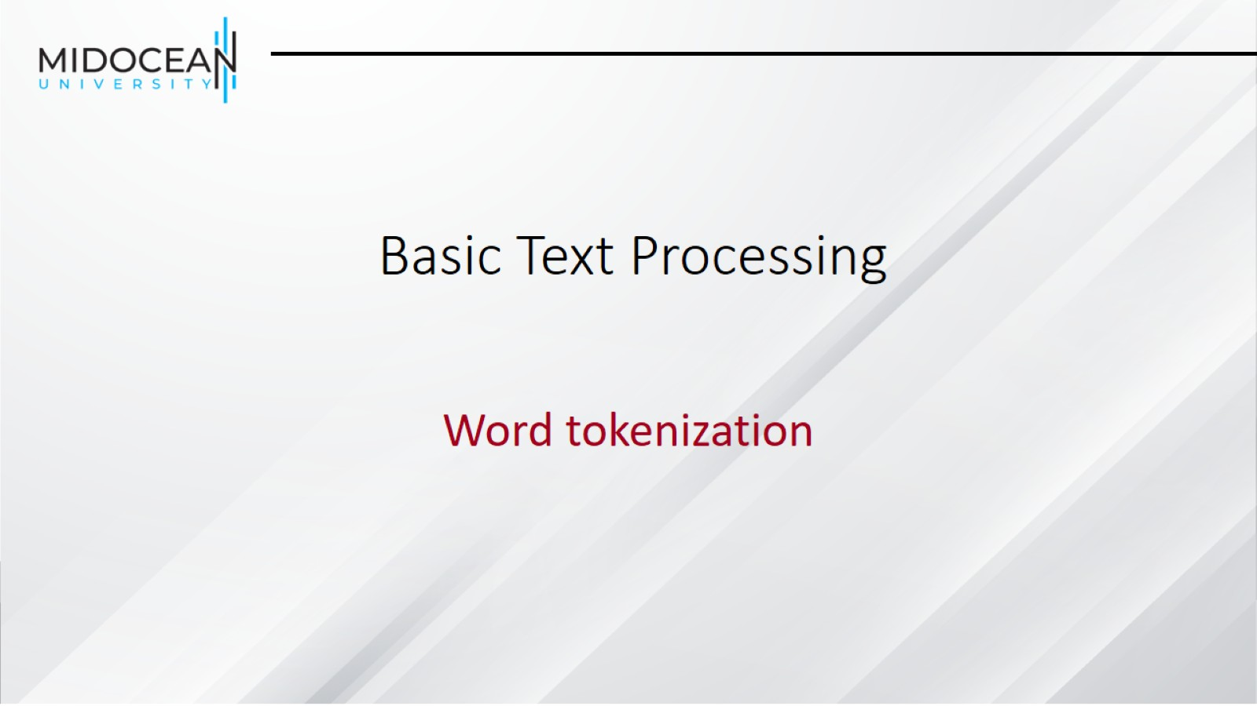
Basic Text Processing

Slide 37
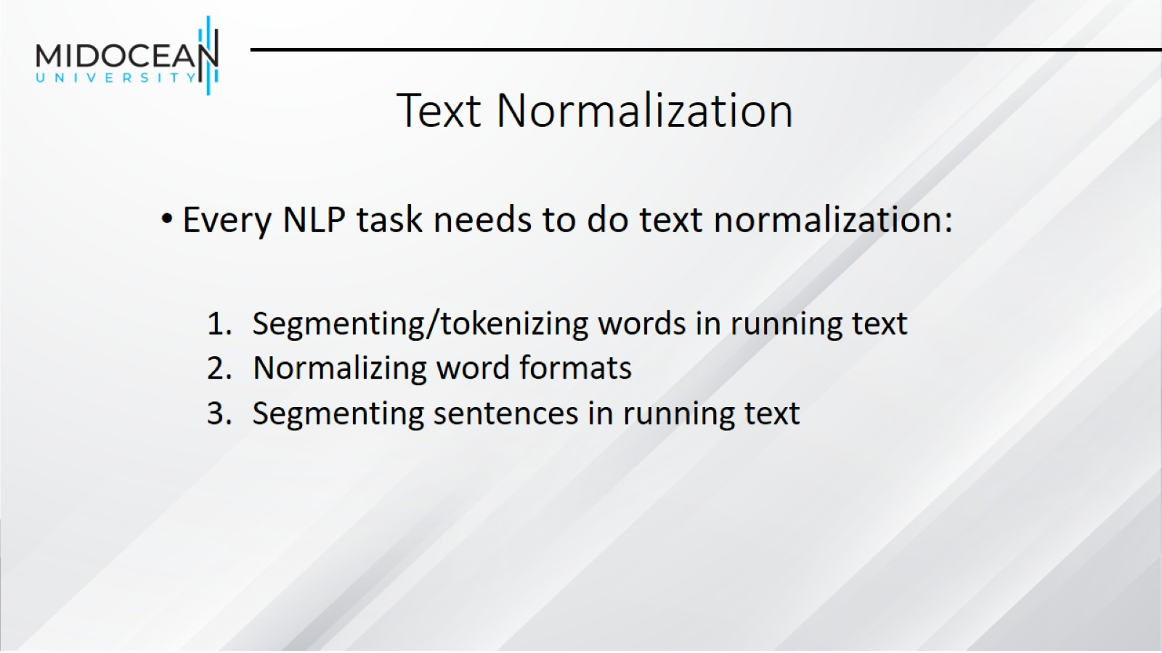
Text Normalization

Slide 38
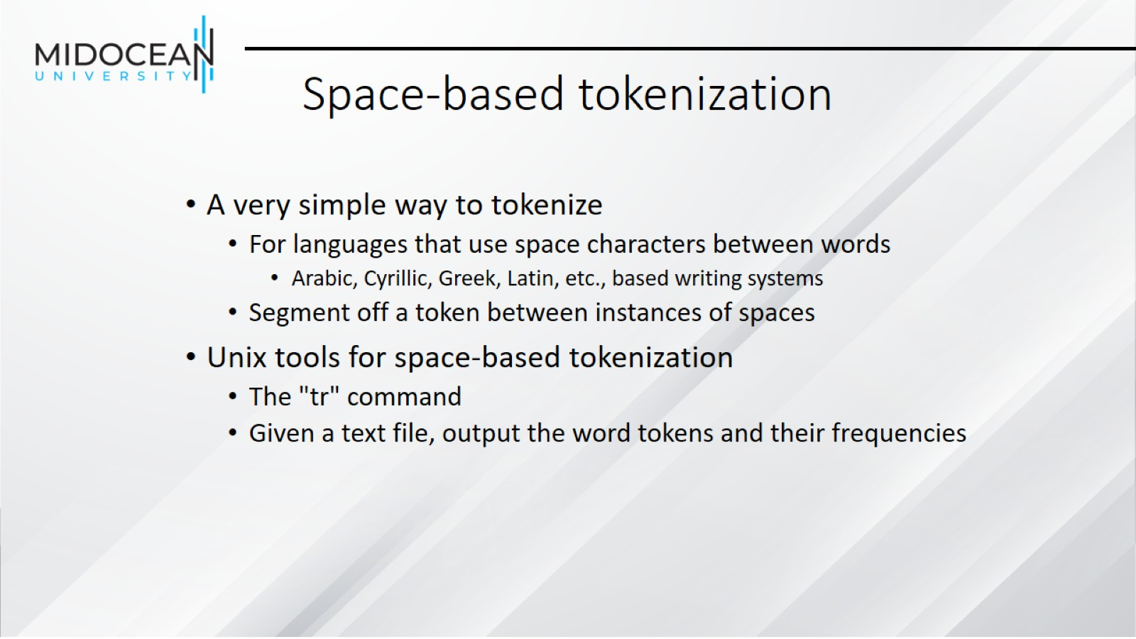
Space-based tokenization

Slide 39
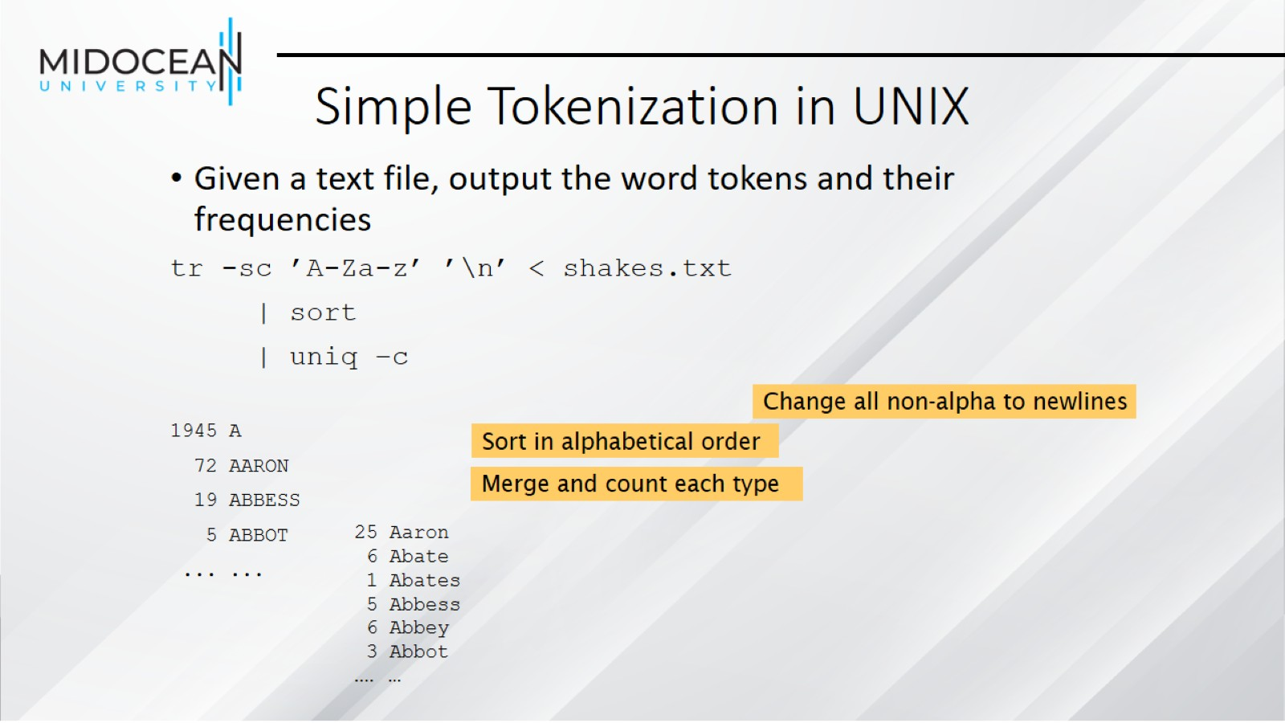
Simple Tokenization in UNIX

Slide 40
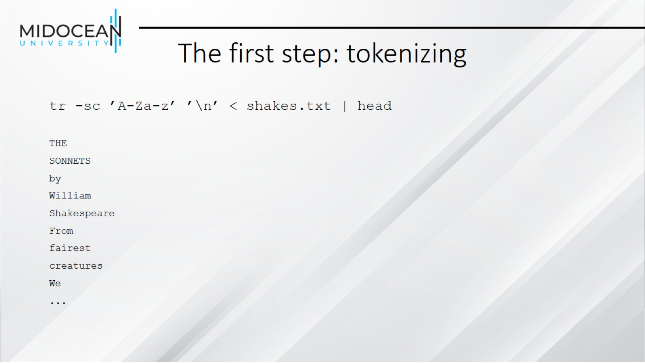
The first step: tokenizing

Slide 41
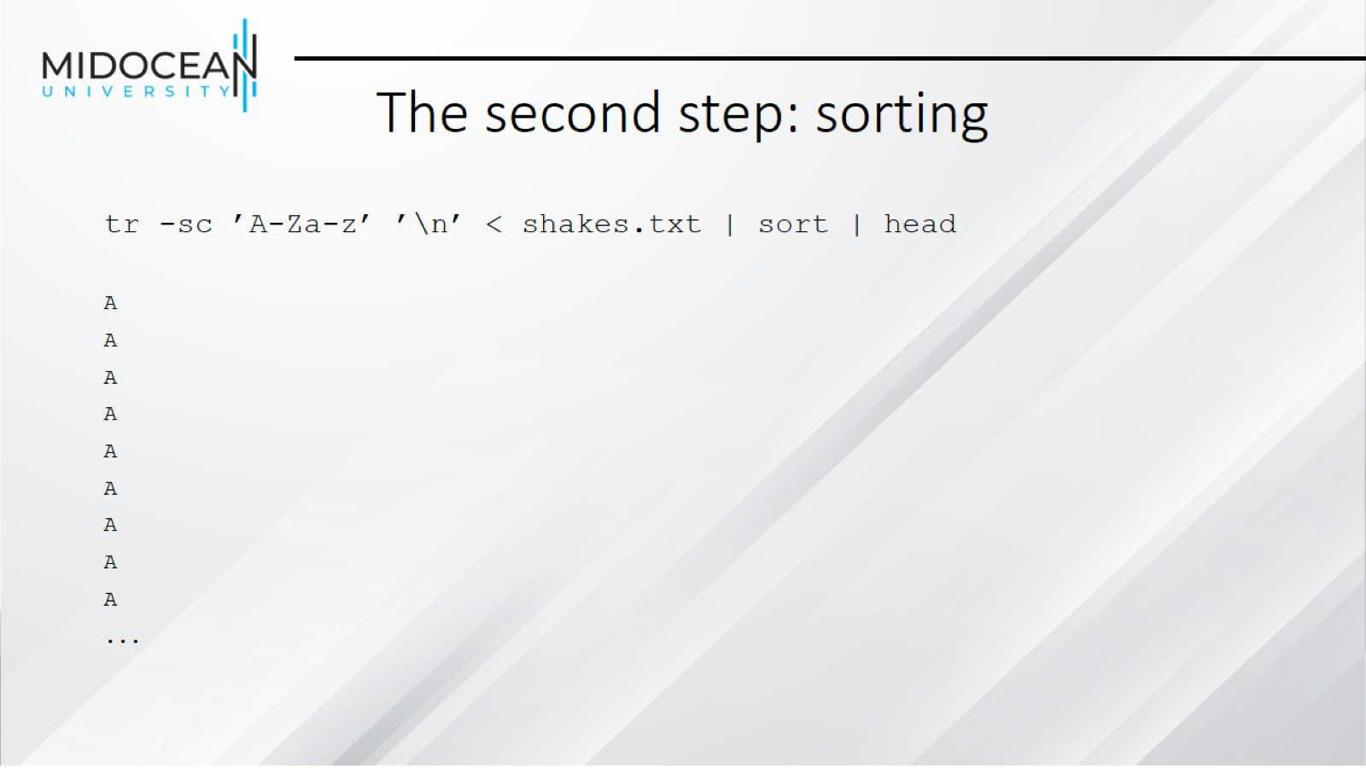
The second step: sorting

Slide 42
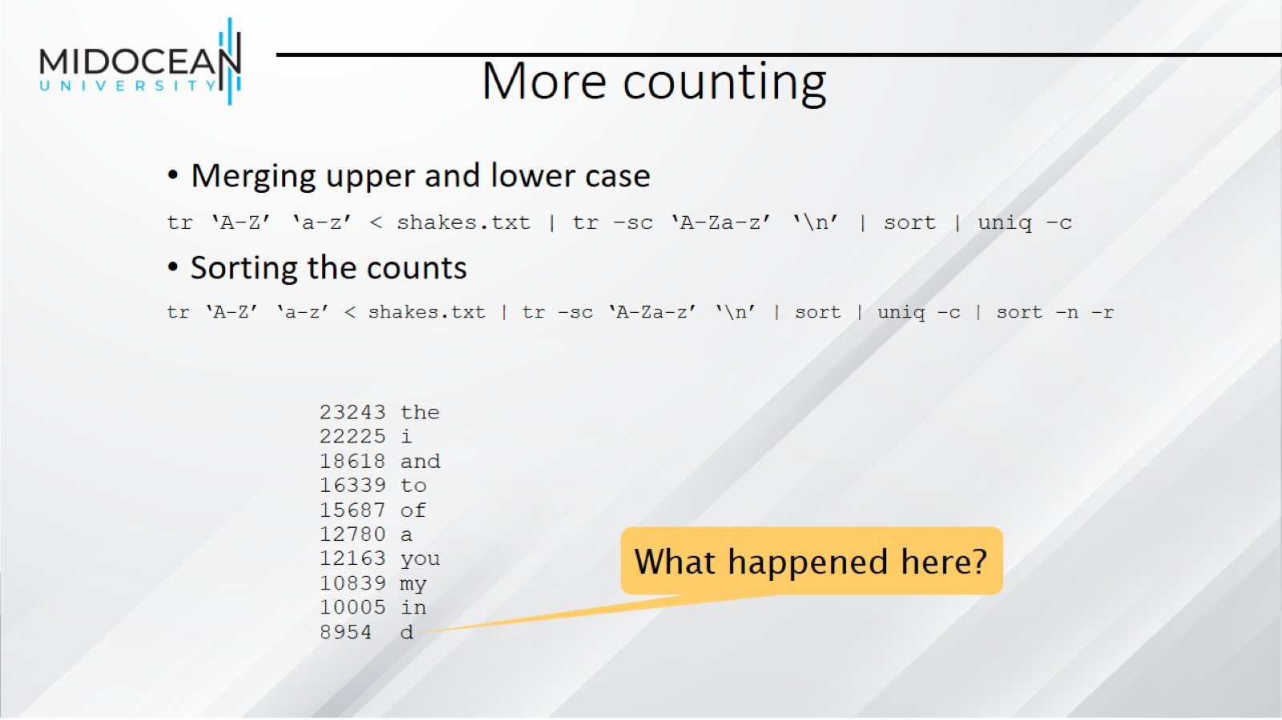
More counting

Slide 43
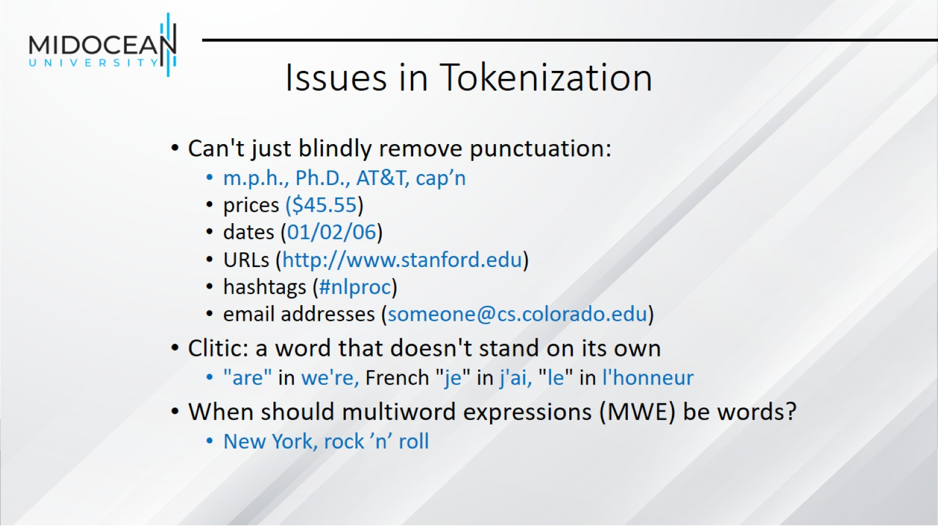
Issues in Tokenization

Slide 44
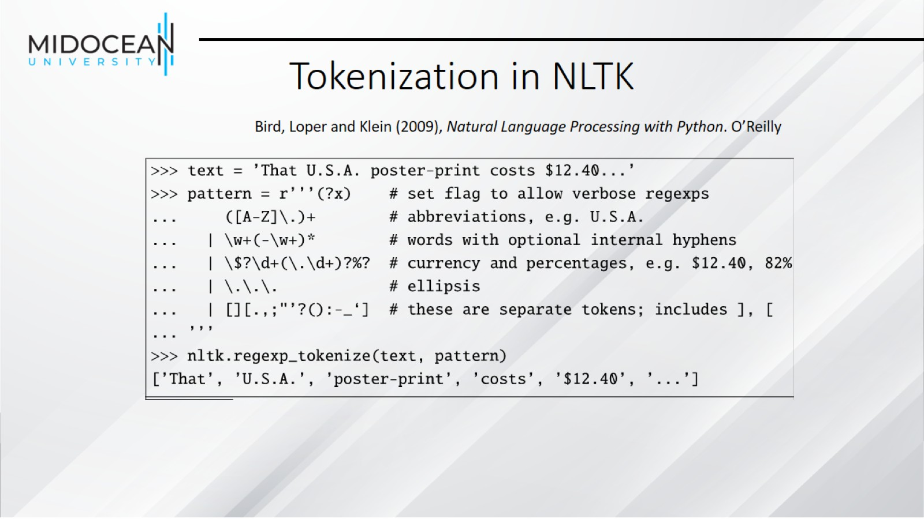
Tokenization in NLTK

Slide 45
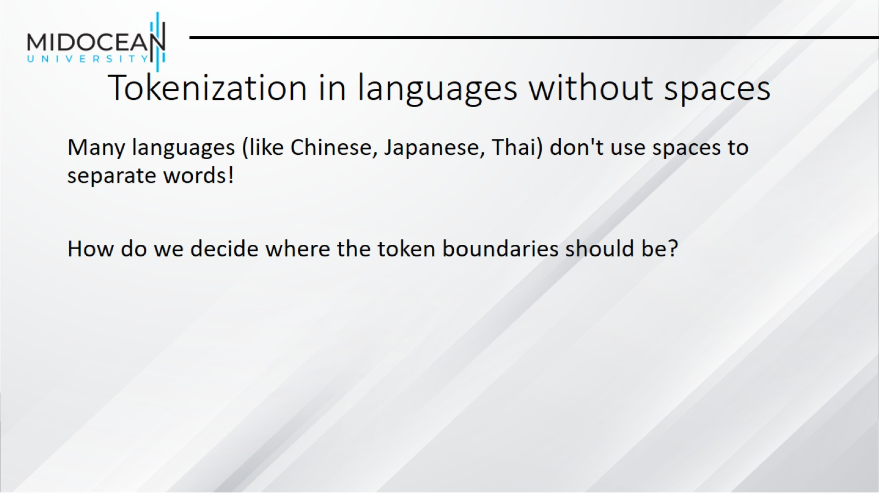
Tokenization in languages without spaces

Slide 46
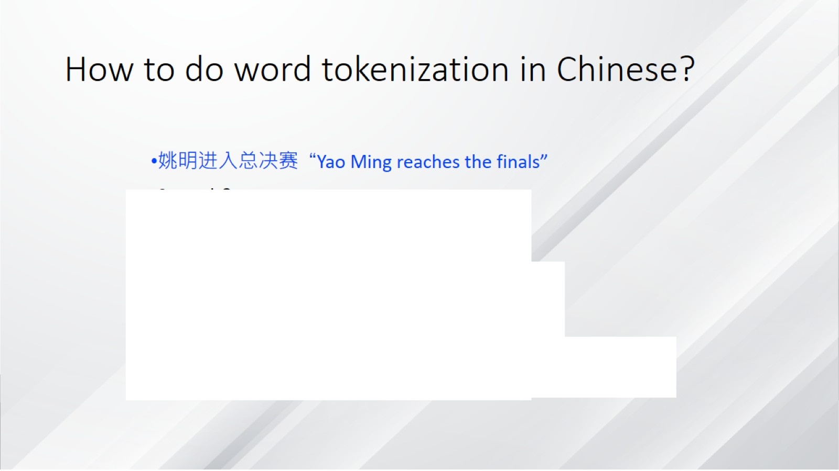
How to do word tokenization in Chinese?

Slide 47
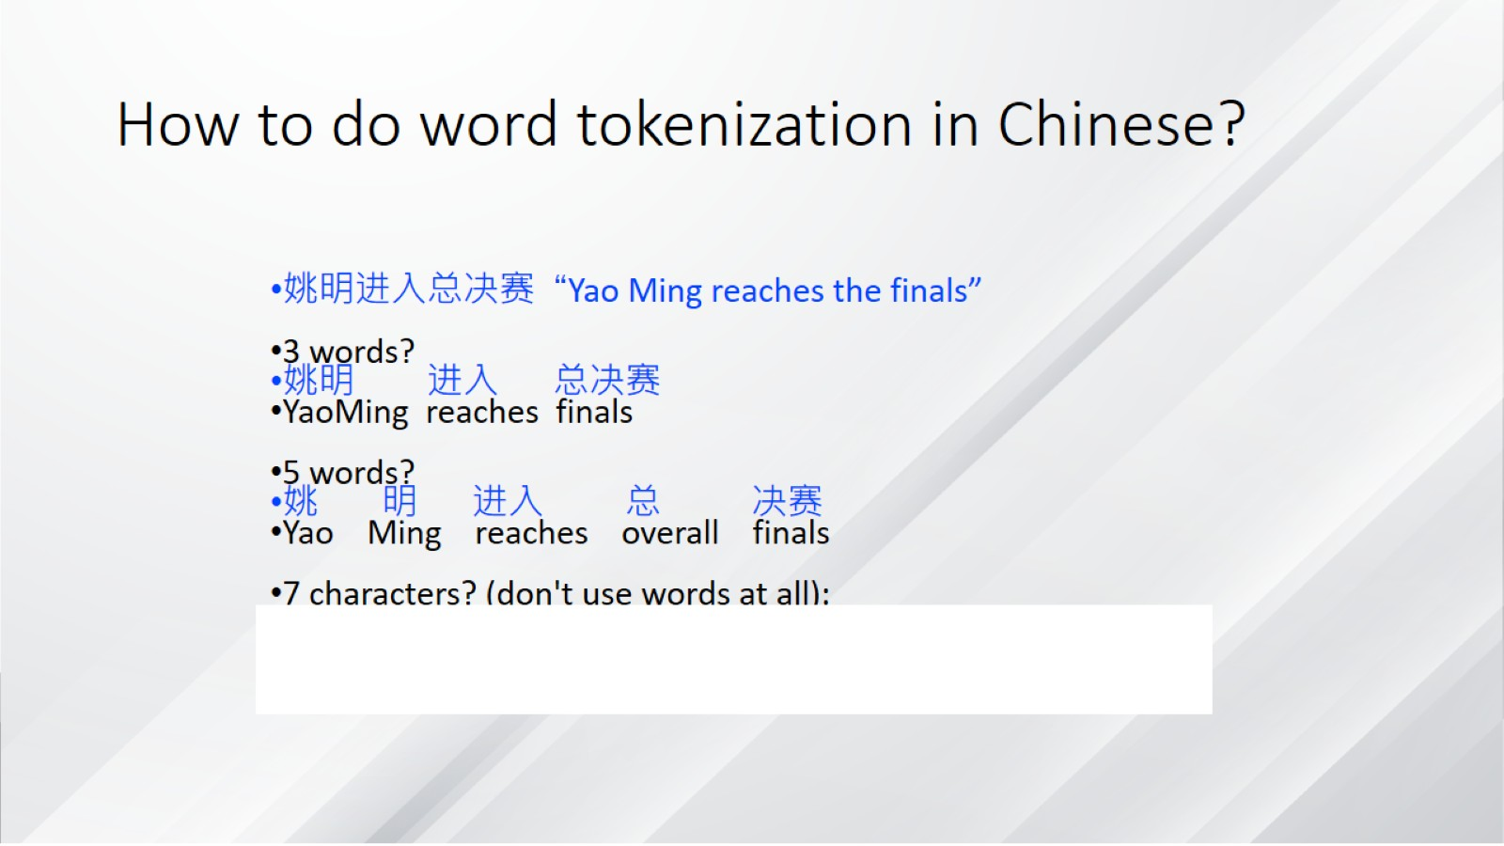
How to do word tokenization in Chinese?

Slide 48
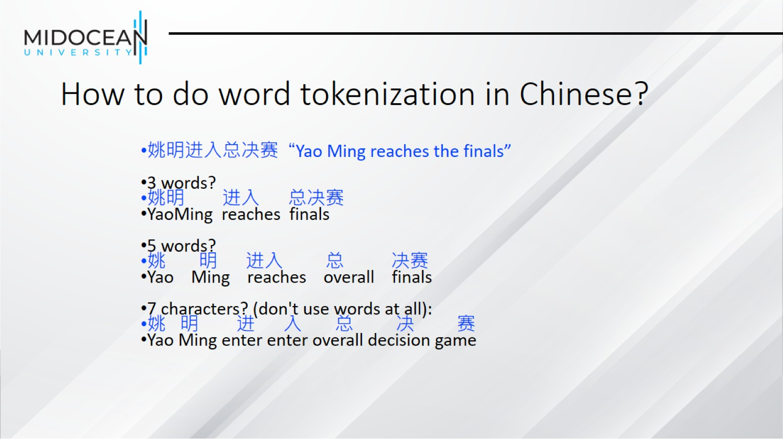
How to do word tokenization in Chinese?

Slide 49
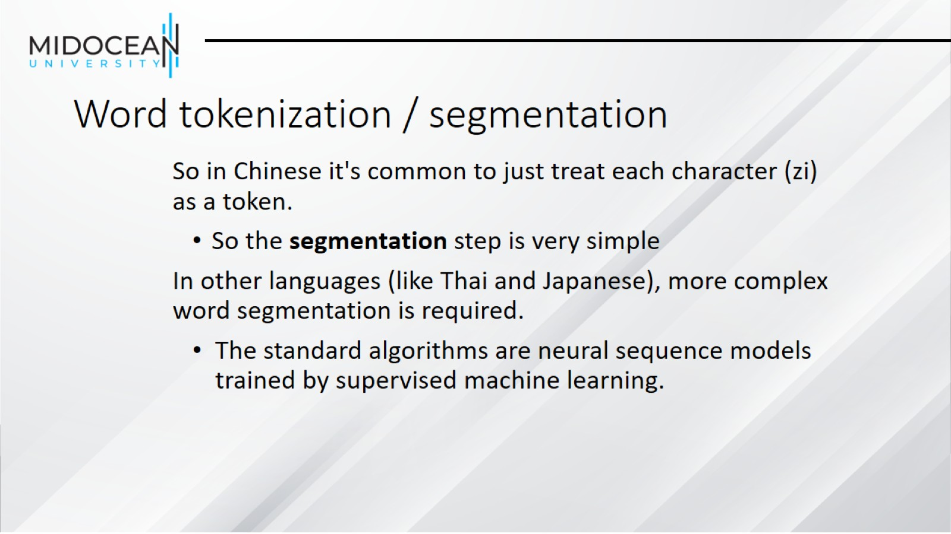
Word tokenization / segmentation

Slide 50


