Slide 1

PMG 202
Project Planning
Prepared by Dr. Maryam ZORGUI
PART II :
Execution and Control Phases
Project
Execution
Lecture 8

Slide 2
In the previous lessons…
The Project Management Body of Knowledge (PMBOK) divides projects into five phases. Although the term ‘phase’ implies that they are carried out in chronological order, in practice they can be performed out of order. For example, when project changes occur the project manager would proceed back to the planning phase. For this reason they are officially called Process Groups.

Slide 3
In the previous lessons…
Project Initiation and Planning are the two phases of the Project Life Cycle and in these stages, we decide if the Project is needed and how beneficial it will be for the Stakeholders.
The two metrics that are used to judge a proposed Project and determine the expectations from it are the Business Case and Feasibility Study.
Project Initiation and Planning, without a doubt, require a clear understanding of the needs of your organization and the immediate steps to be undertaken to get a project off the ground.
Lecture 8

Slide 4
In the previous lessons…
Why is it important?
Take major decisions that establish the direction and resource requirements, like the Project Charter and selecting the Project Stakeholders , are made during these 2 phases.
The Stakeholders arrive at a clear objective to ensure everyone stays on the same page in terms of how the Project should proceed.
Lecture 8

Slide 5
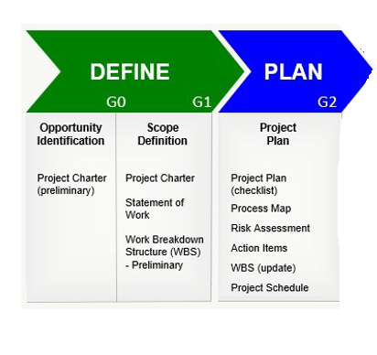
In the previous lessons…
There will be multiple checks during and after Project Execution to prevent miscommunication and to ensure the Project stays on track throughout its course. However, precious time and resources might get wasted which is undesirable.
Effective Project Management requires you to maximize benefits and minimize costs while delivering ‘value’ to the customer.
Having a clear Project Objective helps you achieve all this.

Slide 6
In the previous lessons…
The Project Plan
The Project Plan is a key part of the second phase, i.e. Planning.
It comes after you’ve developed a Project Charter and have a clear understanding of its Scope and Goals.
The Project Plan outlines everything that’s needed to create a successful Project. It tells you what to create (and what not to), what kind of resources to hire, and what schedule to follow. From specific deliverables to broad objectives, this Plan gives you a complete overview of the Project.
The Project Plan is a broad document created initially to summarize the Project’s Schedule, Scope, and Resources. Think of it as a “vision” document.
Lecture 8

Slide 7
In the previous lessons…
This document will guide you on how to create all the other plans (Risk Management, Change Management, Resources, etc.) that combined make up the project management plan.
the PMBOK itself doesn’t make any distinction between Project and Project Management Plans. Each organization will have its own norms and standards for creating these plans and what’s included in them.
But as far as best practices go, the Project Plan should be the first document you create in the Planning phase. All the other key documents – Work Breakdown Structure (WBS), Project Scope Statement, Gantt Chart, etc. – will spring from the Project Plan.
Lecture 8

Slide 8
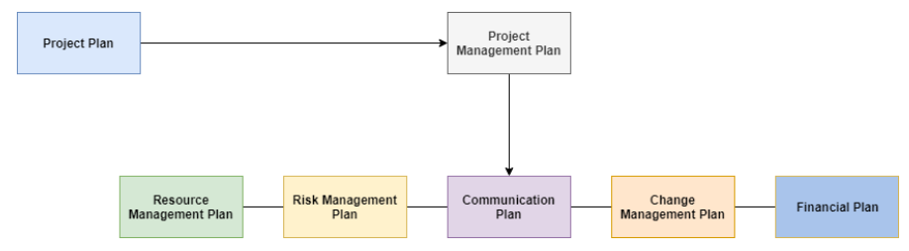
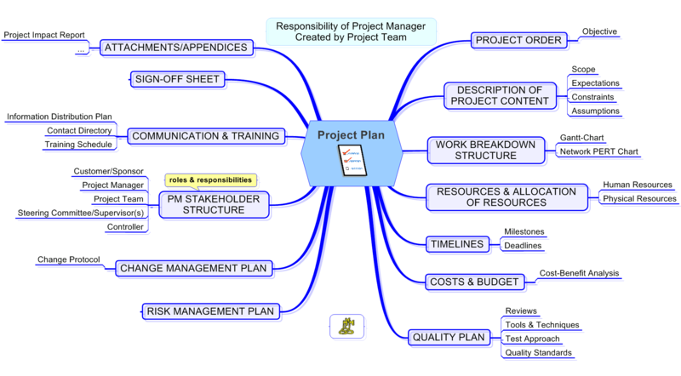

Slide 9
Outcomes of the lesson
In this lesson, we’ll:
Learn the steps, methodology, and processes that lead to successful Project Execution.
Find Project Execution Steps and Processes, the causes and solutions to Execution Gaps , and helpful tools to support your Project’s next success, such as a Project Execution Checklist, solutions to prevent Execution Gaps.
Lecture 8
Notes:
Ref: Filling Execution Gaps: How Executives And Project Managers Turn Corporate Strategy Into Successful Projects Todd Williams, President and Executive Consultant of the management consulting firm eCameron Inc.

Slide 10
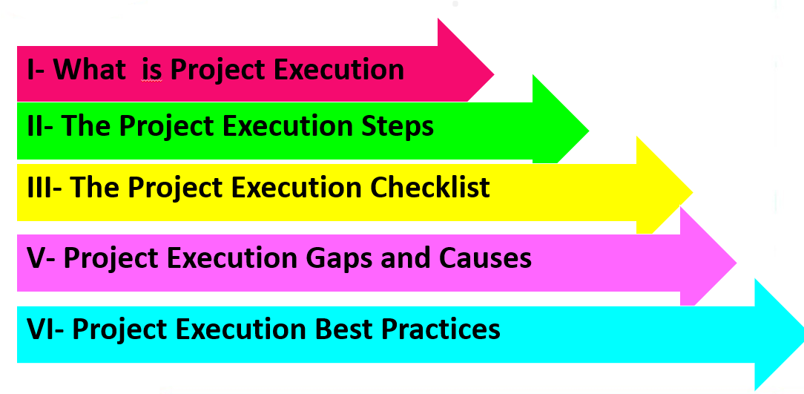
Syllabus
Lecture 8

Slide 11
I- What Is Project Execution?
I-1- Definition
The term Project Execution, also known as Project Implementation, refers to the actions a Team takes during the third phase of the project lifecycle, as outlined by Project Management Institute (PMI).
It is the active stage of the Project, in which you produce deliverables for clients and stakeholders.
During the Project Execution Phase, a Project moves from planning to completion.

Slide 12
I- What Is Project Execution?
The Project Execution stage is the longest, most involved, and most crucial phase of the Project Lifecycle (it can add up to 70 percent of the Project).
It’s also common to spend the majority of the Project’s Budget during this phase.
Project Execution is central to delivering value to Stakeholders and meeting Business Goals.
Successful execution involves catching missteps before they happen and monitoring the Project throughout.
A well-executed Project will meet Budget and Schedule Goals, and deliver the expected Quality.
This phase meets the immediate needs of Stakeholders and provides long-term value to an organization’s reputation.

Slide 13
I- What Is Project Execution?
I-2- The actions performed during the Execution Phase
During Project Execution, the Project Team delivers the agreed-upon products and services.
Processes, frameworks, and methods support deliverable completion, as Project Execution calls for ongoing people management, flexibility, and communication.
A solid Project Plan provides the team with transparency on tasks, Project Needs, and Strategy.
It will also provide an understanding of the Risk(s) involved and how the Team should manage challenges as they arise.
The Planning Stage is essential to keep the Execution on track by providing a reference throughout the Execution Phase.

Slide 14
I- What Is Project Execution?
This phase concerns:
1- Executing the Project Scope.
2- Performing the activities needed to meet the Project Objectives
3- Obtaining and manage quotations, bids and proposals as needed
4- Managing the Project Team and manage other Resources
5- Collecting and analyze performance data.
6- Generating Project data for status reports and forecasts.
7- Managing Risk
8- Conducting change control and implementing approved changes.
9- Establishing and managing Project Communication Channels
10- Collecting and documenting lessons learned.

Slide 15
I- What Is Project Execution?
I-3- What’s produced during the Execution Phase?
The Execution Phase is where all the action happens and the plans start materializing.
There will be changes to the Scope and the documentation will change as a result.
.

Slide 16
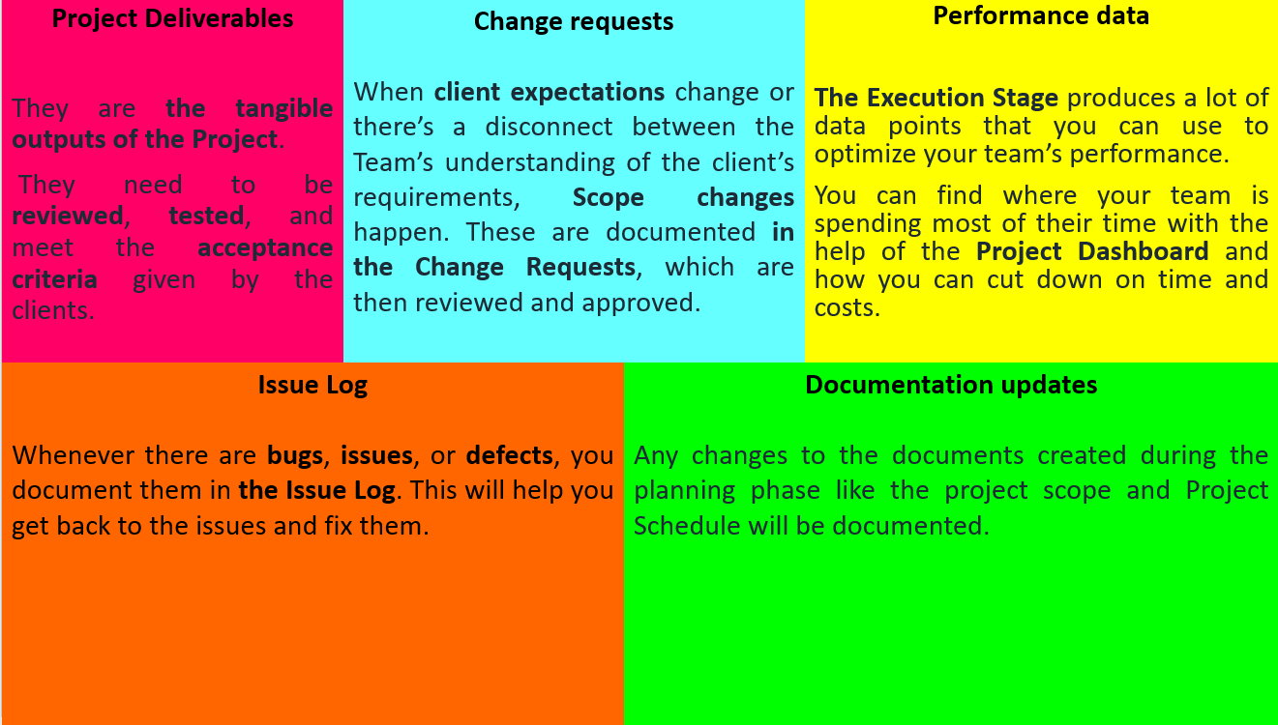
What’s produced during the execution phase?

Slide 17
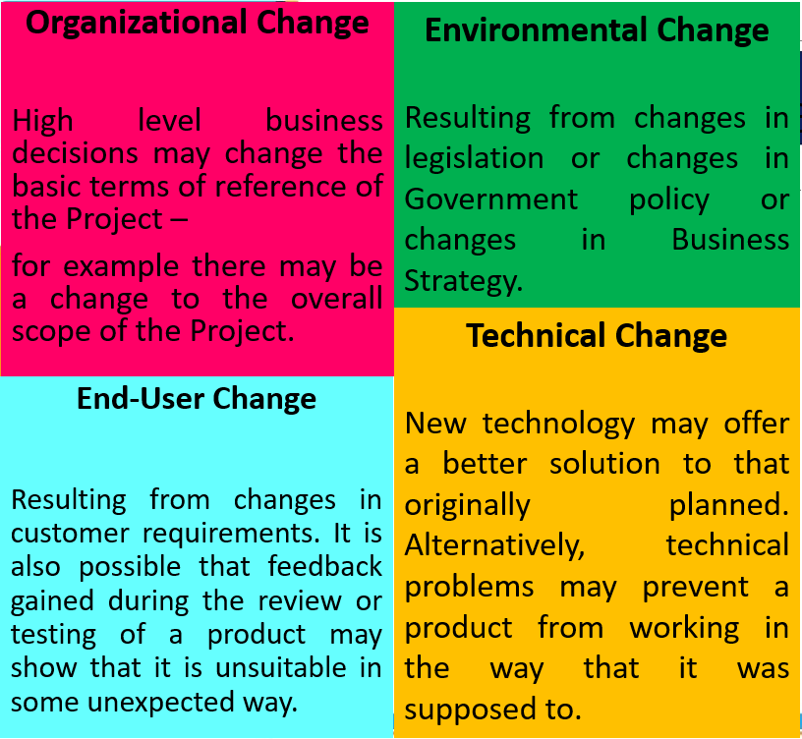
I- What is Project Execution?
The change normally needs to be documented to show what was actually done; this is referred to as Change Management.
No matter how carefully planned a project has been, changes will need to be made as it progresses. These will result from both external influences as well as problems that arise within the project environment.
The 4 main sources of change are:

Slide 18
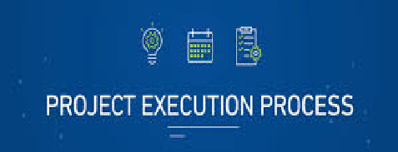
II- What Is the Project Execution Process?
The whole point of a Project is to produce Deliverables of some sort and the Execution phase is where this happens.
Essentially, work is done according to the Project Plan and that work is monitored and the results fed back to the people responsible for the Plan so that it can be updated to reflect the progress made.
The term Project Execution Process (PEP) refers to the set of tasks needed to produce Deliverables. Team members decide and assign Execution tasks during the Project Planning phase.

Slide 19
II- What Is the Project Execution Process?
Execution process involves coordinating people and resources, as well as integrating and performing the activities of the project in accordance with the Project Plan. The main output of Project Execution is the Project Deliverables and producing these will be the responsibility of the Project Team who will be working to the Project Plan.
The Execution Process uses structures (techniques, methodology, and frameworks) to organize the manner of delivery.
The Project Manager will decide which structure best supports the Project at hand.
The 5 commonly used Process Models are the following:

Slide 20
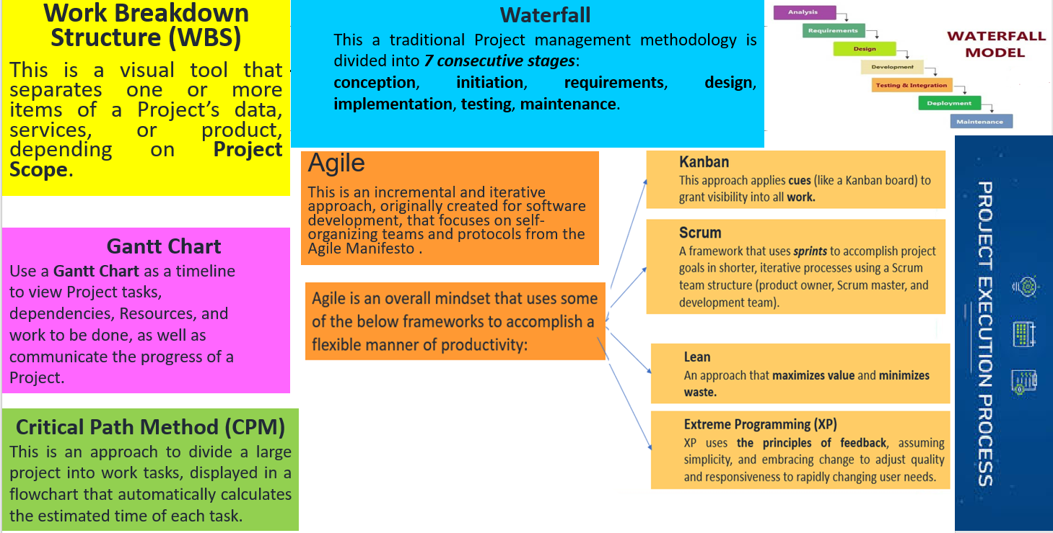
The 5 commonly used Process Models

Slide 21
III- The Project Execution Steps
During the Project Execution Phase, the activities you do to complete tasks will be similar across any Project.
However, the order of the steps will depend on the Project Needs, and therefore, the sequence of activities may change to keep the Project on course.
There are 3 core processes involved during Project Execution centered around People, Strategy, and Operations.
The steps in Project Execution include a series of tasks to deliver a Project on Time, within Scope, and under Budget.

Slide 22
III- The Project Execution Steps
The Execution Phase steps organize the Project’s Resources and coordinate the team’s efforts to meet the Project Goals as planned.
Project Execution steps are not necessarily a linear progression between execution kickoff and closing, especially when you consider the external forces that may disrupt the Project during Implementation.
We can break down the major actions required during Project Execution into 4 categories: produce deliverables, manage the team and stakeholders, monitor and control, and change management:
The Project Execution Steps

Slide 23
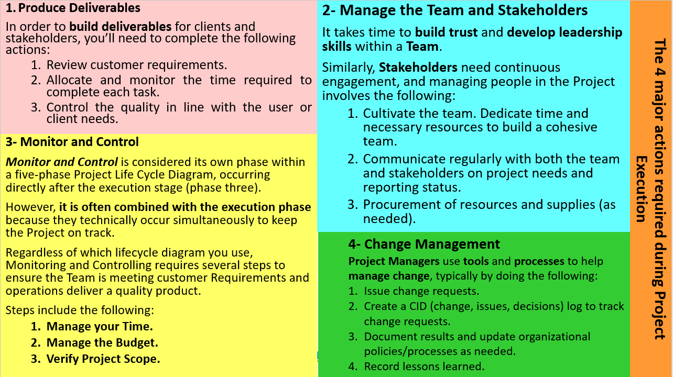

Slide 24
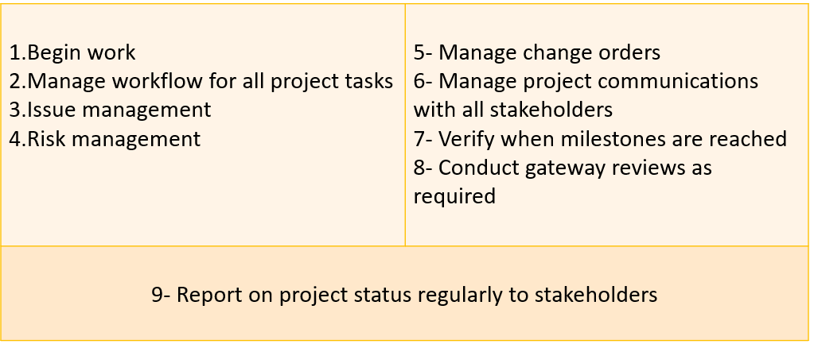
III- The Project Execution Steps
The steps during Project Execution will change depending on the specific requirements of the Project. Those particular steps are typically laid out in the Project Execution Plan . However, there are general activities that should apply to all Projects.
Project Execution Phase Activities include:

Slide 25
III- The Project Execution Steps
In the execution environment, focus on consistent Communication and building Leadership across the Team. Help the Team hold realistic expectations of change to prepare them to be flexible when changes do occur, which will reduce frustration.
It is challenging to visualize Project Execution in real time due to the complexity of linear and non-linear steps, processes, and sub-activities that take place while producing the Deliverable or Product.
The dynamic diagram below places Execution within the Project Lifecycle (with Monitoring and Controlling interacting simultaneously with the Execution) and fully displays the Execution Phase in action and the factors that influence the course of the Project along the way.

Slide 26
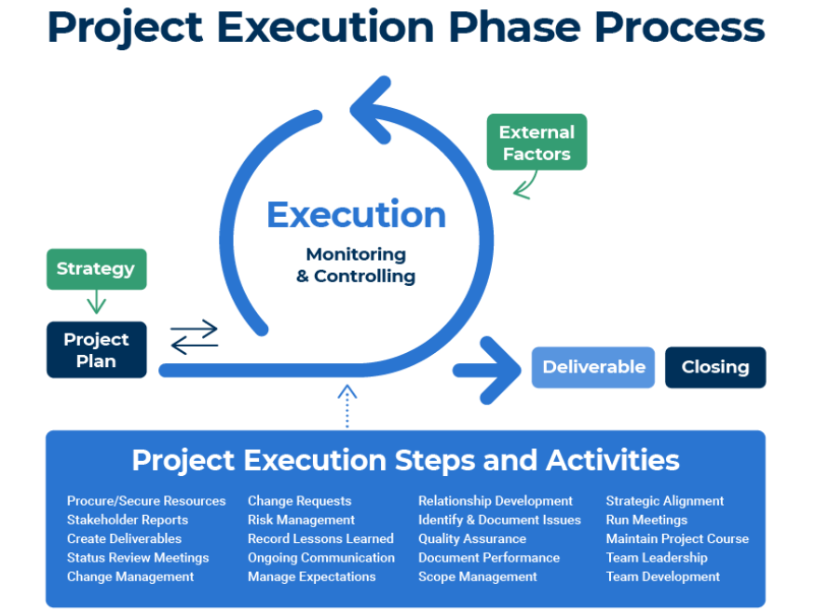
III- The Project Execution Steps

Slide 27
III- The Project Execution Steps
A Project Manager must decide and delegate the steps involved in managing People, Processes, and Communications in order to deliver on the promises of the Project Management Triangle: (delivering the Project on Time, on Scope, and on Budget).
But these Management steps are not the only area of focus: It is also essential to support Team morale throughout the Project.

Slide 28
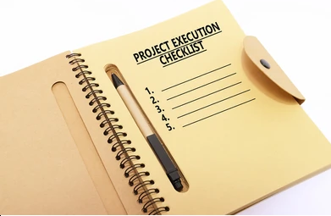
VI- The Project Execution Checklist
A Project Execution Checklist helps organize all of the moving parts of the Execution Process.
We can use one to ensure that the Team doesn’t overlook any planned tasks (or leave any incomplete).
Furthermore, a Checklist can help you keep track of what’s done and not done throughout the Project Execution.
A Project Execution Checklist will include categories identified by the Project Manager or Team.

Slide 29
VI- The Project Execution Checklist
The Checklist also contains a due date and the status to provide transparency across the Team.
With many components per Project, a Checklist will ensure your Project’s timely completion without missing an important detail.
Account for all your Project Execution tasks with this Project Execution Checklist template.
Prior to Project launch, enter the task to complete, due date, and status for streamlined tracking of all Project activities in one centralized location.

Slide 30
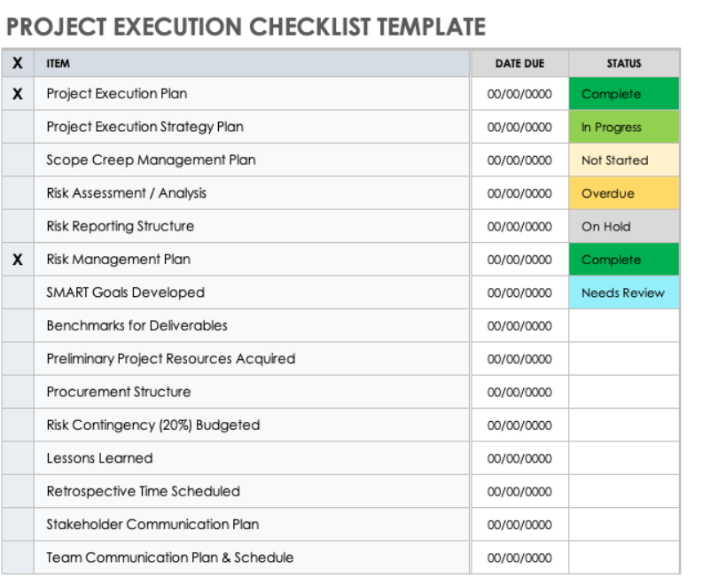
VI- The Project Execution Checklist

Slide 31
V- Project Execution Gaps and Causes
Project Execution Gaps occur when the real-time execution of a Project fails to meet the Strategy or Goals developed during Planning.
A Gap is generally caused by a communication breakdown or a mismanagement of the Project activities.
There are several potential causes of a Project Execution Gap, ranging from developing unrealistic goals to lacking buy-in from key Stakeholders.
One of the most prevalent causes stems from competing resources, which includes people, physical materials, and time.

Slide 32
V- Project Execution Gaps and Causes
The Project Planners have the best intentions as they develop the project goals, but in reality, the Projects Executors are balancing other responsibilities and obligations required by their functional role in the organization.
A Project Manager can avoid and prevent Execution Gaps by identifying where they appear, the root cause of the issue, the risks they pose, and the measures the team can take to proactively prevent the gaps before they occur.
Below, we’ve provided an analysis of the causes and risks of 6 common Execution Gaps to help your Team expedite your Execution Strategy, and avoid gaps using preventative solutions.

Slide 33
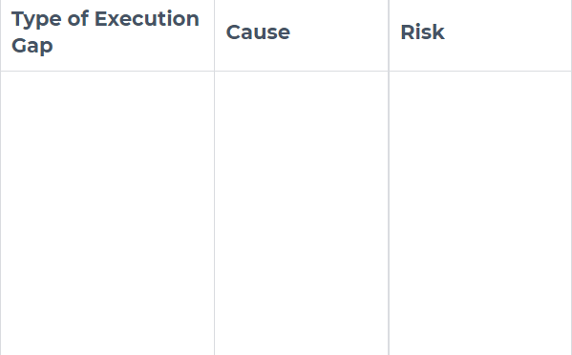
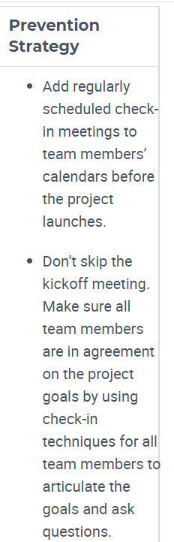
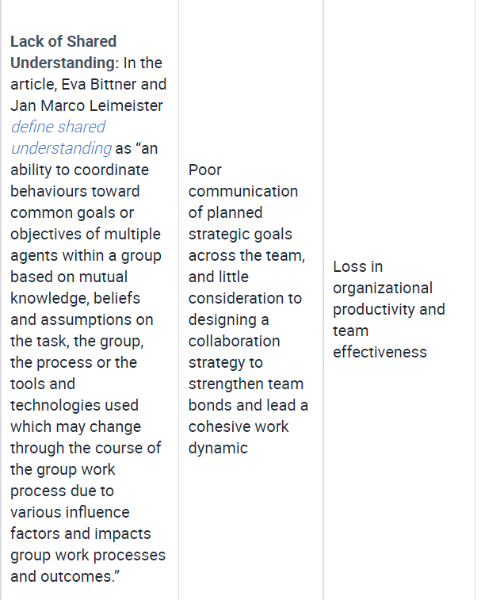
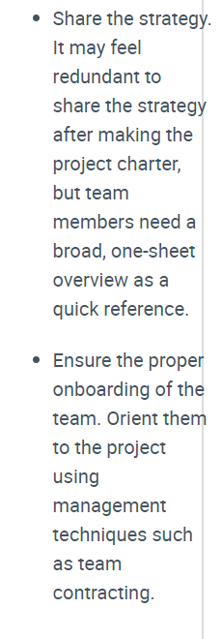
Project Execution Gaps and Causes

Slide 34
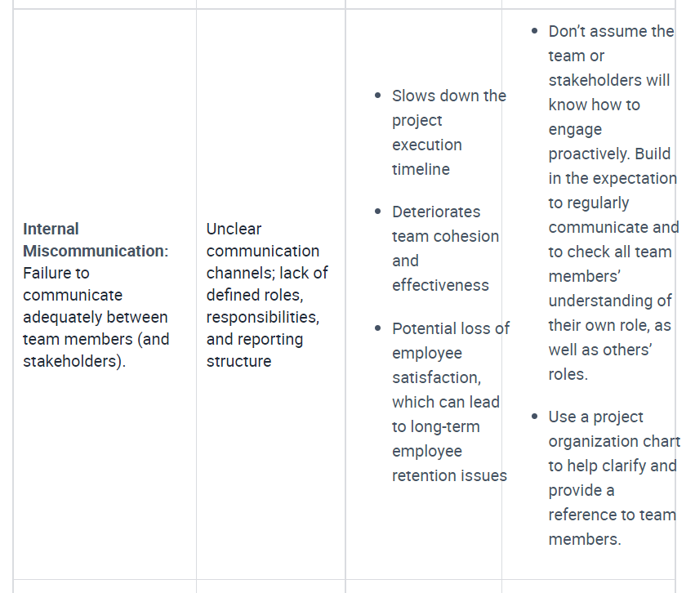
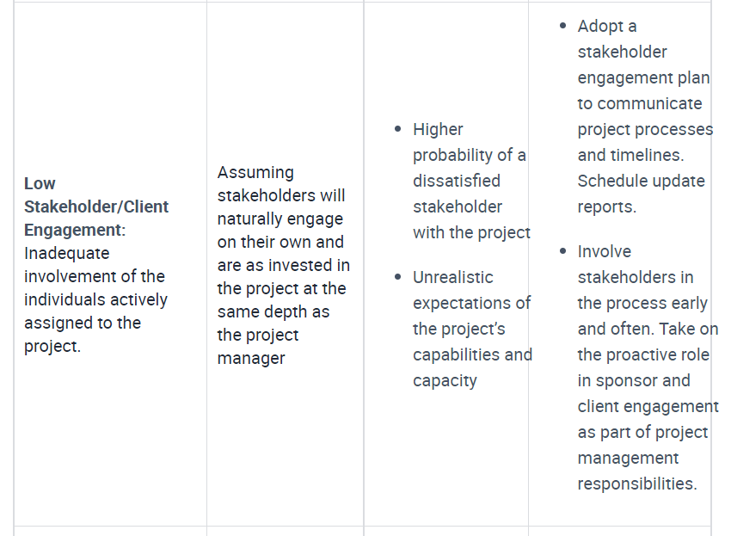
Project Execution Gaps and Causes

Slide 35
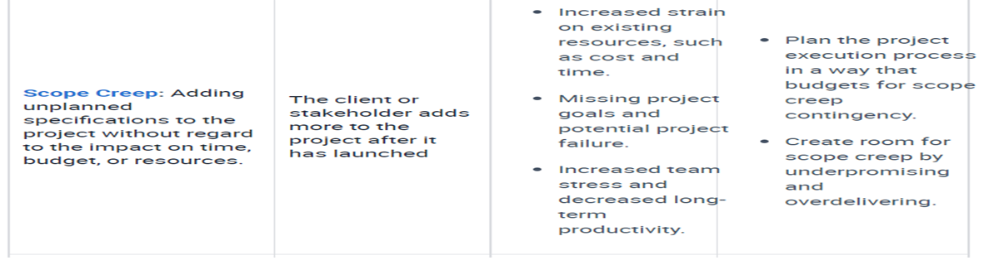
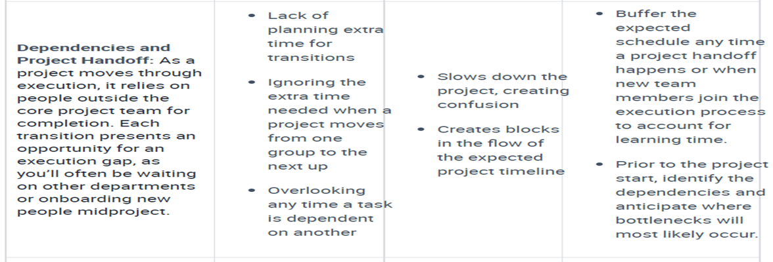
Project Execution Gaps and Causes

Slide 36
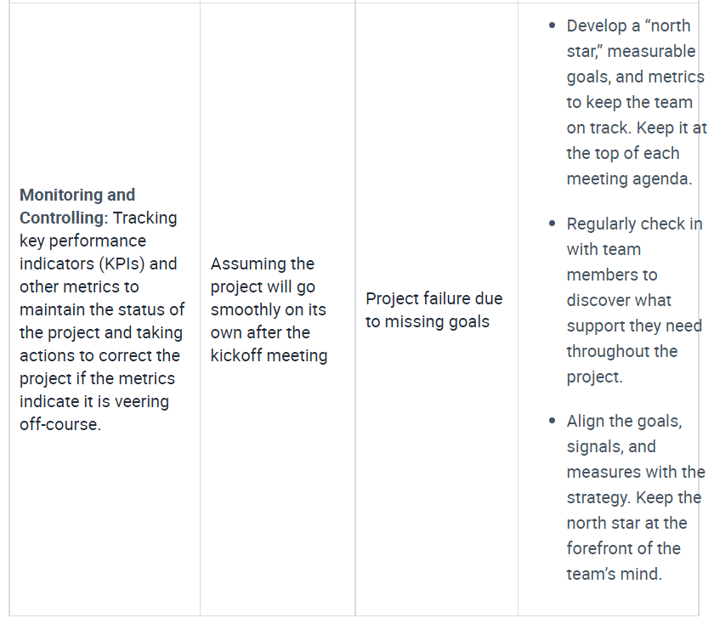
Project Execution Gaps and Causes

Slide 37
V- Project Execution Gaps and Causes
During the Project, create a Gap Analysis to identify each gap’s cause and create a framework for developing a solution.
Changing organizational culture, managing up, and educating the Project reduces execution gaps beyond the immediate Project.
It is also beneficial to reflect on the Project Execution Gaps during Project Closing. This analysis and insight you gain at the conclusion of the Project will reduce Execution Gaps before they occur for any future Projects the Team takes on.

Slide 38
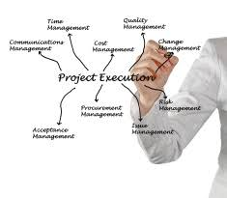
IV- Project Execution Best Practices
VI-1- Project Execution Challenges
There are many challenges to successful project execution, such as missing deadlines and budget overrun, that can cause problems, affect business outcomes, and sometimes even lead to project failure. Problems may appear at any time during the project and need to be addressed right away.
Challenges commonly occur in communication, personnel, strategy, stakeholder engagement, and scope creep. It helps to understand the causes of failure in each of these areas to know what to look for when challenges surface.

Slide 39
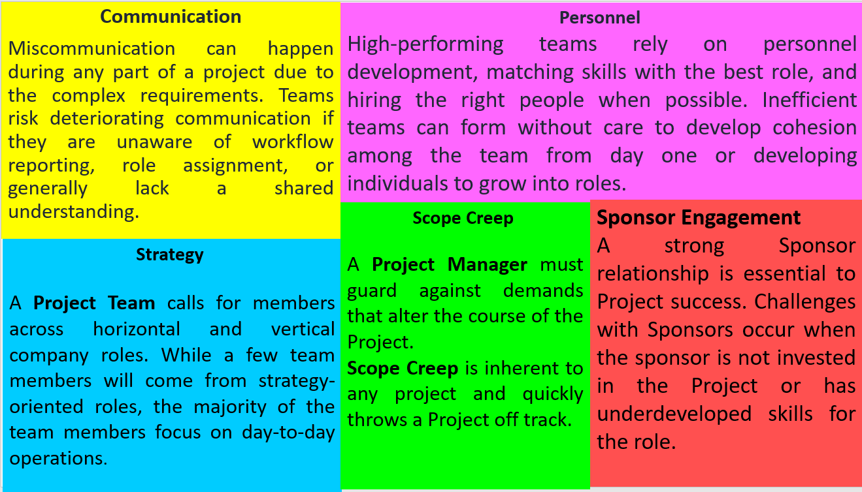

Slide 40
VI- Project Execution Best Practices
Challenges in Project Execution impact Time, Budget, and Resources, and ultimately negate the success of your Project. Understanding these potential challenges is the first step to minimizing Project complications.
Avoiding challenges is ongoing work and needs consistent, proactive attention, such as the following behaviors:
Increase the visibility of the Execution Phase with regular check-ins and transparent communication.
Balance your Leadership Style between monitoring and micromanaging.
Develop an approachable Leadership presence encouraging open Communication.

Slide 41
VI- Project Execution Best Practices
V-2-Strategies for successful Project Execution
A Strategy is long-range, directional, and action-oriented, and it uses multiple angles to accomplish the goal.
The Strategy steers the Project’s Direction, and should align with the Business’s Goals.
A Project Execution Strategy is a tactical approach used in Project Management. The Project Manager and Team Leaders create the Strategy during the Planning Stage.
A Project Execution Strategy is different from a Project Execution Plan which is task-oriented, detailing the specifics on how to allocate resources, time, and expectations.

Slide 42
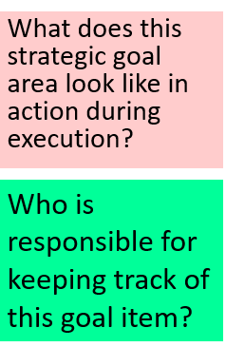
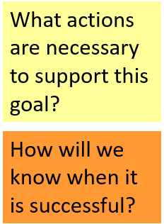
VI- Project Execution Best Practices
Project Execution Strategy must align with the overall company strategy, mapping the actions of the Project to the company Goals and Values.
In Project Execution, the Project Manager will often employ Strategies that revolve around supporting the Team.
For example, a company’s strategic goal of operational excellence (the goals of lowering operational risk and operating costs, and empowering employees) provides an opportunity for the project execution strategy to focus on empowering employees in the areas of communication, engagement, and alignment. To do so, the Project Manager can ask the Team a series of questions to help visualize strategic implementation in action:

Slide 43
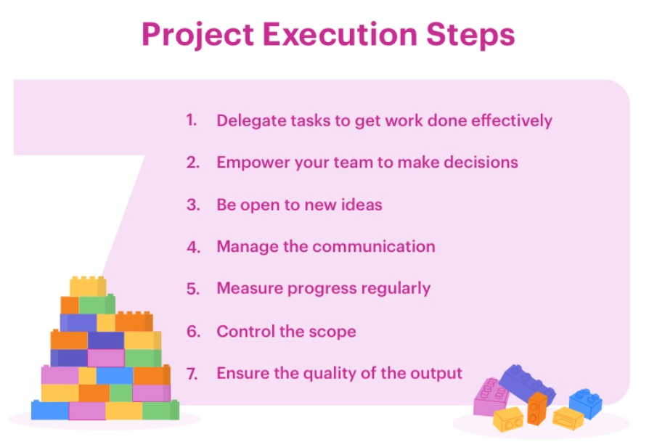
VI- Project Execution Best Practices
Here are some strategies for a project execution plan that will help you bridge that gap:
7 strategies for successful Project
Execution

Slide 44
VI- Project Execution Best Practices
VI-3- Project Execution Best Practices
Project Execution best practices aim to create a Team with the model qualities of a high-performing Team. The leading current Project Execution best practice focuses on soft skills, and encourages productivity and supports the execution success throughout the Project.
The following best practices focus primarily on soft skills and leadership development because they improve the health and execution speed of the Team, which inadvertently leads to meeting and exceeding Project Goals.

Slide 45
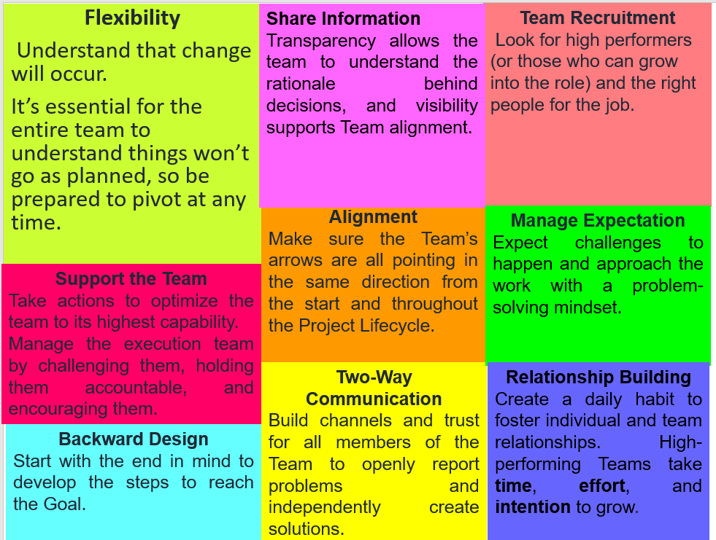
Best practice areas for
Project Execution
VI- Project Execution Best Practices
:

Slide 46


Slide 47

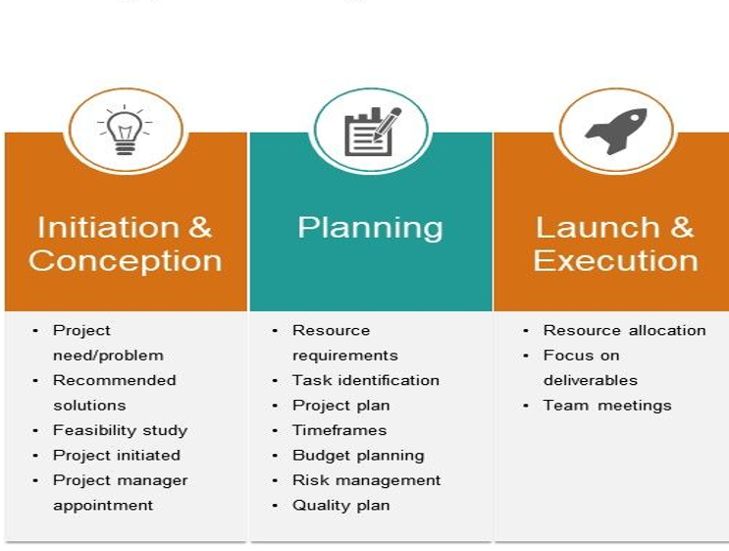
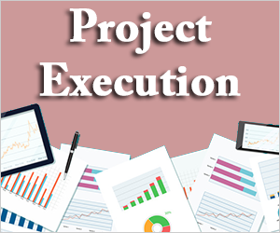

Slide 48
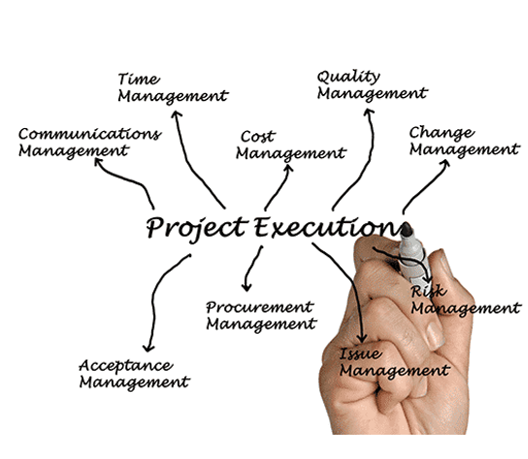

Slide 49
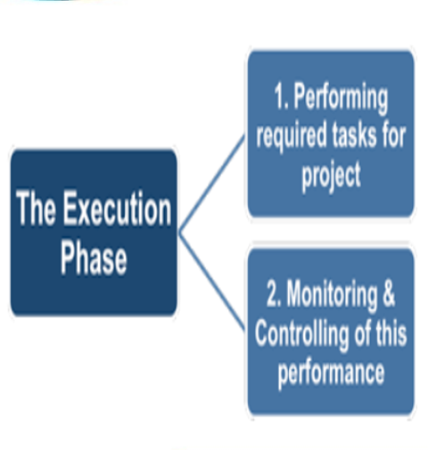
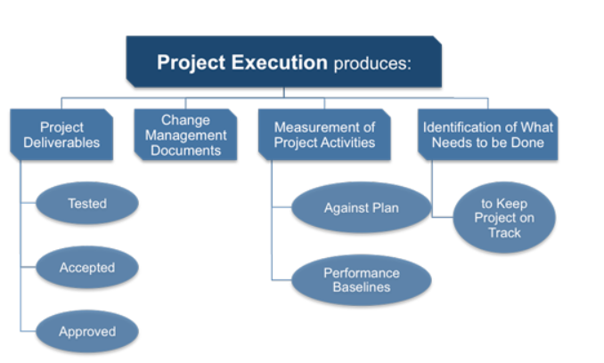

Slide 50


