Slide 1

Project Management Technologies
Prepared by Lecturer Waseem Tabbaa
Chapter 2 and 3
PMG 312
Project management in a nutshell
Power and politics

Slide 2

Chapter
02
Introduction
Chapter 2 Project management in a nutshell........................................ 19
Introduction ............................................................................................... 19
Methodology.............................................................................................. 20
Project requirements definition ................................................................ 22
Workshops.................................................................................................. 22
Brainstorming............................................................................................. 24
Brown paper............................................................................................... 24
Process chart.............................................................................................. 26
Decision logic table ................................................................................... 27
RACI charting............................................................................................. 29
Understanding the project business case ................................................ 30
Project ranking matrix .............................................................................. 31
How to evaluate and prioritize IT project proposals................................. 32
Quality management................................................................................. 32
Sponsor and supplier agreements ............................................................ 35
Microsoft Project 2010...............................................................................37
Challenging..................................................................................................38
References .......................................................................................... 39
Chapter 3 Power and politics................................................................ 41
Root cause of power and politics ............................................................... 41
Organizational structures............................................................................ 43
Centralized organization structure............................................................. 43
Functional organization structure.............................................................. 45
Projectized organization structure............................................................. 46
Matrix organization structure.................................................................... 47
Virtual organization structure ................................................................... 49
Composite organization structure............................................................. 50
Summary............................................................................................ 50
References ......................................................................................... 52

Slide 3
Chapter
02
Introduction
This book has two related objectives.
The first is to find realistic ways to eliminate the negative effects of developing systems using tools and techniques and to look at key ways that are needed to have successful projects that help improve organizations (Smith 1983).
The writing style here uses mostly nontechnical language, which includes a heavy usage of graphics and tables for easy reading and as much as possible adheres to the “KISS” principle.
KISS is an old information-processing acronym that stands for “keep it simple stupid” and more recently has been modified or updated to mean “keep it short and simple.” It is usually referred to the building of new software applications.

Slide 4
Chapter
02
Introduction
The following is an expanded and updated definition of the elements that make up the KISS principle (Smith 1983):
If you are fortunate to have a simple solution to a problem—keep it that way. Sometimes, it is human nature to take a simple solution to a problem and complicate it. Quite often, today’s complicated solutions create tomorrow’s problems.
If the only solution to a problem is a complicated one, then the solution should be divided into simple and workable parts that interface with each other. The complicated solution should be like putting the pieces of a puzzle together.
Once you have defined your solution, there will be many levels of approaches in planning, designing, and implementing that alternative. The difficult part is to choose the overall approach. In today’s highly sophisticated industrial environment, it is often best to partner with other organizations that can perform special segment better than doing it all in-house. The term for this strategy is “outsourcing” and it is increasingly employed in projects.

Slide 5
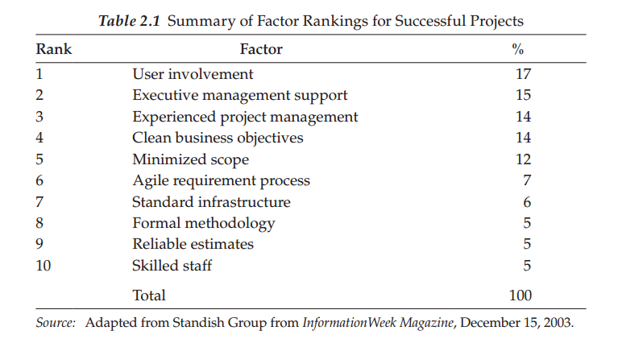
Chapter
02
Introduction
What are the odds of having a successful product that is delivered within the budget and schedule? Various surveys indicate that about 25%
of all projects are completed on time, 50% have late completion dates and/or go over budget, and about 25% are canceled. This means that approximately 75% of all projects undertaken will probably come in late or be canceled!
Also, the projects that are completed (on time or late) usually end up having fewer features and functions than originally specified to save development time and/or costs. Table 2.1 summarizes the top 10 reasons why projects are successful and the first five make up 72% of the total.

Slide 6
Chapter
02
Methodology
The most recognized project management methodology is the PMBOK Guide
and this approach views a project as a defined set of five management groups (PMI 2008). These groups are briefly defined as follows:
Initiating—Tasks and activities that conceptualize and/or authorize the project or phase.
Planning—Activities and related tasks that define and refine objectives within the project.
Executing—Activities and related tasks that coordinate resources to carry out the plan.
Monitoring and controlling—Monitoring and measuring progress regularly to identify variances within the plan, so corrective actions can be taken if needed.
Closing—Finalize all activities/tasks and above processes to close the project.

Slide 7
Chapter
02
Methodology
The nine organizational knowledge management areas covered in PMBOK are as follows:
1. Project integration—These are processes (i.e., coordination of procedures and phases) in place to develop, manage, and monitor your
project, which includes change control.
2. Scope—These are processes (work included and excluded) in place to define the project work.
3. Time—These are processes (i.e., estimating and scheduling) in place to make to support schedule development and status tracking.
4. Cost—These are processes (i.e., costing and cost control) in place to support budget planning and status tracking.
5. Quality—These are processes in place to support meeting quality goals. There are three types of quality assurance (QA) project reviews: deliverable, compliance, and health.

Slide 8
Chapter
02
Methodology
Deliverable is any tangible outcome or item produced to complete a project; this can range from a client’s approval of a project plan to completion sign-off.
Compliance covers areas such as meeting the requirements of a project and complying with established standards and processes.
Health tells how well a project is doing; if it has run off the rails, the team can use the review to decide which actions to take to get the project back on track.
6. Human resources—These are processes (i.e., acquiring, developing, and managing) in place to make sure you have the right project team and support people (i.e., sponsors, stakeholders, and end users).
7. Communication—These are processes (i.e., planning and managing team, user expectations, and performance) in place to support meeting your information needs.
8. Risk—These are processes in place (i.e., identifying, performing qualitative analysis, and planning responses) to support preventing a potential event or future situation that may adversely affect the project.
9. Procurement—These are processes (i.e., planning the solicitation and obtaining) in place to support the procuring of goods and
services, which includes good contract management.

Slide 9
Chapter
02
Methodology
Read Page 22 from our book and go through Tables 2.2 and 2.3
A good methodology encompasses standard policies, processes, and procedures that incorporate a suite of tools and techniques to help guide the process through its life cycle in an efficient, consistent, and repeatable manner. Even though a methodology is described as a standard approach, it should be viewed as a living organism that constantly needs to be reviewed and updated for improvements based on experience (Whitten 1995).
A large part of improving a methodology is keeping a documented history of lessons learned from project outcomes. Unfortunately, most companies do not do this or they record it and just let it collect dust. Using lessons learned is a way of benchmarking and collecting best practices to help you improve your methodology by updating your policies, processes, and procedures along with your associated tools and techniques.

Slide 10
Chapter
02
Project requirements definition
One of the major issues in starting the project is getting good requirements! Project requirements are the further breakdown of the client’s deliverables that are described in detail. This process cannot be done in a vacuum and the requirements collecting process is mostly the client’s or shareholder’s responsibility. It is the responsibility of the PM to facilitate this requirements collecting process and there are many techniques (or combination of) for doing this. The following are some of the popular techniques that are used for this collecting process.

Slide 11
Chapter
02
Workshops
The PM could have designed workshops with the stakeholders and subject matter experts to gather the detailed requirements, which usually enhance user participation, expediting development and improving the quality of the specifications. These workshops have a set of detailed agenda to eliminate uncertainties between parties and help improve communication between all parties. A popular workshop process is joint application design (JAD), which is usually more effective in small, clearly defined projects and less effective in large complex projects.

Slide 12
Chapter
02
Brainstorming
A requirement gathering is a group brainstorming exercise that needs to be facilitated by the PM. The group consists mostly of the clients or shareholders. It is always smart if the PM sends surveys along with the project’s charter to key stakeholders to list their requirements or have individual interviews with the key stakeholders before the brainstorming session(s) begins to save time and have a more effective meeting. Brainstorming should also include the areas of assumptions, constraints, and potential
risks. As for risk identification, the group could look at risks from past projects.
The following are some techniques that could be used during the brainstorming session:
Brown paper
Process chart

Slide 13
Chapter
02
Brown paper
Brown paper is a form of flow-charting used to capture a complete process for evaluation (e.g., finding ways to streamline the system), including highlights of key activities, interfaces, documentation, data sources, strengths, and problems. Brown papers are generally used in the “as-is” and “to-be” model definition phases of a project. They can also be used to develop “should-be” and “could-be” models for evaluation.
It is important to gather the right people to develop a model of the process or system under evaluation. Use the yellow Post-it notes on the top half of the brown paper(s) to define the “as-is” process steps and have the users review and validate the flow. Next, look for problems or flaws in the process and brainstorm on ways that steps in the process can be reduced, eliminated, or simplified. Using the blue Post-it notes on the bottom half of the brown paper(s), develop a new and improved “to-be” process while using the strengths from the “as-is” process. Another advantage in having the users involved in this exercise is that you usually will get “buy in” and support from them on changing the process. A feeling of ownership is important to users!

Slide 14
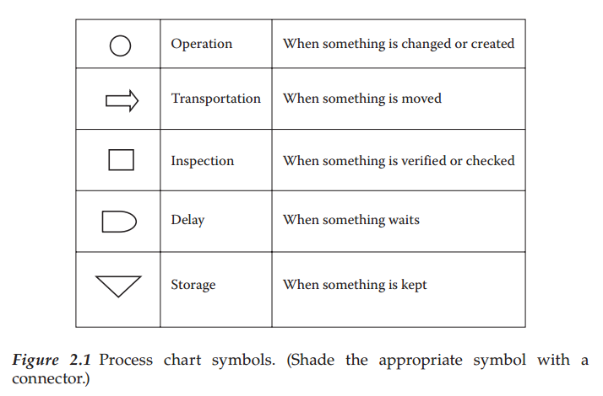
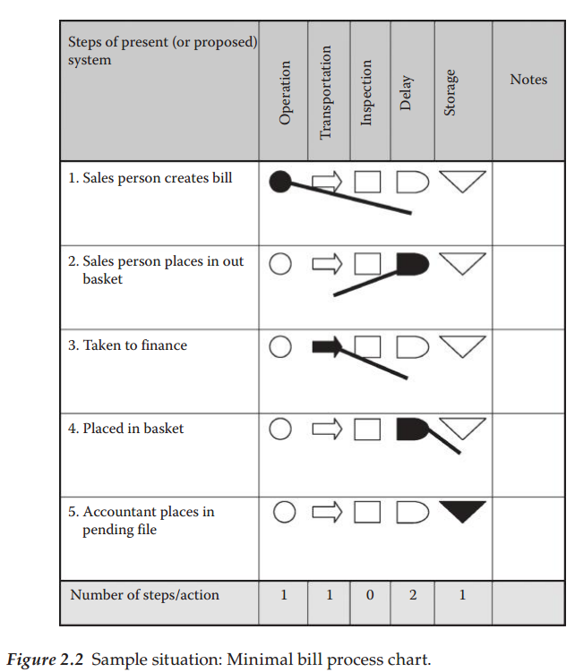
Chapter
02
Process chart
If you want to learn in detail what happens in a situation involving a document, request, material, or even the actions of a person, consider using a process chart. The process chart documents the detailed steps of the flow and categorizes the type of action taken. With this information, you can analyze the process for potential improvements. To add value, you should try to reduce a complex process to its lowest common denominator to a series of simple steps to save time and reduce costs. The type of action involved in each step of using this tool is classified by one of the five standard symbols—operation, transportation, inspection, delay, or storage—as shown in Figures 2.1 and 2.2.
Read Page 27&28 from our book go through Figures 2.1 and 2.2

Slide 15
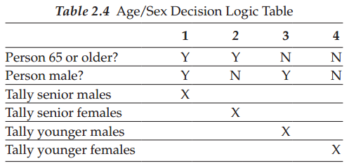
Chapter
02
Decision logic table
A decision logic table (DLT) is a documentation technique that can display an entire situation visually, with all alternatives shown side by side. If you do not use a DLT, you may miss some alternatives that you never thought of which could sink your project. The following describes the characteristics of a DLT, which increases team communication, and an example of one is shown in Table 2.4:
• Displays all the elements of a problem.
• Shows all the conditions affecting the solution.
• Reveals all the relationships that exist among the defined conditions.
• Indicates which action is appropriate for each set of circumstances.
• Illustrates the IF (condition) and THEN (conclusion or action) concept.

Slide 16
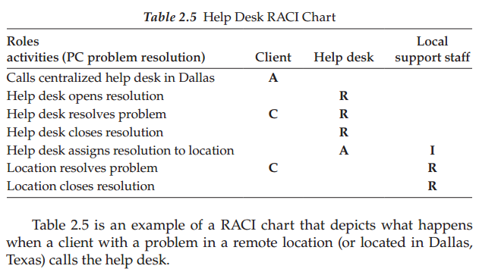
Chapter
02
RACI charting
Responsible Accountable Consult and Inform (RACI) charting is an effective means of analyzing and assigning roles and responsibilities.
It correlates functional roles or individuals to their level of participation in an activity by assigning codes for responsibility, accountability, and communication interfaces. This simple technique can be used any time the span of control for a process needs to be determined or developed. It is a quick means of bringing redundancies and misunderstandings to light, so that better communication can occur.
Steps to complete a chart include:
Selecting a business process to be analyzed.
Listing all of the activities associated with that process in the lefthand column of the chart.
Identifying all functional roles associated with the process and listing them in the top row on the chart.
Establishing participation for each activity, for all roles, by assigning codes as described below:
R (responsible)—The individual working on the activity (the doer)
A (accountable)—The individual with yes/no authority; approval or veto power (Note: If two or more A’s exist, this could be a sign of problems.)
C (consult)—The individual must be consulted prior to action; two-way communication occurs
I (inform)—The individual receives one-way communication and will use the information or take subsequent action

Slide 17
Chapter
02
Understanding the project business case
From many recent studies, the major reason for project failures is not the specifics of what went wrong, but rather the lack of procedures, methodology, and standards for managing the project. The PM who is asked to manage a project with no methodology, standards, procedures, and processes will have a difficult time keeping the project under control and has a high probability of being unsuccessful.
Also keep in mind that technical oriented projects have unusually high degrees of uncertainty for the following reasons:
Technology is changing every 6–12 months—new programming languages, new interface mechanisms, hardware platforms, tools, and version compatibility issues
Immature methodologies
Resource turnover is high—new teams for each project
No standard benchmarks for abilities/skill levels of resources
Dependencies on customer for good requirements and project plan task completions
Fast-changing business environment

Slide 18
Chapter
02
Understanding the project business case
Unfortunately, most projects have no linkage to corporate strategy (i.e., a set of short- and long-range goals), which remains revolutionary thinking in many corporations today. So, in ranking a new project request, you should ask: does this project have any linkage to your corporate strategy? If it does, there is a high probability that you want to execute this project. Also, if the new project request has nothing to do with your corporate strategy, there is a much lower probability that you would execute the project. Going this way shows maturity in your project management process and adds more overall long-term value to your organization. Another advantage of linking projects to your corporate strategy is having more executive support in gaining resources and needed budget monies. In summary, projects need to have more of a business focus that is aligned to strategic business goals!

Slide 19
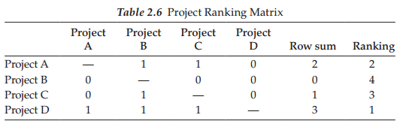
Chapter
02
Project ranking matrix
What occurs when an organization has a number of requested new projects but you have limited time, resources, and/or money to develop the new systems? The best thing to do is to rank the different requested projects against each other in the area of importance or adding extra value to the overall organization and only work on the high-ranking projects. Keep in mind that about 40% of large-scale projects that IT organizations are working on are no longer relevant to the overall business of the organization.
Below are the characteristics of a project ranking matrix as shown in Table 2.6:

Slide 20
Chapter
02
Project ranking matrix
The key column is the first column, which lists all the requested projects.
The first column of projects is ranked in importance against the other projects starting in the second column.
If a project in column 1 is more important than another project in a sequential column, then enter a 1. Otherwise, enter a 0.
When done, sum up the rows, and then rank the projects by importance with the highest row sum getting the number 1 ranking and so on.
As shown in Table 2.6, an organization might only work on Project D and Project A. Project C and Project B could be permanently dropped or be reviewed again at some other time in the future. Companies need to set up a process (e.g., using portfolio management software) to help them prioritize their projects, optimize resource allocation and staffing, and track project progress and to make sure they were successful in meeting their
strategic business goals.
Read Page 32 - 36 from our book go through Table 2.7, 2.8, and 2.9

Slide 21
Chapter
02
Microsoft Project 2010
There is a range of widely used project planning and requirements management packages such as Microsoft Project 2010, Primavera, and IBM’s Telelogic DOORS. This text will focus on MS Project to illustrate many of the techniques, but other competitors also offer similar capabilities. Also, there are many different types of add-ins for Microsoft Project 2010 and Microsoft has a large growing library of project plan templates (e.g., for engineering, construction, new business, new product, and start-up business) that could be used for developing new project plans.
Most companies that have a project management process or program using Microsoft Project 2010 as a planning and scheduling tool (MS has about a 90% market share), which is a key instrument that is referenced many times in this book. The first time you access Microsoft Project 2010, the menu ribbon will be confusing because the user interface is not very intuitive! In short, the user interface has many choices, many screens, and much functionality, which can be confusing at times (Biafore 2010). For example, there are multiple ways of adding a new task and resource.

Slide 22
Chapter
02
Microsoft Project 2010
But overall, the new features and utilities added to Microsoft Project 2010 far outweigh its nonintuitive user interface. Some of the new features
include faster filtering, grouping and sorting, automatic word-wrapping of long task names, easier formatting, leveling overallocations, playing
what-if games, and viewing scheduling issues to be fixed. The following are some time-saving features that you should consider setting up or
using within the first tab—File:
At least 90% of the time you open Microsoft Project 2010, you want to open the last file worked on. You can automate the opening of your last file by choosing Options—Advanced and in the General section, check the box for “Open last file on startup.”
The default for tasks is “Manually Scheduled” when most of the time you want it to be “Auto Scheduled.” You can change this default by
choosing Options—Schedule and select “Auto Scheduled” from the pull-down menu under Scheduling Options.
Most of the time you probably save your project updates every 10 or 15 min but sometimes you get interrupted and forget to do this. You can protect yourself by choosing Option—Save and check the box for “Auto Save Every” by any time you want. 45 minutes would be a safe choice.

Slide 23
Chapter
02
Microsoft Project 2010
Why start a project from scratch when Microsoft on-line has a large library of useful project plan templates you can use as a starting point? This is truly one of the great treasures found within Microsoft Project 2010 and currently has more than 70 different types of project templates (Biafore 2010). Some of these online plans include Project Management Institute Process, Engineering Project Plan, New Product Plan, and Proposal Development Plan. To select your online project template, choose New and under Office.com Templates choose Plans and proposals and then Business plans to see the growing library of useful templates.
To save valuable printing time and paper, which is important, you should get very familiar with Print—Page Setup tabs and the various options you can choose. For example, in the Page tab you might want adjust the scaling to less than 100%, get familiar with the Margins, Header, Footer, and View tab options. Finally, you might want to select None under the Legend tab to not print page legends at the bottom.
For very useful add-ins (Options—Add-Ins), besides Microsoft Visio and Excel see Table 2.10, which shows products with descriptions that you can use with Microsoft Project 2010 that can save you time and add value to your overall project.
Read Page 37 - 39 from our book go through Table 2.10 MS Project Add-Ins

Slide 24
Chapter
02
References
Biafore, B. 2010. Microsoft Project 2010—The Missing Manual. Sebastopol, CA: Pogue Press.
Project Management Institute (PMI). 2008. A Guide to the Project Management Body of Knowledge, 4th ed. Newton Square, PA: American National Standard Institute.
Smith, R.B. 1983. The KISS Principle—Approaches to Building Reliable Systems. New York: Petrocelli Books.
Whitten, N. 1995. Managing Software Development Projects. New York: John Wiley & Sons

Slide 25
Chapter
03
Power and politics
Root cause of power and politics
Projects are natural breeding grounds for conflict resulting in ineffective human behavior, which must be dealt with effectively for the overall success and health of a project (Richardson 2010).
Every organization, regardless of being small or large, has politics due to power struggles.
Every project will also have unique power struggles due to changing parameters of the project resources, environment, or goals and deliverables (Vidal and Marle 2008).
Politics can be in terms of which projects the senior management support and are committed to bringing to fruition (Maddalena 2012).
Trust between the stakeholders and project team is a powerful asset as it can foster loyalty from key stakeholders and result in a positive project environment (Brewer and Strahorn 2012).
It is necessary to identify and manage stakeholders to help in selling and continuing to sell the project throughout the life of the project (Little 2011).
Another important aspect of the project is assembling the right team of individuals (Clark and Colling 2005; Maddalena 2012).
These struggles root from resources being in limited supply.

Slide 26
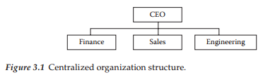
Chapter
03
Organizational structures
Six different types of organizational structures that include centralized, functional, projectized, matrix, virtual, and composite. Each structure has distinct characteristics. There are benefits and challenges in existence for each of these structures as well.
Centralized organization structure
Is set up by different departments that may overlap according to their functions with an example displayed in Figure 3.1. A centralized organization structure has a very clean way of exercising control over project selection. This occurs because all project requests are submitted to the manager of a group for approval, including identifying the project team members to work on the project. In this organization, there is typically one set of management procedures and reporting systems for all projects within the entire organization regarding project planning documents, risk management, change management, conflict resolution, and so on.

Slide 27
Chapter
03
Organizational structures
Benefits of Centralized organization structure
Large benefit to the company because these procedures and reporting systems should technically be more perfected in comparison to each PM creating their own procedure and reporting system.
It is easier for higher-level managers to see the health of the organization as a whole and where weak spots may occur because of the standardization in procedures and reporting systems.
Managers can compare apples with apples since the company has standardized procedures and reporting systems.
Another benefit within the centralized organization structure is that working relationships tend to be more established. This is due to people on a team already know how to successfully work with each other and managers already know the strengths and weaknesses of different team members.
PMs and the project teams can easily be held responsible and accountable for the success of a project. Therefore, clear authority increases pressure for people to honor their commitments since performance appraisals, for instance, are conducted in the same organization where the work is being accomplished.

Slide 28
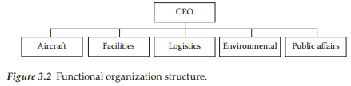
Chapter
03
Organizational structures
Functional organization structure
Is set up according to major business functions such as aircraft, facilities, logistics, environment, or public affairs as shown in Figure 3.2. Therefore, the different divisions are formed based on the main functions of the company, and employees have one clear supervisor (PMI 2008).
Benefits of Functional organization structure
People in a specialty unit have an in-depth understanding of the functional area for which they belong because all of their work revolves around that function such as aircraft-related projects.
Do not have to compete with one another to get the support of their specialty groups because only one group is familiar with aircraft and that eliminates competition within the same organization.
There is at least less politics within the lower and middle levels of the organization, which is a true benefit.
Functional groups are often very adept at technical problem-solving within the group because all of their projects are related and thus
expertise is acquired by the group.

Slide 29
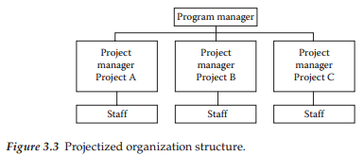
Chapter
03
Organizational structures
Projectized organization structure
The projectized organization structure is a project organization that has PMs with full authority where employees actually report to the PM (PMI
2008). There is also staff to support the PM. This book has an entire chapter devoted to the enterprise PMO in Chapter 24, which goes into the
details of this structure. However, Figure 3.3 depicts a typical organizational chart for the projectized structure.

Slide 30
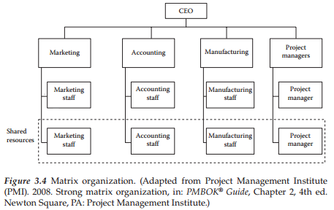
Chapter
03
Organizational structures
Matrix organization structure
This structures involve projects that pull employees from various functional units trying to capitalize on the benefits of both centralized and functional structures. The matrix organization structure can be considered as a weak, balanced, or strong matrix (PMI 2008). The matrix is a combination of functional, centralized, and/or projectized organizations as displayed in Figure 3.4.
The stronger the matrix, the more it resembles a projectized organization where PMs have administrative staff with a significant amount of authority.
The weaker the matrix, the more it resembles a functional organization where the PM has little authority and no administrative staff.
The balanced matrix provides the PM with a greater degree of authority than the weak matrix but still not full authority as found in a strong matrix.

Slide 31
Chapter
03
Organizational structures
Benefits of Matrix organization structure
A large benefit of the matrix organization structure is that teams can be assembled rapidly since there is a larger resource pool to tap into and the organization as a whole already has employees with different expertise.
Scarce expertise can be applied to different projects as needed and therefore the organization as a whole can justify maintaining a full-time employee with a certain expertise because this employee can be used for small amounts of work on multiple projects.
The project cost is lessened since a full-time dedicated resource for one particular project is not necessary since the costs are then shared among multiple projects.
Getting buy-in from team members’ functional units is easier because employees working in the functional area impacted by the project deliverable will be more likely to support the project such as providing input to help develop a better system design for a particular functional area.
Consistent reporting systems and procedures can be used for projects of the same type since employees from the same functional areas with already set systems and procedures work on an array of projects.

Slide 32
Chapter
03
Organizational structures
Challenges of Matrix organization structure
Team members often respond to two different managers. One manager is the PM assigning the work to be accomplished and the other one is the employee’s supervisor responsible for performance appraisals and leave requests. If the two managers do not communicate, it could cause issues such as an employee being approved to be on leave during a critical portion of the project or the employee doing great work but not being rewarded on their performance appraisal since it is work being accomplished that does not serve the employee’s manager.
In this environment, the PM has a weakened power of control over their team since the supervisors have more ultimate power over the employee than the PM. Therefore, the employee may be more apt to please their supervisor who does the performance appraisal and approval of employee leave. Ultimately, the team member has more forced loyalty to the supervisor because of the control the supervisor has.
The PM has also to deal with multiple supervisors as any one team may be comprised of different employees each with different supervisors. This aspect of the matrix organization structure is difficult.
Team members working on multiple projects might have to address competing demands for their time such as trying to please all of their managers resulting in an employee’s workload being too high.

Slide 33
Chapter
03
Organizational structures
Challenges of Matrix organization structure
The employee may not have a single manager looking out directly for their best interest and rather want their project being completed as planned according to outcome, schedule, and budget.
Furthermore, team members may not be familiar with each other’s styles and knowledge because unless the same team has worked together in the past, building trust and being comfortable with each other’s work styles do not occur overnight, yet projects have a limited completion time. Team-building exercises can aid in this effort but not help fully.
Potential lack of focus on project team and its goals, as opposed to each person’s individual assignment, is another area of challenge.
Team members may have a hard time focusing on the overall good for a particular project versus what is best for their particular functional area.
Also, multiple work processes and reporting systems might be used by different team members who could cause internal team politics.
When team members are distributed geographically in different locations, the complexity of coordinating the team is even more challenging.
Typically, large and global companies tend to be matrix organization structures, which include the composite organization structure.
The more mature a company is, the more likely it is to resemble a composite organizational structure similar to Figure 3.5
composite organization structure.

Slide 34
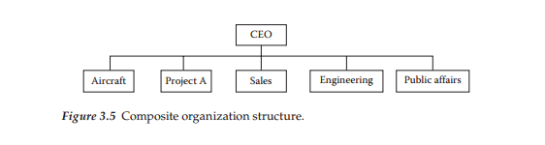
Chapter
03
Organizational structures

Slide 35
Chapter
03
Organizational structures
Virtual organization structure
The virtual organization can take on any of the structures previously described in this chapter. Virtual teams consist of groups of people with a shared goal who work together without necessarily any physical interaction (PMI 2008). However, the virtual organization consists of many employees working out of their homes or different locations. Therefore, employees are not collocated. Since technology has identified many ways for individuals to communicate at a distance, companies that operate virtually can operate just like any other organization.
Benefits of Virtual organization structure
Makes more sense in its existence where multiple projects are being worked, especially if you are a PM.
Costs can be lower when physical facilities are not needed to house employees.
Team members being geographically dispersed and interacting at different times.
Best for individuals within an organization that are self-managing and not in need of much supervision.
Best for a team that communicates to a manager who serves the role of more of a facilitator.
Organizations with off-site employees requiring expertise found in multiple locations around the globe have no choice but to
conduct themselves virtually.

Slide 36
Chapter
03
Organizational structures
Composite organization structure
The composite organization may be referred to as the hybrid organization that has units resembling centralized, functional, projectized, and virtual
and/or matrix organization structures as displayed in Figure 3.5. This organizational structure was developed to meet or customize the structure to the particular needs of a company.
The main benefit that exists is the same as in the centralized organization structure because of standardization throughout the organization regarding processes and reporting systems.
Challenges within this organizational structure tend to be in the area of increased conflict within and between projects because of duplication of effort and overlapping authority. Many managers have issue with regard to the performance appraisal and leave requests residing with one manager where one or more additional managers are responsible for assigning work tasks.
Typically, large and global companies tend to be matrix organization structures, which include the composite organization structure.
The more mature a company tends to be, the more likely it is to be of a matrix or composite organization structure.

Slide 37
Chapter
03
Summary
For many organizations, power and politics occur due to labor resources, monetary resources, facility (space) resources, and equipment resources.
Every organizational culture is different, but regardless of the culture, every project in order to be successful needs support from the organization so that the organizational structure is supportive and not restrictive to the PM. In conclusion, different organizational structures serve different needs, so companies will select which structure or combination of structure best fits their needs.
Depending on the structure in place, different power struggles and politics will occur. However, even though different structures have different types of power struggles and politics, no structure is without these issues.
Six different types of organizational structures were addressed that included centralized organization structures, functional organization structures, projectized organization structure, matrix organization structure, virtual organizational structure, and composite organization systems.
Every structure has distinct characteristics, each with benefits and challenges.

Slide 38
Chapter
03
QUESTIONS
Student review questions
Name the different types of resources that are the root cause of power and politics in an organization.
Describe the benefits and challenges associated with the different organizational structures below:
• Centralized, Functional, Projectized, Virtual, Matrix and Composite organization structure
In-class questions
Identify different companies that follow each of the different organizational structures given below:
• Centralized, Functional, Projectized, Virtual, Matrix and Composite organization structure
EXERCISES
For the student team working on the car case study, identify the type of organizational structure that may best for the company.
What type of power struggles and politics may occur within the car industry?

Slide 39
Chapter
03
References
Brewer, G. and S. Strahorn. 2012. Trust and the project management body of knowledge. Engineering, Construction and Architectural Management 19(3):286–305.
Clark, I. and T. Colling. 2005. The management of human resources in project management-led organizations. Personnel Review 34(2):178–191.
Little, B. 2011. The principles of successful project management. Human Resource Management International Digest 19(7):36–39.
Maddalena, V. 2012. A primer on project management. Leadership in Health Services 25(2):80–89.
Project Management Institute (PMI). 2008. Strong matrix organization, in: PMBOK® Guide, 4th ed. Newton Square, PA: Project Management Institute.
Richardson, G.L. 2010. Project Management Theory and Practice. New York: CRC Press, Taylor & Francis Group.
Vidal, L.-A. and F. Marle. 2008. Understanding project complexity: Implications on project management. Kybernetes 37(8):1094–1110.

Slide 40
Chapter
02 - 03
Thank You
The End..
Thank You

