Slide 1


College of Management
Business Ethics
Lecturer: Dr. Raef Baraka
PMG 750
Lecture 10

Slide 2

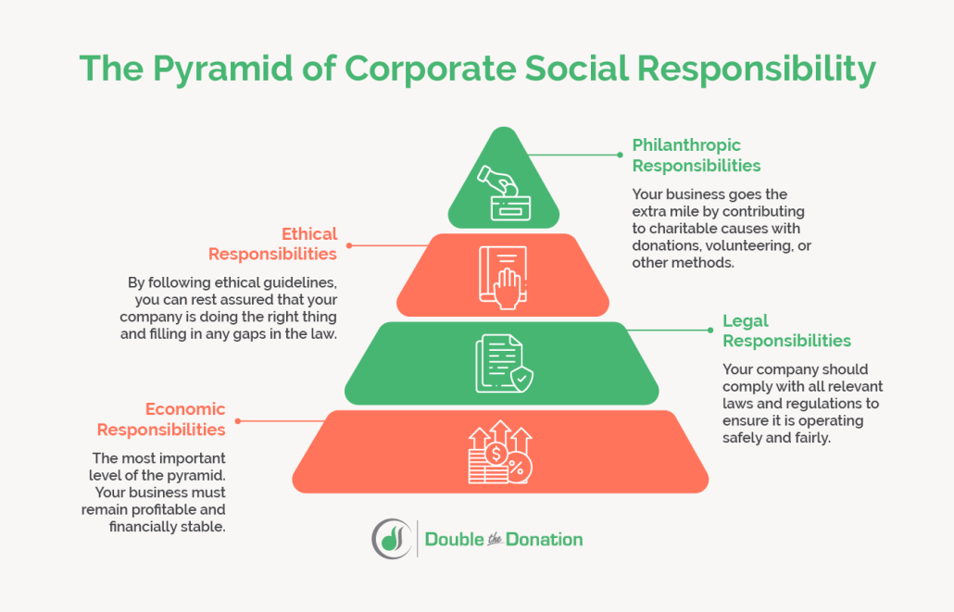
Chapter 12: SUSTAINABILITY: ETHICAL AND SOCIAL RESPONSIBILITY DIMENSIONS
CHAPTER OBJECTIVES:
Relate sustainability to ethical decision making and social responsibility.
Examine global environmental issues related to the atmosphere, water, and land.
Review environmental legislation related to sustainability.

Slide 3
Chapter 12: SUSTAINABILITY: ETHICAL AND SOCIAL RESPONSIBILITY DIMENSIONS
CHAPTER OBJECTIVES:
Compare renewable energy sources that provide alternatives for sustainability.
Evaluate business responses to sustainability related to green marketing and greenwashing.
Provide strategic directions for the Implementation of sustainability.

Slide 4
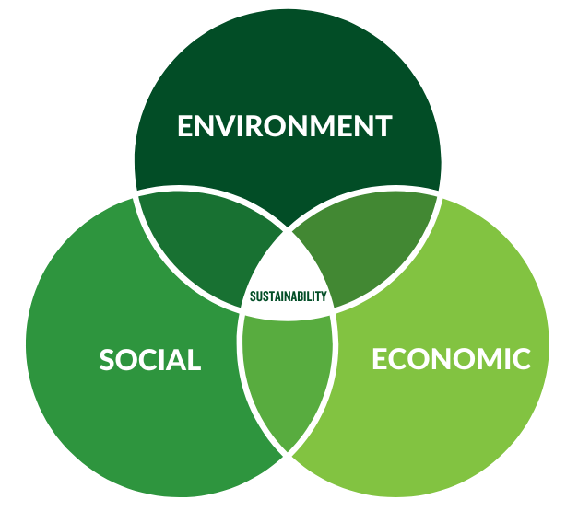
SUSTAINABILITY: ETHICAL AND SOCIAL RESPONSIBILITY DIMENSIONS
DEFINING SUSTAINABILITY

Slide 5
SUSTAINABILITY: ETHICAL AND SOCIAL RESPONSIBILITY DIMENSIONS
Defining Sustainability
Sustainability from a strategic business perspective is the potential for the long-term well-being of the natural environment, including all biological entities, as well as mutually beneficial interactions among nature and individuals, organizations, and business strategies.
Sustainability includes the assessment and improvement of business strategies, economic sectors, work practices, technologies, and lifestyles in the maintenance of the natural environment.
Sustainable development has become a top concern for many businesses as it involves meeting the needs of the present without compromising the ability of future generations to meet their own needs.

Slide 6
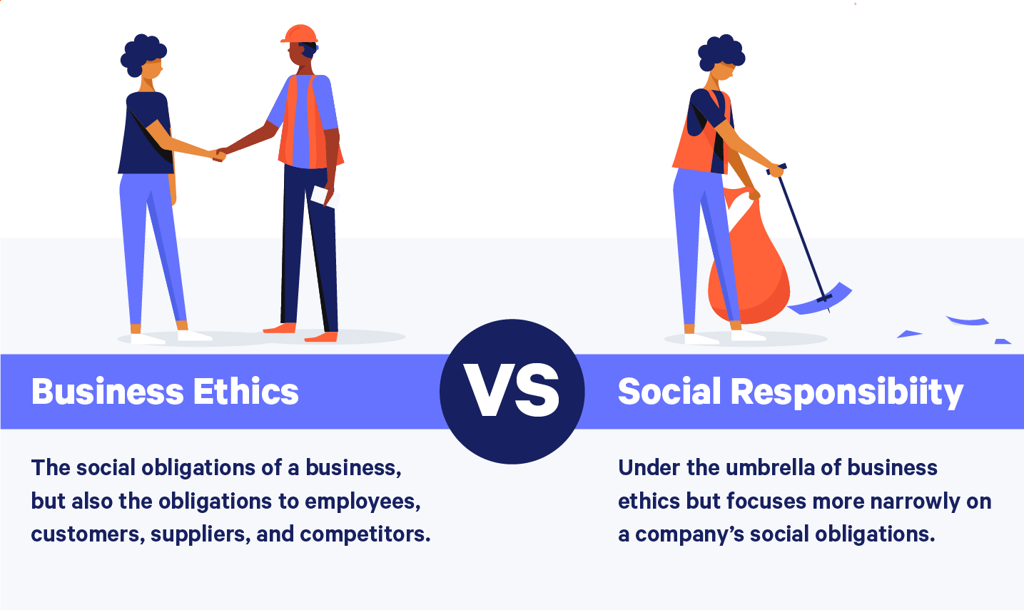
SUSTAINABILITY: ETHICAL AND SOCIAL RESPONSIBILITY DIMENSIONS
HOW SUSTAINABILITY RELATES TO ETHICAL DECISION MAKING AND SOCIAL RESPONSIBILITY

Slide 7
SUSTAINABILITY: ETHICAL AND SOCIAL RESPONSIBILITY DIMENSIONS
Defining Sustainability
Sustainability falls into the social responsibility domain of maximizing positive and minimizing negative impacts on stakeholders.
Because most stakeholders have concerns about some aspects of the natural environment, organizations should respond to those issues in their strategies, policies, and operations.
Decisions in this area relate to assessing risks, monitoring legal compliance, and avoiding misconduct within the environment.

Slide 8
SUSTAINABILITY: ETHICAL AND SOCIAL RESPONSIBILITY DIMENSIONS
Defining Sustainability
A corporate culture that includes a sustainability agenda or a corporate social responsibility (CSR) report can create long-term favorable stakeholder responses.
In addition, CSR performance can increase employees’ company identification and commitment.
Values are an important part of an ethical culture and support an organization’s sustainability agenda.
Research indicates employees’ exposure to sustainability activities increases the ability to implement sustainability programs as well as economic benefits.

Slide 9
SUSTAINABILITY: ETHICAL AND SOCIAL RESPONSIBILITY DIMENSIONS
Defining Sustainability
Many firms use sustainable business practices to demonstrate their social commitment through such activities as sponsoring cleanup events, recycling, modifying manufacturing processes to reduce waste and pollution, using more alternative energy sources, and generally reevaluating the effects of their products on the natural environment.
Table 12-1 provides a list of some of the world’s most sustainable companies.

Slide 10
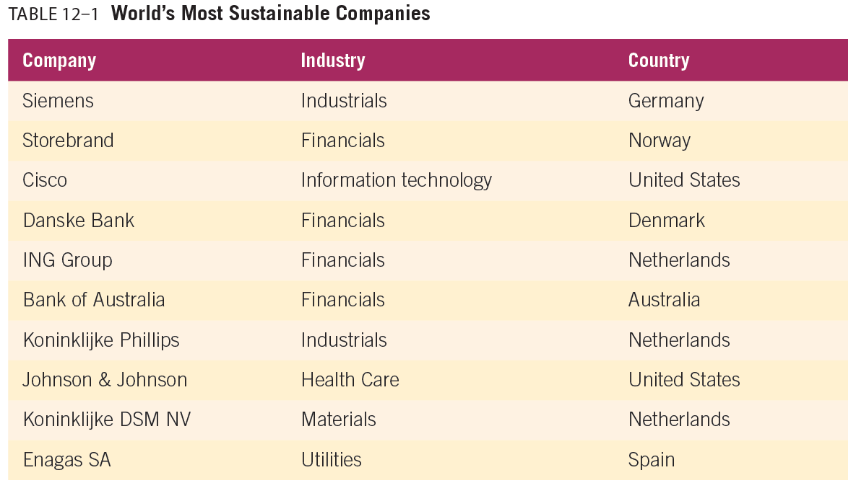
SUSTAINABILITY: ETHICAL AND SOCIAL RESPONSIBILITY DIMENSIONS

Slide 11
SUSTAINABILITY: ETHICAL AND SOCIAL RESPONSIBILITY DIMENSIONS
Defining Sustainability
Sustainability, social responsibility, and ethics should not be used interchangeably.
Some take the approach that if an organization is sustainable, then it is also ethical. However, an organization cannot ignore basic principles, values, and legal obligations to society.
Because ethical decisions relate to specific conduct and relationships in the decision-making process, it becomes clear that sustainability is only one aspect of ethical decision-making.

Slide 12
SUSTAINABILITY: ETHICAL AND SOCIAL RESPONSIBILITY DIMENSIONS
Defining Sustainability
Additionally, social responsibility is a much broader area than sustainability.
Examples of social responsibility topics relating to various stakeholders include consumer protection, corporate governance, employee well-being, and more.
All of these social responsibility areas have an ethical decision-making dimension.
Figure 12-1 describes how ethical decisions impact sustainability as a component of CSR.

Slide 13
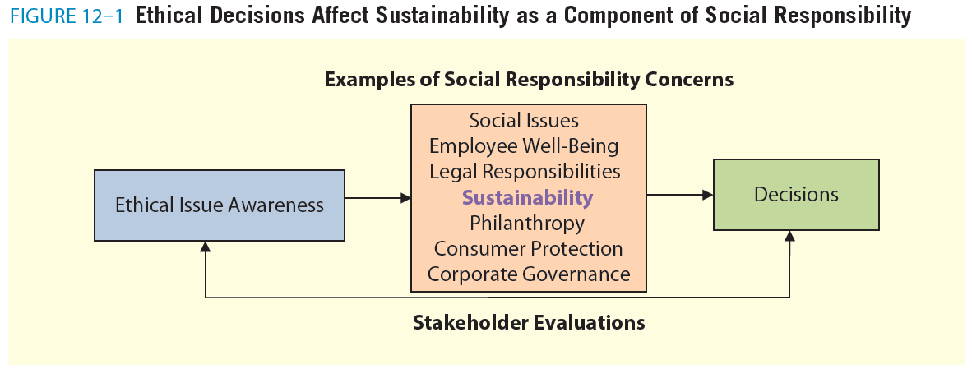
SUSTAINABILITY: ETHICAL AND SOCIAL RESPONSIBILITY DIMENSIONS

Slide 14
SUSTAINABILITY: ETHICAL AND SOCIAL RESPONSIBILITY DIMENSIONS
Defining Sustainability
There are four reasons social responsibility has become such an issue for organizations:
First, socially responsible activities such as sustainable business practices can create competitive advantages.
Consumers’ buying behavior, the interaction of stakeholders with representatives of the organization, advertising practices, and participation in social media can help a firm stay on top of market knowledge and create beneficial relationships with stakeholders.
Second, organizations can use their products and brand identity to create social value, quality, and consumer loyalty.

Slide 15
SUSTAINABILITY: ETHICAL AND SOCIAL RESPONSIBILITY DIMENSIONS
Defining Sustainability
There are four reasons social responsibility has become such an issue for organizations:
Third, both positive and negative information about products and organizations became more available. Therefore, consumers and other stakeholders gain power and can influence the economic success of the company.
Finally, in this interconnected society, companies use their sustainable and socially responsible decisions to differentiate their firms and promote their products

Slide 16
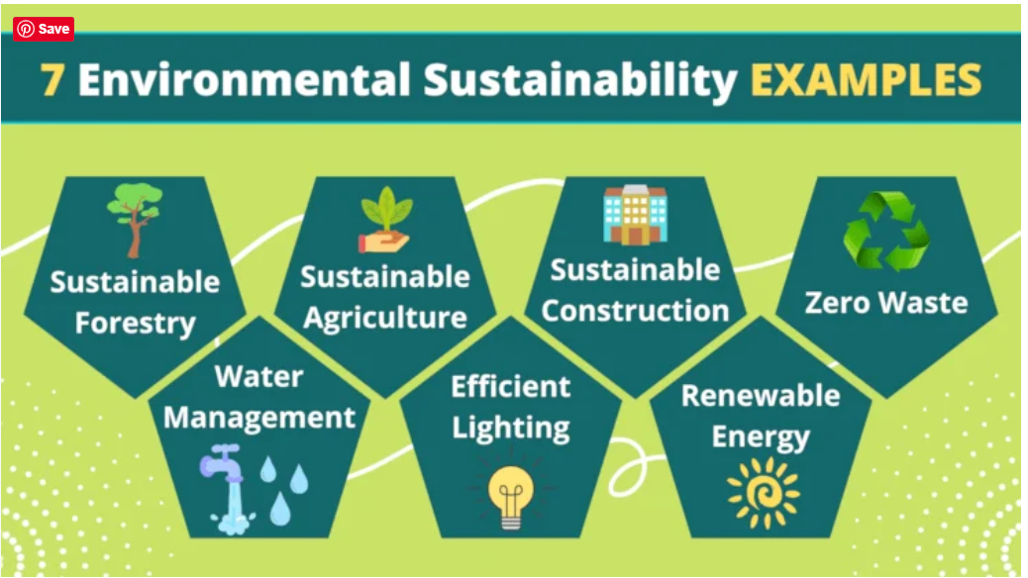
SUSTAINABILITY: ETHICAL AND SOCIAL RESPONSIBILITY DIMENSIONS
GLOBAL ENVIRONMENTAL ISSUES

Slide 17
SUSTAINABILITY: ETHICAL AND SOCIAL RESPONSIBILITY DIMENSIONS
Global Environmental Issues
The protection of air, water, land, biodiversity, and renewable natural resources emerged as a major issue in the twentieth century in the face of increasing evidence that mankind was putting pressure on the long-term sustainability of these resources.
Some of the most significant environmental issues facing business and society today include: air pollution, acid rain, global warming, water pollution and water quantity, land pollution, waste management, deforestation, urban sprawl, biodiversity, and genetically modified foods.

Slide 18
SUSTAINABILITY: ETHICAL AND SOCIAL RESPONSIBILITY DIMENSIONS
1. Atmospheric
Among the most far-reaching and controversial environmental issues are those that relate to the air we breathe.
Atmospherics is segmented into pollution, climate change, and ozone depletion.
AIR POLLUTION: Air pollution typically arises from three different sources: stationary sources such as factories and power plants; mobile sources such as cars, trucks, planes, and trains; and natural sources such as windblown dust and volcanic eruptions.
These sources discharge gases, as well as particulates, that can be carried long distances by surface winds or linger when air stagnation occurs.

Slide 19
SUSTAINABILITY: ETHICAL AND SOCIAL RESPONSIBILITY DIMENSIONS
1. Atmospheric
ACID RAIN: In addition to the health risks posed by air pollution, when nitrous oxides and sulfur dioxides are emitted from manufacturing facilities, the compounds are exposed to air and rain and form new compounds, resulting in what is commonly called acid rain.
The vital aspect of this type of pollution is that one country can produce it while another can have the negative impacts.
Cleaning up emissions from factories and cars is one way to reduce acid rain.

Slide 20
SUSTAINABILITY: ETHICAL AND SOCIAL RESPONSIBILITY DIMENSIONS
1. Atmospheric
GLOBAL WARMING: When carbon dioxide and other gases collect in Earth’s atmosphere, they trap the sun’s heat like a greenhouse and prevent Earth’s surface from cooling.
Without this process, the planet becomes too cold to sustain life.
However, during the twentieth century, the burning of fossil fuels—gasoline, natural gas, oil, and coal—accelerated dramatically, increasing the concentration of “greenhouse” gases (carbon dioxide, methane, nitrogen oxides, and fluorinated gases) in Earth’s atmosphere.

Slide 21
SUSTAINABILITY: ETHICAL AND SOCIAL RESPONSIBILITY DIMENSIONS
1. Atmospheric
GLOBAL WARMING:
At the same time, chlorofluorocarbons—from refrigerants, coolants, and aerosol cans—are believed to be the cause of a giant hole in the Earth’s atmospheric ozone layer.
The ozone layer filters out the sun’s harmful ultraviolet light. These and other factors cause what the media call “global warming.”
One attempt at addressing global warming was the Kyoto Protocol.
This international treaty was meant to curb global greenhouse gas emissions by having countries voluntarily reduce their national outputs.

Slide 22
SUSTAINABILITY: ETHICAL AND SOCIAL RESPONSIBILITY DIMENSIONS
1. Atmospheric
GLOBAL WARMING:
Coal is another area of contention among different countries.
Burning coal contributes to air pollution by releasing large amounts of gaseous and particulate emissions into the atmosphere. Some countries are combating coal usage by implementing cap-and-trade programs.
A cap-and-trade program sets carbon emissions limits (caps) for businesses, countries, or individuals.
Companies are given a certain amount of carbon they are allowed to emit, and to legally emit anything beyond the limit requires a company to purchase carbon credits from another company that does not pollute as much.

Slide 23
SUSTAINABILITY: ETHICAL AND SOCIAL RESPONSIBILITY DIMENSIONS
2. Water
Water is emerging as the most important and contested resource of the twenty-first century.
Nothing is more important to human survival, yet fresh water is being polluted and consumed at an unprecedented rate..
To remain viable, all businesses must think about water conservation, purification, and allocation.
WATER POLLUTION is one of the biggest contributors to illnesses in developing countries. Chemicals found in commonly used fertilizers and pesticides can drain into water supplies with each rainfall.
Mercury, a common chemical found in batteries and some household products, is another concern as it contaminates oceans and, therefore, human food supplies.

Slide 24
SUSTAINABILITY: ETHICAL AND SOCIAL RESPONSIBILITY DIMENSIONS
2. Water
WATER QUANTITY In addition to concerns about the quality of water, some parts of the globe are increasingly worried about its quantity. Water use has increased dramatically in the last two decades, creating serious consequences for the global water supply and for business.
Proactive companies are facing this reality and coming forward with solutions.
Starbucks installed a manually operated pump faucet to replace regular turn-on fixtures in their stores, estimated to save approximately 100 gallons of water per store each day.

Slide 25
SUSTAINABILITY: ETHICAL AND SOCIAL RESPONSIBILITY DIMENSIONS
3. Land
Land sustainability issues include everything from pollution and waste to loss of biodiversity and genetically modified food.
These ethical issues are decreasing the use of viable land for human and animal habitation.
Because businesses generate waste, contribute to urban sprawl, and often require the use of hard-to-restore natural resources, they have an ethical responsibility to minimize their harmful impact on the land.

Slide 26
SUSTAINABILITY: ETHICAL AND SOCIAL RESPONSIBILITY DIMENSIONS
3. Land
LAND POLLUTION Land pollution results from the dumping of residential and industrial wastes, strip mining, and poor forest conservation.
Such pollution causes health problems in humans, jeopardizes wildlife habitats, causes erosion, alters watercourses (leading to flooding), and can eventually poison groundwater supplies.
While soil pollution may not be as much of a problem in other countries, balancing the needs of stakeholders, including consumers, businesses, the environment, and society at large, is an important ethical consideration.
In order to reduce pollution around the planet, all businesses must become aware of and accept responsibility for the problem of pollution.

Slide 27
SUSTAINABILITY: ETHICAL AND SOCIAL RESPONSIBILITY DIMENSIONS
3. Land
WASTE MANAGEMENT One of the biggest factors in land pollution is the dumping of waste into landfills. American consumers are by far the world’s biggest wasters. The nation has up to 40,000 abandoned landfills that are often left untreated and are filled with plastics and other materials that can take 1,000 years to degrade.
DEFORESTATION The world’s forests are being destroyed at a rate of 46,000 to 58,000 square miles annually.36 The reasons for this wide-scale destruction are varied.

Slide 28
SUSTAINABILITY: ETHICAL AND SOCIAL RESPONSIBILITY DIMENSIONS
3. Land
URBAN SPRAWL Urban sprawl began in the United States with the post-World War II building boom.
This boom transformed the nation from primarily low-density communities designed to accommodate one-car households, bicyclists, and pedestrians to largescale suburban developments at the edges of established towns and cities.
Although limiting urban sprawl creates disadvantages for car and oil companies, many businesses can benefit from urban renewal movements that reduce sprawl.

Slide 29
SUSTAINABILITY: ETHICAL AND SOCIAL RESPONSIBILITY DIMENSIONS
3. Land
BIODIVERSITY Deforestation, pollution, development, and urban sprawl put increasing pressure on wildlife, plants, and their habitats.
Many plants and animals became extinct, and thousands more are threatened.
Experts fear overutilization of natural resources will cause catastrophic imbalances in the environment.
Because each biological species plays a unique role in its ecosystem and is part of a complex chain of events, the loss of any of them may threaten the entire ecosystem.

Slide 30
SUSTAINABILITY: ETHICAL AND SOCIAL RESPONSIBILITY DIMENSIONS
3. Land
GENETICALLY MODIFIED ORGANISMS Depending on whom you ask, genetically modified foods are going to save impoverished areas from starvation and revolutionize agriculture or destroy biodiversity and make us all sick.
Genetically modified (GM) organisms are created through manipulating plant and animal DNA to produce a desired effect like resistance to pests and viruses, drought resistance, or high crop yield.
This process generally involves transferring genes from one organism to another in a way that would never occur naturally, in order to create a new life form with unique traits.

Slide 31
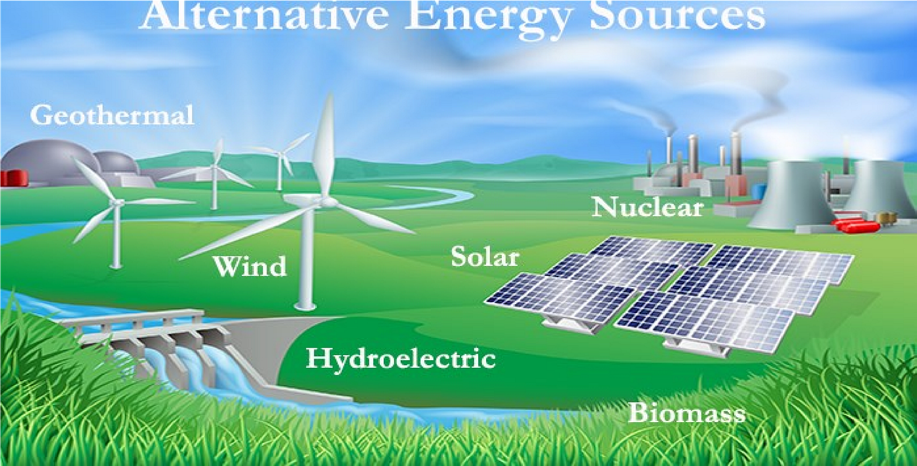
SUSTAINABILITY: ETHICAL AND SOCIAL RESPONSIBILITY DIMENSIONS
ALTERNATIVE ENERGY SOURCES

Slide 32
SUSTAINABILITY: ETHICAL AND SOCIAL RESPONSIBILITY DIMENSIONS
Alternative Energy Sources
Alternative energy sources already have a major impact on many stakeholders.
In some cases, they significantly decreased the carbon footprint of communities, cities, and even countries.
Businesses such as New Belgium Brewing incorporated alternative energy sources into their operations, decreasing their carbon emissions as well as their energy costs.
The following section will describe some of the more popular forms of alternative energy sources being explored.

Slide 33
SUSTAINABILITY: ETHICAL AND SOCIAL RESPONSIBILITY DIMENSIONS
Alternative Energy Sources
Wind Power, experts believe wind energy could meet as much as 20 percent of the nation’s energy needs.
Geothermal Power Geothermal power has significant advantages and disadvantages that either advance or limit its adoption.
On the one hand, geothermal energy provides a constant source of heat.
It is subsequently a more dependable energy source than some other forms of alternative energy.
Solar power is 100 percent renewable energy that can be converted into electricity through the use of either photovoltaic cells (solar cells) on homes and other structures or solar power plants.

Slide 34
SUSTAINABILITY: ETHICAL AND SOCIAL RESPONSIBILITY DIMENSIONS
Alternative Energy Sources
The major disadvantages of solar power are that the technology remains expensive and inefficient compared to traditional fossil fuel–generated energy, and the infrastructure for mass production of solar panels is not in place in many locations.
Nuclear Power Countries throughout Europe managed to greatly reduce their emissions through the implementation of nuclear power plants, yet this form of power remains controversial.
Because of the danger associated with nuclear meltdowns and radioactive waste disposal, nuclear power earned a bad reputation in the United States.
On the one hand, nuclear power is pollution-free and cost-competitive.

Slide 35
SUSTAINABILITY: ETHICAL AND SOCIAL RESPONSIBILITY DIMENSIONS
Alternative Energy Sources
Biofuels Perhaps the most controversial form of alternative energy after nuclear power is ethanol.
Critics argue that manufacturing ethanol takes a lot of energy and is not much more sustainable than oil.
Hydropower, Throughout history people used water as a power source and means of transportation.
From the water-powered mills of centuries past to modern hydroelectric dams, water is a powerful renewable energy source

Slide 36
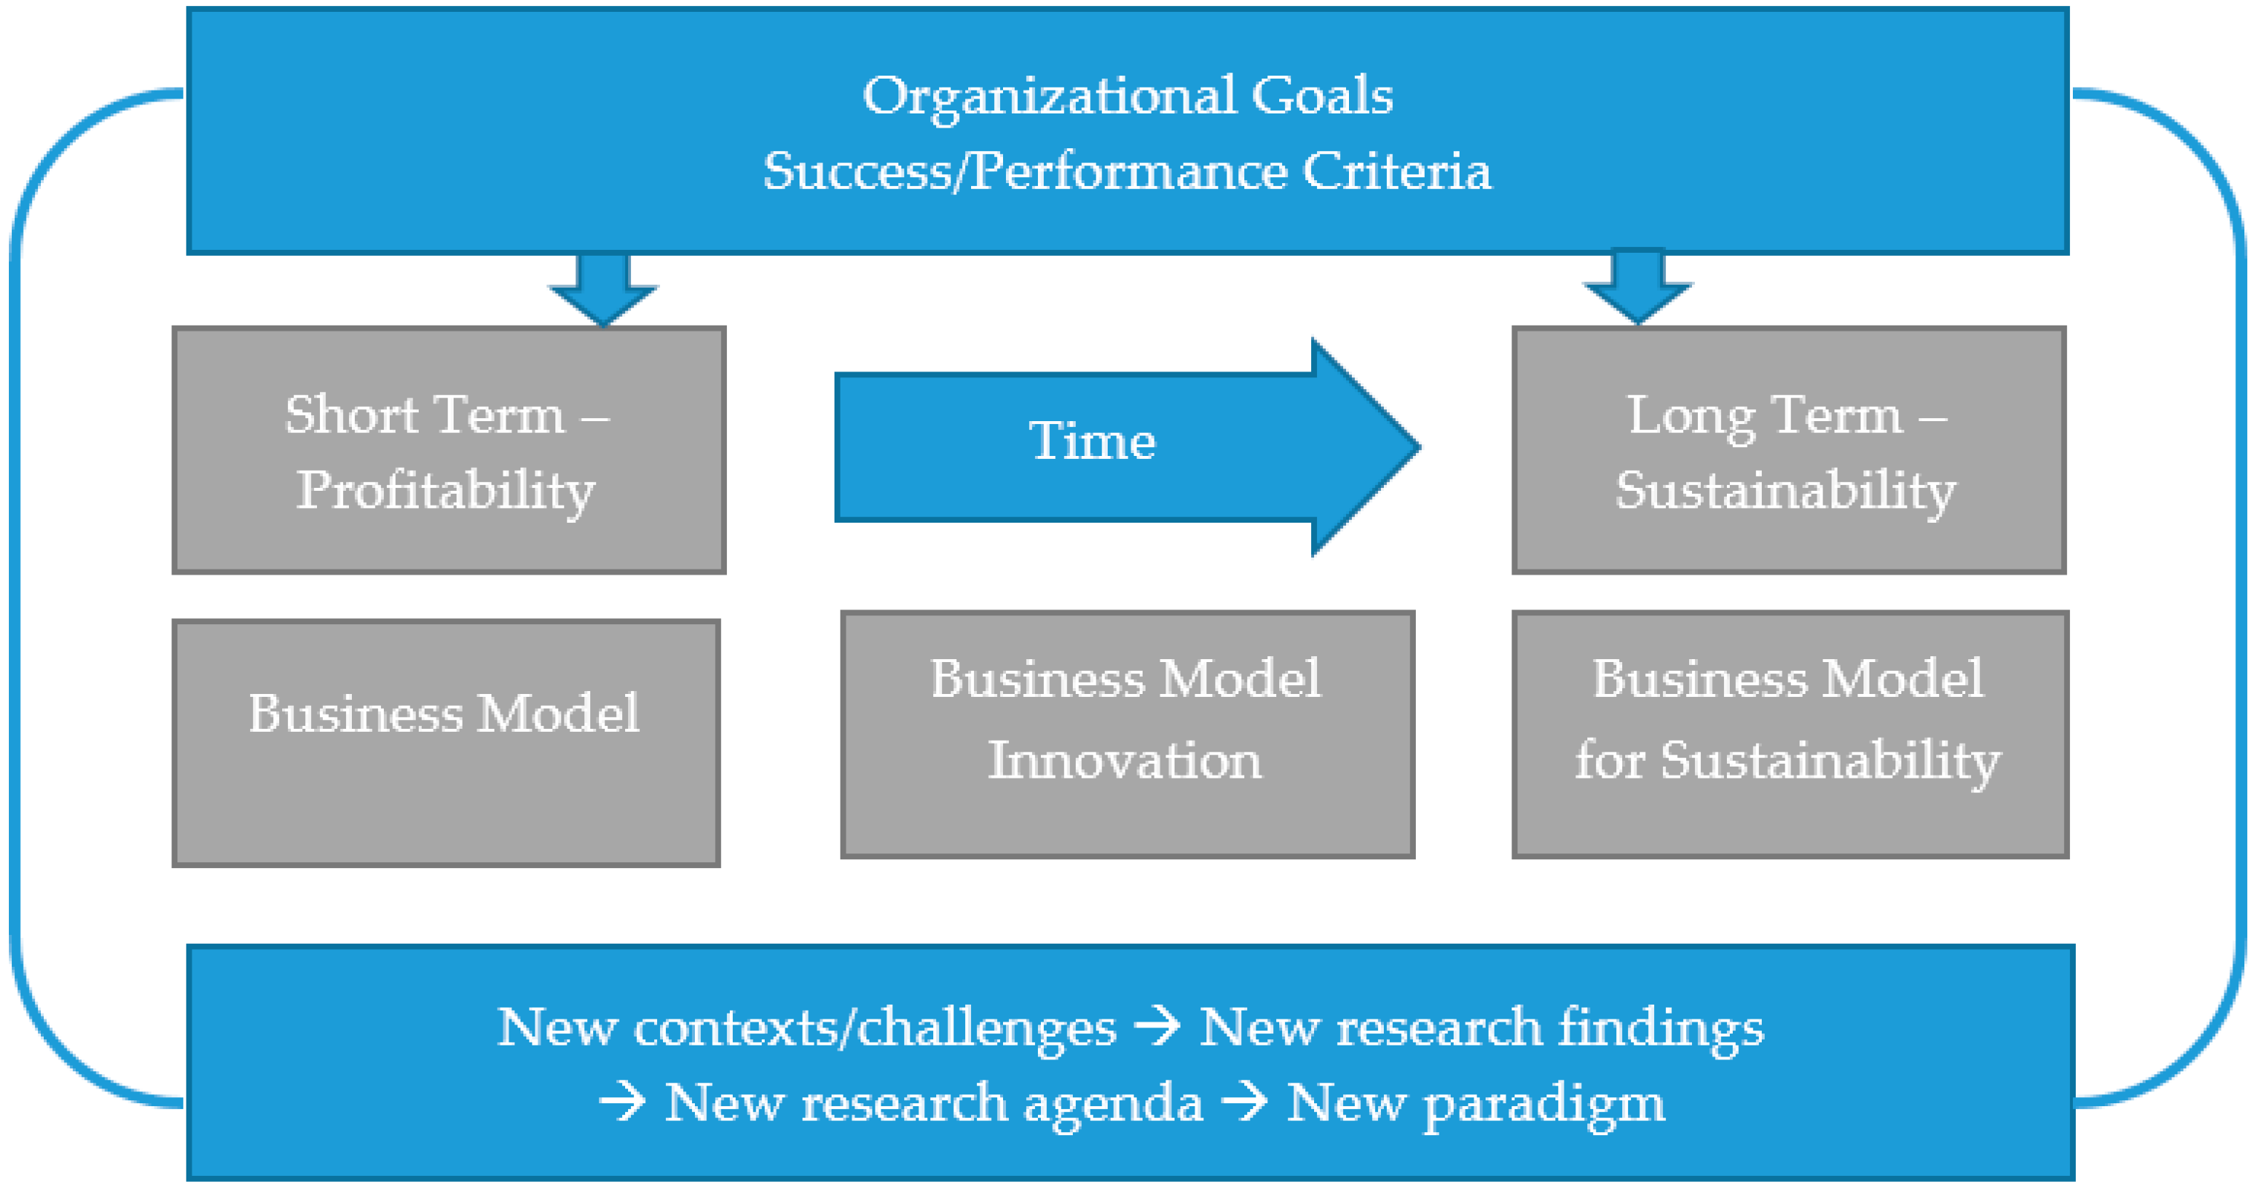
SUSTAINABILITY: ETHICAL AND SOCIAL RESPONSIBILITY DIMENSIONS
BUSINESS RESPONSE TO SUSTAINABILITY ISSUES

Slide 37
SUSTAINABILITY: ETHICAL AND SOCIAL RESPONSIBILITY DIMENSIONS
Business Response to Sustainability Issues
Green marketing is a strategy involving stakeholder assessment to create meaningful long-term relationships with customers, while maintaining, supporting, and enhancing the natural environment.
Greenwashing As green products become more popular, greenwashing increasingly becomes an ethical issue. Greenwashing involves misleading a consumer into thinking a good or service is more environmentally friendly than it really is.
Greenwashing ranges from making environmental claims required by law and are therefore irrelevant (CFC-free) to puffery (exaggerating environmental claims) to fraud.

Slide 38
SUSTAINABILITY: ETHICAL AND SOCIAL RESPONSIBILITY DIMENSIONS
Business Response to Sustainability Issues
The most common reason for greenwashing is to attract environmentally conscious consumers.
Many consumers do not find out about the false claims until after the purchase.
Therefore, greenwashing may increase sales in the short term.
However, while greenwashing might make a company appear sustainable, this strategy can seriously backfire when consumers find out they are being deceived.

Slide 39
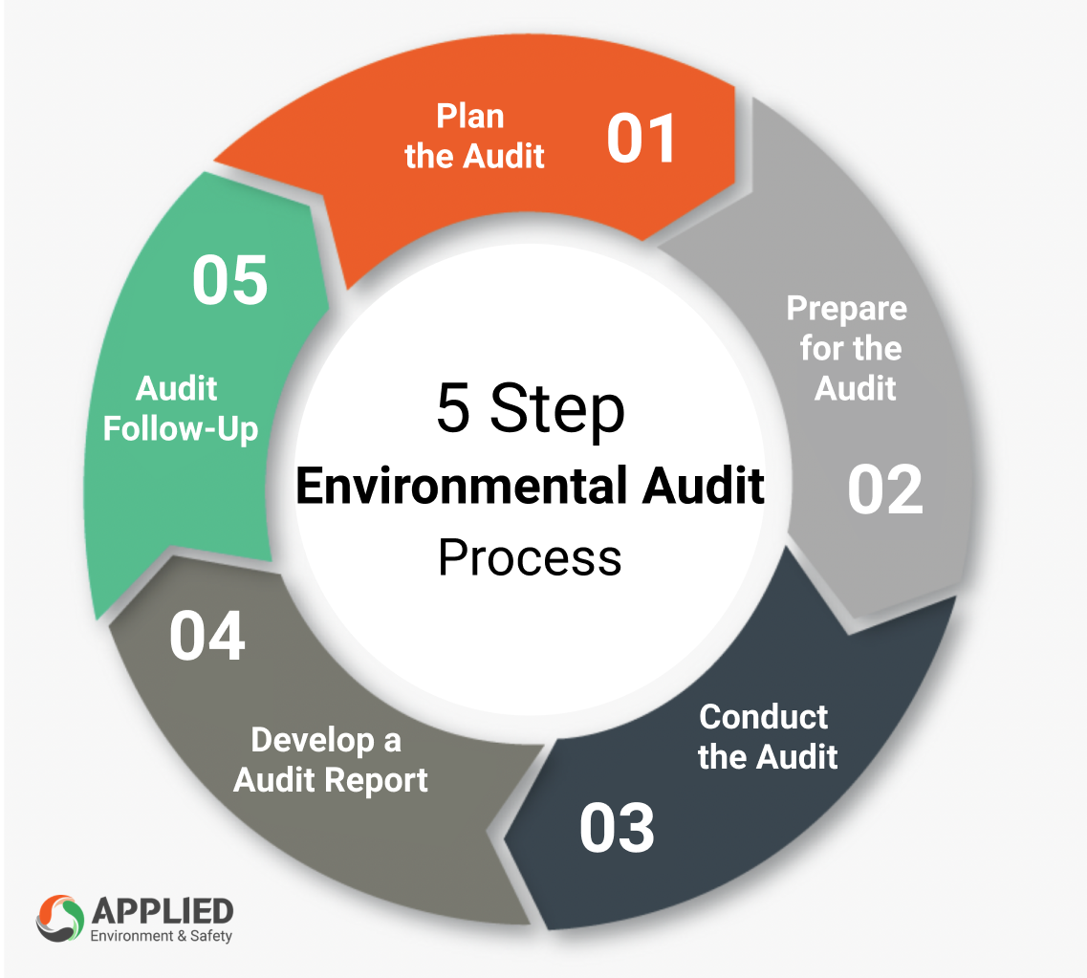
SUSTAINABILITY: ETHICAL AND SOCIAL RESPONSIBILITY DIMENSIONS
The Strategic Environmental Audit

Slide 40
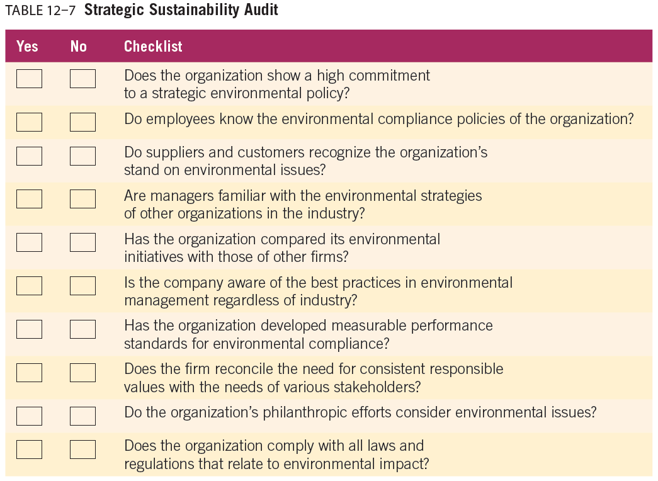

Slide 41



Thank You

