Slide 1


Project Fundamental- Part 2
Values, Needs, and Process
Chapter 4
Everyone’s Smart University
PMG101
Project communication

Slide 2
Section 2
Project quality
Lecture
Section 1
Project Values
Project Process models

Slide 3
Section 1
Project Values

Slide 4
Project values
Just as organizations vary in how they organize projects and the resources assigned to them, there are many different ways an organization can choose to execute their projects. Understanding the organization and project’s values and needs is necessary when planning how a project is to progress.

Slide 5
Project values
A project and organization’s values can vary quite dramatically in several different categories. The word “value” speaks to what’s most important to an organization, team, or project. Examples of values include:
• Prominence of the customer’s input: Are we relying more on the customer or our team to decide what is produced?
• Risk aversion: How developed is the organization’s ability to deal with uncertainty?
• Schedule predictability: How important is it to know exactly when things are to occur?

Slide 6
Project values
A project and organization’s values can vary quite dramatically in several different categories. The word “value” speaks to what’s most important to an organization, team, or project. Examples of values include:
• Preferred experience level of staff and managers: Do they typically employ lower-cost/entry-level or more expensive/experienced professionals?
• Perception and visibility to the customer: Is the customer’s view of the project’s progress extremely important?

Slide 7
Project values
In addition to the values that establish the themes of how work is done, there are also needs that vary from project-to-project. Understanding these variations is essential when plotting the course forward. Examples of these needs include:
• Resources and time required for the project’s size and complexity
• The level of documentation needed as the project progresses and the level needed at delivery
• A need to clarify requirements, specifications, and external variables as the project continues

Slide 8
Project values
In addition to the values that establish the themes of how work is done, there are also needs that vary from project-to-project. Understanding these variations is essential when plotting the course forward. Examples of these needs include:
• Flexibility in reacting to change as the project progresses
• The need for prototypes and the ability to evolve designs before completing the final product
• Whether the project calls for a defined end-point or an ongoing effort

Slide 9
Project values
Why are these important to your project?
An organization’s values and a project’s needs are heavily considered when choosing whether or not a potential project should be carried out at all. An extreme mismatch between the two may indicate that the project isn’t a good idea, is likely to fail, or should even be outsourced.
A solid understanding of these values and needs is also important.
Those assembling the team should consider whether the skills, experiences, and personalities of potential resources are a strong match.

Slide 10
Project values
Why are these important to your project?
Once the decision is made to move forward, values and needs affect the way in which project phases and steps are carried out—this is known as the project’s process model.
Most organizations have processes that they follow when completing work.

Slide 11
Section 1
Project process models

Slide 12
Project process models
For project work, process models generally fall into one of three categories:
Plan focused process models
Change focused process models
Cyclical process models
In some cases, the project team is allowed to decide which is appropriate; in others, a formal decision has already been made by the organization or is dictated by the standards of the industry.

Slide 13
Project process models
Plan focused process models
Plan-focused process models place the highest value on planning ahead and considering what will happen before moving forward with the project.
In general, plan-focused models require focus on one phase or step at a time, taking the time to ensure that plans have been laid out for the future before proceeding. At the most basic level, this model resembles a waterfall.

Slide 14
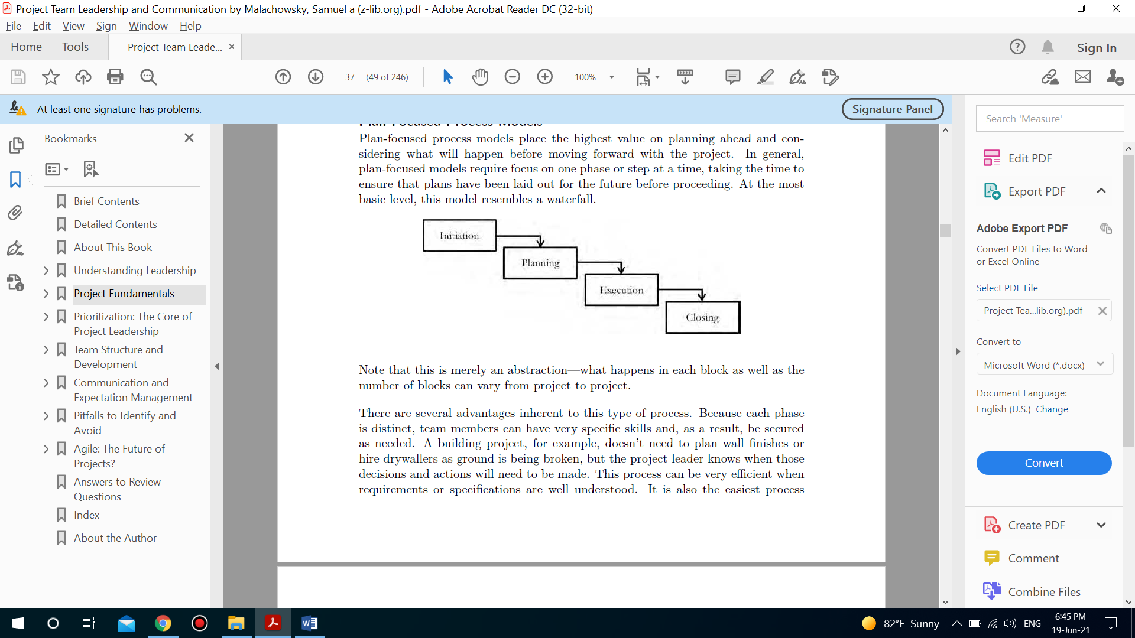
Project process models
Plan focused process models

Slide 15
Project process models
Plan focused process models characteristics
There are several advantages inherent to this type of process. Because each phase is distinct, team members can have very specific skills and, as a result, be secured as needed.
A building project, for example, doesn’t need to plan wall finishes or hire drywallers as ground is being broken, but the project leader knows when those decisions and actions will need to be made.
This process can be very efficient when requirements or specifications are well understood.

Slide 16
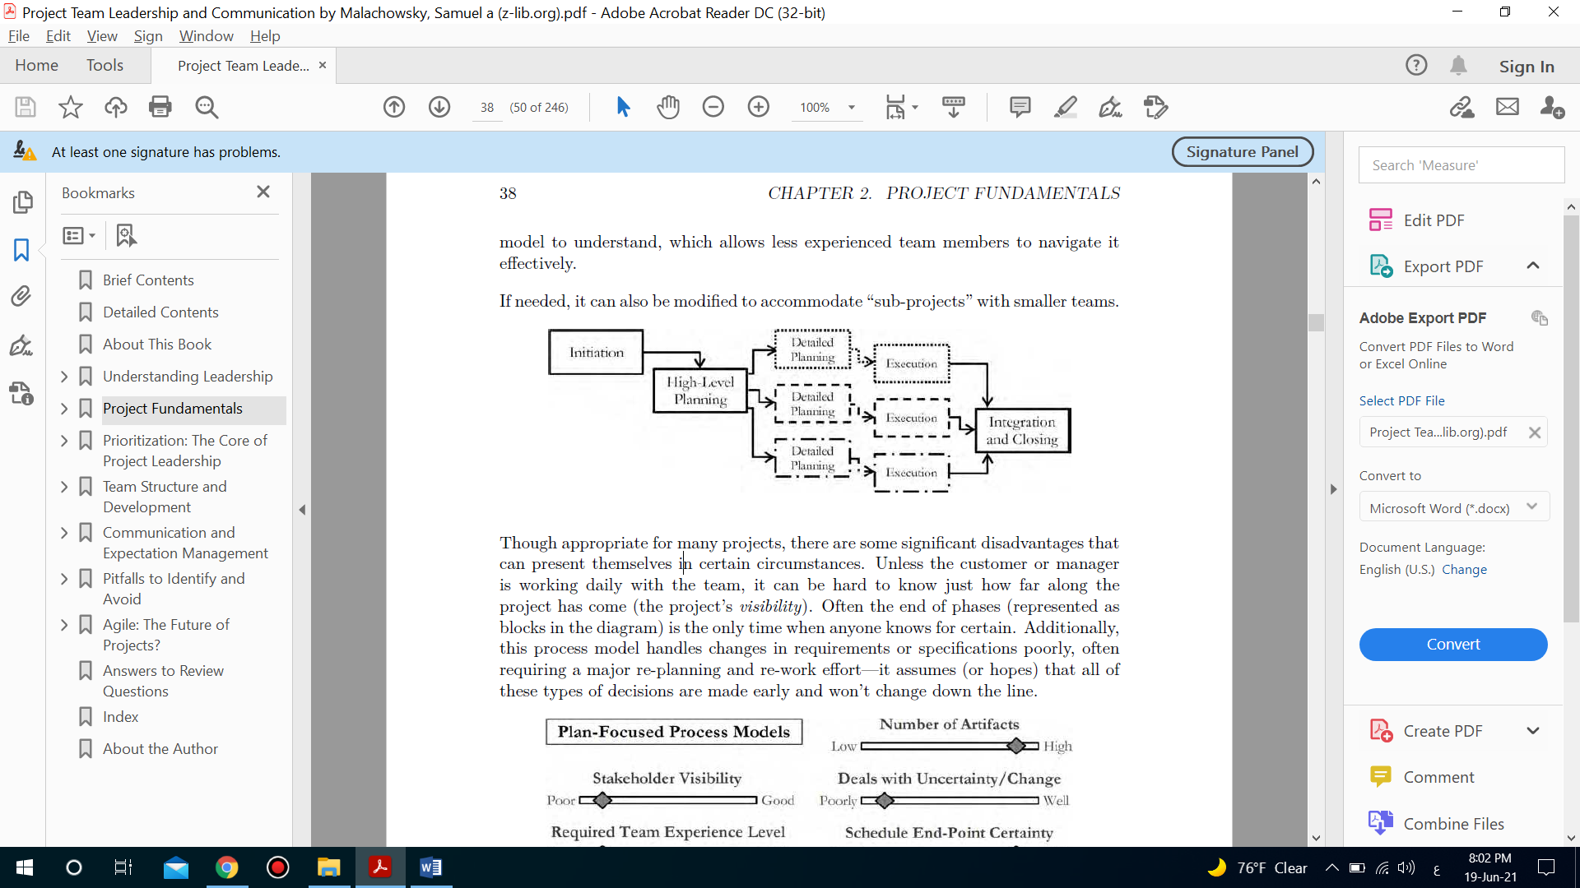
Project process models
Plan focused process models characteristics
It is also the easiest process model to understand, which allows less experienced team members to navigate it effectively. If needed, it can also be modified to accommodate “sub-projects” with smaller teams.

Slide 17
Project process models
Plan focused process models disadvantages
Though appropriate for many projects, there are some significant disadvantages that can present themselves in certain circumstances.
Unless the customer or manager is working daily with the team, it can be hard to know just how far along the project has come (the project’s visibility).

Slide 18
Project process models
Plan focused process models disadvantages
Often the end of phases (represented as blocks in the diagram) is the only time when anyone knows for certain.
Additionally, this process model handles changes in requirements or specifications poorly, often requiring a major re-planning and re-work effort—it assumes (or hopes) that all of these types of decisions are made early and won’t change down the line.

Slide 19
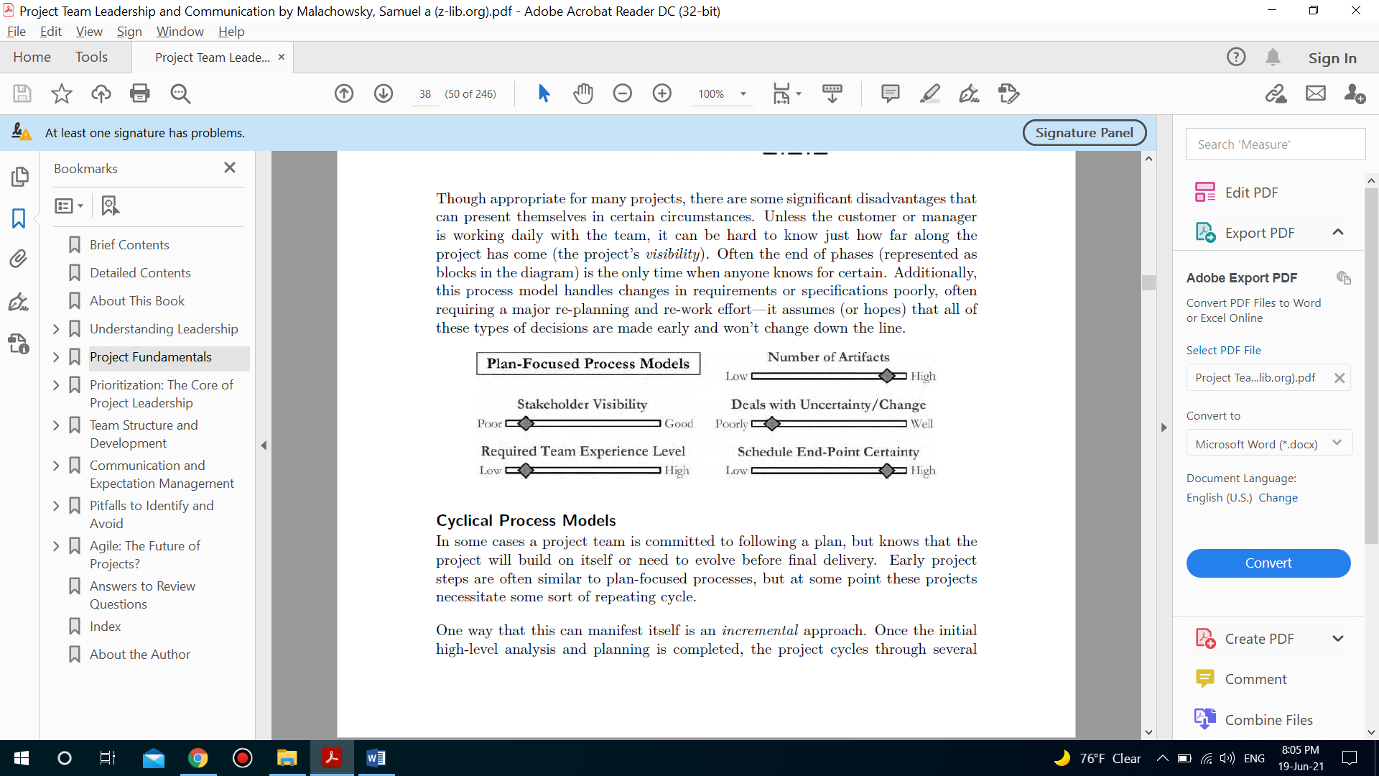
Project process models
Plan focused process models disadvantages

Slide 20
Project process models
Cyclical process models Characteristics
In some cases a project team is committed to following a plan, but knows that the project will build on itself or need to evolve before final delivery.
Early project steps are often similar to plan-focused processes, but at some point these projects necessitate some sort of repeating cycle.
One way that this can manifest itself is an incremental approach. Once the initial high-level analysis and planning is completed, the project cycles through several steps, delivering an ever-expanding result each time.

Slide 21
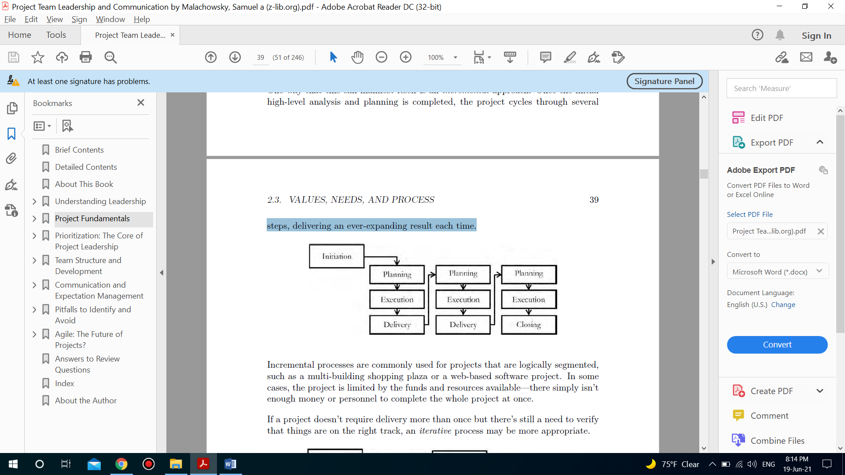
Project process models
Cyclical process models Characteristics

Slide 22
Project process models
Cyclical process models Characteristics
Incremental processes are commonly used for projects that are logically segmented, such as a multi-building shopping plaza or a web-based software project.
In some cases, the project is limited by the funds and resources available—there simply isn’t enough money or personnel to complete the whole project at once.

Slide 23
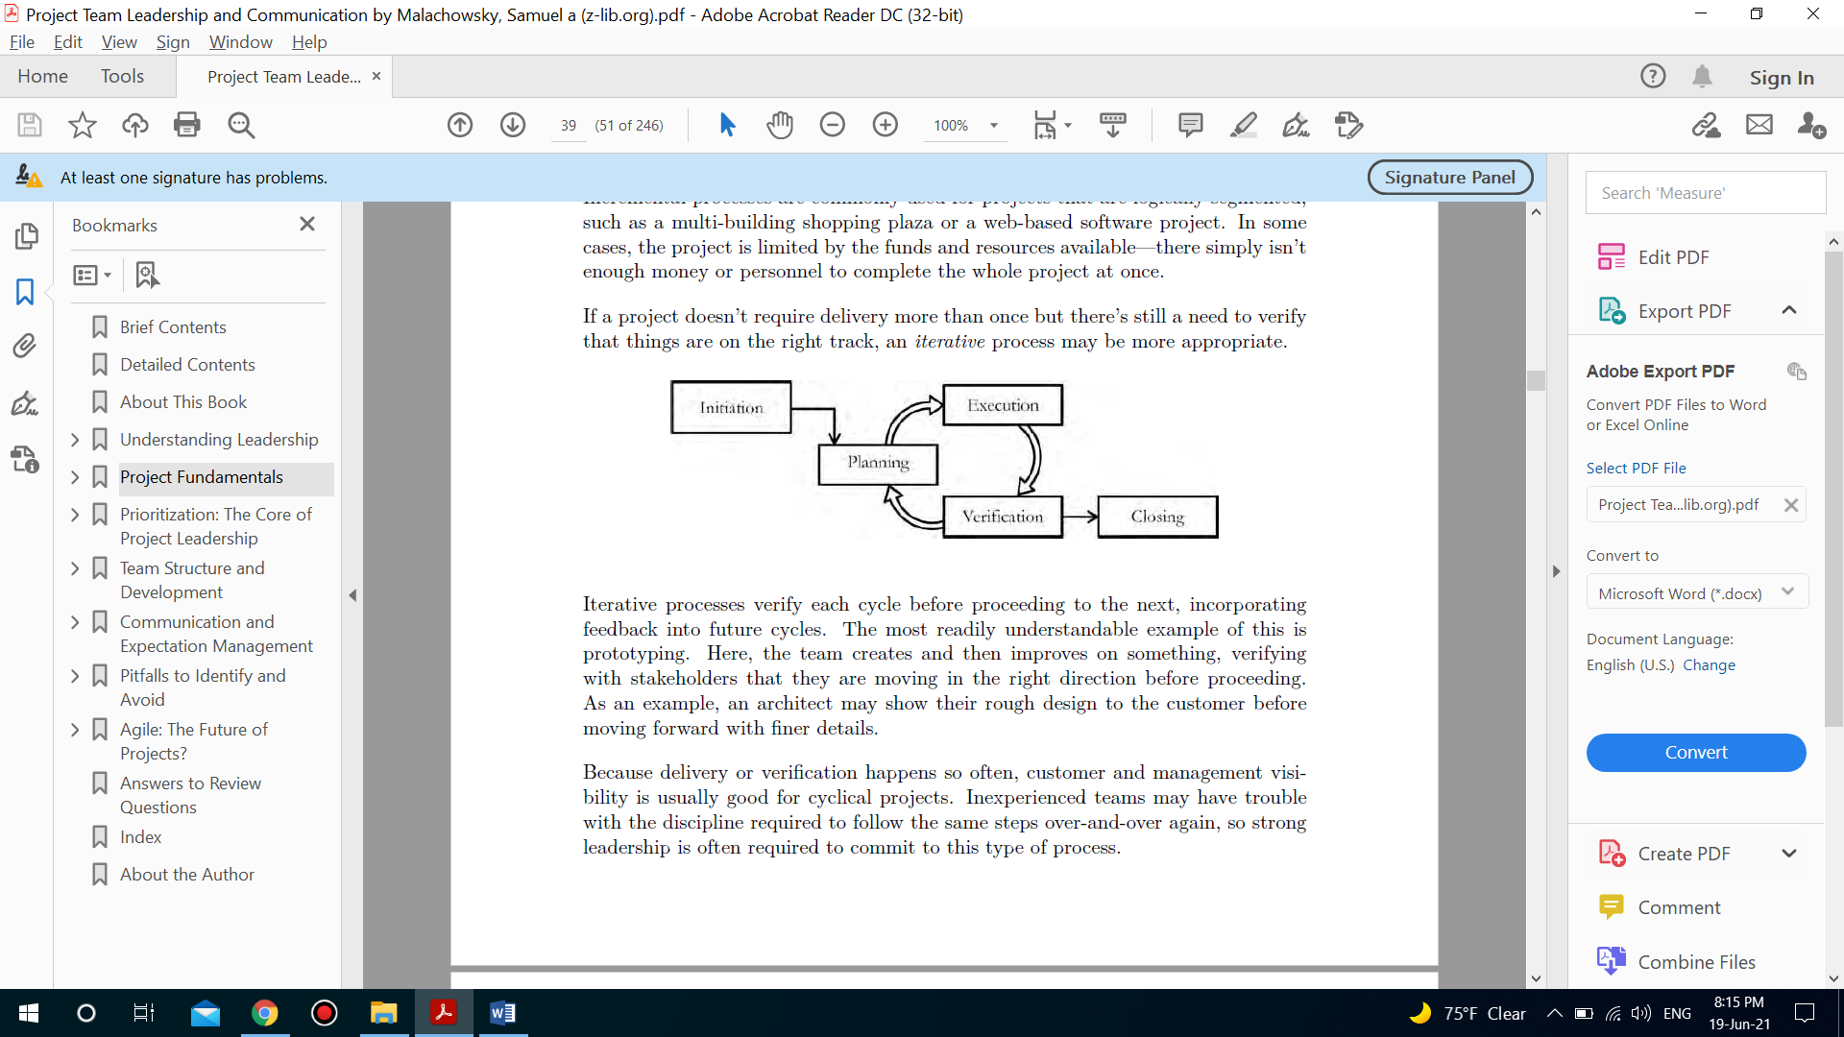
Project process models
Cyclical process models Characteristics
If a project doesn’t require delivery more than once but there’s still a need to verify that things are on the right track, an iterative process may be more appropriate.

Slide 24
Project process models
Cyclical process models Characteristics
Iterative processes verify each cycle before proceeding to the next, incorporating feedback into future cycles. The most readily understandable example of this is prototyping. Here, the team creates and then improves on something, verifying with stakeholders that they are moving in the right direction before proceeding.

Slide 25
Project process models
Cyclical process models disadvantages
All cyclical processes share a rather important weakness: it can be difficult at times to know when you are done. There can be a perpetual temptation to complete one more increment or iteration—both the team and the customer are enticed by this, often saying “we could make it just a bit better”.

Slide 26
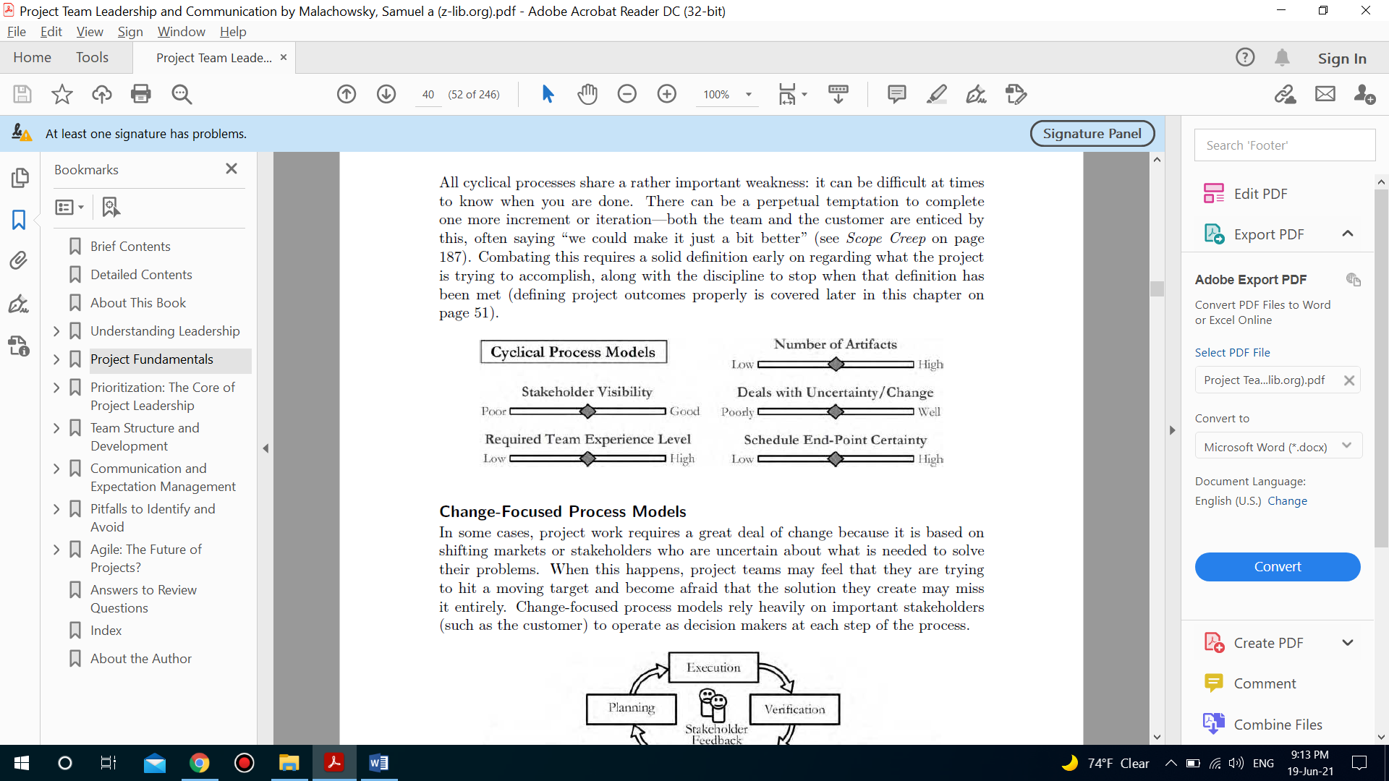
Project process models
Cyclical process models disadvantages
Combating this requires a solid definition early on regarding what the project is trying to accomplish, along with the discipline to stop when that definition has been met.

Slide 27
Project process models
Change focused process models characteristics
In some cases, project work requires a great deal of change because it is based on shifting markets or stakeholders who are uncertain about what is needed to solve their problems.
When this happens, project teams may feel that they are trying to hit a moving target and become afraid that the solution they create may miss it entirely. Change-focused process models rely heavily on important stakeholders (such as the customer) to operate as decision makers at each step of the process.

Slide 28
Project process models
Change focused process models characteristics
This type of project requires an experienced team—each member must be able to effectively communicate, plan, execute, and verify their work on a regular basis. Whereas other models allow for a single point of contact between the stakeholders and the team, the need for continuous stakeholder feedback makes this impossible with change-focused process models.

Slide 29
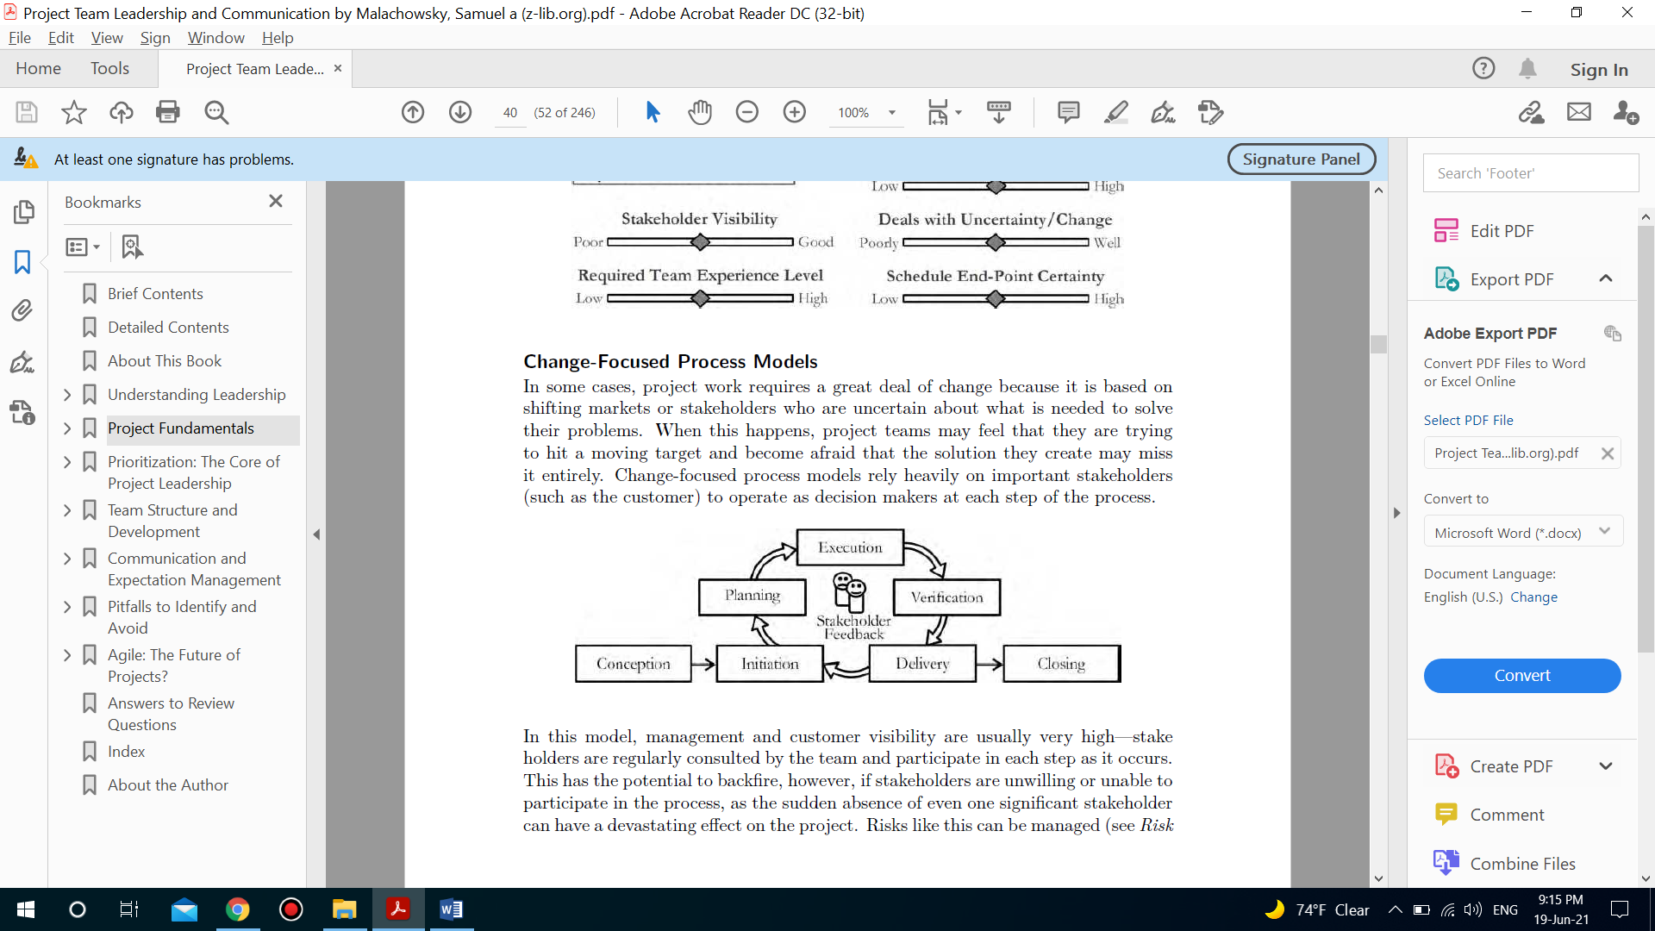
Project process models
Change focused process models characteristics

Slide 30
Project process models
Change focused process models characteristics
Team members must be able to understand what the team members are saying, and sometimes more importantly, they need to be careful not to commit to results that are beyond the intent of the project or capabilities of the team.
Change-focused processes clearly share one main feature with cyclical processes, a repeating incremental/iterative delivery model. Because of this, they come with the same danger of never reaching completion, adapting and growing in perpetuity and taking on the characteristics of operational (ongoing, not time-limited) work.

Slide 31
Project process models
Change focused process models disadvantages
stakeholders are regularly consulted by the team and participate in each step as it occurs. This has the potential to backfire, however, if stakeholders are unwilling or unable to participate in the process, as the sudden absence of even one significant stakeholder can have a devastating effect on the project.
Risks like this can be managed but if it seems that stakeholders won’t be consistently available throughout the project life cycle, choosing another process model may be necessary.

Slide 32
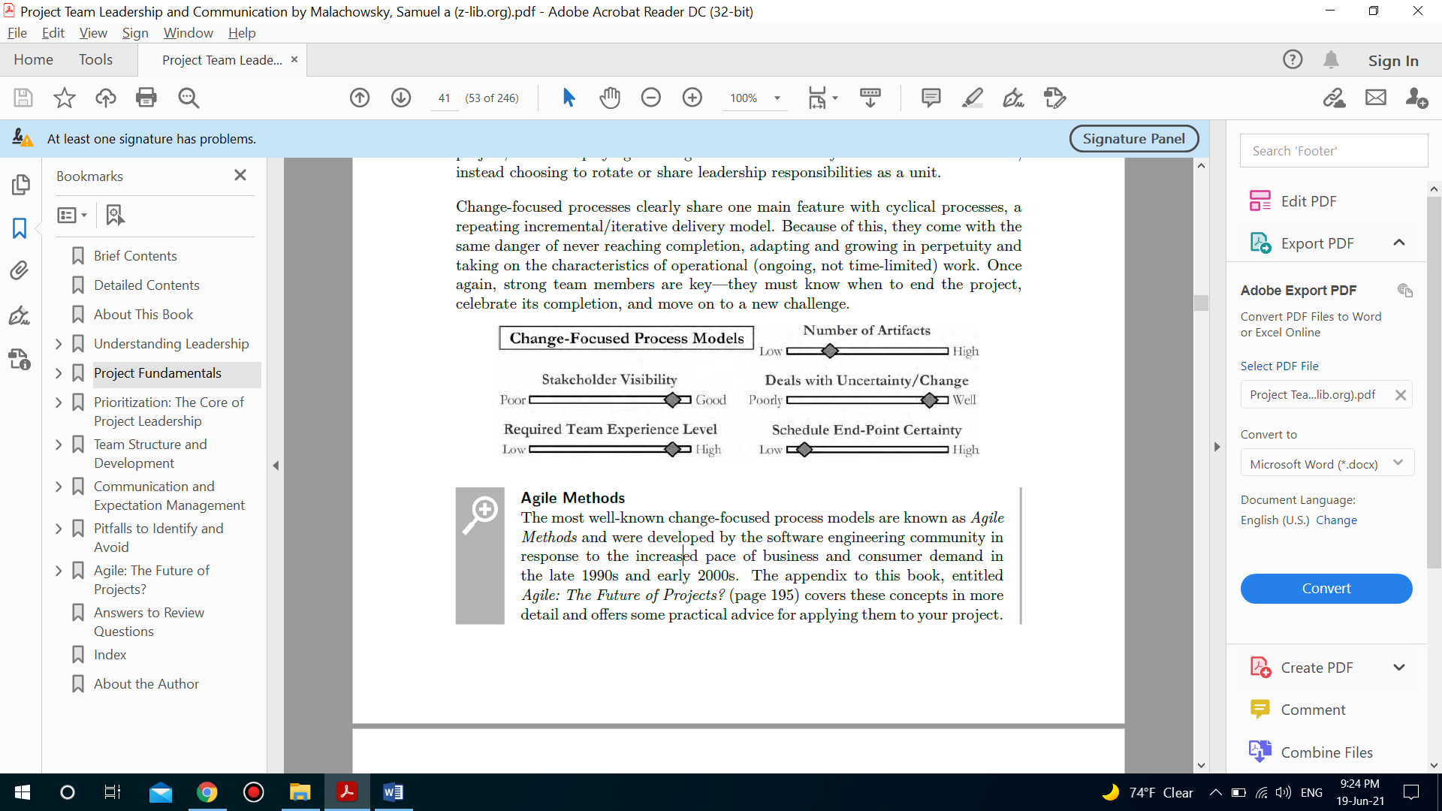
Project process models
Change focused process models disadvantages

Slide 33
Project process models
Abstract to Exact
Mature organizations and teams have a clear view of their needs and values, and understand that the very way they work, their processes, are directly related to those values and needs. Though processes can be generalized into the three types covered above, they are merely an abstraction or model of how the work is carried out.
The “blocks” in the processes can vary, and the classification refers to the general shape or flow of the steps. It’s up to the organization or team to define exactly how these things should be carried out in a way that makes sense within the context of their values and needs.

Slide 34
Section 2
Project quality

Slide 35
Project quality
Definition of quality
Though it is clearly important, the term “quality” is notoriously hard to define concisely; words like “excellence,” “superiority,” and “distinguish” are often used when trying to define what it means.
A physical product’s quality is often determined by physical attributes measured against the expectations of the customer such as performance, features, durability, and aesthetics as important attributes.

Slide 36
Project quality
Definition of quality
When the project is producing something nonphysical, (typically a service), quality often focuses primarily on customer satisfaction; these views and opinions become the most important measure of success
When the project is creating something somewhere in the middle such as software, documentation, or an advertising product, thoughts about quality also reside in that middle space—customer satisfaction is measured in addition to the attributes of the project outcome itself.

Slide 37
Project quality
Quality criteria
So, given the wide variability in how quality is defined, how do we narrow things down? For most project-focused teams, there are three main quality concerns:
Standards:
By considering and following established standards, regulations, procedures, and best practices, a project team is able to gain the benefits and meet the expectations that prompted the creation of those standards in the first place.

Slide 38
Project quality
Quality criteria
So, given the wide variability in how quality is defined, how do we narrow things down? For most project-focused teams, there are three main quality concerns:
Excellence
Considering excellence in the pursuit of quality goes beyond simply meeting the basic objectives and standards described above—it involves thinking about the project from multiple perspectives.

Slide 39
Project quality
Quality criteria
So, given the wide variability in how quality is defined, how do we narrow things down? For most project-focused teams, there are three main quality concerns:
Conformance
Another name for this can be “explicit quality”; it relates directly to the requirements, specifications, designs, or other outcome definitions created for the project.
These documents represent a commitment by the project team to the stakeholders.

Slide 40
Project quality
Quality criteria
So, given the wide variability in how quality is defined, how do we narrow things down? For most project-focused teams, there are three main quality concerns:
Conformance
Determining whether the project is meeting these commitments defines quality at the most basic level. Later in the process, commitments regarding schedule and budget will also be seen as elements of the project that the team should conform to as strictly as possible.

Slide 41
Project quality
Quality criteria
Does the project really solve the problem for the customer?
When work is in progress, am I thinking about the people who will be working after me?
Are the outcomes worth the time and resources expended in getting there? Could we improve this somehow?
What about the project’s long-term viability—did we consider aspects like its maintainability, adaptability, or durability?
These questions speak to the implicit quality and added value of the project’s expected outcomes. Excellence can be hard to measure, but it’s an important factor nonetheless.

Slide 42
Project quality
Project perception
Perception of quality usually refers to the view of the stakeholders for whom the project is completed. When considering this, it’s important to understand that this pertains primarily to the project as it is in progress— this is in contrast with the concepts listed above, which are mostly focused on the project’s end result.
As a team leader, managing this aspect of quality requires:
• attention to interactions (professionalism, frequency, etc.) between the team and the stakeholders,
• consideration of internal and external visibility into process and project elements, and
• careful planning of content and frequency of communication, an element of expectation management.

Slide 43
Thank You

