Slide 1

CCNA - Introduction to Networks v7.0 (ITN)
Prepared by Dr. Abdelrhman Ahmed
Lecture 10
Module 17: Build a Small Network

Slide 2
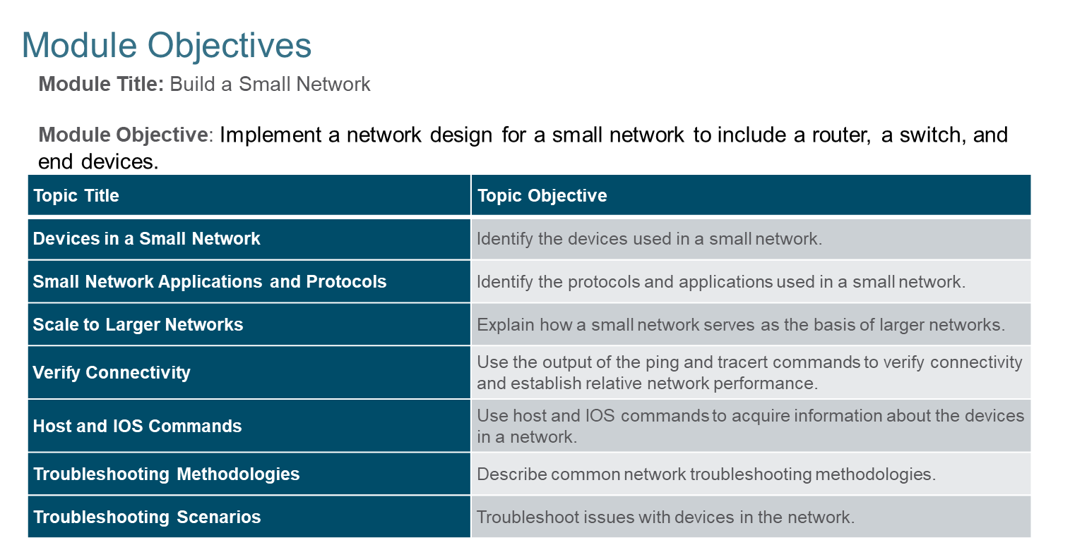

Chapter 10
Build a Small Network

Slide 3
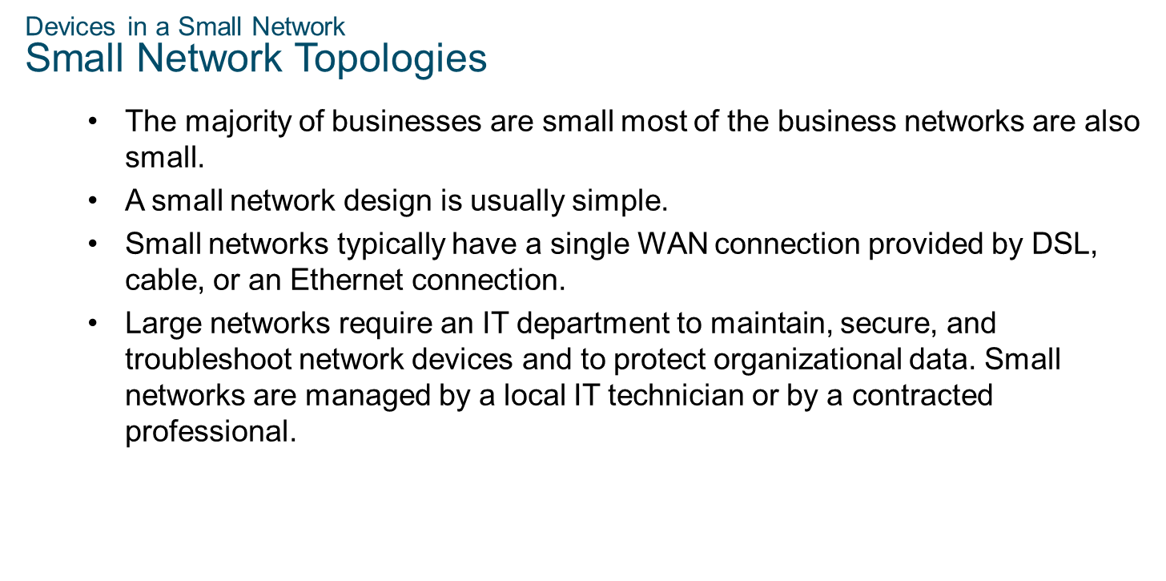
Chapter 10
Build a Small Network

Slide 4
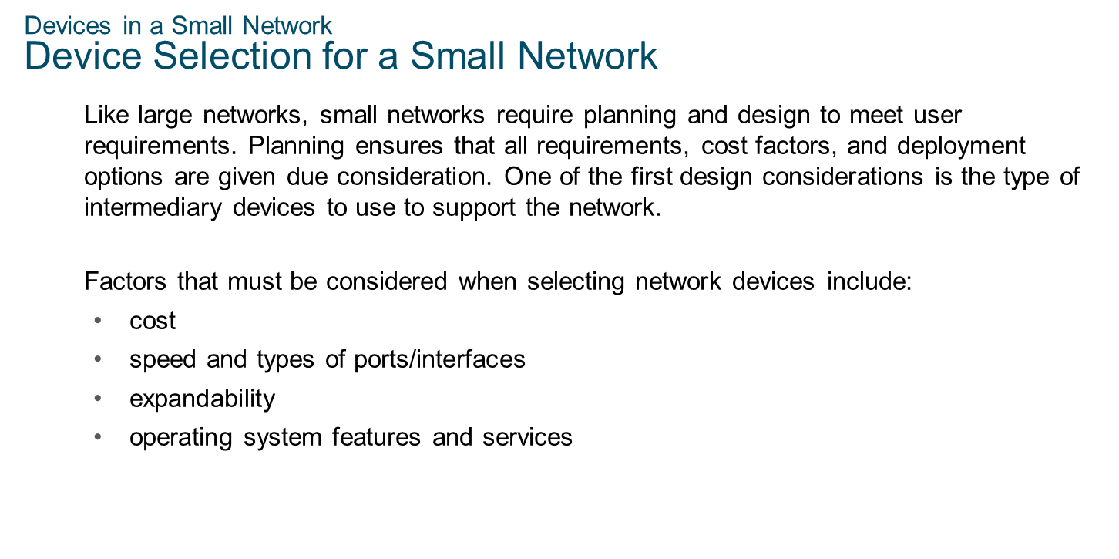
Chapter 10
Build a Small Network

Slide 5
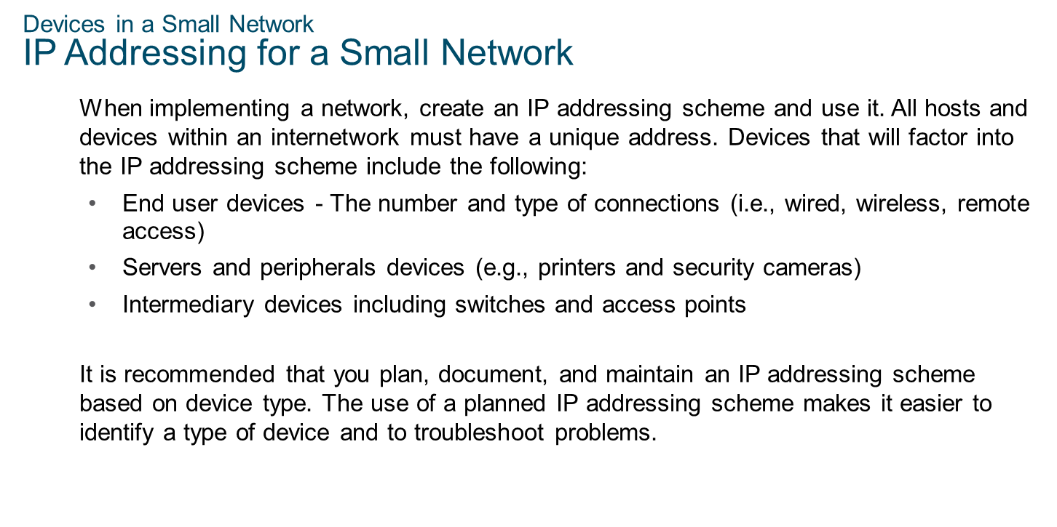
Chapter 10
Build a Small Network

Slide 6
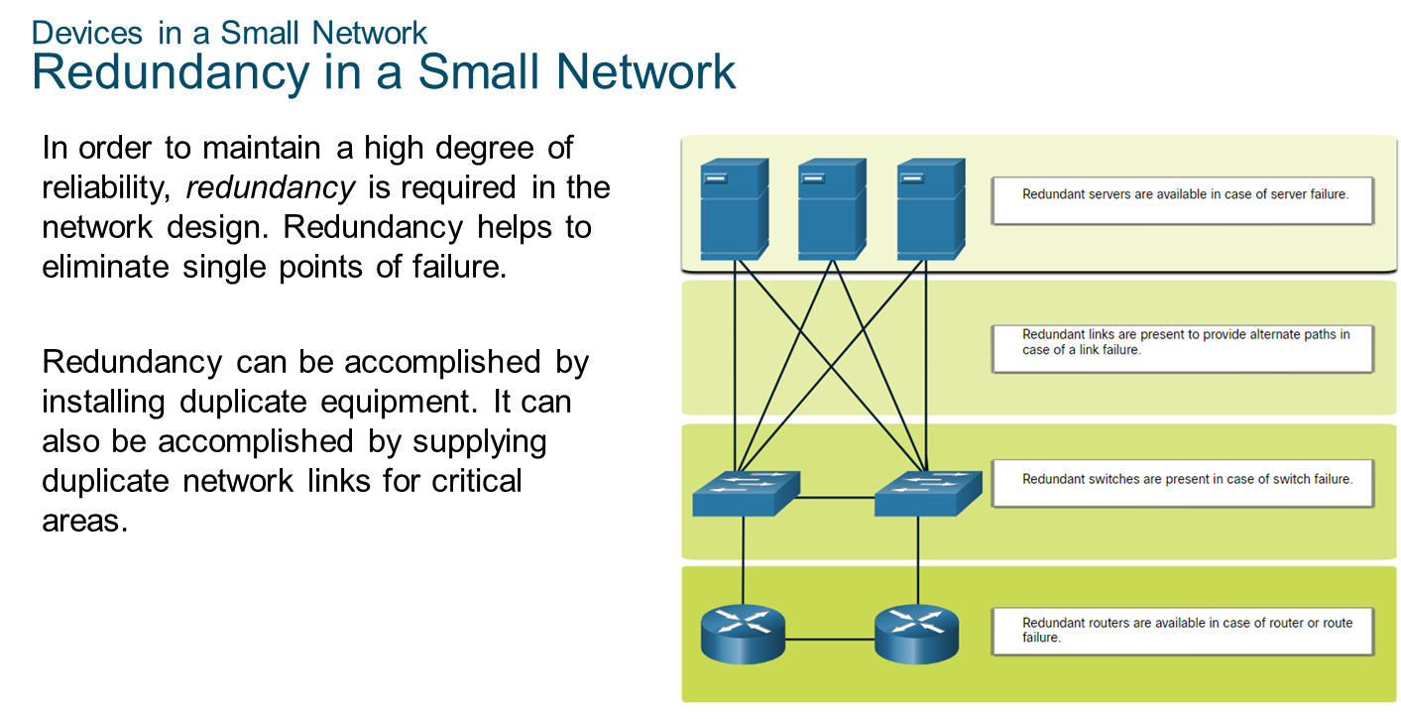
Chapter 10
Build a Small Network

Slide 7
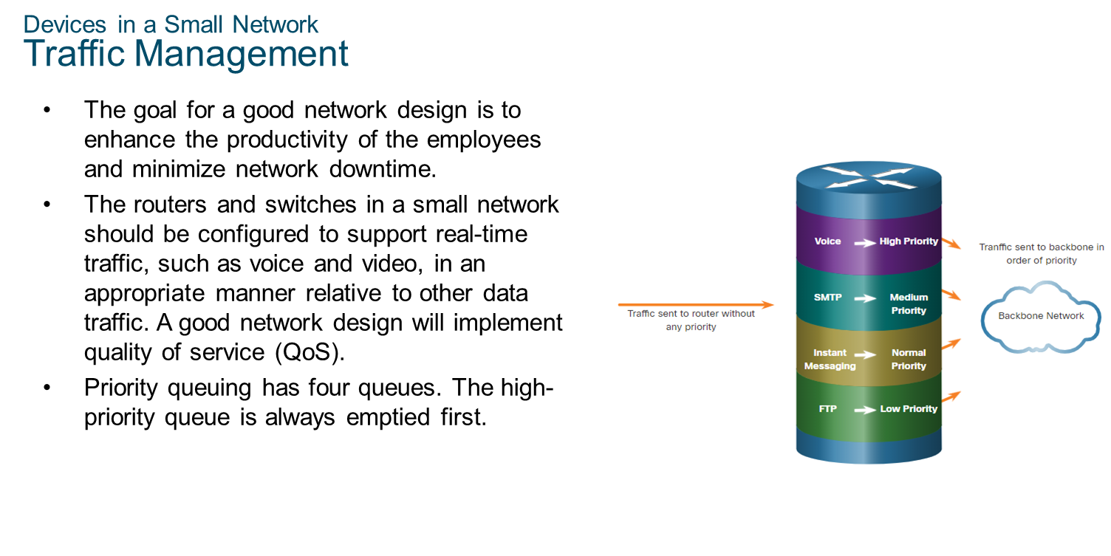
Chapter 10
Build a Small Network

Slide 8
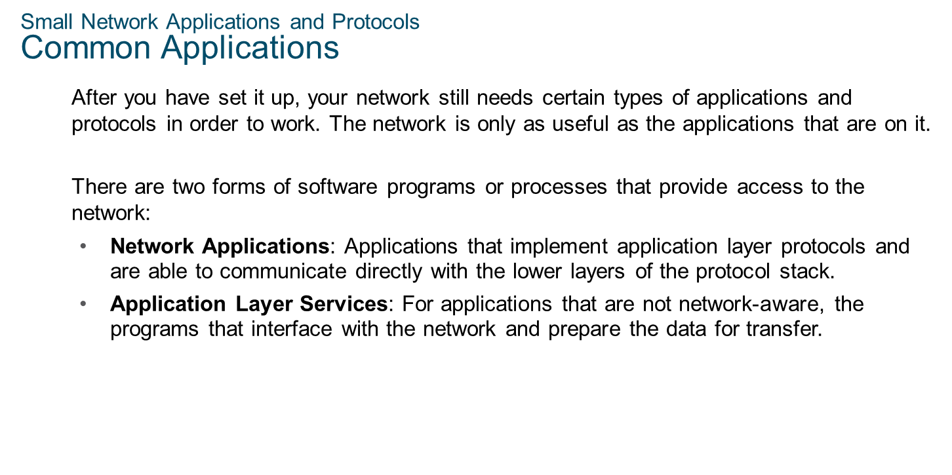
Chapter 10
Build a Small Network

Slide 9
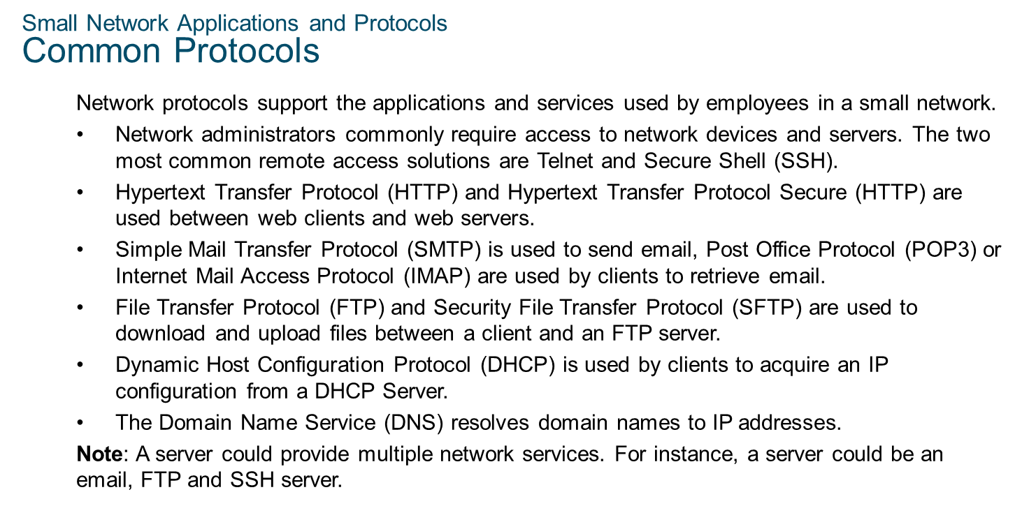
Chapter 10
Build a Small Network

Slide 10
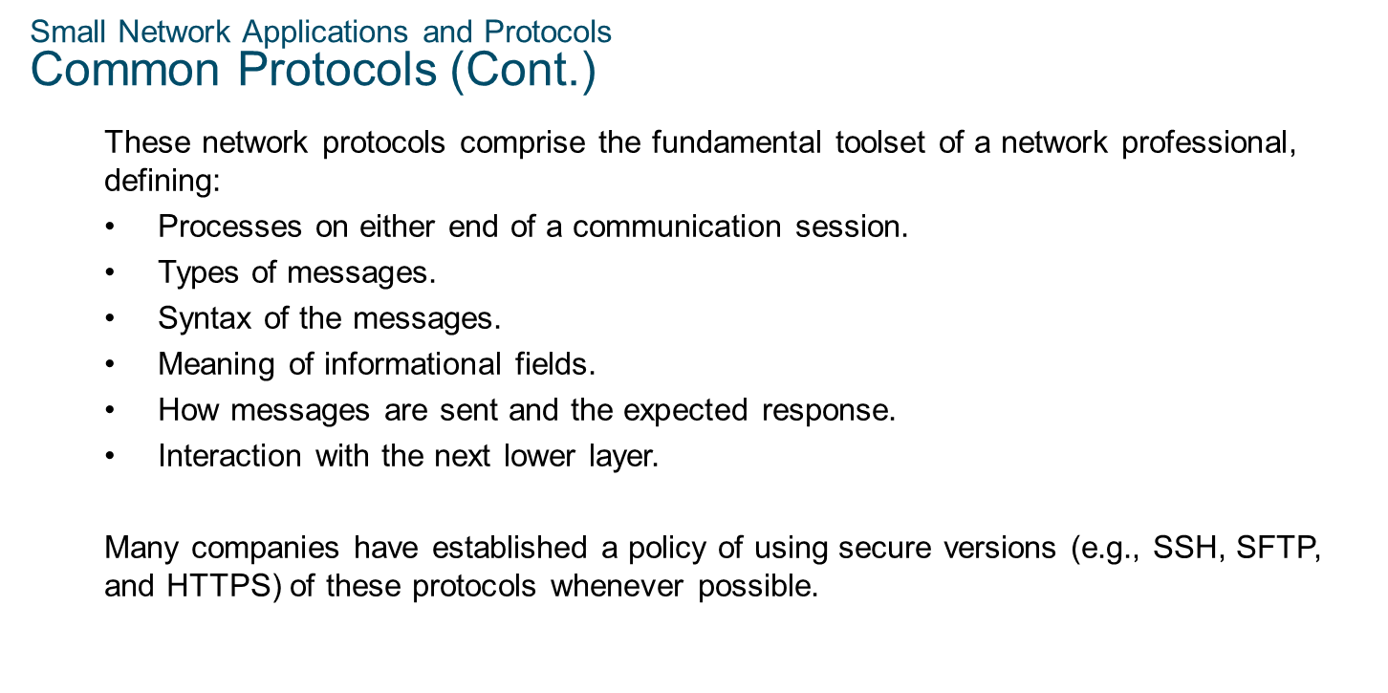
Chapter 10
Build a Small Network

Slide 11
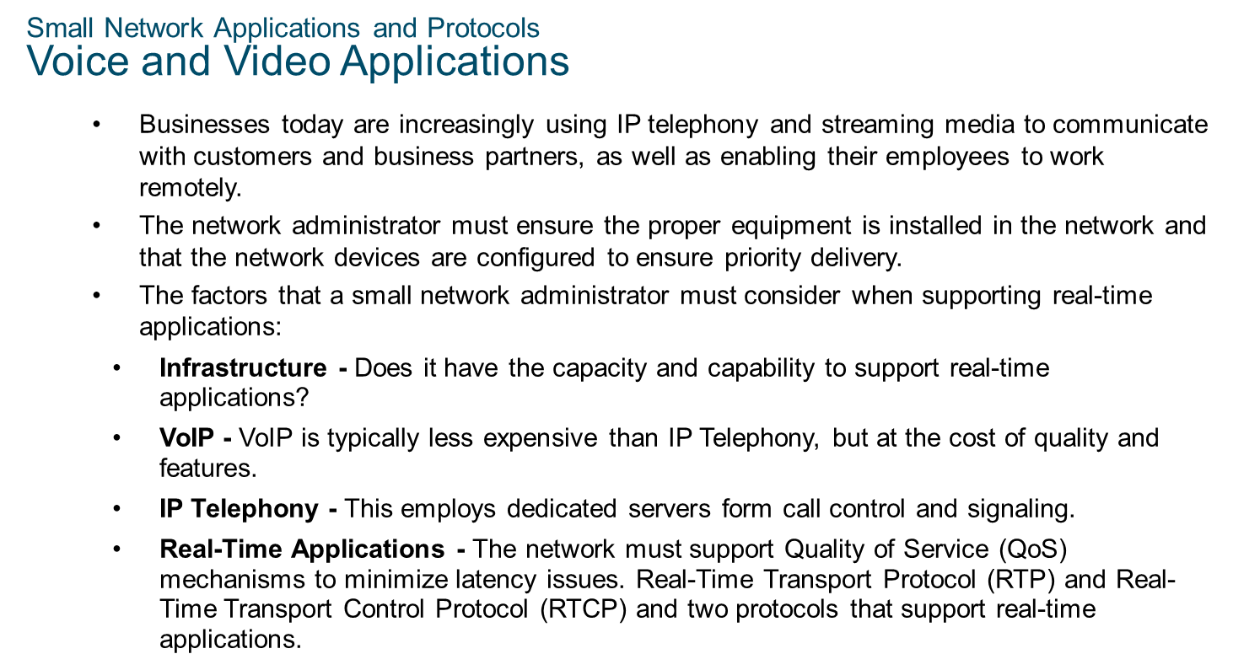
Chapter 10
Build a Small Network

Slide 12
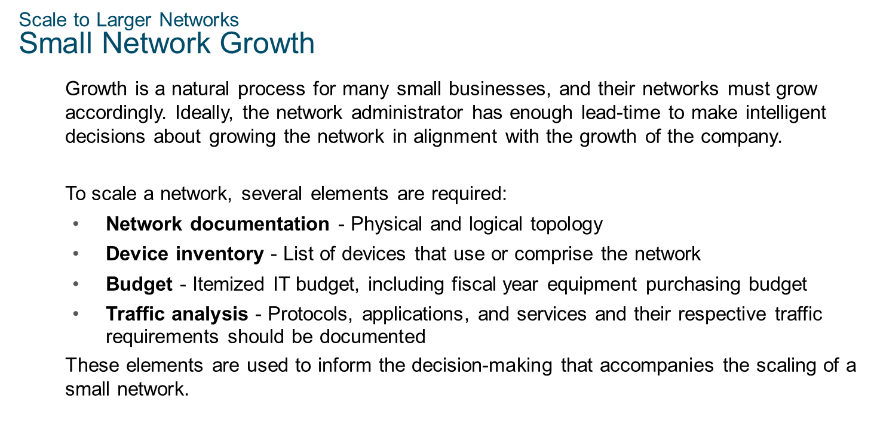
Chapter 10
Build a Small Network

Slide 13
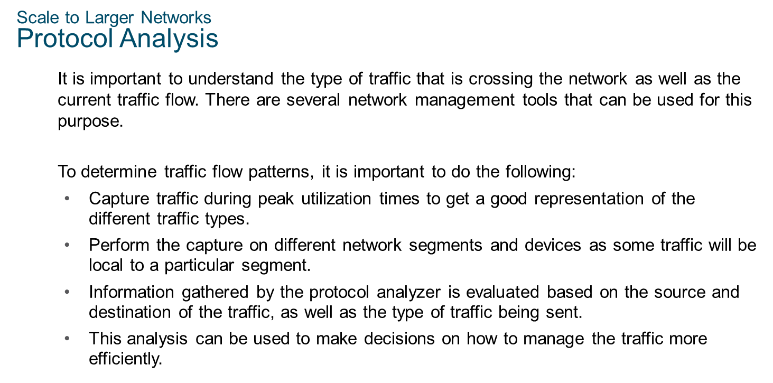
Chapter 10
Build a Small Network

Slide 14
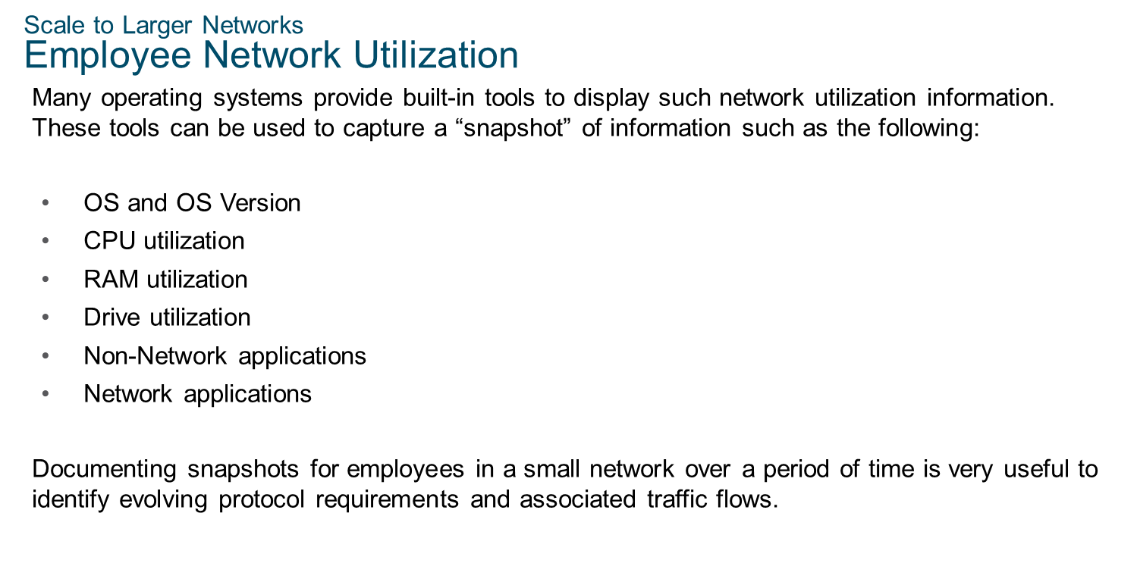
Chapter 10
Build a Small Network

Slide 15
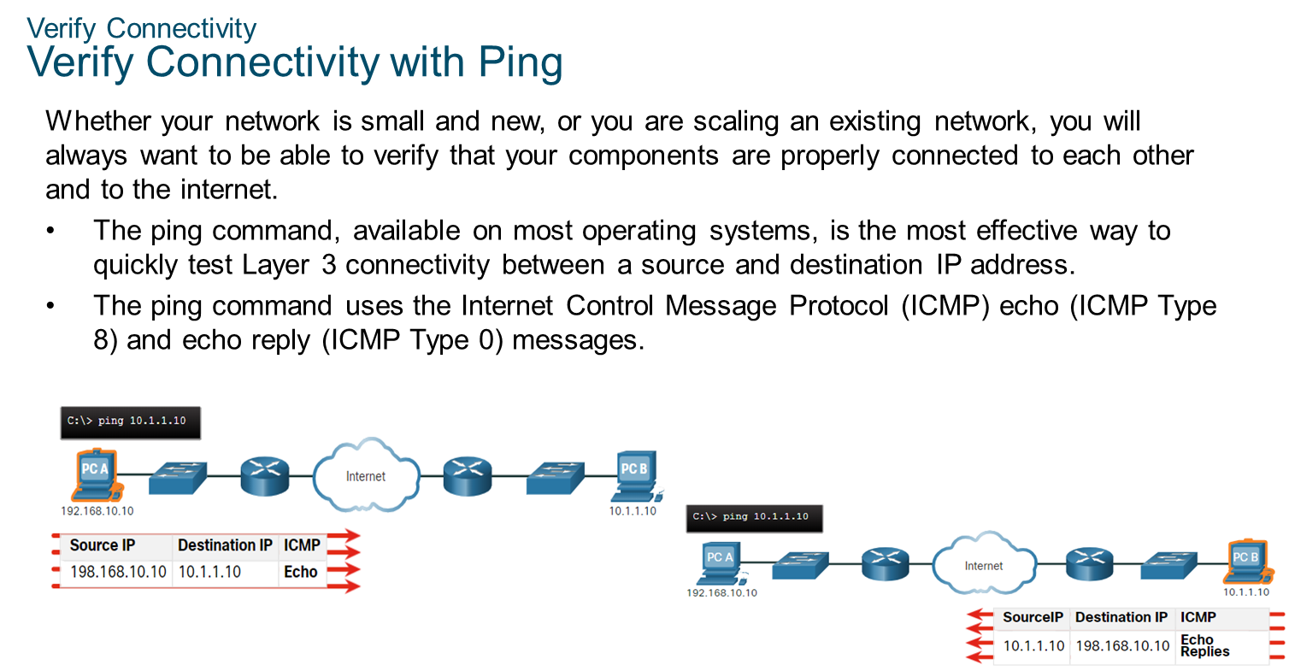
Chapter 10
Build a Small Network

Slide 16
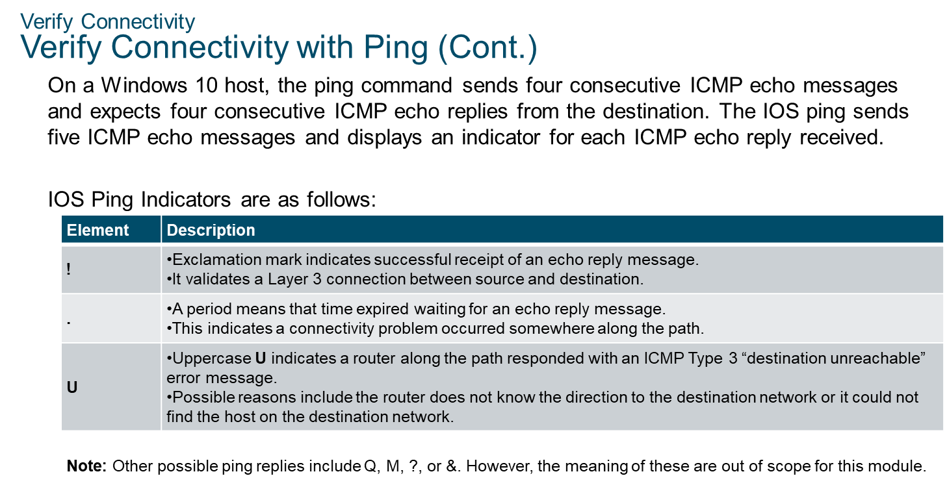
Chapter 10
Build a Small Network

Slide 17
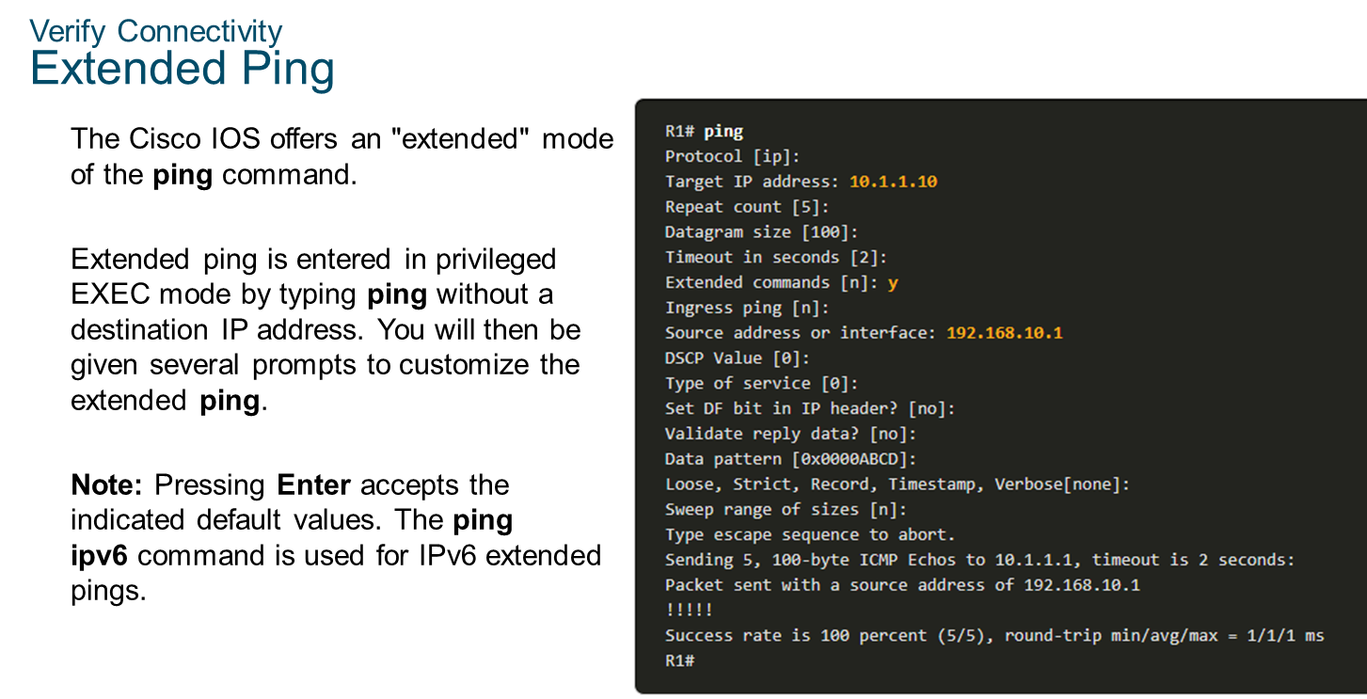
Chapter 10
Build a Small Network

Slide 18
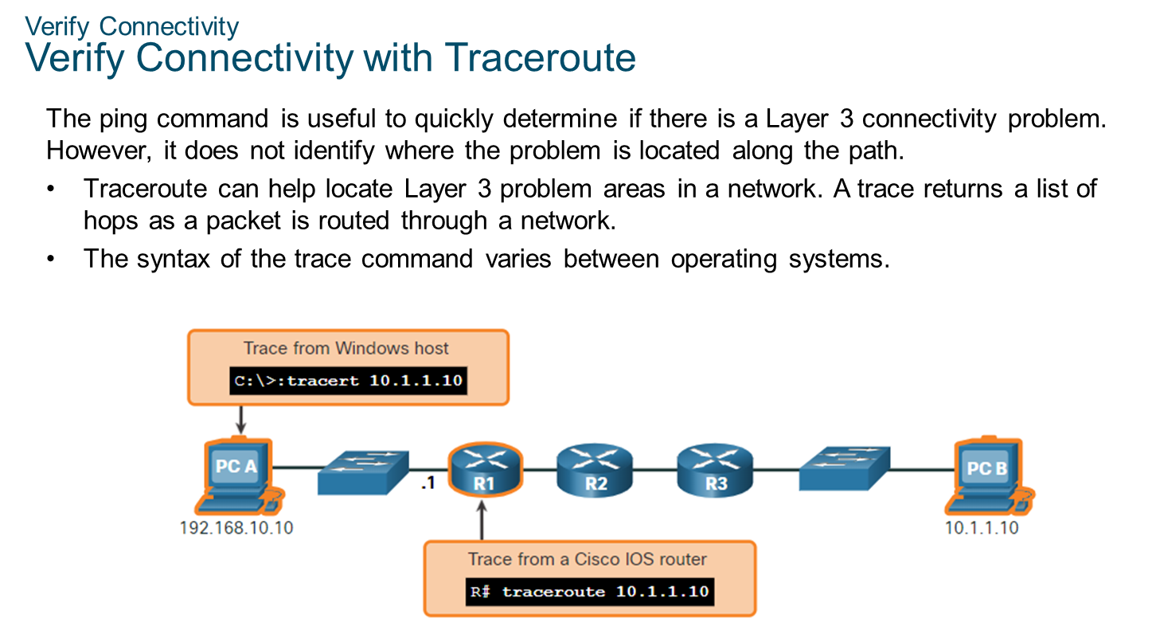
Chapter 10
Build a Small Network

Slide 19
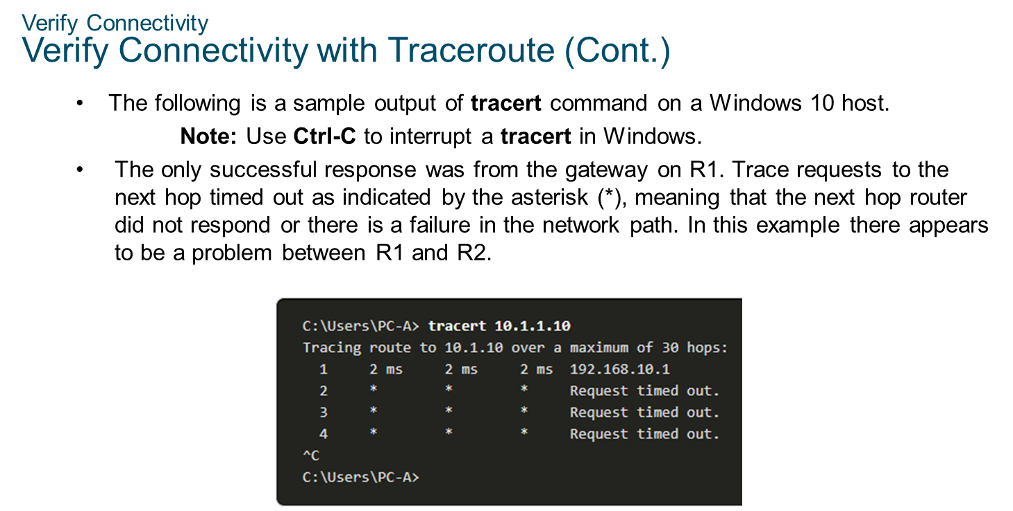
Chapter 10
Build a Small Network

Slide 20
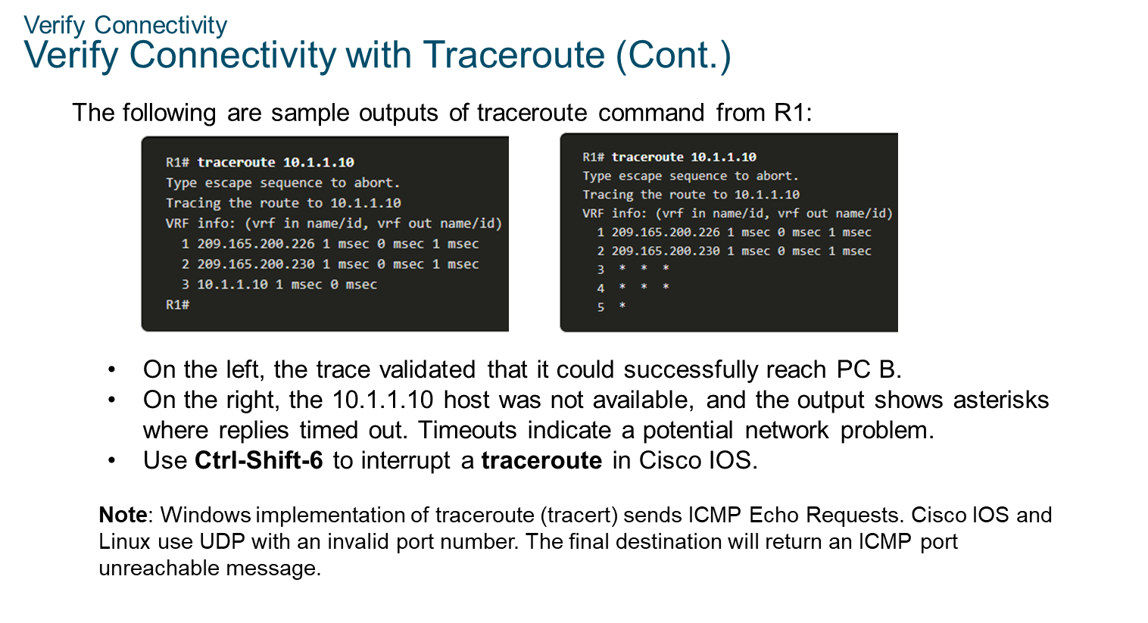
Chapter 10
Build a Small Network

Slide 21
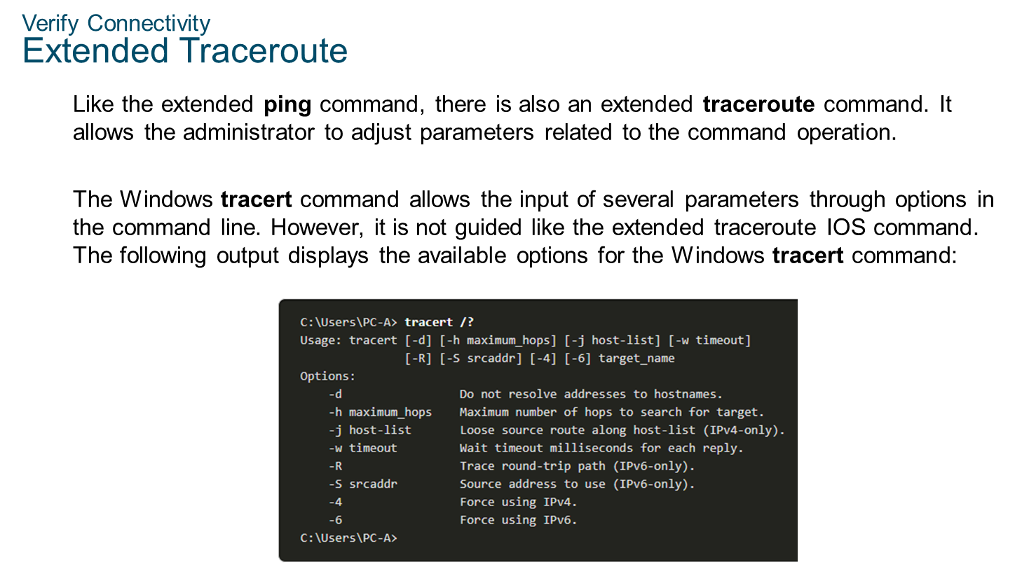
Chapter 10
Build a Small Network

Slide 22
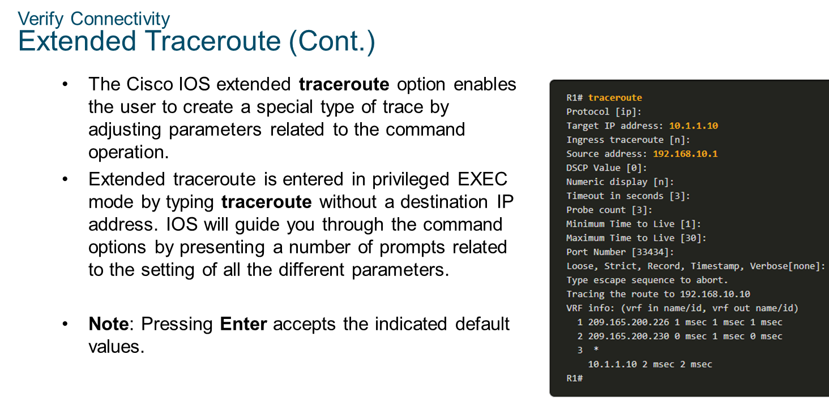
Chapter 10
Build a Small Network

Slide 23
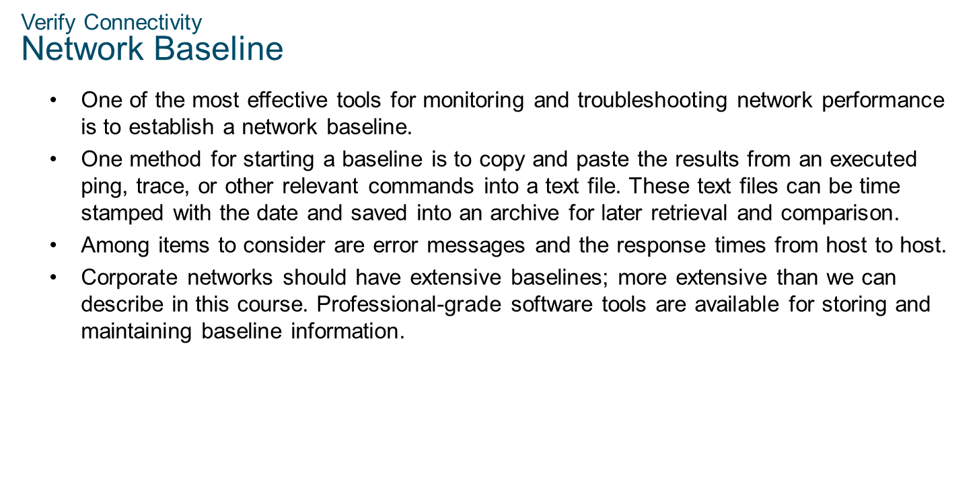
Chapter 10
Build a Small Network

Slide 24
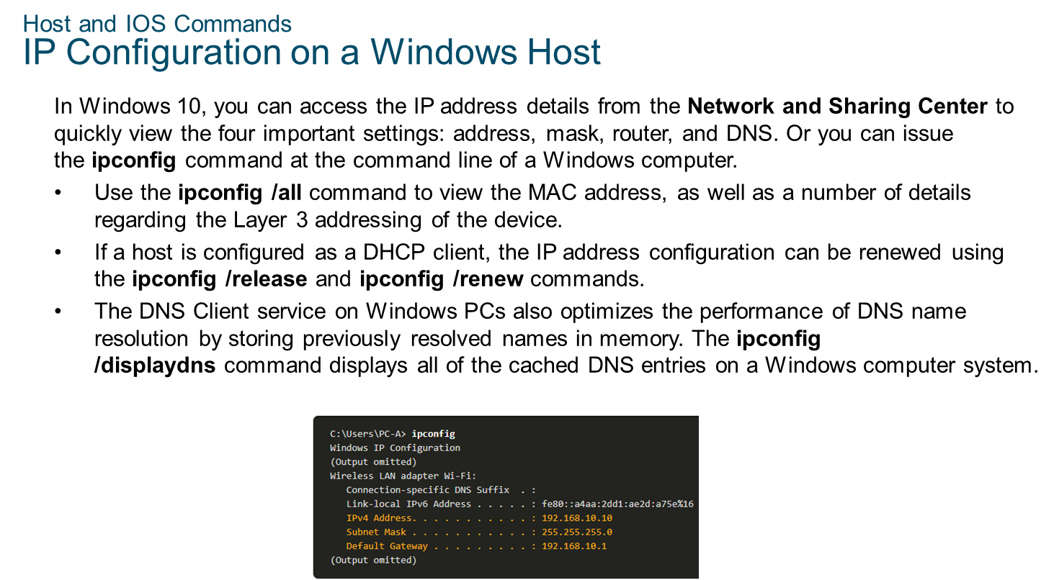
Chapter 10
Build a Small Network

Slide 25
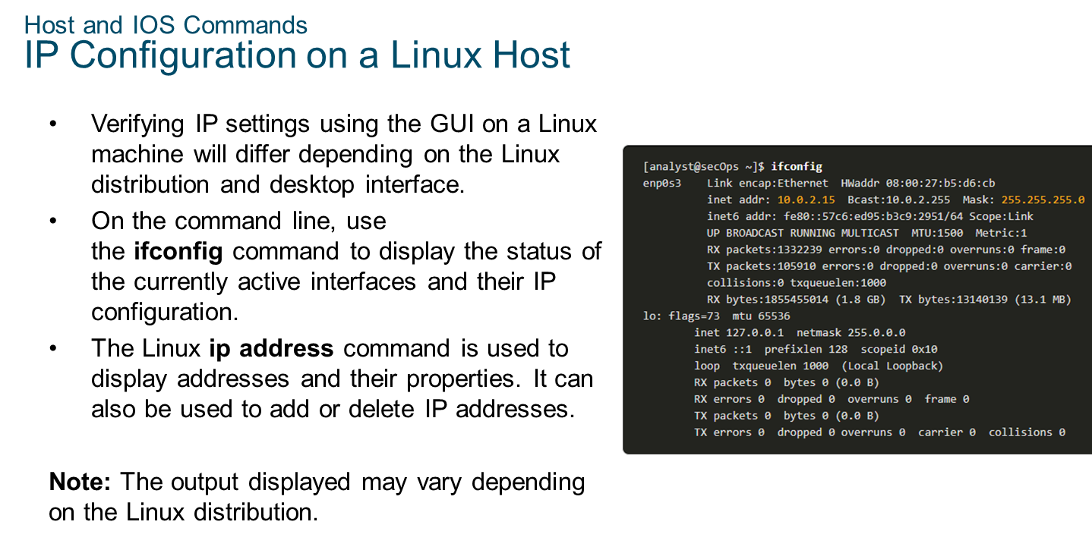
Chapter 10
Build a Small Network

Slide 26
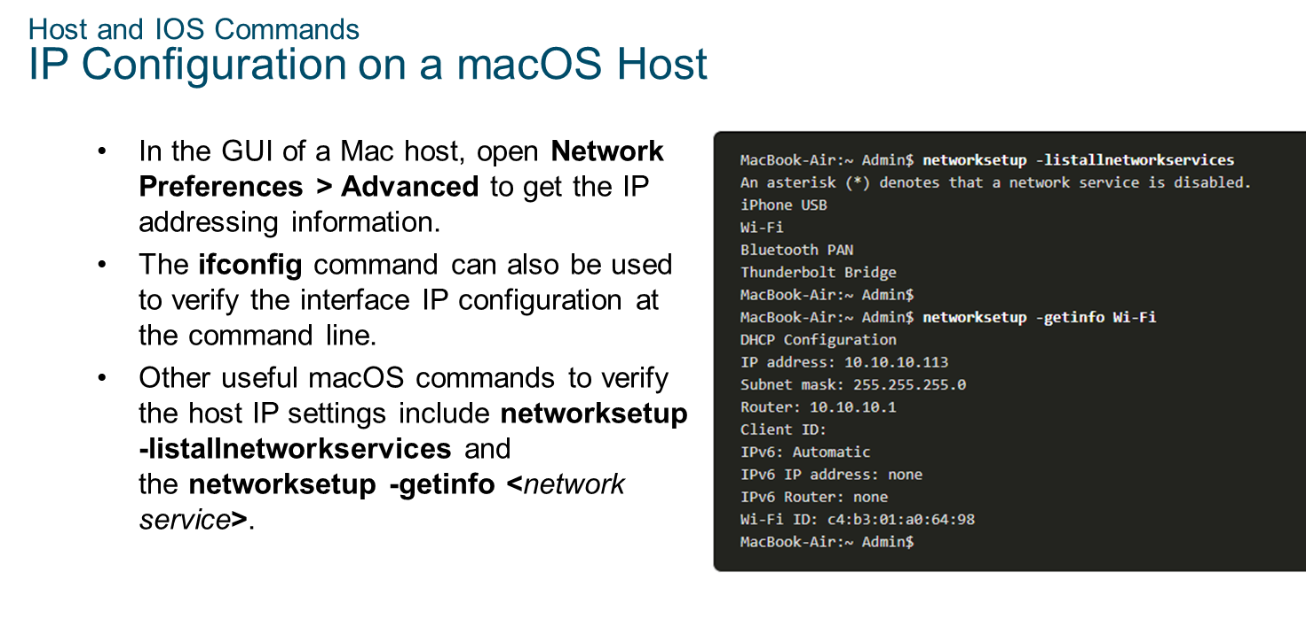
Chapter 10
Build a Small Network

Slide 27
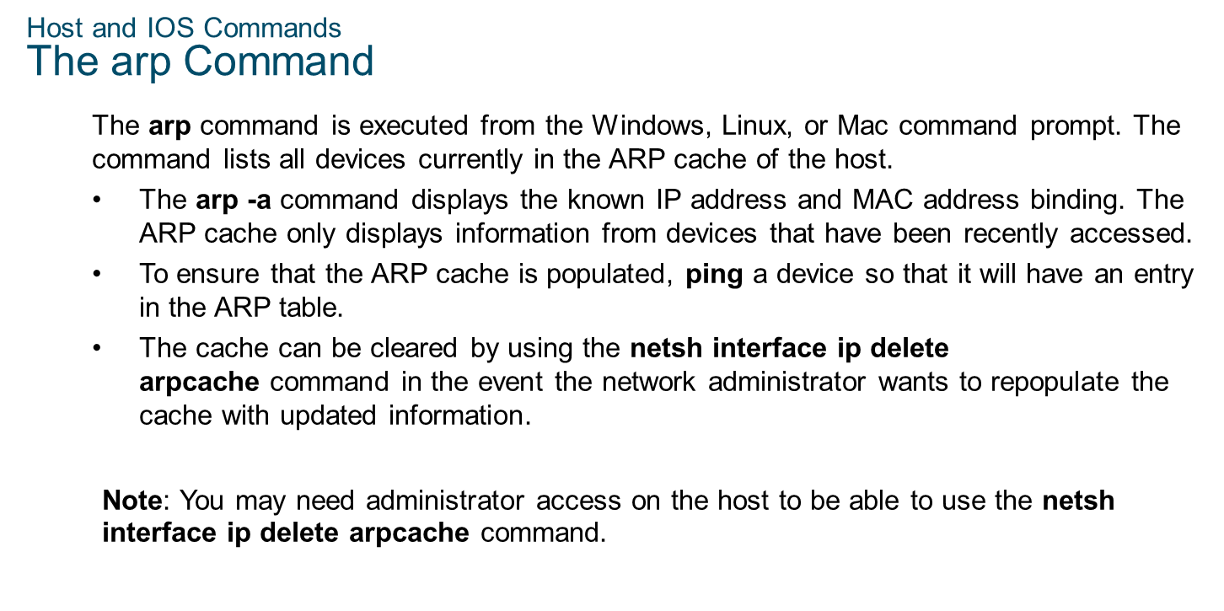
Chapter 10
Build a Small Network

Slide 28
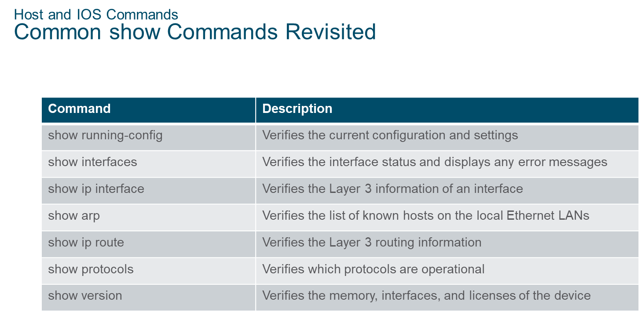
Chapter 10
Build a Small Network

Slide 29
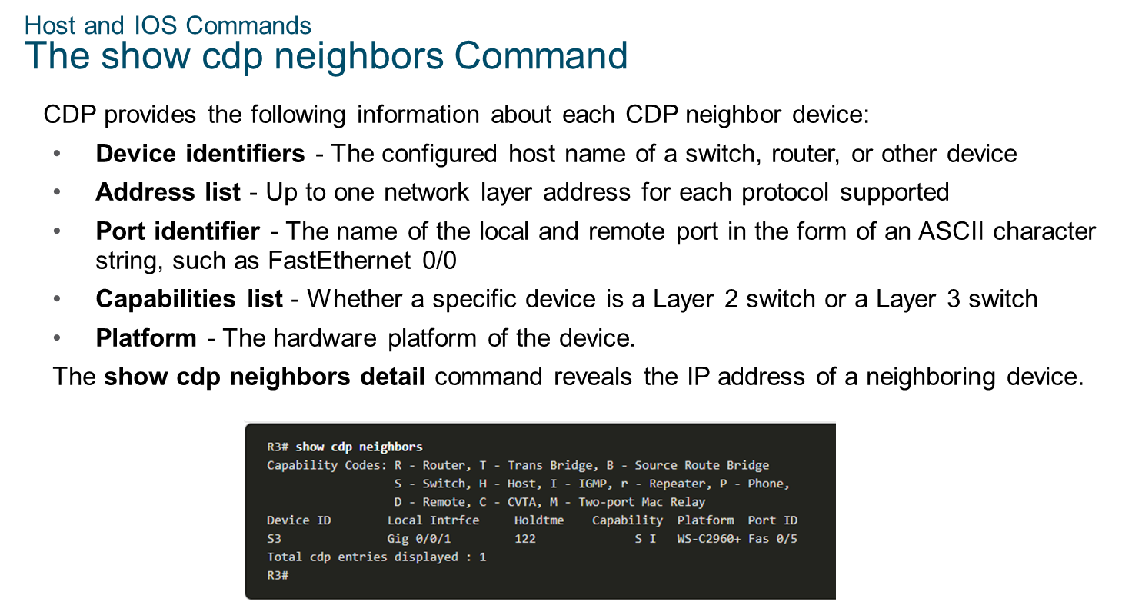
Chapter 10
Build a Small Network

Slide 30
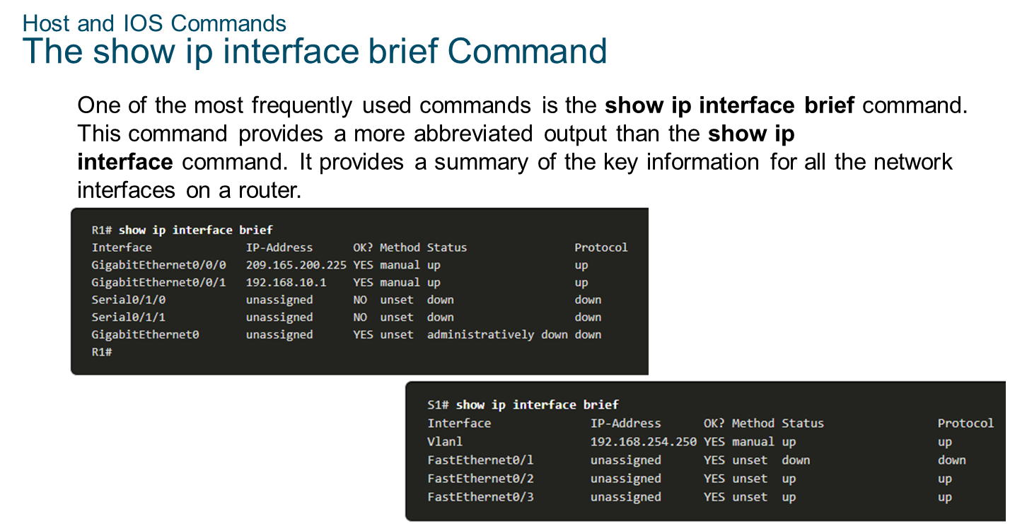
Chapter 10
Build a Small Network

Slide 31
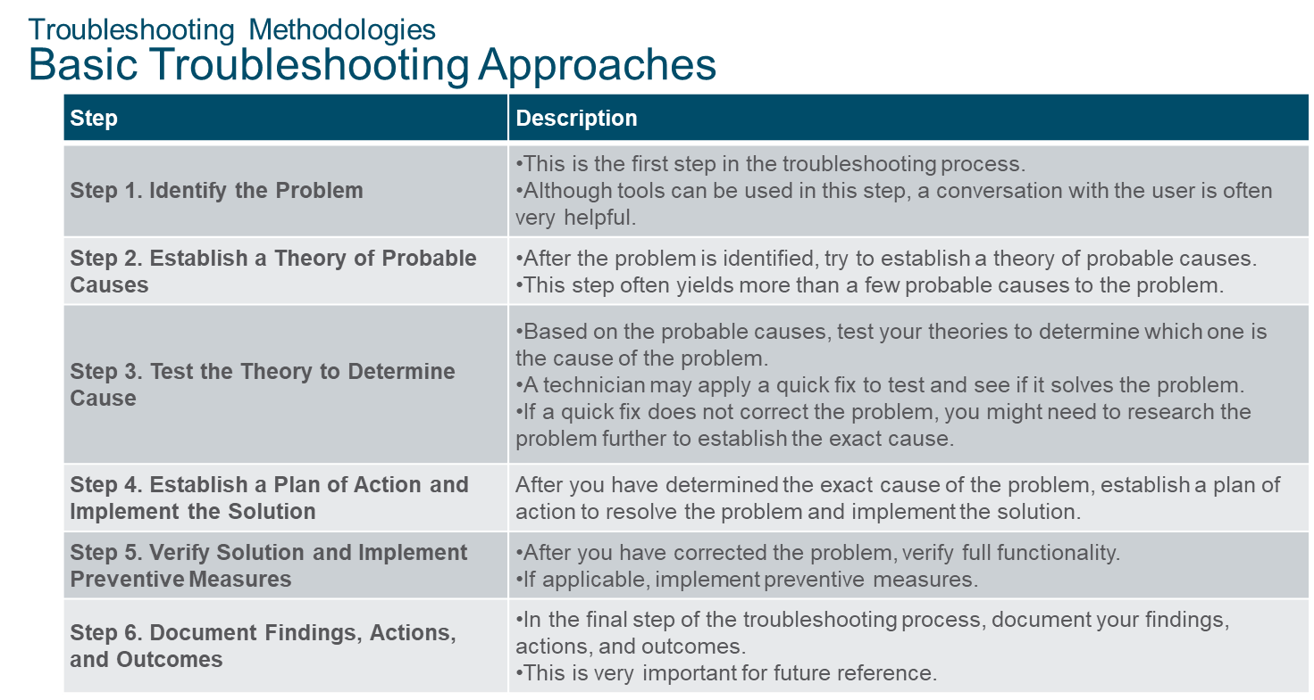
Chapter 10
Build a Small Network

Slide 32
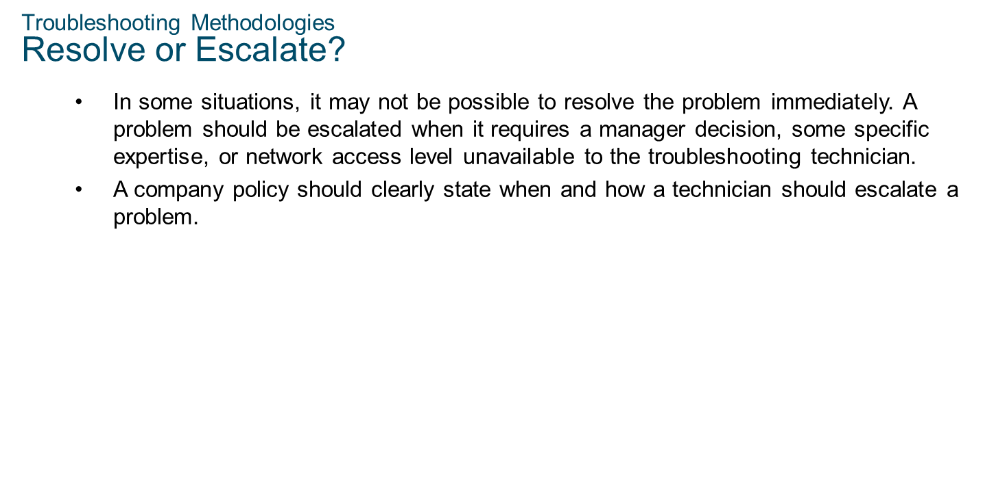
Chapter 10
Build a Small Network

Slide 33
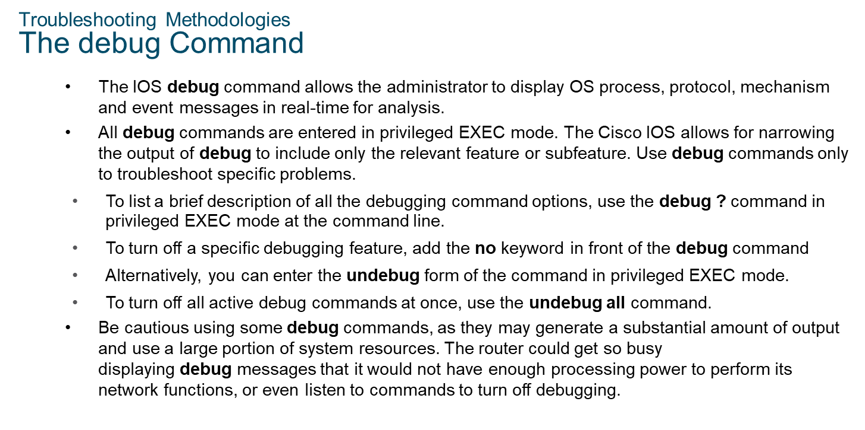
Chapter 10
Build a Small Network

Slide 34
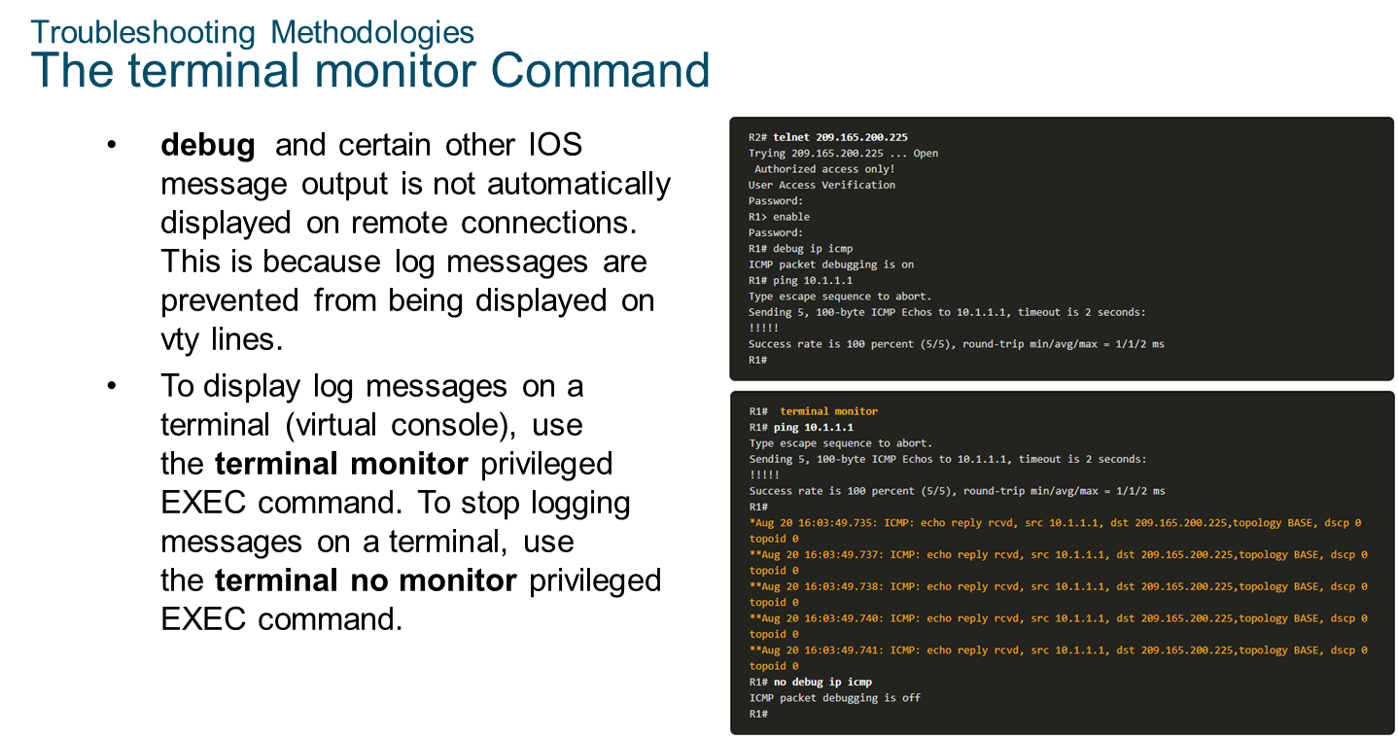
Chapter 10
Build a Small Network

Slide 35
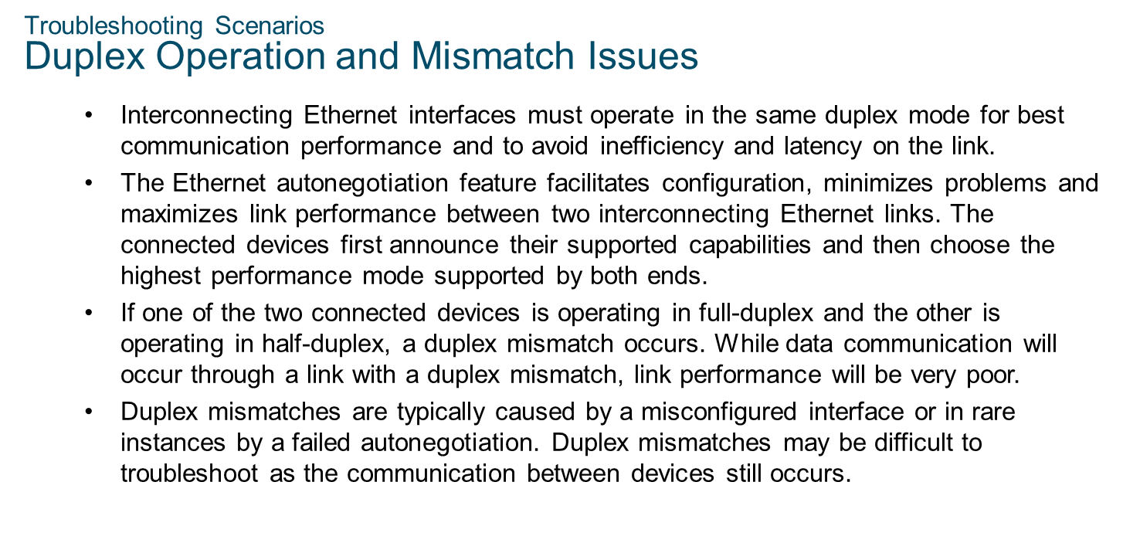
Chapter 10
Build a Small Network

Slide 36
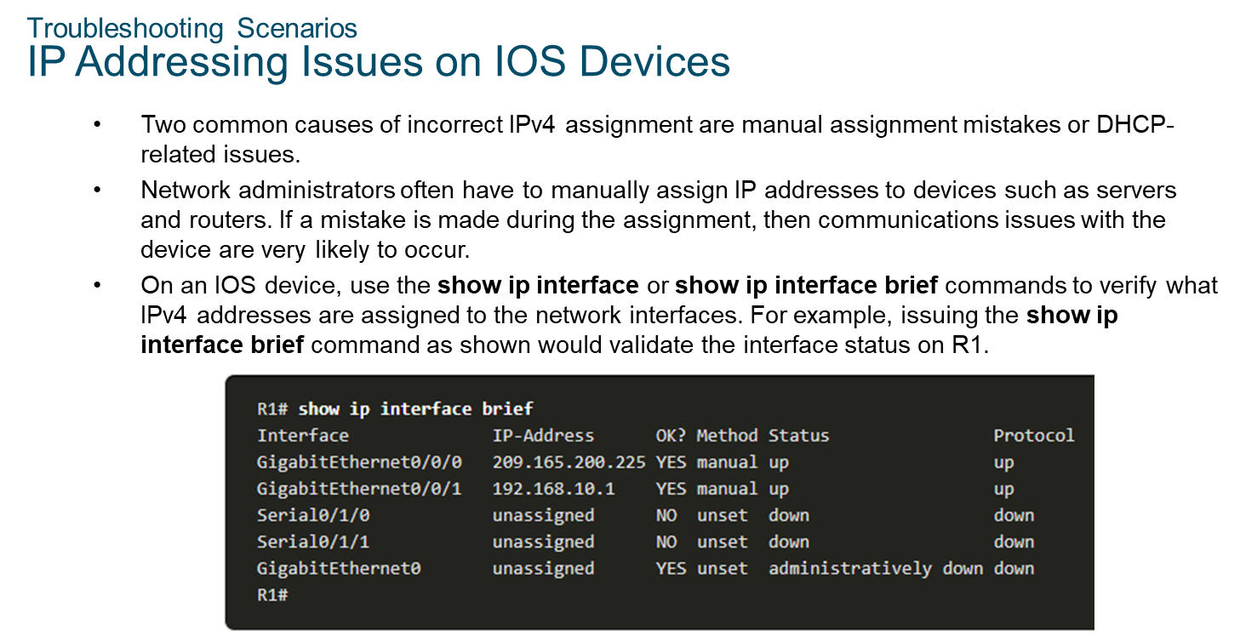
Chapter 10
Build a Small Network

Slide 37
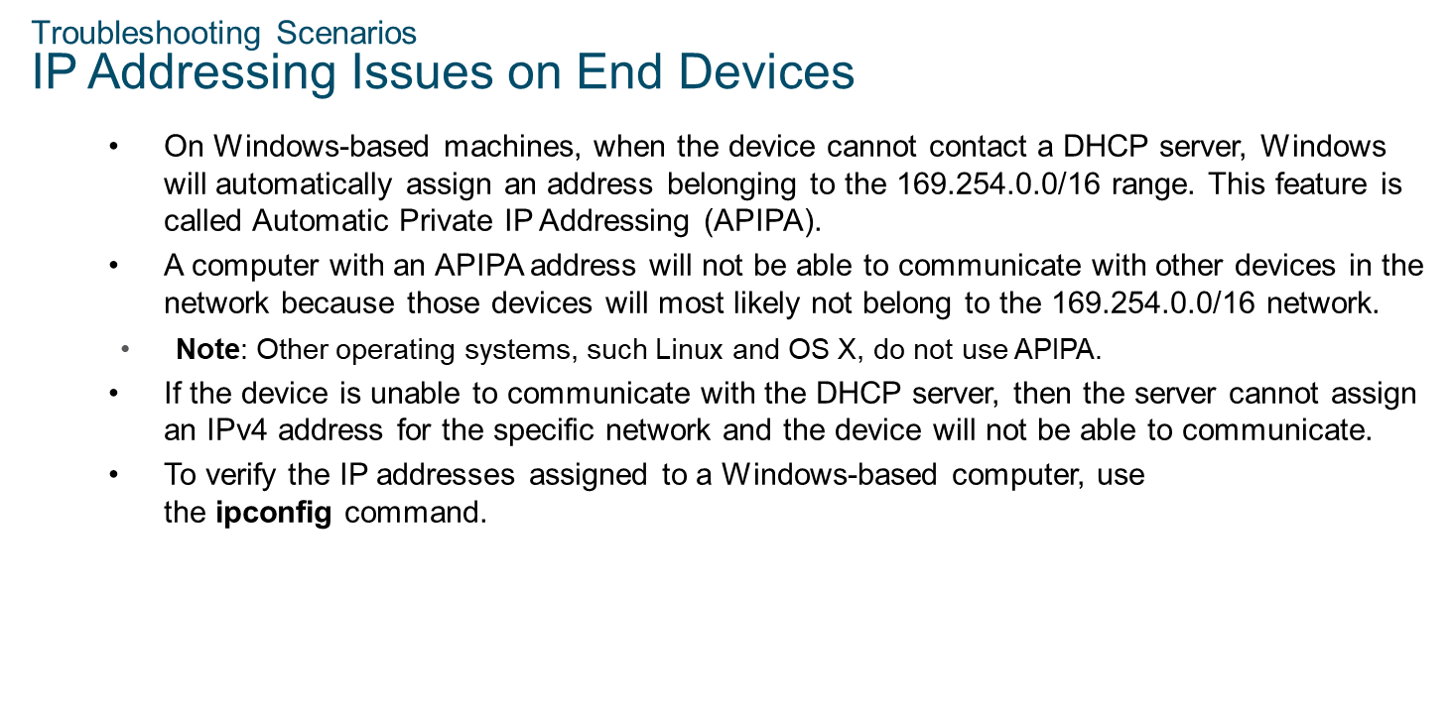
Chapter 10
Build a Small Network

Slide 38
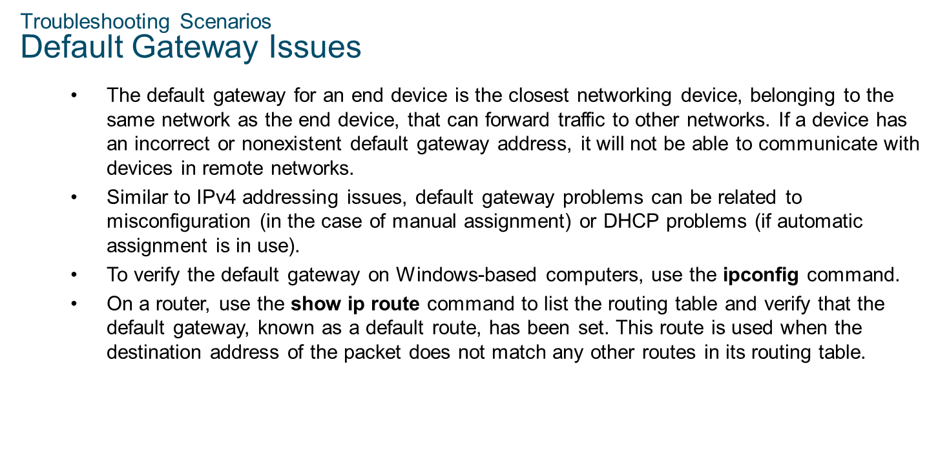
Chapter 10
Build a Small Network

Slide 39

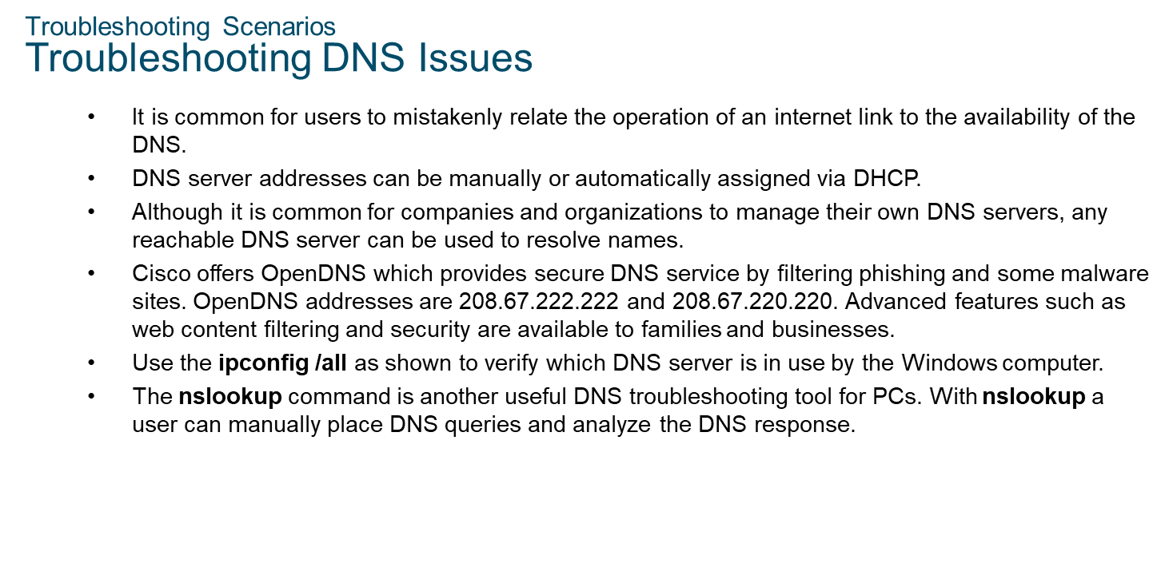
Chapter 10
Build a Small Network

