Slide 1

PMG 202
Project Planning
Prepared by Dr. Maryam ZORGUI
PART I :
Initiate & Plan a Project
Lecture 4
The Business Case &
The Feasibility Study

Slide 2
In the previous lessons….
Project initiation is the first phase of a Project’s Life Cycle.
It is at this point where the opportunity or reason for the project is identified and a project is developed to take advantage of that opportunity.
It is during this phase of the project that a team is assembled, and a Business Case, Feasibility Study and Project Charter are created to define the project in detail.

Slide 3

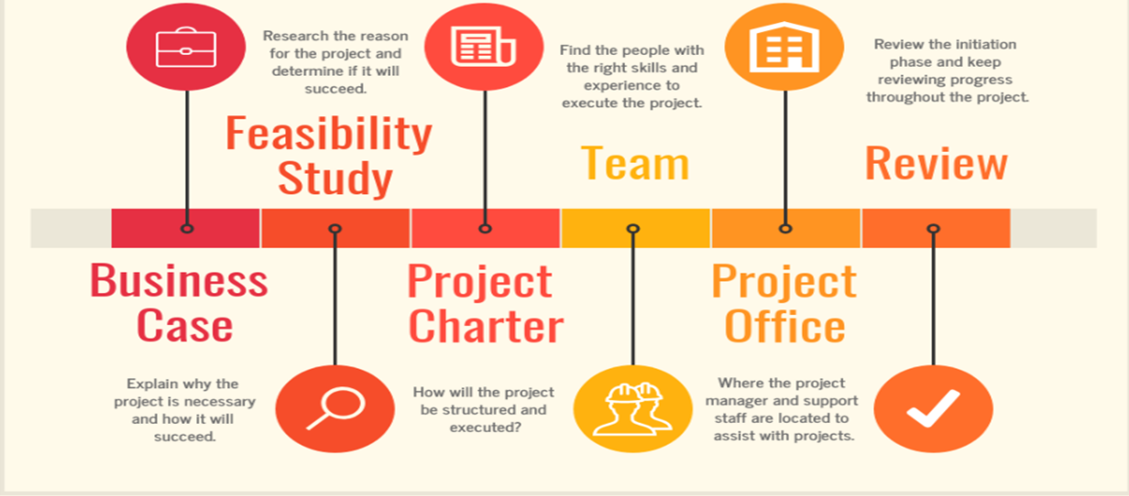

Slide 4
In the previous lessons….
Among the objectives of this initiating phase is the study of the feasibility and viability of the project before making the decision to start it or abandon it.
The most profitable project will be favored according to:
* the expected profit,
* the constraints detected (economic and/or technical).

Slide 5
In the previous lessons….
Before proceeding with the scoping and planning of the project , it is therefore necessary to go through these steps beforehand:
1-The expression of needs
2- Business Case = Opportunity Study
3- The Feasibility Study

Slide 6

Chapter objectives
Discover the Business Case and the Feasibility Study
Their relation with the Project Charter
Their importance in the initiating phase

Slide 7
Syllabus
.
I- The Project Needs
II- The Business Case
IV- …To the Project Charter
III- The Feasibility Study

Slide 8
I- The Project Needs
Also called the needs assessment or the needs study , this step helps to highlight the objectives of the project as well as its genesis.
Determining project needs, a process known as the project needs analysis or needs study, is an essential part of the project planning phase.
Needless to say, this step is particularly important, as it serves as the foundation for a successful project.

Slide 9
I- The Project Needs
I-1-Why you should determine the needs of your project
Why should you take the time to reflect on what your project needs?
Carefully determining project requirements can serve as a good early evaluation of:
The workload,
The human, material and technical resources required to complete the project,
The time needed to complete the project,
The budget that should be allocated to the project.

Slide 10
I- The Project Needs
Writing comprehensive requirements allows project managers and other stakeholders to:
Understand the goals and objectives of the project from the beginning,
Define the scope of the project by collecting and writing down customer expectations and the needs of end-users in an easy-to-read document that can be shared with all kinds of relevant stakeholders,
Set up a sound project governance structure, after roles and responsibilities have been assigned,
Study the feasibility of the project from a technical or financial perspective, in light of its scope versus the resources of the project.

Slide 11
I- The Project Needs
I-2- Who expresses project needs
The Project Sponsor is usually in charge of defining the requirements for the project, but the project team or the contractor may have to conduct the needs analysis themselves.
This usually happens when the former lacks time, project management skills or technical expertise.
To analyse needs, techniques such as organizing a workshop, an interview or sending a questionnaire can be used.
Notes:
The Project Sponsor is a person or group who owns the project and provides resources and support for the project, program or portfolio in order to enable its success.

Slide 12
I- The Project Needs
I-3-Before you start: give context and a global vision
Understanding who is at the root of the project, what is their strategy, competitors and how the project came to exist is a key step towards project success. Therefore, expressing project needs should be a collaborative effort and a way for the client and the project team to bond over common objectives.
Making sure everyone is on the same page ensures that operational teams will be able to deliver on the expectations set by the project sponsor and ensure the project will serve the long-term goals of the client.

Slide 13
I- The Project Needs
I-4-How to write project needs
Keep in mind that at this step, the project is still at the early stages of its development.
The key is to be efficient and avoid misunderstanding.
The needs analysis should be simple, clear and to the point to draw an outline of the project without getting lost in the details.

Slide 14
I- The Project Needs
Project needs should include:
* The goal, the purpose of the project, meaning why it came to be,
* Its context and environment,
* Its objectives, meaning what it wants to achieve from a business standpoint,
* The project scope (what services will be affected, the key and support elements of the project),

Slide 15
I- The Project Needs
Who will be the end-users and their needs,
A list of the stakeholders (use stakeholder mapping to help your analysis),
A SWOT analysis to determine the opportunities and risks associated with the need,
The expected benefits,
Key Performance Indicators (KPIs), metrics that will allow you to evaluate whether the objective was achieved,
The potential impacts for the company.

Slide 16
II- The Business Case
I-1- Definition
A Business Case provides justification for undertaking a project, programm or portfolio.
It evaluates the benefit, cost and risk of alternative options and provides a rationale for the preferred solution.

Slide 17
II- The Business Case
Every Business Case has the same basic ingredients.
It has a beginning, a middle, and an end. It typically looks like this:
* Beginning: Someone identifies a problem within the business and presents the business case to the key decision-makers.
* Middle: With the project go-ahead, the company launches an internal team to address the business case and deliver results.
* End: The team delivers a presentation on the changes made and their long-term effects.
So, what’s the simple answer to “What is a business case?” It’s the story of a problem that needs solving.

Slide 18
II- The Business Case
A business case is used to explain the reason for starting a project.
The business case shows how the use of financial and other resources are in support of a business need.
A business case will be adaptable, fitting the size and risk of the proposal, but it will structurally be the same from project to project.

Slide 19
II- The Business Case
The Business Case deals not in technical issues, but the business concerns of the project, and it needs to be comprehensive.
Ideally, the Business Case should be easy to understand, clear, logical and relevant.
The key aspects need to be tracked and measured and justified. There also must be accountability and commitment for the delivery and costs involved.

Slide 20
II- The Business Case
II-2- Componenets
For a complex project with significant stakes, it may be wise to carry out the opportunity study to confirm its merits.
The expression of needs the analysis of the situation , in particular the strategy of the company, the key factors of success, the evaluation criteria, the expected results , with SMART indicators (Specific, Measurable, Ambitious, Realistic, Time-bound), | the different possible options and scenarios, the recommendation resulting from the study, the evaluation criteria , etc

Slide 21
II- The Business Case
II-3- Importance
A Business Case often provides decision makers, stakeholders and the public with a management tool for evidence based and transparent decision making.
It is a framework for delivery and performance monitoring of the subsequent policy, strategy or project to follow thereafter.
The approved Business Case provides a record of the decisions made by governance about how to achieve the required return on investment from the project.

Slide 22
II- The Business Case
II-4- The 5 views or “Cases”
The 5 views or “Cases” are:
The “strategic case” : there is a compelling case for change that fits with the strategic objectives of the sponsoring organisation.
The “economic case” : the solution represents best value.
The “commercial case” : the proposed solution is attractive to the market place, can be procured on appropriate terms so it is commercially viable.
The “financial case” : the proposed financial investment is affordable.
The “management case” : the input required from all parties involved in the project is achievable.

Slide 23
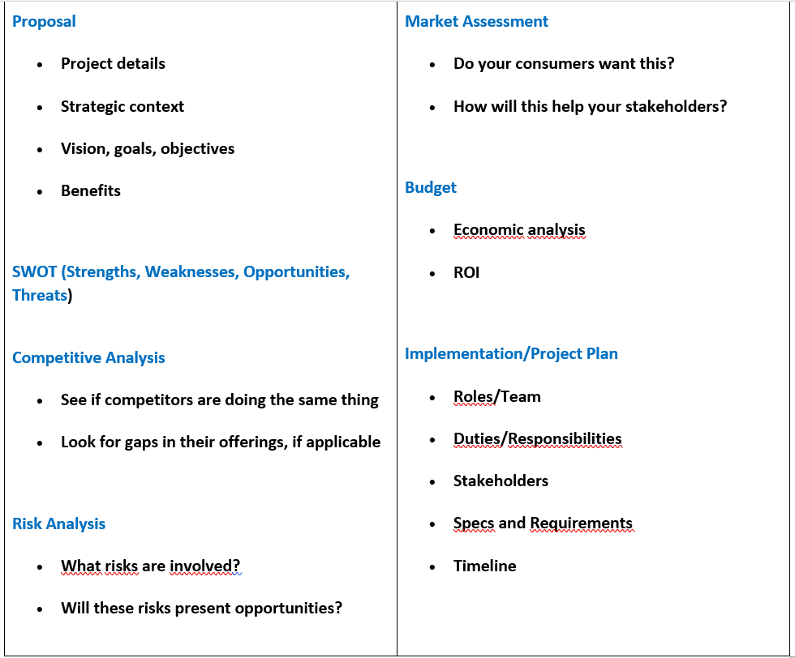
II- The Business Case
The elements that must exist in
a Business Case

Slide 24
III- The Feasibility Study
III- 1- Definition
Once the Business Case has been approved, the next step is taking a Feasibility Study, which documents potential solutions to the opportunity or business problem that the project is proposed to address.
It directs you to the right way to approach the project.
A Feasibility Study researches the opportunity and documents what is required to complete a successful project. It will also identify any other solutions, if available.

Slide 25
III- The Feasibility Study
Risks and issues are outlined at this time, as well as what the proposed solution to each will be if they occur.
Finally, the Feasibility Study consolidates the Opportunity Study (Business Case) .
Its purpose is to check the balance between the 3 important factors of any project, which are:
the quality to be achieved ,
the deadlines to be met,
the costs to bear.

Slide 26
III- The Feasibility Study
III-2- Importance of the Feasibility Study
It describes in detail the resources and contraints of the project :
* techniques
* quality
* financial
* temporal
all the stakeholders are aware of the objectives and challenges of the project before validating it and moving on to the scoping phase .

Slide 27
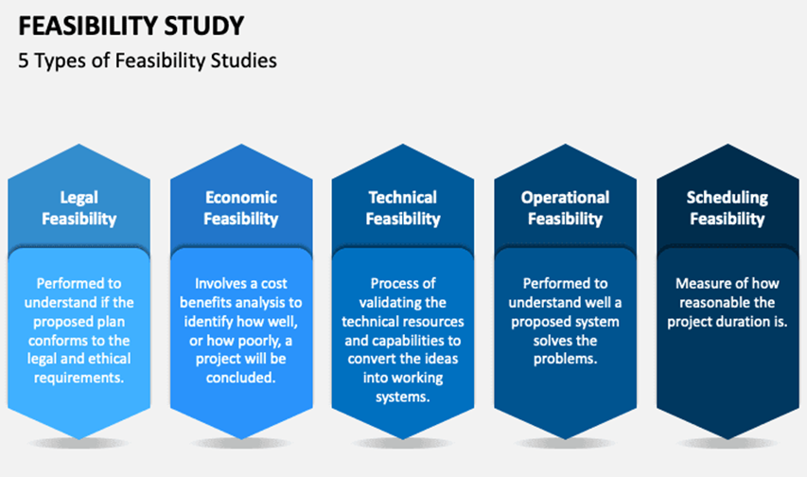
III- The Feasibility Study
III- 3- The 5 types of
Feasibility Studies

Slide 28
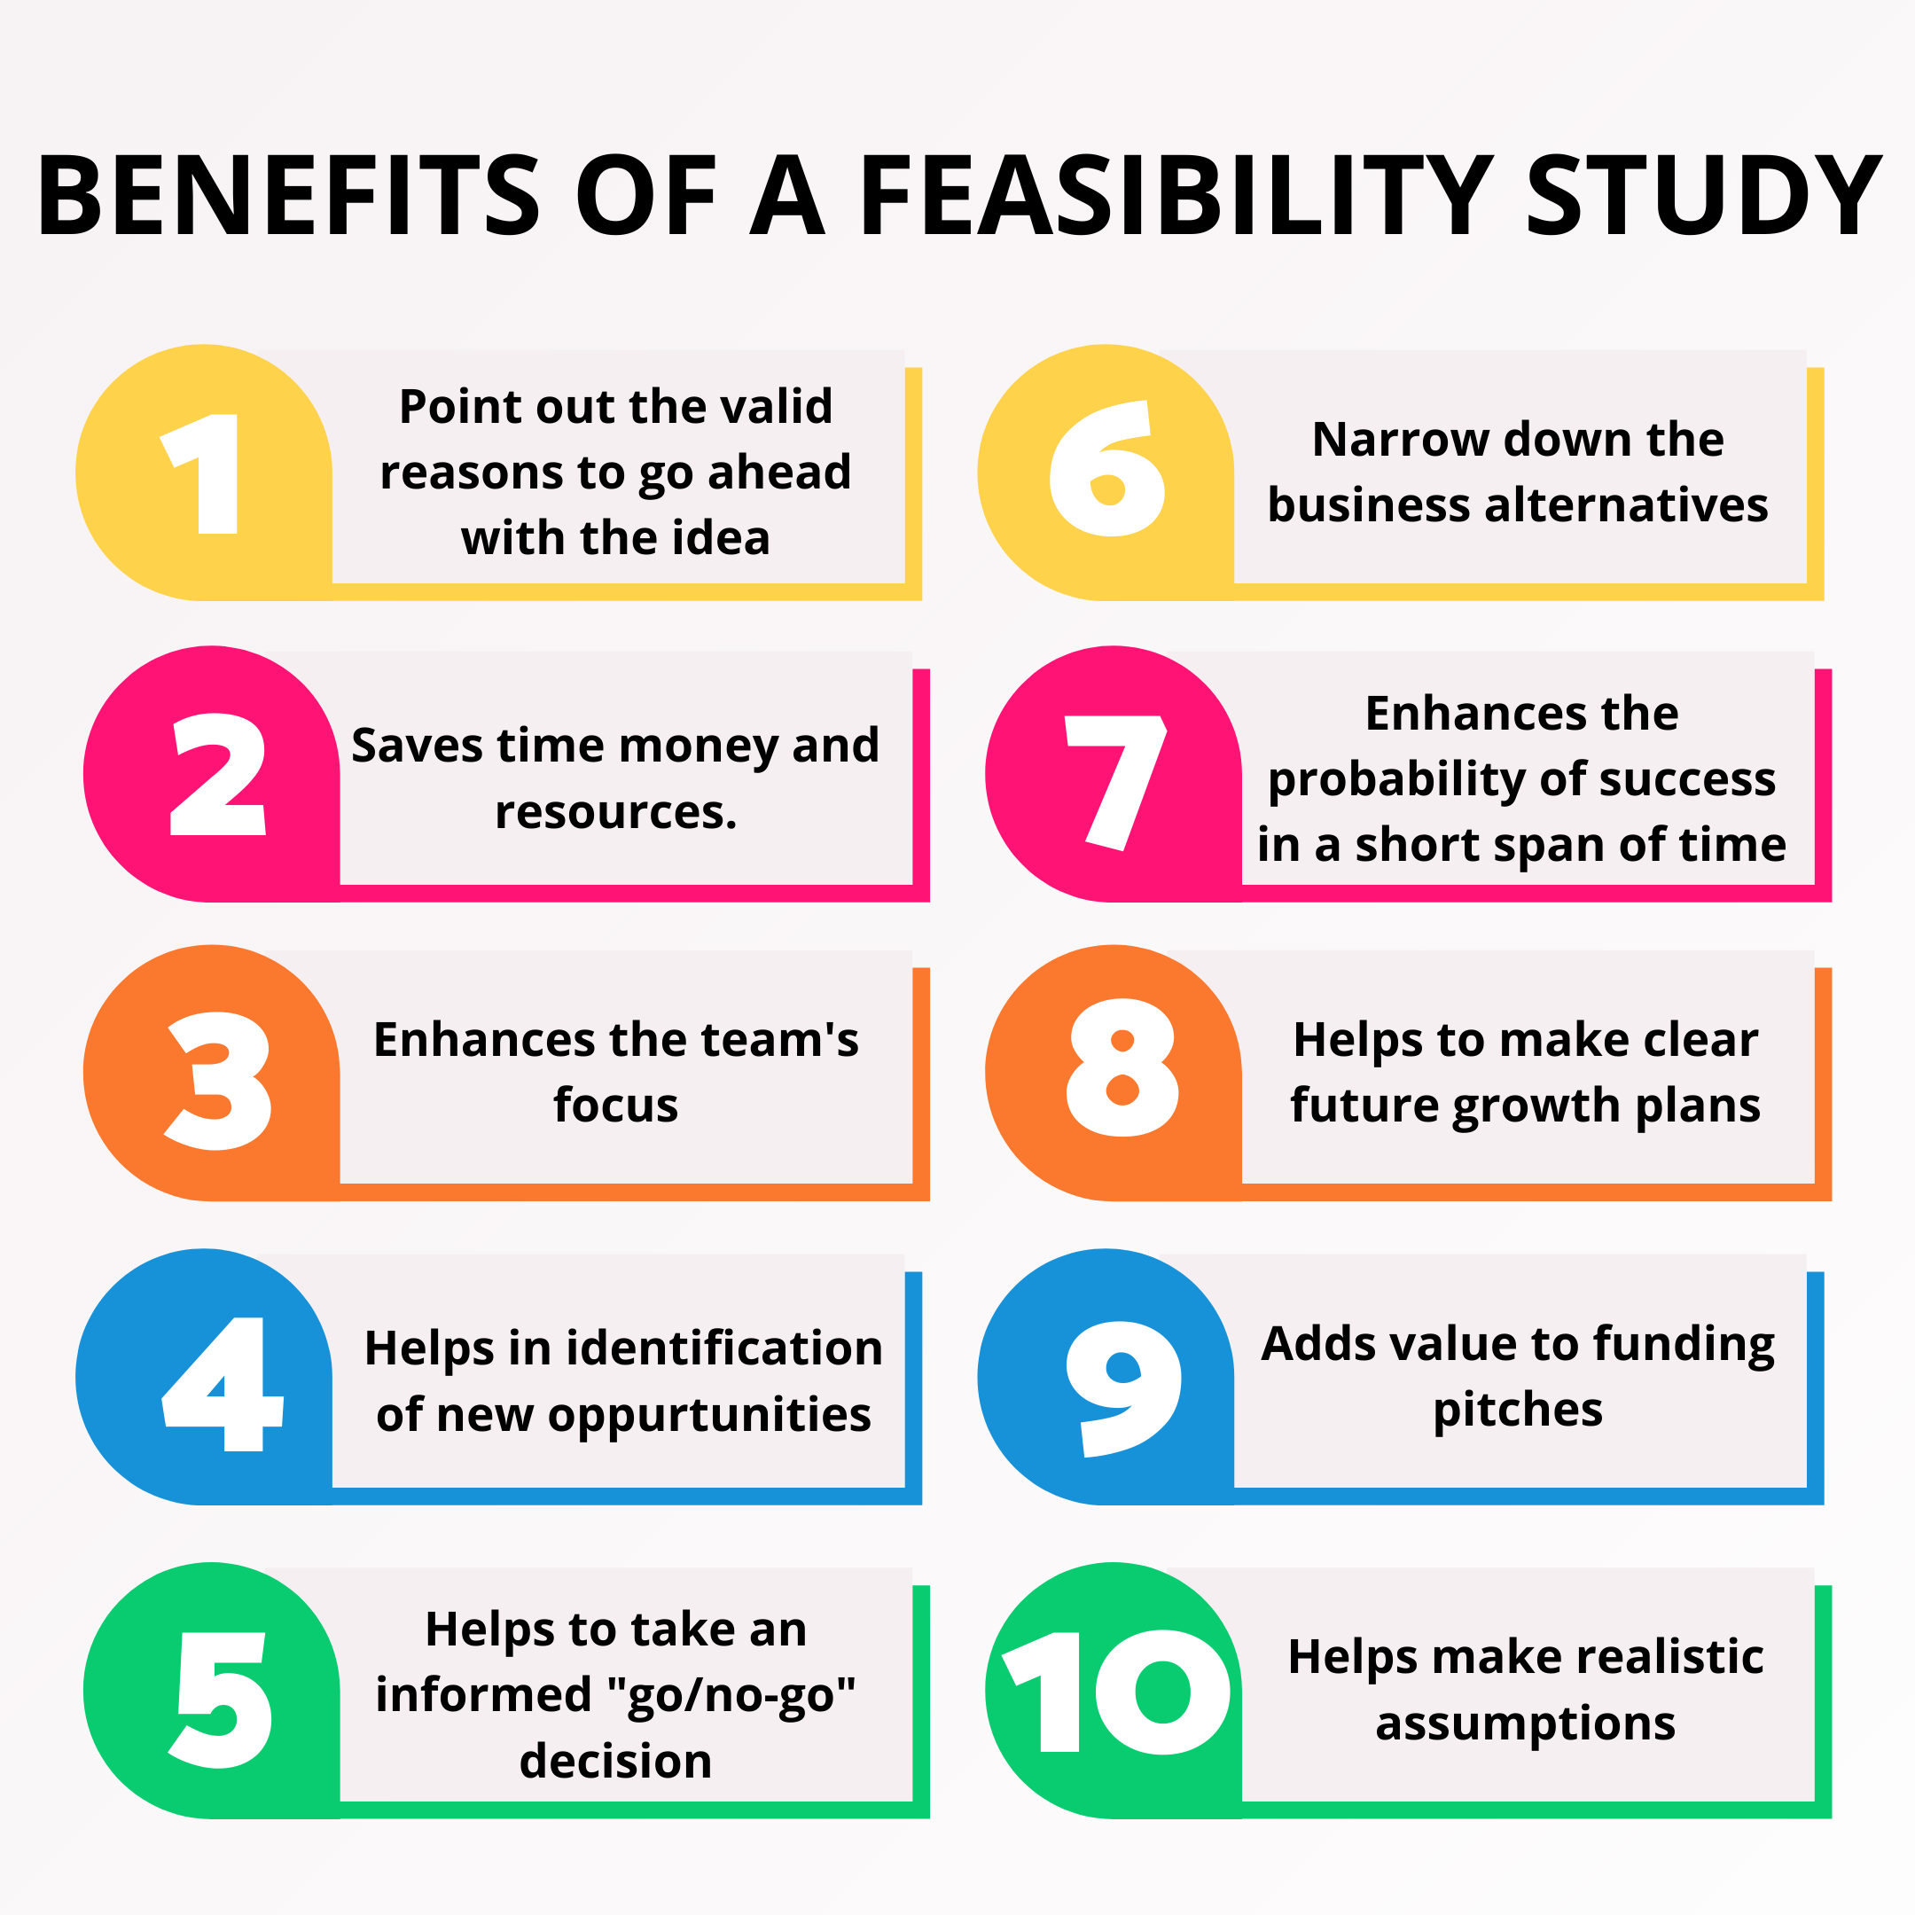
III-3- Benefits of a Feasibility Study

Slide 29
III- The Feasibility Study
A Feasibility Study is conducted to determine whether or not a given project or system is economically viable.
Before embarking on a project involving thousands of resources and costing millions of dollars, executives and the board of directors want to see a feasibility study report.
If a large error is made during the decision-making process, it may have an impact on the organization's future performance.
As a result, preparing a Feasibility Study report is essential for determining the project's viability.

Slide 30
IV- …To the Project Charter
The Business Case is the document that gets created first. It makes assumptions on a project in terms of its costs and expected revenue and based on that it determines if it makes sense financially. If it does, and if there are not better projects at the moment, then the project is pursued.
A Feasibility Study is utilized to decide the practicality of a project is legally and technically feasible as well as economically justifiable. It lets us know whether a project is worth the investment—in some cases, a project may not be possible.

Slide 31
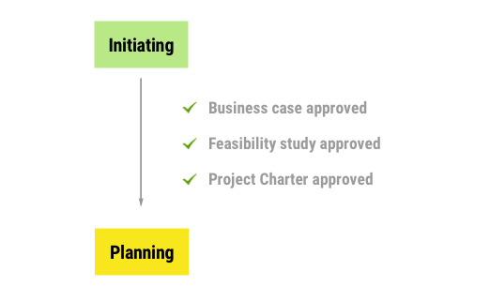
IV- …To the Project Charter
A Project Charter outlines the purpose for
the project and how it will be structured and executed.
In it, the vision, objectives, scope and deliverables
for the project are all detailed.
Responsibilities for the project team and stakeholders
are also described.

Slide 32
IV- …To the Project Charter
A Project Charter is a relatively informal document to pitch your project to stakeholders.
Think of the charter like an elevator pitch of your project objectives, scope, and responsibilities.
Typically, your Project Sponsor or executive stakeholders reviews the charter before ratifying the project.

Slide 33
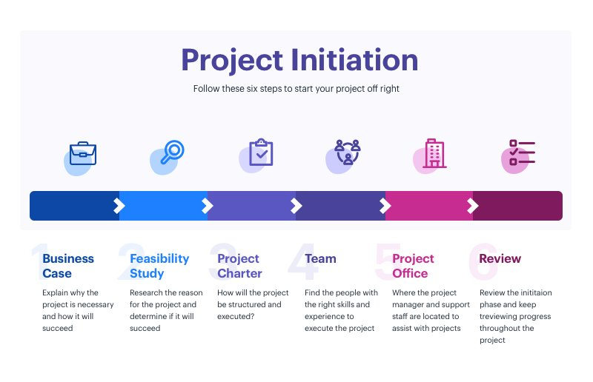
IV- …To the Project Charter

Slide 34


Slide 35
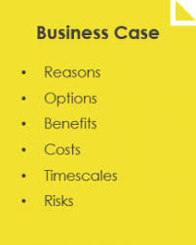
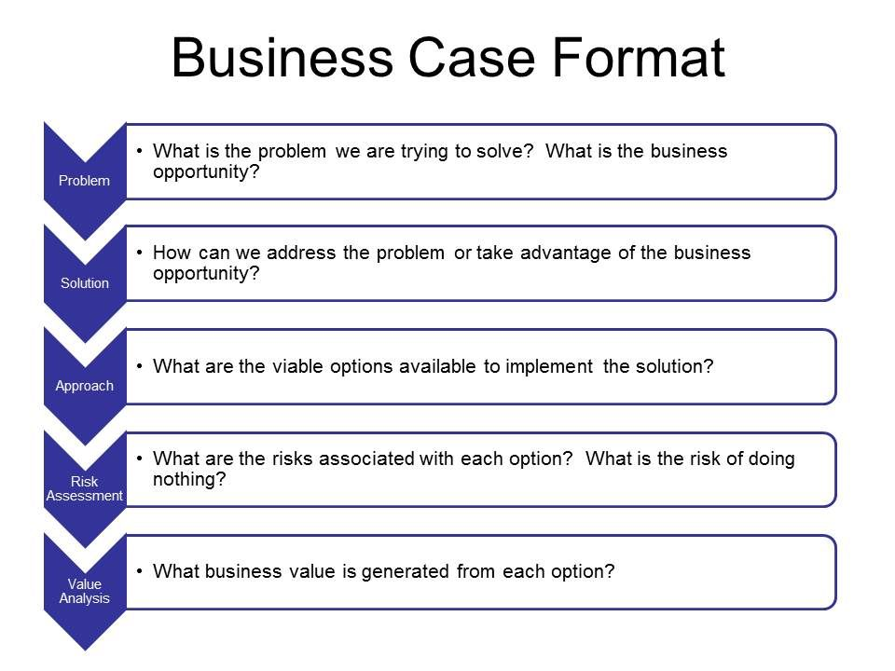

Slide 36
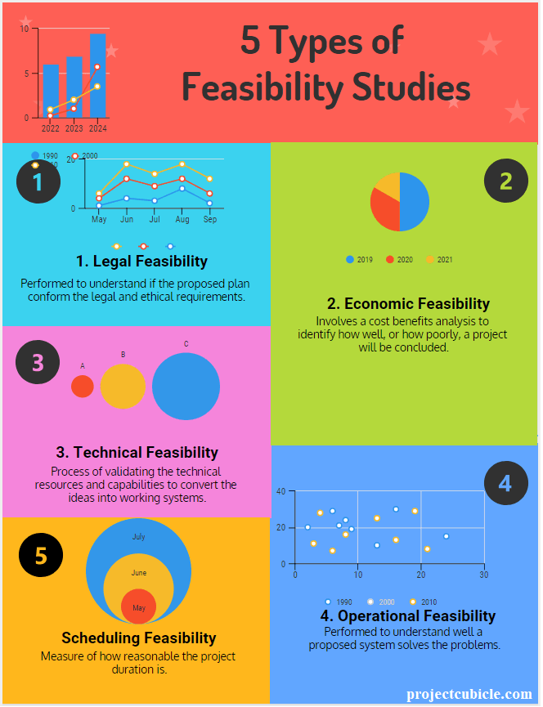

Slide 37
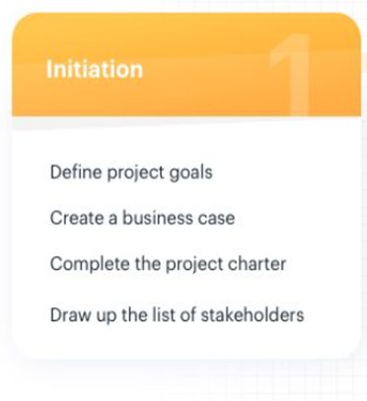

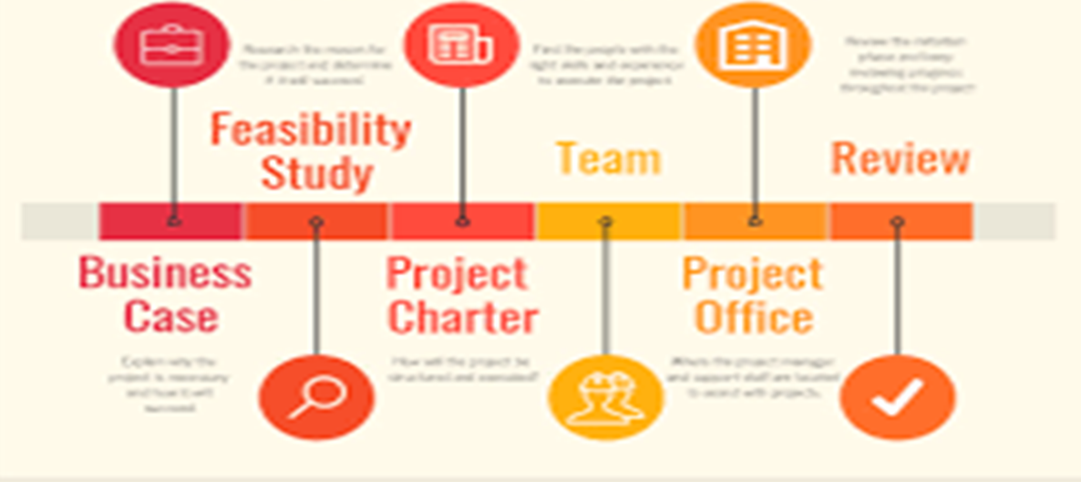

Slide 38


