Slide 1



Information Systems
Prepared by Dr. Amjad Qtaish
IT372
Information Systems
Lecture 02

Slide 2


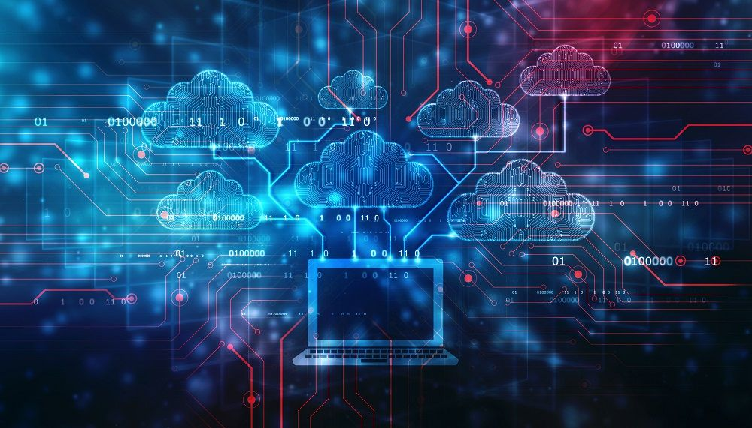

Module 2: Information Technology Infrastructure
Information Systems
Chapter 3: Hardware and Software
Chapter 4: Emerging Technologies
Dr. Amjad Qtaish
Faculty of Informatics
Midocean University
Information Systems (IT372)

Slide 3

Chapter
Outline
03
    An Information Technology Infrastructure :
Information Technology Infrastructure
Hardware Components
Computer Systems Types and Upgrading
Software Component
System Software
Application Software
Contemporary Hardware Platform
Contemporary Software Platform
Management Issues of IT infrastructure
Information Systems, Dr. Amjad Qtaish
3

Slide 4
Chapter
Learning Objectives
03
    An Information Technology Infrastructure :
Identify the IT infrastructure and its components
Describe how to select Hardware or IS
Describe characteristics of memory, processor, storage, input and output devices
Identify and briefly describe the functions of two basic types of software
Outline the role of operating systems
Discuss how application software support personal, workgroup and enterprise business objectives
Discuss the current trends in computer hardware platforms
Discuss the current trends in computer software platforms
Identify the challenges of managing IT infrastructure and providing management solutions
Information Systems, Dr. Amjad Qtaish
4

Slide 5
Chapter
Information Technology Infrastructure
03
Physical devices and software applications
Services “ Service Platform”
  Computing platforms
  Telecomm services
  Data management services
  Application software services
  Physical facility management
  IT management services
  IT standards services
  IT training
  IT research
Information Systems, Dr. Amjad Qtaish
5

Slide 6
Chapter
Information Technology Infrastructure
03
Important to know service platform
  Value of technology
IT infrastructures have evolved
  Developments in computer processing/memory chips etc
Reason:
To make technology practical and yield business benefits
Information Systems, Dr. Amjad Qtaish
6

Slide 7
Chapter
Hardware Components
03
Communication Devices
Processing device
CU/ ALU
Input Devices
Output Devices
Memory (Primary Storage)
Secondary Storage
Information Systems, Dr. Amjad Qtaish
7

Slide 8
Chapter
Memory
03
Cache Memory
  High speed memory
  Stores frequently used data is stored
Costs for memory capacity continue to decline
Effectiveness of a CBIS depends on memory capacity too
  Computer assisted product design require more memory
Information Systems, Dr. Amjad Qtaish
8

Slide 9
Chapter
Multiprocessing and Parallel Computing
03
Multiprocessing involves simultaneous execution of two or more instructions at the same time
  Multicore microprocessor (dual core)
  AMD and Intel
  Core Duo technology
Parallel Computing is simultaneous execution of same task on multiple processors
  Massively Parallel computing systems
  Single instruction/ Multiple data (SIMD)
  Multiple Instruction/ Multiple data (MIMD)
Information Systems, Dr. Amjad Qtaish
9

Slide 10
Chapter
Multiprocessing and Parallel Computing
03
Grid Computing: use of collection of computers to work in a coordinated manner
  Solve extremely large processing problems
  Central server acting as Grid leader
  World Community Grid ( through Rosetta Software)
Business Uses: Modeling, simulating, analysing large amounts of data
  Marketing programs or boosting sales and customer relationships
Information Systems, Dr. Amjad Qtaish
10

Slide 11
Chapter
Secondary Storage
03
Amount of data to be stored is increasing every year
Secondary storage: non volatile, greater capacity, greater economy
  IS needs determine the access methods, storage capacity and portability
  Access faster = expensive than slower media
  Security
Types
  Magnetic Disks - Hard Disk
  Optical Discs – CD-ROM, CD-RW, DVD, DVD-R
  Memory Cards – used in digicams, video cams, photo printers, handheld games, smart phones
  Flash Memory - EEPROM
Information Systems, Dr. Amjad Qtaish
11

Slide 12
Chapter
Secondary Storage
03
RAID (redundant array of independent disks)
  Fault tolerance – requirement of organizations
  Technology to rebuild lost data
  Data is split and stored on different physical drives
  Improves system performance and reliability
  Simpler way is duplicating data, disk mirroring
Enterprise Storage
  Large secondary storage
  Attached Storage
  Network Attached Storage
  Storage Area Network
Information Systems, Dr. Amjad Qtaish
12

Slide 13
Chapter
Input Devices
03
Businesses consider certain features
  Form of output
  Nature of data required
  Speed and accuracy
PC Input
  Keyboard, mouse, track ball, touch pad
Voice/ Video
  Microphone, digital camera, web camera
Scanning Devices
  Optical Scanner (flatbed , handheld etc)
Pen Input
  Stylus, Digital Pen
Information Systems, Dr. Amjad Qtaish
13

Slide 14
Chapter
Input Devices
03
Reading Devices
  Magnetic strip reader, Bar code reader, RFID reader
Touch Sensitive Screens
Terminals
  Dumb, Smart , Special purpose (POS, ATM)
Biometric Input Devices
  Translates personal characteristics into digital code
  Finger print scanner, Face recognition, Voice verification, Signature verification, Retina/ Iris scanners
Information Systems, Dr. Amjad Qtaish
14

Slide 15
Chapter
Output Devices
03
Output should be the right information at right time to the right person in the right format
Display Devices
  CRT Monitors: use the CRT to display images on the screens. Dot on the screen is called Pixel (on/off)
    More pixels, more resolution (ppi)
    Dot pitch: distance between pixels in millimetres ( .25 to .33 mm)
  LCD monitors and screens: flat panel displays that use liquid crystals to display images on screen
    Less space, costlier, less power consumption, flicker free
    TFT: use transistors to control each pixels
  OLED screens: organic light emitting diodes, organic molecules that emit light
    Brighter than LCD, flexible displays, less expensive
    cell phones, car radios, digital cameras
Information Systems, Dr. Amjad Qtaish
15

Slide 16
Chapter
Output Devices
03
Printers and Plotters
  Produce text/ graphics on physical medium (hard copy)
  Non Impact (inkjet, Laser, Mobile)
    Different speeds (ppm), quality (dpi), capabilities
  Impact (Dot Matrix)
    Continuous form of paper (cps)
  Plotters: high quality drawings like blue prints, maps, circuit diagrams
    Upto 60 inch width
Audio Output
  Speakers, head phones, ear phones
Data Projectors
  Projects text and images on larger screens
Information Systems, Dr. Amjad Qtaish
16

Slide 17
Chapter
Computer Systems Types and Upgrading
03
Handheld/Mobile Devices
  As small as a credit card, pocket size, portability
  No disk, save data on special memory, GPS
  Handheld computer, PDA, smartphones
Portable Computers
  Laptops, notebooks, tablet PCs
  Thin, lightweight, powerful
Thin Client
  Low-cost , centrally managed computer, no drives, limited capabilities
Desktop and Workstation
  Inexpensive, single user systems
  Expensive, powerful
  Mathematical computing, CAD, special effects for motion pictures
Information Systems, Dr. Amjad Qtaish
17

Slide 18
Chapter
Computer Systems Types and Upgrading
03
Servers
  Used by many people to perform certain tasks, provides access to hardware, software, resources
  Scalability : ability to increase processing capability
  Blade servers: thinner than box-based servers, circuit board with processors, memory and network connections, secondary storage maybe added
Mainframes
  Large, powerful, thousand computers connected, and handle millions of instructions
  Information processing and data storage that are too large, backups
Supercomputers
  Special purpose machines, complex, sophisticated mathematical calculations
Information Systems, Dr. Amjad Qtaish
18

Slide 19
Case Study: Mainframes or Distributed Systems
Chapter
03
Bank of NewYork
traditionally information services are provided by z-series mainframes
Competition from server based distributed systems
  midrange servers, blade servers
  Distributed systems: system dividing business processes among network servers,
    Open and agile
    Deployment of applications easy
    Scalability
    Inexpensive servers
Information Systems, Dr. Amjad Qtaish
19

Slide 20
Case Study: Mainframes or Distributed Systems
Chapter
03
Mainframes
  Ease of management
  More secure and stable
  Useful means or consolidation
  Very large complex problem solving
Expensive to shift from mainframe to distributed system
IS professionals need to take advantage of both the technologies
Information Systems, Dr. Amjad Qtaish
20

Slide 21
Chapter
Software Component
03
System software
  Set of programmes that coordinate activities and functions of computer hardware & other programs
Application Software
  Programs to help the users perform tasks
Sphere of Influence
  Scope of problem/opportunities addressed by organizations
    Personal
    Workgroup
    Enterprise
    Support the firm in the interactions with environment
Information Systems, Dr. Amjad Qtaish
21

Slide 22
Chapter
System Software
03
Operating System
  Plays a central role in the functioning of complete computer system
  After boot up, OS is loaded in RAM
  Common Hardware Function: acting as intermediary between hardware and programs
  User Interfacing: command based, GUI
  Memory Management: control access of memory & maximize usage and storage
  Processing tasks: task management allocates computer resources, allows multitasking (running more than one application at a time) and task sharing
  Networking capabilities: features and capabilities to aid users in connecting to computer network
  File Management: files are available when needed, protected from access by unauthorized users
  Security: provided by logon feature and identification code
Information Systems, Dr. Amjad Qtaish
22

Slide 23
Chapter
System Software
03
PERSONAL | WORKGROUP | ENTERPRISE
Windows Vista Widows mobile and Windows Embedded Android Mac OS Mac OS X UNIX Solaris Linux Red Hat Linux Palm OS | Windows NT Server Windows 2003 Server Mac OS Server UNIX Linux Netware IBM OS/390 IBM z/OS HP MPE/iX | Windows NT Server Windows Advanced Server Linus UNIX Red Hat Linux IBM OS/390 IBM z/OS HP MPE/iX
Information Systems, Dr. Amjad Qtaish
23

Slide 24
Chapter
System Software
03
Embedded Operating Systems
  Certain OS are embedded into the devices
  Some developed for special purpose devices e.g. computers on the space shuttle
  Windows CE : embedded in small computer devices
  Windows Mobile
  BlackBerry
  Symbian OS
  Google Android
  iPhone OS
Information Systems, Dr. Amjad Qtaish
24

Slide 25
Chapter
System Software
03
Utility Programs
  Help to perform maintenance with a computer system
  Hardware Utilities: Disk Scanner, Disk defragmenter, Diagnostic Utility
  Virus Detection and Recovery Utilities
  File compression Utilities
  Pop up blocker utilities
  Server and Mainframe Utilities
    Reporting workgroup activities
    Managing power supply
    Archiving contents of database
    Reporting status of computer jobs
Information Systems, Dr. Amjad Qtaish
25

Slide 26
Chapter
Application Software
03
Most of the jobs and activities can be handled by application software
  Proprietary software: one of a kind program for specific application
  Off the shelf software: acquiring an existing software program
Personal Application Software
Workgroup Application Software
  Collaborative software
  Google docs, Yahoo groups
Enterprise Application Software
  SAP’s ERP
Mobile Application Software
  App stores provide them
Information Systems, Dr. Amjad Qtaish
26

Slide 27
Chapter
Types of Application Software
03
Open Source
Freeware
Shareware
Public Domain
Information Systems, Dr. Amjad Qtaish
27

Slide 28
Chapter
Contemporary Hardware Platform
04
Emerging Mobile Digital Platform
  Smartphones evolving to become handheld computers
  Transmission of data, surfing Web, e-mail and IM, display digital content
  Low-cost light weight subnotebooks called netbooks
  Tablet computers
  Digital e-book readers
  Business computing will gradually move towards mobile devices
Grid Computing
  Connecting geographically remote computers into a single network to create a virtual supercomputer
  Combines computational power of all computers in the grid
  Reason: most computer use CPU for 25% of the time for a certain work
  Special software programs control and allocate resources
  Benefits:
    Cost savings
    Speed of computing
    Agility
    Reduced power consumption
Information Systems, Dr. Amjad Qtaish
28

Slide 29
Chapter
Contemporary Hardware Platform
04
Virtualization
  Process of presenting computing resources, that are accessed without restriction of geographic location or physical configuration
  Enables Single physical resource appears to users are multiple logical resources
  Enables Multiple physical resources appear as a single logical resource
  Benefit
    Computing processing storage handled using computer resources at remote locations
    Increase equipment utilization
    Conserving data center space
    Conserving energy usage
    Run legacy systems on old OS on the same server
    Centralization of hardware administration
Information Systems, Dr. Amjad Qtaish
29

Slide 30
Chapter
Contemporary Hardware Platform
04
Cloud Computing
  Computer processing, storage, software and other services are obtained as a pool of virtualized resources over networks
  Main characteristics:
    ON-demand self –service
    Ubiquitous network access
    Location independent resource pooling
    Rapid elasticity
    Measured service
  Available as three services: Cloud infrastructure, cloud platform and cloud software
  Types: Public cloud and private cloud
Information Systems, Dr. Amjad Qtaish
30

Slide 31
Chapter
Contemporary Hardware Platform
04
Green Computing
  Practises and technologies for designing, manufacturing, and using devices to minimize impact on environment
  Reducing power consumption
  Metrics:
    Power Usage Effectiveness
    Data Center Infrastructure efficiency
    Average Data Efficiency
Autonomic Computing
  The more computer systems become complex, more difficult to manage
  Effort to develop systems themselves, optimize and heal themselves, also protect from intruders
  E.g. firewalls and virus protection
Information Systems, Dr. Amjad Qtaish
31

Slide 32
Chapter
Contemporary Hardware Platform
04
Service Oriented Architecture
  Web Service: set of loosely coupled software components that exchange information with each other using standard web communications standards and languages
  XML: more powerful than HTML
    Perform presentation, communication and storage of data
    Provides standard format for data exchange
  SOA: set of self contained services that communicate with one another to create a working software application
  IBM’s Websphere e-business software platform
  Microsoft's .Net platform
Information Systems, Dr. Amjad Qtaish
32

Slide 33
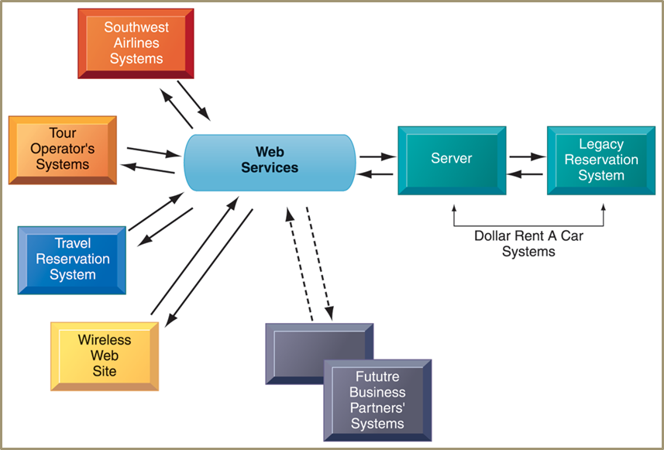
Chapter
Contemporary Hardware Platform
04
How Dollar rent a Car uses Web services
Information Systems, Dr. Amjad Qtaish
33

Slide 34
Chapter
Contemporary Hardware Platform
04
Software Outsourcing and Cloud Services
  Software package: prewritten, commercially available , e.g. SAP
  Outsourcing: enables firms to contract custom software development to outside firms, usually off shore
    Low-level maintenance, data entry, call center, and now new program development
  Cloud-based: software and data hosted on powerful servers and accessed through Internet and Web browser
    MS Word, Adobe Illustrator
  Enterprise software, other business function also available as a service
  Software as a Service (SaaS)
    Subscription or per transaction
Information Systems, Dr. Amjad Qtaish
34

Slide 35
Chapter
Contemporary Software Platform
04
Linux and Open Source Software
  OSS: software produced by a community of several hundred thousands of programmers around the world
  Free, modifiable, and free to be redistributed
  Linux: operating systems based on Unix
  Applications embedded in smart phones, netbooks, consumer electronics
  IBM, HP, Dell, Oracle produce Linux-compatible version o their products
  Used in Web servers, high performance computing
Information Systems, Dr. Amjad Qtaish
35

Slide 36
Chapter
Management Issues of IT infrastructure
04
Platform and Infrastructure issues
  Scalability: ability of a computer, product, or system to expand to serve large number of users
  New policies, procedures or legal contracts required if changing kind of infrastructure
    Response time and availability of mission critical systems
Management and Governance
  Who controls the IT infrastructure?
  How will infrastructure costs be allocated among business units?
Making Wise Investments
  How much should be spent?
  Cloud computing low-cost and flexible but issue of security and work flow
Information Systems, Dr. Amjad Qtaish
36

Slide 37
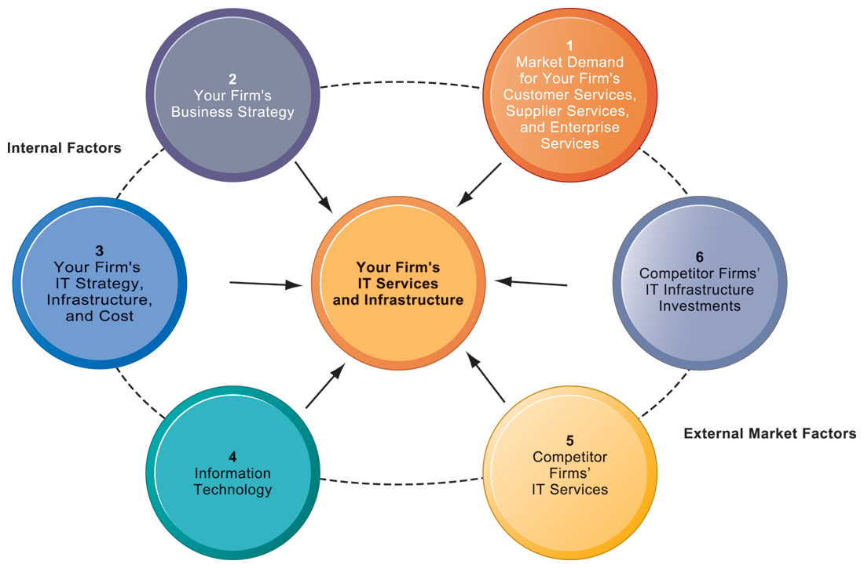
Chapter
Management Issues of IT infrastructure
04
Competitive Forces Model
Information Systems, Dr. Amjad Qtaish
37

Slide 38
Chapter
Case Study: Cloud Services Go Mainstream
04
Company: SalesForce.com
  Provides CRM and other application software solutions as ‘software as a service’
On-demand model
  Eliminates need for hardware/software investments
  Very low subscription rate
  No OS, database servers, application servers to install
  No expensive licensing and maintenance fees
Challenges
  Increased competition
  Security and reliability
  Need to expand business model
  Constant availability
Information Systems, Dr. Amjad Qtaish
38

Slide 39
Chapter
Case Study: Cloud Services Go Mainstream
04
Company providing additional functionality
  Partnership with Google App
  Partnership with Apple
  Integration with Facebook
Service improvement
  SaaS to Platform as a Service
Intensified efforts
  Sales Cloud, Service Cloud, Custom Cloud
  Force.com application development platform
    Customise CRM application or built new one and run them in the cloud
  AppExchange: for small businesses
Information Systems, Dr. Amjad Qtaish
39

Slide 40
Chapter
Case Study: Cloud Services Go Mainstream
04
Using Cloud Computing
  SaaS on-demand model
Challenges and meeting challenges
  Partnerships and integration
  Providing broader cloud computing ‘platform’
  Providing tools to assure customers about system reliability
  Offer PC applications so that users can work offline as well
Factors to use SalesForce.com
  Availability
  Reliability
  Security
  Long term costs and subscription costs
  Customization
Information Systems, Dr. Amjad Qtaish
40

Slide 41
Chapter
Summary
04
System and application software are critical in achieving organizational goals
Developing proprietary application software is effective only if it meets an organizational need and provide competitive advantage
Software industry continues to undergo constant change, so users need to be aware of trends and issues
Current trends in Computer Hardware platforms
Current Trends in Computer software platforms
Challenges of managing IT infrastructure and management solutions
Information Systems, Dr. Amjad Qtaish
41

Slide 42



Thank You

