Slide 1


Slide 2


Slide 3
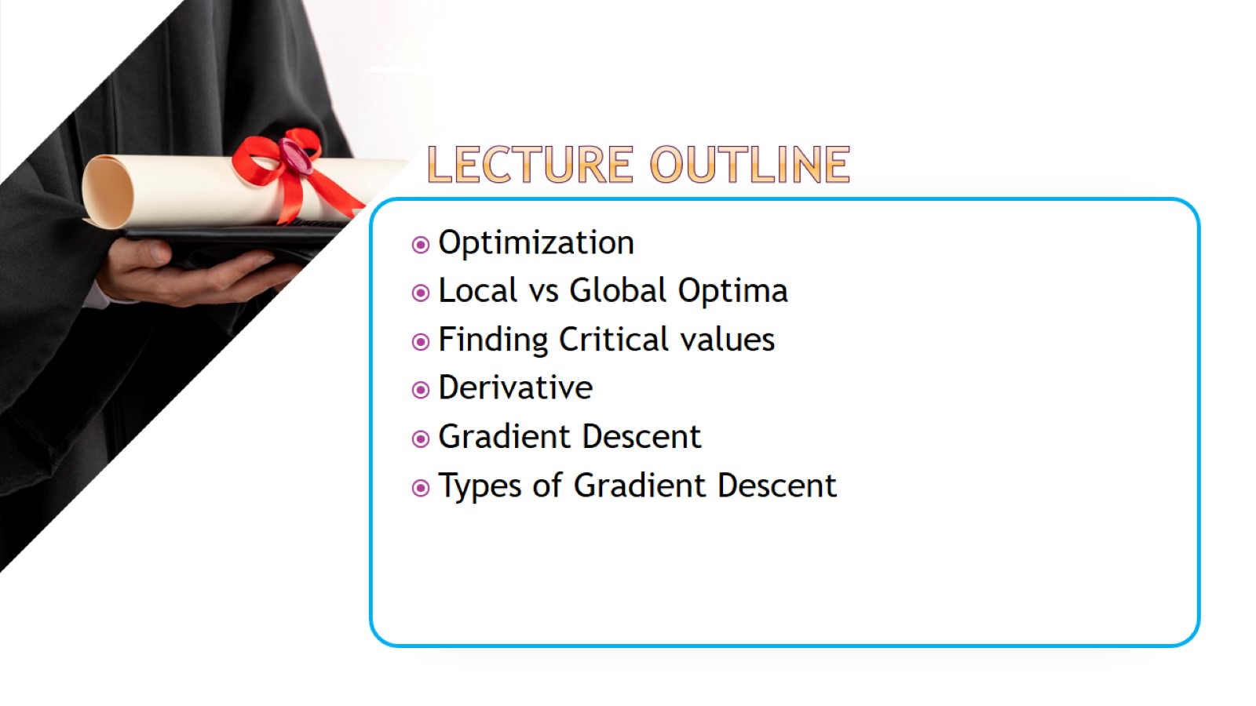

Slide 4
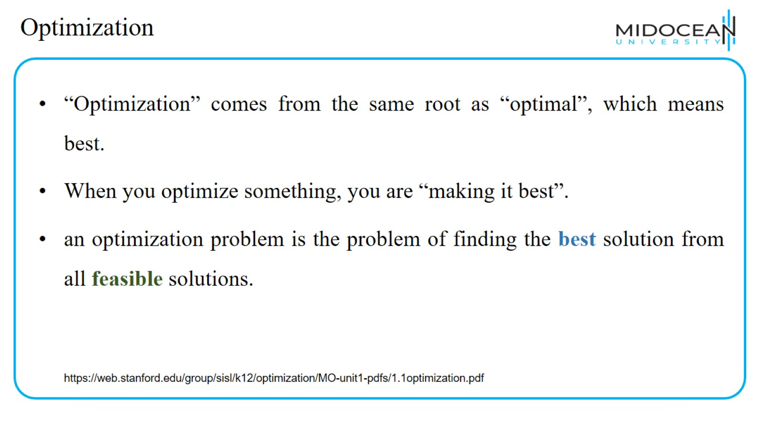
Optimization

Slide 5
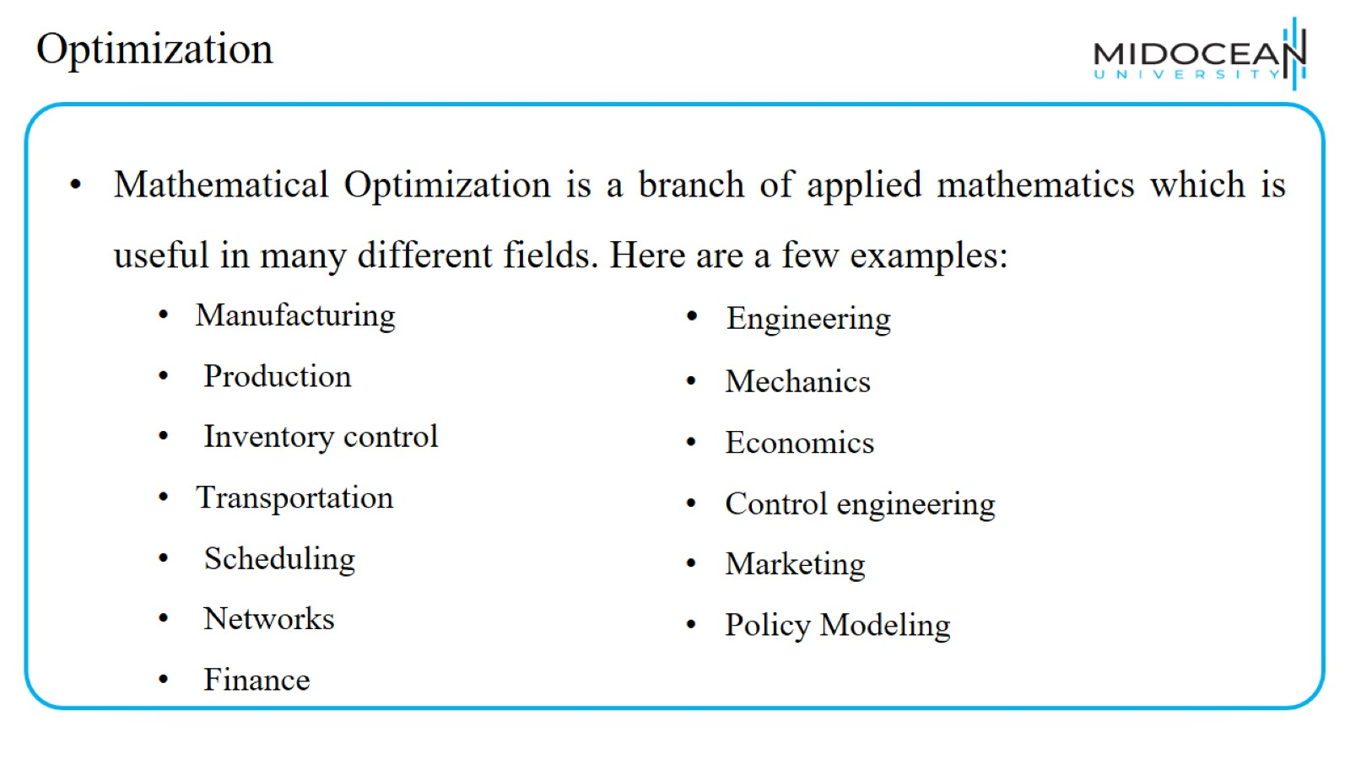
Optimization

Slide 6
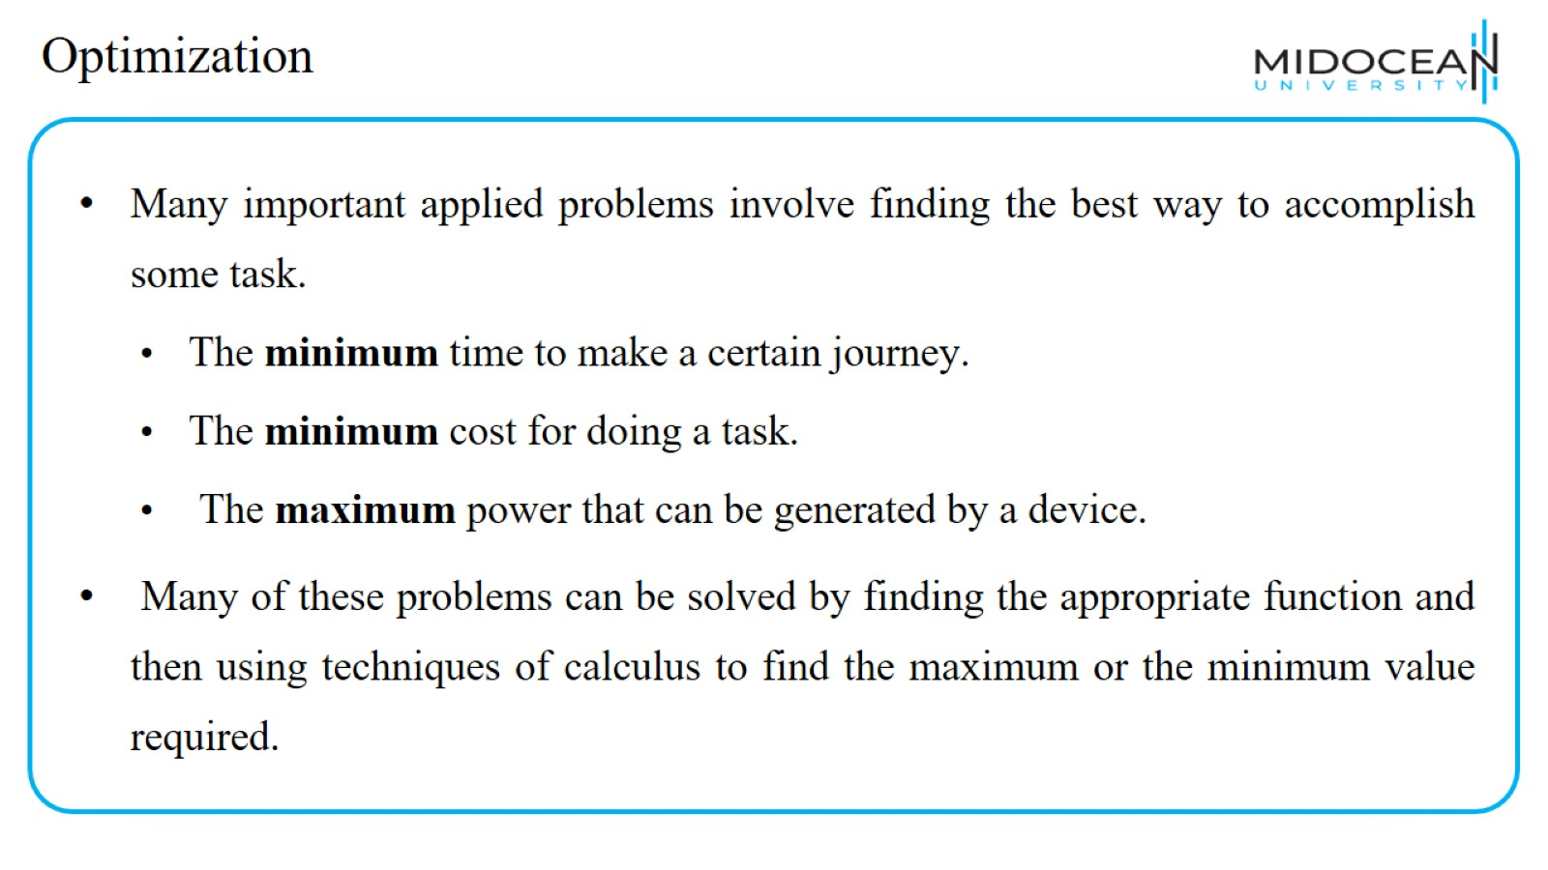
Optimization

Slide 7
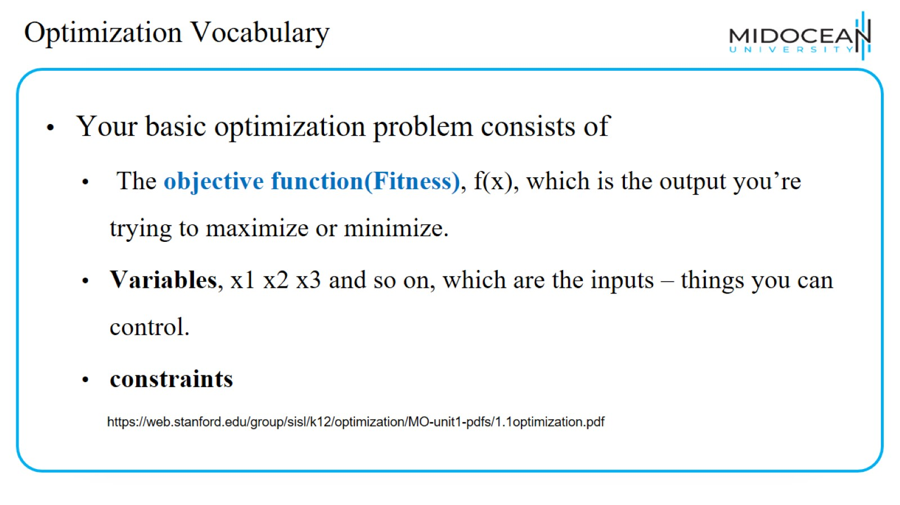
Optimization Vocabulary

Slide 8
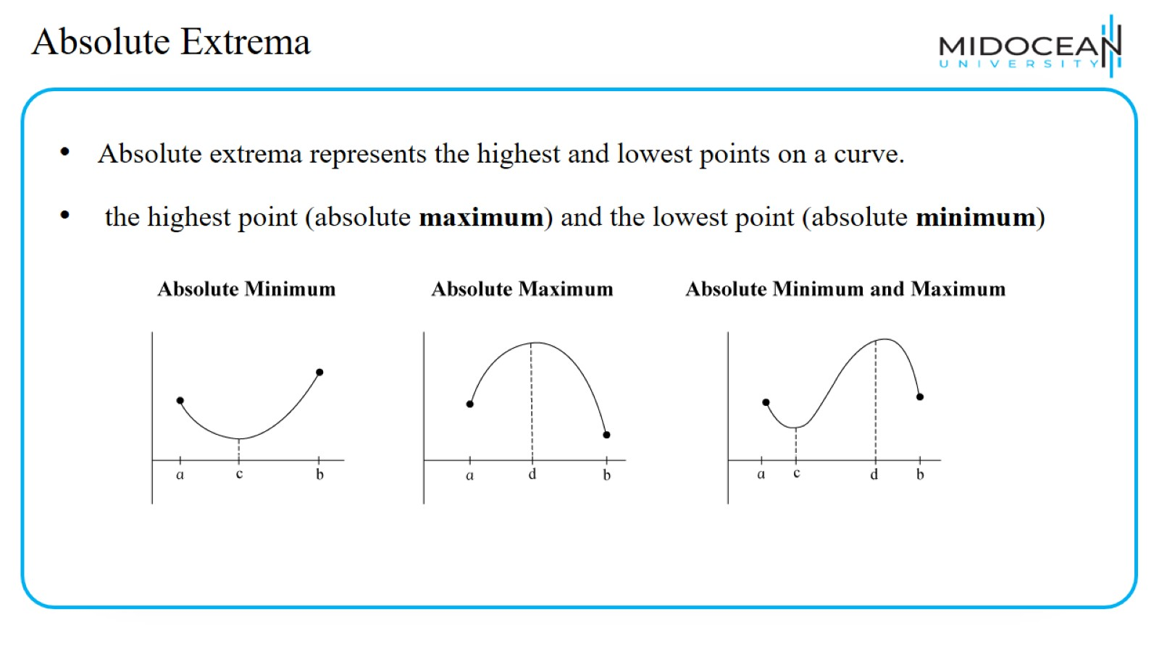
Absolute Extrema

Slide 9
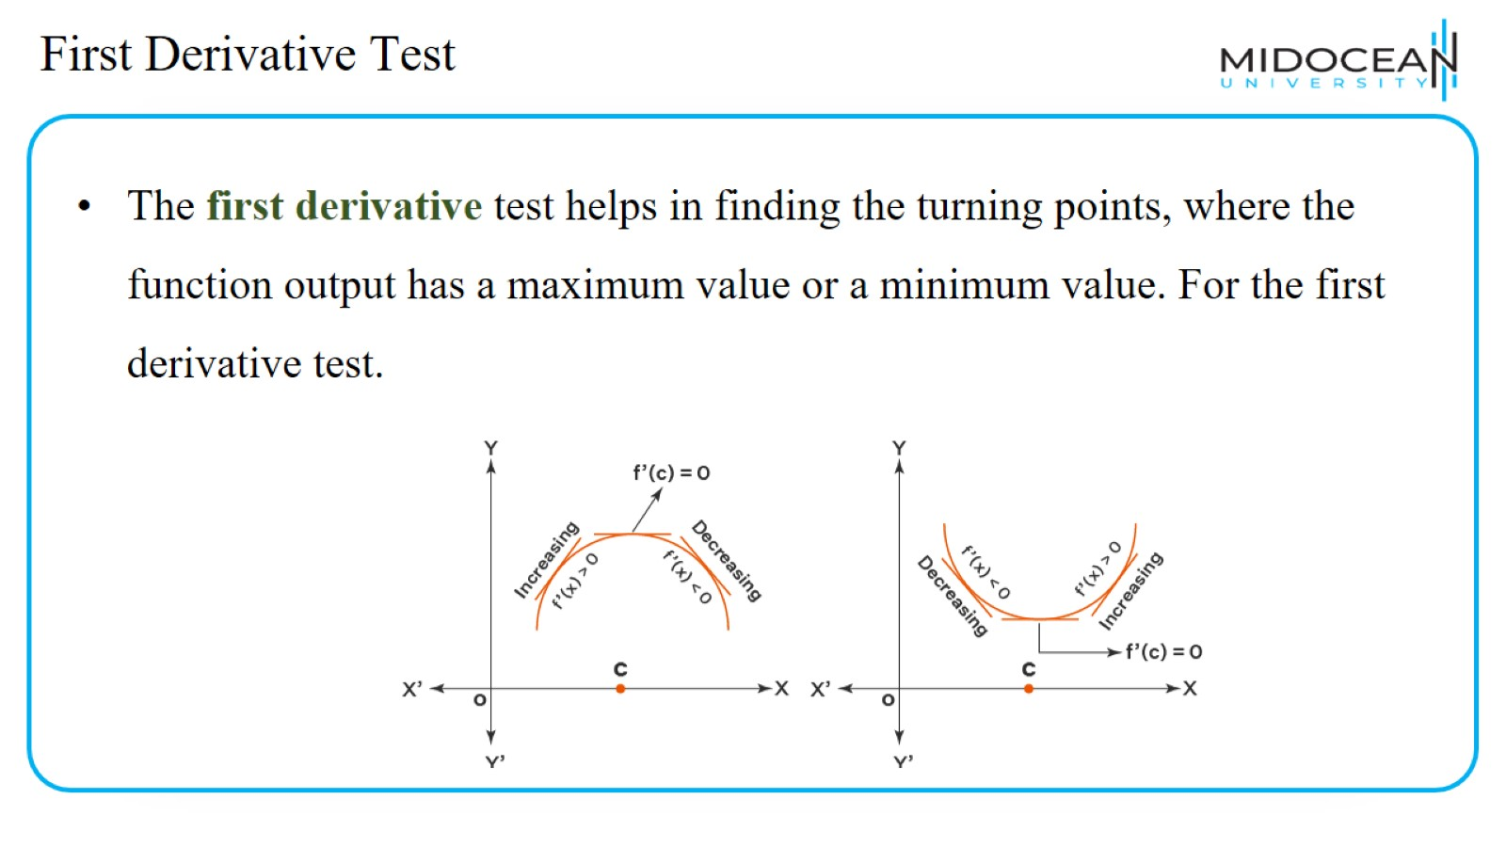
First Derivative Test

Slide 10
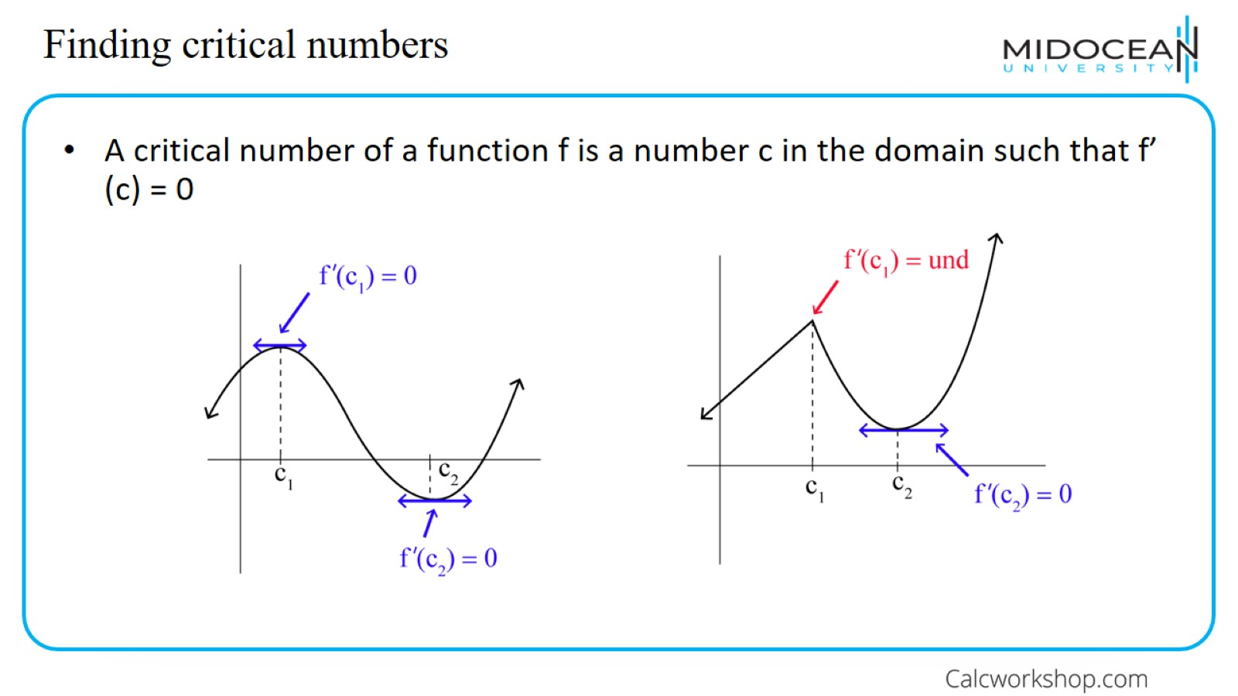
Finding critical numbers

Slide 11
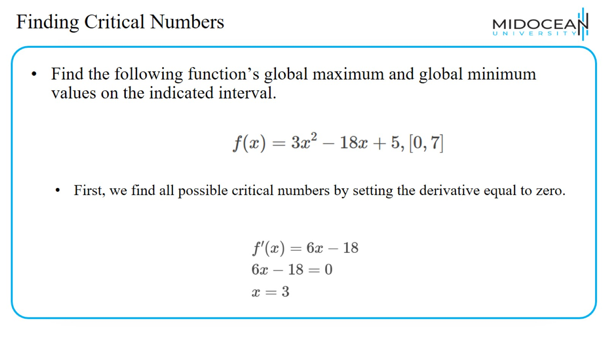
Finding Critical Numbers

Slide 12
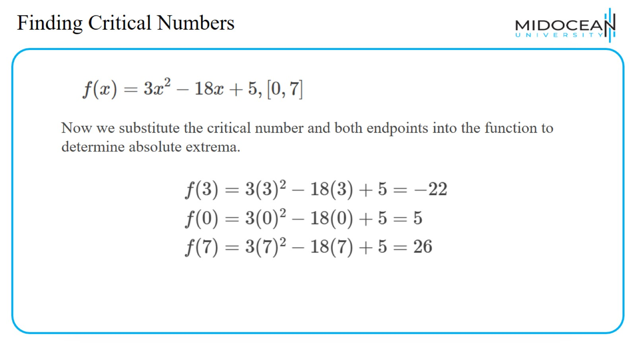
Finding Critical Numbers

Slide 13
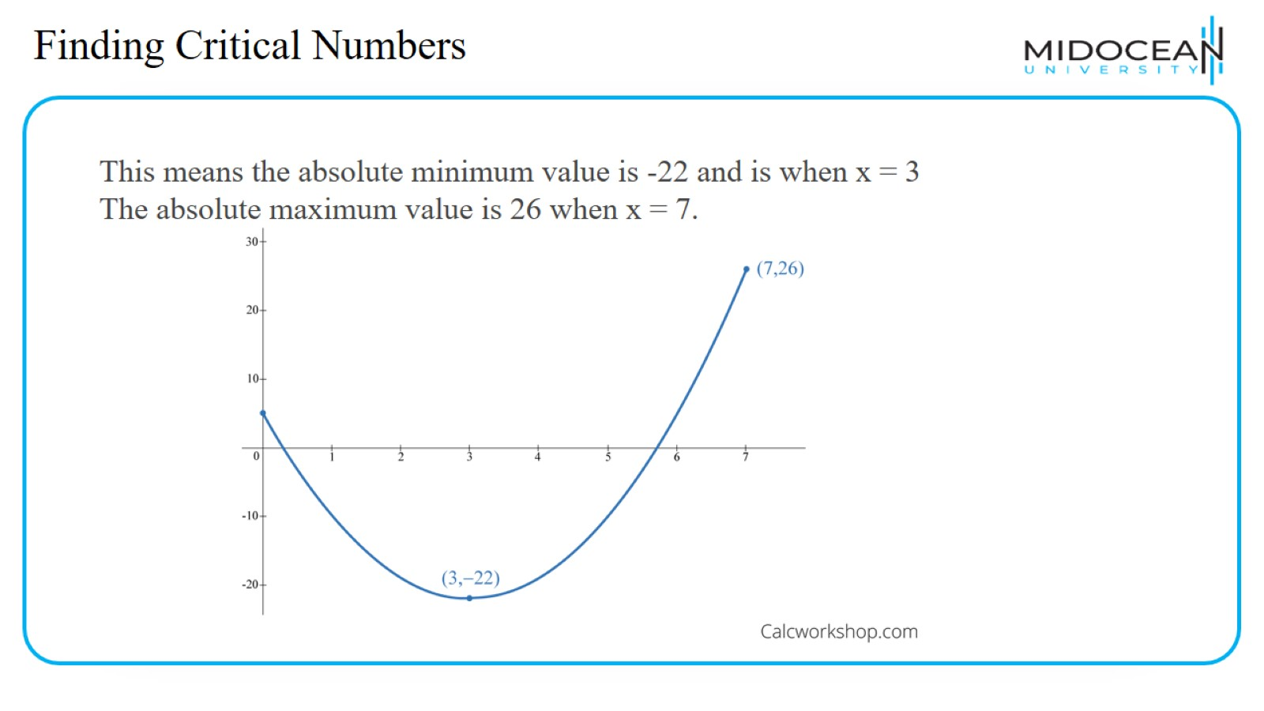
Finding Critical Numbers

Slide 14
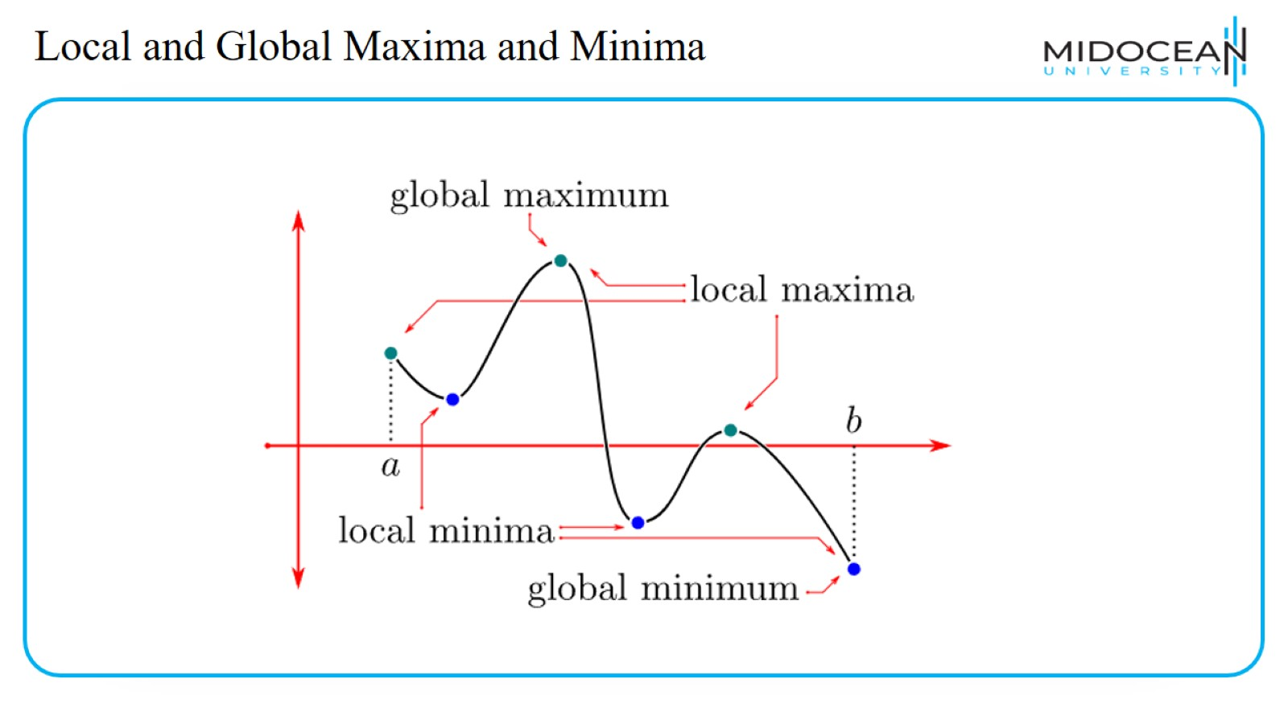
Local and Global Maxima and Minima

Slide 15
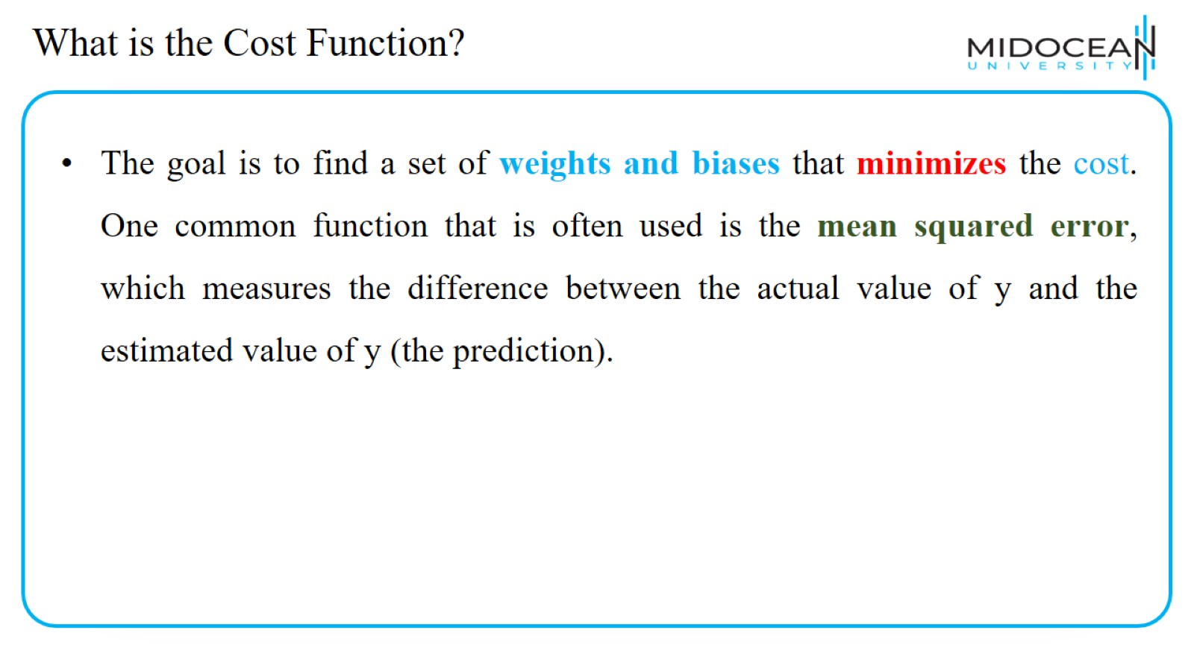
What is the Cost Function?

Slide 16
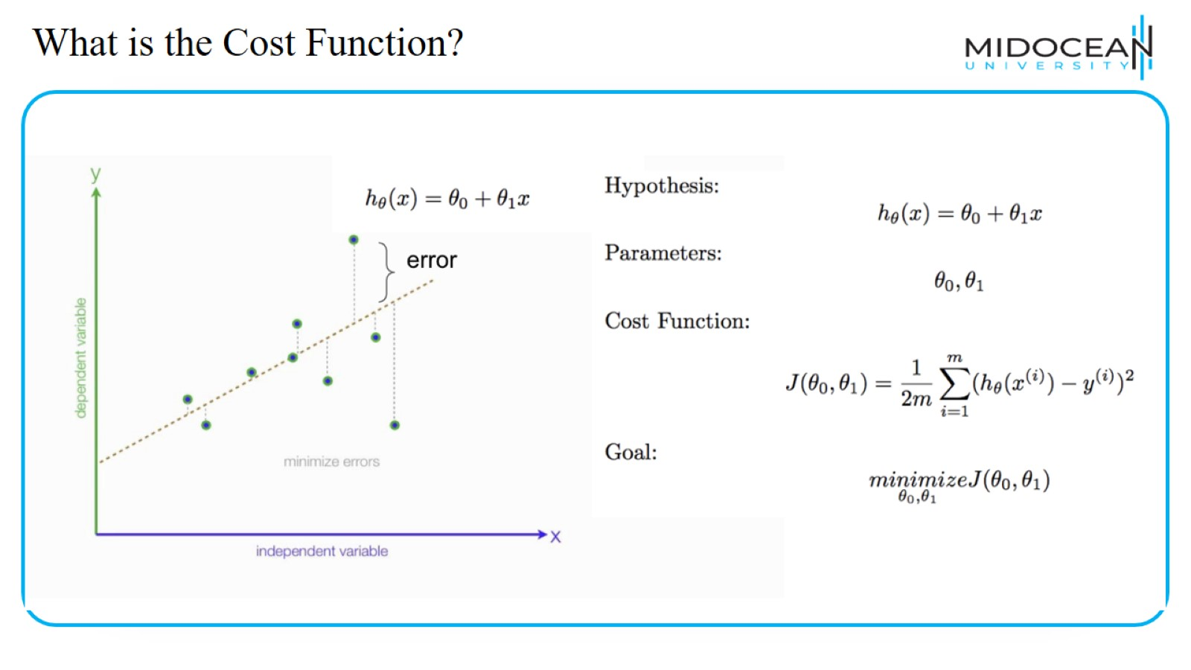
What is the Cost Function?

Slide 17
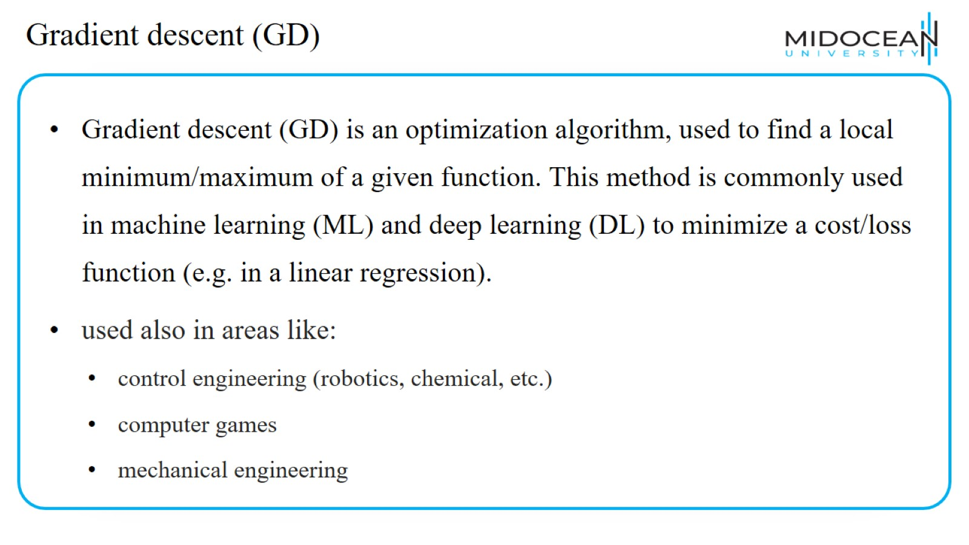
Gradient descent (GD)

Slide 18
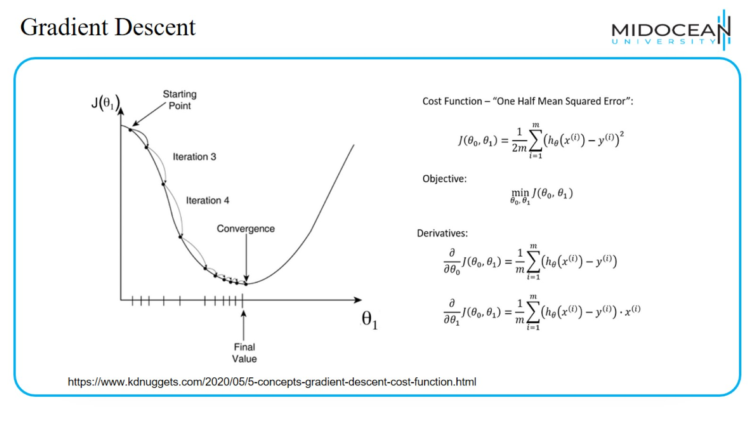
Gradient Descent

Slide 19
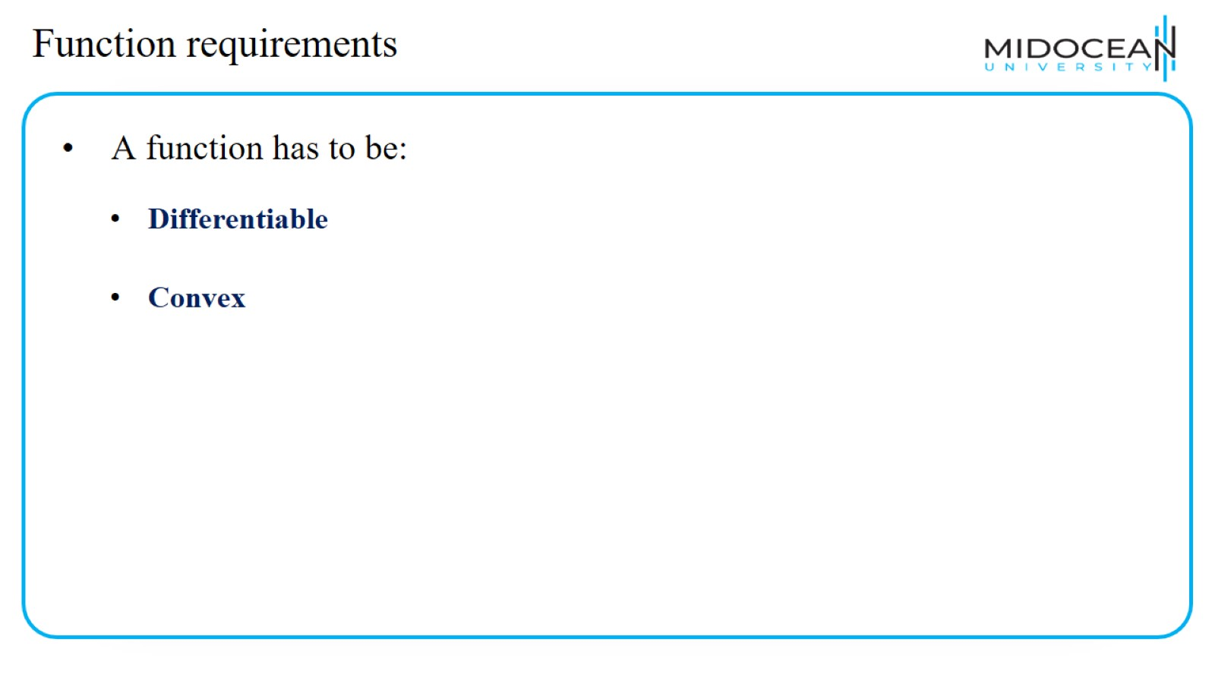
Function requirements

Slide 20
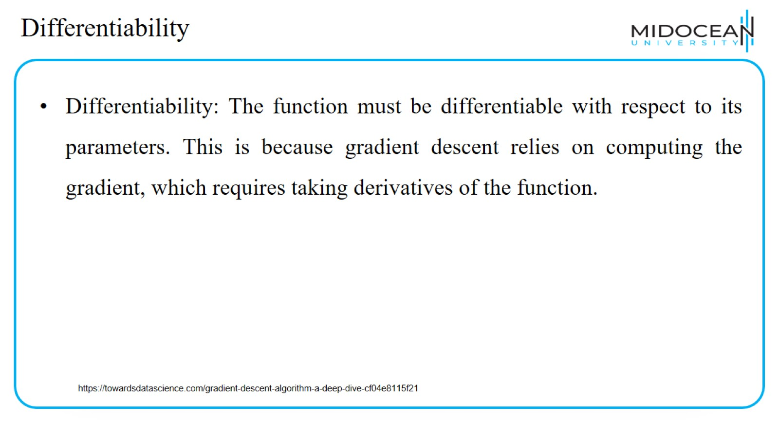
Differentiability

Slide 21
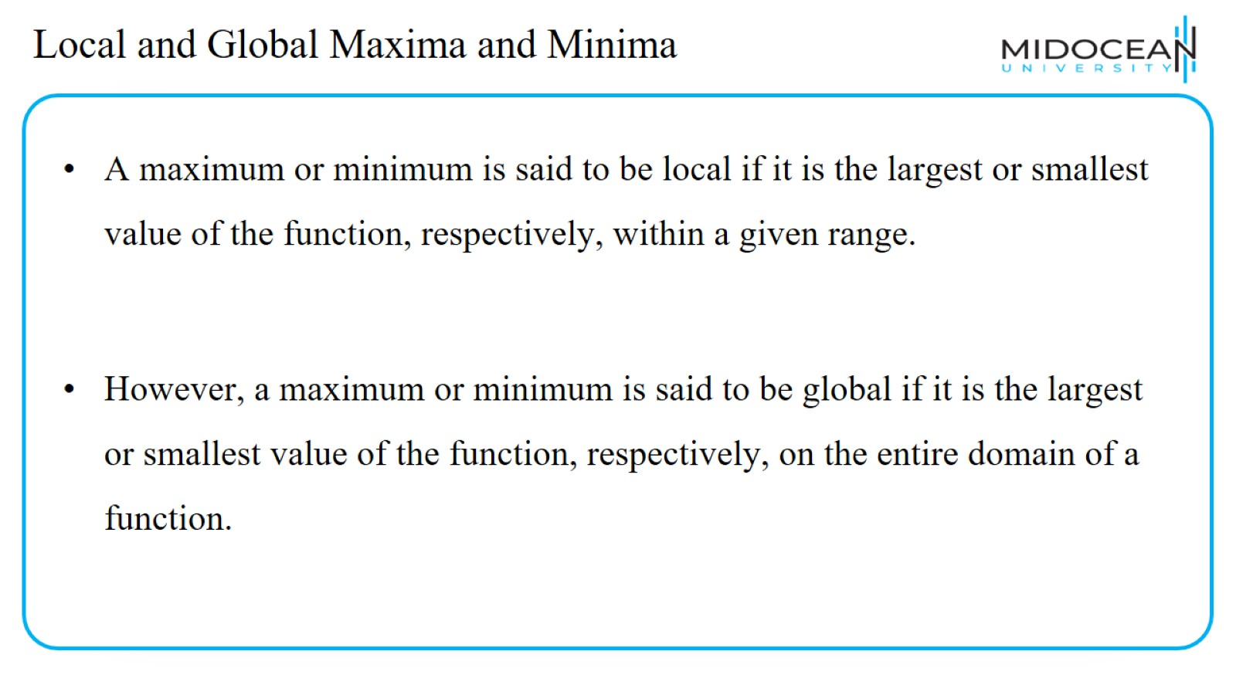
Local and Global Maxima and Minima

Slide 22
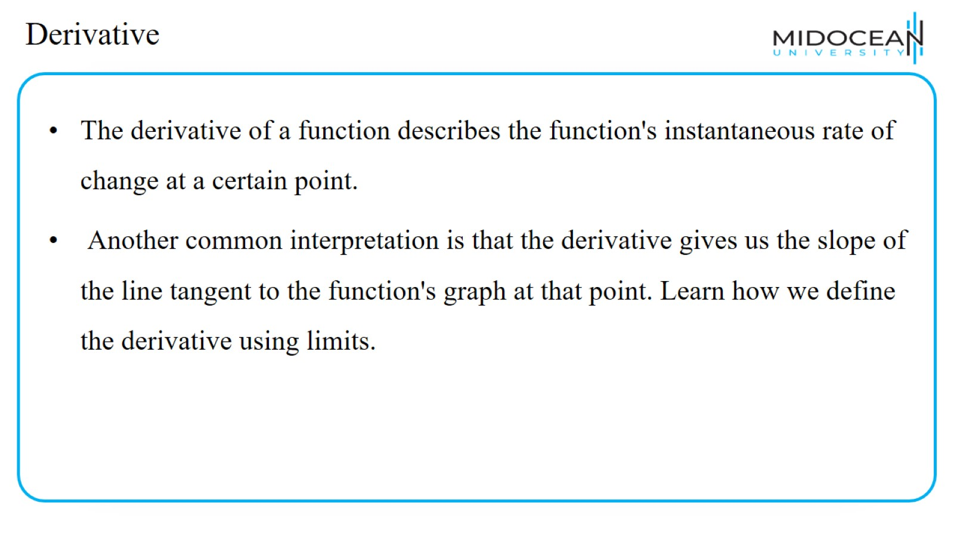
Derivative

Slide 23
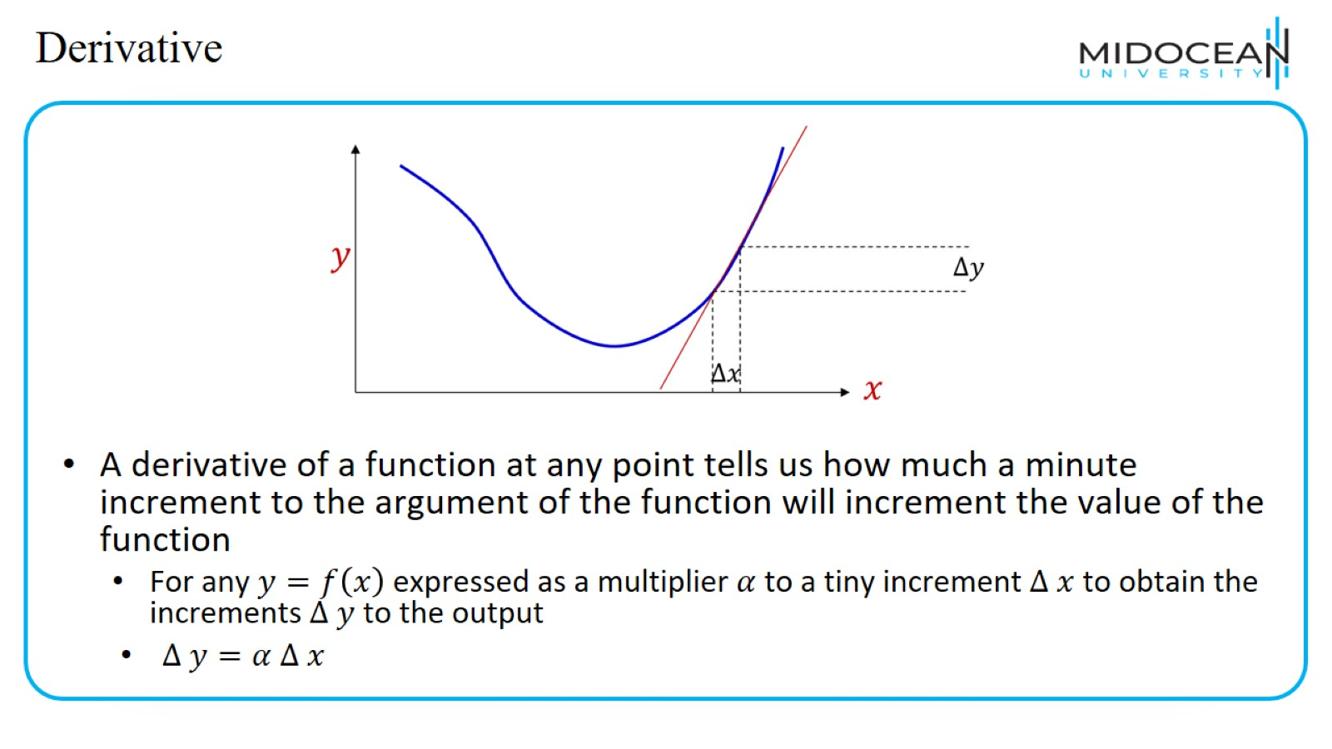
Derivative

Slide 24
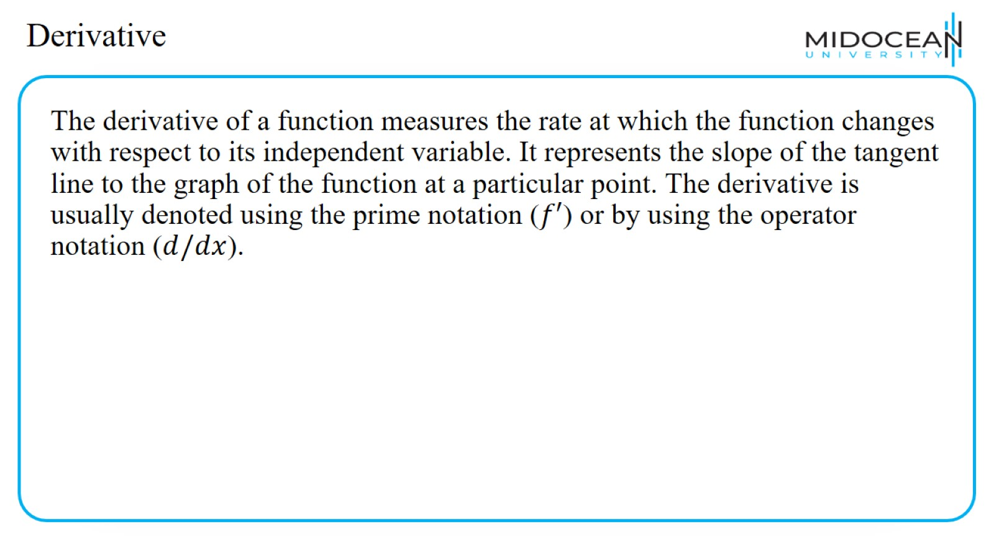
Derivative

Slide 25
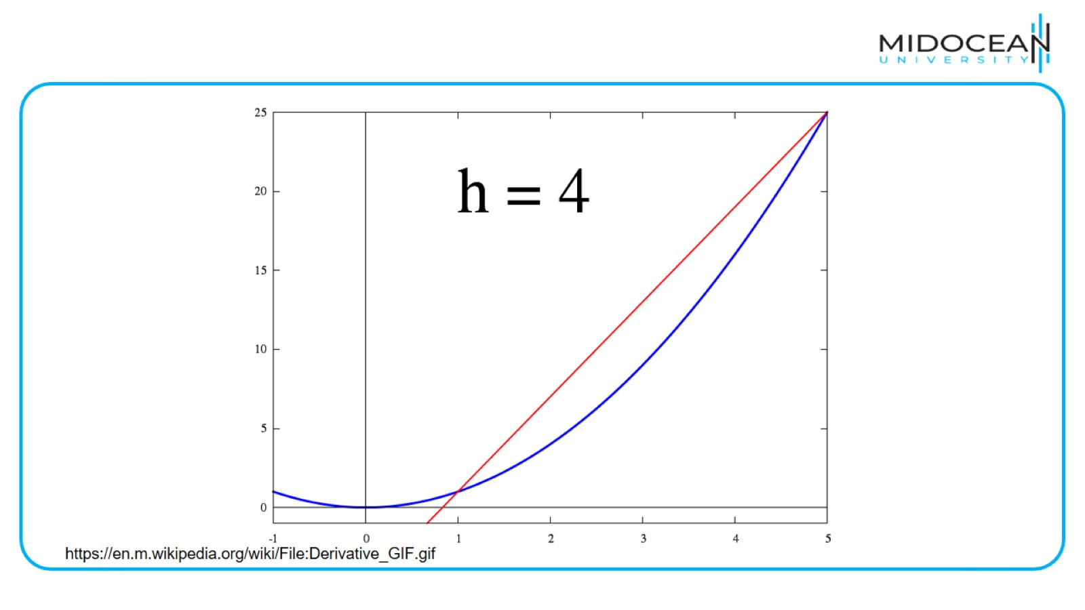

Slide 26
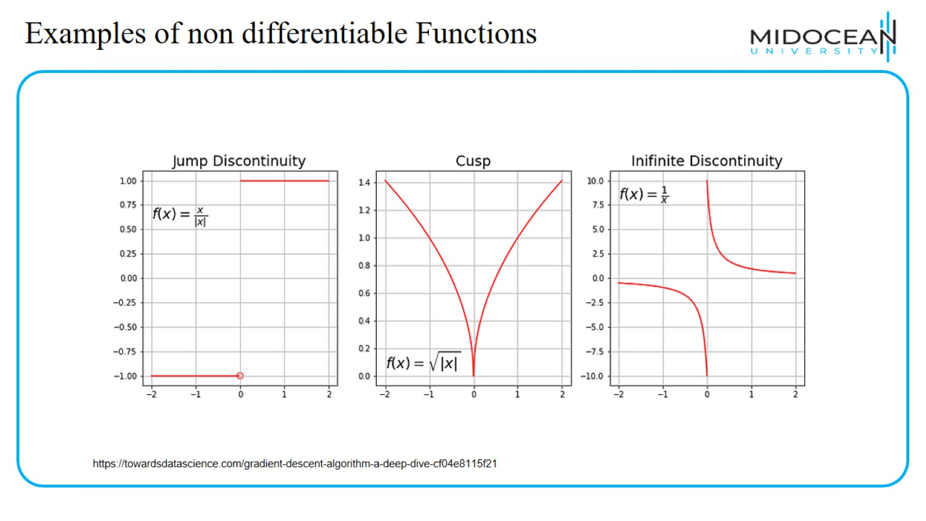
Examples of non differentiable Functions

Slide 27
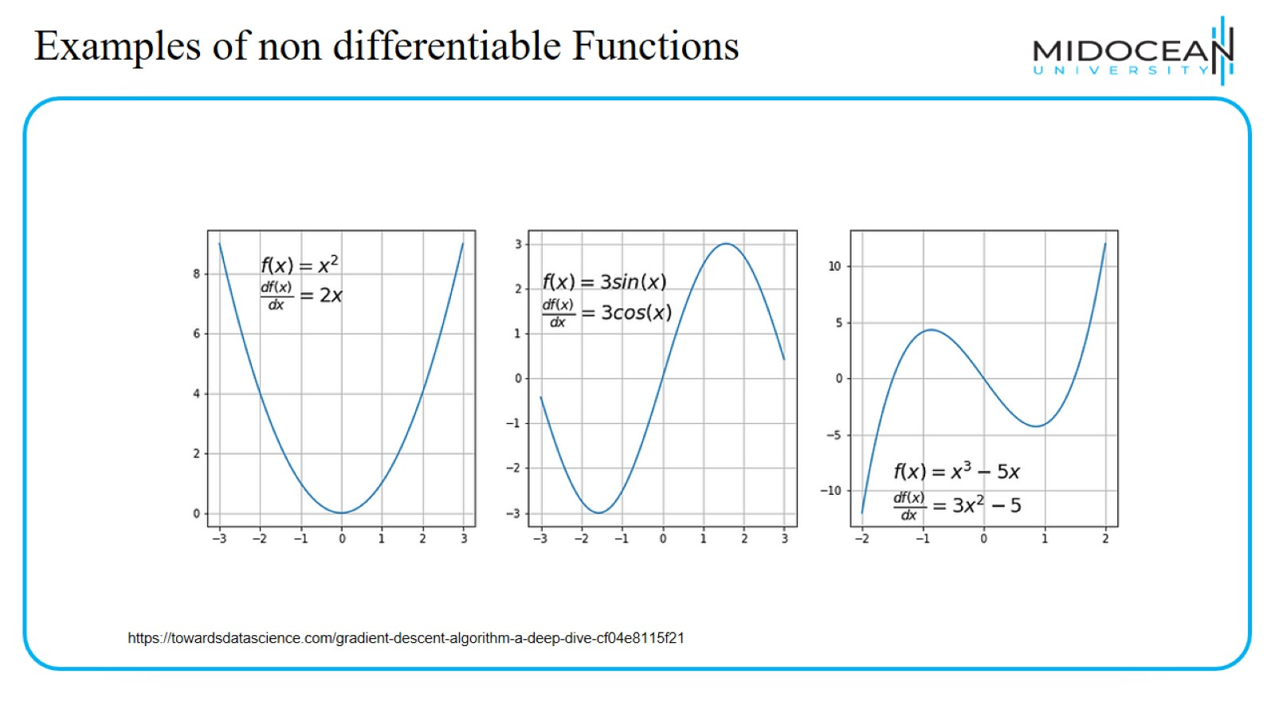
Examples of non differentiable Functions

Slide 28
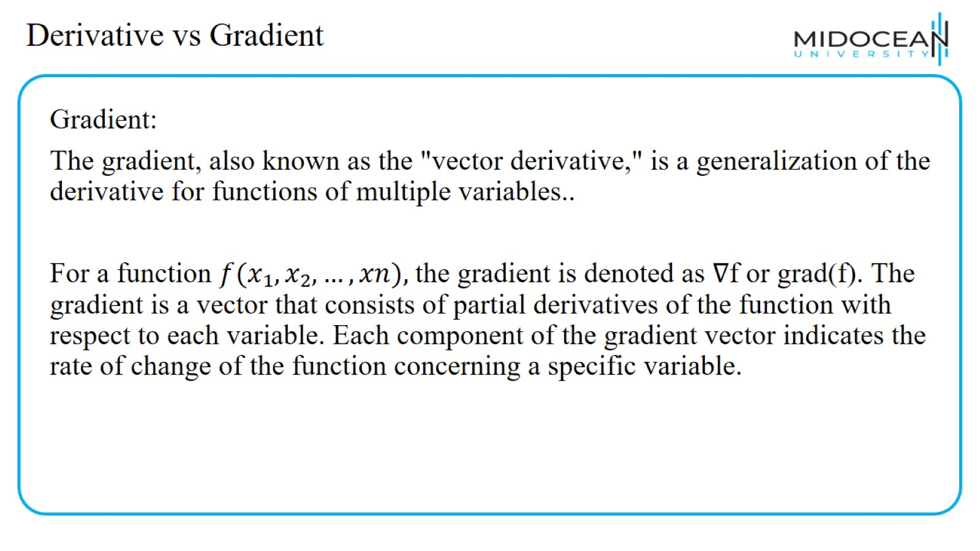
Derivative vs Gradient

Slide 29
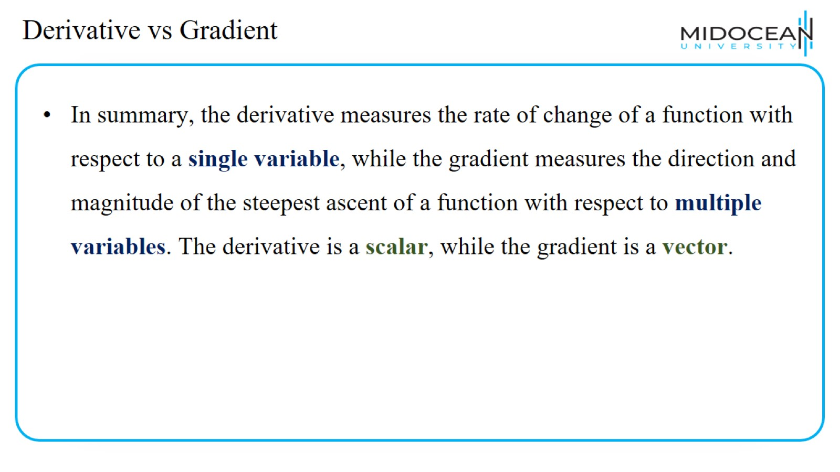
Derivative vs Gradient

Slide 30
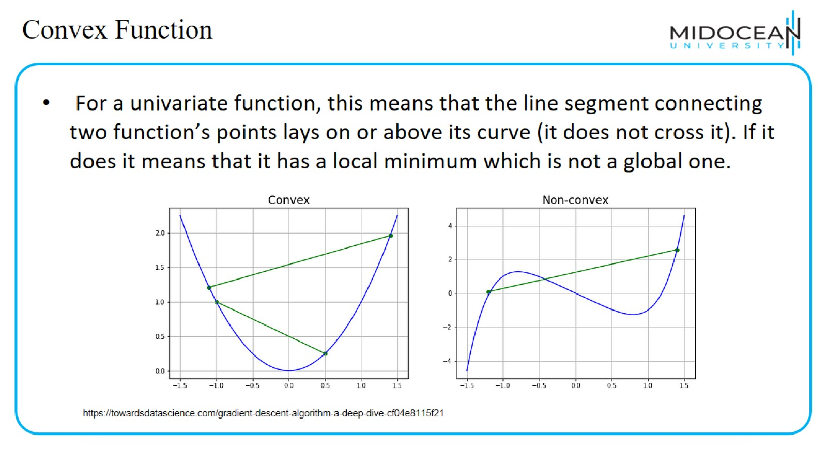
Convex Function

Slide 31
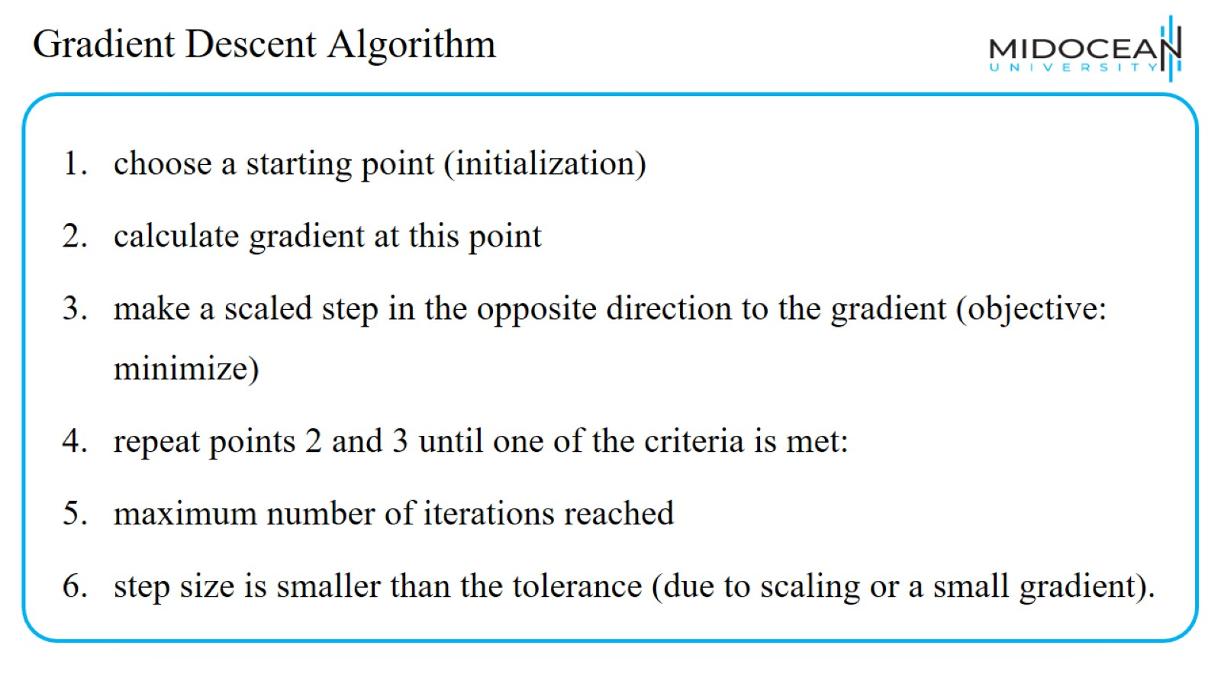
Gradient Descent Algorithm

Slide 32
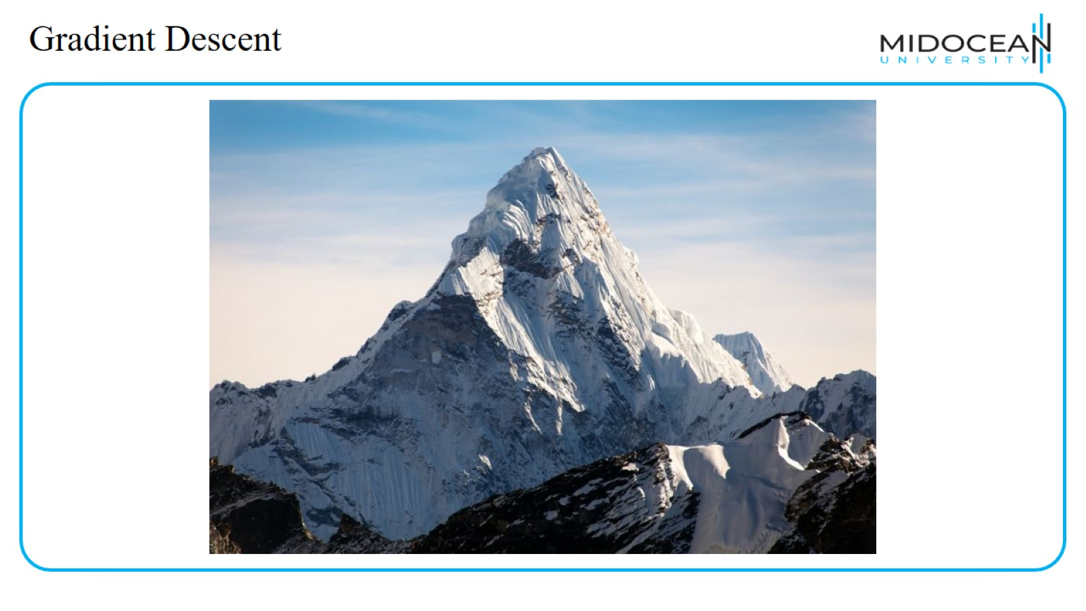
Gradient Descent

Slide 33
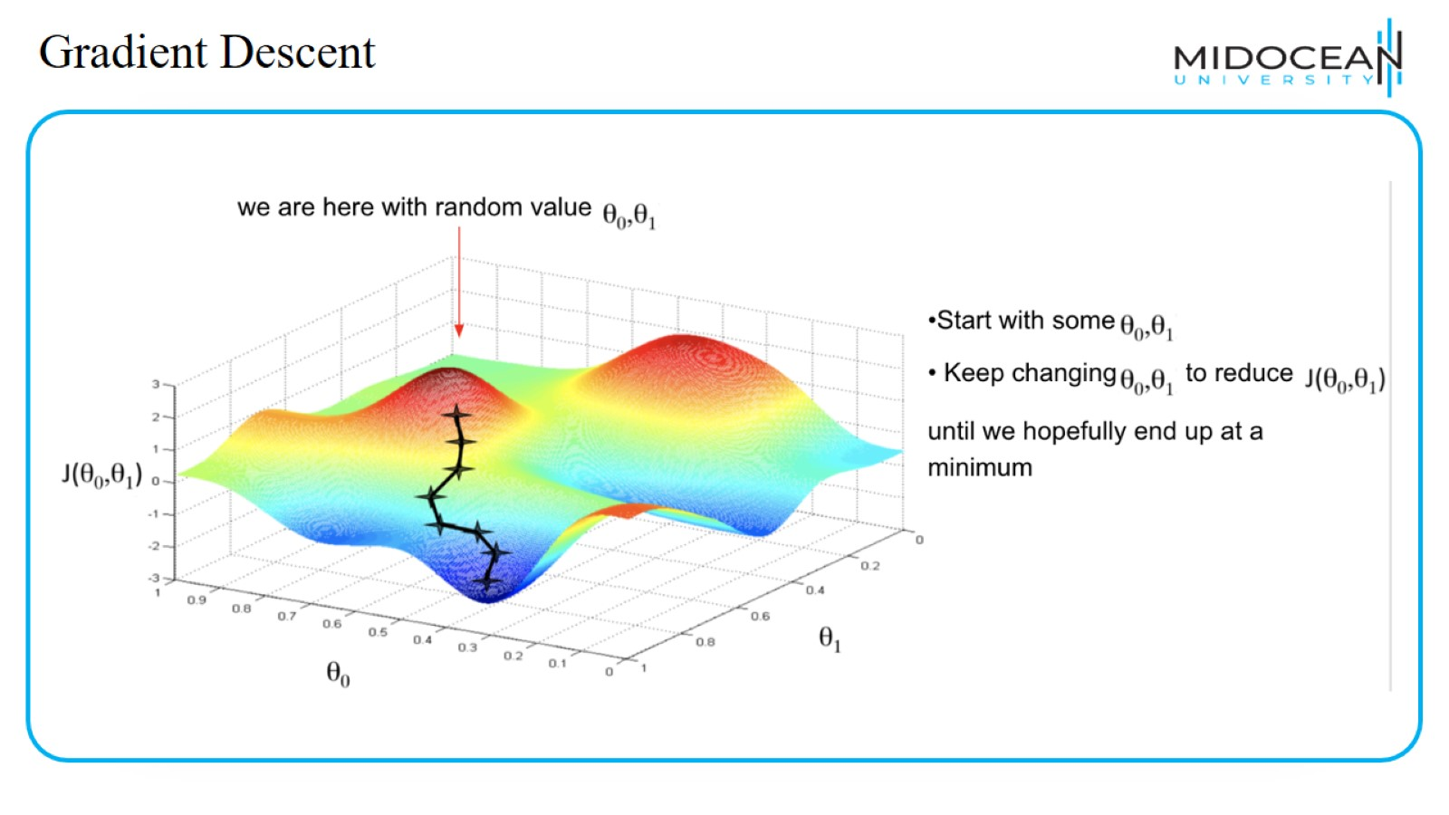
Gradient Descent

Slide 34
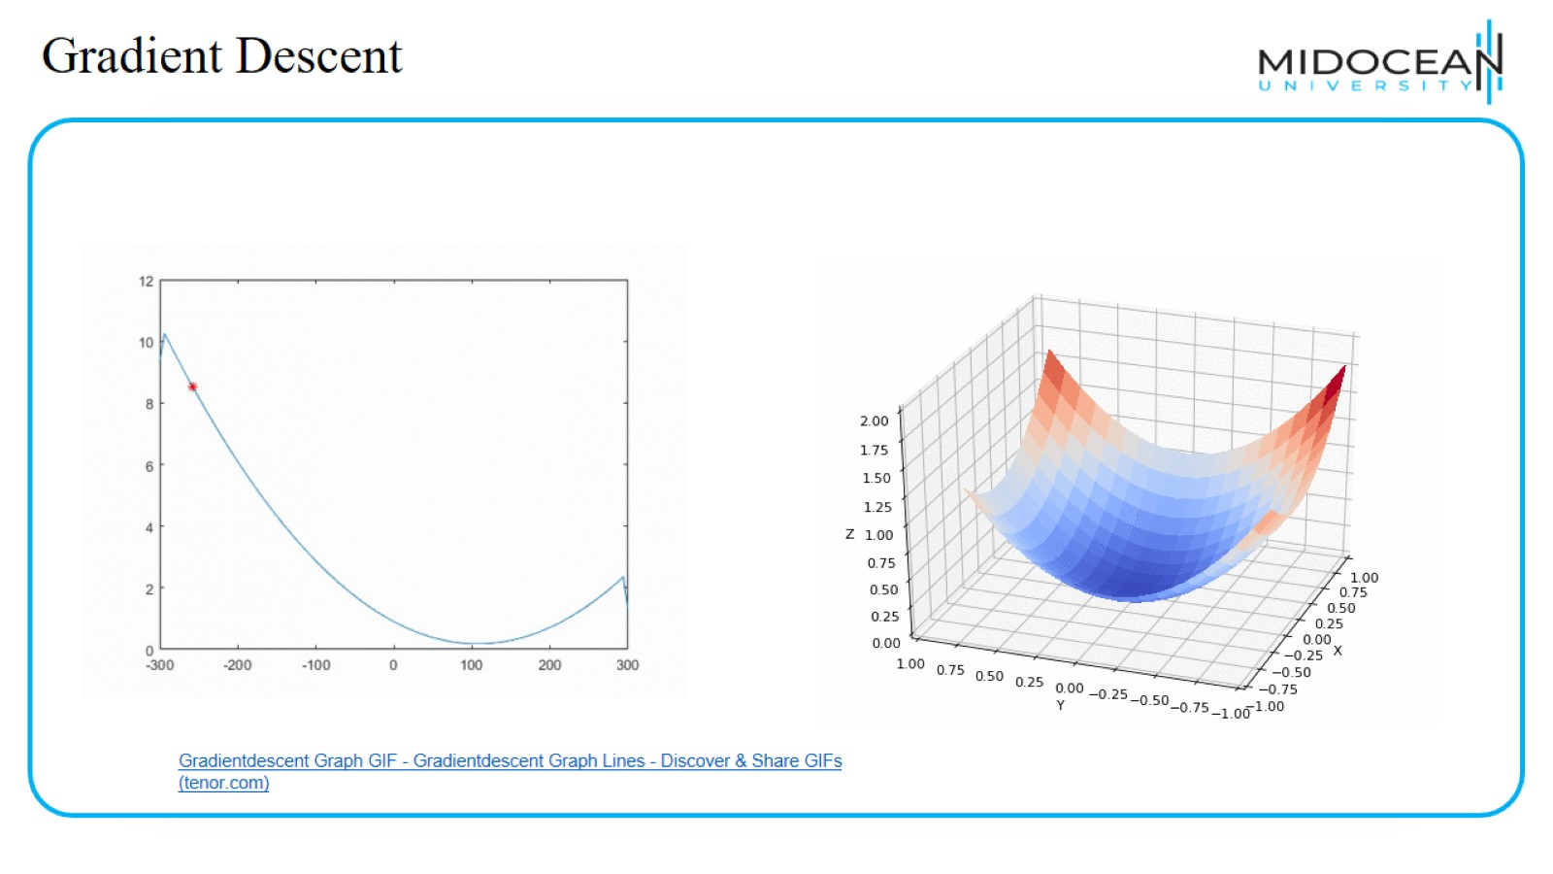
Gradient Descent

Slide 35
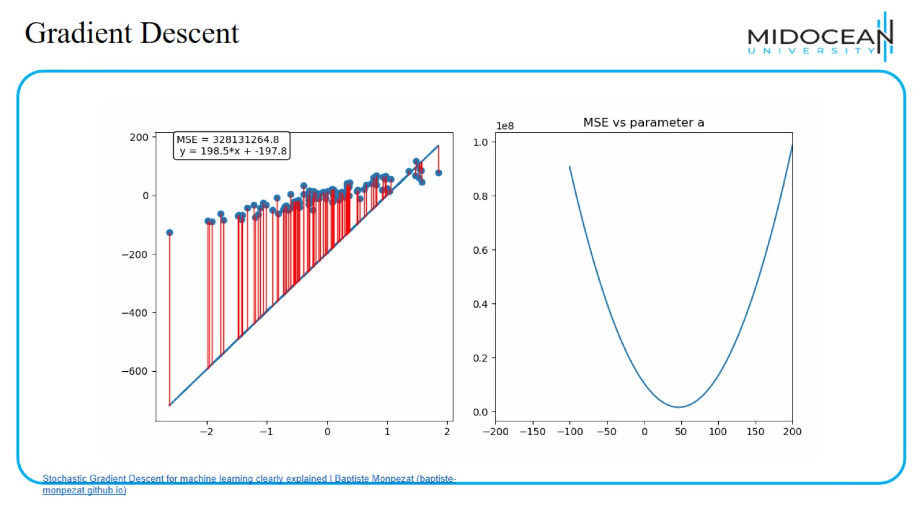
Gradient Descent

Slide 36
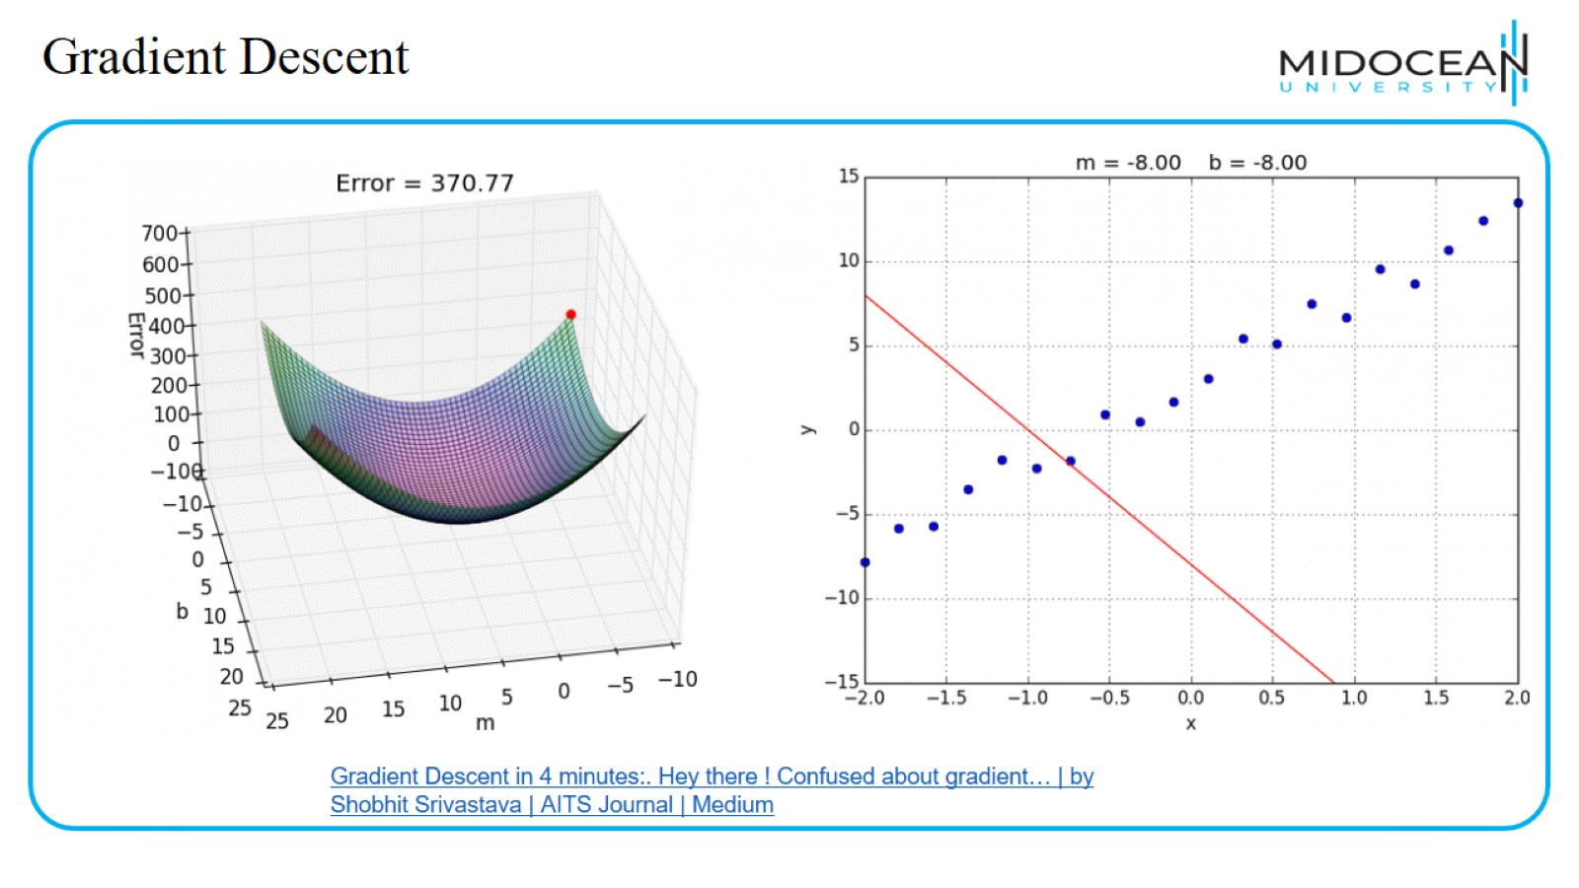
Gradient Descent

Slide 37
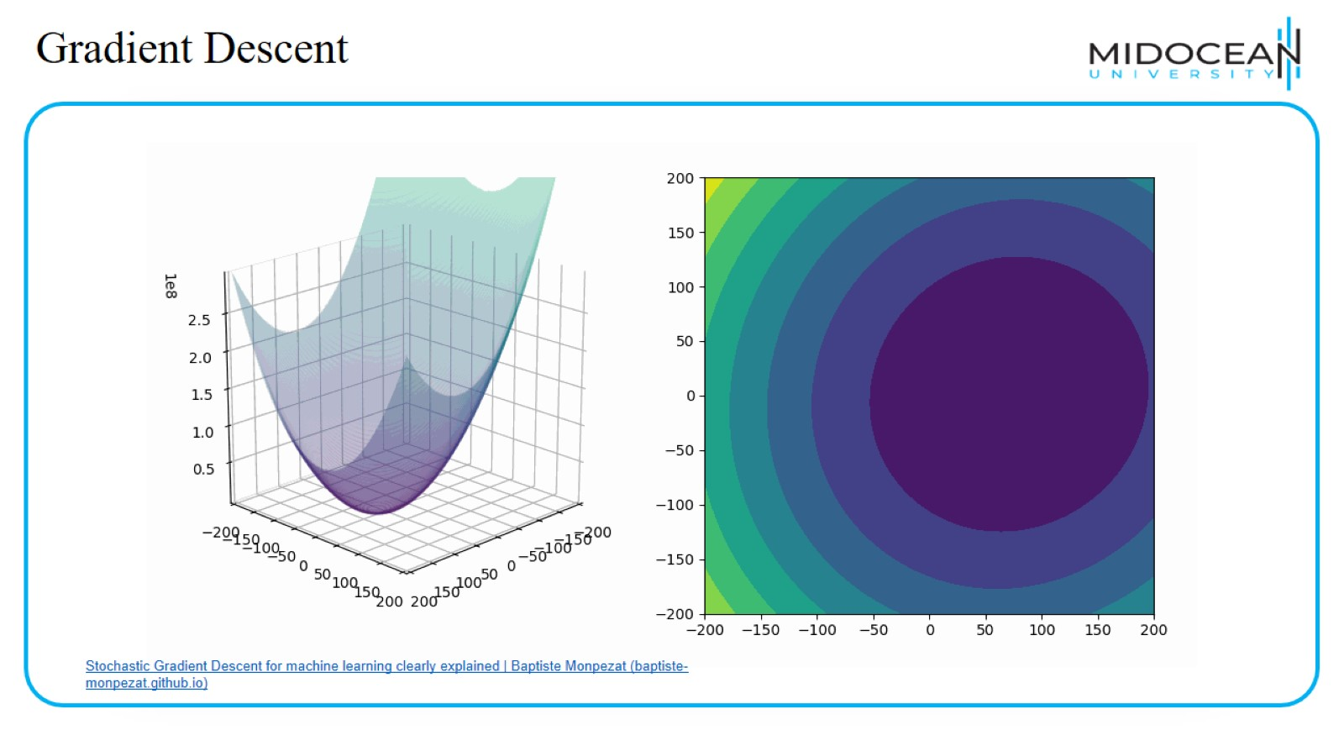
Gradient Descent

Slide 38
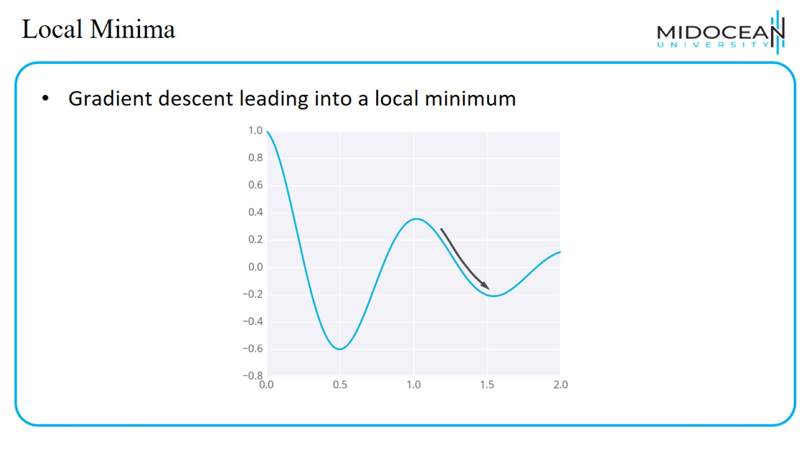
Local Minima

Slide 39
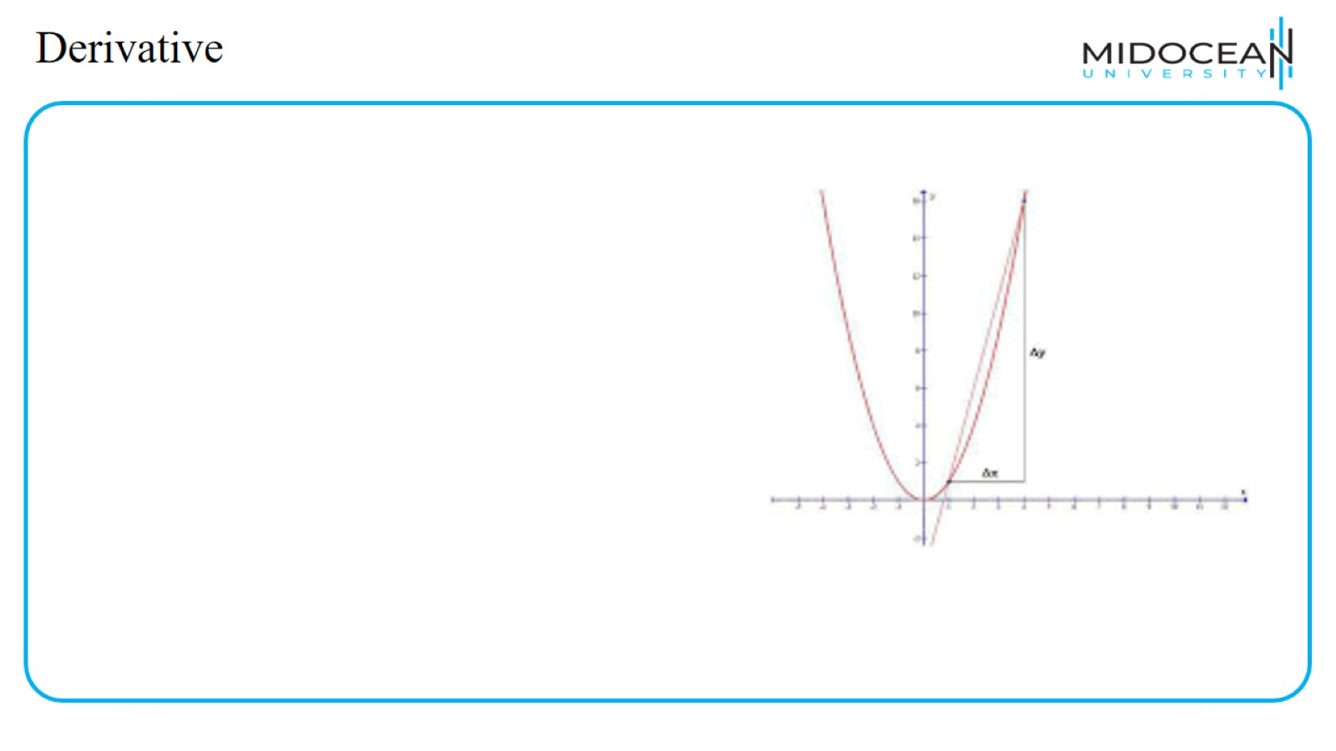
Derivative

Slide 40
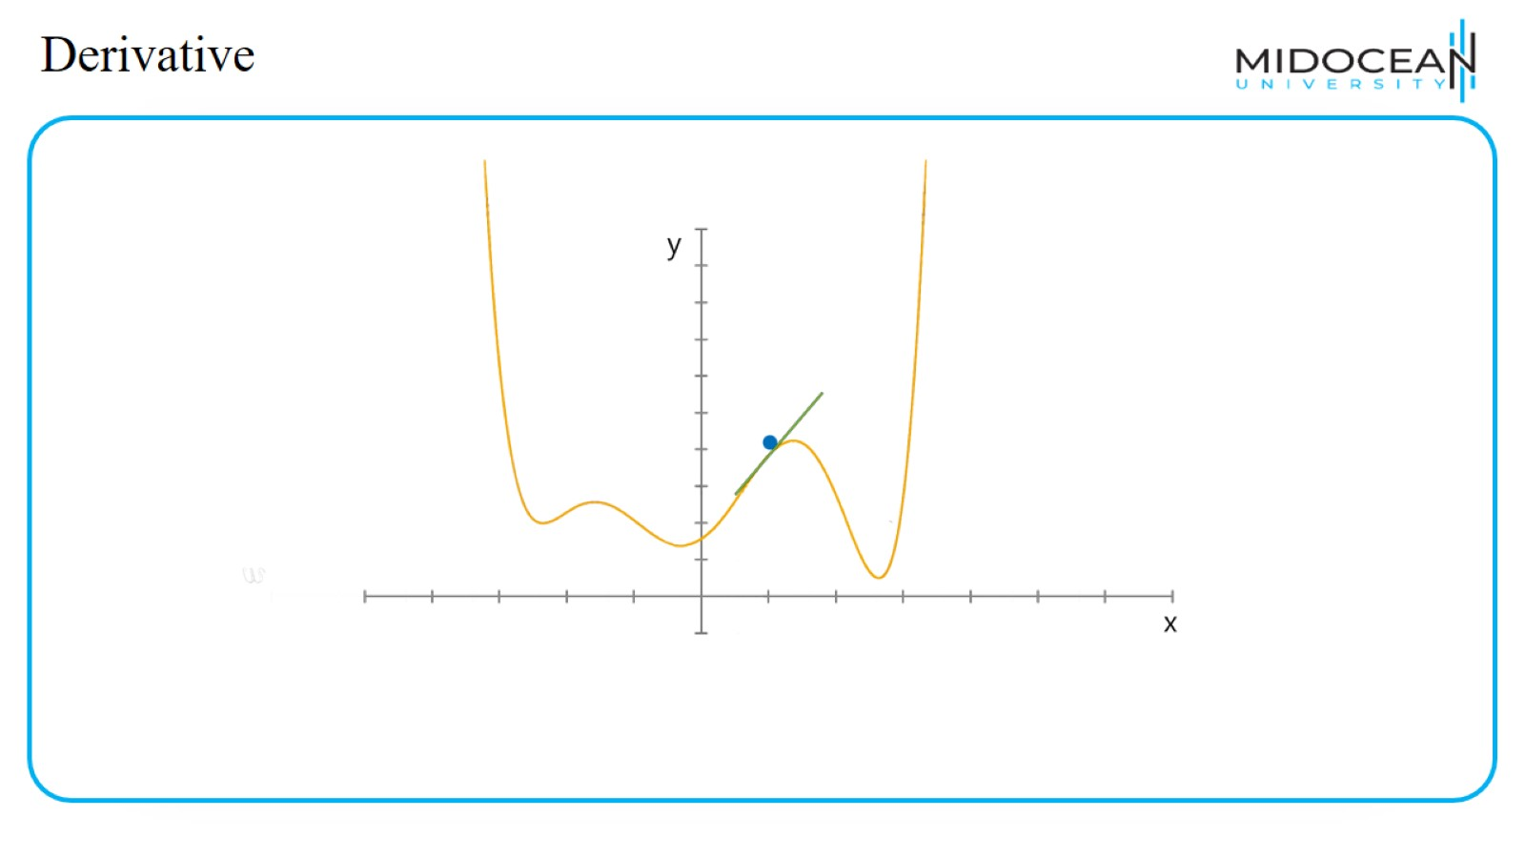
Derivative

Slide 41
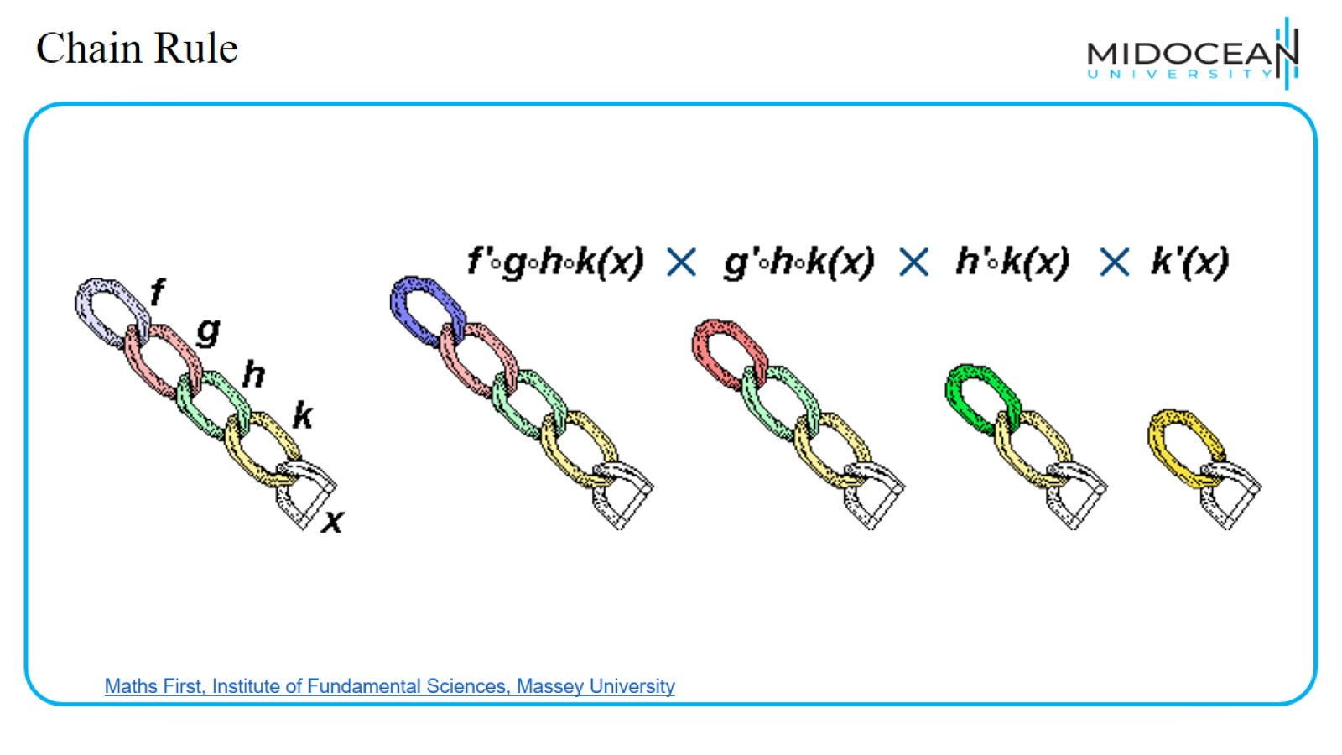
Chain Rule

Slide 42
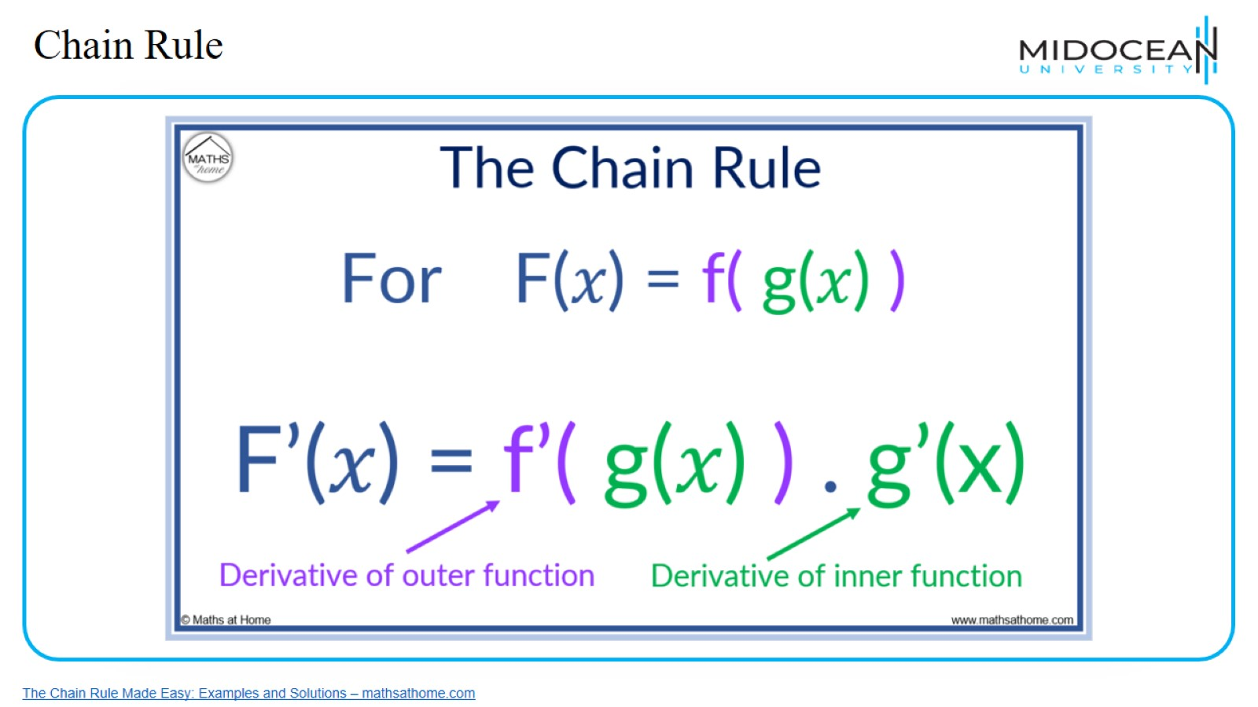
Chain Rule

Slide 43
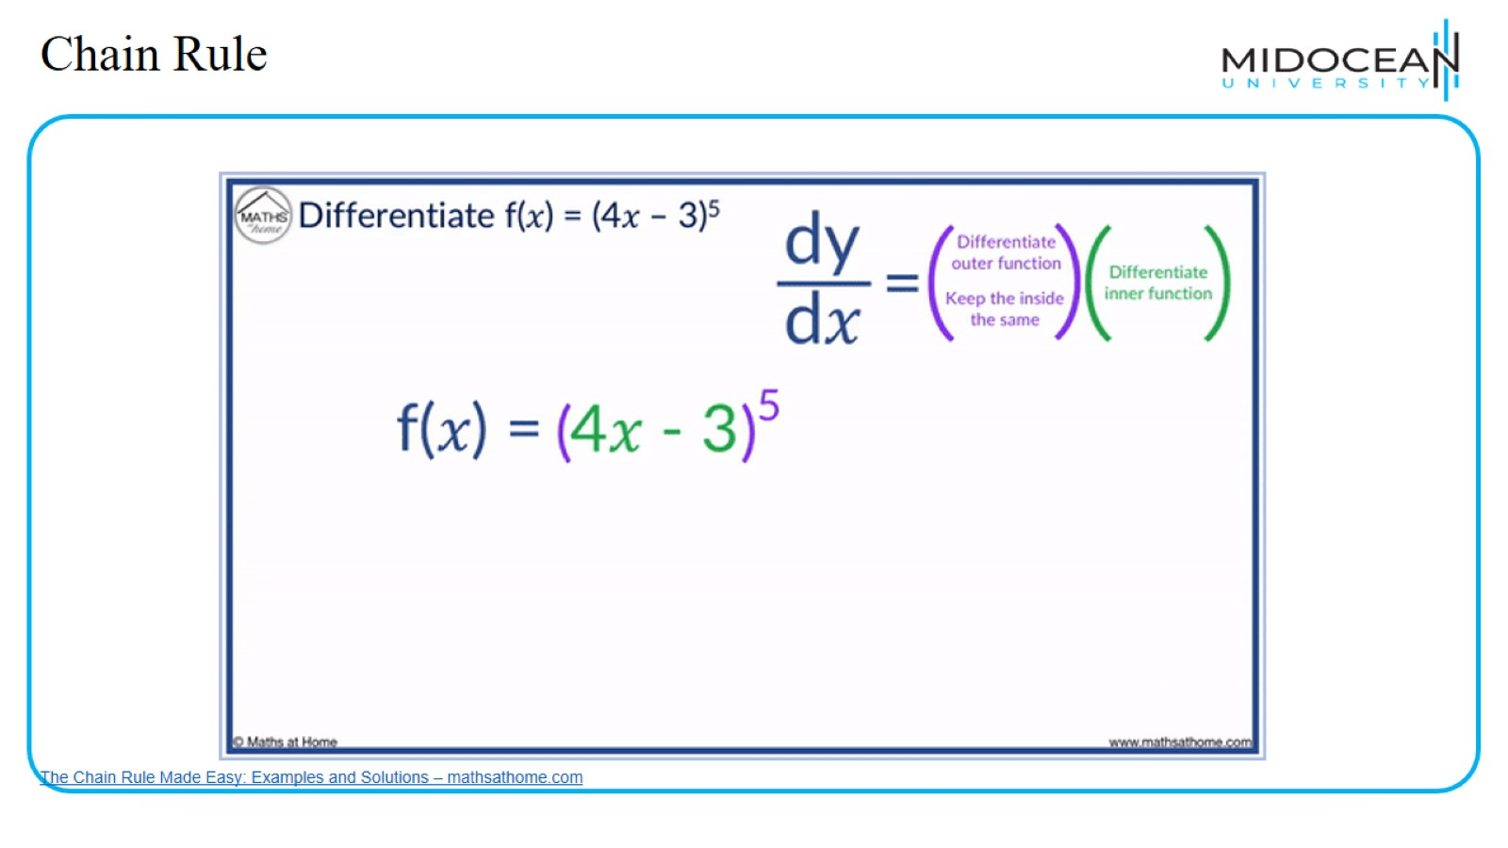
Chain Rule

Slide 44
Gradient Descent Algorithm

Slide 45
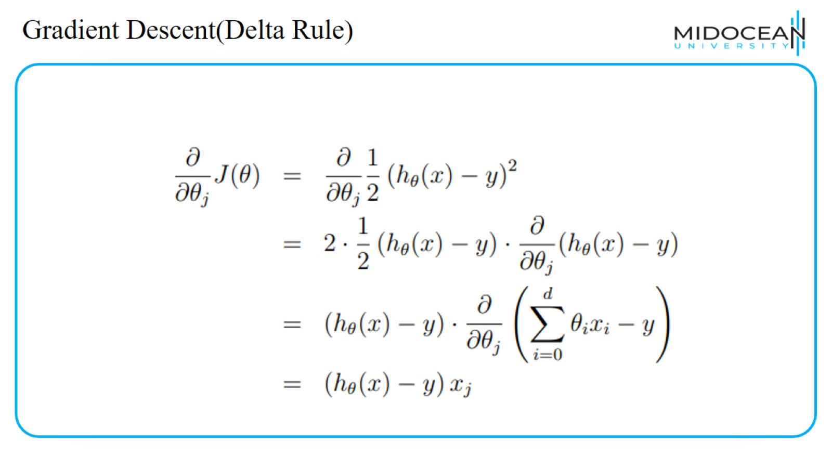
Gradient Descent(Delta Rule)

Slide 46
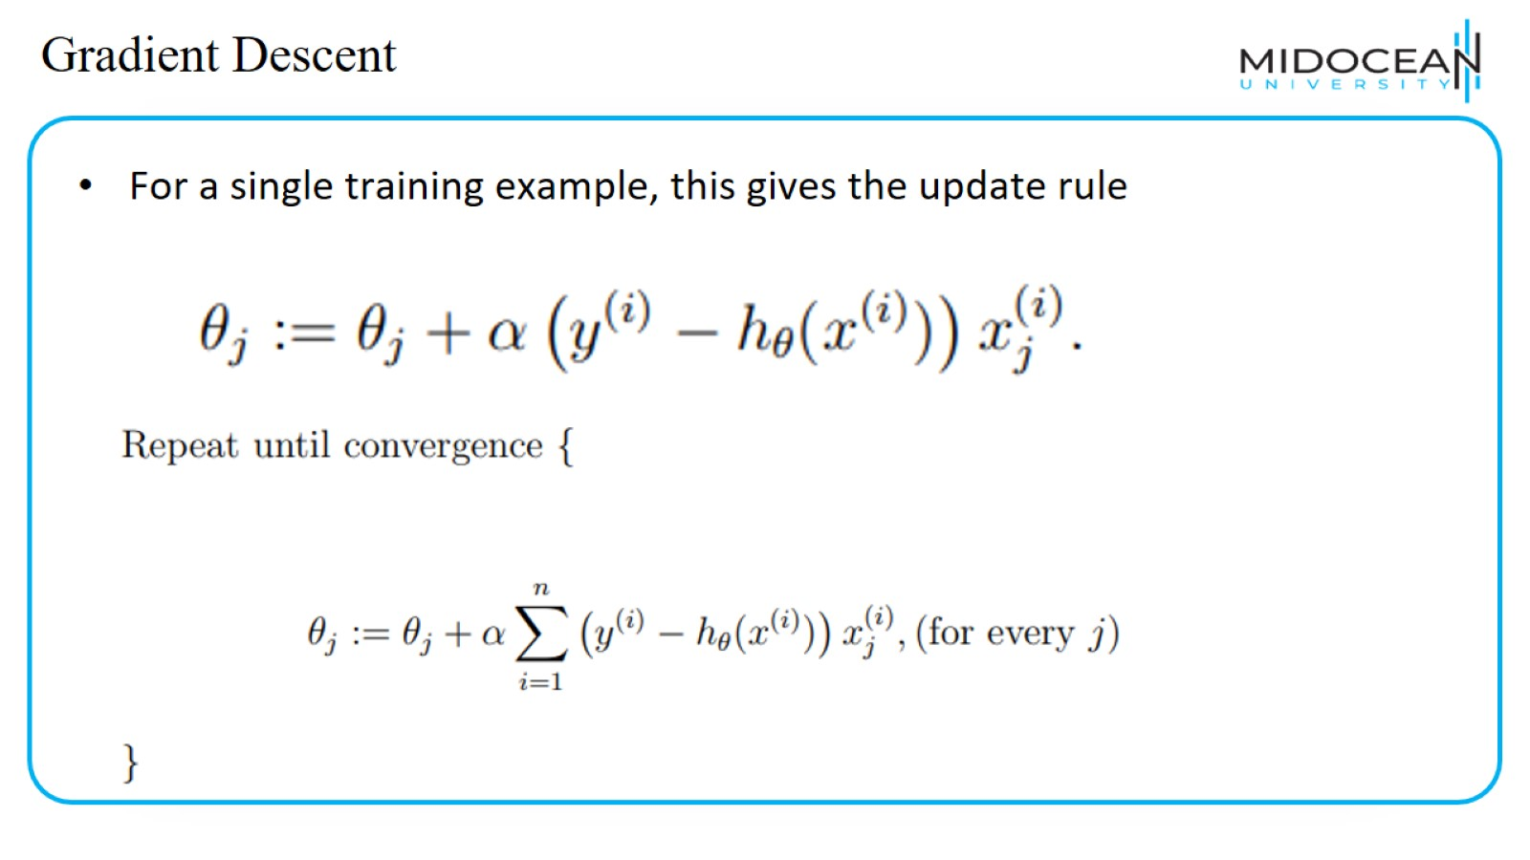
Gradient Descent

Slide 47
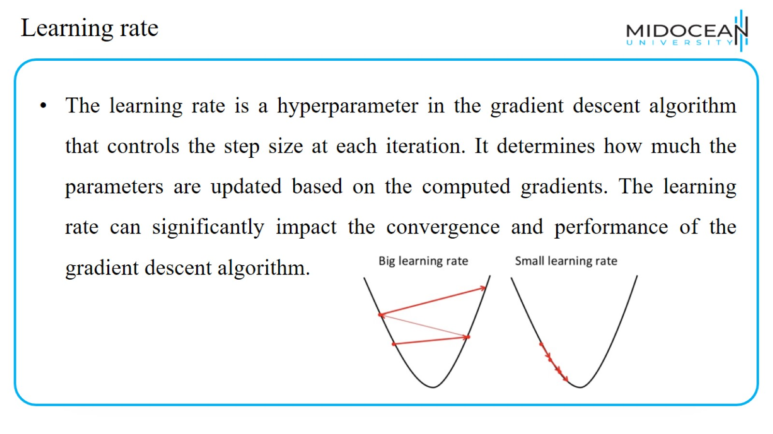
Learning rate

Slide 48
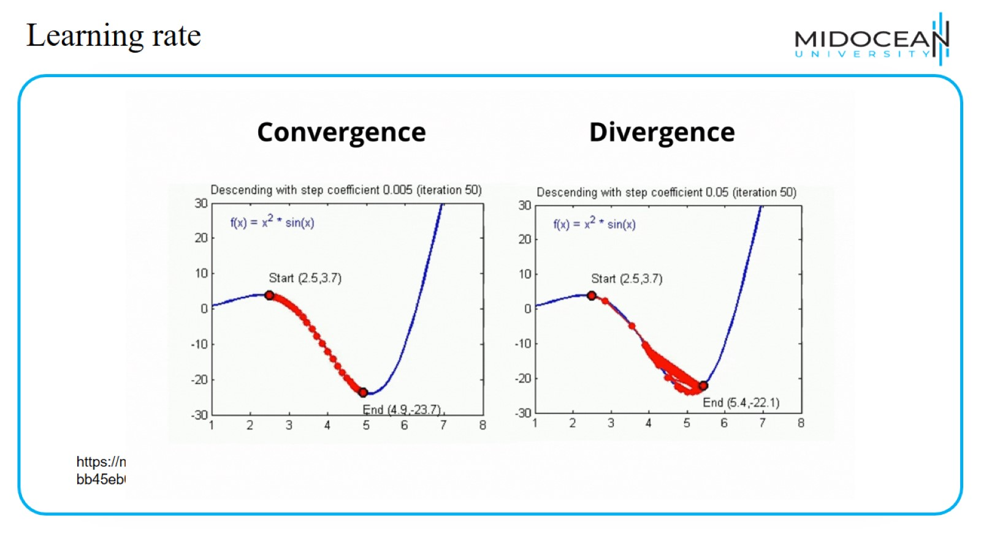
Learning rate

Slide 49
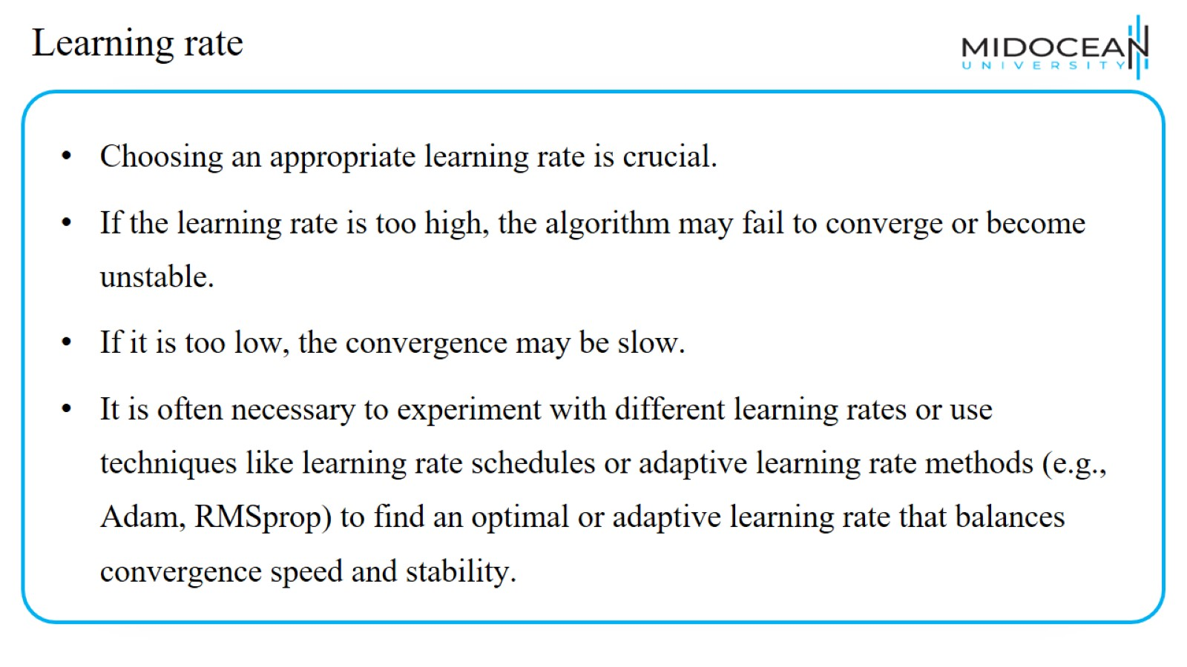
Learning rate

Slide 50
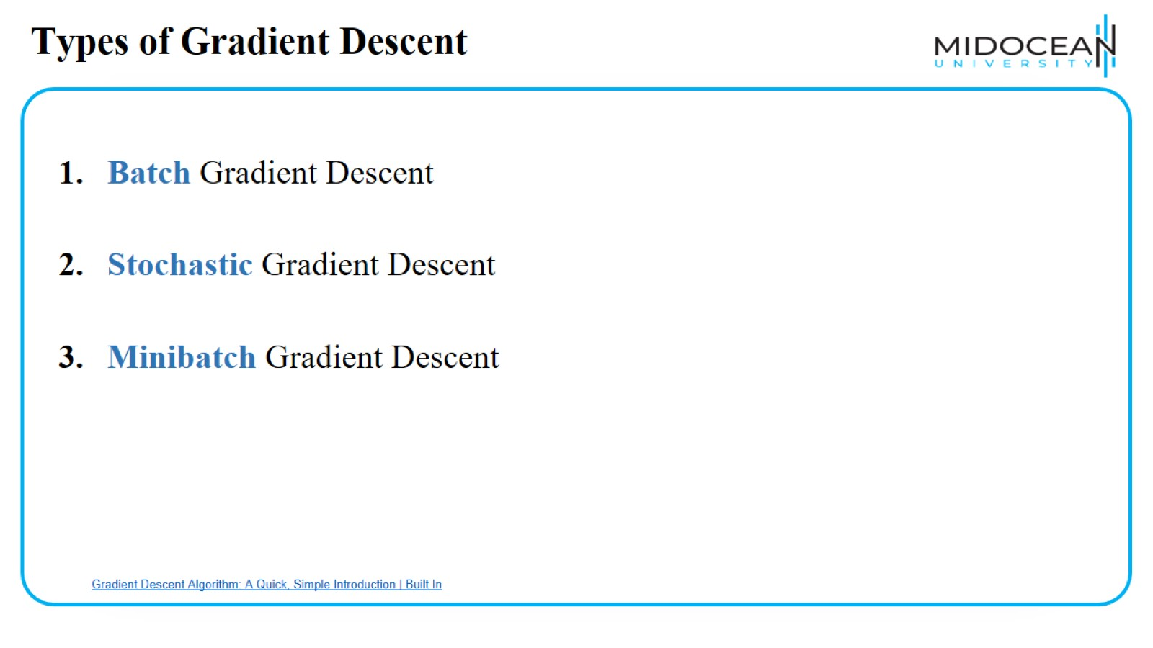
Types of Gradient Descent

Slide 51
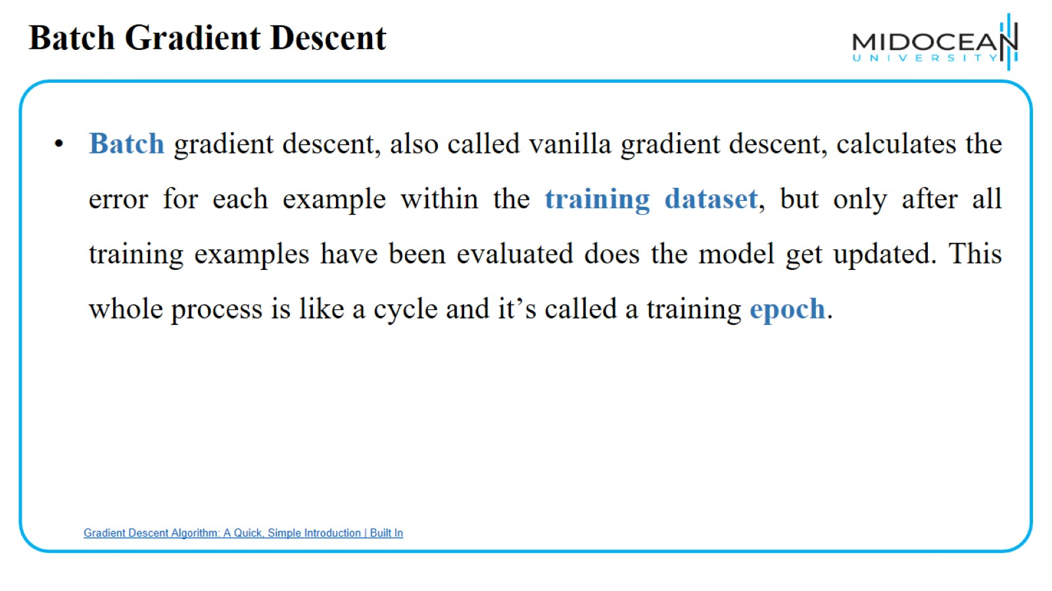
Batch Gradient Descent

Slide 52
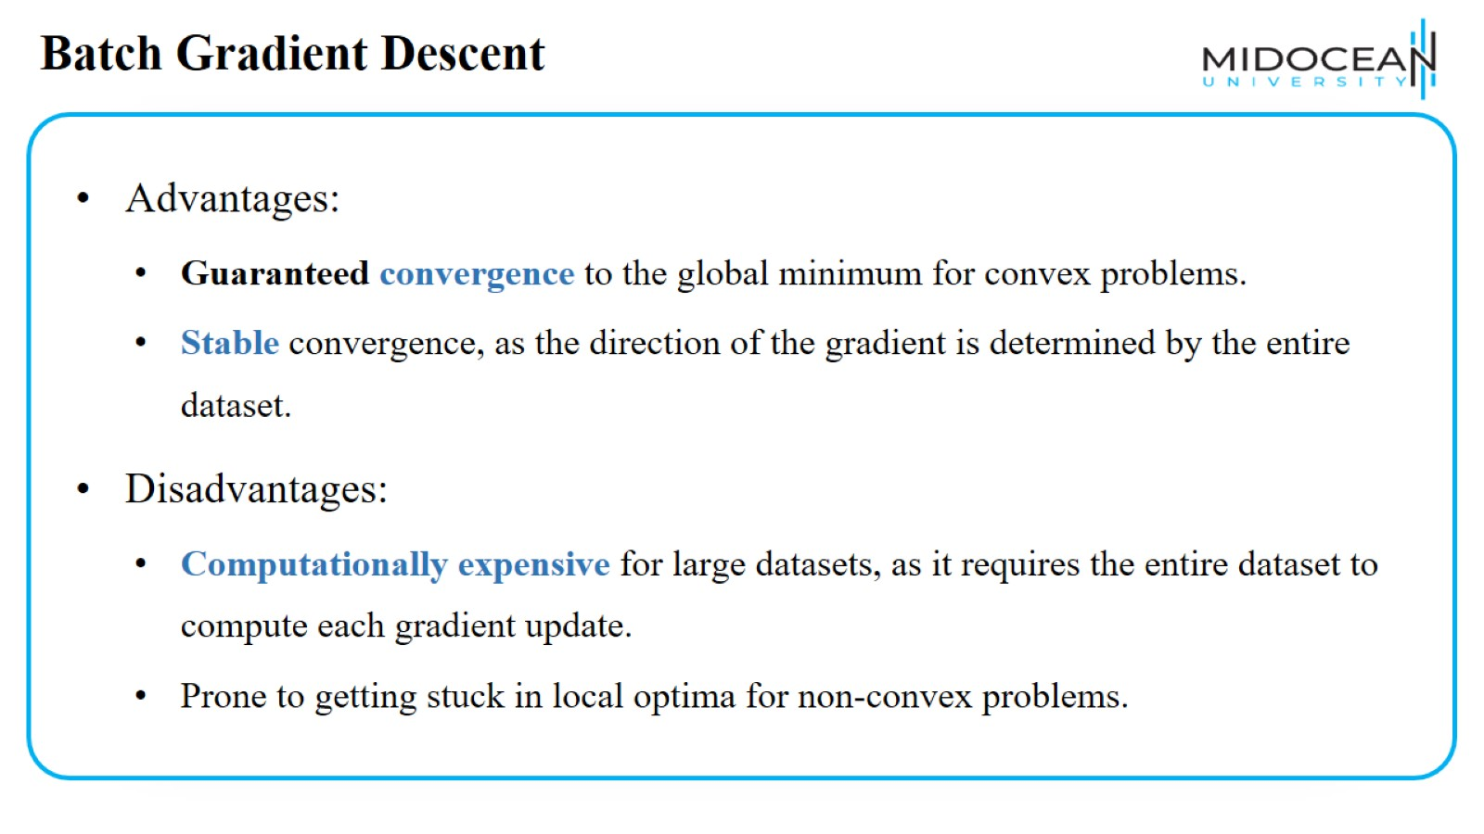
Batch Gradient Descent

Slide 53
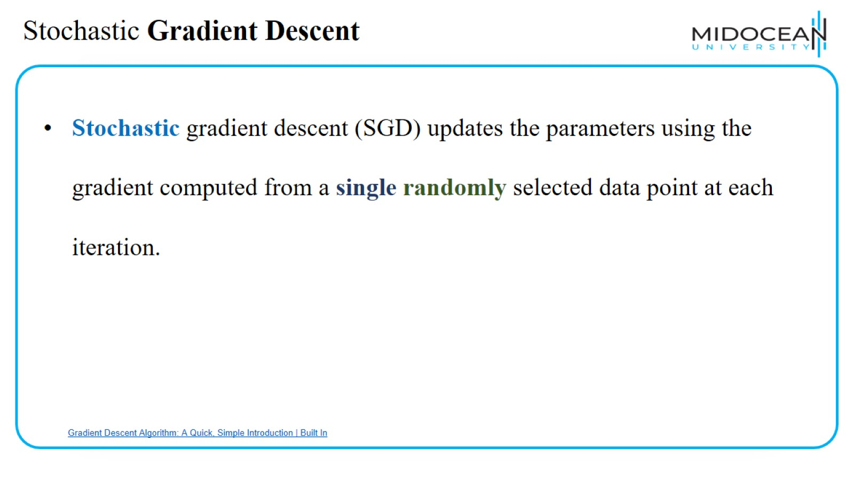
Stochastic Gradient Descent

Slide 54

Stochastic Gradient Descent

Slide 55

Mini batch Gradient Descent

Slide 56

Mini batch Gradient Descent

Slide 57

Types of Gradient Descent

Slide 58

Types of Gradient Descent

Slide 59

Types of gradient Descent

Slide 60

Scalar function of scalar argument

Slide 61

Why?

Slide 62

Numerical Example

Slide 63

Numerical Example

Slide 64

Numerical Example

Slide 65

Numerical Example

Slide 66

Numerical Example

Slide 67

When GD Stop?

Slide 68


Slide 69


