Slide 1


Human Resources Management
Robert L. Mathis ⏐ John H. Jackson
Prepared by Dr. Samah Abdelfatah
MGM 243
Lecture 06

Slide 2



Part3:Developing HRM
Training Human Resources
Chapter
09
Lecture 06
MGM 243
Prepared by
Dr. Samah Abdelfatah

Slide 3

Chapter
Learning Outcomes
09
After you have read this chapter, you should be able to:
Define training and discuss why a strategic approach is important.
Discuss the four phases of the training process.
Identify three types of analyses used to determine training needs.
Explain different means of internal and external training delivery.
Describe the importance of e-learning as part of current training efforts.
Give an example for each of the four levels of training evaluation.

Slide 4


Chapter
Nature of Training
09
Organizational usage of training may include:
Training is the process whereby people acquire capabilities to perform jobs.
Training provides employees with specific, identifiable knowledge and skills for use in their present jobs.
"Hard" Skills
Teaching sales representatives how to use CRM and intranet resources
"Soft" Skills
Communicating, mentoring, Now includes Emotional Intelligence (EQ), Psychological Safety, Virtual Collaboration, and Resilience

Slide 5
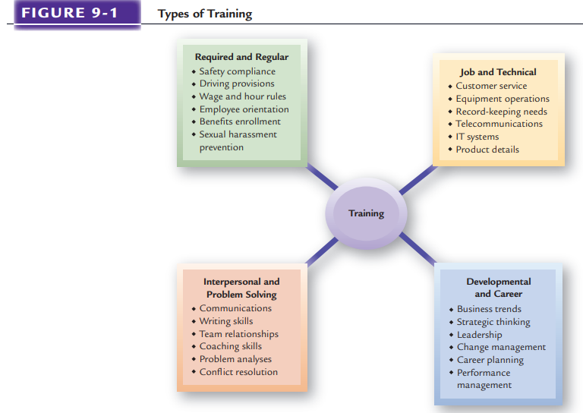
Training Categories
Figure 9-1

Slide 6



Chapter
Strategic Training
09
Strategic Role
The Tactical Trap
Enables HR/training professionals to partner with operating managers and contribute to organizational results.
Training is too often viewed tactically rather than strategically—seen as a short-term activity rather than one with long-term effects on organizational success.
Current Trends
Strategic Alignment
Modern Approach
Training linked to long-term organizational goals
Upskilling & Reskilling
Training must be experiential and immersive, moving beyond traditional classroom lectures to real-world application.
Budgets increased significantly post-pandemic

Slide 7






Chapter
Strategic Training Cont.
09
Contemporary Example
Customer service trainees use Virtual Reality (VR) Simulations to experience real-world scenarios
Hotel Check-in
Handling Complaints
Emotional Triggers
Real-time Feedback

Slide 8





Chapter
09
Organizational Competitiveness and Training
Knowledge Management
Training as Revenue Source
The process of capturing, organizing, sharing, and using knowledge within an organization to improve performance and decision-making.
Refers to the practice of generating income by offering training programs, certifications, courses, or learning subscriptions to external individuals and organizations.
Social Learning Platforms
Microsoft Viva, Slack
Certification Programs
Microsoft, Cisco, Hewlett-Packard
AI-Powered Repositories
Intelligent knowledge curation
Learning Subscriptions
Standalone revenue streams
Goal: Get the right knowledge to the right people at the right time
Shift: From cost center to profit center via productized learning

Slide 9
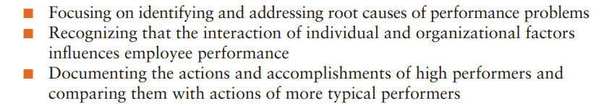
Performance Consulting and Strategic Training
Performance consulting Process in which a trainer and the organizational client work together to determine what needs to be done to improve organizational and individual results.
Performance consulting takes a broad approach by:

Slide 10
Performance Consulting and Strategic Training
Integration of Performance and Training
Organizations are seeking more authentic (and hence more effective) training experiences for their employees by using real business problems to advance employee learning.
Chief Learning Officers
some organizations have created a position entitled chief learning officer (CLO) or chief knowledge officer (CKO). The CLO is a leader who designs knowledge through training for individual employees and the organization.

Slide 11
Chapter
Training and Global Strategies
09
For global firms the most brilliant strategies ever devised will not work unless they have well-trained employees throughout the world to carry them out.
Global Assignment Training: The orientation and training that expatriates and their families receive before departure significantly affect the success of an overseas assignment.
Intercultural Competence Training: Intercultural competence incorporates a wide range of human social skills and personality characteristics. As noted in Figure 9-3.

Slide 12
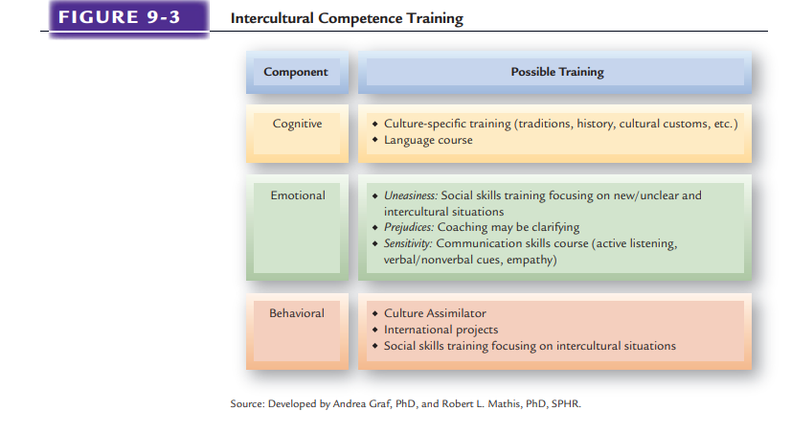
Intercultural Competence Training
Figure 9-2

Slide 13

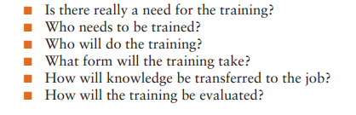
Chapter
Training Components
09
Training plans allow organizations to identify what is needed for employee performance before training begins. It is at this stage that fit with strategic issues is ensured.
Effective training efforts consider the following questions:

Slide 14
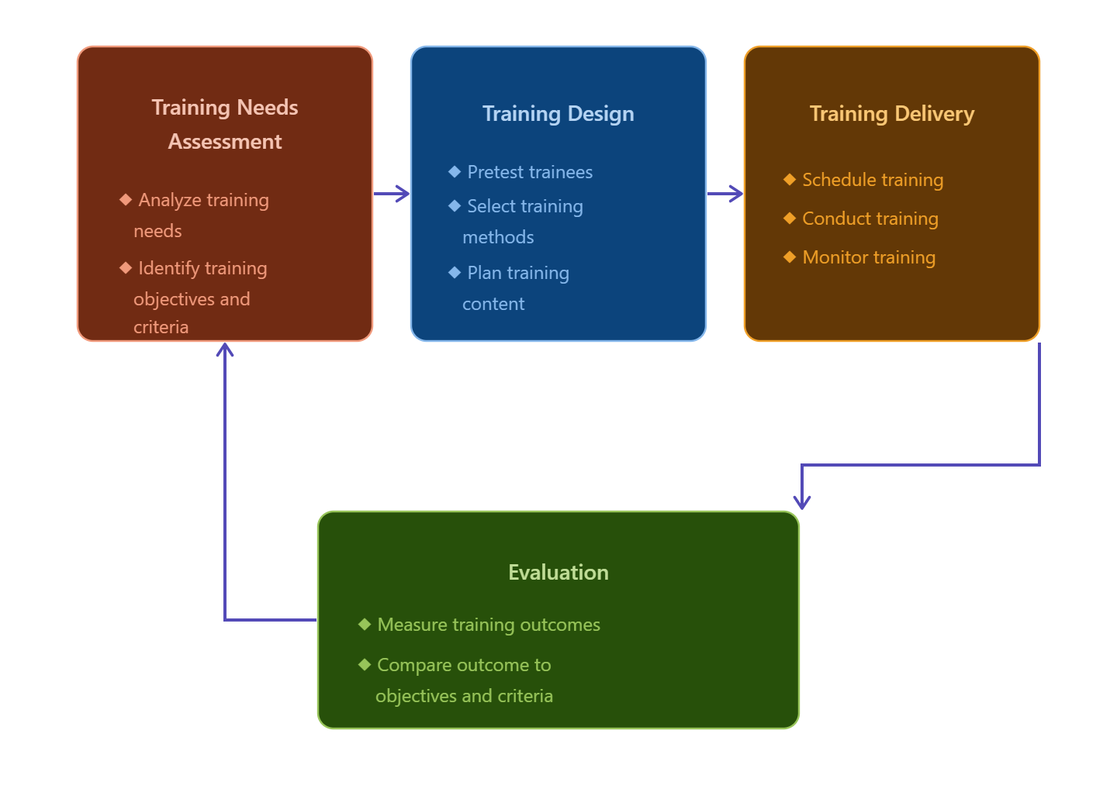
Systematic Training Process
Chapter
09
Figure 9-3

Slide 15
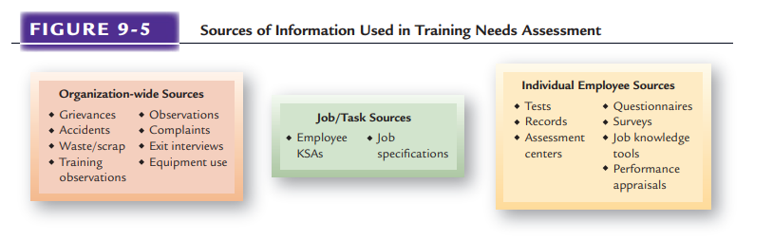
Chapter
09
Sources of information Used in of Training Needs Assessment
Figure 9-4

Slide 16





Chapter
Establishing Training Objectives and Priorities
09
Once training requirements have been identified using appropriate needs analyses, then training objectives and priorities can be established.
Training objectives and priorities are then determined to close the gap.
Three types of training objectives can be set
Gap Analysis
Knowledge
Current State
THE GAP
Future State
Impart cognitive information & concepts to trainees
Existing Capabilities
Required Capabilities
Skill
Develop behavior changes & abilities in how jobs and various tasks
requirements are performed
Modern Enhancements:
Skills Gap Analysis
Attitude
People Analytics
Create interest and awareness for the importance of training
Competency Modeling

Slide 17


Chapter
Training Design
09
Once training objectives have been determined, training design can start. Whether job specific or broader in nature, training must be designed to address the assessed specific needs.
Effective training design considers learning concepts and a wide range of different approaches to training.
There are three primary considerations when designing training:
Determining learner readiness
Understanding different learning styles
Designing training for transfer.
Each of this elements must be considered for the training design to mesh and produce effective learning.

Slide 18
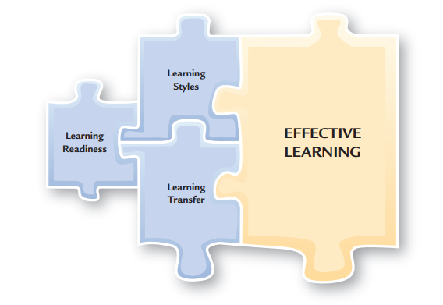
Elements of Training Design
Chapter
09
Figure 9-5

Slide 19
Chapter
Learner Readiness
09
1. Learning Readiness
Learner readiness means individuals having the ability to learn, which many people have. However, if effective learning is to occur, individuals must also have the motivation to learn and self-efficacy.
Ability to Learn
Learners must possess basic skills, such as fundamental reading and math proficiency, and sufficient cognitive abilities.
Motivation to Learn
A person’s desire to learn training content is referred to as “motivation to learn” and is influenced by multiple factors.
Self-Efficacy Person’s belief
Companies may discover that some workers lack the requisite skills to comprehend their training effectively.
Person’s belief that he or she can learn the training program content.

Slide 20
Adult Learning
Chapter
Adult Learning Malcolm Knowles’s classic work on adult learning suggests five principles for designing training for adults.
09
Adult Learning Principles
2. Learning Styles
Have need to know why they are learning something.
Have need to be self-directed.
Bring more work-related experiences into the process.
Employ a problem-solving approach in the experience.
Are motivated by both internal and external factors.

Slide 21
Adult Learning
Chapter
09
Active practice
Performance of job-related tasks and duties by trainees during training.
Spaced practice
is performed in several sessions spaced over a period of hours or days.
Massed practice
is performed all at once.
2. Learning Styles

Slide 22
Adult Learning Cont.
2. Learning Styles
Behavior modeling Copying someone else’s behavior
Reinforcement and Immediate Confirmation
Reinforcement Based on the idea that people tend to repeat responses that give them some type of positive reward and avoid actions associated with negative consequences.
Immediate confirmation Based on the idea that people learn best if reinforcement and feedback are given as soon as possible after training

Slide 23
3. Learning Transfer
Transfer of Training
Finally, trainers should design training for the highest possible transfer from the class to the job.
Transfer occurs when trainees actually use on the job what knowledge and information they learned in training.
How much training effectively gets transferred to the job is estimated to be relatively low, given all of the time and money spent on training.

Slide 24
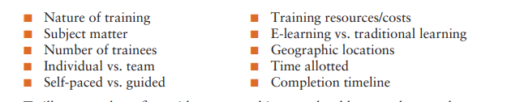
Training Delivery
Once training has been designed, then the actual delivery of training can begin.
Whatever the approach used, a variety of considerations must be balanced when selecting training delivery methods.
The common variables considered are:

Slide 25


Chapter
Internal Training
09
Informal training
Training that occurs through interactions and feedback among employees.
The most common type of training ,because it is flexible and relevant to what employees do
Cross Training
On-the-Job Training
Training people to do more than one job
Social Learning Platforms
Job Rotation
Digitally Enabled OJT NEW
Peer Coaching via Slack/Teams NEW
Career Pathing & Development NEW
Video-based Instructions
Learning in the Flow of Work NEW
Workforce Flexibility
AR-assisted Guidance

Slide 26
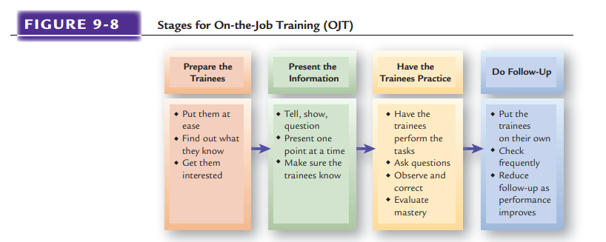
Figure 9-6

Slide 27

Chapter
External Training
09
External training, or training that takes place outside the employing organization, is used extensively by organizations of all sizes.
Large organizations use external training if they lack the capability to train people internally or when many people need to be trained quickly.

Slide 28
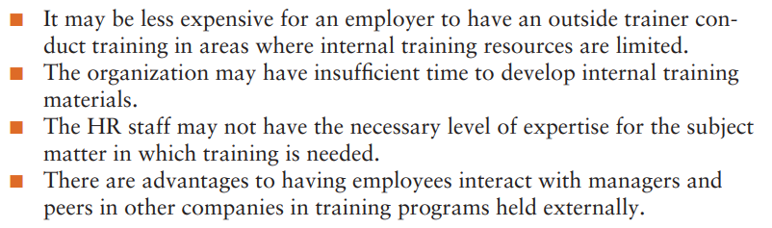
Chapter
External Training(Cont.)
09
Whatever the size of the organization, external training occurs for several reasons:

Slide 29
External Training(Cont.)
Outsourcing of Training
Government-Supported Job Training
Educational Assistance Programs

Slide 30
Chapter
Combination Training Approaches
09
Cooperative Training
Cooperative training approaches mix classroom form, generally referred to as school-to-work transition, helps individuals move into jobs while still in school or on completion of formal schooling. Such efforts may be arranged with high schools or with community colleges.
Instructor-Led Classroom and Conference Training
Is still the most prevalent approach to training. Employer-conducted short courses, lectures, and meetings usually consist of classroom training, whereas numerous employee development courses offered by professional organizations, trade associations, and educational institutions are examples of conference training.

Slide 31

Orientation: Training for New Employees
Achievements of
Effective Orientation
Favorable
Impression
Provides
Information
Co-Worker
Acceptance
Socialization
and
Integration
Performance
and
Productivity
Figure 9-7

Slide 32
Effective New Employee Orientation
Prepare New Employee
Consider “buddy” mentors
Use an orientation checklist
Cover needed information
Present information effectively
Avoid information overload
Evaluation and follow-up

Slide 33
Chapter
E-LEARNING: ON-LINE TRAINING
09
The use of the Internet or an organizational intranet to conduct training online.
Distance Training/Learning
A growing number of college and university classes use some form of Internet-based course support.
Simulations and Training
Computer-supported simulations within organizational training can replicate the psychological and behavioral requirements of a task, often in addition to providing some amount of physical resemblance to the trainee’s work environment.
Blended Learning
Learning approach that combines short, fast-paced, interactive computer-based lessons and teleconferencing with traditional classroom instruction and simulation..

Slide 34
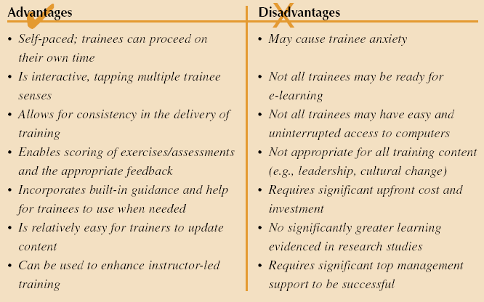
Advantages and Disadvantages of E-learning
Source: Developed by Lisa A. Burke. May not be reproduced without permission.

Slide 35
Developing E-Learning
Criteria for adopting e-learning:
Sufficient top management support and funding
Accepting the idea of decentralized and individualized training
Current training methods not meeting needs
Computer literacy and access to computers
Time and travel cost concerns for trainees
The number and self-motivation of trainees

Slide 36
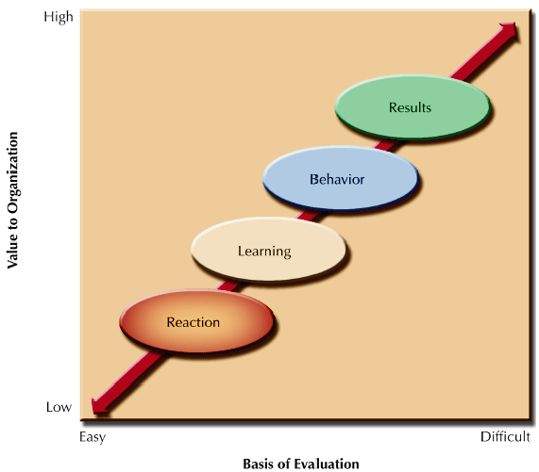
LEVELS OF TRAINING EVALUATION
Results Employers evaluate results by measuring the effect of training on the achievement of organizational objectives. Because results such as productivity, turnover, quality, time, sales, and costs are relatively concrete, this type of evaluation can be done by comparing records before and after training.
Behavior Evaluating training at the behavioral level means: (1) measuring the effect of training on job performance through interviews of trainees and their co-workers, and (2) observing job performance.
Learning levels can be evaluated by measuring how well trainees have learned facts, ideas, concepts, theories, and attitudes.
Reaction Organizations evaluate the reaction levels of trainees by conducting interviews with or administering questionnaires to the trainees.
Figure 9-8

Slide 37
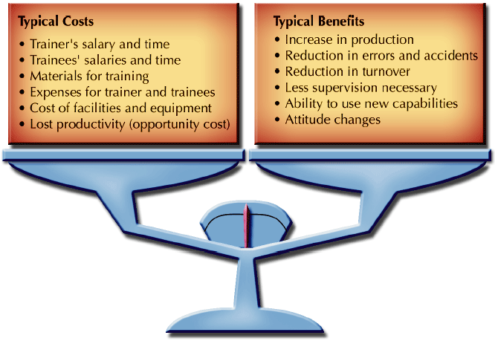
Balancing Costs and Benefits of Training
Figure 9-9

Slide 38
Training Evaluation
Chapter
09
Cost-Benefit Analyses
  Comparison of costs and benefits associated with training
Return on Investment
Benchmarking Training
Training Evaluation Designs
Pre-/Post-Measure
Post-Measure
Pre-/Post-Measure
Pre-/Post-Measure with a Control Group

Slide 39
Chapter
SUMMARY
09
Nature Of Training
Training Categories
Training And Organizational Strategy
Performance Consulting And Strategic Training
Training Components
Training Needs Assessment & Analysis
Establishing Training Objectives And Priorities
Training Design
Training Delivery
E-learning: On-line Training
Balancing Costs And Benefits Of Training
Training Evaluation

Slide 40

Chapter
References
09
Textbook: Mathis & Jackson, Human Resource Management
Aguinis, H., & Kraiger, K. (2009). Benefits of training and development for individuals and teams, organizations, and society. *Annual Review of Psychology*, 60, 451–474.
2. Armstrong, M., & Taylor, S. (2023). *Armstrong's handbook of human resource management practice* (16th ed.). Kogan Page.
3. Association for Talent Development (ATD). (2023). *2023 State of the industry report*. ATD.
4. Boxall, P., & Purcell, J. (2022). *Strategy and human resource management* (5th ed.). Palgrave Macmillan.
5. Cappelli, P., & Tavis, A. (2018). HR goes agile. *Harvard Business Review*, 96(2), 46–52.
6. Dessler, G. (2023). *Human resource management* (17th ed.). Pearson.
7. Knowles, M. S., Holton, E. F., & Swanson, R. A. (2020). *The adult learner: The definitive classic in adult education and human resource development* (9th ed.). Routledge.
8. Kraiger, K., & Ford, J. K. (2021). The science of training and development in organizations: What matters in practice. *Annual Review of Organizational Psychology and Organizational Behavior*, 8, 281–309.
9. Noe, R. A., & Kodwani, A. D. (2023). *Employee training and development* (9th ed.). McGraw-Hill.
10. Phillips, J. J., & Phillips, P. P. (2022). *Show me the money: How to determine ROI in people, projects, and programs* (3rd ed.). Berrett-Koehler.
11. Salas, E., Tannenbaum, S. I., Kraiger, K., & Smith-Jentsch, K. A. (2012). The science of training and development in organizations: What matters in practice. *Psychological Science in the Public Interest*, 13(2), 74–101.
12. Sitzmann, T., & Weinhardt, J. M. (2019). Training engagement theory: A multilevel perspective on the effectiveness of work-related training. *Journal of Management*, 45(2), 732–756.
13. World Economic Forum. (2023). *The future of jobs report 2023*. WEF.

Slide 41


Thank You

