Slide 1



Risk Management
MGM 510
Lecture 1
Prepared by
Dr. Nael Zabel
www.midocean.ae

Slide 2
Topics to Cover in Week 1
Project Meaning
Definition of risk.
Risks vs. problems.
Risk triggers.
Risk management: what & how ????

Slide 3
Meaning of “ Project “
A project: is a temporary endeavor undertaken to create a unique product, service, or result.
Project characteristic:
  Projects are temporary.
  Has definite beginning and end, the end is reached when the project’s objective have been achieved.
  Projects are unique.
  Every project creates a unique product, service, or results.
  Progressively elaborated.
  Progressively: proceeding in steps.
  Elaborated: worked with care and detail.

Slide 4
Meaning of “ Project “
The temporary nature of projects indicates that a project has a definite beginning and end.
Temporary does not necessarily mean a project has a short duration.
The end of the project is reached when one or more of the following is true:
  The project’s objectives have been achieved;
  The objectives will not or cannot be met;

Slide 5

Project Ending
  Funding is exhausted or no longer available for allocation to the project;
  The need for the project no longer exists (e.g., the customer no longer wants the project completed, a change
  in strategy or priority ends the project, the organizational management provides direction to end the project);
  The human or physical resources are no longer available; or
  The project is terminated for legal cause or convenience.

Slide 6
Meaning of “ RISK “
When the word “risk” is mentioned, most people
tend to think of negative consequences.
A risk is a possible/potential event.
An example is fluctuations in exchange rate.

Slide 7
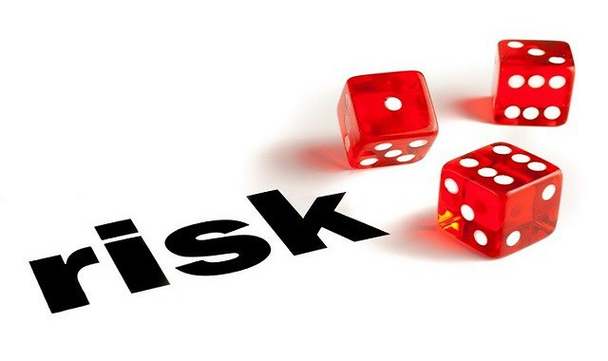
Meaning of “ RISK “
Any possible/potential event could have either:
  Positive consequence (opportunity)
  Negative consequence (threats)
  Typically, we get more concerned about threats than opportunities.

Slide 8
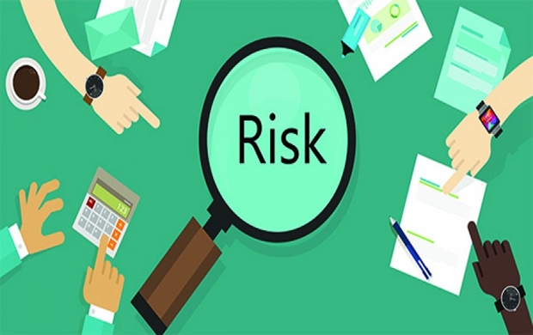
Risk VS Problem
Risks aren’t problems/Issues.
Problems/Issues are negative events that are in the process of occurring right now.
Risks are potential/possible event that can materialize and then become problems.

Slide 9
Definitions of ‘Risk’
‘Effect of uncertainty on objectives’ - "تأثير عدم اليقين على الأهداف"
ISO 3100:2009 Risk Management – Principles and Guidelines
NOTE 1 – An effect is a deviation from the expected – positive and/or negative
الملاحظة 1 - التأثير هو التغير عن المتوقع إما إيجابا أو سلبا او كليهما
NOTE 2 – Objectives can have different aspects (such as financial, health and safety, and environmental goals) and can apply at different levels (such as strategic, organization-wide, project, product and process).
الملاحظة 2 – قد يكون للأهداف أبعاد مختلفة (مثل الأهداف المالية ، والصحة والسلامة ، والأهداف البيئية) ويمكن تطبيقها على مستويات مختلفة مثل (الاستراتيجية ، على مستوى المنظمة ، المشروع ، المنتج والعملية).

Slide 10
Definitions of ‘Risk’
NOTE 3 – Risk is often characterized by reference to potential events and consequences, or a combination of these.
الملاحظة 3 - تتصنف المخاطر في كثير من الأحيان بالرجوع إلى الأحداث والعواقب المحتملة ، أو مزيج منها.
NOTE 4 – Risk is often expressed in terms of a combination of the consequences of an event (including change in circumstances) and the associated likelihood of occurrence.
الملاحظة 4 - يُعبَّر عن المخاطر في كثير من الأحيان من خلال مجموعة من عواقب الحدث (بما في ذلك التغيير في الظروف) وما يرتبط به من احتمالية حدوثه.
NOTE 5 – Uncertainty is the state, even partial, of deficiency of information related to, understanding or knowledge of, an event, its consequence or likelihood.
الملاحظة 5 - عدم اليقين هو حالة حتى ولو كانت جزئية ، لنقص المعلومات المتعلقة بفهم او معرفة عواقب اواحتمالية حدوث حدث ما.

Slide 11
Definitions of ‘Risk’
‘A hazard is the potential for harm arising from an intrinsic property or disposition of something to cause detriment.’
"الخطورة هو احتمال حدوث ضرر ناتج عن خاصية جوهرية أو التصرف في شيء ما لإلحاق الضرر ".
‘Risk is the chance, high or low, that somebody or something could be harmed by these and other hazards, together with an indication of how serious the harm could be.’
"الخطورة هي فرصة حدوث( سواء كانت عالية أو منخفضة) ضرر شخص ما أو شيء ما، وكذلك مدى خطورة الضرر".
UK Health and Safety Executive – www.hse.gov.uk/risk/index.htm

Slide 12
Definitions of ‘Risk’
‘A hazard is the potential for harm arising from an intrinsic property or disposition of something to cause detriment.’
"الخطورة هو احتمال حدوث ضرر ناتج عن خاصية جوهرية أو التصرف في شيء ما لإلحاق الضرر ".
‘Risk is the chance, high or low, that somebody or something could be harmed by these and other hazards, together with an indication of how serious the harm could be.’
"الخطورة هي فرصة حدوث( سواء كانت عالية أو منخفضة) ضرر شخص ما أو شيء ما، وكذلك مدى خطورة الضرر".
UK Health and Safety Executive – www.hse.gov.uk/risk/index.htm

Slide 13
Risk Triggers
Risk triggers are “signs” that a risk event is about to occur.
A risk trigger signals that something more relevant to the project is on the horizon.

Slide 14

Open thinking
What risks did you face today as you traveled to the workshop?
What was the risk?
How did you manage the risk?

Slide 15

Example
Boss!!!
There is a strange sound coming from the excavation…??!!

Slide 16
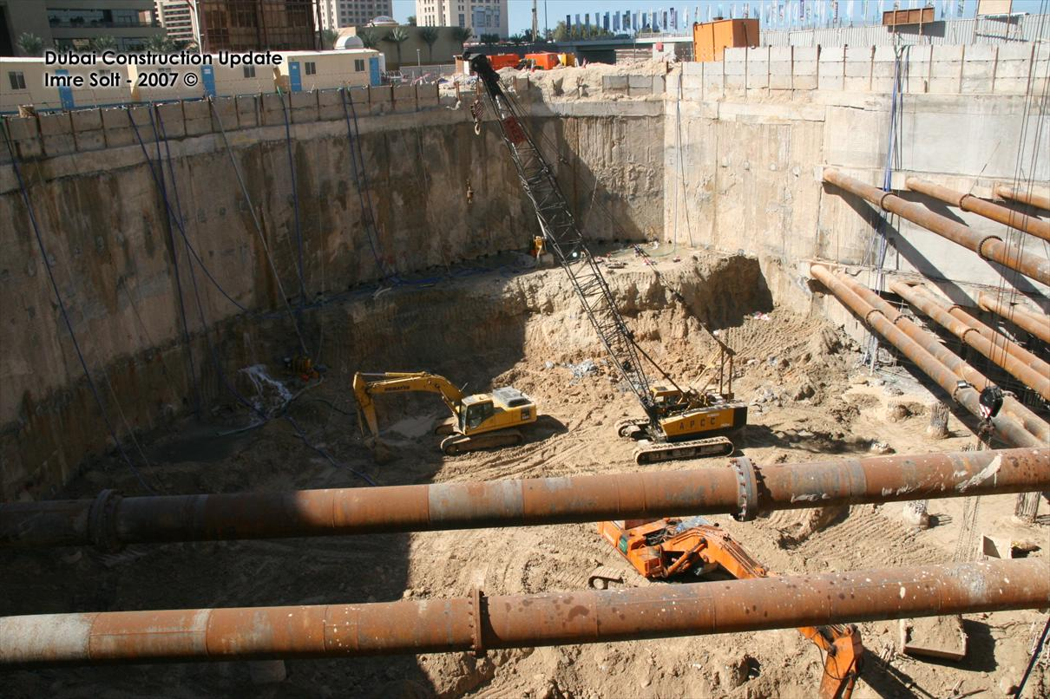
Example
Strange Sound

Slide 17
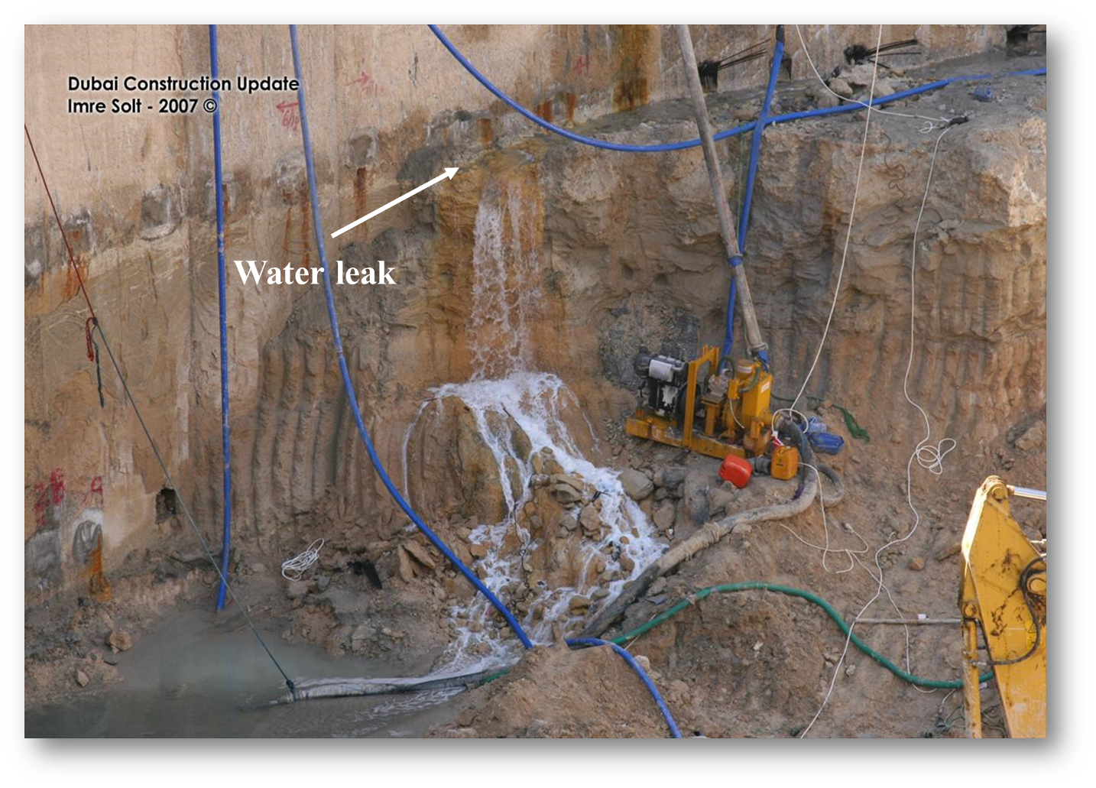
Example
What Happen??

Slide 18
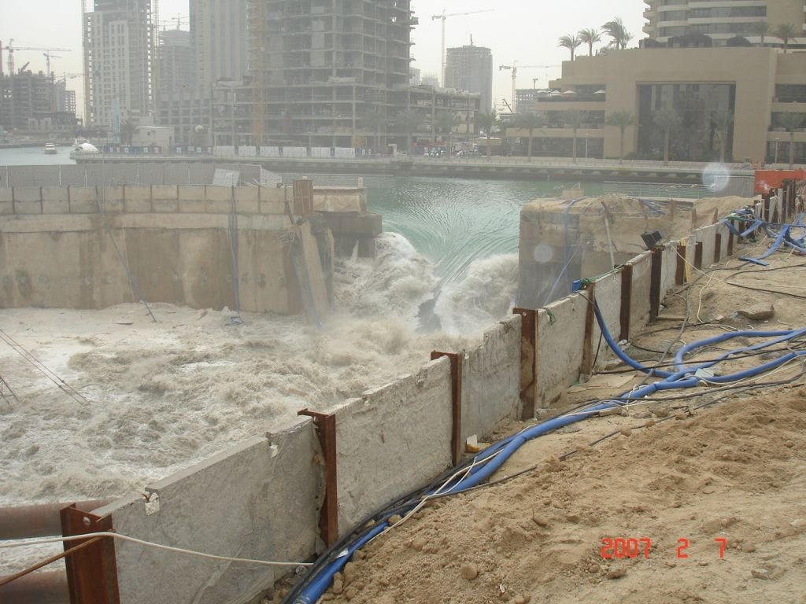
Operational Risk

Slide 19

Without Risk Management!!
You will be surprised by the Threats surrounding you and will miss opportunities, as well!

Slide 20
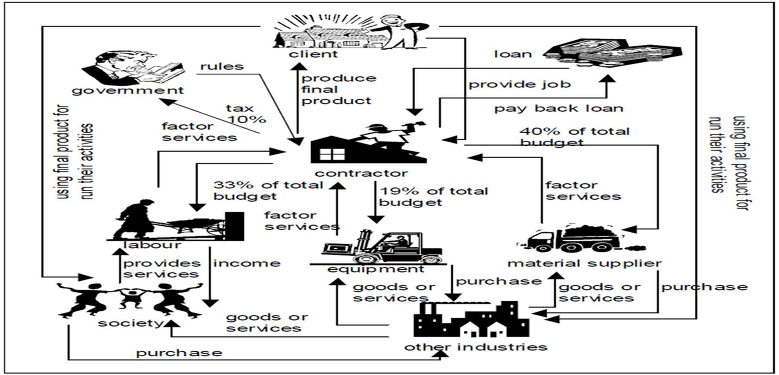
Why does Risk Management

Slide 21
Why does Risk Management
Good risk management can save time, improve quality, and reduce the costs of achieving an agreed outcome.
Effective risk management can be a significant contributor to project success.

Slide 22
Why does Risk Management
Analysis of common causes of project failure by the UK’s National Audit Office (NAO) highlighted the following:
  Importance of starting well
  Residual uncertainty related to following aspects can put project at risk:
    Size
    Timescale
    Ambition / scope
    Complexity.

Slide 23
Benefits of Risk Management
‘HARD’ (tangible)
Enables better informed and more believable plans, schedules and budgets
Increases the likelihood of a project adhering to its schedules and budgets
Leads to the use of the most suitable type of contract
Allows a more meaningful assessment of contingencies
Contributes to the build-up of statistical information to assist in better management of future projects
Enables a more objective comparison of alternatives
Identifies, and allocates responsibility to, the best risk owner

Slide 24
Benefits of Risk Management
‘SOFT’ (intangible)
Improves corporate experience and general; communication
Leads to a common understanding and improved team spirit
Helps distinguish between good luck / good management and bad luck / bad management
Helps develop the ability of staff to assess risks
Focuses project management attention on the real and most important issues.

Slide 25
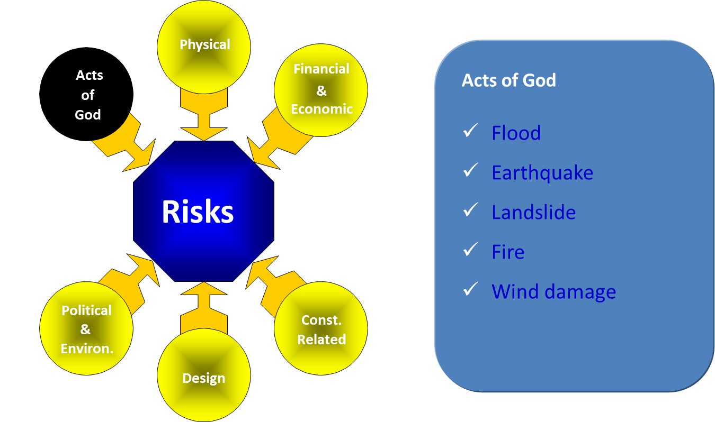
Risk Examples

