Slide 1
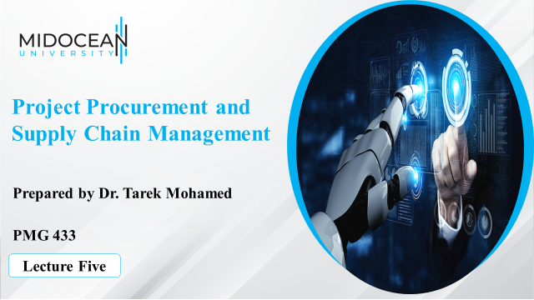

Slide 2
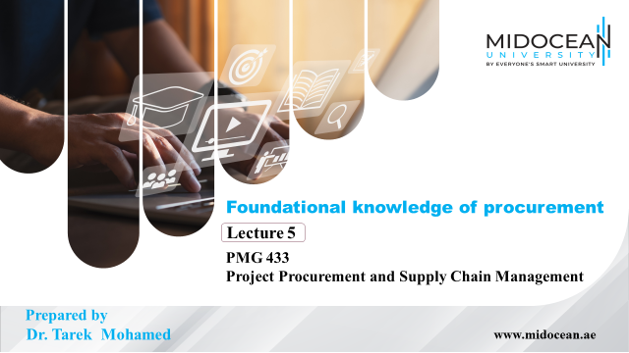

Slide 3


Learning Objectives
To discuss the Scope of Procurement.
To overview the procurement process.
To understand the factors affecting the procurement.
To differentiate between the two meanings of Procurement and Purchasing
To explain the roles of procurement team members.
To understand the relationship between Supply Chain and purchasing.
www.midocean.ae

Slide 4
PROCUREMENT
Effective Procurement is critical for effective project management. Depending upon the specific type of project being managed, over 50 percent of the total project cost can be attributed to parts, supplies, and services procured, and for many high-technology projects, this procurement fraction can approach 90 percent.
Further, because of long lead times, procured items nearly always define the critical path through the project schedule network. And dependence upon markets for procured items can create project management difficulties in terms of agency (e.g., information asymmetries, incentives) and coordination (e.g.,redundant project management organizations, inter-organizational communications).
www.midocean.ae

Slide 5
PROCUREMENT
In short, if a project manager is not managing procurement, then he or she is only managing 50 percent or less of the project as a whole.
Despite this critical role, however, the term ‘‘procurement’’ remains broadly defined and is used to describe a variety of entities (e.g., functions, organizations, systems, processes).
The term is also evolving through time, as the activities associated with procurement have become increasingly important to enterprise success.
For instance, procurement was once descriptive of the simple clerical activities associated with purchasing well-specified items, but it has evolved in some organizations to describe instead strategic partnering efforts made by senior executives.
www.midocean.ae

Slide 6
PROCUREMENT
In the former case, all that is required is buying an item that has already been specified, from a vendor that has already been selected, for a purpose that has already been determined (e.g., a part to be installed on an assembly line).
But procurement also involves the activities associated with deciding whether an item will be made in-house or purchased from outside vendors (i.e., the make/buy analysis), and deciding from which vendor—or collection of vendors—to purchase an item is commonly included within the responsibilities assigned to procurement organizations
www.midocean.ae

Slide 7
PROCUREMENT
Procurement further represents a central activity in terms of supply chain management, which seeks to integrate the processes and activities of vendors, suppliers, producers, and customers, and procurement executives are routinely relied upon to shape enterprise strategy based on opportunities to form partnerships, alliances, and joint ventures with ‘‘vendors.’’
As implied, the project management professional has a number of different lenses through which to view procurement.
www.midocean.ae

Slide 8
PROCUREMENT
For instance, procurement has long been referred to in functional terms, which depict a division of labor (e.g., buying items vs. making them), specific job tasks (e.g., market research, obtaining vendor quotations), and worker skills (e.g., contract interpretation, negotiation).
As another instance, procurement is also referred to in organizational terms, which depict a specific department or other organizational entity in the enterprise, complete with its own managerial hierarchy, worker roles, and organizational responsibilities.
www.midocean.ae

Slide 9
PROCUREMENT
Procurement is further referred to in terms of a system, which involves examination of its inputs (e.g., requirements, information), outputs (e.g., purchase orders, received vendor items), transfer function (e.g., vendor selection, vendor management), and environment (e.g., corporation, industry).
To describe procurement in terms of a process—actually is , a set of processes interlinking vendors, producers, and customers along the supply chain—with its attendant work activities (e.g., requirements determination, source selection), actors (e.g., market researchers, buyers), organizations (e.g., purchasing, contract management), and technologies (e.g., electronic catalogues, communication networks).
www.midocean.ae

Slide 10
What is Procurement?
Procurement – The process of acquiring and evaluating goods and services beginning with determining needs through product utilization, conclusion of contracted service, or until the end of the useful life of a capital equipment item.
Purchasing – The process of “buying:” placing an order, receiving a product or service, and paying the supplier.
www.midocean.ae

Slide 11
What is Procurement?
Procurement involves a more comprehensive scope of activities than does “purchasing”.
The term “purchasing” is most similar to the term buying.
Those with procurement responsibilities have two primary concerns: to identify and secure the products and services that will best allow the organization to meet the wants and needs of its customers, and to obtain them at a fair price.
www.midocean.ae

Slide 12
What is Procurement?
There is typically a direct relationship between the quality of a product or service and the price that the organization will pay for it
When a “Do or Buy” analysis is undertaken, the buyer considers the availability of alternatives (first), quality considerations (second) and, finally cost.
The final step in the procurement process is an evaluation of the process.
A purchasing system whose primary goal is to get needed products delivered on time at the lowest cost would be considered a Price-Conscious Purchasing system.
www.midocean.ae

Slide 13
Objectives of Effective Procurement
Obtain the right product or service at the right price from the right source in the right quantity at the right time.
www.midocean.ae

Slide 14
Overview of Procurement Process
1: Identify Need for Product/Service
2: Determine Quality Requirements
3: Conduct “Make (Do) or Buy Analysis”
  Make (do) or buy analysis – A systematic process to determine whether products should be prepared on-site or purchased from an external supply source. Sometimes called “Do/Buy Analysis” when on-site versus supplier-provided services are analyzed.
4: Determine Quantity to Purchase
www.midocean.ae

Slide 15
Overview of Procurement Process
5: Identify Alternative Supplier Sources
6: Determine Sources (Supplier) for Order
7: Order Product/Service
8: Receive Product or Service
9: Pay for Product or Service
10: Review Supplier Performance and Ordering Process
11: Evaluate Procurement Process
www.midocean.ae

Slide 16
Factors Affecting Procurement
Internal Factors
  Skills and abilities of their staff members
  Anticipated business volume
  Available storage space for products
  Timing requirements for service deliveries
  Property’s ability to pay on a timely basis
  Interest of owners and managers to participate in non-traditional purchasing methods
www.midocean.ae

Slide 17
Factors Affecting Procurement
External Factors
  Consumer demands
  Distributions channels (e-commerce)
  Global trade conditions
  Governmental regulations
  Environmental concerns
  Competitors processes
    Benchmarking – A search for best practices and an understanding of how they are achieved in efforts to determine how well an organization is doing and to learn ways to become even better.
www.midocean.ae

Slide 18
Roles of Procurement Team Members
Purchasing director – The top-level manager in a large organization with responsibilities for that organization’s procurement function; also called purchasing manager.
Purchasing agent – A staff member in a large organization with responsibilities to purchase specific lines of products, services, supplies, or equipment; also called buyer.
www.midocean.ae

Slide 19
Roles of Procurement Team Members
Purchasing system (centralized) – A purchasing system in which all (or most) purchases are made by the designated purchasing agent for the entire organization.
Purchasing system (decentralized) – A purchasing system in which all (or most) purchases needed by a department are made by Department heads or someone within their department who is designated to do so.
www.midocean.ae

Slide 20
Roles of Procurement Team Members
Staff positions – Organizational roles (positions) occupied by technical, advisory specialists such as purchasing agents who provide advice to, but who do not make decisions for, those in the chain of command.
Line positions – Organizational roles (positions) occupied by decision-makers in the chain of command. Line decision-makers have authority that flows from one level of management to the next.
www.midocean.ae

Slide 21
Roles of Procurement Team Members
Issue (product) – The task of transferring products from storage areas to user departments in quantities that enable user personnel to meet production needs.
Delivery invoice – A document signed by an authorized representative of the organization’s operation when products are delivered to transfer product ownership to the property. The delivery invoice is the source of supplier charges to the property.
Purchase order – A document used by the organization’s operation to solicit prices from suppliers, and to inform the appropriate supplier that a shipment should be delivered.
www.midocean.ae

Slide 22
Evolution of Procurement Systems
Phase 1: Price-Conscious Purchasing
Phase 2: Price and Quality Purchasing
Phase 3: Purchaser-Supplier “Partnerships”
Phase 4: Integrative Procurement
www.midocean.ae

Slide 23
Evolution of Procurement Systems
Speculative purchasing – The act of making decisions about the quantities of products to purchase based upon forecasted future prices.
If prices are judged to be increasing, larger quantities of items may be ordered.
Conversely, if prices are judged to be decreasing, smaller quantities with more frequent deliveries may be purchased.
www.midocean.ae

Slide 24
Evolution of Procurement Systems
Outsourcing – The act of purchasing a product or service from an external provider that could, alternatively, be provided by the organization’s own employees.
www.midocean.ae

Slide 25
Evolution of Procurement Systems
Outsourcing –Is a growing practice within the IT industry, and it is important to appreciate the reasons it is adopted:
To reduce both fixed and recurrent costs.
To allow the client organization to focus on its core business.
To access skills and technologies.
To provide flexibility.
To increase accountability.
www.midocean.ae

Slide 26
Distribution Channels
Intermediaries – All organizations and/or individuals involved in the flow of products from their source to the buyer; often called “middle-man.”
  Basic functions include:
    Business functions
    Logistical functions
    Facilitating functions
www.midocean.ae

Slide 27
Distribution Channels
Types of Intermediaries:
  Agent – An intermediary who does not take title to the products and who makes a profit from commissions and fees paid for services provided
  Broker – An independent organization or individual who negotiates a contract between a buyer and a seller.
  Merchant wholesaler – An intermediary that purchases products handled and who generates a profit from the sale of these items; see full-line merchant wholesaler and limited-line merchant wholesaler.
www.midocean.ae

Slide 28
Distribution Channels
Types of Intermediaries:
  Distributor – An intermediary who sells specific (branded) products within a specifically-defined sales territory.
  Retailer (cash and carry) – An outlet that sells products to organizations and to individual consumers at retail prices.
www.midocean.ae

Slide 29
Distribution Channels
Indirect Channels of distribution – Distribution channels involving intermediaries who perform channel functions between the producer of the item and the organization.
Direct Channels of distribution – A distribution channel in which the producer and the organization interact directly with each other.
www.midocean.ae

Slide 30
Distribution Channels
Vertical distribution system – A distribution system in which one or more functions normally performed by an intermediary is undertaken by the organization.
www.midocean.ae

Slide 31
Channel Flow Begins With the Order
Traditional Method
Alternative Methods
  Contract leakage – A term referring to the purchase of products “out of contract” by a property whose product purchase needs can be addressed in group purchase contracts with affiliated properties.
  Group buying – A purchasing system in which orders for products of a specified quality are combined for participating properties. Suppliers receiving the order deliver products to and receive payment from the participating properties
www.midocean.ae

Slide 32
Supply Chain Management and Purchases
Logistics – Activities designed to best assure that the correct amount of the correct products are at the correct place at the correct time, and that they were moved there at lowest possible cost.
Logistics management – The practice of planning and implementing the cost-effective flow of raw products, in-process inventory, and finished products from product source to the product user while satisfying customer requirements.
Total logistics cost – All costs related to transportation, handling and warehousing, inventory, stock outs, order processing, and return of unacceptable products.
www.midocean.ae

Slide 33
Supply Chain Management and Purchases
Internal customers – The organization’s employees who use the products which are purchased.
Distribution centers – Locations used by multi-unit organizations to store products, consolidate products from different suppliers, and sort them into shipments to specific properties.
Freight forwarders – Businesses that accumulate small product shipments into larger lots, and then contract with a carrier to transport them to, for example, a local merchant wholesaler; also called freight consolidator.
www.midocean.ae

Slide 34
Summary of Learning Objectives
To discuss the Scope of Procurement.
To overview the procurement process.
To understand the factors affecting the procurement.
To differentiate between the two meanings of Procurement and Purchasing
To explain the roles of procurement team members.
To understand the relationship between Supply Chain and purchasing.
www.midocean.ae

Slide 35
Essential Reference
Morris, P. W., & Pinto, J. K. (Eds.). (2007). The Wiley guide to project technology, supply chain, and procurement management (Vol. 4). John Wiley & Sons.
www.midocean.ae

Slide 36



Thank You

