Slide 1

Financial Risk Management
Prepared by Dr. Walaa Mohamed
Lecture 8
PMG 633
Credit Risk Management

Slide 2
Chapter Outline
  Portfolio Management
  Techniques to Reduce Portfolio Risk
  Credit Rating Agencies
  Alternative Credit Risk Assessment Tools
  Early Warning Signals
  Managing Default
  Calculating portfolio return & risk

Slide 3
Lecture 8
Key Learning Points
Portfolio management involves determining the contents and the structure of the portfolio, monitoring its performance, making any changes, and deciding which assets to acquire and which assets to divest.
Key portfolio risks are concentration risk, correlation risk, and contagion risk.
Banks use various techniques to reduce the overall risk of their loan portfolios.
Credit rating agencies provide independent credit assessments, which can be used to independently verify a counterparty’s creditworthiness and also to monitor credit.
Market-derived ratings can identify where market sentiment may differ from an internal or external credit rating and may indicate a warning signal to a portfolio manager.
Portfolio managers should learn to recognize the signals of increasing default risk.
Portfolio managers should have an effective framework to limit potential losses.
A portfolio manager needs a process of practical actions to manage the documentation and liquidation of assets in a controlled and prudent manner.
Banks consider the legal, loan losses, and reputational risks of default.

Slide 4
  Portfolio Management
An investment portfolio held by a bank or an individual contains various investments that typically include stocks (equity), bonds, loans, financial derivatives (options, futures, etc.), investible commodities such as gold or platinum, real estate, or similar assets of value. The investor is the entity that holds the portfolio and may be a company, a bank, or an individual. Portfolio management involves determining the contents and the structure of the port- folio, monitoring its performance, making any changes, and deciding which assets to acquire and which assets to divest. Portfolio managers weigh both the expected risk and return characteristics of individual assets, the performance of the entire portfolio, and the investor’s financial objectives in order to find an optimal combination of investments that provides the highest level of return for any given level of risk.
Banks use several approaches to measure portfolio performance and reduce credit losses. The approaches utilize quantitative assessment tools to predict the likelihood of a default and estimate the impact of the default.

Slide 5
    Portfolio Management Terminology
      Probability of default (PD). The likelihood that the borrower will default. PD is normally represented as a percentage.
      Exposure at default (EAD). The total exposure the lender could have at the time of default. EAD is influenced by debt type, asset type, recourse, assignment terms, and payment delays. EAD is normally represented as an amount of money.
      Recovery rate (RR). The assumption of the fraction of the asset value that will likely be recovered after a default. RR is normally represented as a percentage.
      Loss given default (LGD). The actual loss the lender suffers in the wake of a default: a function of (1 – RR). LGD is normally represented as a percentage. Gross LGD is used for bonds, whereas Blanco LGD is used for loans where bankers include the effects of collateral, if any.
      Expected loss (EL). The loss given default multiplied by the probability of default multiplied by exposure at default.

Slide 6
Example
In 2012, XYZ Corporation arranged a facility to borrow EUR 10 million from Bank A for a five- year period at an annual interest rate of 7%. After two years, XYZ had repaid EUR 4 million, but still owed the bank EUR 6 million plus EUR 300,000 in interest. Bank A made the following assessment about XYZ Corporation in January 2014:
      If XYZ Corporation defaulted in 2014, Bank A’s exposure at default (EAD) would be EUR 6.3 million: EUR 6 million in principal and EUR 300,000 in interest.
      Bank A is assuming a recovery rate (RR) in the event of a default in 2014 of 90% or EUR 5.67 million (90% of EUR 6.3 million).
      The actual loss Bank A would suffer in default (LGD) would be (1 – 0.9), or 10% of the actual exposure. Applied to the EAD of EUR 6,300,000, this gives EUR 630,000.
      The probability that XYZ Corporation would default during 2014 was 1%.
      Therefore, the expected loss (EL) is EUR 630,000 * 1% = EUR 6,300.

Slide 7
In addition to finding the best combination of investments that delivers the optimal return for the allowable risk profile of the portfolio, the portfolio manager must also seek to minimize specific portfolio risks, namely concentration and default correlation risks.
    Concentration Risk
An inherent risk in lending is that a bank can become skilled in lending to, for example, one geographical area or to one industry (e.g., shipping) and will then tend to focus the majority of its underwriting efforts on that area or sector. This can lead to a highly concentrated, or not suitably diversified, credit portfolio, which will increase the bank’s exposure to potential losses in the event of deterioration in that particular area or industry.

Slide 8
A diversified loan portfolio will be diversified by geography, industry type, demographic profile, or other indicators and should reduce the impact to the bank of a severe market disruption. Although development of a core competency in lending to a specific market or industry might lead to concentration risks, its effects might be mitigated somewhat by the possibility that the bank’s expertise in that specific sector helps it avoid the weakest credits.
Reducing concentration risk may require active management of a bank’s loan portfolio. For example, a bank might sell some of its loans to third parties, thereby removing those risks from its banking book. Or it might introduce diversification into its portfolio by buying nonsimilar loans from other banks.

Slide 9
    Default Correlation Risk
Default correlation risk refers to the likelihood that the default of one bor- rower is affected by the default of another borrower.
An example of positive correlation would be two companies that are not part of the same corporate or group structure but are trade creditors to each other. An example of negative correlation could be two competitors, the default of one of which takes capacity out of the market, possibly providing some pricing or volume improvement for the remaining company.
The key drivers for default correlation risk are the macroeconomic cli- mate in general and specific industry factors such as timing with respect to an industry cycle.
Industry cycle
The four phases of an industry life cycle are the introduction, growth, maturity, and decline stages. Industries are born when new products are developed, with significant uncertainty regarding market size, product specifications, and main competitors.

Slide 10
    Contagion Risk
Contagion risk refers to a ripple effect of defaults that may occur in a particular industry or country or between countries where the default of one borrower—or counterparty—has a negative impact on other borrowers.

Slide 11
  2. Techniques to Reduce Portfolio Risk
    Syndication
The loan syndication process (Section 4.5.14) provides a useful mechanism to enable a bank that has developed strong relationships or expertise in a particular market or industry sector to reduce its exposure by syndicating portions of the loan to other financial institutions. The other syndication members, for their part, may be looking to diversify their own portfolio hold ings by adding transactions that meet their risk-adjusted investment criteria.

Slide 12
Whole Loan Sales
Whole loan sales enable a bank to reduce its exposure by selling a specific loan to another financial institution. An example would be the sale of a mortgage from one bank to another. The loan originator—the bank that arranged the original mortgage—may not want to have such a long-dated loan in its portfolio. Selling the loan will allow the originator to remove it from its books and receive funds in return for the loan, providing it with capital to make other loans.

Slide 13
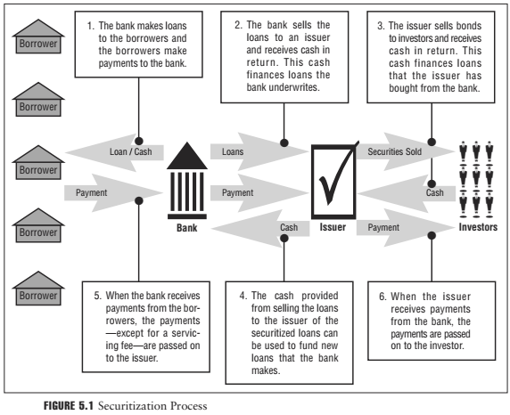

Slide 14
From the originator’s perspective, securitizing such credit products not only reduces potentially high levels of risk exposure, including concentration risk (Section 5.1.2), but the removal of such assets from its books also reduces the bank’s capital requirements. Furthermore, as with whole loan sales, the securitization process earns proceeds for the bank from which it can generate new loans or conduct other business.

Slide 15
Typically, the bank will transfer or sell the securitized loans to an issuer that may be affiliated with the bank. The issuer then bundles the assets (mortgages, credit card receivables, etc.) and sells securities backed by them. The payments on the pool of loans are used to pay off the securities. If the transfer or sale of securities is without recourse (that is, the selling bank is not liable to pay compensation to the buyer in case the loan defaults), this process then decreases the bank’s default risk. Figure 5.1 illustrates a securitization process.
Another technique banks employ to reduce the effects of credit losses is to pool or bundle together assets such as mortgages or credit card receivables, and sell them to other financial institutions or into the capital markets. This is known as securitization. A pool of loans is more diversified than one individual loan—since not all loans will be expected to default simultaneously—and is therefore more attractive to investors seeking to achieve port- folio diversification. Many types of loan products can be securitized as long as they are associated with a cash flow.

Slide 16
    Credit Default Swaps
A credit default swap (CDS) is a form of credit derivative. A CDS contract is similar to insurance—it is often referred to as default protection—and involves the transfer of credit risk between two parties. The buyer of the CDS (who may already own the underlying credit exposure—for instance, a specific reference bond) essentially sells or transfers its default risk to the seller of the CDS contract.
Through the use of the CDS market, a portfolio manager is therefore able to limit losses in the event of a default without actually having to eliminate the exposure by outright sale. This is also referred to as a hedge. If a negative credit event occurs—say a default on a specific corporate bond— then the seller of the CDS will have to deliver the value of the principal and interest on that bond to the CDS buyer. If no credit event occurs, the CDS seller receives a periodic fee from the CDS buyer over the life of the bond.

Slide 17
Credit Rating Agencies
In some ways credit rating agencies (CRAs) play a role similar to that of lenders in that they both evaluate the creditworthiness of various borrowers. The clear difference between them, however, is the fact that CRAs do not lend money.
CRAs evaluate the creditworthiness of borrowers and publicly traded debt, and assign credit ratings to borrowers and the debt instruments they issue. Ratings are intended to provide an independent assessment of a bor- rower’s general creditworthiness based on a wide array of risk factors. Rat- ings on individual debt instruments incorporate the creditworthiness of the issuer with relevant instrument-specific risk factors.

Slide 18
The ratings range from the highest credit rating (typically AAA or Aaa indicates a very high ability to repay the loan) to the lowest credit rating (typically C or D suggests the bond is about to default or is in fact in default). Investment grade credit ratings are generally from AAA/Aaa to BBB/Baa, and non–investment grade credit ratings generally fall in the BB/Ba to C/D range. Figure 5.2 contains a detailed description of the various ratings.
Credit analysis by CRAs is similar to the credit analysis process described in Section 4.7. CRAs examine the borrower’s fundamental and vital characteristics, including the borrower’s industry, prospects for growth, risks, threats, and weaknesses.
Rating agencies evaluate different criteria for different borrower types. For instance, when rating sovereign borrowers, rating agencies analyze a country’s ability and willingness to repay a debt, and consider relevant and substantive information on the economic and fiscal strength of the country, the stability and viability of the political and social system, and susceptibility to event risk.

Slide 19
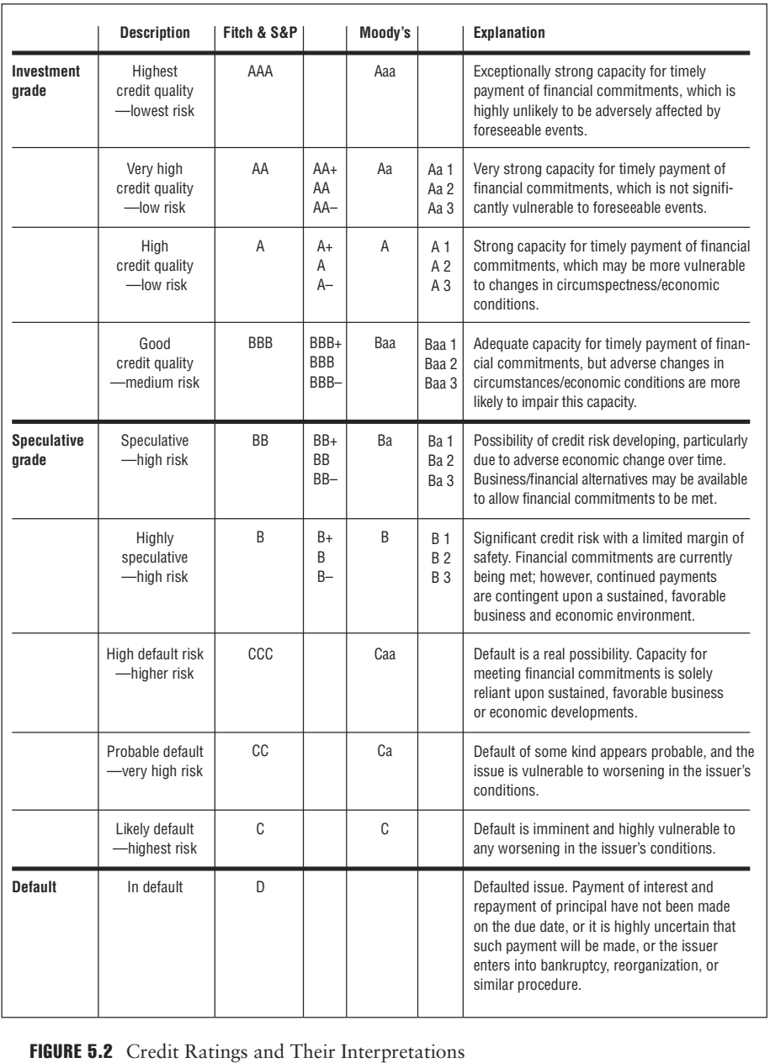

Slide 20
In addition to credit ratings, CRAs also assign recovery ratings to individual instruments issued by low-rated firms (i.e., firms with high probability to default on their debt). This is an attempt by the CRAs to quantify recovery risk: the value a lender to these low-rated firms might expect to recoup on an obligation in the event of default. This approach effectively separates default risk from recovery risk.

Slide 21
3. Alternative Credit Risk Assessment Tools
Also referred to as market-derived ratings, these tools typically take market information such as bond prices or spreads, CDS prices, and equity performance and translate them into market-implied ratings. Both Moody’s Investors Service and S&P offer products that provide this (Moody’s Market Implied Ratings and S&P’s Market Derived Signals).
One of the objectives of these market-derived ratings is to identify where market sentiment may differ from an internal or external credit rating and may therefore be useful as an early warning signal to the portfolio manager. While these tools may be valuable for analyzing the market’s perception of credit risk, the signals are often very volatile, reverse frequently, and cannot be relied on as predictors of an issuer’s credit rating change. In addition, it is important to note that while a credit rating is based on a longer-term view of creditworthiness, market-derived signals are calculated based on daily trading data, and therefore the results may be skewed during periods lacking sufficient market activity.

Slide 22
  4. Early Warning Signals
The purpose of early warning signals is to alert a bank of deteriorating credit risk or, in other words, of increasing default risk. A robust credit monitoring process should capture signals such as reporting of past-due loans. Early warning signals may come from macroeconomic stress, company-specific issues, or industry-wide characteristics. A checklist covering these and other issues provides a useful starting point in setting a standard of vigilance throughout the credit process. A well-crafted loan policy will set out what actions should follow upon the recognition of an early warning signal. It is important to remember that early protection actions provide the best chance to improve a bank’s position, to reduce exposures to risk, and to exit deteriorating relationships.

Slide 23
Management Issues
“Lending is not based primarily on money or property. No sir, the first thing is character.” This quotation, attributed to J. P. Morgan, is relevant here in considering characteristics of company owners or managers that may alert a bank to potential problems. Allegations of unethical behavior, weak corporate governance, evidence of a lavish lifestyle, and lack of transparency with respect to financial or operational disclosure are all examples of possible early warning signals that a bank may encounter difficulties with a company.

Slide 24
Liquidity Issues
The one overriding objective in assessing credit risk is to evaluate whether a loan will be serviced and repaid in cash on schedule. Both liquidity (does the company have the internal sources of cash to service and repay the debt when due?) and solvency (does the company have access to alternative sources of cash flow, e.g., through asset sales or capital contributions to meet its interest and repayment schedules?) are fundamental issues that must be addressed early in the credit process. Through the credit monitoring process, careful attention should be paid to a company’s liquidity position. Increased use of overdrafts, lateness in paying trade creditors, and decreasing cash balances may all signal a weakening liquidity position and a potentially increased probability of default.

Slide 25
Industry/Peers
Certain industries or sectors develop reputations for corruption or unethical practices. When uncovered, such actions may result in large fines, tarnished reputations, and loss of public confidence. This in turn may lead to a ratings downgrade and or a widening of a company’s credit spreads, the difference between the yield on (risk-free) government bonds and the company's bonds of similar structure, both of which will have implications for the risk profile of the portfolio.

Slide 26
EXAMPLE
In September 2014, a Chinese court found a local subsidiary of UK pharmaceutical company GlaxoSmithKline plc (GSK) guilty of bribery, and fined the company RMB 3 billion (approximately USD 492 million)—at that time, the largest fine imposed by a Chinese court. The Chinese authorities accused GSK of bribing doctors and hospital officials to use GSK products. The case highlights the potential dangers to a company negotiating in countries where what is acceptable with regard to local practices may be unclear, and where a change in government may result in local laws being enforced more rigorously than had been the case in the past.

Slide 27
5. Managing Default
If however, the situation cannot be remedied and the borrower does indeed default or is expected to default, there are a number of steps that need to be followed.
1.Documentation and Perfection
The first step is to check documentation regarding the collateral and confirm the bank’s position.
■Check that no tax or judgment liens are in place—such liens will be the result of nonpayment of taxes or a lawsuit by another creditor for an unpaid debt.
■Ensure that liens on any special collateral such as patents or intellectual property rights have been perfected. Perfecting a lien is the legal process that establishes a lender’s priority vis-à-vis other creditors. Typically it requires filing a record with the appropriate legal authority (e.g., the land records office). (This should have been done as a matter of course when the loan was originated.)
■Confirm the lender’s rights under the appropriate legal jurisdiction. This will obviously require consultation with local legal counsel.

Slide 28
2. Review Collateral
It may be necessary to undertake site inspections, view equipment, and conduct a review of accounts receivable to ascertain the condition of the collateral and to estimate the value of the business as a going concern.
3. Review the Borrower’s Plans
Consider the borrower’s financial and business plans. In light of the current situation, are the plans reasonable or achievable? Is the incumbent management team staying or being replaced? What is the time frame for any expected turnaround?
3. Additional Credit Support
Revisit avenues of potential support that may previously have been denied (e.g., parent guarantees, letters of credit, equity injections, etc.).

Slide 29
6. How to Calculate Expected Return of a portfolio
To calculate the expected return of a portfolio, the investor needs to know the expected return of each of the securities in their portfolio as well as the overall weight of each security in the portfolio.
Expected return = (w₁ * r₁) + (w₂ * r₂) + ………… + (w_{n} * r_{n})
w_{i} = weight of each investment in the portfolio
r_{i} = rate of return of each investment in the portfolio

Slide 30



d. calculate and interpret the mean, variance, and covariance (or correlation) of asset returns based on historical data;
Variance (Standard Deviation) of Returns for an Individual Security
We can calculate the population variance, σ2, when we know the return R for each period, the total number periods (T ), and the mean or expected value of the population’s distribution (μ), as follows:
In the world of finance, we are typically analyzing only a sample of returns data, rather than the entire population. To calculate sample variance, s2, using a sample of T historical returns and the mean, R¯, of the observations, we use the following formula:
Covariance and Correlation of Returns for Two Securities
Covariance measures the extent to which two variables move together over time. A positive covariance means that the variables (e.g., rates of return on two stocks) tend to move together. Negative covariance means that the two variables tend to move in opposite directions. A covariance of zero means there is no linear relationship between the two variables.

Slide 31


The covariance of the returns of two securities can be standardized by dividing by the product of the standard deviations of the two securities. This standardized measure of co-movement is called correlation and is computed as:
A correlation coefficient of +1 means that deviations from the mean or expected return are always proportional in the same direction. That is, they are perfectly positively correlated.
A correlation coefficient of –1 means that deviations from the mean or expected return are
always proportional in opposite directions. That is, they are perfectly negatively correlated.
A correlation coefficient of zero means that there is no linear relationship between the two stocks’ returns. They are uncorrelated. One way to interpret a correlation (or covariance) of zero is that, in any period, knowing the actual value of one variable tells you nothing about the value of the other.

Slide 32
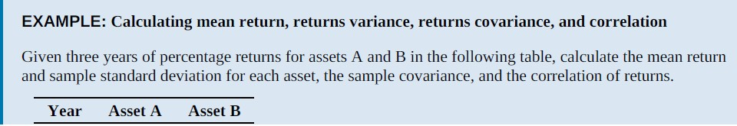
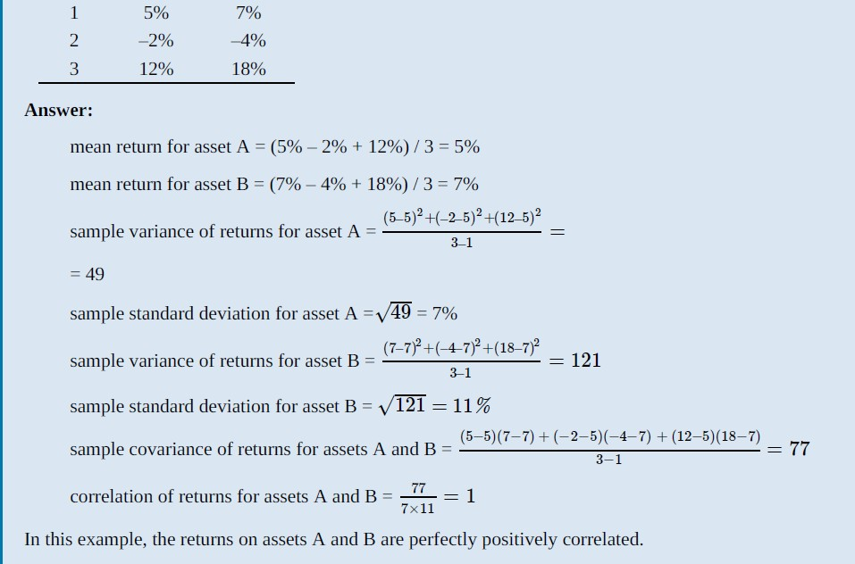

Slide 33

f. calculate and interpret portfolio standard deviation;
The variance of returns for a portfolio of two risky assets is calculated as follows:
where w1 is the proportion of the portfolio invested in Asset 1, and w2 is the proportion
of the portfolio invested in Asset 2. w2 must equal (1 − w1).
Substituting this term for Cov12 in the formula for the variance of returns for a portfolio of two risky assets, we have the following:

Slide 34
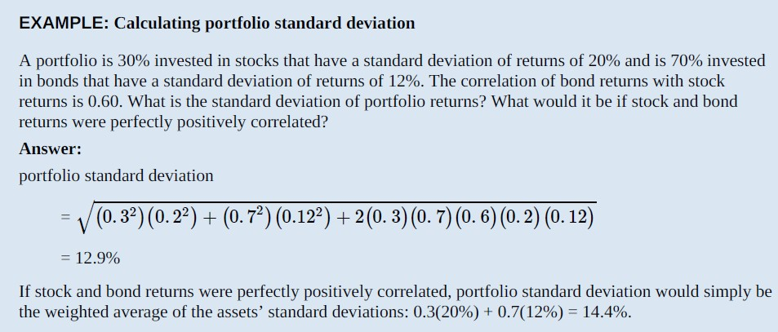

Slide 35
g: Describe the effect on a portfolio’s risk of investing in assets that are
less than perfectly correlated.
If two risky asset returns are perfectly positively correlated, ρ = +1, then the square root of portfolio variance (the portfolio standard deviation of returns) is equal to:
Focusing on returns correlation, we can see that the greatest portfolio risk results when the correlation between asset returns is +1. For any value of correlation less than +1, portfolio variance is reduced.
Note that for a correlation of zero, the entire third term in the portfolio variance equation is zero.
For negative values of correlation ρ, the third term becomes negative and further reduces portfolio variance and standard deviation.
The lower the correlation of asset returns, the greater the risk reduction (diversification)
benefit of combining assets in a portfolio.
If asset returns were perfectly negatively correlated, portfolio risk could be eliminated altogether for a specific set of asset weights.
Adding more assets to the portfolio with low correlation , standard deviation of the portfolio is decreased when they are equally weighted as correlation is the only determinant of risk reduction as weights are constant.

Slide 36
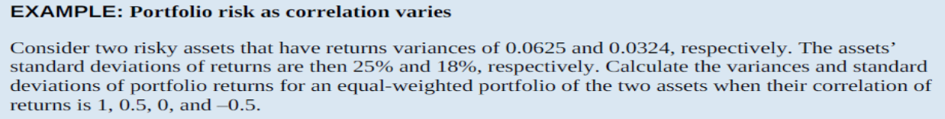

Slide 37
Reference
Foundations of Financial Risk.
An Overview of Financial Risk and Risk-Based Regulation.
Richard Apostolik
Christopher Donohue
Chapter 5

