Slide 1
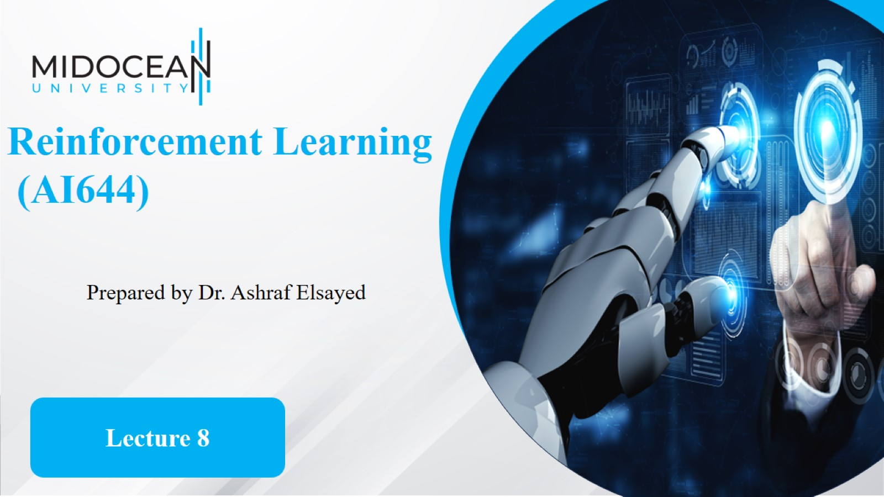

Slide 2


Slide 3
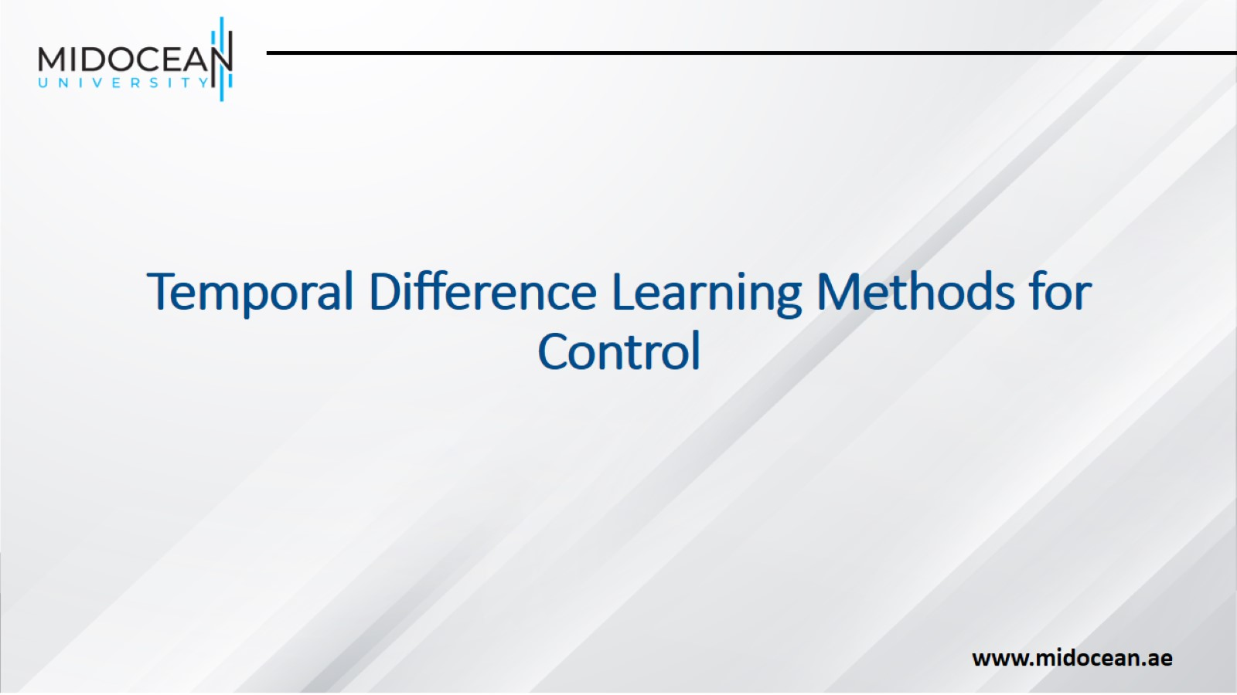
Temporal Difference Learning Methods for Control

Slide 4
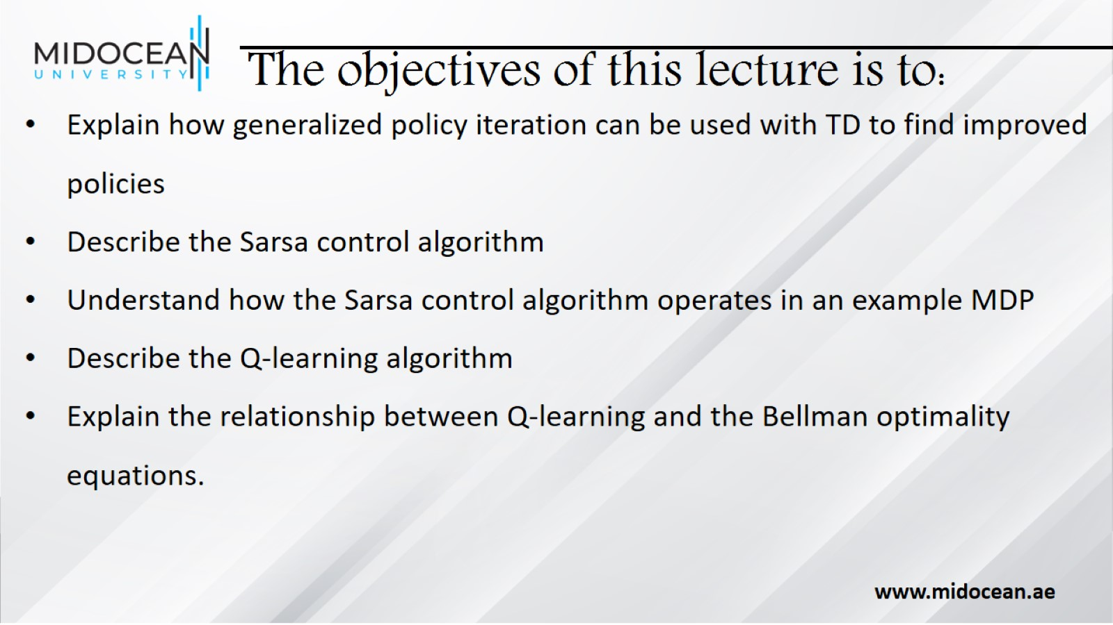
The objectives of this lecture is to:

Slide 5
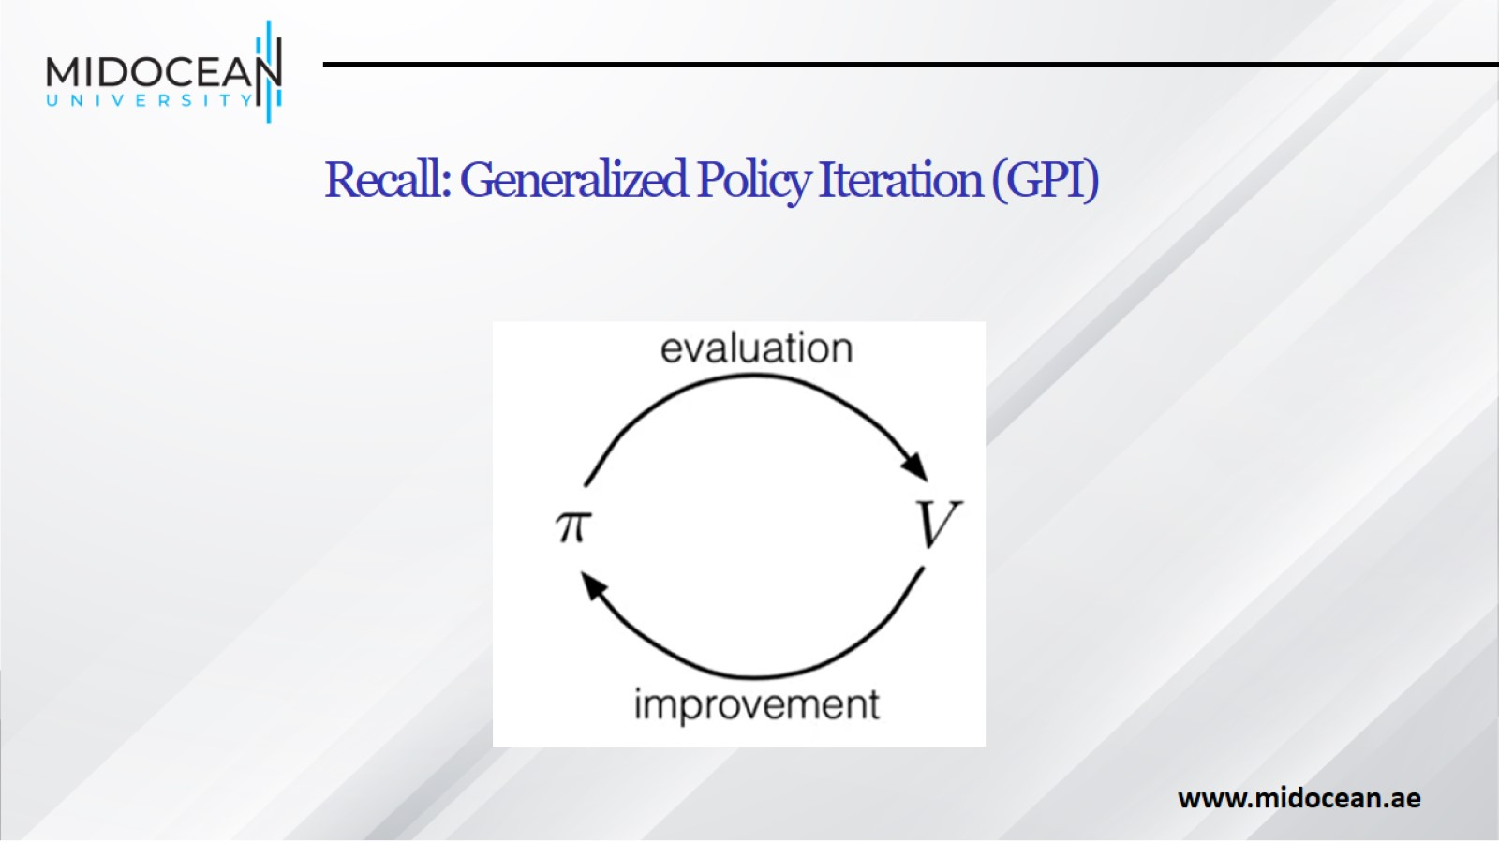
Recall: Generalized Policy Iteration (GPI)

Slide 6
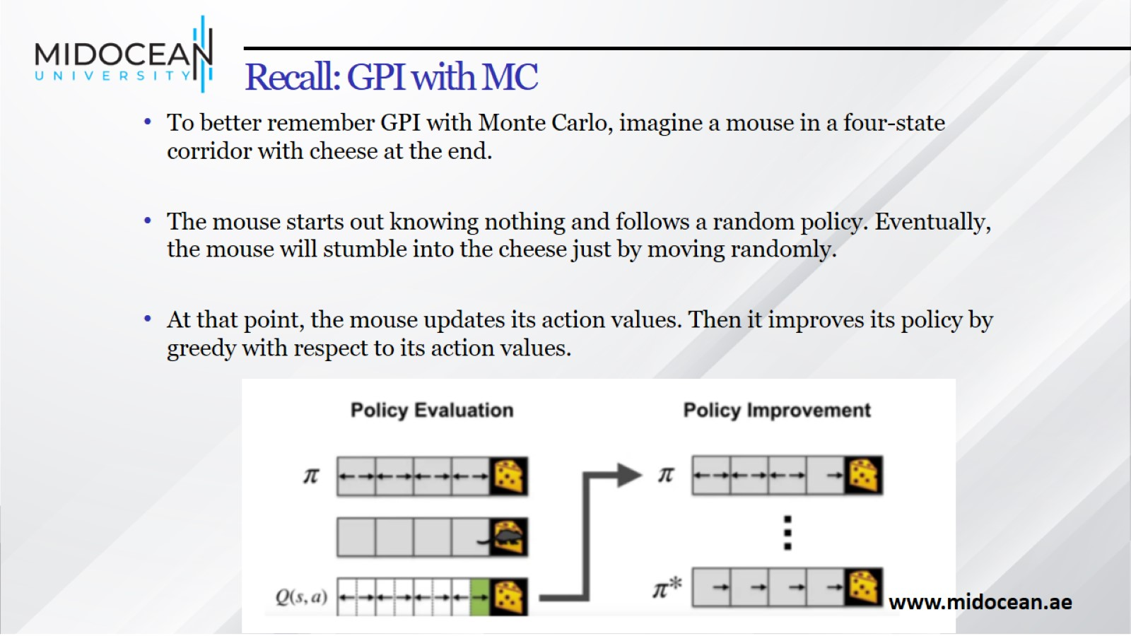
Recall: GPI with MC

Slide 7
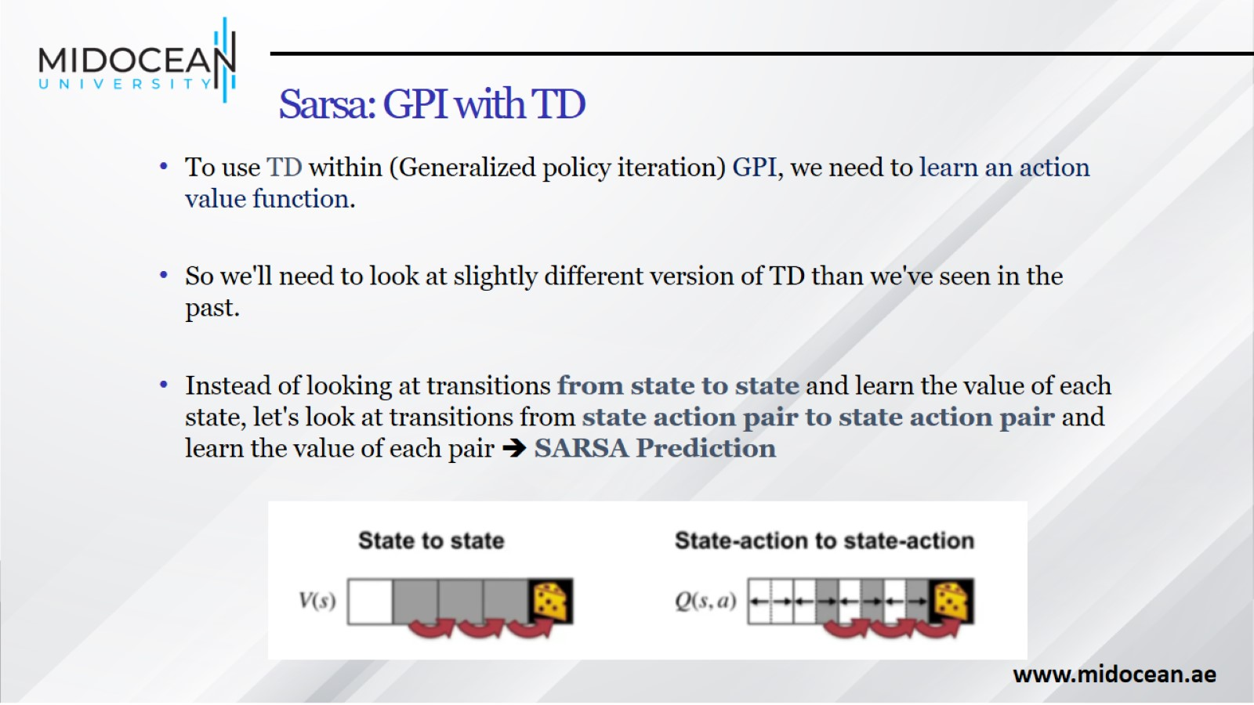
Sarsa: GPI with TD

Slide 8
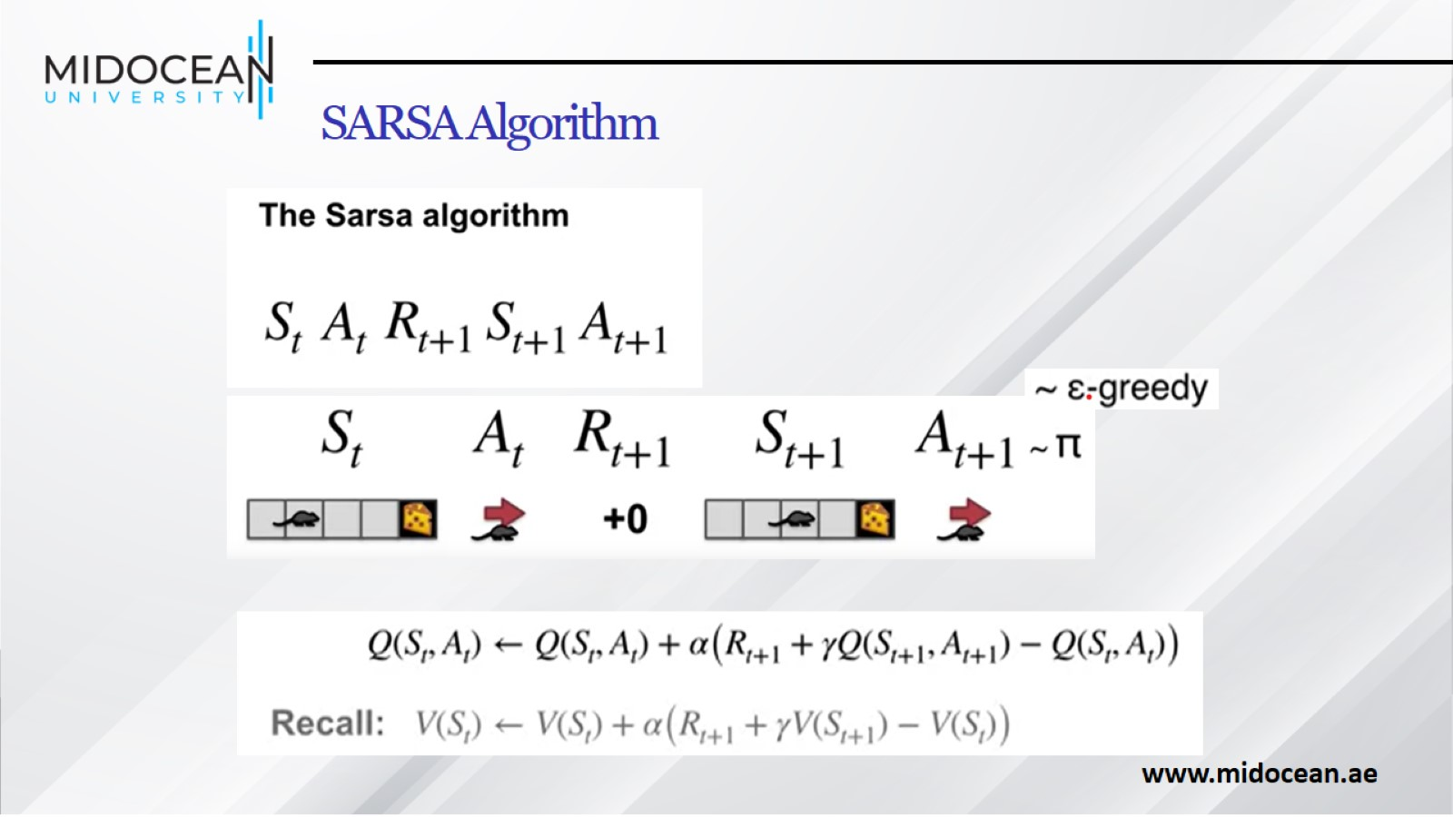
SARSA Algorithm

Slide 9
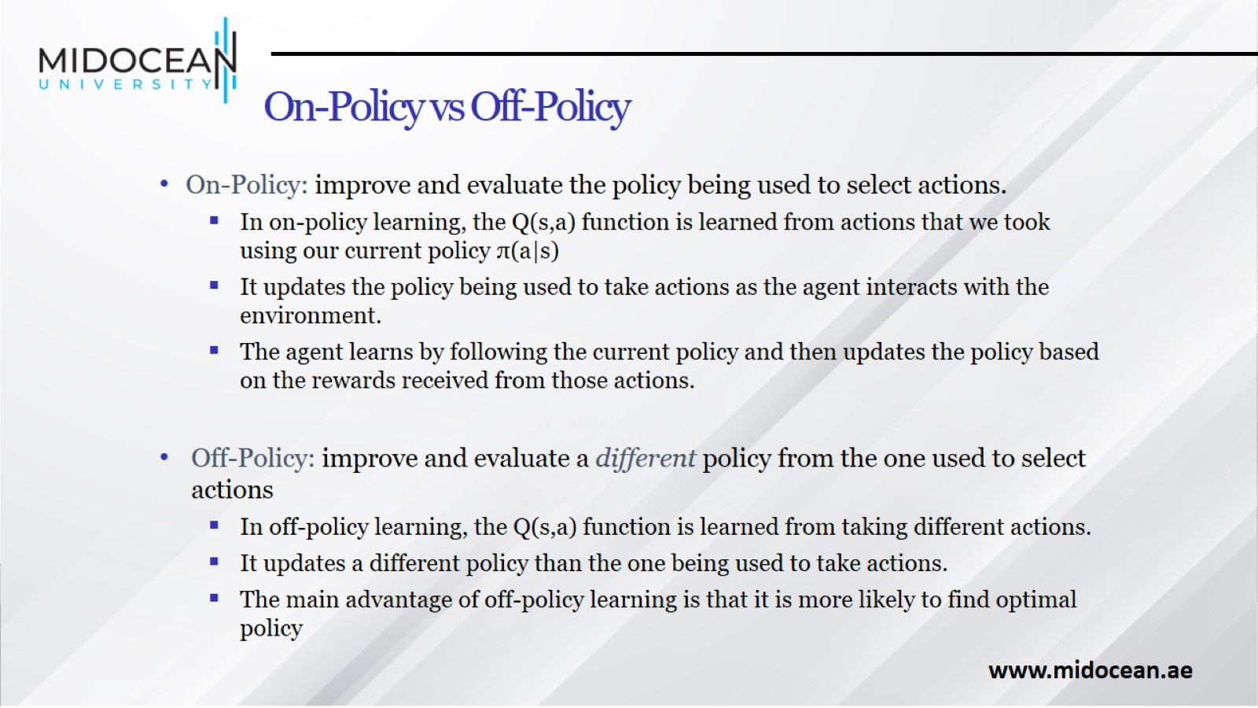
On-Policy vs Off-Policy

Slide 10
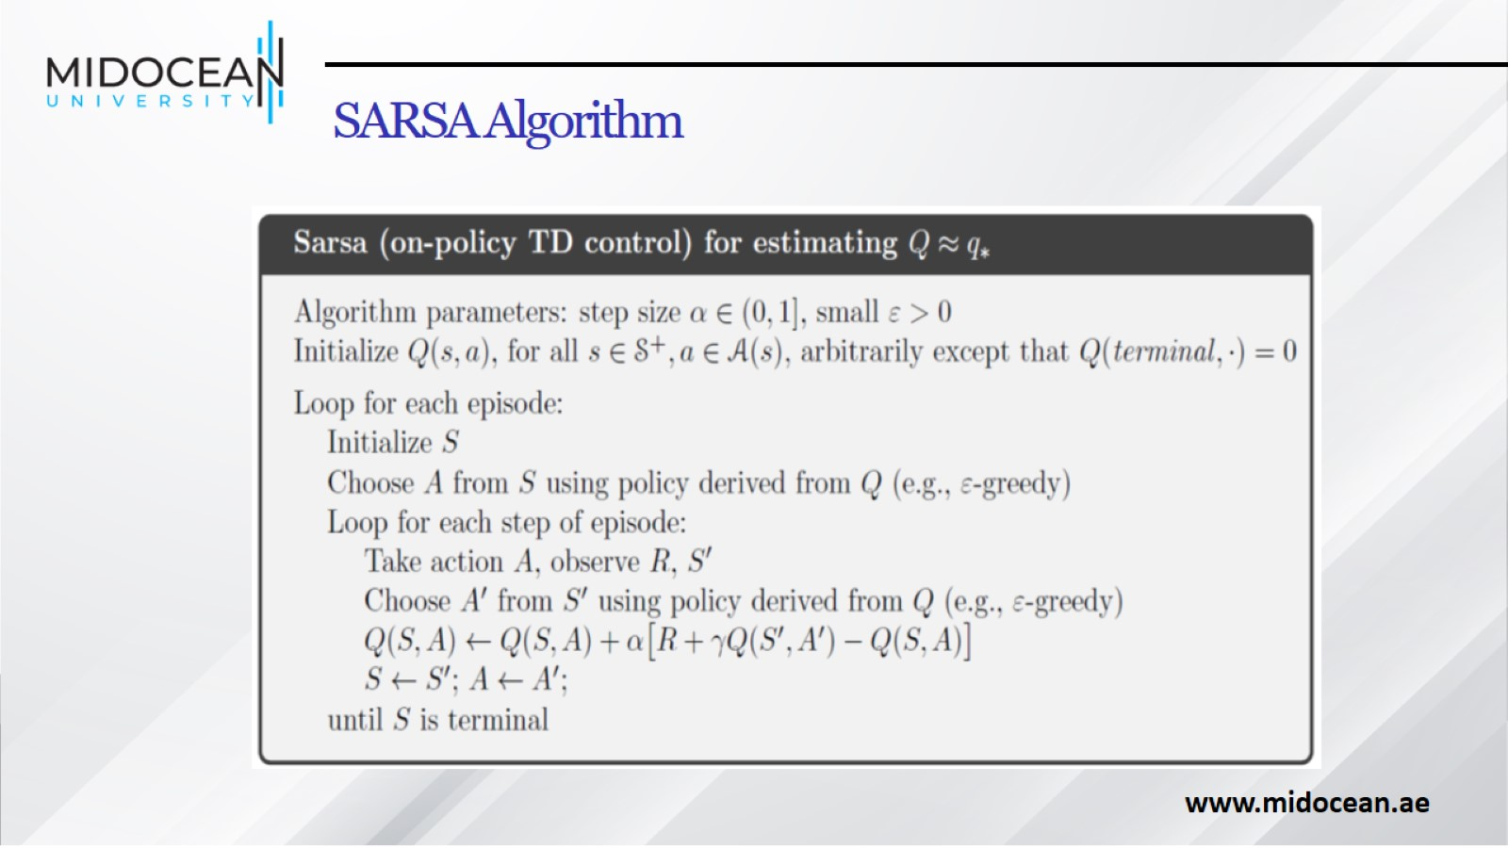
SARSA Algorithm

Slide 11
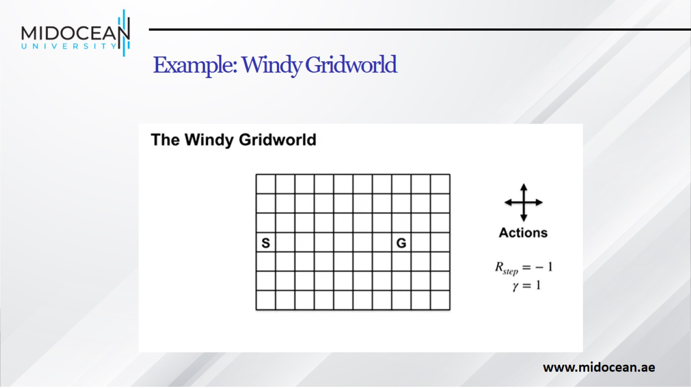
Example: Windy Gridworld

Slide 12
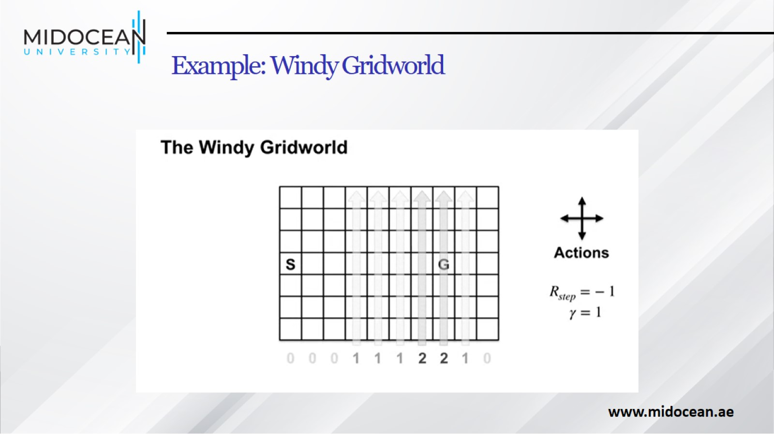
Example: Windy Gridworld

Slide 13
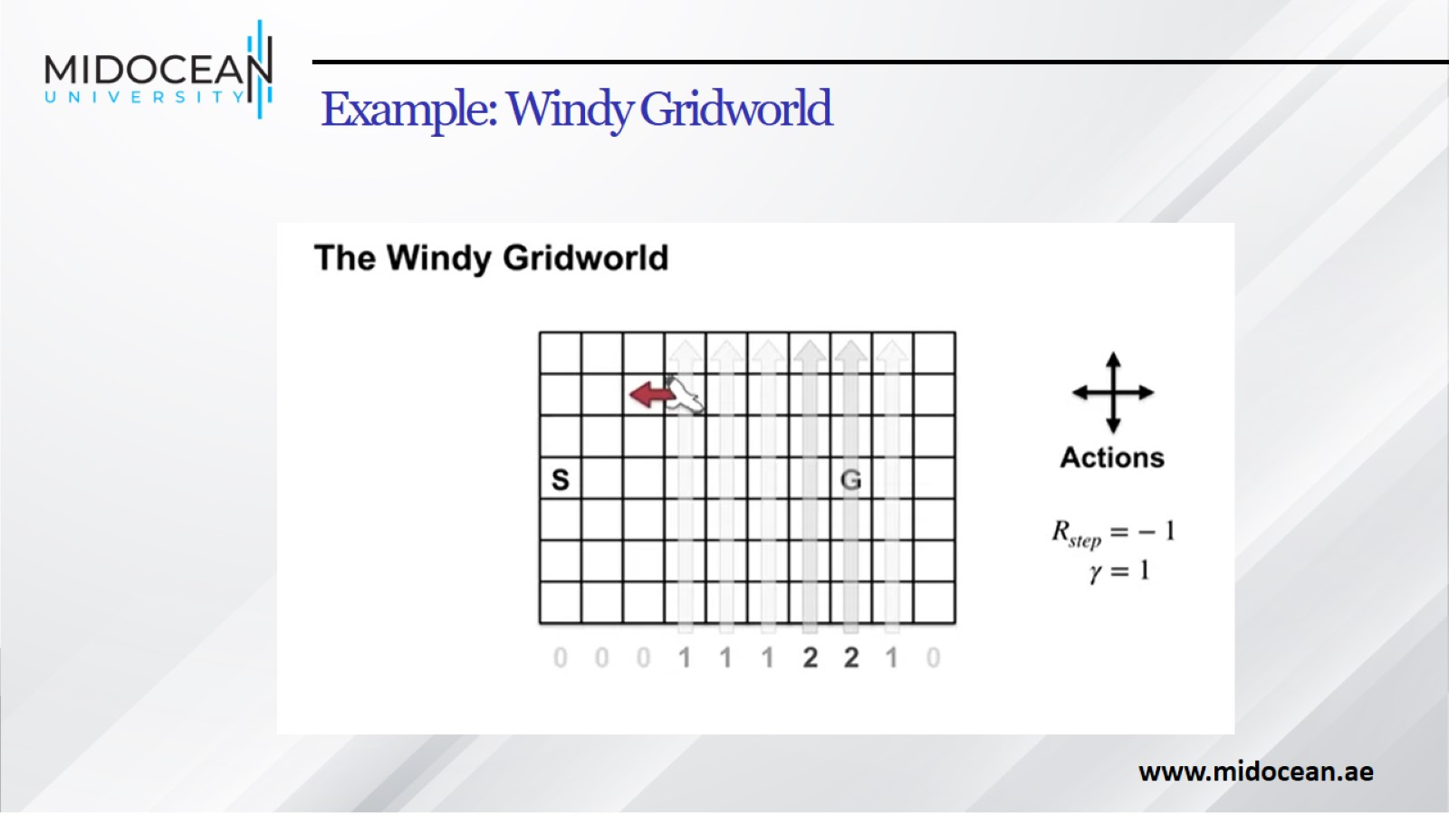
Example: Windy Gridworld

Slide 14
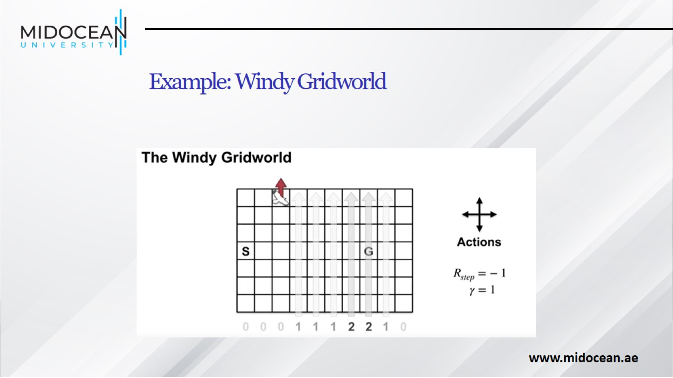
Example: Windy Gridworld

Slide 15
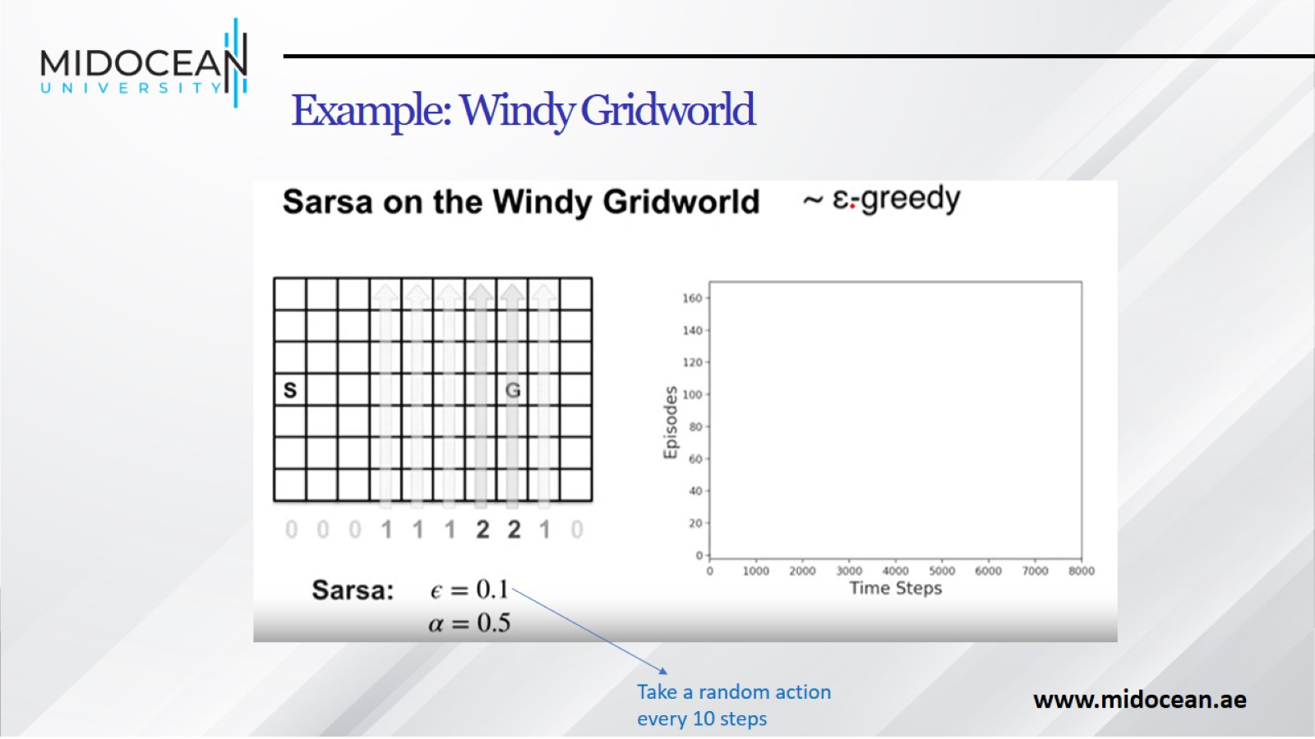
Example: Windy Gridworld

Slide 16
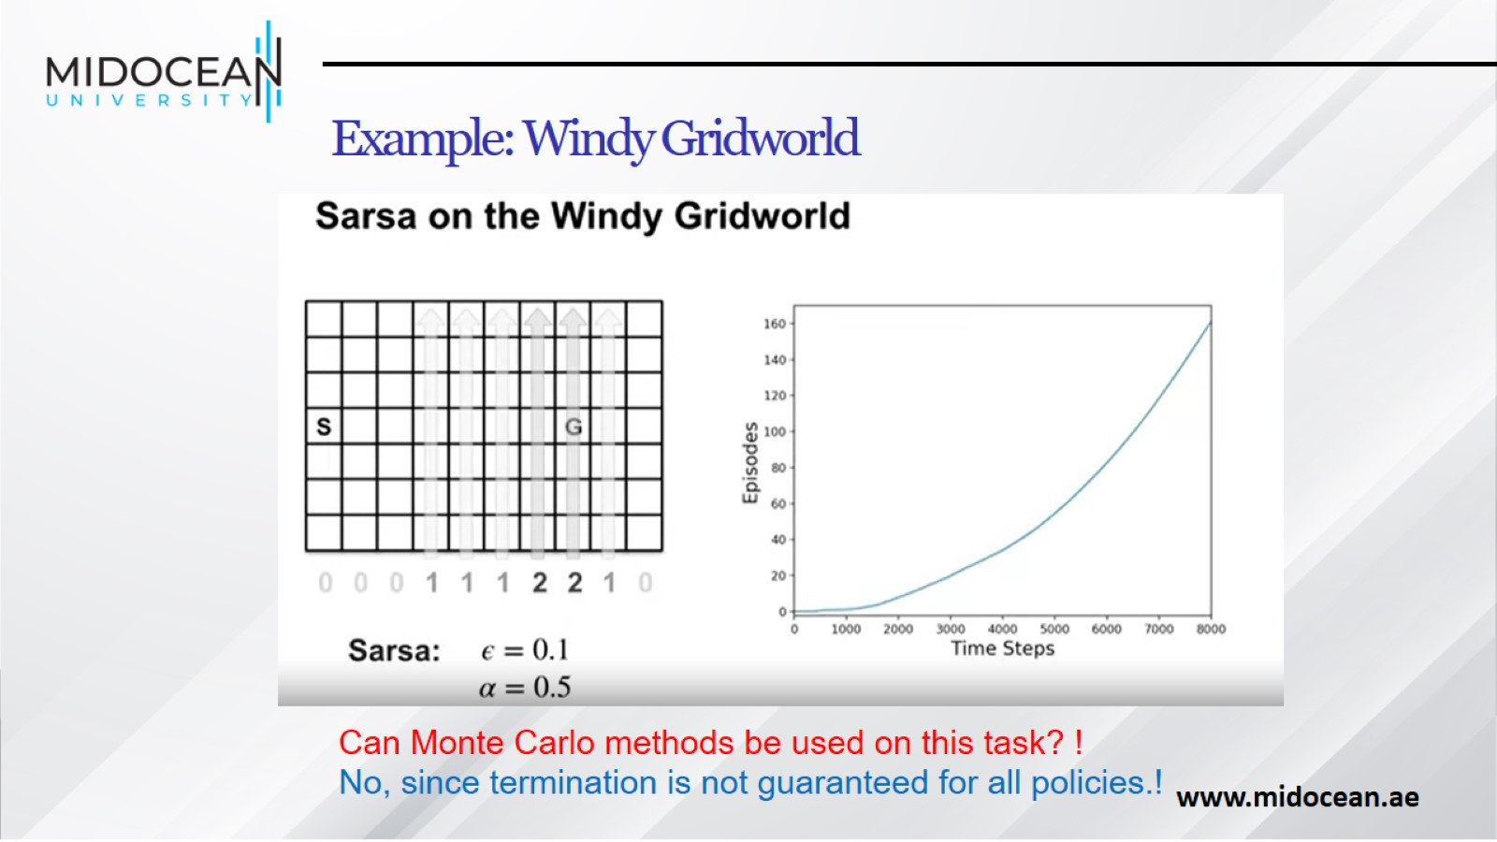
Example: Windy Gridworld

Slide 17
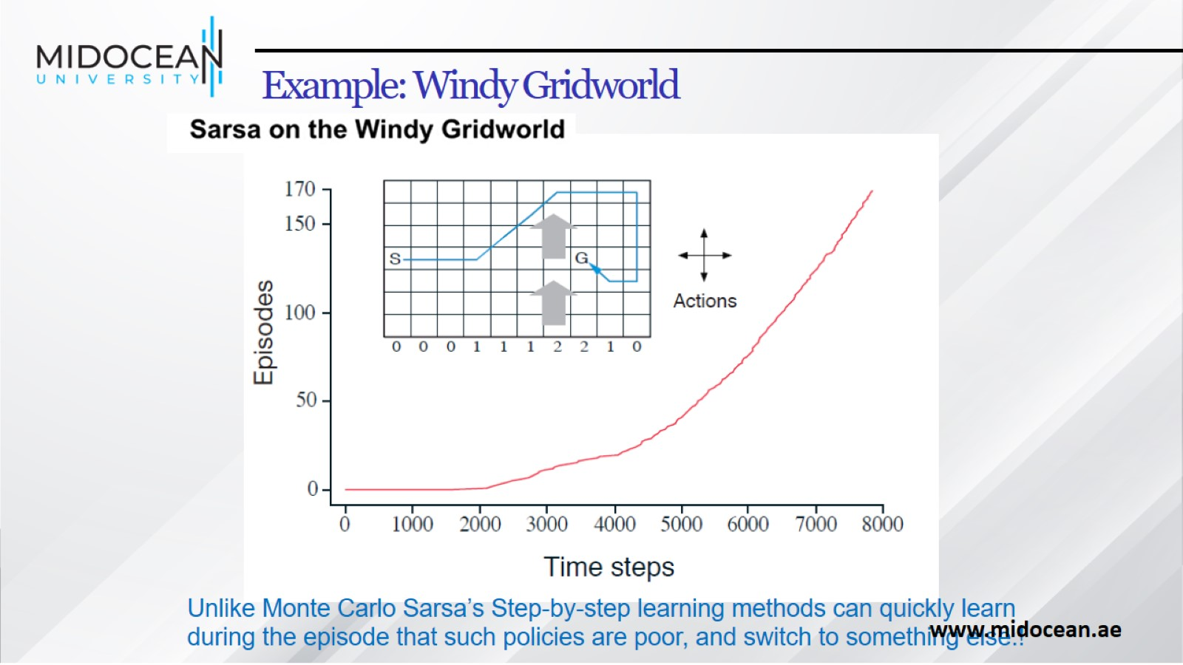
Example: Windy Gridworld

Slide 18
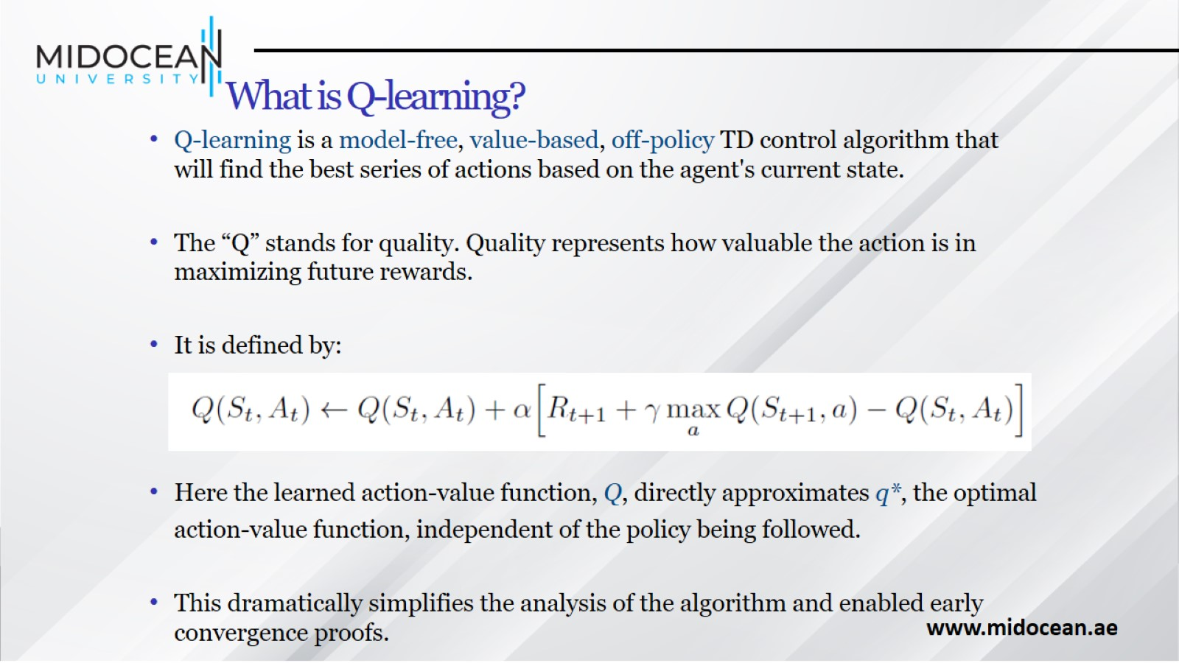
What is Q-learning?

Slide 19
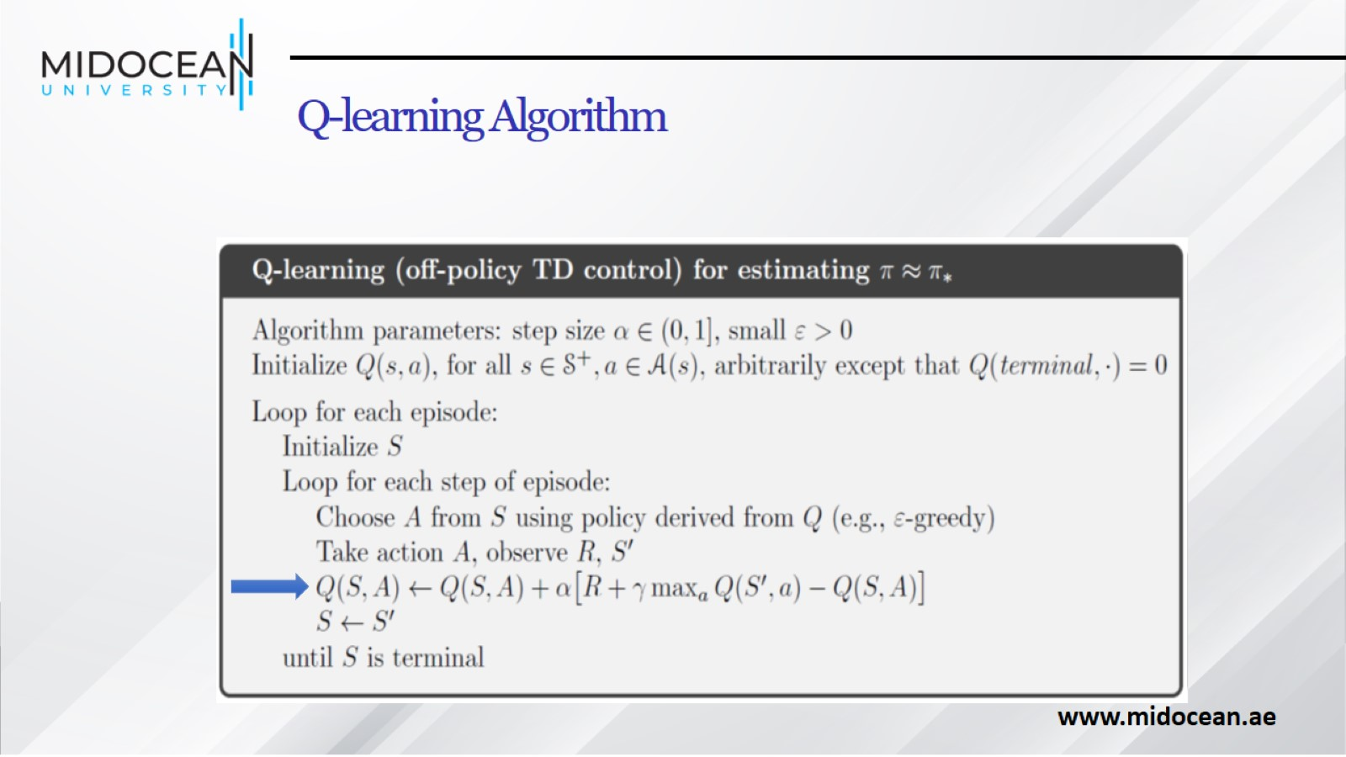
Q-learning Algorithm

Slide 20
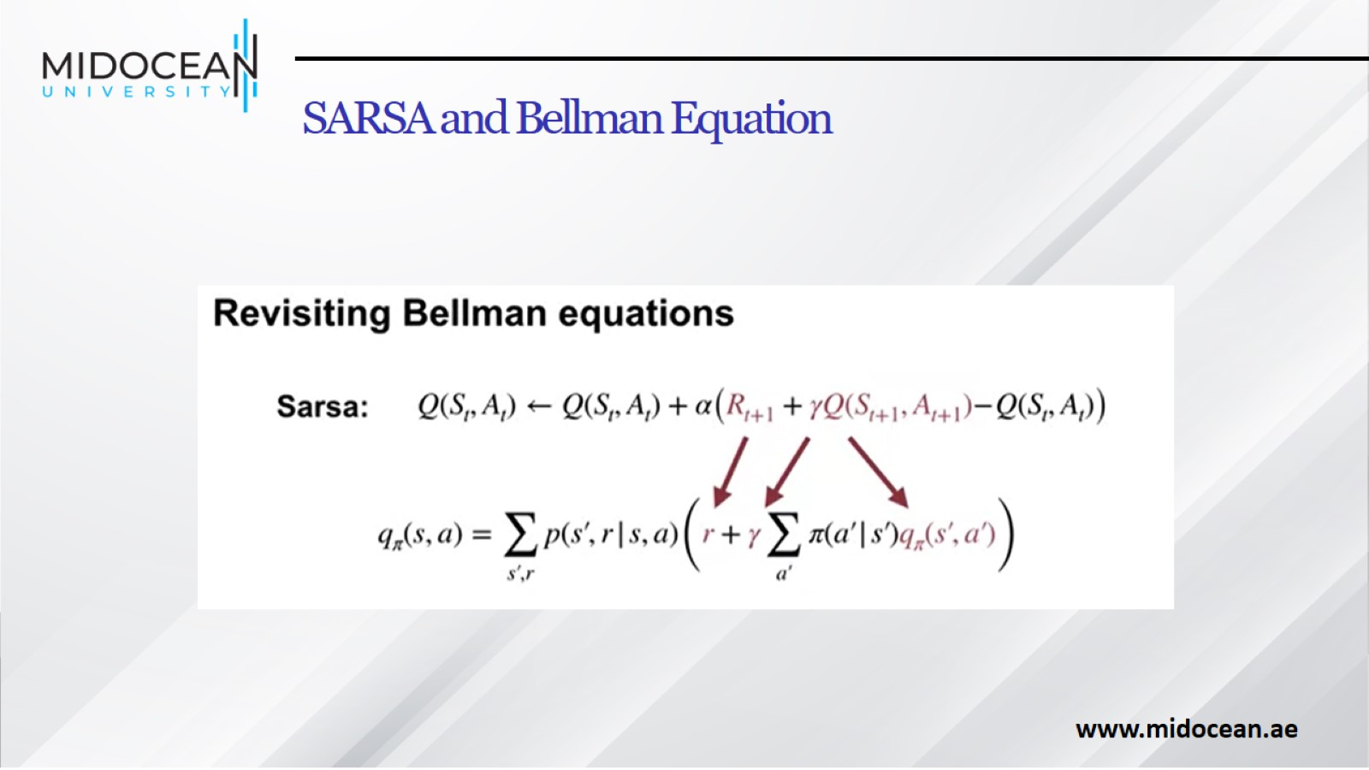
SARSA and Bellman Equation

Slide 21
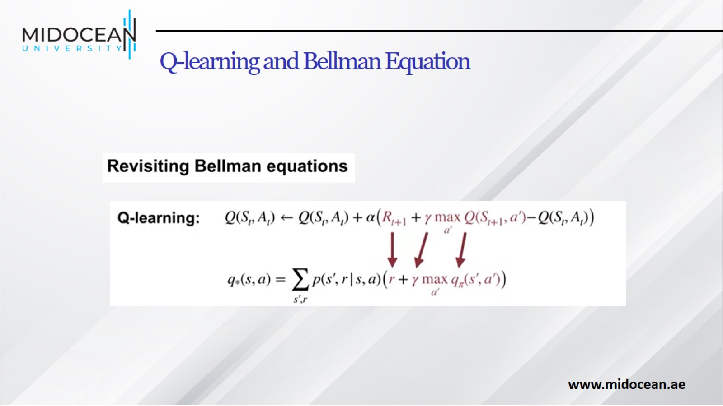
Q-learning and Bellman Equation

Slide 22
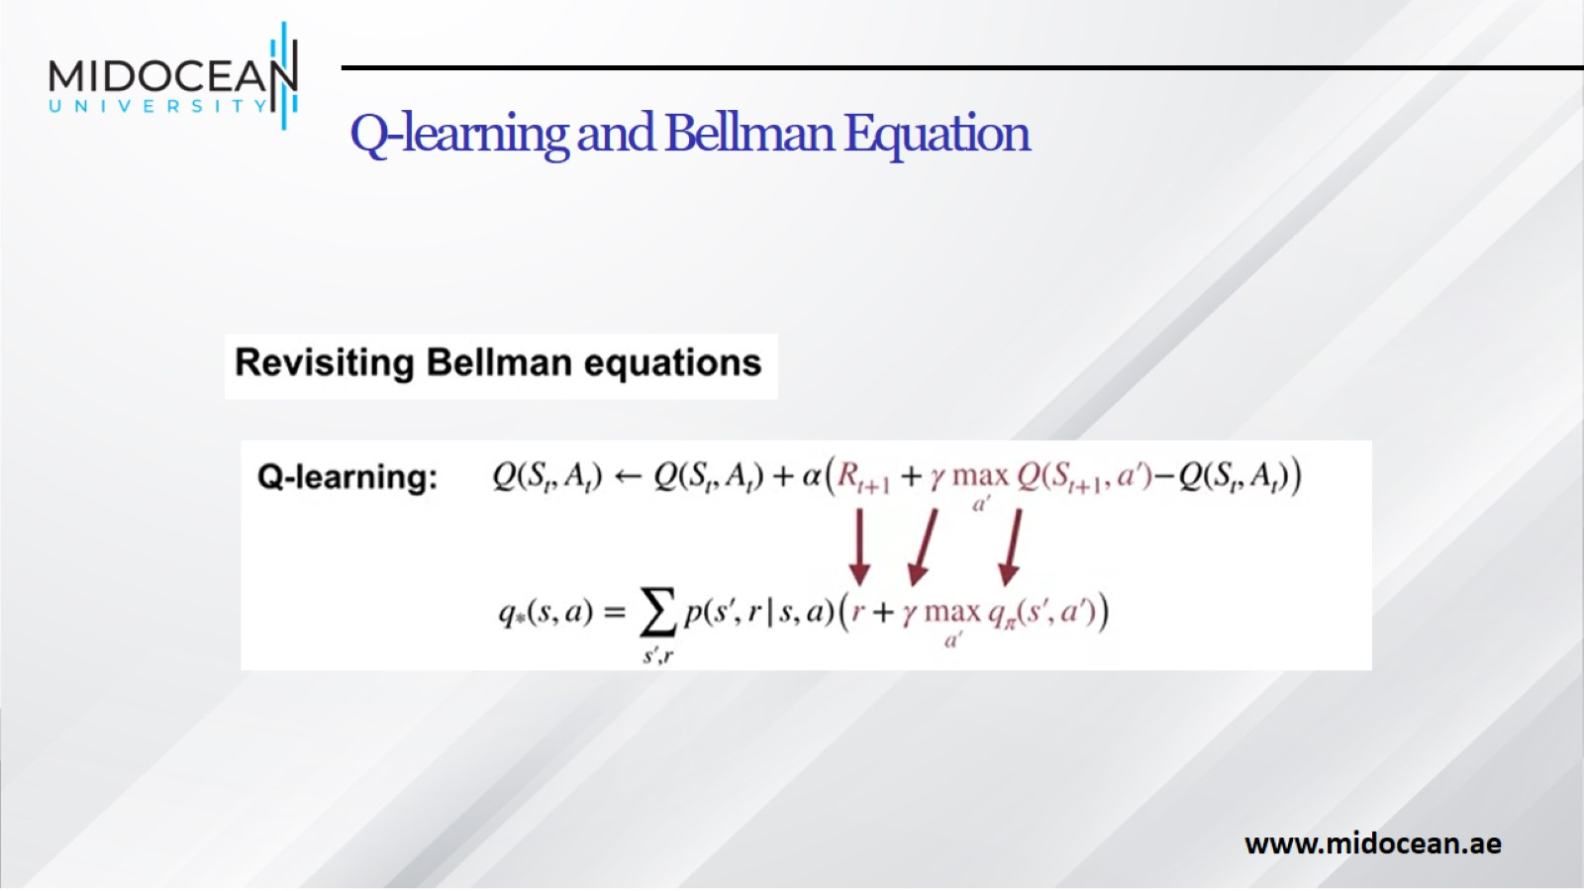
Q-learning and Bellman Equation

Slide 23
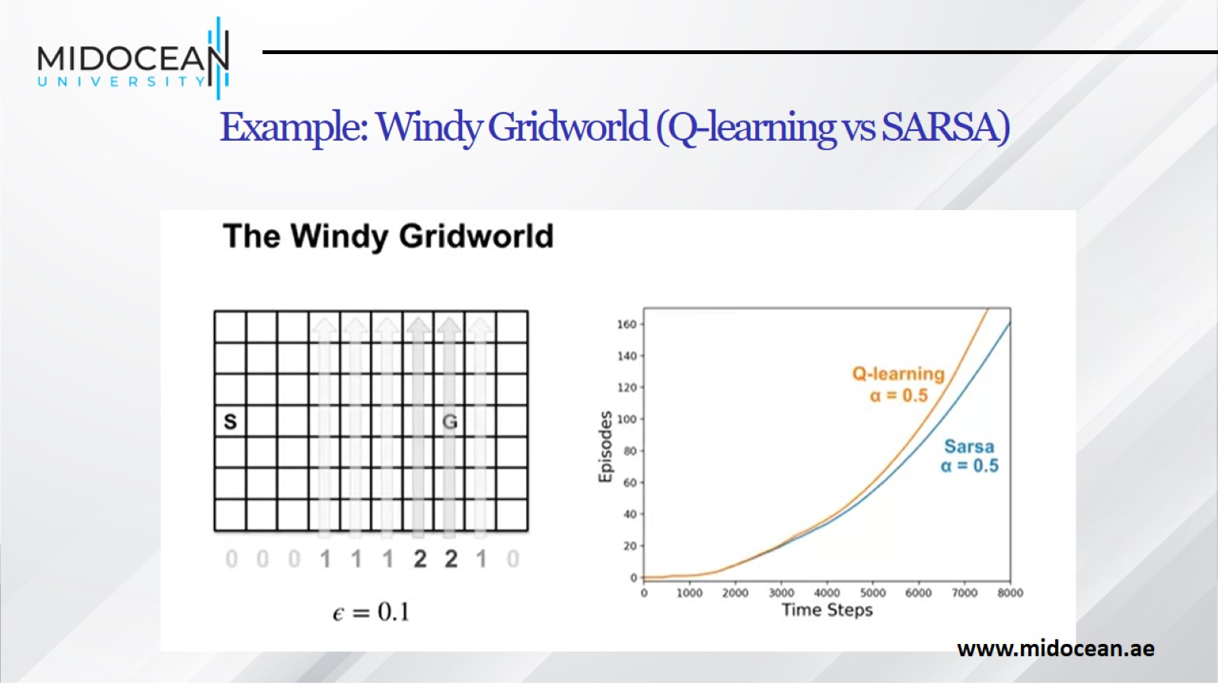
Example: Windy Gridworld (Q-learning vs SARSA)

Slide 24
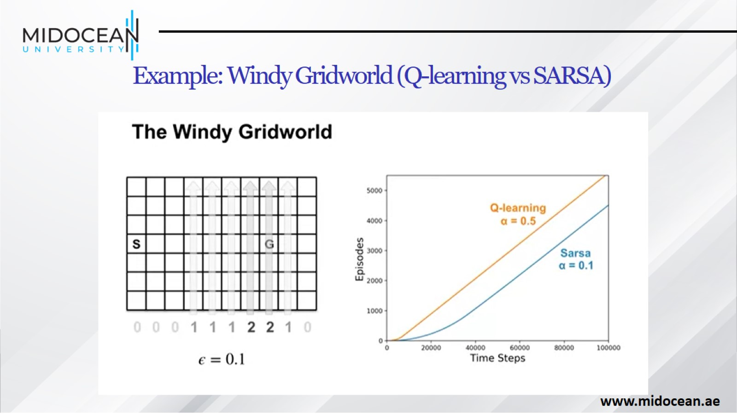
Example: Windy Gridworld (Q-learning vs SARSA)

Slide 25
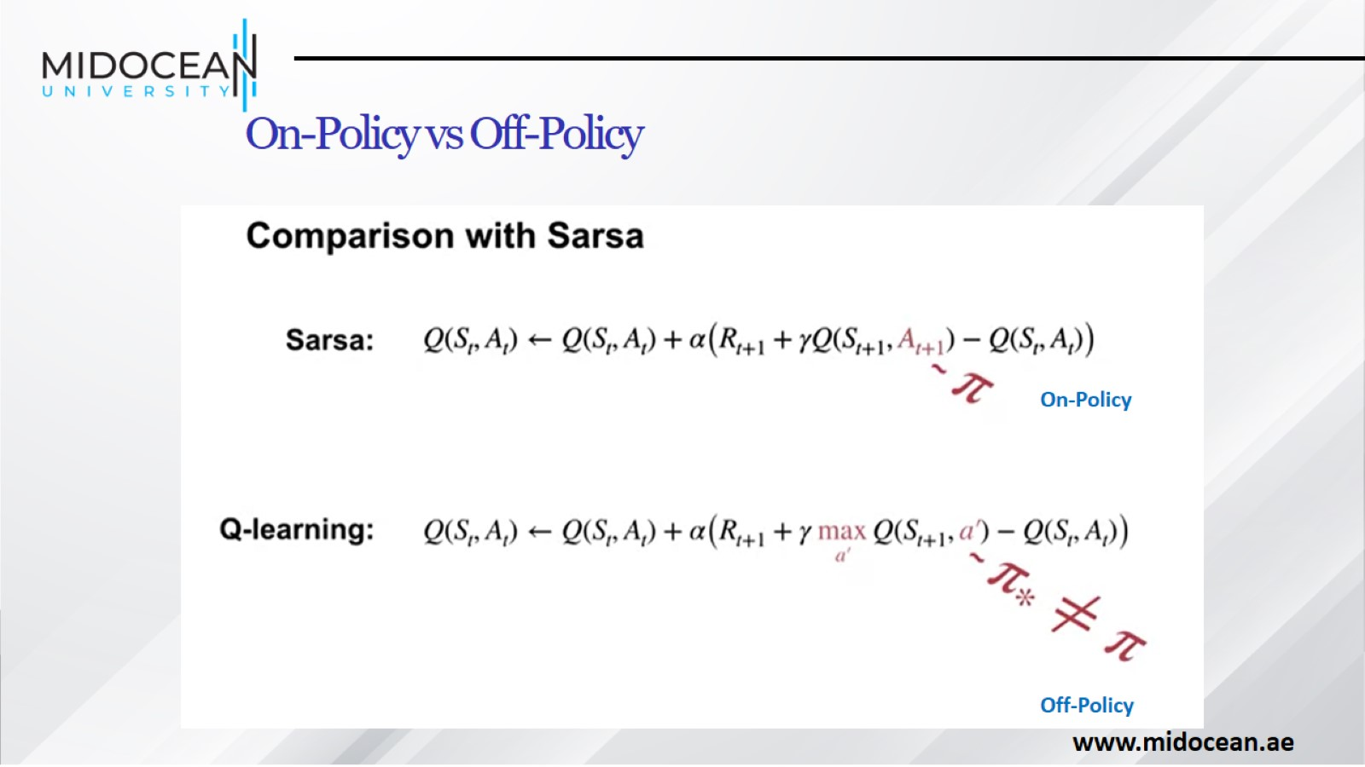
On-Policy vs Off-Policy

Slide 26
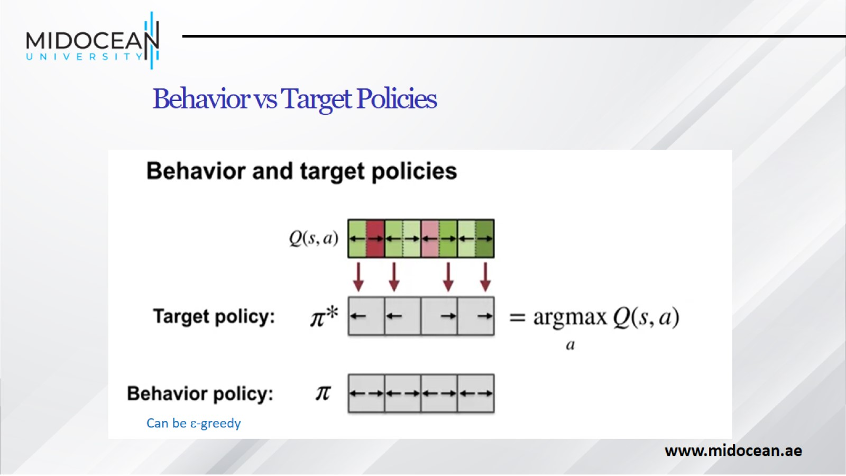
Behavior vs Target Policies

Slide 27
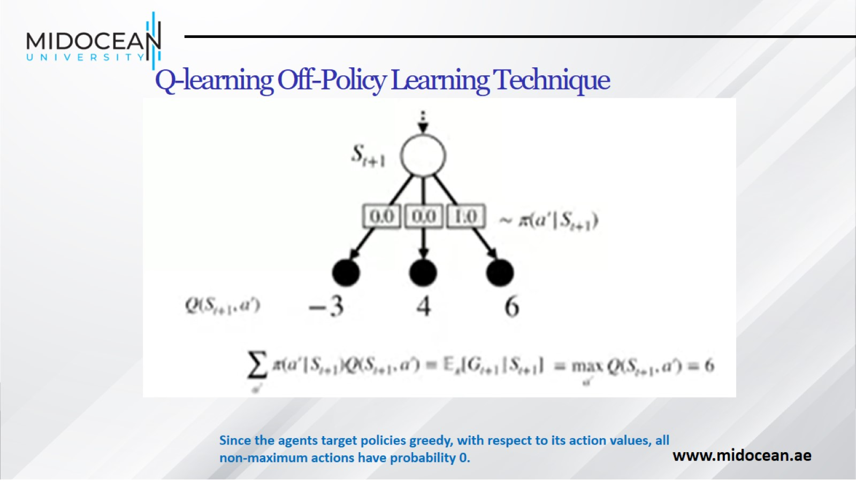
Q-learning Off-Policy Learning Technique

Slide 28
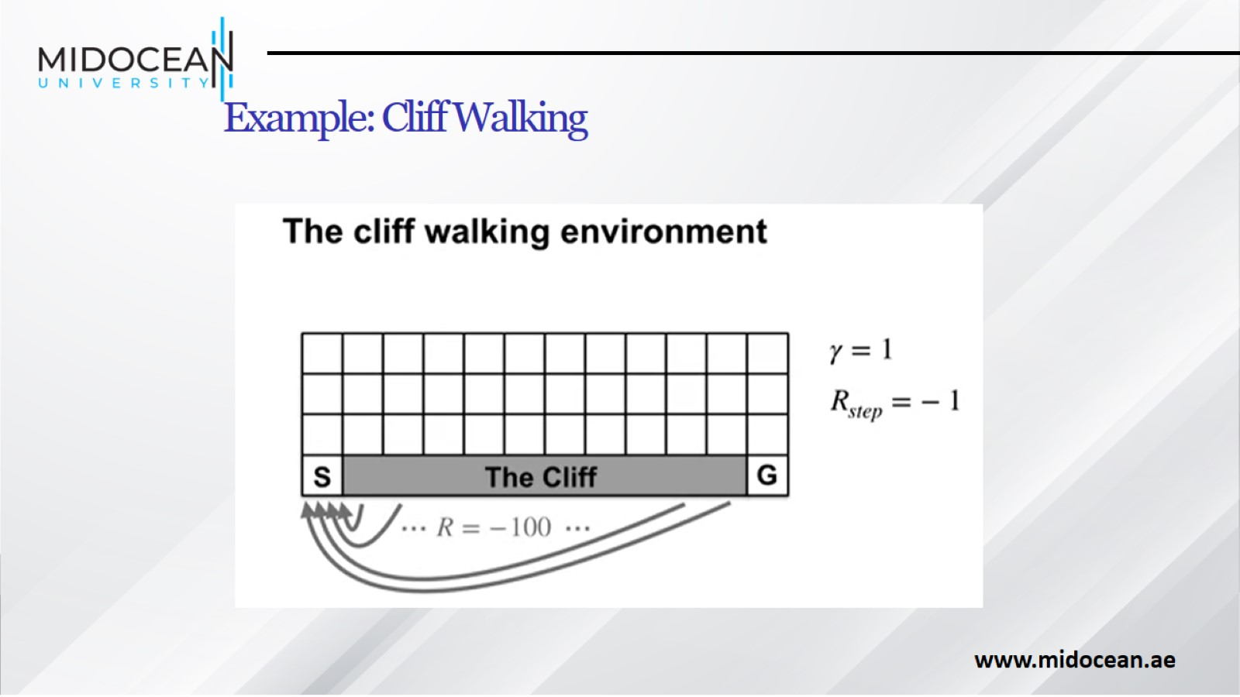
Example: Cliff Walking

Slide 29
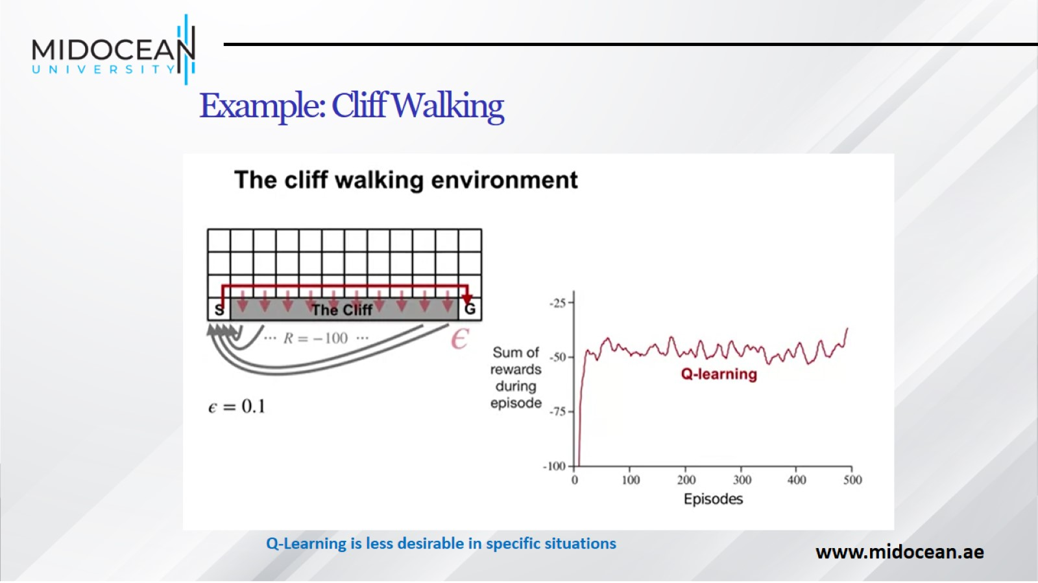
Example: Cliff Walking

Slide 30
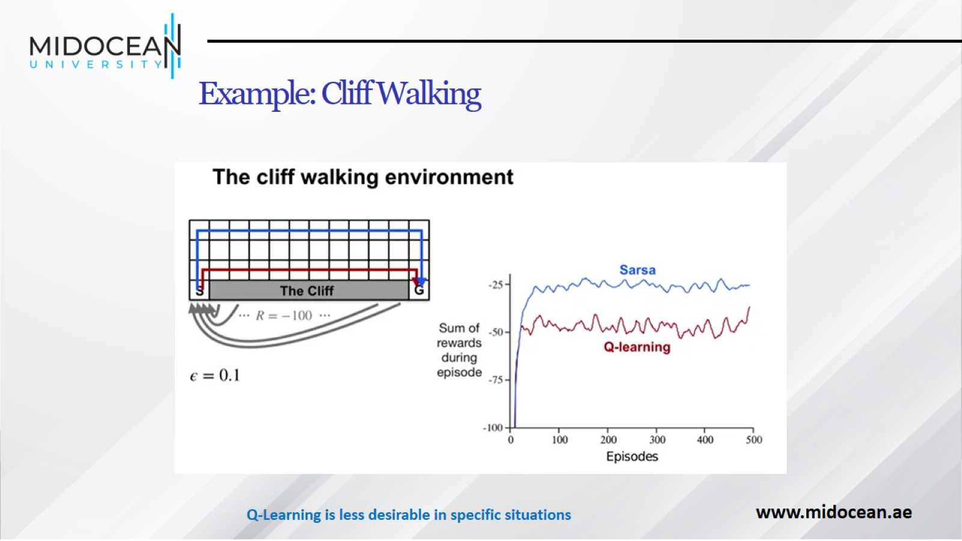
Example: Cliff Walking

Slide 31
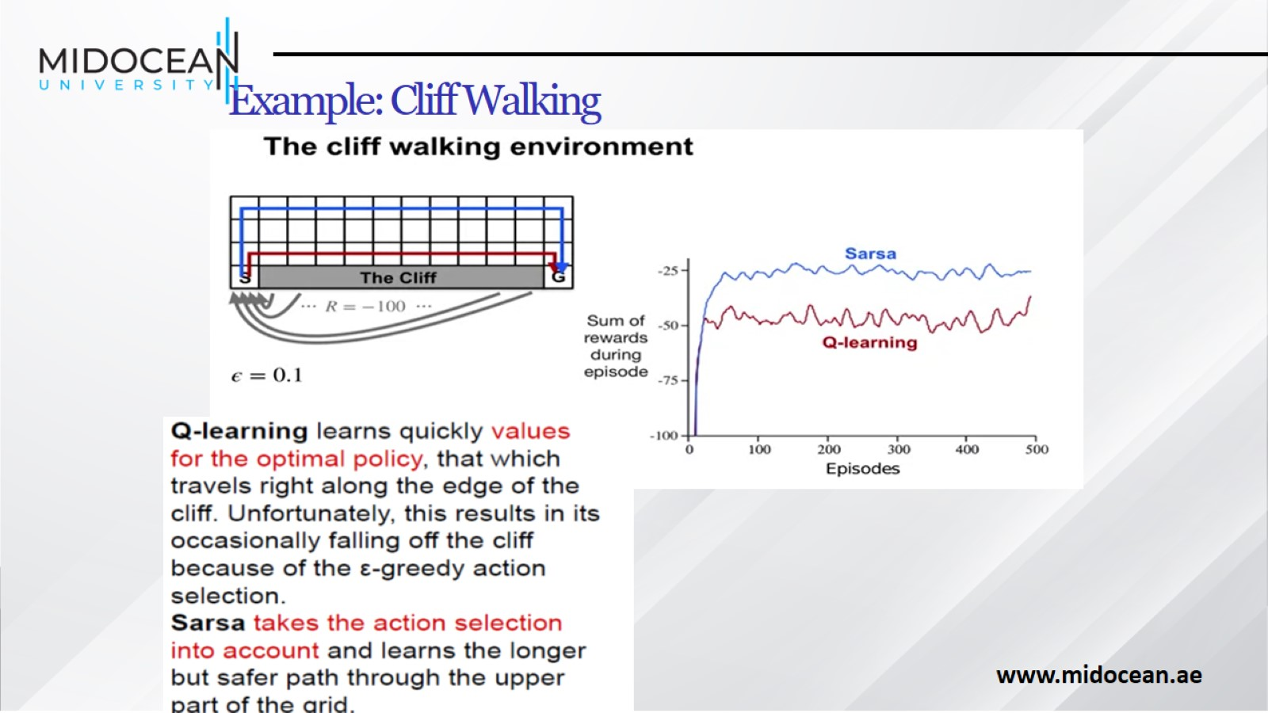
Example: Cliff Walking

Slide 32
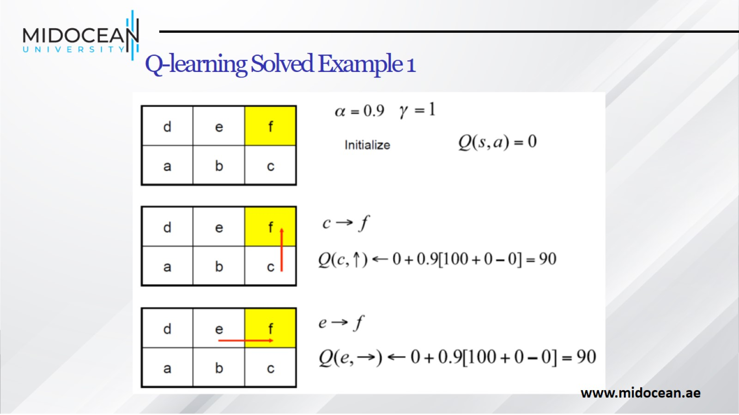
Q-learning Solved Example 1

Slide 33
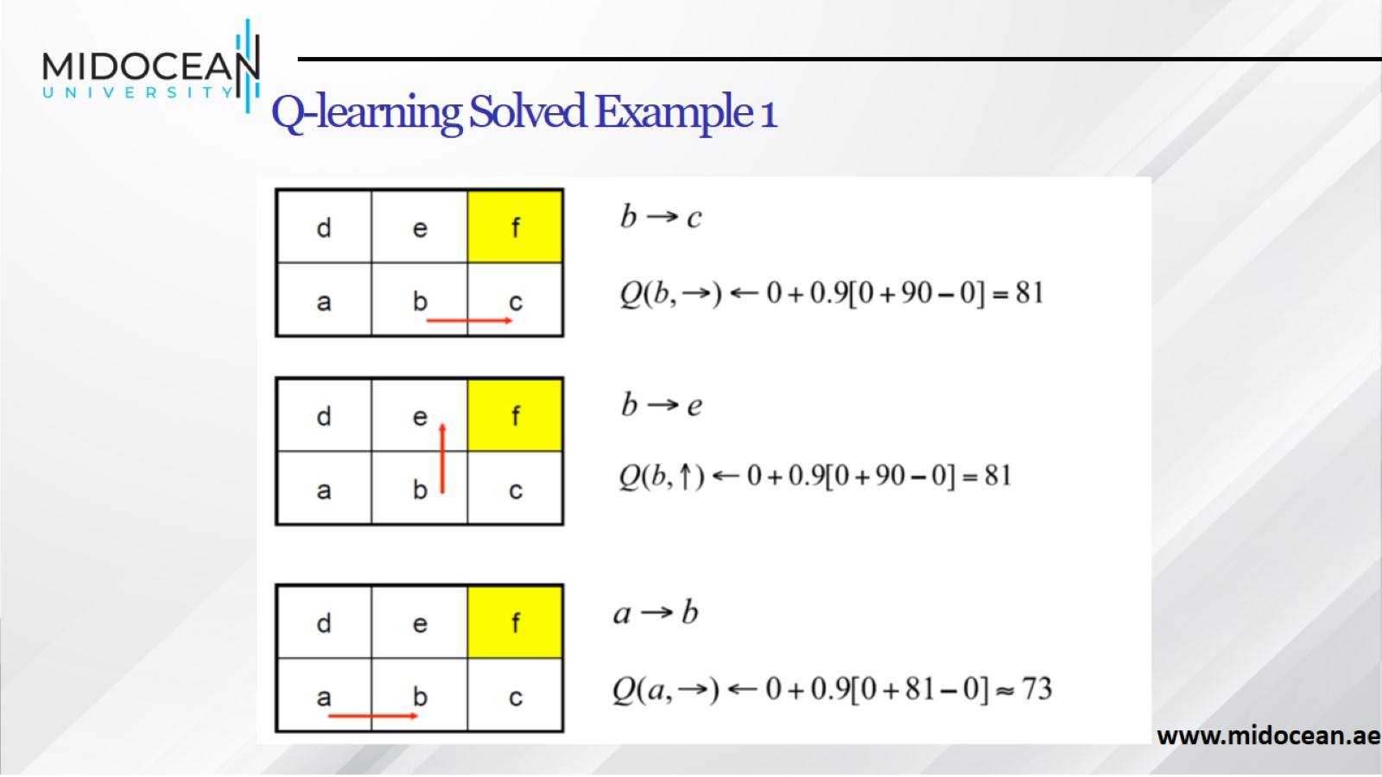
Q-learning Solved Example 1

Slide 34
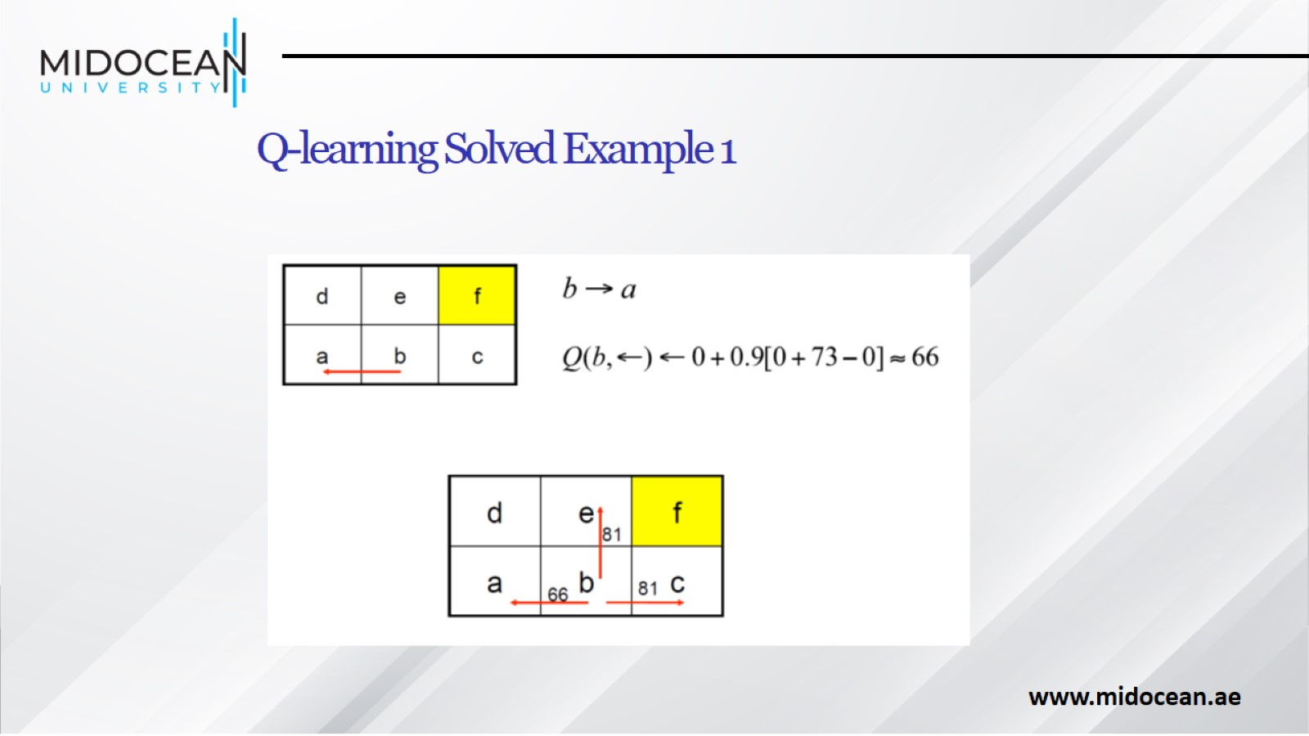
Q-learning Solved Example 1

Slide 35
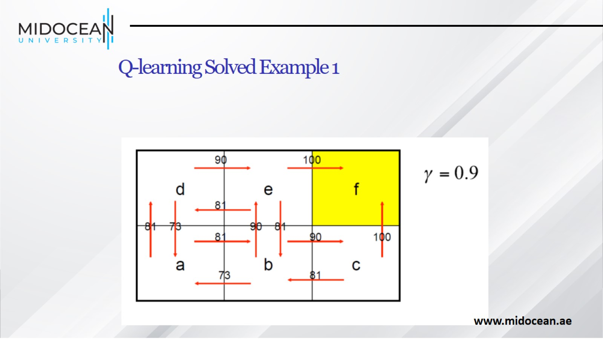
Q-learning Solved Example 1

Slide 36
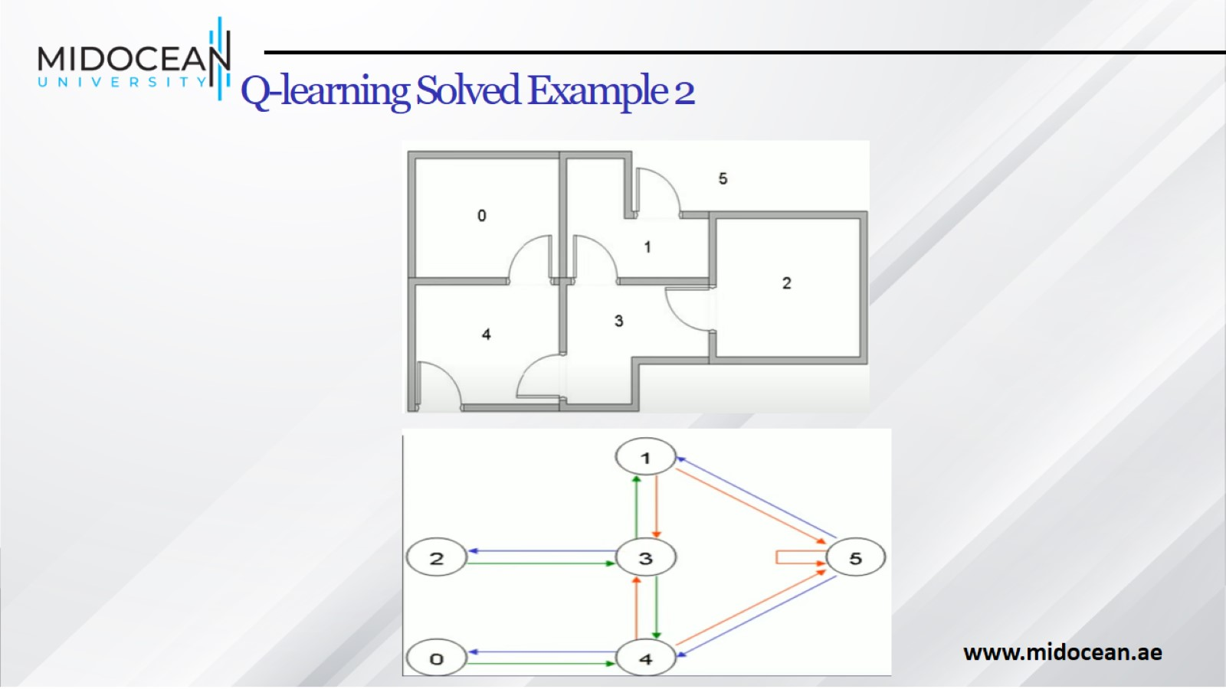
Q-learning Solved Example 2

Slide 37
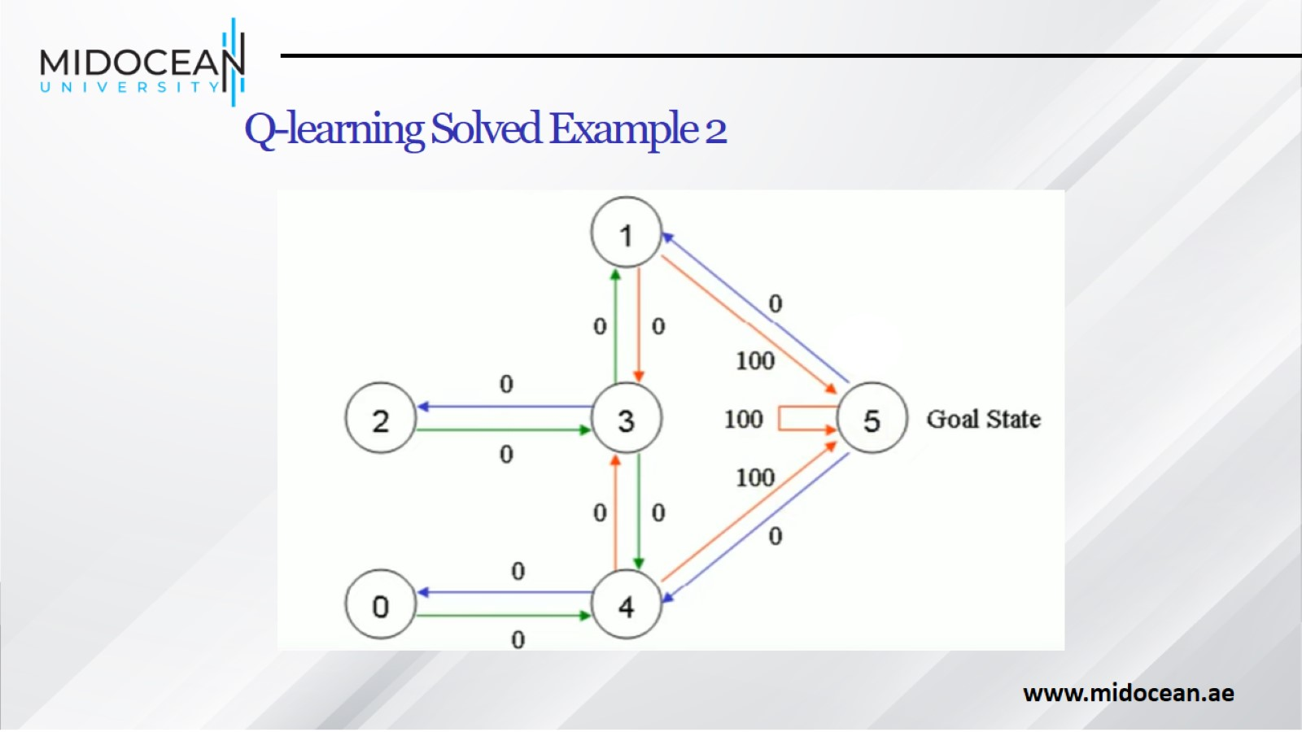
Q-learning Solved Example 2

Slide 38
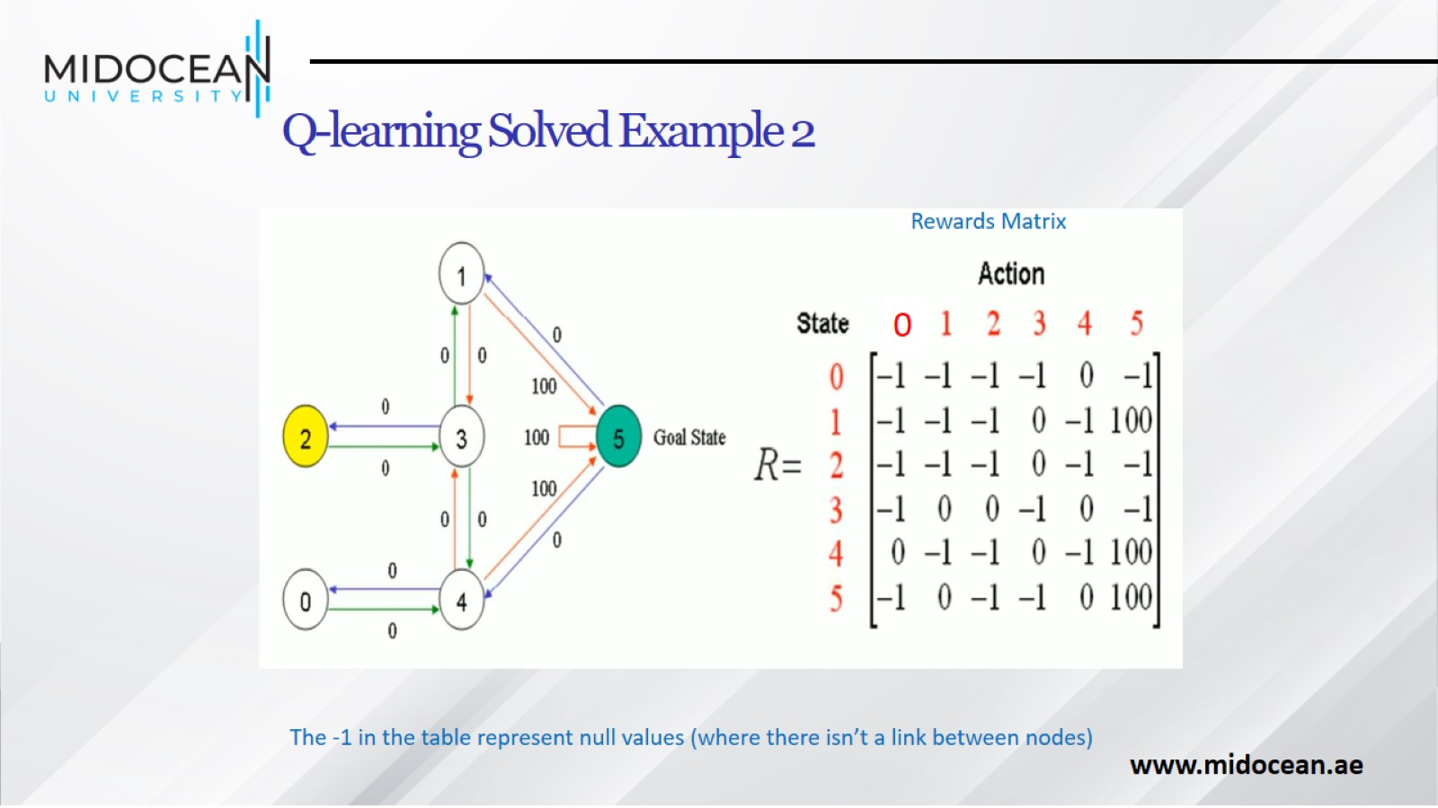
Q-learning Solved Example 2

Slide 39
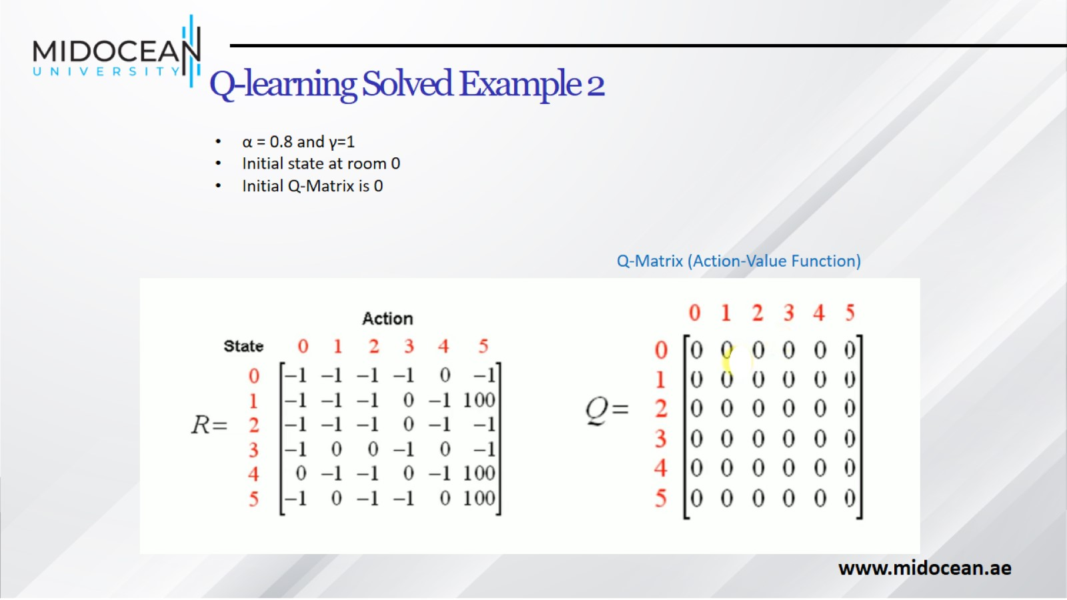
Q-learning Solved Example 2

Slide 40
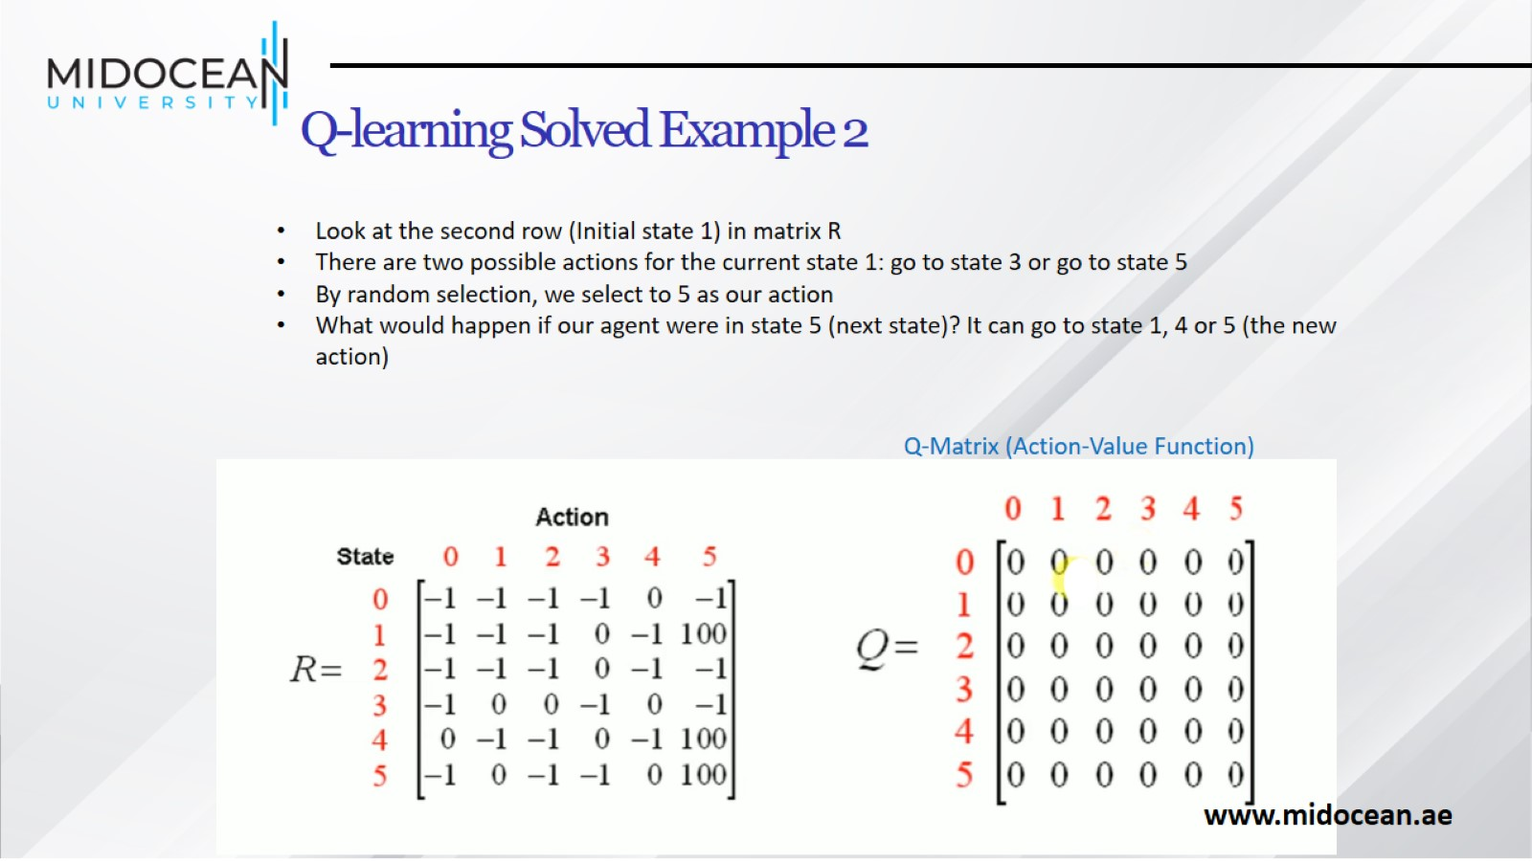
Q-learning Solved Example 2

Slide 41
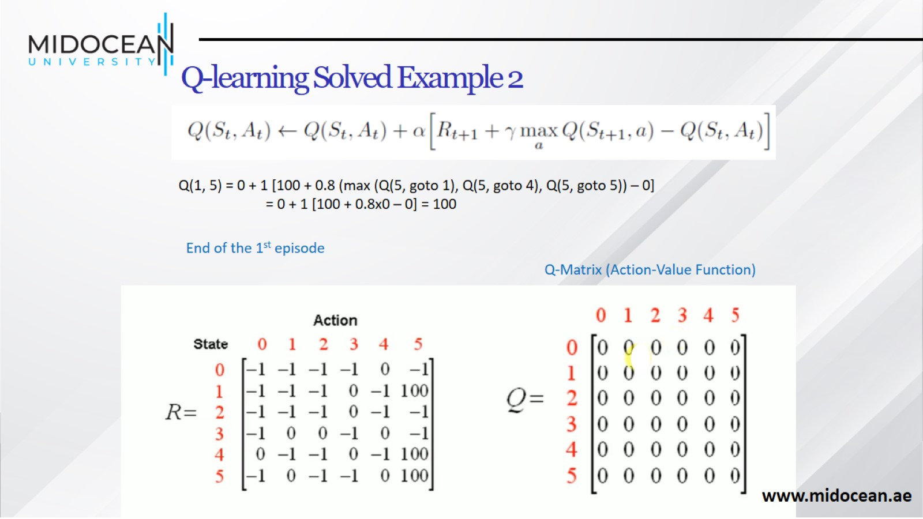
Q-learning Solved Example 2

Slide 42
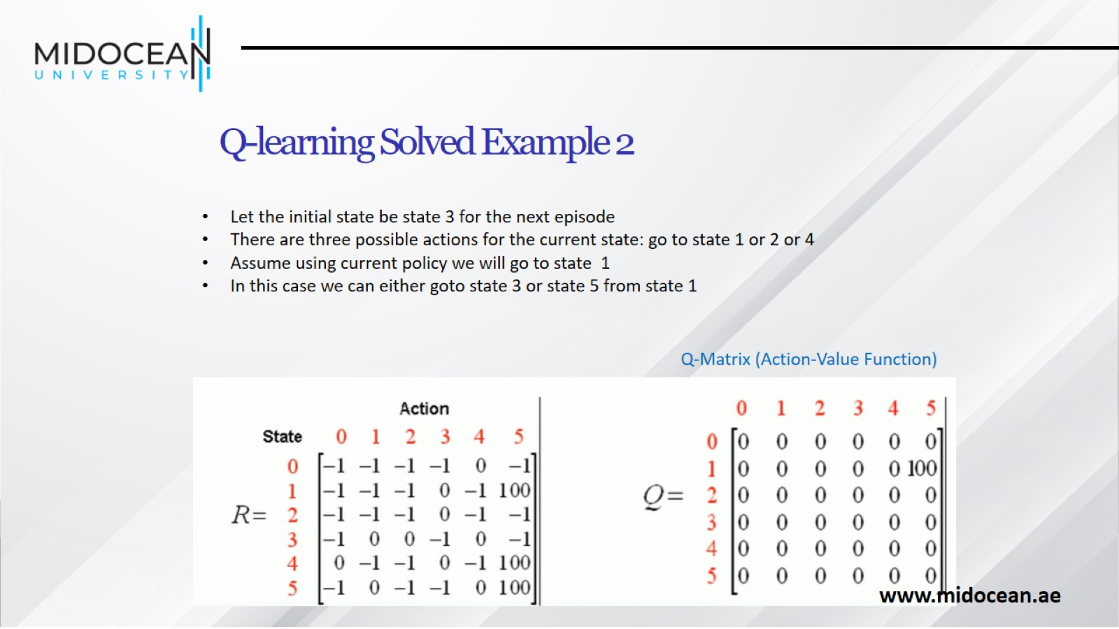
Q-learning Solved Example 2

Slide 43
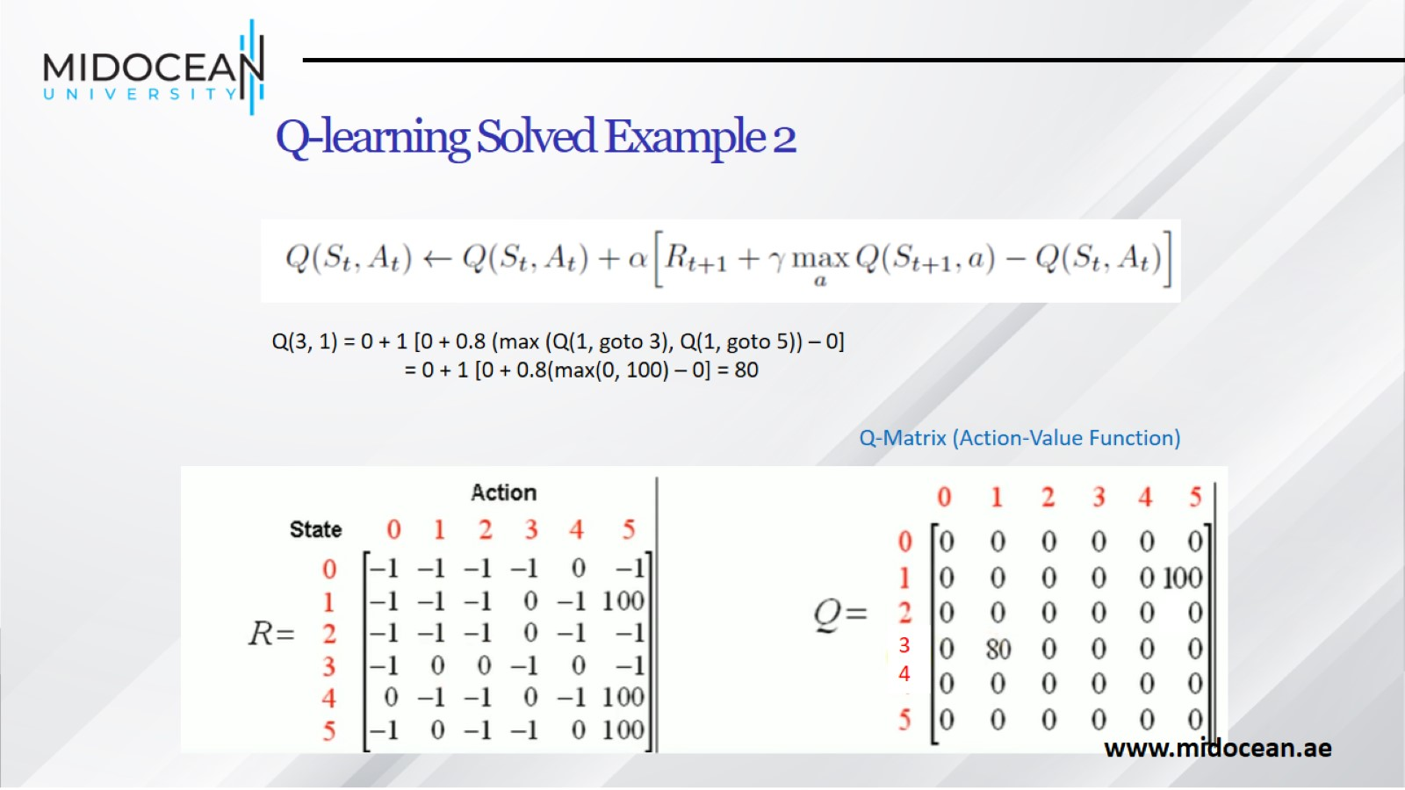
Q-learning Solved Example 2

Slide 44
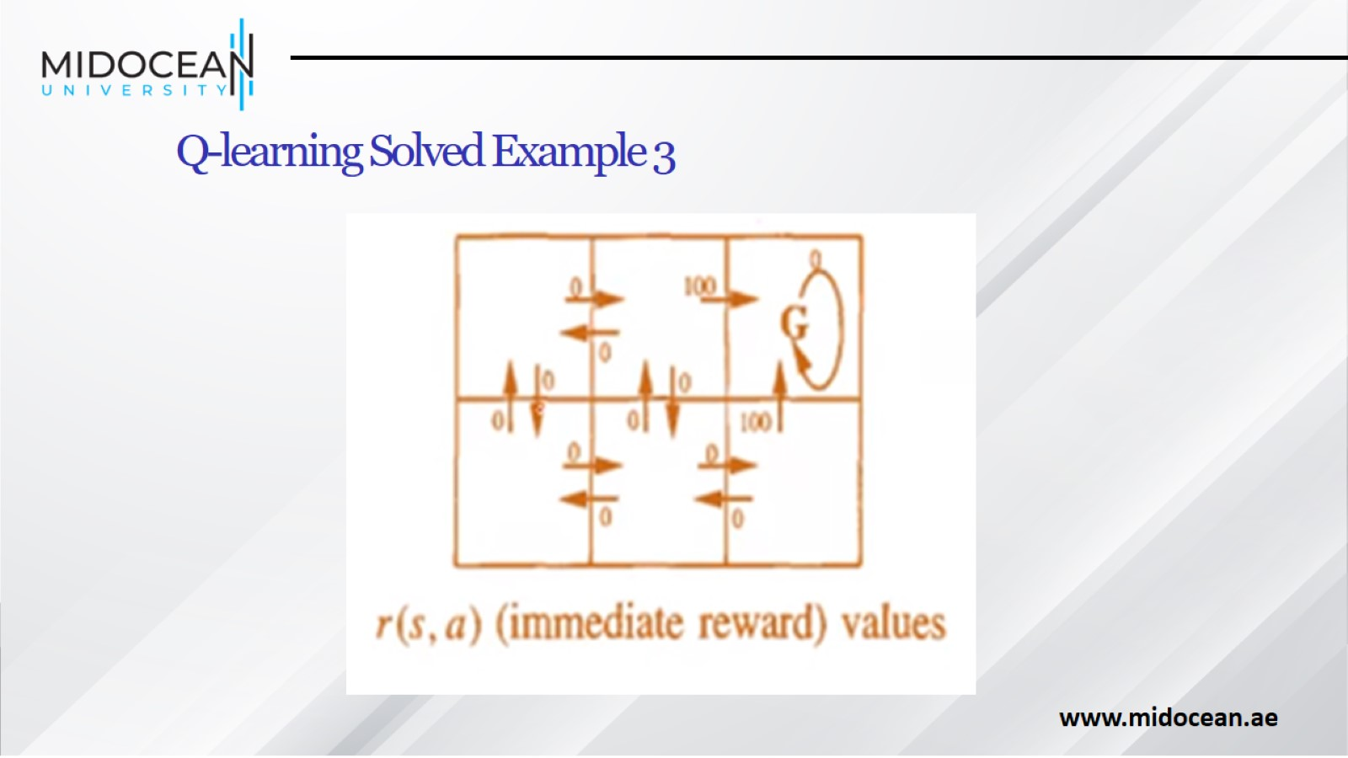
Q-learning Solved Example 3

Slide 45
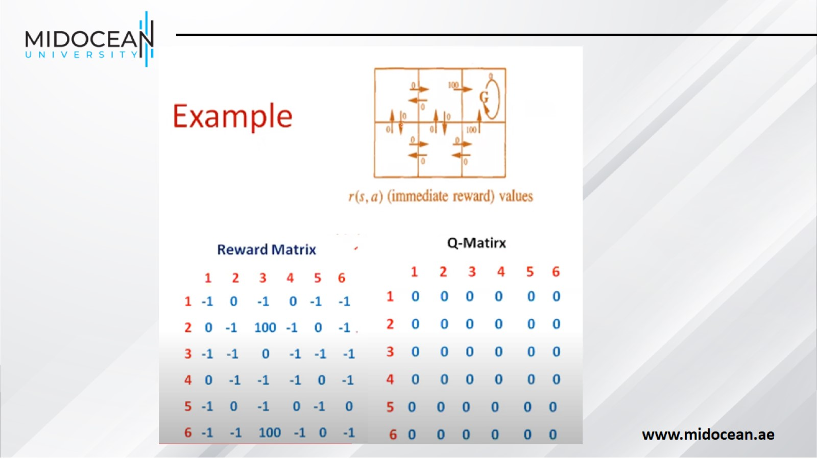

Slide 46
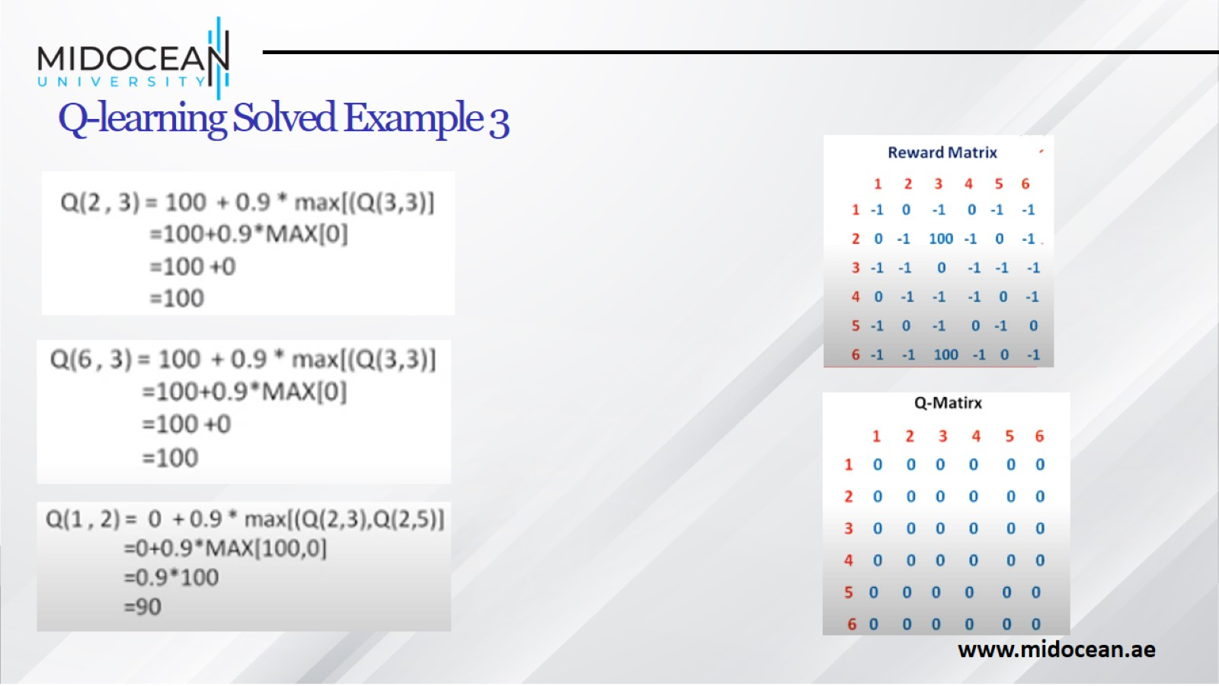
Q-learning Solved Example 3

Slide 47
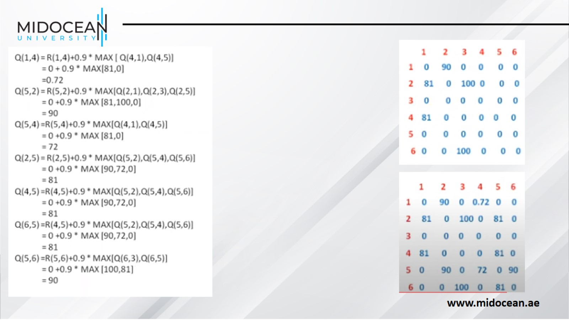

Slide 48
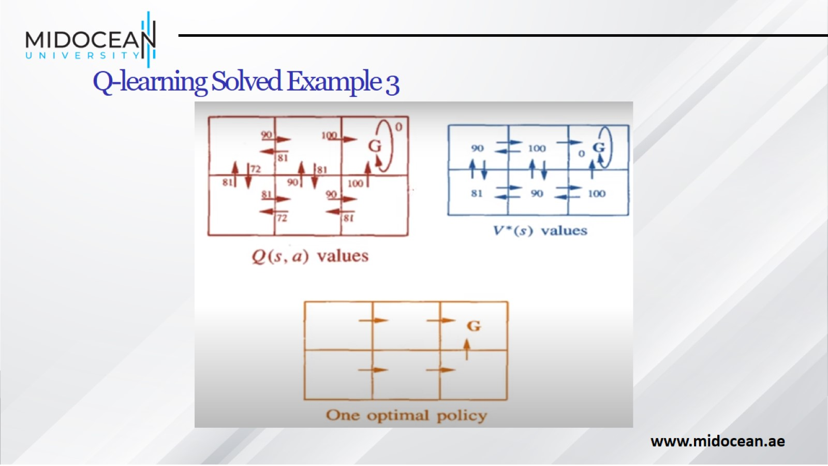
Q-learning Solved Example 3

Slide 49
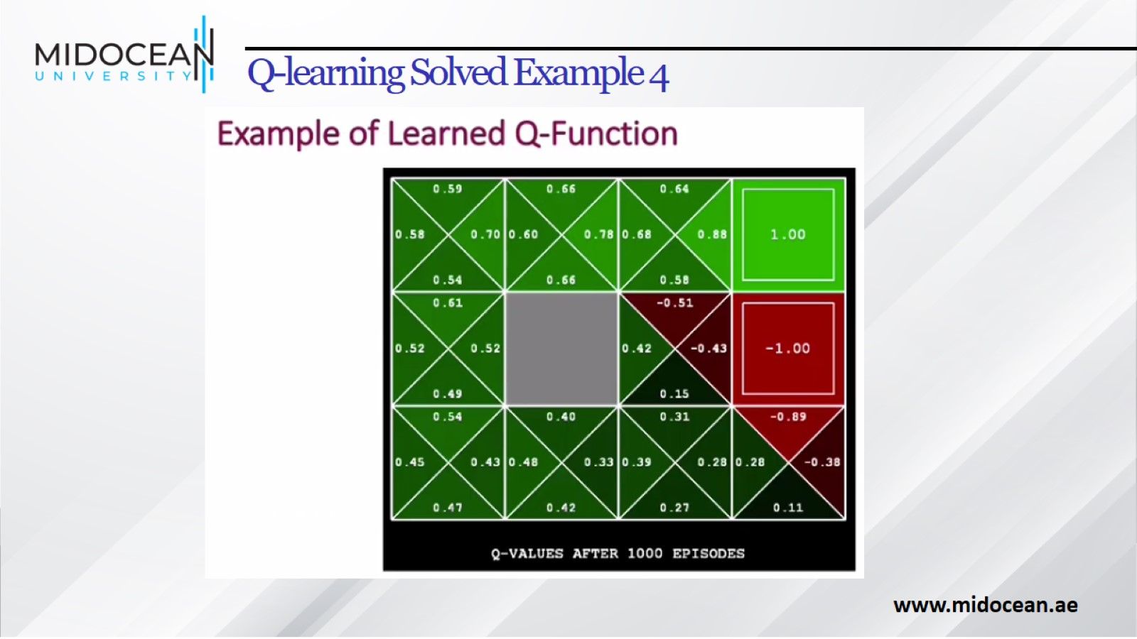
Q-learning Solved Example 4

Slide 50
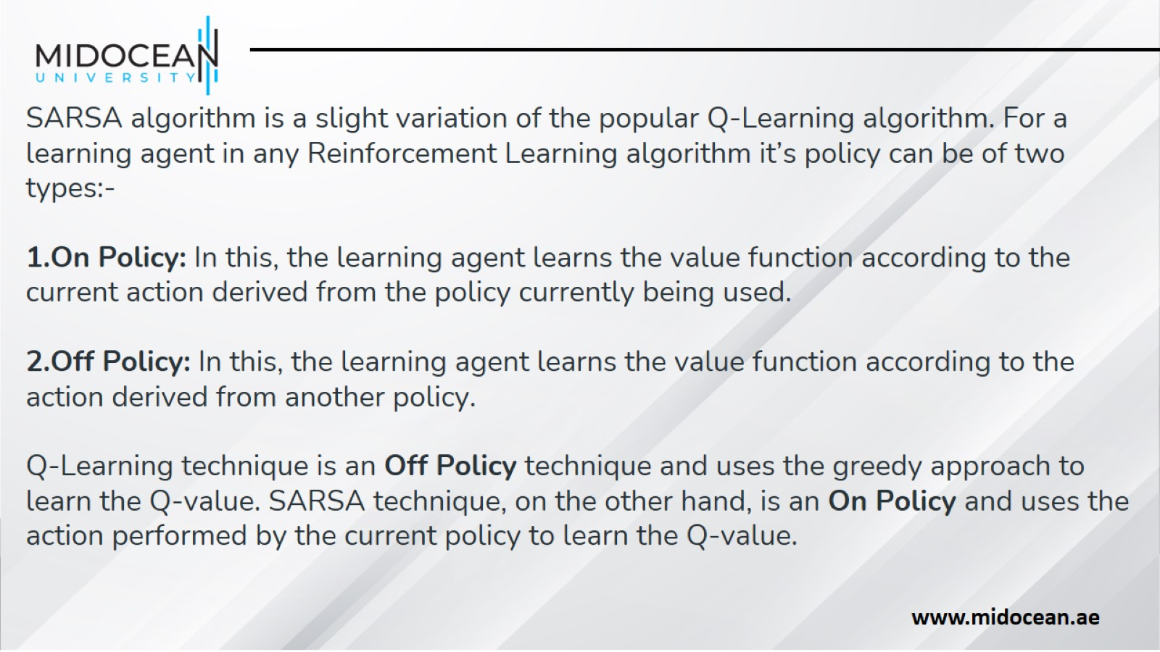

Slide 51
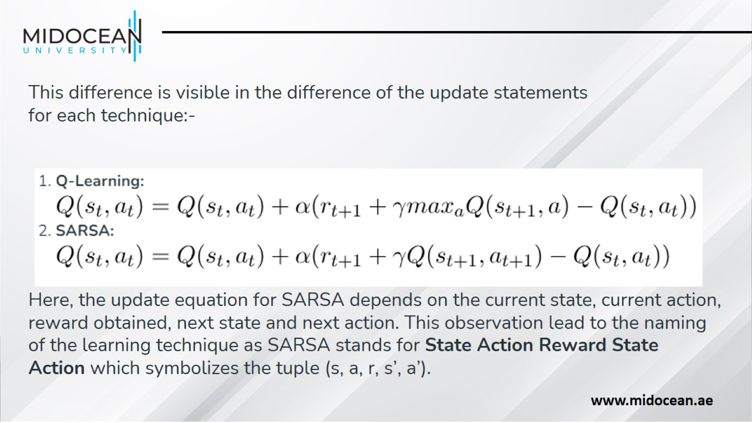

Slide 52

Summary

Slide 53


