Slide 1



Machine Learning
Prepared by Dr. Yasser Abdelhamid
DS 620
Machine Learning
Lecture 10

Slide 2

Outline
Ensemble learning
Bagging
Boosting
Stacking
Cascading
Random forests

Slide 3
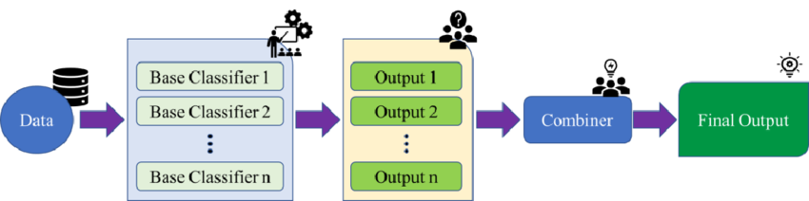
Ensemble learning
Ensemble Learning is a technique that combines multiple individual models (learners) to achieve better predictive accuracy and generalization than any single model alone.

Slide 4
benefits of Ensemble Learning
Improved robustness,
Reduction of bias and variance, and
Better handling of complex datasets.

Slide 5
base classifiers
The individual classifiers in an ensemble are known as base classifiers.
Homogeneous base classifiers
  Base classifiers are all of the same kind (e.g. decision trees).
Heterogeneous base classifiers
  Base classifiers are not all of the same kind.

Slide 6
ensemble classification algorithm
Generate N classifiers for a given dataset
For an unseen instance X
  Compute the predicted classification of X for each of the N classifiers
  Select the classification that is most frequently predicted.
With N classifiers in the ensemble there will be a total of N votes and the classification with most votes wins.

Slide 7
There are several ways in which an ensemble can be formed
N trees generated using the same tree generation algorithm, with different parameter settings, all using the same training data.
N trees generated using the same tree generation algorithm, all with different training data and either with the same or with different parameter settings.
N trees generated using a different subset of the attributes for each one.

Slide 8
Classifier selection strategy
Generate trees (or other classifiers) that are diverse, in the hope that some will give much better than ‘standard’ performance.
Choose those classifiers with best performance.
This leads naturally to the idea of generating a large number of classifiers in some random way and then retaining only the best.

Slide 9
Estimating the Performance of a Classifier
1. Divide the available data into a test set and the remainder.
2. For each candidate classifier
  a) Divide the remaining data from step (1) into training data and validation data in some suitable fashion.
  b) Generate a classifier using the training data.
  c) Run the classifier against the validation data to give an estimate of its
  performance.
3. Use the performance estimates to find the best classifiers, e.g. all those with
predictive accuracy greater than a specified percentage or perhaps the best
X. If the number of classifiers remaining from this step is M, together they
comprise an ensemble of size M.
4. Use the ensemble to classify each of the instances in the test set selected
at step (1) and use the result as an estimate of the performance of the
ensemble on (genuinely) unseen data.

Slide 10
Bagging
Bagging “bootstrap aggregating”
Randomly select N instances, one-by-one, at each stage selecting from the full set of instances (we call this sampling with replacement).
This will lead to a training set of N instances in which inevitably some of the instances will appear more than once, perhaps several times, and others will not appear at all.
There are likely to be many instances left unselected by this process. Collect them together to form a validation set.

Slide 11
Max Voting / Voting Classifier
The max voting method is generally used for classification problems.
In this technique, multiple models are used to make predictions for each data point. The predictions by each model are considered as a ‘vote’.
The predictions which we get from the majority of the models are used as the final prediction.

Slide 12
Hard Voting
Each model in the ensemble casts a single vote for its predicted class label, and the class label that receives the majority of votes is selected as the final prediction.

Slide 13
Example
Suppose three classifiers predicted the output class(A, A, B), so here the majority predicted A as output.
Hence A will be the final prediction.

Slide 14
Soft Voting
Each model provides a probability or a score for each class label.
The final prediction is based on the average of these probabilities or scores.

Slide 15
Example
Consider an ensemble with three models, and their predicted probabilities for a binary classification task are as follows:
  Model 1: Class A - 0.8, Class B - 0.2
  Model 2: Class A - 0.6, Class B - 0.4
  Model 3: Class A - 0.7, Class B - 0.3

Slide 16
Example (cont.)
In soft voting, the final prediction is obtained by averaging the probabilities for each class label:
  Class A: (0.8 + 0.6 + 0.7) / 3 = 0.7
  Class B: (0.2 + 0.4 + 0.3) / 3 = 0.3
Based on the higher average probability for Class A, the final prediction would be Class A.

Slide 17
Soft voting vs hard voting
Soft voting takes into account the confidence or certainty of the individual models by considering the probabilities or scores they assign to each class label.
It can be advantageous when the models provide well-calibrated probabilities or scores.

Slide 18
Boosting
Boosting is an ensemble learning technique that combines multiple weak learners to create a strong learner.
Boosting focuses on building a sequence of models where each subsequent model aims to correct the mistakes of its predecessors.
This iterative process allows boosting to create a powerful ensemble that can handle complex tasks and improve predictive performance.

Slide 19
Start with weak learners
Boosting starts with a weak learner, which is a simple model that performs slightly better than random guessing.
Weak learners are typically models with low complexity, such as shallow decision trees.

Slide 20
Sequential Training
The first weak learner is trained on the original training dataset.
During training, the weak learner focuses on the instances that were misclassified or had high errors, attempting to learn from those mistakes.

Slide 21
Weighted Training
Each instance in the training dataset is assigned a weight based on its difficulty in being correctly predicted by the previous weak learners.
Initially, all weights are equal, but as the boosting process continues, the weights of the misclassified instances increase, making them more influential in subsequent training iterations.

Slide 22
Iterative Process
Boosting proceeds through a series of iterations, with each iteration producing a new weak learner.
In each iteration, the training dataset is reweighted based on the misclassification errors made by the previous weak learners.

Slide 23
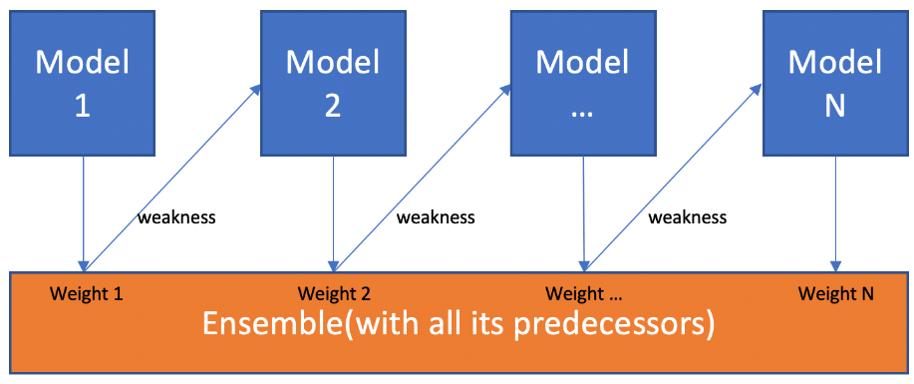
Boosting Iterative Process

Slide 24
Boosting Ensemble Prediction
To make predictions, boosting combines the predictions of all the weak learners.
Each weak learner's prediction is weighted by its performance during training, giving more weight to those that performed better.
The final prediction is typically obtained by majority voting for classification problems or weighted averaging for regression problems.

Slide 25
Adaboost
Adaboost (Adaptive Boosting) is one of the most well-known boosting algorithms.
It adjusts the weights of misclassified instances to focus on the difficult examples, allowing subsequent weak learners to improve on those instances.

Slide 26
Gradient Boosting
Gradient Boosting is another popular boosting algorithm that builds the ensemble by iteratively fitting new models to the residuals (errors) of the previous models.
It uses gradient descent to find the optimal direction in the loss function space.

Slide 27
Limitations of Boosting
Boosting can be sensitive to noisy data or outliers, as it assigns higher weights to misclassified instances.
The training process of boosting can be computationally expensive and time-consuming, especially with a large number of weak learners or iterations.

Slide 28
Cascading
Cascading ensemble learning is an ensemble learning technique that combines multiple models sequentially, with each model focusing on solving a specific subset of the problem.
Unlike other ensemble methods where all models contribute to the final prediction simultaneously, cascading ensemble learning uses a hierarchical approach where the output of one model becomes the input for the next model in the cascade.

Slide 29
Stacking
Stacking combines multiple classifications or regression models via a meta-classifier or a meta-regressor.
The base-level models are trained on a complete training set, then the meta-model is trained on the features that are outputs of the base-level model.
The base-level often consists of different learning algorithms and therefore stacking ensembles are often heterogeneous.

Slide 30
Steps of stacking ensemble learning
Split the original training data into two or more subsets: the training set and the validation set.
The training set is used to train the base models, while the validation set is used to generate predictions for the meta-model.

Slide 31
Base Model Training
Select a set of diverse base models (e.g., decision trees, support vector machines, neural networks) that are capable of capturing different aspects of the data.
Train each base model independently on the training set.
The base models can use different algorithms, hyperparameters, or feature representations.

Slide 32
Generating Base Model Predictions
Use the trained base models to make predictions on the validation set.
Each base model generates predictions for the validation set, resulting in a set of prediction values or probabilities.

Slide 33
Creating the Meta-Model Training Set
Combine the predictions from the base models with the original features of the validation set.
The base model predictions serve as additional features in the meta-model training set.
The meta-model training set now contains the original features and the predictions from the base models.

Slide 34
Meta-Model Training
Train the meta-model using the augmented training set (including the original features and base model predictions) and the corresponding true labels from the validation set.

Slide 35
Ensemble Prediction
Once the meta-model is trained, it can be used to make predictions on new, unseen data.
To make predictions, the base models are used to generate predictions on the test set.
These predictions, along with the original features, are then fed into the trained meta-model to produce the final prediction.

Slide 36
Random Forests
Random Forest is an ensemble learning method that combines the predictions of multiple decision trees to make more accurate and robust predictions.
It harnesses the power of decision trees by introducing randomness and diversity in the learning process.

Slide 37
Building Decision Trees
Decision trees are powerful machine learning models that make predictions by dividing the input space into regions based on a set of decision rules.
Each decision tree is built by recursively partitioning the data based on features and their values, aiming to create homogeneous subsets with respect to the target variable.

Slide 38
randomization
Random sampling:
  Random Forest begins by randomly sampling the training data with replacement (bootstrapping) to create multiple subsets of the data.
Random feature selection:
  At each node of the decision tree, only a subset of features is considered for splitting, introducing randomness and reducing correlation among trees.
These two sources of randomness promote diversity among the decision trees, enhancing the collective predictive power of the ensemble.

Slide 39
Aggregating Predictions
After constructing all the decision trees, Random Forest combines their predictions to make the final prediction.
For classification tasks, the most common approach is to use majority voting. Each tree "votes" for a class label, and the class with the majority of votes becomes the final prediction.
For regression tasks, the predictions of all the trees are averaged to obtain the final prediction.

Slide 40
Advantages of Random Forest
Reduced overfitting:
  By aggregating predictions from multiple decision trees, Random Forest mitigates the tendency of decision trees to overfit the training data.
Improved generalization:
  Random Forest reduces variance and provides robust predictions by leveraging the combined knowledge of multiple trees.
Robustness to noise and outliers:
  The ensemble nature of Random Forest makes it more resilient to noisy data and outliers compared to individual decision trees.

Slide 41
Advantages of Random Forest(cont.)
Feature importance estimation:
  Random Forest can estimate the importance of features, providing insights into which features contribute most to the predictive performance.
Scalability:
  Random Forest can handle large datasets efficiently, as the training process can be parallelized due to the independence among decision trees.

Slide 42
Hyperparameters and Training
Random Forest has hyperparameters that need to be set before training, such as the number of trees, maximum depth of trees, minimum samples for splitting, and feature subset size.
Random Forest can be trained using techniques like bootstrapping to create subsets of the training data and evaluate the model's performance using out-of-bag (OOB) error estimation.

Slide 43
Out-of-bag (OOB) error estimation
Out-of-bag (OOB) error estimation is a technique used in Random Forest to estimate the performance of the model without the need for a separate validation set.
It takes advantage of the randomness introduced during the training process.

Slide 44
OOB error estimation in Random Forest
During the construction of each decision tree in the Random Forest, a random subset of the training data is selected through bootstrapping.
Bootstrapping involves randomly sampling the training data with replacement, resulting in each subset having approximately two-thirds of the original data while leaving out about one-third of the data.
The left out samples are referred to as out-of-bag (OOB) samples.

Slide 45
OOB error estimation in Random Forest (Cont.)
Since each decision tree is built using a different subset of the data, the OOB samples for each tree are different.
For each sample in the training dataset, the OOB samples that were not used to build the decision tree are identified.
The OOB samples are then passed down the tree, and their predictions are obtained by following the decision rules of the tree.
The OOB prediction for a sample is determined by aggregating the predictions from all the decision trees in the Random Forest that did not use that sample during their construction.

Slide 46
OOB error estimation in Random Forest (Cont.)
The OOB predictions are compared to the true labels of the corresponding OOB samples.
The OOB error is calculated by measuring the accuracy or loss between the predictions and the true labels.
This error estimation provides an unbiased estimate of how well the Random Forest will perform on unseen data, as the OOB samples were not used in training.

Slide 47
Evaluating Model Performance
The OOB error can serve as an approximation of the model's performance on unseen data, acting as an internal validation metric.
It can be used to compare different Random Forest models with varying hyperparameters or feature configurations and aid in model selection.

Slide 48
Latest advancements in Machine Learning

Slide 49
Machine learning, the next step
For years, the core challenge was often designing the model itself.
Today, with powerful foundational architectures like the Transformer, the focus has shifted.
The biggest advancements are now in scale, efficiency, and accessibility.
We're engineering systems around these core models to make them more capable, trustworthy, and usable.

Slide 50
Multimodal Foundational Models
Multimodal models are AI systems that can simultaneously understand and generate information across different modalities—text, images, audio, and even video.
A single model that processes and connects multiple types of data.
GPT-4V (Vision), is an example of these models, which can take an image as input and reason about it conversationally.
This will enable richer AI assistants, content creation, and scientific discovery (e.g., analyzing a medical scan and a patient's history simultaneously).

Slide 51
Reasoning, Planning, and the "AGI" Spark
While LLMs are incredible pattern matchers, true reasoning and planning have been elusive.
New techniques are enabling models to 'think step-by-step' in a more structured, human-like way.
  Chain-of-Thought (CoT) Prompting: Encouraging the model to break down its reasoning.
  Tree-of-Thoughts (ToT): Allowing models to explore multiple reasoning paths and backtrack, like a chess player.
  Graph-of-Thoughts (GoT): An even more advanced paradigm where information can be combined and synthesized in a graph structure.
This will drastically improve performance on complex math, coding, and strategic problems.

Slide 52
Scaling Laws & The Drive for Efficiency
We've learned that performance predictably improves with more data, more parameters, and more computing.
Training a single large model can cost millions of dollars.
Trends for solutions:
  Using lower-precision numbers (e.g., 4-bit instead of 16-bit) to drastically reduce memory needs.
  Using better architectures, offering faster inference and linear scaling with sequence length.

Slide 53
Responsible AI
As AI models become more integrated into society, ensuring they are safe, fair, and aligned with human intent is a primary research focus.
  Constitutional AI & RLHF: Training models to be helpful and harmless using human feedback and a set of principles (a "constitution").
  Interpretability (XAI): Efforts like Anthropic's "Conceptual Scaling" aim to open the "black box" and understand how models represent concepts internally.
  Robustness & Fairness: Developing techniques to detect and mitigate bias and to prevent adversarial attacks.

Slide 54
SUmmary
Ensemble learning
Bagging
Boosting
Stacking
Cascading
Random forests
Latest advancements in Machine Learning

Slide 55


Thank You

