Slide 1

Business Mathematics
Prepared by Dr. Faisal Hasan
Lecture NO 1
MTH 112
Business Mathematics

Slide 2
Business Mathematics
Prepared by Dr. Faisal Hasan
Lecture NO 1
MTH 112
Business Mathematics

Slide 3
Business Mathematics
Prepared by Dr. Faisal Hasan
Lecture NO 1
MTH 112
Business Mathematics

Slide 4

Topics
Chapter 1: Mathematical preliminaries
Chapter 2: The straight line and applications
Chapter 3: Functions and Graphs
Chapter 4: Limits and Continuity
Chapter 5: Financial Mathematics
Chapter 6: Differentiation
Chapter 7: Methods of Differentiation
Chapter 8: Function of several variables
Chapter 9: Integration and applications
Chapter 10: Linear algebra and applications

Slide 5
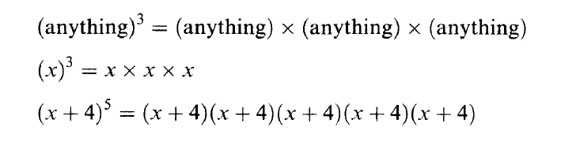
Chapter
01
Some Mathematical Preliminaries
Powers: positive whole numbers such as 2⁴ which means
2 x 2 x 2 x 2= 16

Slide 6
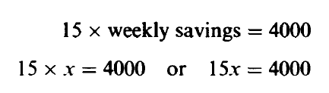

Chapter
01
Some Mathematical Preliminaries
Variables and letters: when we don’t know the value of quantity, we give that quantity a symbol, such as x
This statements may be expressed as a mathematical equation:

Slide 7
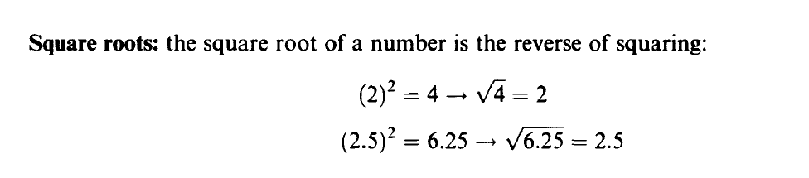
Chapter
01
Some Mathematical Preliminaries

Slide 8
Chapter
01
Arithmetic Operations
Adding: If all the signs are the same, simply add all the terms and give the answer with the common overall sign.
Subtracting: When subtract any two numbers or any two similar terms, give the answer with the sign of the largest number or terms.

Slide 9
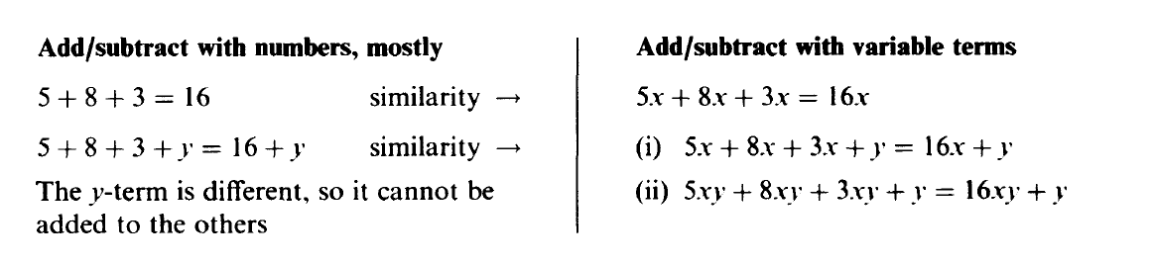
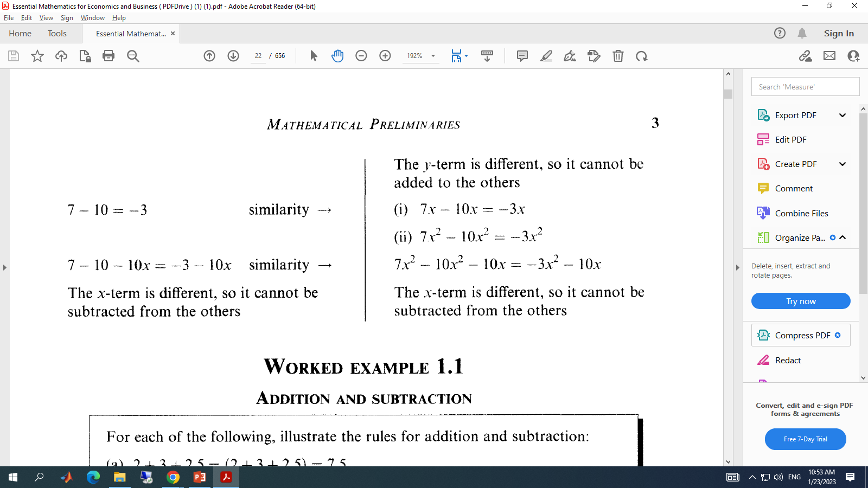
Chapter
01
Arithmetic Operations

Slide 10
Chapter
01
Arithmetic Operations

Slide 11
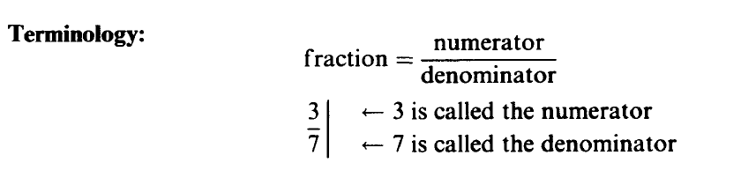
Chapter
01
Fractions

Slide 12
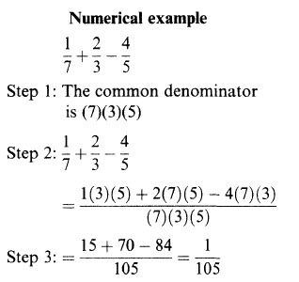
Chapter
01
Fractions

Slide 13
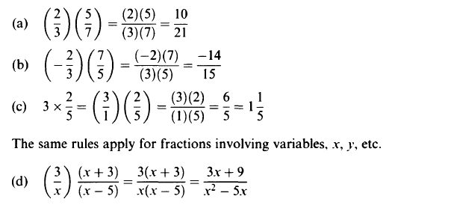
Chapter
01
Fractions

Slide 14

Chapter
01
Solving Equations
What do you notice about each of the following?
6 + 3 = 9
5 - 3 = 2
5 + 3 = 1 + 7
x = 4.
2x = x + x
3x = 2x + x = x + x + x
What does this picture represent?
What is this apparatus called?

Slide 15
Chapter
01
Solving Equations
What is an equation?
Equation - a balanced statement of equality
between two quantities.
4 + 3 = 7
4 + 3
=
7

Slide 16
Chapter
01
Solving Equations
Solve.
a) m + 2 = 10
c) m - 4 = 9
-2 -2
+4 +4
m = 8
m = 13
b) x - 4 = 6
d) x + 7 = 3
+4 +4
-7 -7
x = 10
x = -4

Slide 17
Chapter
01
Solving Equations
Solve.
a) -4 + x = 15
c) - 4 = m + 9
+4 +4
-9 -9
x = 19
-13 = m
b) 7 = x + 13
d) 9 + 7 = x
-13 -13
16 = x
-6 = x

Slide 18
Chapter
01
Solving Equations
Solve.
a) 5x = 35
b) 9 = -3m
5 5
-3 -3
x = 7
-3 = m

Slide 19
Chapter
01
Solving Equations
Solve.
2)
4)
(-6)
(-6)
-72 = x

Slide 20
Chapter
01
Solving Equations
-4k = 14
-4 -4
All answers must be fully reduced

Slide 21
Chapter
01
Solving Equations involving fractions
Solve.
Easier to multiply by the reciprocal!

Slide 22
Chapter
01
Solving Equations involving fractions
Solve.
a)
b)

Slide 23
Chapter
01
Solving Equations involving fractions
Solve.
a)
b)

Slide 24
Chapter
01
Simple Inequalities
An inequality is like an equation, but instead of an equal sign (=) it has one of these signs:
< : less than
≤ : less than or equal to
> : greater than
≥ : greater than or equal to

Slide 25
Chapter
01
Simple Inequalities
x < 5
means that whatever value x has,
it must be less than 5.
What could x be?

Slide 26
Chapter
01
Simple Inequalities
x ≥ -2
means that whatever value x has,
it must be greater than or equal to -2.
What could x be?

Slide 27
Chapter
01
Simple Inequalities
Graphing Rules
Symbol | Circle | Direction of Arrow
< | Open | Left
> | Open | Right
≤ | Closed | Left
≥ | Closed | Right

Slide 28

Chapter
01
Simple Inequalities
Examples:
x < 5
x > -2

Slide 29
Chapter
01
Simple Inequalities
Examples:
x ≤ -8
x > -2
x ≥ 4

Slide 30
Chapter
01
Solving one-step Inequalities
Multiply both sides by the reciprocal of the coefficient

Slide 31
Chapter
01
Solving one-step Inequalities
Division Property for Inequalities
Divide both sides by the coefficient of x

Slide 32
Chapter
01
Solving Inequalities
Solving inequalities is the same as solving equations.
There are only 2 things you need to know…
  1.) If you multiply or divide by a negative number you must switch the sign.
  -7x < 21
  -7 -7
  x > -3
  2.) You will graph your solutions.
Dividing by a negative means switch the sign!!

Slide 33
Chapter
01
Solving Inequalities
When solving inequalities, if you multiply or divide by a negative you must switch the signs.
Switching the signs:
  Less than becomes Greater than < switches to >
  Greater than becomes Less than > switches to <
  Less than or equal to becomes Greater than or equal to
  ≤ switches to ≥
  Greater than or equal to becomes Less than or equal to
  ≥ switches to ≤

Slide 34
Chapter
01
Solving Inequalities
Caution! Dividing by a negative number
Same if multiplying?
Notice: Sign CHANGED

Slide 35
Chapter
01
Solving Inequalities
Caution! When you multiply by a negative number…
YES!
…the sign CHANGES
-x > 2
5
(-5 )-x > 2(-5)
1 5
x < -10

Slide 36
Chapter
01
Solving Inequalities
Follow same steps used to solve equations:
3x + 4 < 13
- 4 -4
3x < 9
3 3
x < 3

