Slide 1


Project Financial
Management
Prepared by Dr. Sarah Chahine
ENT 634
Building a New Venture Team
Lecture 7

Slide 2


Project Financial
Management
Lecture 7
ENT 634
Building a New Venture Team
Prepared by
Dr. Sarah Chahine
www.midocean.ae

Slide 3

Chapter
Building a New Venture Team
09
In this chapter, we focus on how the founders of an entrepreneurial venture build a new-venture team as well as the importance of the team to the firm’s overall success.
www.midocean.ae

Slide 4

Chapter
Introduction
09
A new-venture team is the group of founders, key employees, and advisers that move a new venture from an idea to a fully functioning firm. Usually, the team doesn’t come together all at once. Instead, it is built as the new firm can afford to hire additional personnel. The team also involves more than paid employees. Many firms have a board of directors, a board of advisors, investors, and other professionals on whom they rely for direction and advice.
www.midocean.ae

Slide 5
Chapter
Liability of Newness as a Challenge
09
The high failure rate is due in part to what is known as the liability of newness, which refers to the fact that companies often falter because the people who start them aren’t able to adjust quickly enough to their new roles and because the firm lacks a “track record” with outside buyers and suppliers.
Assembling a talented and experienced new-venture team is one path firms can take to overcome these limitations.
www.midocean.ae

Slide 6
Chapter
Liability of Newness as a Challenge
09
Experienced management teams that get up to speed quickly are much less likely to make a novice’s mistakes.
In addition, firms able to persuade high-quality individuals to join them as directors or advisers quickly gain legitimacy with a variety of people, such as some of those working inside the venture as well as some outside the venture (e.g., suppliers, customers, and investors). In turn, legitimacy opens doors that otherwise would be closed.
www.midocean.ae

Slide 7
Chapter
Liability of Newness as a Challenge
09
Another way entrepreneurs overcome the liability of newness is by attending entrepreneurship-focused workshops and events, such as business plan competitions, Startup Weekends, hackathons, boot camps, and so on.
Another route to overcoming the liabilities of newness is joining one of the growing number of start-up accelerators that are popping up across the country. Start-up accelerators provide entrepreneurs access to mentors, investors, subject matter experts and other entrepreneurs.
www.midocean.ae

Slide 8
Chapter
Creating a New-Venture Team
09
A well-conceived business plan cannot get off the ground unless a firm has the leaders and personnel to carry it out.
Often, several start-ups develop what is essentially the same idea at the same time. When this happens, the key to success is not the idea but rather the ability of the initial founder or founders to assemble a team that can execute the idea better than anyone else.
In general, the way to impress potential investors, partners, and employees is to put together as strong a team as possible. Investors and others know that experienced personnel and access to good-quality advice contribute greatly to a new venture’s success.
www.midocean.ae

Slide 9
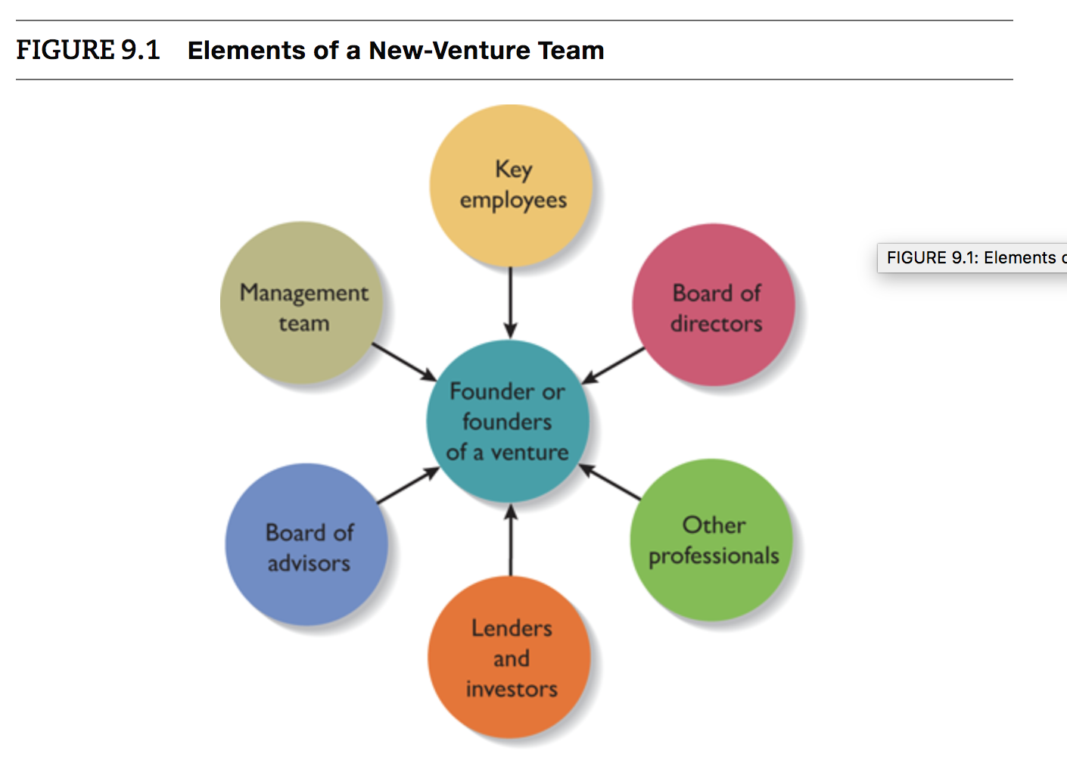
Chapter
Creating a New-Venture Team
09
www.midocean.ae

Slide 10
Chapter
Creating a New-Venture Team
09
There is a common set of mistakes to avoid when putting together a new- venture team. These mistakes raise red flags when a potential investor, employee, or business partner evaluates a new venture. For instance:
  Placing unqualified friends or family members in management positions.
  Assuming that previous success in other industries automatically translates to your venture’s industry.
  Vague or unclear plans for filling the skill or competency gaps that clearly exist.
www.midocean.ae

Slide 11
Chapter
The Founder or Founders of a Venture
09
Founders’ characteristics and their early decisions significantly affect the way an entrepreneurial venture is received and the manner in which the new-venture team takes shape. The size of the founding team and the qualities of the founder or founders are the two most important issues in this matter.
www.midocean.ae

Slide 12
Chapter
The Founder or Founders of a Venture
09
Size of the Founding Team
The first decision that most founders face is whether to start a firm on their own or whether to build an initial founding team.
Teams bring more talent, resources, ideas, and professional contacts to a new venture than does a sole entrepreneur.
The psychological support that cofounders of a business can offer one another can be an important element in a new venture’s success.
Conversely, team members can easily differ in terms of work habits, tolerances for risk, levels of passion for the business, ideas on how the business should be run, and similar key issues.
www.midocean.ae

Slide 13
Chapter
The Founder or Founders of a Venture
09
Size of the Founding Team
When a new venture is started by a team, several issues affect the value of the team.
  First, teams that have worked together before, as opposed to teams that are working together for the first time, have an edge.
  If people have worked together before and have decided to partner to start a firm together, it usually means that they get along personally and trust one another. They also tend to communicate with one another more effectively than people who are new to one another.
www.midocean.ae

Slide 14
Chapter
The Founder or Founders of a Venture
09
Size of the Founding Team
  Second, if the members of the team are heterogeneous, meaning that they are diverse in terms of their abilities and experiences, rather than homogeneous, meaning that their areas of expertise are very similar to one another, they are likely to have different points of view about technology, hiring decisions, competitive tactics, and other important activities. Typically, these different points of view generate debate and constructive conflict among the founders, reducing the likelihood that decisions will be made in haste or without the airing of alternative points of view.
www.midocean.ae

Slide 15
Chapter
The Founder or Founders of a Venture
09
Size of the Founding Team
There are three potential pitfalls associated with starting a firm as a team rather than as a sole entrepreneur:
  The team members may not get along. This is the reason investors favor teams consisting of people who have worked together before.
  If two or more people start a firm as “equals,” conflicts can arise when the firm needs to establish a formal structure and designate one person as the chief executive officer (CEO).
  If the founders of a firm have similar areas of expertise, it can be problematic.
www.midocean.ae

Slide 16
Chapter
The Founder or Founders of a Venture
09
Qualities of the Founders
One reason the founders are so important is that in the early days of a firm, their knowledge, skills, and experiences are the most valuable resource the firm has. Because of this, new firms are judged largely on their “potential” rather than their current assets or current performance. This results in people judging a firm’s future prospects by evaluating the strength of its founders and initial management team.
www.midocean.ae

Slide 17
Chapter
The Founder or Founders of a Venture
09
Qualities of the Founders
Several features are significant to a founder’s success:
The level of a founder’s education is important because it is believed that entrepreneurial abilities such as search skills, foresight, creativity, and computer skills are enhanced by obtaining a college degree.
Prior entrepreneurial experience, relevant industry experience, and networking are other attributes that strengthen the chances of a founder’s success. Entrepreneurs with experience in the same industry as their current venture will have a more mature network of industry contacts and will have a better understanding of the subtleties of their respective industries.
www.midocean.ae

Slide 18
Chapter
The Founder or Founders of a Venture
09
Qualities of the Founders
Several features are significant to a founder’s success:
The presence of a mature network of social and professional contacts. Networking is building and maintaining relationships with people whose interests are similar or whose relationship could bring advantages to a firm. The way this might play out in practice is that a founder calls a business acquaintance or friend to ask for an introduction to a potential investor, business partner, or customer. For some founders, networking is easy and is an important part of their daily routine. For others, it is a learned skill.
www.midocean.ae

Slide 19
Chapter
The Management Team and Key Employees
09
Once the decision to launch a new venture has been made, building a management team and hiring key employees begins. Start-ups vary in terms of how quickly they need to add personnel. In some instances, the founders work alone for a period of time while the business plan is being written and the venture begins taking shape. In other instances, employees are hired immediately.
One technique available to entrepreneurs to help prioritize their hiring needs is to maintain a skills profile. A skills profile is a chart that depicts the most important skills that are needed and where skills gaps exist.
www.midocean.ae

Slide 20

Chapter
The Management Team and Key Employees
09
www.midocean.ae

Slide 21
Chapter
The Management Team and Key Employees
09
To save money, increase flexibility, and mitigate the difficulty in finding good employees, new ventures use four different sources of labor to get their work done.
The first is employees. An employee is someone who works for a business, at the business’ location or virtually, utilizing the business’ tools and equipment and according to the business’ policies and procedures.
The second resource that businesses utilize to get their work done is interns. An intern is a person who works for a business as an apprentice or trainee for the purpose of obtaining practical experience.
www.midocean.ae

Slide 22
Chapter
The Management Team and Key Employees
09
The third resource that firms utilize to get their work done is freelancers. A freelancer is a person who is in business for themselves, works on their own time with their own tools and equipment, and performs services for a number of different clients. For example, a business may hire a freelancer to manage the search engine optimization (SEO) for its website, and pay the freelancer an hourly or monthly fee.
www.midocean.ae

Slide 23
Chapter
The Management Team and Key Employees
09
The fourth resource that businesses draw upon to complete their work is virtual assistants. A virtual assistant is a freelancer who provides administrative, technical, or creative assistance to clients remotely from a home office. Businesses use virtual assistants for everything from making customer service calls, to data entry in accounting or bookkeeping platforms, to sending out thank you notes to clients. Similar to freelancers, virtual assistants can be located on online platforms.
www.midocean.ae

Slide 24
Chapter
The Roles of the Board of Directors
09
If a new venture organizes as a corporation, it is legally required to have a board of directors—a panel of individuals who are elected by a corporation’s shareholders to oversee the management of the firm.
A board is typically made up of both inside and outside directors. An inside director is a person who is also an officer of the firm. An outside director is someone who is not employed by the firm. A board of directors has three formal responsibilities: (1) appoint the firm’s officers (the key managers), (2) declare dividends, and (3) oversee the affairs of the corporation.
www.midocean.ae

Slide 25
Chapter
The Roles of the Board of Directors
09
Most boards meet formally three or four times a year.
Large firms pay their directors for their service. New ventures are more likely to pay their directors in company stock.
Many boards also have nominating committees to select stockholders to run for vacant board positions.
Providing expert guidance and legitimacy in the eyes of others (e.g., customers, investors, and even competitors) are two ways a board of directors can help a new firm get off to a good start and develop what, it is hoped, will become a sustainable competitive advantage.
www.midocean.ae

Slide 26
Chapter
Board of Advisors
09
An advisory board is a panel of experts who are asked by a firm’s managers to provide counsel and advice on an ongoing basis.
Unlike a board of directors, an advisory board possesses no legal responsibility for the firm and gives nonbinding advice. As a result, more people are willing to serve on a company’s board of advisors than on its board of directors because it requires less time and no legal liability is involved.
The main purpose of a board of advisors is to provide guidance and lend legitimacy to a firm.
The most important thing that advisory board members can do is make high-level introductions to early customers, suppliers, and business partners.
www.midocean.ae

Slide 27
Chapter
Board of Advisors
09
Most boards of advisers have between 5 and 15 members.
Entrepreneurial firms typically pay the members of their board of advisors a small honorarium for their service either annually or on a per-meeting basis.
Some advisory boards meet three or four times a year at the company’s headquarters or in another location. Other advisory boards meet in an online environment.
www.midocean.ae

Slide 28
Chapter
Board of Advisors
09
Several guidelines are followed when organizing a board of advisors:
A board of advisors should not be organized just so a company can boast of it. Advisers will become quickly disillusioned if they don’t play a meaningful role in the firm’s development and growth.
A firm should look for board members who are compatible and complement one another in terms of experience and expertise. A board that includes members with varying backgrounds is preferable..
Third, when inviting a person to serve on its board of advisors, a company should carefully spell out to the individual the rules in terms of access to confidential information
www.midocean.ae

Slide 29
Chapter
Lenders and Investors
09
Lenders and investors have a vested interest in the companies they finance, often causing these individuals to become very involved in helping the firms they fund. The institutional rules governing banks and investment firms typically require that they monitor new ventures fairly closely.
The amount of time and energy a lender or investor dedicates to a new firm depends on the amount of money involved.
Lenders and investors help new firms by providing guidance and lending legitimacy and assuming the natural role of providing financial oversight.
Investors often take a seat on the boards of directors of the firms they fund to provide oversight and advice.
www.midocean.ae

Slide 30


Thank You

