Slide 1


College of Management
Business Ethics
Lecturer: Dr. Raef Baraka
PMG 750
Lecture 03

Slide 2

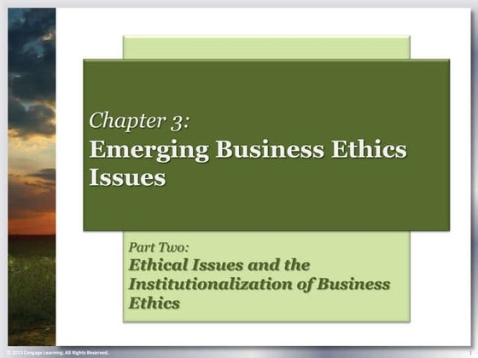
Chapter 3: EMERGING BUSINESS ETHICS ISSUES
CHAPTER OBJECTIVES:
Define ethical issues in the context of organizational ethics.
Examine ethical issues as they relate to the basic values of honesty, fairness, and integrity.
Delineate misuse of company resources, abusive and intimidating behavior, lying, conflicts of interest, bribery, corporate intelligence, discrimination, sexual harassment, fraud, financial misconduct, insider trading, intellectual property rights, and privacy as business ethics issues.
Examine the challenge of determining an ethical issue in business.

Slide 3

EMERGING BUSINESS ETHICS ISSUES
RECOGNIZING AN ETHICAL ISSUE (ETHICAL AWARENESS)

Slide 4
EMERGING BUSINESS ETHICS ISSUES
Recognizing An Ethical Issue (Ethical Awareness)
Some ethical issues are difficult to recognize because they are gray areas that are hard to navigate.
Our personal morals or values issues are easier to define and control but the complexity of the work environment, however, makes it harder to define and reduce ethical issues.
Business decisions, like personal decisions, may involve a dilemma.
People make decisions and then recognize that a particular issue or situation has an ethical component; therefore, a first step toward understanding business ethics is to develop ethical issue awareness.

Slide 5
EMERGING BUSINESS ETHICS ISSUES
Recognizing An Ethical Issue (Ethical Awareness)
Some ethical issues are difficult to recognize because they are gray areas that are hard to navigate.
Ethical issues typically arise because of conflicts among individuals’ morals and the core values and culture of the organizations where they work.
In a dilemma all of the alternatives have negative consequences, so the less harmful choice is made.
An ethical issue in business is simply a situation involving a group, a problem, or even an opportunity that requires thought, discussion, or investigation before a decision can be made.
Because the business world is dynamic, new ethical issues emerge all the time.

Slide 6
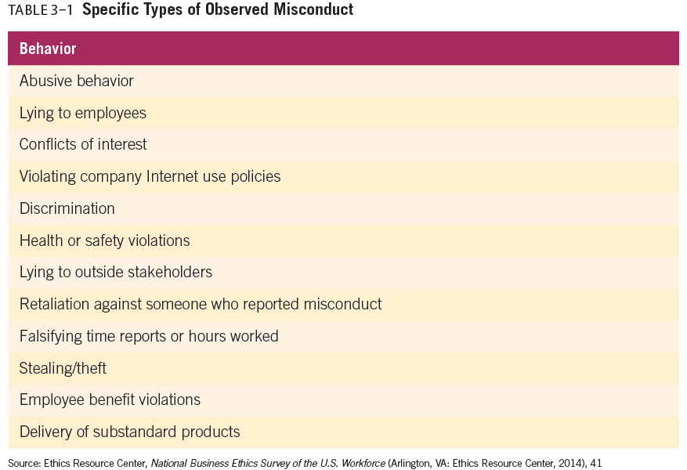
EMERGING BUSINESS ETHICS ISSUES
Recognizing An Ethical Issue (Ethical Awareness)

Slide 7
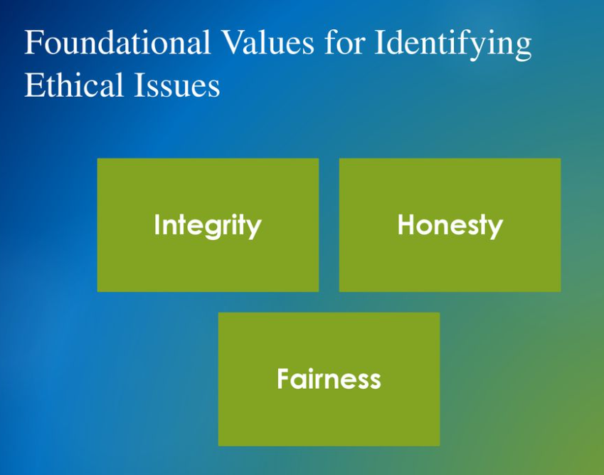
EMERGING BUSINESS ETHICS ISSUES
FOUNDATIONAL VALUES FOR IDENTIFYING ETHICAL ISSUES

Slide 8
EMERGING BUSINESS ETHICS ISSUES
Stakeholders Define Ethical Issues In Business
Integrity, honesty, and fairness are widely used values for evaluating activities that could become ethical issues..
Ethical issues can emerge from almost any decision made in an organization.
Understanding these foundational values can help identify and develop discussions and a constructive dialogue on appropriate conduct.
It is just as important to emphasize appropriate conduct associated with these values as it is to discover inappropriate conduct.

Slide 9
EMERGING BUSINESS ETHICS ISSUES
Stakeholders Define Ethical Issues In Business
Integrity
Integrity is one of the most important and oft-cited elements of virtue and refers to being whole, sound, and in an unimpaired condition.
Integrity relates to product quality, open communication, transparency, and relationships. Therefore, it is a foundational value for managers to build an ethical internal organizational culture.
In an organization, integrity means uncompromising adherence to a set or group of values.
An organization’s integrity usually rests on its enduring values and unwillingness to deviate from standards of behavior as defined by the firm and industry.

Slide 10
EMERGING BUSINESS ETHICS ISSUES
Stakeholders Define Ethical Issues In Business
Integrity
At a minimum, businesses are expected to follow laws and regulations. In addition, organizations should not knowingly harm customers, clients, employees, or even other competitors through deception, misrepresentation, or coercion.
Although they often act in their own economic self-interest, business relations should be grounded in integrity.
Failure to live up to this expectation or abide by laws and standards destroys trust and makes it difficult, if not impossible, to continue business exchanges.
Integrity complements honesty, which becomes the glue that holds business relationships together to make everything else more effective and efficient.

Slide 11
EMERGING BUSINESS ETHICS ISSUES
Stakeholders Define Ethical Issues In Business
Honesty
Honesty refers to truthfulness or trustworthiness. To be honest is to tell the truth to the best of your knowledge without hiding anything..
Although they often act in their own economic self-interest, business relations should be grounded in integrity.
Many argue that because people are not economically self-sufficient, they cannot withdraw from the relationships of business.
Therefore, business must not only make clear what rules apply but also develop rules appropriate to the involuntary nature of its many participants.
Such rules should contain the value of honesty.

Slide 12
EMERGING BUSINESS ETHICS ISSUES
Stakeholders Define Ethical Issues In Business
Honesty
The opposite of honesty is dishonesty.
Dishonesty can be broadly defined as a lack or absence of integrity, incomplete disclosure, and an unwillingness to tell the truth.
Lying, cheating, and stealing are actions usually associated with dishonest conduct.
The causes of dishonesty are complex and relate to both individual and organizational pressures.
Many employees lie to help achieve performance objectives.

Slide 13
EMERGING BUSINESS ETHICS ISSUES
Stakeholders Define Ethical Issues In Business
Fairness
Fairness is the quality of being just, equitable, and impartial.
Fairness clearly overlaps with the concepts of justice, equity, and equality.
There are three fundamental elements that motivate people to be fair: equality, reciprocity, and optimization.
Equality is about the distribution of benefits and resources. This distribution could be applied to stakeholders or the greater society.
Reciprocity is an interchange of giving and receiving in social relationships. Reciprocity occurs when an action that has an effect upon another is reciprocated with an action that has an approximately equal effect.

Slide 14
EMERGING BUSINESS ETHICS ISSUES
Stakeholders Define Ethical Issues In Business
Fairness
There are three fundamental elements that motivate people to be fair: equality, reciprocity, and optimization.
Optimization is the trade-off between equity (equality) and efficiency (maximum productivity). Discriminating on the basis of gender, race, or religion is generally considered unfair because these qualities have little bearing upon a person’s ability to do a job.
The optimal way to hire is to choose the employee who is the most talented, proficient, educated, and able.

Slide 15
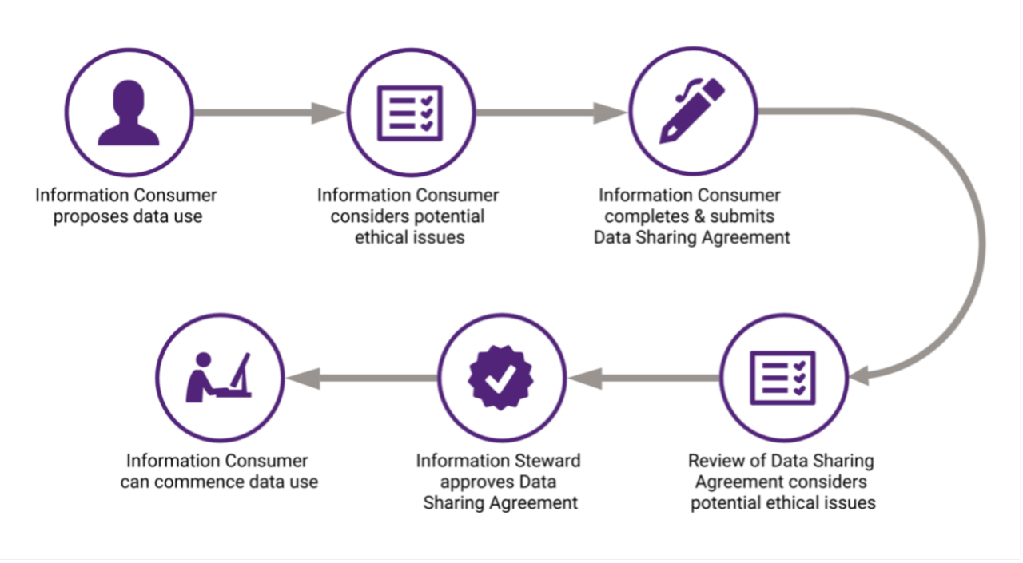
EMERGING BUSINESS ETHICS ISSUES
ETHICAL ISSUES AND DILEMMAS IN BUSINESS

Slide 16
EMERGING BUSINESS ETHICS ISSUES
Ethical Issues And Dilemmas In Business
An ethical issue is a problem, situation, or opportunity that requires an individual, group, or organization to choose among several actions that must be evaluated as right or wrong, ethical or unethical.
An ethical dilemma is a problem, situation, or opportunity that requires an individual, group, or organization to choose among several actions that have negative outcomes.
There is not a right or ethical choice in a dilemma, only less unethical or illegal choices as perceived by any and all stakeholders.
ETHICAL ISSUES AND DILEMMAS IN BUSINESS INCLUDE:

Slide 17
EMERGING BUSINESS ETHICS ISSUES
ETHICAL ISSUES AND DILEMMAS IN BUSINESS INCLUDE:
Misuse of Company Time and Resources
Time theft can be difficult to measure but is estimated to cost companies hundreds of billions of dollars annually.
It is widely believed the average employee “steals” 4.25 hours per week with late arrivals, leaving early, long lunch breaks, inappropriate sick days, excessive socializing, and engaging in personal activities such as online shopping, watching sports, or texting while on the job.
One of the greatest ways that employees misuse their work time and company resources is by using the company computer for personal uses.

Slide 18
EMERGING BUSINESS ETHICS ISSUES
ETHICAL ISSUES AND DILEMMAS IN BUSINESS INCLUDE:
Misuse of Company Time and Resources
Many employees observe others using their computers for personal reasons or violating internet policies.
Often lax enforcement of company policies creates the impression among employees that they are entitled to certain company resources, including how they spend their time at work.
Such misuse can range from unauthorized equipment usage to misuse of financial resources.
Using company computer software and Internet services for personal business is one of the most common ways employees misuse company resources.

Slide 19
EMERGING BUSINESS ETHICS ISSUES
ETHICAL ISSUES AND DILEMMAS IN BUSINESS INCLUDE:
Misuse of Company Time and Resources
Typical examples of using a computer to abuse company time include sending personal emails, shopping, downloading music, doing personal banking, surfing the Internet for information about sports or romance or visiting social networking sites such as Facebook.
Such misuse can range from unauthorized equipment usage to misuse of financial resources.
Employees are expected to use their judgment to determine when personal activities might be detracting too much from work responsibilities.

Slide 20
EMERGING BUSINESS ETHICS ISSUES
ETHICAL ISSUES AND DILEMMAS IN BUSINESS INCLUDE:
Abusive or Intimidating Behavior
Abusive or intimidating behavior is another common ethical problem for employees, but what does it mean to be abusive or intimidating?
These terms refer to many things—physical threats, false accusations, being annoying, profanity, insults, yelling, harshness, ignoring someone, and unreasonableness—and their meaning differs from person to person.
For example, behavior one person might define as yelling could be another’s definition of normal speech.
Wage theft is another way that employers create an abusive environment. Employees are increasingly claiming that companies are failing to pay them overtime for working extra hours.

Slide 21
EMERGING BUSINESS ETHICS ISSUES
ETHICAL ISSUES AND DILEMMAS IN BUSINESS INCLUDE:
Abusive or Intimidating Behavior
Bullying is associated with a hostile workplace where someone (or a group) considered a target is threatened, harassed, belittled, verbally abused, or overly criticized?
Bullying also occurs between companies that are in intense competition.
In many cases, the alleged misconduct can not only have monetary and legal implications but also threaten reputation, investor confidence, and customer loyalty.

Slide 22
EMERGING BUSINESS ETHICS ISSUES
ETHICAL ISSUES AND DILEMMAS IN BUSINESS INCLUDE:
Lying
Two forms of lying can become troublesome for businesses:
Commission lying is creating a perception or belief by words that intentionally deceive the receiver of the message.
For example, lying about being at work, expense reports, or carrying out work assignments.
Commission lying also entails intentionally creating “noise” within the communication that knowingly confuses or deceives the receiver.
Lying by commission can involve complex forms, procedures, contracts, words that are spelled the same but have different meanings or refuting the truth with a false statement.

Slide 23
EMERGING BUSINESS ETHICS ISSUES
ETHICAL ISSUES AND DILEMMAS IN BUSINESS INCLUDE:
Lying
Two forms of lying can become troublesome for businesses:
Omission lying is intentionally not informing others of any differences, problems, safety warnings, or negative issues relating to the product or company that significantly affect awareness, intention, or behavior.
A classic example of omission lying was in the tobacco manufacturers’ decades-long refusal to allow negative research about the effects of tobacco to appear on cigarettes and cigars.
The point at which a lie becomes unethical in business is based on the context of the statement and its intent to distort the truth.

Slide 24
EMERGING BUSINESS ETHICS ISSUES
ETHICAL ISSUES AND DILEMMAS IN BUSINESS INCLUDE:
Conflicts of Interest
A conflict of interest exists when an individual must choose whether to advance his or her own interests, those of the organization, or those of some other group.
To avoid conflicts of interest, employees must be able to separate their private interests from their business dealings.
Conflicts of interest usually relate to hiring friends, relatives, or retired military officers to enhance the probability of getting a contract.

Slide 25
EMERGING BUSINESS ETHICS ISSUES
ETHICAL ISSUES AND DILEMMAS IN BUSINESS INCLUDE:
Bribery
Bribery is the practice of offering something (often money) in order to gain an illicit advantage from someone in authority. Gifts, entertainment, and travel can also be used as bribes.
The key issue regarding whether or not something is considered bribery is whether it is used to gain an advantage in a relationship.
Bribery can be defined as an unlawful act, but it can also be a business ethics issue in that an industry or even national culture may include such payments as standard practice.

Slide 26
EMERGING BUSINESS ETHICS ISSUES
ETHICAL ISSUES AND DILEMMAS IN BUSINESS INCLUDE:
Bribery
Related to the ethics of bribery is the concept of active corruption or active bribery, meaning the person who promises or gives the bribe commits the offense.
Passive bribery is an offense committed by the official who receives the bribe.
It is not an offense, however, if the advantage was permitted or required by the written law or regulation of the foreign public official’s country, including case law.
When a government official accepts a bribe, it is usually from a business that seeks some advantage, perhaps to obtain business or the opportunity to avoid regulation.
Bribes have been associated with the downfall of many managers, legislators, and government officials. It is also not limited to rogue employees—approximately
Giving bribes to legislators or public officials is both a legal and a business ethics issue.

Slide 27
EMERGING BUSINESS ETHICS ISSUES
ETHICAL ISSUES AND DILEMMAS IN BUSINESS INCLUDE:
Corporate Intelligence (CI)
Corporate intelligence (CI) is the collection and analysis of information on markets, technologies, customers, and competitors, as well as on socioeconomic and external political trends.
There are three distinct types of intelligence models:
  A passive monitoring system for early warning,
  Tactical field support, and
  Support dedicated to top-management strategy.
CI involves an in-depth discovery of information from corporate records, court documents, regulatory filings, and press releases, as well as any other background information about a company or its executives.

Slide 28
EMERGING BUSINESS ETHICS ISSUES
ETHICAL ISSUES AND DILEMMAS IN BUSINESS INCLUDE:
Corporate Intelligence (CI)
CI can be a legitimate inquiry into meaningful information used in staying competitive. For instance, it is legal for a software company to monitor its competitor’s online activities such as blogs and Facebook posts.
If the company learns from monitoring its competitor’s public postings it is likely planning to launch a new product the company could use this intelligence to release the product first and beat the competition. Such an activity is acceptable.
CI has its own set of procedures. For example, can you tell which of the following are acceptable strategies and practices in CI?

Slide 29
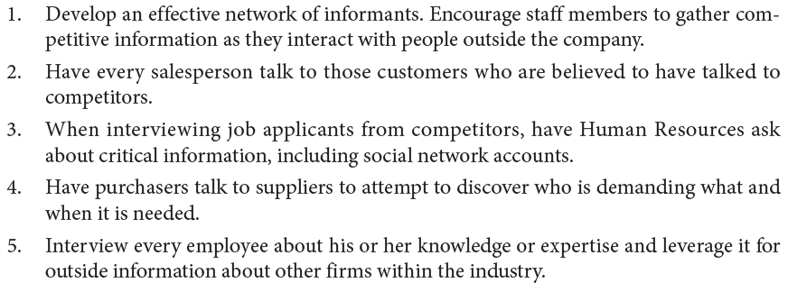
EMERGING BUSINESS ETHICS ISSUES
ETHICAL ISSUES AND DILEMMAS IN BUSINESS INCLUDE:

Slide 30
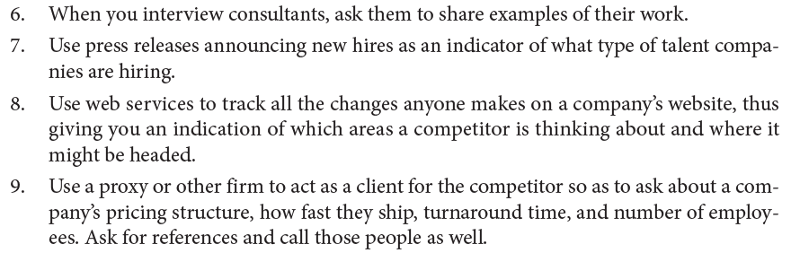
EMERGING BUSINESS ETHICS ISSUES
ETHICAL ISSUES AND DILEMMAS IN BUSINESS INCLUDE:

Slide 31
EMERGING BUSINESS ETHICS ISSUES
ETHICAL ISSUES AND DILEMMAS IN BUSINESS INCLUDE:
Corporate Intelligence (CI)
However, corporate intelligence, like other areas in business, can be abused if due diligence is not taken to maintain legal and ethical methods of discovery.
Computers, local-area networks (LANs), and the Internet have made the theft of trade secrets very easy.
Proprietary information like secret formulas, manufacturing schematics, merger or acquisition plans, and marketing strategies all have tremendous value.
A lack of security and proper training allows a person to use a variety of techniques to gain access to a company’s vital information.

Slide 32
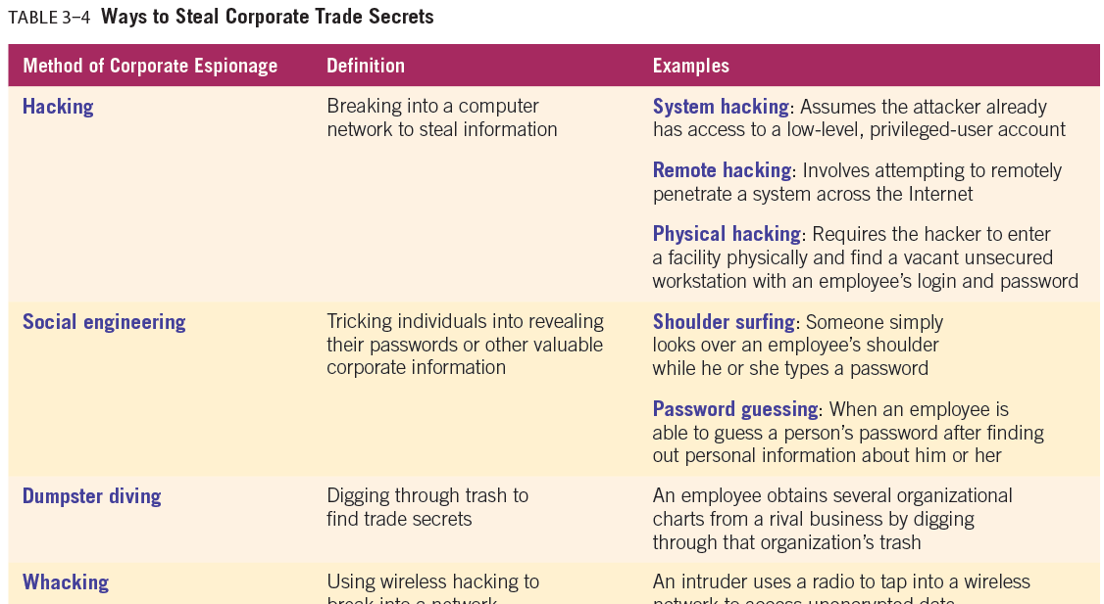

Slide 33
EMERGING BUSINESS ETHICS ISSUES
ETHICAL ISSUES AND DILEMMAS IN BUSINESS INCLUDE:
Discrimination
Discrimination on the basis of race, color, religion, sex, marital status, sexual orientation, public assistance status, disability, age, national origin, or veteran status is illegal in most countries.
Discrimination on the basis of political opinions or affiliation with a union is defined as harassment.
Discrimination can also be an ethical issue in business when companies use race or other personal factors to discriminate against specific groups of customers. Many companies have been accused of using race, disabilities, gender, or age to deny service or to charge higher prices to certain ethnic groups. Employees have also been terminated or denied jobs due to discrimination.

Slide 34
EMERGING BUSINESS ETHICS ISSUES
ETHICAL ISSUES AND DILEMMAS IN BUSINESS INCLUDE:
Sexual Harassment
Sexual harassment can be defined as any repeated, unwanted behavior of a sexual nature perpetrated upon one individual by another. It may be verbal, visual, written, or physical and can occur between people of different genders or those of the same gender.
Displaying sexually explicit materials “may create a hostile work environment or constitute harassment, even though the private possession, reading, and consensual sharing of such materials is protected under the Constitution.

Slide 35
EMERGING BUSINESS ETHICS ISSUES
ETHICAL ISSUES AND DILEMMAS IN BUSINESS INCLUDE:
Sexual Harassment
To establish sexual harassment, an employee must understand the definition of a hostile work environment, for which three criteria must be met:
  The conduct was unwelcome;
  The conduct was severe, pervasive, and regarded by the claimant as so hostile or offensive as to alter his or her conditions of employment; and
  The conduct was such that a reasonable person would find it hostile or offensive.
  Sexual harassment includes unwanted sexual approaches (including touching, feeling, or groping) and/or repeated unpleasant, degrading, or sexist remarks directed toward an employee with the implied suggestion that the target’s employment status, promotion, or favorable treatment depend on a positive response and/or cooperation.

Slide 36
EMERGING BUSINESS ETHICS ISSUES
ETHICAL ISSUES AND DILEMMAS IN BUSINESS INCLUDE:
Fraud
When individuals engage in intentional deceptive practices to advance their own interests over those of the organization or some other group, they are committing fraud.
In general, fraud is any purposeful communication that deceives, manipulates, or conceals facts in order to harm others. Fraud can be a crime, and convictions may result in fines, imprisonment, or both.
Accounting fraud usually involves a corporation’s financial reports, in which companies provide important information on which investors and others base decisions involving millions of dollars.
If the documents contain inaccurate information, intentional or not, lawsuits and criminal penalties may result..

Slide 37
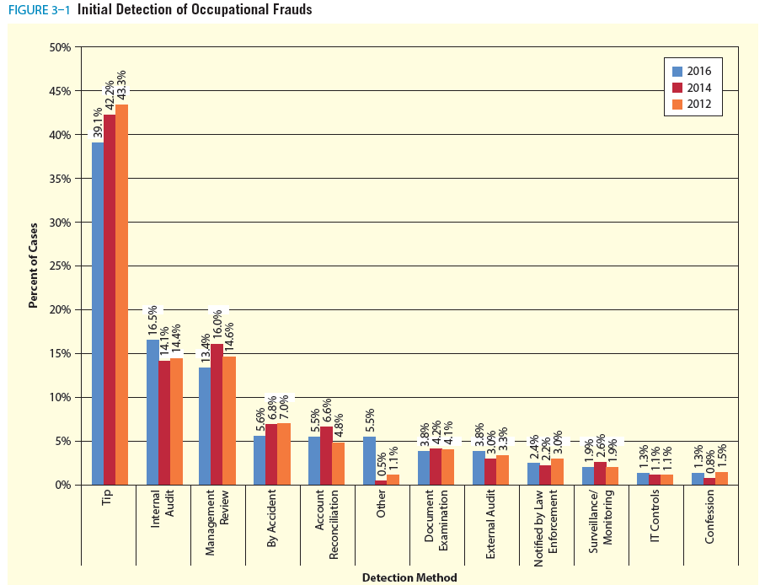

Slide 38
EMERGING BUSINESS ETHICS ISSUES
ETHICAL ISSUES AND DILEMMAS IN BUSINESS INCLUDE:
Consumer Fraud
Consumer fraud occurs when consumers attempt to deceive businesses for their own gain.
Consumers engage in many other forms of fraud against businesses, including price tag switching, item switching, lying to obtain age-related and other discounts, and taking advantage of generous return policies by returning used items, especially clothing that has been worn (with the price tags still attached).
Consumer fraud involves intentional deception to derive an unfair economic advantage by an individual or group over an organization.

Slide 39
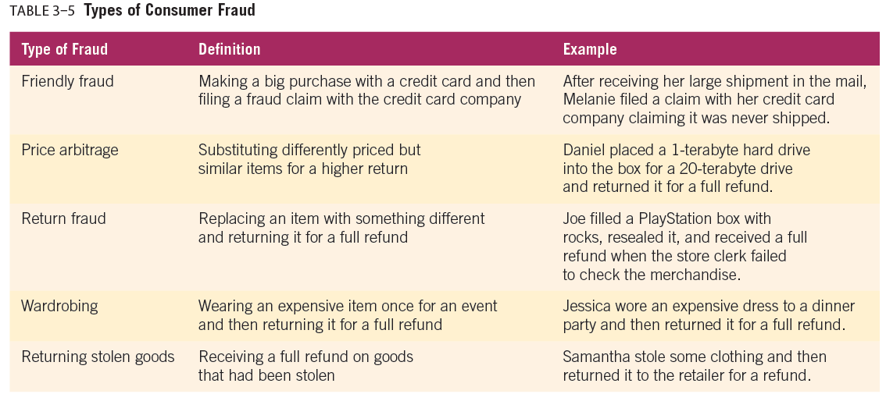

Slide 40
EMERGING BUSINESS ETHICS ISSUES
ETHICAL ISSUES AND DILEMMAS IN BUSINESS INCLUDE:
Intellectual Property Rights
Intellectual property rights involve the legal protection of intellectual property such as music, books, and movies.
While intellectual property rights’ infringement always poses a threat to companies that risk losing profits and reputation, it can also threaten the health and well-being of consumers.

Slide 41
EMERGING BUSINESS ETHICS ISSUES
ETHICAL ISSUES AND DILEMMAS IN BUSINESS INCLUDE:
Privacy Issues
Consumer advocates continue to warn consumers about new threats to their privacy, especially within the health care and Internet industries. As the number of people using the Internet increases, the areas of concern related to its use increase as well.
Some privacy issues that must be addressed by businesses include the monitoring of employees’ use of available technology and consumer privacy.
A challenge for companies today is meeting their business needs while protecting employees’ desire for privacy.

Slide 42
EMERGING BUSINESS ETHICS ISSUES
ETHICAL ISSUES AND DILEMMAS IN BUSINESS INCLUDE:
Privacy Issues
From computer monitoring and telephone taping to video surveillance and GPS satellite tracking, employers are using technology to manage their productivity and protect their resources.
The ability to gather and use data about employee behavior creates an ethical issue related to trust and responsibility.
There is an ethical responsibility to protect consumer’s personal information from cybercrime. Any organization needs to develop a compliance system to stop or create a greater risk to deter cybercriminals. Also, every organization needs a recovery plan for when a hacker steals personal data

Slide 43



Thank You

