Slide 1



Secure Operating Systems (CYB610)
Master of Science in Cybersecurity
Lecture 1
Security Threats to OS
Dr. Ibrahim Gomaa
Faculty of Informatics
Midocean University
Lecture-Intro
www.midocean.ae

Slide 2


Chapter
Topics
01
This chapter covers the following topics and concepts:
What the origins of Linux are
How security works in the open-source world
What distributions of Linux exist
What the C-I-A triad is
How Linux operates as a security device
What Linux’s place in the enterprise is
What some examples of recent security issues are

Slide 3
Chapter
Goals
01
When you complete this chapter, you will be able to:
Describe the basics of security in an open-source world
Explain various roles of Linux systems in the IT architecture
Differentiate between Linux and the operating environment that runs on top of Linux
Explain threats that can target Linux

Slide 4
Chapter
Learning Key Concepts
01
Key Concepts
The origins of Linux
Open-source software security considerations
The confidentiality, integrity, and availability (C-I-A) triad
Linux distributions
Linux security and security threats

Slide 5
Chapter
Computer Security
01
  Computer security is about provisions and policies adopted to protect Hardware, Software, information and property from theft, corruption, or natural disaster
– while allowing the information and property to remain accessible and productive to its intended users.
security of computers against intruders (e.g. Attackers) and malicious software (e.g., viruses).

Slide 6
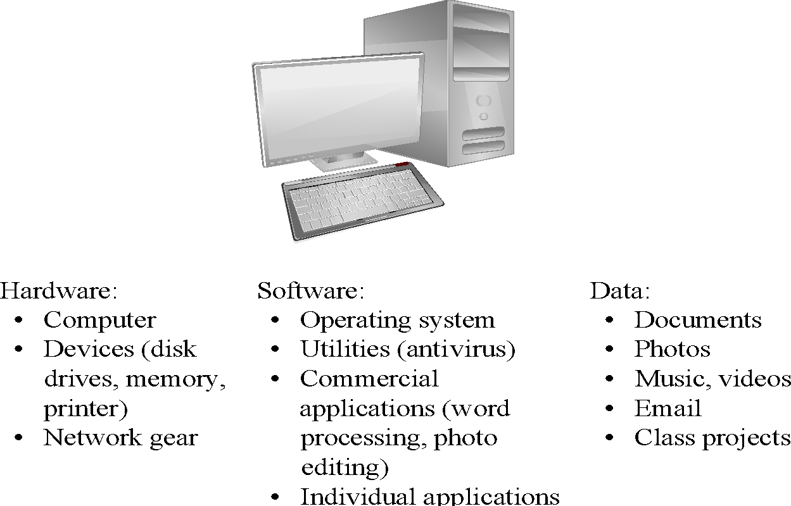
Assets

Slide 7
Chapter
Why need security at the OS level?
01
No more standalone computer system environments.
Any system can be globally accessible through a set of vast inter and intra-network connections.
Transition motivated by the need to work remotely,
convenience in accessing personal records, online shopping etc.
A single security vulnerability in the OS design and implementation known to a malicious attacker could do serious damage.

Slide 8
Chapter
01
Who are the attackers?
Vandals (Hackers, crackers) driven by intellectual challenge.
Insiders: employees or customers seeking revenge or gain informal benefits
Natural disasters: flooding, fire, storms, earthquake…
Criminals seeking financial gain.
Organized crime seeking gain or hiding criminal activities.
Organized terrorist groups or nation states trying to influence national policy.
Foreign agents seeking information (spying) for economic, political, or military purposes.
Tactical countermeasures intended to disrupt military capability.
Large organized terrorist groups

Slide 9
Chapter
01
What are the vulnerabilities?
Physical vulnerabilities (Eg. Computer can be stolen)
Natural vulnerabilities (Eg. Earthquake)
Hardware and Software vulnerabilities (Eg. Failures)
Media vulnerabilities (Eg. Hard disks can be stolen)
Communication vulnerabilities (Ex. Wires can be tapped)
Human vulnerabilities (Eg. Insiders)
Poorly chosen passwords
Software bugs (non reliability of software)
– buffer overflow attacks

Slide 10
Chapter
01
What are the vulnerabilities?
Automatically running active content: active-x, scripts, Java programs (applet)
Open ports: telnet, HTTP
Incorrect configuration
  file permissions
  administrative privileges
Untrained users/system administrators

Slide 11
Chapter
01
Security features in Operating System
An operating system manages and controls access to hardware components
Older operating systems focused on ensuring data confidentiality
Modern operating systems support four basic functions
  Positively identify a user
  Restrict access to authorized resources
  Record user activity
  Ensure proper communications with other computers and devices (sending and receiving data)

Slide 12
Chapter
01
Security features in ordinary OS
Authentication of users
  password comparison
Protection of memory
  user space, paging, segmentations
File and I/O device access control
  access control matrix
Allocation & access control to general objects

Slide 13
Chapter
01
Security features in ordinary OS
Enforcement of sharing resources
  To preserve integrity and consistency (critical section)
Fair service
  no starvation and deadlock
Inter-process communication & synchronization
  Shared variable (e.g, using semaphores)
Protection of data
  encryption, isolation

Slide 14
Chapter
01
Security features in ordinary OS
Identification and Authentication
Mandatory Access Control (enforce multilevel security by classifying the data and users into various security classes)
Discretionary Access Control (grant privileges to users)
Object use and reuse protection (Subject and object)
Anti-virus scan
Accountability and Audit (security log)
Firewall
Intrusion detection (patterns of normal system usages, anomalies)

Slide 15
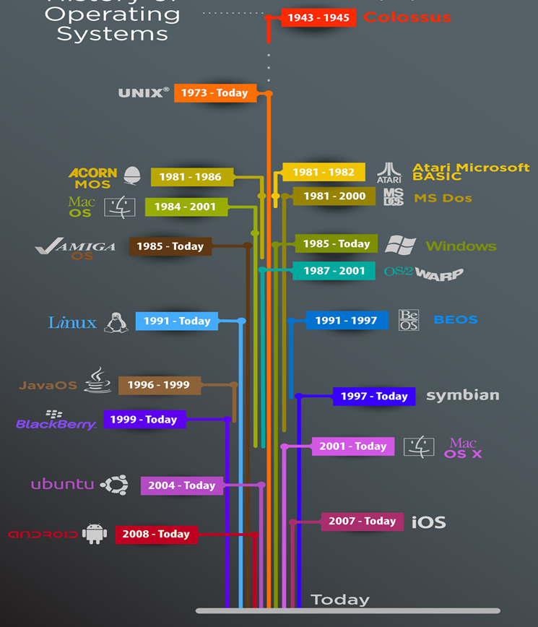
Chapter
01
History of Operating Systems
First, an entire computer was dedicated to one program at a time, but this approach proved wasteful
The first operating systems saved startup, loading, and shutdown time and made much better use of limited resources
The first personal computers took a major step back, as they were dedicated to single users and effectively one program at a time
Multitasking returned to the mainstream in the 1990s, and with it came all the lessons of the early shared computers

Slide 16
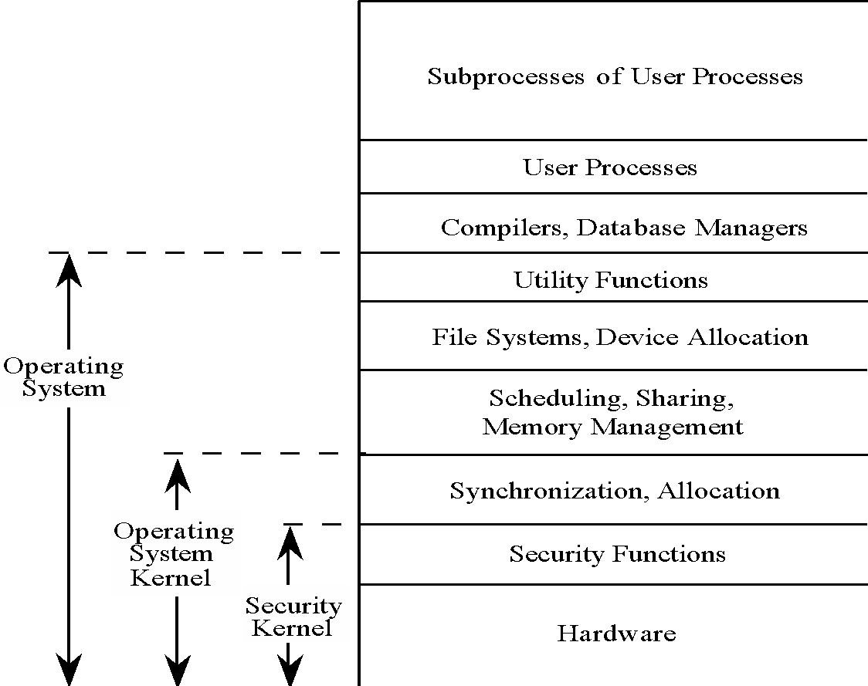
Chapter
01
OS Layered Design
Operating system visualized in layers, from most critical (bottom) to least critical.

Slide 17
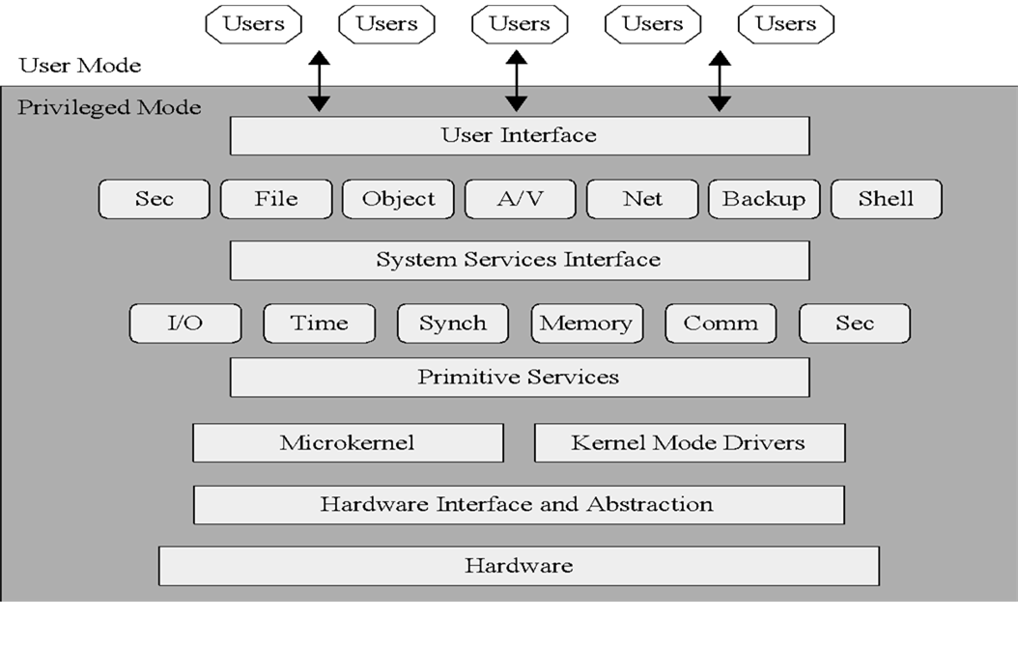
Chapter
01
Modular OS Design
Modern OSs are built from discrete modules. These modules generally come from a variety of sources and are subject to updating/overwriting, so they cannot trust one another.

Slide 18
Chapter
01
Protected Objects
These are some of the common objects that need protection by and in OSs.
Memory
Sharable I/O devices, such as disks
Serially reusable I/O devices, such as printers
Sharable programs and sub procedures
Networks
Sharable data

Slide 19
Chapter
01
Operating Systems Hardening
First critical step in securing a system is to secure the base operating system
Basic steps
  Install and patch the operating system
  Harden and configure the operating system to adequately address the identified security needs of the system by:
    Removing unnecessary services, applications, and protocols
    Configuring users, groups, and permissions
    Configuring resource controls
  Install and configure additional security controls, such as anti-virus, host-based firewalls, and intrusion detection system (IDS)
  Test the security of the basic operating system to ensure that the steps taken adequately address its security needs

Slide 20
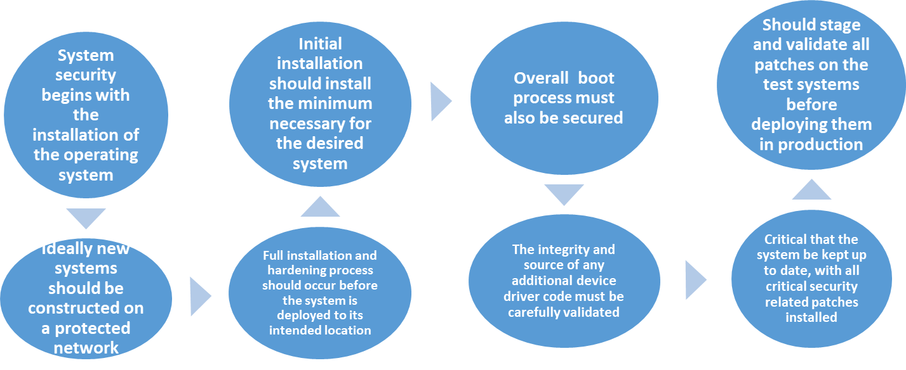
Chapter
01
Operating Systems Hardening

Slide 21
Chapter
01
Operating Systems Hardening
System planning process should consider:
  Categories of users on the system
  Privileges they have
  Types of information they can access
  How and where they are defined and authenticated
Default accounts included as part of the system installation should be secured
  Those that are not required should be either removed or disabled
  Policies that apply to authentication credentials configured

Slide 22
Chapter
01
Application Configuration
May include:
  Creating and specifying appropriate data storage areas for the application
  Making appropriate changes to the application or service default configuration details
Some applications or services may include:
  Default data, Scripts and User accounts of particular concern with remotely accessed services such as Web and file transfer services
  Risk from this form of attack is reduced by ensuring that most of the files can only be read, but not written, by the server

Slide 23
Chapter
01
Security Maintenance
Process of maintaining security is continuous
Security maintenance includes:
  Monitoring and analyzing logging information
  Performing regular backups
  Regularly testing system security
  Using appropriate software maintenance processes to patch and update all critical software, and to monitor and revise configuration as needed

Slide 24
Chapter
01
Security Maintenance
Performing regular backups of data is a critical control that assists with maintaining the integrity of the system and user data
Backup
Archive
Needs and policy relating to backup and archive should be determined during the system planning stage
Can only inform you about bad things that have already happened
In the event of a system breach or failure, system administrators can more quickly identify what happened
Key is to ensure you capture the correct data and then appropriately monitor and analyze this data
The process of retaining copies of data over extended periods of time in order to meet legal and operational requirements to access past data
Information can be generated by the system, network and applications
Range of data acquired should be determined during the system planning stage
Generates significant volumes of information and it is important that sufficient space is allocated for them
The process of making copies of data at regular intervals
Kept online or offline
Automated analysis is preferred
May be legal or operational requirements for the retention of data
Stored locally or transported to a remote site
Logging
Backup & archive

Slide 25
Chapter
01
The Origins of Linux
1960s
  1964: MIT joins with GE and Bell Labs to create a multiuser, time-sharing operating system
1980s
  Multiple Unix versions available from AT&T, University of California .
  1987: Unix-like operating system called MINIX released
1990s
  1991: Torvalds releases Linux in October
  Numerous open-source projects contributed to Linux over past 20 years.

Slide 26
Chapter
01
The Origins of Linux
Linux is a common operating system used for Internet infrastructure.
With Linux, security is much more than just firewalls and permissions.
As with any operating system, a Linux implementation requires strategies to harden it against attack.

Slide 27
Chapter
01
Linux Security
The reality is that no operating system can be called secure.
Security results from appropriate controls and processes
Has evolved into one of the world's most popular operating systems
Free, Open-sourced
Available in a wide variety of distributions targeted at almost every usage scenario imaginable

Slide 28
Chapter
01
Linux Security
The traditional Linux security model can be summed up quite shortly: People or processes with “root” privileges can do anything; other accounts can do much less
From the attacker’s perspective the challenge in cracking a Linux system is gaining root privileges
Once an attacker gains root privileges they can:
  Erase or edit logs & hide their processes, files, and directories
  Basically, redefine the reality of the system as experienced by its administrators and users
Thus, Linux security (and UNIX security in general) is a game of “root takes all”

Slide 29
Chapter
01
Security in an Open-Source World
Open source
  Software developed by teams that provide access to the source code and all the programming language text from which the final executable is generated
  Source code is open for anyone to see
Closed source
  Commercial software developed by companies that ask you to pay for the program

Slide 30
Chapter
01
Security in an Open-Source World
Most open-source code is free and can be used without restriction.
Access to open source enables users to learn from source code, see what it does, and understand how a program operates.
Open source provides the ability for anyone to pick up source code and fix it.
  Enables speedy resolutions
Most open-source software is licensed in a way that requires changes to remain open as well.

Slide 31
Chapter
01
Security in an Open-Source World
Open-source code may not be written securely.
Testing standards vary, and source code may not have sufficient security or regression testing.
Open-source projects are typically not process heavy.
If open-source code is modified by a user and then shared, there’s no guarantee of a quality fix.

Slide 32
Chapter
01
Linux Distributions
RedHat
  Red Hat Enterprise Linux (RHEL)
  Fedora Core
CentOS was based on released versions of RHEL, now developed as CentOS Stream (non-Red Hat)
Debian
  Created by Ian Murdock years ago
  Debian is a merging of the name Ian with the name Debra (Ian’s girlfriend at the time)
  Mint and Ubuntu are derivatives

Slide 33
Chapter
01
Linux Distributions
Advantages
  Stable
  Distributions have pre-compiled packages
  Can avoid unnecessary packages by building your own Linux
Disadvantages
  Distribution determines dependencies; may get packages you don’t want or need
  Source-based distributions must be compiled from source each time, can be time-consuming

Slide 34
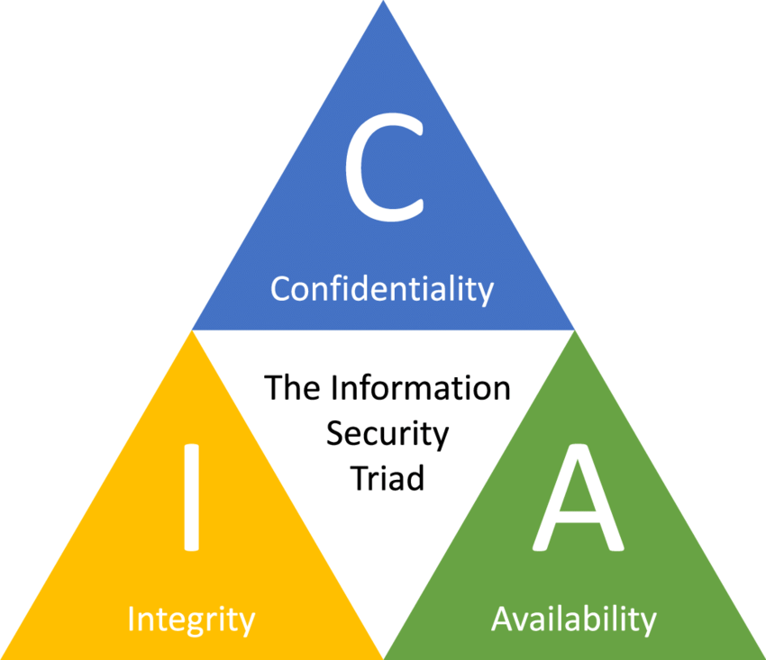
Chapter
01
The C-I-A Triad

Slide 35
Chapter
01
The C-I-A Triad
Confidentiality
  Keeping secrets
Integrity
  Ensuring that the data that are sent are the data that are received
Availability
  Ensuring use of a service, such as a networked application
  Software that is buggy and crashes a lot affects availability
  A denial of service (DoS) attack is a specific and malicious form of a denial-of-service condition

Slide 36
Chapter
01
The Parkerian Hexad
In the late 1990s, Donn Parker, a security professional, proposed an expansion of the C-I-A triad to cover additional concepts he felt were critical to the realm of information security:
  Confidentiality
  Possession or control
  Integrity
  Authenticity
  Availability
  Utility

Slide 37
Chapter
01
Linux as a Security Device
Operating system hardening:
  Limit the number of software packages installed.
  Remove all but the most critical users from the system.
  Restrict permissions on files and directories.
  Remove all but necessary system services.
Can deploy a completely hardened operating system as a bastion host
  A bastion host is a system that is presented to the outside world that can be used to protect other systems that are more sensitive.

Slide 38
Chapter
01
Linux as a Security Device
Firewall
  Hardware or software capable of blocking networking communications based on established criteria, or rules
  Common firewalls available for Linux are iptables and firewalled
You can set up firewall rules to allow, drop, or log specific packets from the network.
If there are multiple network interfaces and a network behind a Linux firewall, you can have it perform Network Address Translation (NAT), effectively hiding all the systems behind your Linux firewall.
On top of the firewall, you can deploy encryption services using Transport Layer Security (TLS).

Slide 39
Chapter
01
Linux in the Enterprise
Web server
  The way customers get access to information, products, and services offered by businesses.
Application server
  Software that provides a framework inside which applications can be written
Security systems
  Firewalls and intrusion-detection systems
Operating systems
  Linux is operating system for many security-based appliances
  You can use Linux as Proxy server or gateway, jump host, or bastion server

Slide 40
Chapter
01
Linux in the Enterprise
Filtering
  Between network segments
Remote Desktop Protocol (RDP) system
  Many packages support functions commonly found on Windows systems
File server / file sharing
  Makes use of Server Message Block (SMB) or Common Internet File System (CIFS) systems, or Network File System (NFS)

Slide 41
Chapter
01
Recent Security Issues
Vulnerabilities
  Addition of more functions to a system increases complexity
  Increased complexity results in more potential for unforeseen problems
  Testing is essential but cannot account for all user behaviors
Increased prevalence of notification laws
  Businesses must notify customers of a breach
  Customers have the right to know when their personal information is at risk

Slide 42
Chapter
01
Recent Security Issues
White-hat hacker
  May use some of the same techniques as a black-hat hacker but is a good guy
Gray-hat hacker
  Performs a range of actions that a white-hat hacker will not undertake; somewhere in between a white-hat hacker and a black-hat hacker

Slide 43
Chapter
01
Recent Security Issues
The Internet is filled with professional organizations and their skilled employees, running businesses that exist to steal information, extort money, or perform other illegal actions.
They may be related to the military for different countries, sometimes called nation-states.
Some attackers look for information, such as intellectual property, that could be sold. They also might engage in corporate espionage or inter-country espionage.

Slide 44
Chapter
01
Recent Security Issues
A malware attack may be launched to get more zombie hosts for a botnet.
  This is also an attack for financial gain because the zombies may be running web server software as a front to an illegal storefront for, say, pharmaceuticals.
  The botnet may also be rented to an attacker for political or financial gain.

Slide 45
Chapter
01
Summary
Who are the attackers
What are the vulnerabilities
Security features in Operating System
Operating Systems Hardening
Security Maintenance
The origins of Linux
Open-source software security considerations
The confidentiality, integrity, and availability (C-I-A) triad
Linux distributions, Linux security and security threats

Slide 46



Thank You

