Slide 1
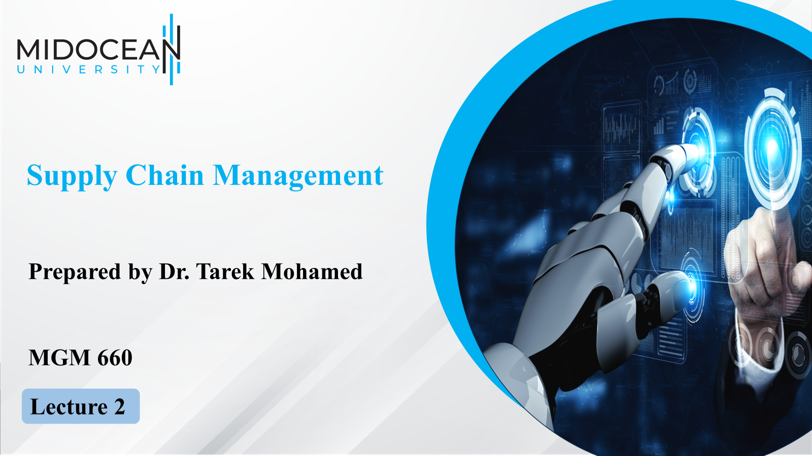

Slide 2


Slide 3


Course Agenda
Chapter
01
1-Explain why achieving strategic fit is critical to a
company’s overall success.
2-Describe how a company achieves strategic fit between
its supply chain strategy and its competitive strategy.
3-Discuss the importance of expanding the scope of
strategic fit across the supply chain.
4-Describe the major challenges that must be overcome
to manage a supply chain successfully.
www.midocean.km

Slide 4
Competitive and Supply Chain Strategies
Competitive strategy defines the set of customer needs a firm seeks to satisfy through its products and services.
Product development strategy specifies the portfolio of new products that the company will try to develop.
Marketing and sales strategy specifies how the market will be segmented, and product positioned, priced, and promoted.
Supply chain strategy determines the nature of material procurement, transportation of materials, manufacture of product or creation of service, distribution of product.
All functional strategies must support one another and the competitive strategy.
www.midocean.km

Slide 5
Competitive and Supply Chain Strategies
A company’s competitive strategy defines, relative to its competitors, the set of customer needs that it seeks to satisfy through its products and services.
For example,
Walmart aims to provide high availability of a variety of products of reasonable quality at low prices.
Most products sold at Walmart are commonplace (everything from home appliances to clothing) and can be purchased elsewhere.
www.midocean.km

Slide 6
Competitive and Supply Chain Strategies
What Walmart provides is a low price and product availability. McMaster-Carr sells maintenance, repair, and operations (MRO) products. It offers more than 500,000 products through both a catalog and a website.
Its competitive strategy is built around providing the customer with convenience, availability, and responsiveness.
With this focus on responsiveness, McMaster does not compete based on low price.
Clearly, the competitive strategy at Walmart is different from that at McMaster.
www.midocean.km

Slide 7
Competitive and Supply Chain Strategies
In each case, the competitive strategy is defined based on how the customer prioritizes product cost, delivery time, variety, and quality.
A McMaster-Carr customer places greater emphasis on product variety and response time than on cost.
A Walmart customer, in contrast, places greater emphasis on cost.
A Blue Nile customer, purchasing online, places great emphasis on product variety and cost.
A customer purchasing jewelry at Zales is most concerned with fast response time and help in product selection.
www.midocean.km

Slide 8
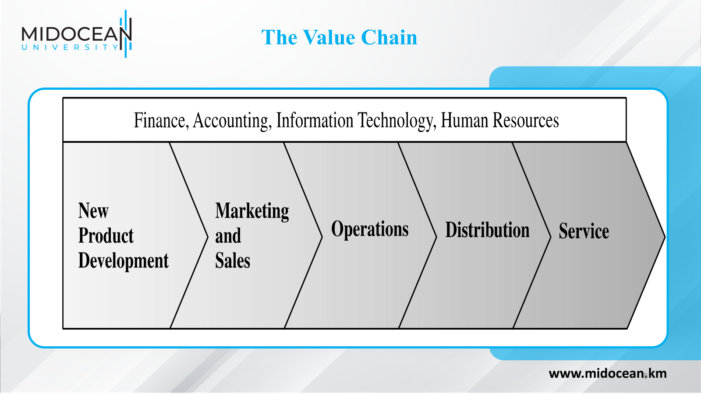

Slide 9
Competitive and Supply Chain Strategies
The value chain begins with new product development, which creates specifications for the product.
Marketing and sales generate demand by publicizing the customer priorities that the products and services will satisfy. Marketing also brings customer input back to new product development.
Operations transforms inputs to outputs to create the product according to new product specifications.
Distribution either takes the product to the customer or brings the customer to the product.
Service responds to customer requests during or after the sale.
These are core processes or functions that must be performed for a successful sale.
Finance, accounting, information technology, and human resources support and facilitate the functioning of the value chain.
www.midocean.km

Slide 10
Competitive and Supply Chain Strategies
For a firm to succeed, all functional strategies must support one another and the competitive strategy.
For example,
Seven-Eleven Japan’s success can be related to the excellent fit among its functional strategies.
Marketing at Seven-Eleven has emphasized convenience in the form of easy access to stores and availability of a wide range of products and services.
New product development at Seven-Eleven is constantly adding products and services, such as bill payment services that draw customers in and exploit the excellent information infrastructure and the fact that customers frequently visit Seven-Eleven.
www.midocean.km

Slide 11
Competitive and Supply Chain Strategies
Operations and distribution at Seven-Eleven have focused on having a high density of stores, being very responsive, and providing an excellent information infrastructure.
The result is a virtuous cycle in which supply chain infrastructure is exploited to offer new products and services that increase demand, and the increased demand in turn makes it easier for operations to improve the density of stores, responsiveness in replenishment, and the information infrastructure.
www.midocean.km

Slide 12
Achieving Strategic Fit
Strategic fit requires that both the competitive and supply chain strategies of a company have aligned goals.
A company may fail because of a lack of strategic fit or because its processes and resources do not provide the capabilities to execute the desired strategy.
It refers to consistency between the customer priorities that the competitive strategy hopes to satisfy and the supply chain capabilities that the supply chain strategy aims to build.
www.midocean.km

Slide 13
Achieving Strategic Fit
Strategic fit
Requires that both the competitive and supply chain strategies of a company have aligned goals.
The competitive strategy and all functional strategies must fit together to form a coordinated overall strategy. Each functional strategy must support other functional strategies and help a firm reach its competitive strategy goal.
2. The different functions in a company must appropriately structure their
processes and resources to be able to execute these strategies successfully.
3. The design of the overall supply chain and the role of each stage must
be aligned to support the supply chain strategy.
www.midocean.km

Slide 14
How is Strategic Fit Achieved?
There are three basic steps to achieving this strategic fit
Understanding the customer and supply chain uncertainty
Understanding the supply chain capabilities
Achieving strategic fit
www.midocean.km

Slide 15
How is Strategic Fit Achieved?
Understanding the customer and supply chain uncertainty
First,
A company must understand the customer needs for each targeted segment and the uncertainty these needs impose on the supply chain.
These needs help the company define the desired cost and service requirements.
The supply chain uncertainty helps the company identify the extent of the unpredictability of demand and supply that the supply chain must be prepared for.
www.midocean.km

Slide 16
How is Strategic Fit Achieved?
Understanding the supply chain capabilities
Each of the many types of supply chains is designed to perform different tasks well. A company must understand what its supply chain is designed to do well.
Achieving strategic fit
If a mismatch exists between what the supply chain does particularly
well and the desired customer needs, the company will either need to restructure the supply chain to support the competitive strategy or alter its competitive strategy.
www.midocean.km

Slide 17
Step 1: Understanding the Customer and Supply Chain Uncertainty
Quantity of product needed in each lot
An emergency order for material needed to repair a production line is likely to be small. An order for material to construct a new production line is likely to be large.
Response time customers will tolerate
The tolerable response time for the emergency order is likely to be short, whereas the allowable response time for the construction order is apt to be long.
Variety of products needed
A customer may place a high premium on the availability of all parts of an emergency repair order from a single supplier. This may not be the case for the construction order.
www.midocean.km

Slide 18
Step 1: Understanding the Customer and Supply Chain Uncertainty
Service level required
A customer placing an emergency order expects a high level of product availability. This customer may go elsewhere if all parts of the order are not immediately available. This is not apt to happen in the case of the construction order, for which a long lead time is likely.
Price of the product
The customer placing the emergency order is apt to be much less sensitive to price than the customer placing the construction order.
Desired rate of innovation in the product
Customers at a high-end department store expect a lot of innovation and new designs in the store’s apparel. Customers at Walmart may be less sensitive to new product innovation.
www.midocean.km

Slide 19
Step 1: Understanding the Customer and Supply Chain Uncertainty
Demand uncertainty
Uncertainty of customer demand for a product
Implied demand uncertainty
Resulting uncertainty for the supply chain given the portion of the demand the supply chain must handle and attributes the customer desires
www.midocean.km

Slide 20
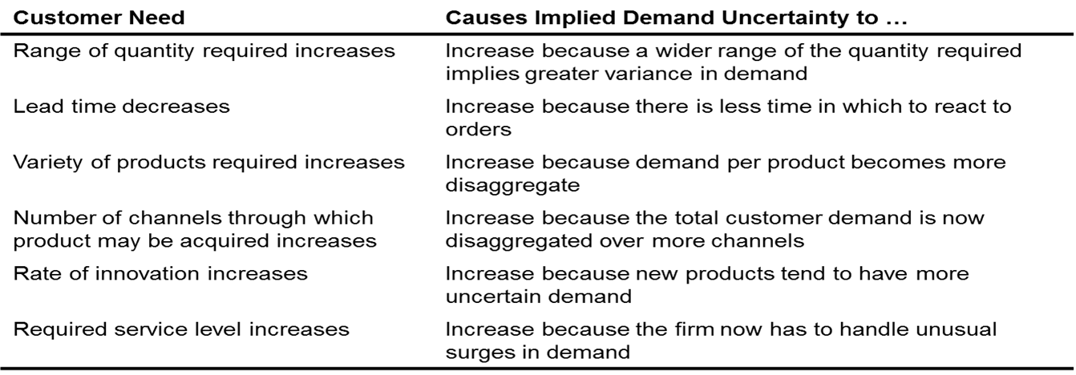
Customer Needs and Implied Demand Uncertainty
www.midocean.km

Slide 21
Implied Uncertainty and Other Attributes
Products with uncertain demand are often less mature and have less direct competition. As a result, margins tend to be high.
Forecasting is more accurate when demand has less uncertainty.
Increased implied demand uncertainty leads to increased difficulty in matching supply with demand. For a given product, this dynamic can lead to either a stockout or an oversupply situation.
Markdowns are high for products with greater implied demand uncertainty because oversupply often results.
www.midocean.km

Slide 22
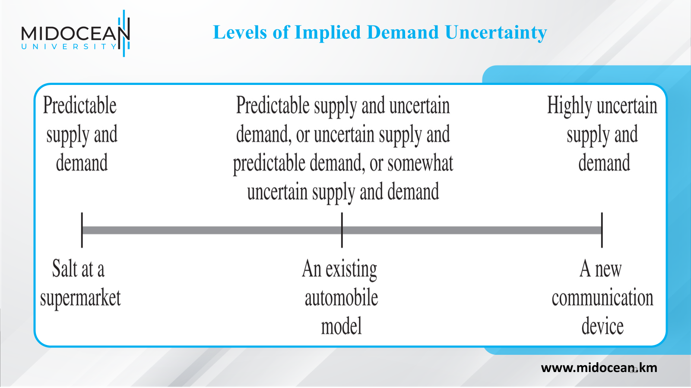

Slide 23
Step 2: Understanding Supply Chain Capabilities
How does the firm best meet demand?
Supply chain responsiveness is the ability to
Respond to wide ranges of quantities demanded
Meet short lead times
Handle a large variety of products
Build highly innovative products
Meet a high service level
Handle supply uncertainty
www.midocean.km

Slide 24
Step 2: Understanding Supply Chain Capabilities
Responsiveness comes at a cost
Supply chain efficiency is the inverse to the cost of making and delivering the product to the customer
The cost-responsiveness efficient frontier curve shows the lowest possible cost for a given level of responsiveness
www.midocean.km

Slide 25
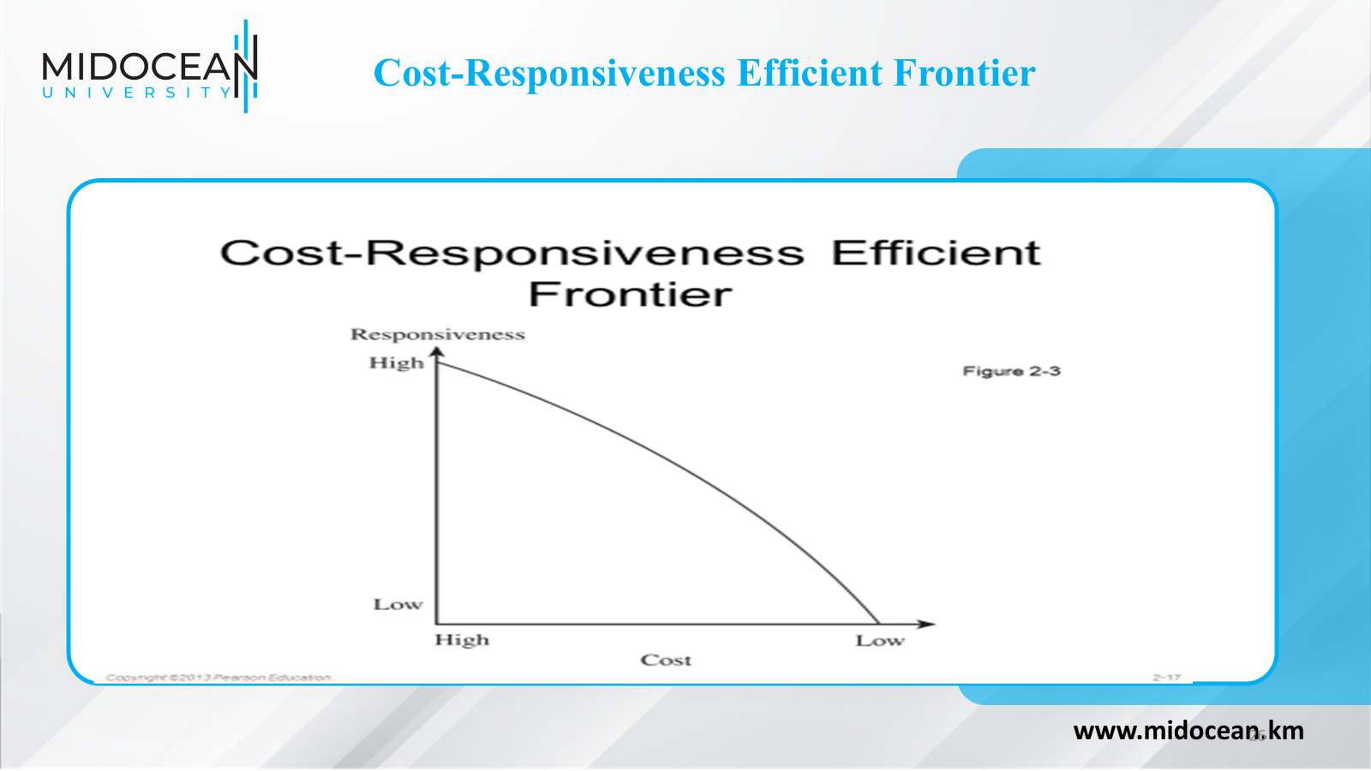

Slide 26
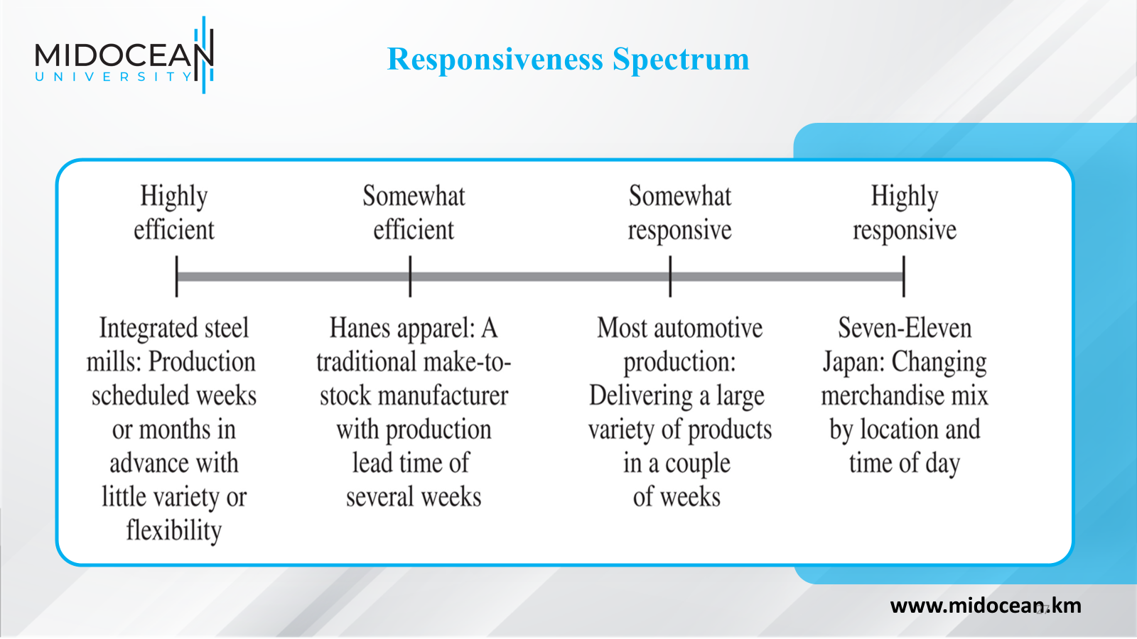

Slide 27
Step 3: Achieving Strategic Fit
Ensure that the degree of supply chain responsiveness is consistent with the implied uncertainty
Assign roles to different stages of the supply chain that ensure the appropriate level of responsiveness
Ensure that all functions maintain consistent strategies that support the competitive strategy
www.midocean.km

Slide 28
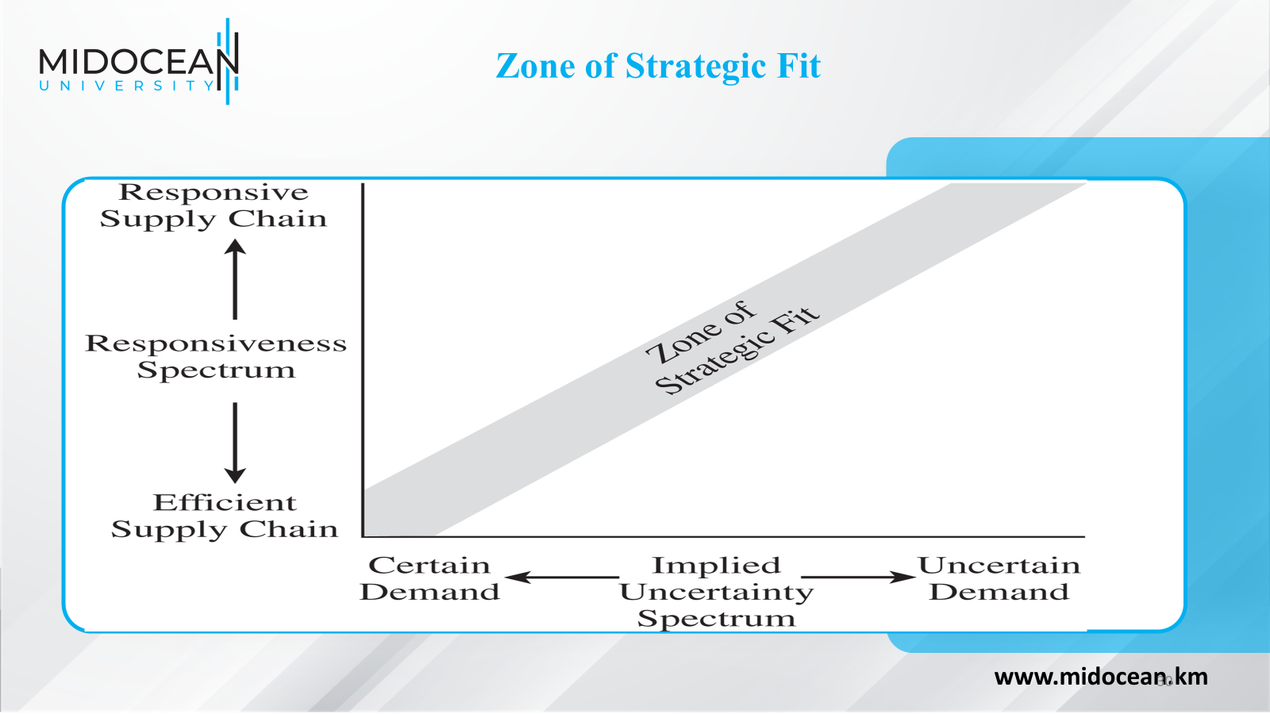

Slide 29
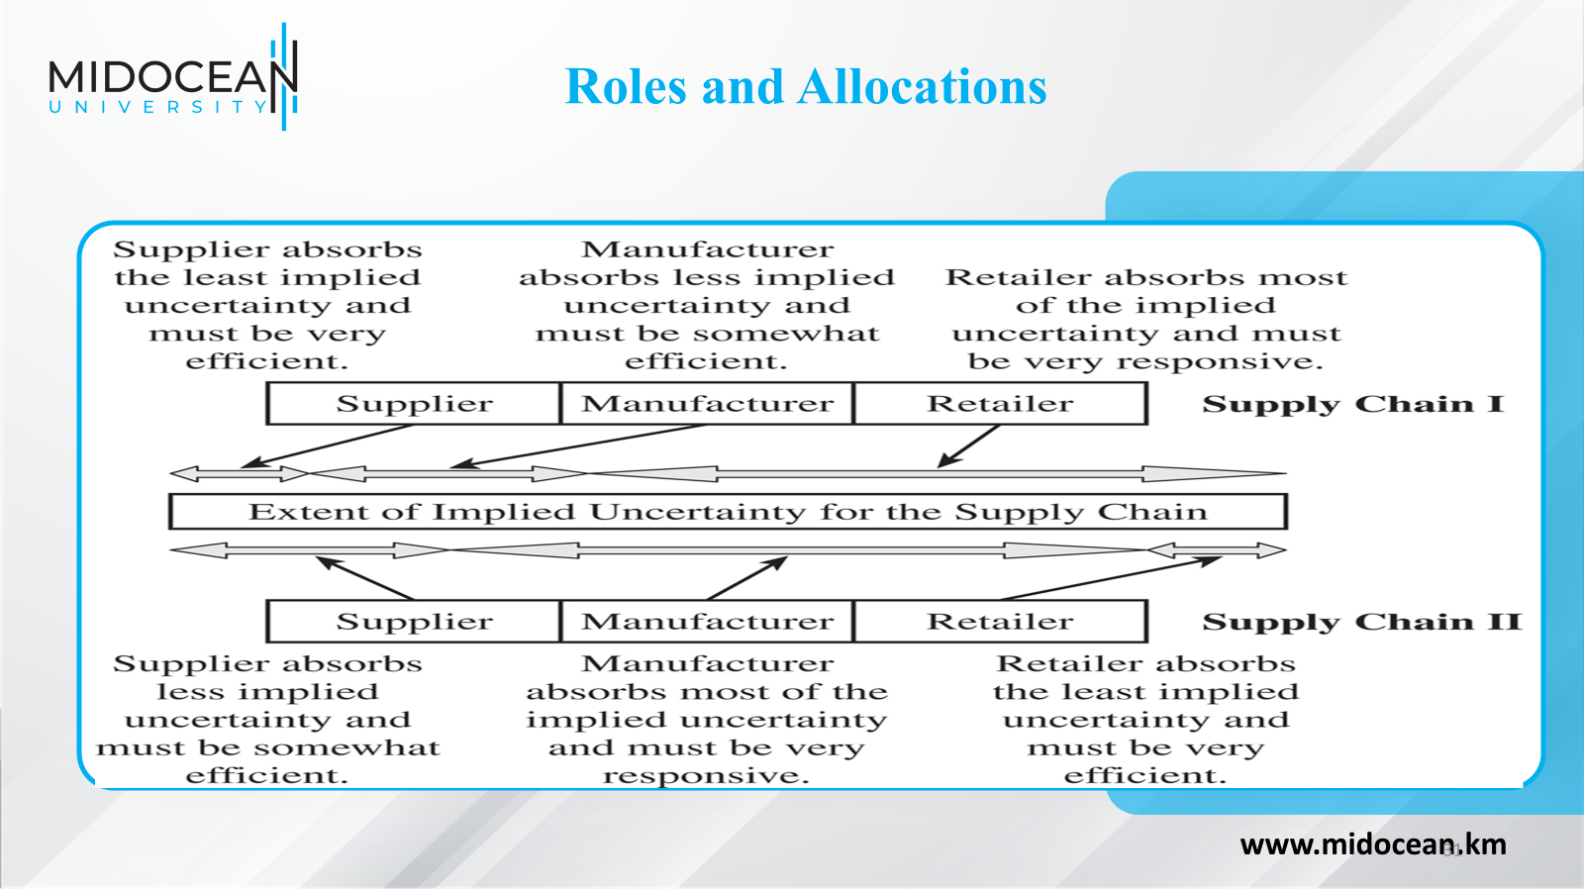

Slide 30
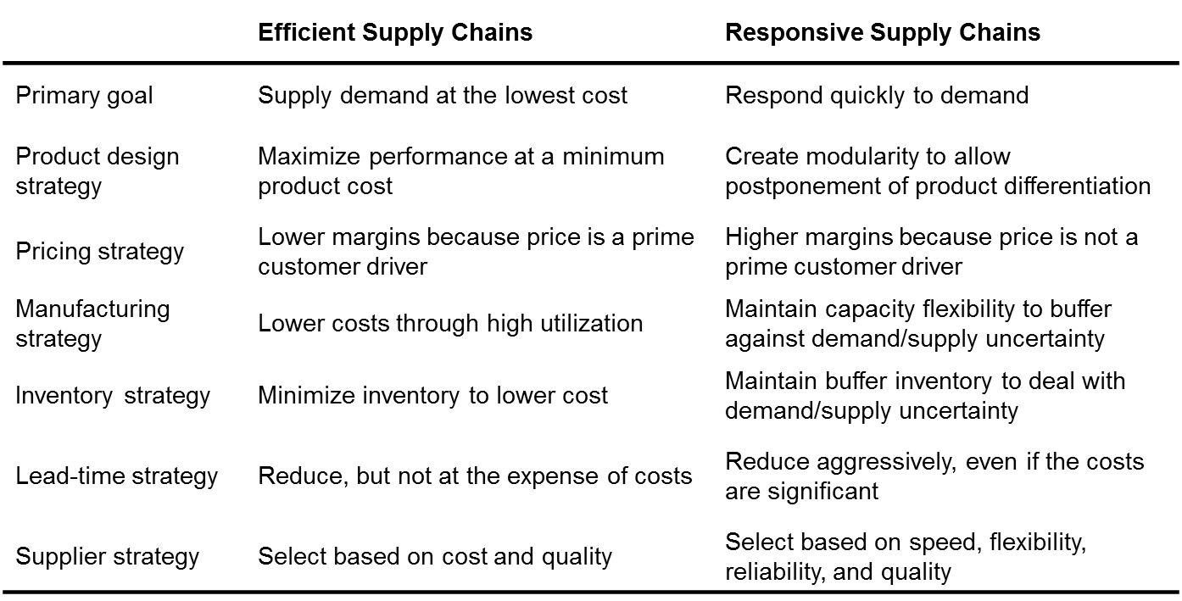
Efficient and Responsive Supply Chains
www.midocean.km

Slide 31
Tailoring the Supply Chain
Achieve strategic fit while serving many customer segments with a variety of products across multiple channels
Requires sharing some links in the supply chain with some products, while having separate operations for other links
www.midocean.km

Slide 32
Changes Over Product Life Cycle
Beginning stages
Demand is very uncertain, and supply may be unpredictable
Margins are often high, and time is crucial to gaining sales
Product availability is crucial to capturing the market
Cost is often a secondary consideration
www.midocean.km

Slide 33
Changes Over Product Life Cycle
Later stages
Demand has become more certain, and supply is predictable
Margins are lower as a result of an increase in competitive pressure
Price becomes a significant factor in customer choice
www.midocean.km

Slide 34
Expanding Strategic Scope
Scope of strategic fit
The functions within the firm and stages across the supply chain that devise an integrated strategy with an aligned objective
Intraoperation Scope: Minimize Local Cost View
Each stage of the supply chain devises strategy independently
www.midocean.km

Slide 35
Expanding Strategic Scope
Intrafunctional Scope: Minimizing Total Functional Cost
Firms align all operations within a function
Interfunctional Scope: Maximize Company Profit
Functional strategies are developed to align with one another and the competitive strategy
www.midocean.km

Slide 36
Expanding Strategic Scope
Intercompany scope – maximize supply chain surplus
  Supplier and customer work together and share information to reduce total cost and grow supply chain surplus
Agile intercompany scope – a firm’s ability to achieve strategic fit when partnering with supply chain stages that change over time
www.midocean.km

Slide 37
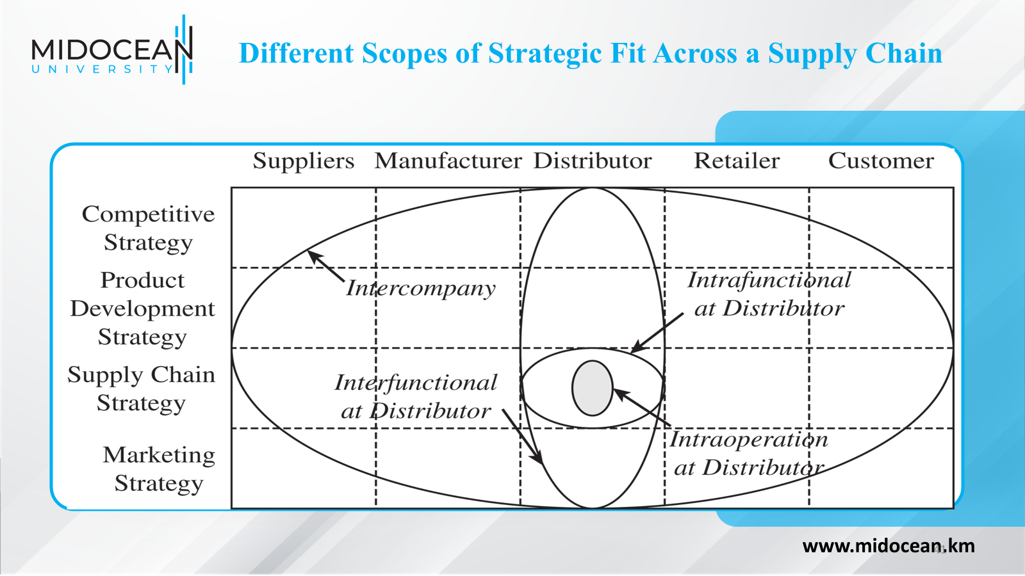

Slide 38
Challenges
Increasing product variety and shrinking life cycles
Greater product variety and shorter life cycles increase uncertainty while reducing the window of opportunity within which the supply chain can achieve fit
Globalization and increasing uncertainty
Significant fluctuations in exchange rates, global demand, and the price of crude oil affecting supply chain performance
www.midocean.km

Slide 39
Challenges
Fragmentation of supply chain ownership
Firms are less vertically integrated
Take advantage of supplier and customer competencies they did not have
New ownership structure makes aligning and managing the supply chain more difficult
Aligning all members of a supply chain has become critical to achieving supply chain fit
www.midocean.km

Slide 40
Challenges
Increasing product variety and shrinking life cycles
Greater product variety and shorter life cycles increase uncertainty while reducing the window of opportunity within which the supply chain can achieve fit
Globalization and increasing uncertainty
Significant fluctuations in exchange rates, global demand, and the price of crude oil affecting supply chain performance
www.midocean.km

Slide 41
Challenges
Changing technology and business environment
Changes in customer needs and technology may force a firm to rethink their supply chain strategy to maintain strategic fit
The environment and sustainability
Growing in relevance and must be accounted for when designing supply chain strategy
Opportunities may require coordination across different members of the supply chain
www.midocean.km

Slide 42
Summary of Learning Objectives
Chapter
01
Explain why achieving strategic fit is critical to a company’s overall success
Describe how a company achieves strategic fit between its supply chain strategy and its competitive strategy
Discuss the importance of expanding the scope of strategic fit across the supply chain
Describe the major challenges that must be overcome to manage a supply chain successfully
www.midocean.km

Slide 43
Essential Reference
Chopra, S., & Meindl, P. (2016). Global Edition. Pearson Education Limited
Chapter 2.
Lysons, K., & Farrington, B. (2020). Procurement and supply chain management. Pearson UK.
Morris, P. W., & Pinto, J. K. (Eds.). (2007). The Wiley guide to project technology, supply chain, and procurement management (Vol. 4). John Wiley & Sons.
Schwalbe, K. (2015). Information technology project management. Cengage Learning.
Supply Chain Council
www.midocean.km

Slide 44


Thank You

