Slide 1



Introduction to Economics
Lecture 1
MGM112
The Economic Problem
Prepared by
Lec. Dina ElWakkad
www.midocean.ae

Slide 2


Chapter
Objectives of Lecture (1)
01
After studying this lecture, you will be able to:
  Define the Production Possibility frontier (PPF) and use it to calculate Opportunity cost
  Explain How the production possibilities frontier (PPF) illustrates production efficiency, and Scarcity
  Show How economic growth influences the Production Possibility frontier (PPF)
www.midocean.ae

Slide 3
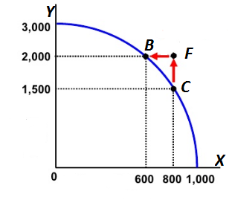
Chapter
Definition of Production Possibility frontier (PPF).
01
v
It is a graphical model that represents all the different combinations of goods and services that can be produced and those that cannot given resources and the current state of technology.
www.midocean.ae

Slide 4
Chapter
Definition of Production Possibility frontier (PPF).
01
v
Under assumptions as :
  O Only Two goods
  O Fixed resources
  O Fixed technology
  O At given moment / Time
  O Efficiency - the economy is achieving maximum production by utilizing scarce resources to the fullest.
www.midocean.ae

Slide 5
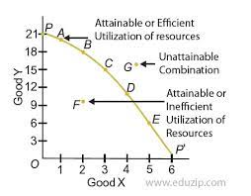
Chapter
Definition of Production Possibility frontier (PPF).
01
v
Points on/ Along the PPF (A, B,C , D, E): Efficient, Attainable
  Efficient: full employment of resources
    The production possibilities frontier shows the combination of goods and services that can be produced efficiently
  Attainable: Can be produced by the current available resources
    The production possibilities frontier shows the maximum levels of production that can be attained.
www.midocean.ae

Slide 6
Chapter
Definition of Production Possibility frontier (PPF).
01
v
Points inside the PPF (F): Inefficient, Attainable
  Inefficient: Underemployment of resources
  Attainable: Can be produced by the current available resources
www.midocean.ae

Slide 7
Chapter
Definition of Production Possibility frontier (PPF).
01
v
Points Outside/ Beyond the PPF (G): Unattainable (Can nor be produced by the current available resources)
  Unattainable: Can not be produced by the current available resources
www.midocean.ae

Slide 8
Chapter
Definition of Production Possibility frontier (PPF).
01
v
  The PPC can be used to illustrate the concepts of:
  Scarcity,
  Efficiency, Inefficiency,
  Opportunity cost,
  Economic growth.
www.midocean.ae

Slide 9
1) the PPF& scarcity
Chapter
01
v
( Attainable , Unattainable )
Inside / Along / Outside
www.midocean.ae

Slide 10
1) the PPF& scarcity
Chapter
01
v
( attainable , unattainable )
All points Outside/ Beyond PPF as point (G) are unattainable and illustrate the concept of scarcity.
  Because there simply are not enough resources to produce any of these combinations of outputs
www.midocean.ae

Slide 11
1) the PPF& scarcity
Chapter
01
v
( attainable , unattainable )
All points On PPF as points (A, B, C, D, E) or Inside PPF as point (D) are attainable and illustrate the concept of scarcity.
  Because while moving along/On the PPF to increase the production of one good requires that the production of another good be reduced (Trade-Off) , which also illustrates scarcity
www.midocean.ae

Slide 12
1) the PPF& scarcity
Chapter
01
v
( attainable , unattainable )
  i.e., while moving along/On the PPF from point B to C , this will lead to increase the production of good (X) and this requires the production of good(Y) be reduced, which also illustrates scarcity
www.midocean.ae

Slide 13
2) the PPF& Efficiency
Chapter
01
v
(Efficient, Inefficient)
Along / Inside
www.midocean.ae

Slide 14
2) the PPF& Efficiency
Chapter
01
v
(Efficient, Inefficient)
Efficiency:
means the full employment of resources in production; all resources are fully utilized
www.midocean.ae

Slide 15
2) the PPF& Efficiency
Chapter
01
v
(Efficient, Inefficient)
Efficiency:
Efficient combinations of output will always be on the PPF as points (A, B, C, D, E)
  Movements along the PPF illustrate that producing more of one good requires producing less of other good. This observation reflects the result that a tradeoff must be made when producing output efficiently
www.midocean.ae

Slide 16
2) the PPF& Efficiency
Chapter
01
v
(Efficient, Inefficient)
Inefficiency:
means the Underemployment of resources in production; all resources are not fully utilized
  i.e., one or both outputs may be increased without decreasing the other output level.
Inefficient combinations of output will always be inside the PPF as point (F)
www.midocean.ae

Slide 17
3) the PPF& opportunity cost
Chapter
01
v
Opportunity cost: The units you give up/ sacrifice of one good to get extra units of the other good
www.midocean.ae

Slide 18
3) the PPF& opportunity cost
Chapter
01
v
The negative slope of PPF illustrates the concept of opportunity cost (the marginal rate of transformation (MRT)),
  Which implies that whenever moving along PPF to increase the production of one good, we must decrease the production of the other good. (Trade off in choices)
  i.e. At given resources, production of both the goods cannot be increased together. More of good Y can be produced only with less of good X as resources are scarce
www.midocean.ae

Slide 19
3) the PPF& opportunity cost
Chapter
01
v
Opportunity cost of good X in terms of good Y = │∆Y/∆X│ Opportunity cost of good Y in terms of good X=│∆X/∆Y│
www.midocean.ae

Slide 20
3) the PPF& opportunity cost
Chapter
01
v
Numerical example
Start at point C (800X , 1500Y) ,
If we want to increase the number of good Y to 2000, so we will move along PPF from point C to point B , At point B ( 600X, 2000Y ) ,
www.midocean.ae

Slide 21
3) the PPF& opportunity cost
Chapter
01
v
Numerical example
-So, to increase the production of good Y by 500 ( 2000-1500) ,
We must decrease the production of good X by 200( 800-600)
www.midocean.ae

Slide 22
3) the PPF& opportunity cost
Chapter
01
v
Numerical example
-Opportunity cost of good Y in terms of good X = │the decrease in X / The increase in Y│
    Opportunity cost of good Y in terms of good X = │200/500│ = 0.4 ,
    Means The cost of producing one more unit of good Y is giving up 0.4 units of good X
www.midocean.ae

Slide 23
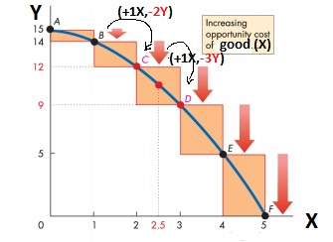
3) the PPF& opportunity cost
Chapter
01
v
Why does the PPF concave?
www.midocean.ae

Slide 24
3) the PPF& opportunity cost
Chapter
01
v
Why does the PPF concave?
The Concavity of the PPF means that as the quantity produced of each good increases, So when one factor is shifted from the production of one good to another, then its productivity falls, causing marginal opportunity cost of increasing product to rise,
www.midocean.ae

Slide 25
3) the PPF& opportunity cost
Chapter
01
v
Why does the PPF concave?
As we move down along PPF → produce additional unit of one good → more and more units of the other good needed to be sacrificed → The opportunity cost increases → Causes the concave shape of PPF
www.midocean.ae

Slide 26
3) the PPF& opportunity cost
Chapter
01
v
Why does the PPF concave?
Numerical example
Starting at point B (1X, 14 Y )
2) B→C : if we move down to point (C) to produce additional unit of good X → so we will sacrifice 2 units of Y (14-12) so we will move to point C (2X, 12Y)
  opportunity cost for good X = │∆Y/∆X│ = 2
www.midocean.ae

Slide 27
3) the PPF& opportunity cost
Chapter
01
v
Why does the PPF concave?
Numerical example
3) C→D: if we move down to point (D) to produce additional unit of good X → so we will sacrifice 3 units of Y(12-9 ) so we will move to point D (3X, 9Y)
  opportunity cost for good X = │∆Y/∆X│ = 3
www.midocean.ae

Slide 28
3) the PPF& opportunity cost
Chapter
01
v
Why does the PPF concave?
Numerical example
4) So, as we move down along PPF (B→C →D )
Good (X) increases
Sacrifice more and more of good (Y)
opportunity cost for good X increases
so, the PPF is concave
www.midocean.ae

Slide 29
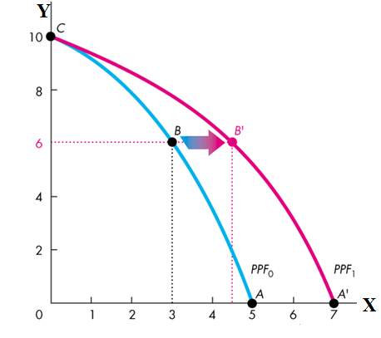
4) the PPF& Economic Growth
Chapter
01
v
Economic growth shifts the PPF outward.
www.midocean.ae

Slide 30
4) the PPF& Economic Growth
Chapter
01
v
The two key factors that generate economic growth are
Technological change
  allows an economy to produce more of goods with the same amount of limited resources
www.midocean.ae

Slide 31
4) the PPF& Economic Growth
Chapter
01
v
The two key factors that generate economic growth are
2) Capital accumulation (human capital).
  The growth of capital resources including human capital, Means that an economy has increased its available resources for production of goods.
www.midocean.ae

Slide 32

Think
Chapter
01
v
The production possibilities frontier represents________.
A) the maximum number of resources available at any given time.
B) combinations of goods and services that do not fully use available resources.
C) the maximum rate of growth of output possible for an economy.
D) the maximum levels of production that can be attained.
When producing at a production efficient point, ________.
A) our choice of the goods can be either on or within the production possibilities frontier
B) we can satisfy our all wants
C) the opportunity cost of another good is zero
D) we face a tradeoff and incur an opportunity cost
www.midocean.ae

Slide 33
Think
Chapter
01
v
A production possibilities frontier figure does NOT illustrate ________.
A) the limits on production imposed by our limited resources and technology.
B) who gets the goods.
C) opportunity cost.
D) attainable and unattainable points.
Scarcity is represented on a production possibilities frontier figure by ________.
A) the amount of the good on the horizontal axis forgone.
B) the fact that there are only two goods in the diagram.
C) technological progress.
D) the fact there are attainable and unattainable points.
www.midocean.ae

Slide 34
Think
Chapter
01
v
A country that must decrease production of one good in order to increase the production of another________.
A) must be using resources inefficiently.
B) must be producing on its production possibilities frontier.
C) must be producing beyond its production possibilities frontier.
D) must have private ownership of property.
Production points inside the production possibilities frontier________.
A) are unattainable.
B) are attainable only with the full utilization of all resources.
C) are associated with unused or misallocated resources.
D) result in more rapid growth.
www.midocean.ae

Slide 35
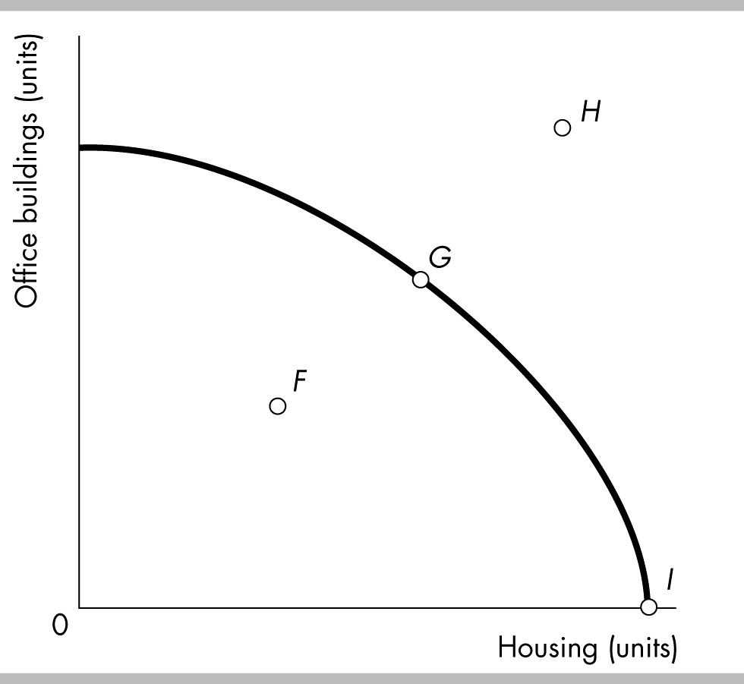
Think
Chapter
01
v
Consider the PPF for office buildings and housing shown in the figure. Which point in the diagram shows that resources to produce office buildings and housing are being misallocated, unused, or both?
A) Point F
B) Point G
C) Point H
D) Point I
www.midocean.ae

Slide 36
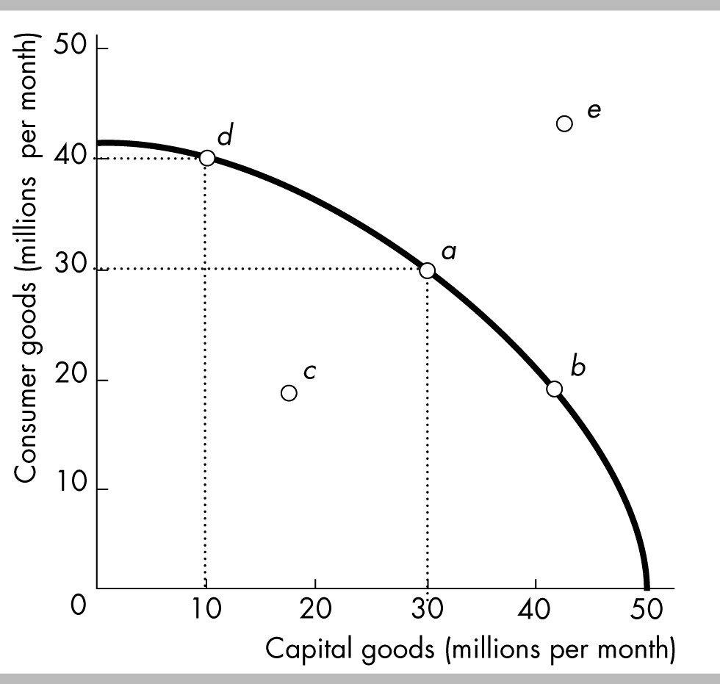
Think
Chapter
01
v
Refer to the production possibilities frontier in the figure. Production point ________ represents an ________ production point.
A) b; unattainable.
B) c; unattainable.
C) e; inefficient.
D) c; inefficient.
www.midocean.ae

Slide 37
Think
Chapter
01
v
A president of the United States promises to produce more defense goods without any decreases in the production of other goods. This promise can be valid
A) if the United States is producing at a point on its production possibilities frontier.
B) if the United States is producing at a point inside its production possibilities frontier.
C) if the United States is producing at a point beyond its production possibilities frontier.
D) only if the production possibilities frontier shifts rightward
Using the production possibilities frontier model, unemployment is described as producing at a point
A) on the exact middle of the PPF curve.
B) on either end of the PPF curve.
C) inside the PPF curve.
D) outside the PPF curve.
www.midocean.ae

Slide 38
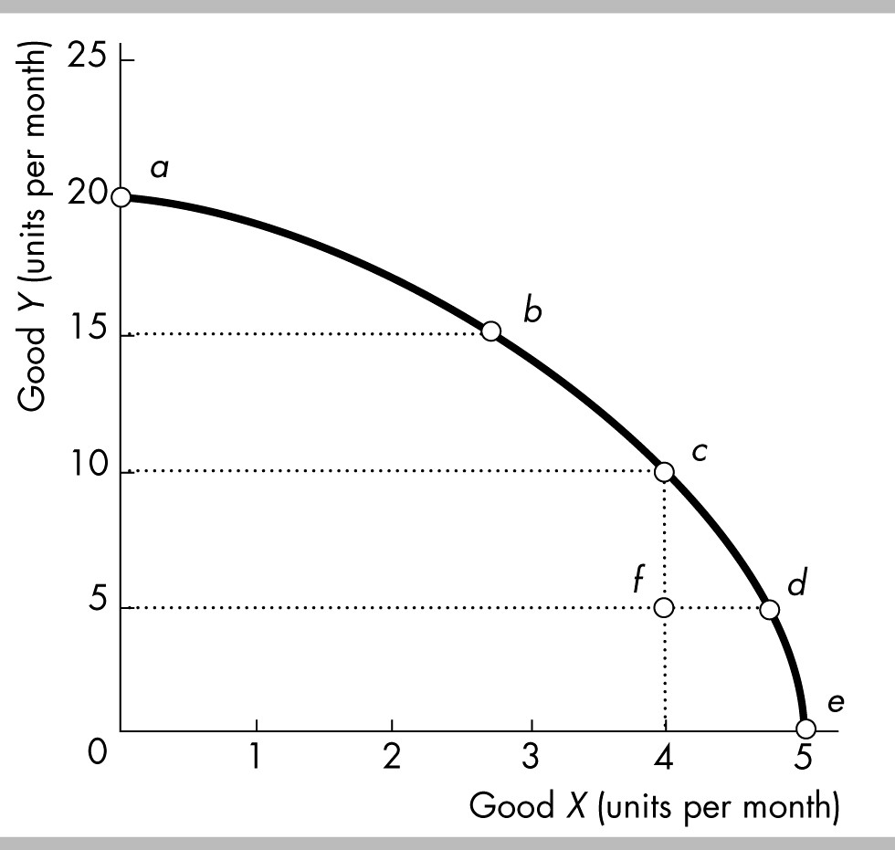
Think
Chapter
01
v
When resources are assigned to inappropriate tasks, that is, tasks for which they are not the best match, the result will be producing at a point
A) where the slope of the PPF is positive.
B) where the slope of the PPF is zero.
C) inside the PPF.
D) outside the PPF.
The figure above illustrates Mary's production possibilities frontier. If Mary wants to move from point b to point c, she must
A) improve technology.
B) increase the accumulation of capital.
C) give up some of good Y in order to obtain more of good X.
D) give up some of good X in order to obtain more of good Y.
www.midocean.ae

Slide 39
Think
Chapter
01
v
A nation can produce at a point outside its PPF
A) when it trades with other nations.
B) when it produces inefficiently.
C) when its PPF is bowed out.
D) never.
A key factor that leads to economic growth is
A) human capital accumulation.
B) increasing current consumption.
C) avoiding the opportunity cost of investment.
D) Both answers A and B are correct.
www.midocean.ae

Slide 40
Summary outlines
Chapter
01
v
Definition of PPF
The PPF& Scarcity
The PPF& Efficiency
The PPF& Inefficiency
The PPF& Opportunity cost
The PPF& Economic Growth
www.midocean.ae

Slide 41


Thank You

