Slide 1



Risk Management
MGM 510
Lecture 2
Prepared by
Dr. Hamed Almahadin
www.midocean.ae

Slide 2
Chapter#2
Impact of Risk on Organizations
Lecture 2
Prepared by
Dr. Hamed Almahadin
www.midocean.ae

Slide 3
Topics to be Covered
Level of Risk
Attachment of Risks
Risk and Reward
Attitudes to Risk
Risk and Triggers

Slide 4
Level of Risk
Following the events in the world financial system during 2008, all organizations are taking a greater interest in risk and risk management.
It is increasingly understood that the explicit and structured management of risks brings benefits.

Slide 5
Level of Risk
By taking a proactive approach to risk and risk management, organizations will be able to achieve the following four areas of improvement:
  Strategy
  Tactics
  Operations
  Compliance

Slide 6
Level of Risk
Strategy: because the risks associated with different strategic options will be fully analyzed and better strategic decisions will be reached.

Slide 7
Level of Risk
Tactics: because consideration will have been given to selection of the tactics and the risks involved in the alternatives that may be available.

Slide 8
Level of Risk
Operations: because events that can cause disruption will be identified in advance and actions taken to reduce the likelihood of these events occurring, limit the damage caused by these events and contain the cost of the events.

Slide 9
Level of Risk
Compliance: will be enhanced because the risks associated with failure to achieve compliance with statutory and customer obligations will be recognized.

Slide 10
Attachment of Risks
Most standard definitions of risk refer to risks as being attached to corporate objectives.
Figure 2.1 provides an illustration of the options for the attachment of risks.

Slide 11
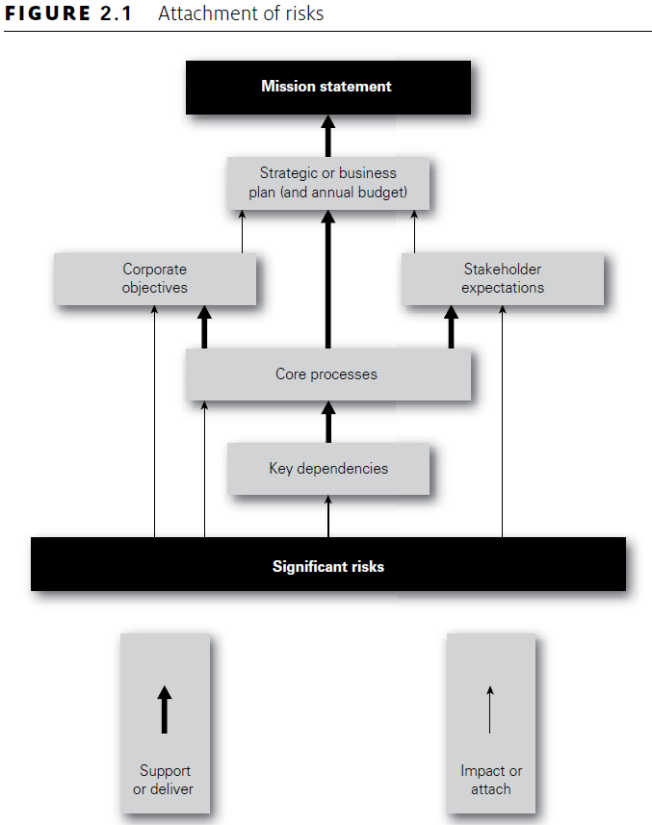
Attachment of Risks

Slide 12
Attachment of Risks
Figure 2.1: Explanations
Risks are shown in the diagram as being capable of impacting the key dependencies that deliver the core processes of the organization.
Corporate objectives and stakeholder expectations help define the core processes of the organization.
These core processes are key components of the existing nature and future enhancement of the business model and can relate to operations, tactics and corporate strategy, as well as compliance activities.

Slide 13
Attachment of Risks
Figure 2.1: Explanations
The intention of Figure 2.1 is to demonstrate that significant risks can be attached to features of the organization other than corporate objectives.
Significant risks can be identified by considering the key dependencies of the organization, the corporate objectives and/or the stakeholder expectations, as well as by analysis of the core processes of the organization.

Slide 14
Attachment of Risks
Figure 2.1: Explanations
For example, the failure of “Northern Rock Bank” occurred because the wholesale money markets, on which the bank depended, stopped functioning.
Another way of viewing the concept of attachment of risks is to consider that the features shown in Figure 2.1 offer alternative starting points for undertaking a risk assessment.
For example, a risk assessment can be undertaken by asking ‘what do stakeholders expect of us?’ and ‘what risks could impact the delivery of those stakeholder expectations?’

Slide 15
Attachment of Risks
Figure 2.1: Explanations
In the build-up to the recent financial crisis, banks and other financial institutions established operational and strategic objectives.
By analyzing these objectives and identifying the risks that could prevent the achievement of them, risk management contributed to the achievement of the high-risk objectives that ultimately led to the failure of the organizations.
This example illustrates that attaching risks to attributes other than objectives is not only possible but may well have been desirable in these circumstances.

Slide 16
Attachment of Risks
Figure 2.1: Explanations
It is clearly the case that risks are greater in circumstances of change.
Therefore, linking risks to change objectives is not unreasonable, but the analysis of each objective in turn may not lead to robust risk recognition/identification.
In any case, business objectives are usually stated at too high a level for the successful attachment of risks.

Slide 17
Attachment of Risks
Figure 2.1: Explanations
To be useful to the organization, the corporate objectives should be presented as a full statement of the short-, medium- and long-term aims of the organization.
Internal, annual, change objectives are usually inadequate, because they may fail to fully identify the operational (or efficiency), change (or competition) and strategic (or leadership) requirements of the organization.

Slide 18
Attachment of Risks
Figure 2.1: Explanations
The most important disadvantage associated with the ‘objectives-driven’ approach to risk and risk management is the danger of considering risks out of the context that gave rise to them.
Risks that are analyzed in a way that is separated from the situation that led to them will not be capable of rigorous and informed evaluation.
It can be argued that a more robust analysis can be achieved when a ‘dependencies-driven’ approach to risk management is adopted.

Slide 19
Attachment of Risks
Figure 2.1: Explanations
It remains the case that many organizations continue to use an analysis of corporate objectives as a means of identifying risks, because some benefits do arise from this approach.
For example, using this ‘objectives-driven’ approach facilitates the analysis of risks in relation to the positive and uncertain aspects of the events that may occur, as well as facilitating the analysis of the negative and compliance aspects.

Slide 20
Attachment of Risks
Figure 2.1: Explanations
If the decision is taken to attach risks to the objectives of the organization, it is important that these objectives have been fully and completely developed.
Not only do the objectives need to be challenged to ensure that they are full and complete, but the assumptions that underpin the objectives should also receive careful and critical attention.

Slide 21
Attachment of Risks
Figure 2.1: Explanations
In the example of a sports club, one of the key processes is the operational process of ‘delivering successful results on the pitch’.
Risks may be attached to this core process, as well as being attached to objectives and/or key dependencies.

Slide 22
Attachment of Risks
Figure 2.1: Explanations
Core processes can be classified as strategic, tactical, operational and compliance (STOC).
In all cases, the core processes need to be effective and efficient.
Mature (or sophisticated) risk management activities can then be designed to enhance the effectiveness and efficiency of core processes.

Slide 23
Attachment of Risks
Figure 2.1: Explanations
Although risks can be attached to other features of the organization, the standard approach is to attach risks to corporate objectives.
One of the standard definitions of risk is that it is something that can impact (undermine, enhance or cause doubt about) the achievement of corporate objectives.
This is a useful definition, but it does not provide the only starting point for identifying significant risks.

Slide 24
Attachment of Risks
Figure 2.1: Explanations
Attachment of risks to key dependencies and, especially, stakeholder expectations is becoming more common.
The use of key dependencies to identify risks can be a straightforward exercise.
The organization will need to ask what are the features or components of the organization and its external context that are key to success.
This will result in the identification of the strengths, weaknesses, opportunities and threats facing the organization; this is often referred to as a SWOT analysis.

Slide 25
Risk and Reward
Another feature of risk and risk management is that many risks are taken by organizations in order to achieve a reward.

Slide 26
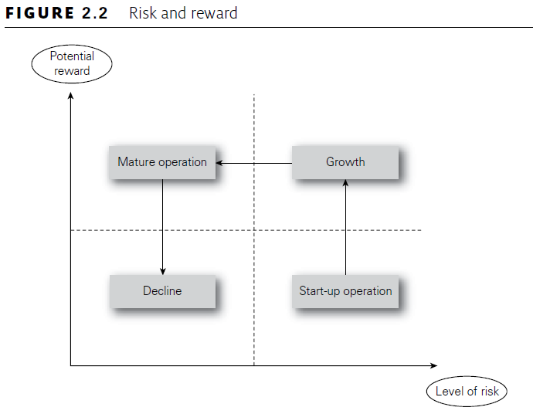
Risk and Reward
Figure 2.2 illustrates the relationship between the level of risk and the anticipated size of reward.

Slide 27
Risk and Reward
Figure 2.2: Explanations
A business will launch a new product because it believes that greater profit is available from the successful marketing of that product.
In launching a new product, the organization will put resources at risk because it has decided that a certain amount of risk taking is appropriate.
The value at risk represents the risk appetite of the organization with respect to the activity that it is undertaking.

Slide 28
Risk and Reward
Figure 2.2: Explanations
When an organization puts value at risk in this way, it should do so with the full knowledge of the risk exposure, and it should be satisfied that the risk exposure is within the appetite of the organization.
Even more important, it should ensure that it has sufficient resources to cover the risk exposure.
In other words, the risk exposure should be quantified, the appetite to take that level of risk should be confirmed, and the capacity of the organization to withstand any foreseeable adverse consequences should be clearly established.

Slide 29
Risk and Reward
Figure 2.2: Explanations
Not all business activities will offer the same return for the same level of risk taken.
Start-up operations are usually high risk, and the initial expected return may be low.
Figure 2.2 demonstrates the probable risk versus reward development for a new organization or a new product.
The activity will commence in the bottom right-hand corner as a start-up operation, which is high risk and low return.

Slide 30
Risk and Reward
Figure 2.2: Explanations
As the business develops, it is likely to move to a higher return for the same level of risk. This is the growth phase for the business or product.
As the investment matures, the reward may remain high, but the risks should reduce.
Eventually, an organization will become fully mature and move towards the low-risk and low-return quadrant.
The normal expectation in very mature markets is that the organization or product will be in decline.

Slide 31
Risk and Reward
Figure 2.2: Explanations
The particular risks that the organization faces will need to be identified by management or by the organization.
Appropriate risk management techniques will then need to be applied to the risks that have been identified.

Slide 32
Risk and Reward
Figure 2.2: Explanations
In the case of hazard risks, it is likely that the reward for increased risk management effort will be fewer disruptive events.
In the case of project risks, the reward for increased risk management effort will be that the project is more likely to be delivered on time, within budget and to specification/quality.
For opportunity risks, the risk versus reward analysis should result in fewer unsuccessful new products and a higher level of profit or (at worst) a lower level of loss for all new activities or new products; in all cases, profit or enhanced level of service is the reward for taking risk.

Slide 33
Attitudes to Risk
Different organizations will have different attitudes to risk.
Some organizations may be considered to be risk averse, whilst others will be risk aggressive.
To some extent, the attitude of the organization to risk will depend on the sector and the nature and maturity of the marketplace within which it operates, as well as the attitude of the individual board members.

Slide 34
Attitudes to Risk
Risks cannot be considered outside the context that gave rise to them.
It may appear that an organization is being risk aggressive, when in fact, the board has decided that there is an opportunity that should not be missed.
However, the fact that the opportunity entails high risk may not have been fully considered.

Slide 35
Attitudes to Risk
One of the major contributions from successful risk management is to ensure that strategic decisions that appear to be high risk are actually taken with all of the information available.
Improvement in the robustness of decision-making activities is one of the key benefits of risk management.
Attitude to risk is a complex subject and is closely related to the risk appetite of the organization, but they are not the same.

Slide 36
Attitudes to Risk
Risk attitude indicates the long-term view of the organization to risk and risk appetite indicates the short-term willingness to take risk.
This is similar to the difference between the long-term or established attitude of an individual towards the food they eat and their appetite for food at a particular moment in time.

Slide 37
Attitudes to Risk
Other key factors that will determine the attitude of the organization to risk include the stage in the maturity cycle, as shown in Figure 2.2.
For an organization that is in the start-up phase, a more aggressive attitude to risk is required than for an organization that is enjoying growth or one that is a mature organization in a mature marketplace.
Where an organization is operating in a mature marketplace and is suffering from decline, the attitude to risk will be much more risk averse.

Slide 38
Attitudes to Risk
It is because the attitude to risk has to be different when an organization is a startup operation rather than a mature organization, that it is often said that certain high-profile businessmen are very good at entrepreneurial start-up but are not as successful in running mature businesses.
Different attitudes to risk are required at different parts of the business maturity cycle shown in Figure 2.2.

Slide 39
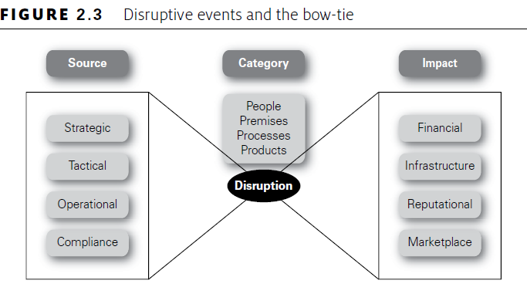
Risk and Triggers

Slide 40
Thank you
MGM 510 - Risk Management

