Slide 1

International Business Management
Prepared by Dr. Badur Elgasim
Lecture 1
MGM 506
The Management of International
Business

Slide 2

Lecture 1
Learning objectives
Overview of international business
The Changing Profile of the Global Business Environment
Major factors underline the significance of international business
The Imperatives of Globalization of Business
Theories of International Trade
Revised International Product Life Cycle:

Slide 3
Lecture 1
Introduction
This chapter proposes that we are in the midst of a transition period in which economic competition and international business are the new arenas for international rivalry. International business is the instrument, multinational companies (MNCs) are the force, and international managers are the strategists with which nations attempt to gain a competitive advantage. In such an environment, it is vital for us to understand and learn how to manage international business. Ten major factors underline the importance of international business and the management of such an operation. These factors are discussed in detail.

Slide 4
Lecture 1
The Changing Profile of the Global Business Environment
The Changing Profile of the Global Business Environment:
There are many factors that increase the impact of international business, and consequently the role of MNCs, in our lives. The increased volume of international business heightens the importance of international management. The world economy is moving ever faster to a highly interrelated, interdependent state, in which no nation will be immune from the forces of the global market. In such an environment, it is vitally important that we know how to manage international business operations. Eleven major factors underline the significance of international business (see Fig. 1.1).

Slide 5
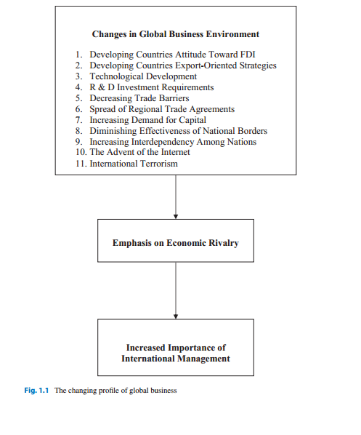
Lecture 1
The Changing Profile of the Global Business Environment

Slide 6
Lecture 1
major factors underline the significance of international business
Decreased Trade Barriers
The tendency of most countries is to strive for free world trade and the removal of trade barriers. A very good indication of this tendency is the expansion of world trade. Figure 1.2shows a tremendous expansion of world trade for both exports (a) and imports (b) of goods and services and a decrease in the average tariff rate of all products including agricultural and nonagricultural products.

Slide 7
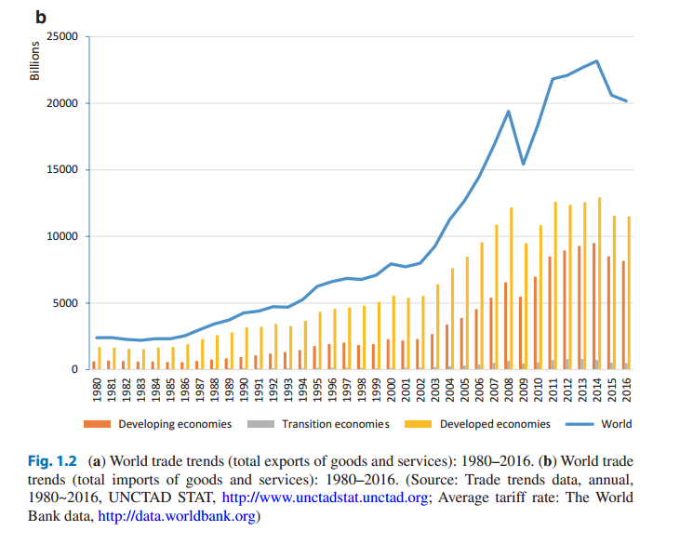
Lecture 1

Slide 8
Lecture 1
The supporters of free trade believe that free world trade is vital to their economic prosperity. Since World War II, countries that have been more open to international business and free trade have grown faster than countries that were less open to the global economy. Some, however, would like to take advantage of the open markets of other countries without reciprocating and allowing others free access to their domestic markets. A few have been fairly successful in such practices.

Slide 9
Lecture 1
The imposition of trade and nontrade restrictions has created friction among the European countries, Japan, and the United States. The handling of such friction, however, suggests the willingness of all to solve these problems in a mutually acceptable and amicable manner. Of course, totally free world trade will not arrive overnight. But there is an inexorable movement toward the removal of most trade restrictions and barriers.

Slide 10
Lecture 1
Certain transitory arrangements are already developing. For example, Europe has created an integrated economic and monetary system. Integrated Europe could produce a market larger than the United States. The United States, Canada, and Mexico have created the North America Free Trade Agreement (NAFTA), which removes most of the trade restrictions among them and creates the largest free trade bloc. A free trade agreement between the United States and the Central American countries (CAFTA) was signed. Members of the CAFTA are the United States, Costa Rica, the Dominican Republic, El Salvador, Guatemala, Honduras, and Nicaragua. Similar events may occur in the Australasia region.

Slide 11
Lecture 1
Developing Countries’ Attitude Change:
The attitudes of many developing countries toward MNCs and FDI have changed. Before the mid-1970s, most developing countries took a dim view of FDI. Expropriation, the forced divestment of foreign assets, and nationalization, the host government seizure of MNC assets, were frequently used as a policy choice by many developing countries in their disputes with MNCs. The large number of pre-1970s expropriations has been attributed to certain problems that developing countries were experiencing. Among them were the lack of administrative capability, the low level of economic development, and an inability to service foreign debts.

Slide 12
Lecture 1
Adoption of Export-Oriented Strategies by Developing Countries:
Hoping to duplicate the success achieved by Japan, Korea, and other Asian nations, many developing countries are adopting an export-oriented strategy of economic growth. The circumstances under which Japan, and to some extent Korea, employed their export-oriented strategies have changed. During the period in which these countries used export-oriented strategies, the US market absorbed the bulk of their exports. This resulted in a substantial trade deficit in the United States. Since this trend cannot continue unabated, and the United States is determined to reverse it, other nations may not fully succeed in emulating Japan.

Slide 13
Lecture 1
If these countries do not succeed in keeping their markets relatively closed to others, global exports will increase, international trade will expand further, and international management will gain more prominence.
Export-oriented strategy, in part, involves MNCs’ participation. 30–40% of industrialized countries’ imports are through intrafirm trade by MNCs. As more countries view MNCs as an instrument for achieving this goal, we must understand how these firms operate and how they are managed.

Slide 14
Lecture 1
Spread of Regional Trade Agreements:
Regional trade agreements and pacts are reducing trade restrictions among the members and increasing intraregional trade. Membership in regional trade agreements is on the rise. The most notable trade agreements are the NAFTA, the European Union (EU), the Association of South East Asian Nations (ASEAN.

Slide 15
Lecture 1
Some speculate that in the future, there will be three trading blocs dominating world trade. The first bloc is the EU. The second bloc is the ASEAN, with the expanded membership that could include Australia, India, and Japan. The third bloc is America, with the membership of Argentina, Brazil, Canada, Chile, Mexico, the United States, and Venezuela. There could be relatively free or open trade within these blocs and trade restrictions between them. A strategic response to such a scenario is for firms to have a foothold within each bloc or form strategic alliances with those that already operate within the blocs. Either case results in the expansion of the roles and scope of international management.

Slide 16
Lecture 1
Technological Developments:
Recent technological developments, particularly in manufacturing, have altered the nature of international business. Robotics, computer-aided design (CAD), computer- aided manufacturing (CAM), and flexible manufacturing have reduced production costs for most products. These technologies have also reduced the labor component of some products. As a result, the low-labor-cost position is less effective as a competitive strategy. Therefore, we expect that the low-labor-cost countries would try to tap MNCs for technology transfer and attempt to move up the supply chain.

Slide 17
Lecture 1
Global Demand for Capital:
One of the key features of globalization is the increase in capital mobility, which propels national and local governments alike into a heightened competition. Competition for capital will increase further as demand for it rises. Demand for capital from Eastern European countries, and also from the various republics of the former Soviet Union, will likely intensify competition in capital markets. Another important factor in the rising demand for capital is the sovereign debt crisis of the 1980s. In the 1980s, heavily indebted developing countries experienced great difficulty paying back their debts.

Slide 18
Lecture 1
This resulted in a very serious financial strain on the American and European banks and financial institutions that had given them the loans. Ever since, these institutions have become more cautious, and private sources of capital have become scarce and costly. The financial turmoil during the 1990s in Southeast Asia did not improve matters either. Consequently, more countries are viewing the equity capital from MNCs as a viable alternative. They are realizing the important role of FDI in economic development and its impact on future opportunities for catching up with the developed countries. This is another reason for the changing attitudes of developing countries toward MNCs.

Slide 19
Lecture 1
Diminishing Effectiveness of National Borders:
Slowly but steadily, national borders are losing their effectiveness in dealing with MNCs. Although we are witnessing a rising national fervor among the subjugated people of the former Soviet bloc, there is evidence that certain new developments are evolving that defy the traditional model. For example, a number of Americans with dual citizenship have served in the governments of Armenia, former Yugoslavia, and Estonia.

Slide 20
Lecture 1
Investment Requirement in R&D:
The enormous investment required in new technologies and in research and development (R&D) and the increasing scale of economies needed for an optimum operation are compelling firms to consider the whole world as a market. In many industries, even the largest and most resourceful firms cannot afford the enormous investment required in today’s research and development and new technologies. For example, the estimated $1 billion needed to develop a new generation of dynamic random access memory chips (DRAMs) forced IBM to form a joint venture with Toshiba Corporation of Japan and Siemens AG of Germany.

Slide 21
Lecture 1
Increasing Interdependence Among Nations:
International linkages among countries are creating a higher degree of interdependency, characterized by the increasing volume of FDI. Figure 1.3illustrates the dramatic growth of FDI inflows (a) and outflows (b) between 1980 and 2016. The total volume of FDI inflows (i.e., world) has grown dramatically since the 1980s, particularly in developed economies (e.g., the United States, Canada, and Europe). recently during the 2010s, the volume of FDI inflows in developing/transition economies such as BRICS (Brazil, Russian Federation, India, China, and South Africa) has also increased.

Slide 22
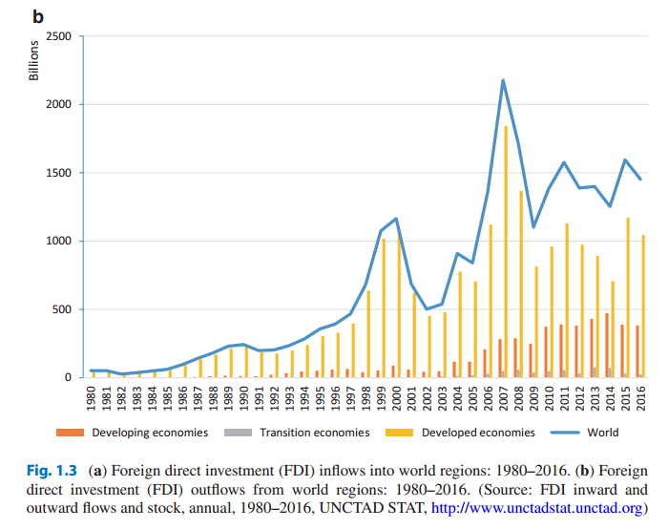
Lecture 1

Slide 23
Lecture 1
On the other hand, the volume of FDI outflows shows that outward FDIs were done mostly by MNCs in developed economies. FDI inflows and outflows were plummeted significantly after 2001 and 2008. These drops were caused by 9/11 terrorist attacks and global financial crisis starting from the United States, respectively. These were the evidences of interdependent global economies; these started from a nation, but the impacts spread all over the world.

Slide 24
Lecture 1
The Effect of the Internet:
In addition to the nine factors already discussed, the development and widespread use of the Internet is a force that greatly influences internationalization of business activities. The advent of the Internet is akin to a revolution. It has permeated many aspects of our lives in ways no one could have anticipated. It has affected many business practices, transformed some, and created new ones.

Slide 25
Lecture 1
The Internet affects international business in the following ways:
1. It increases global commonality in consumer needs and tastes. This, in turn, makes it possible for MNCs to use more global strategies through offering standardized products and services. This is possible because the appeal of globally recognized brands will increase as a result of the worldwide use of the Internet. At the same time, it creates more opportunities for less recognized products and companies in international markets. Dell Computer, for example, by shifting its marketing and sales efforts to the Web, transformed itself from a contender to a leader in the personal computer industry.

Slide 26
Lecture 1
2. It enables MNCs to centralize or coordinate their purchasing globally. In effect, it provides the opportunity to MNCs to become global customers. At the same time, it allows regional firms such as United Parcel Service and DHL to grow faster. Before the advent of the Internet and the Web, globally centralized purchasing required complex, expensive paper-based coordination of dispersed subsidiaries and suppliers. In the case of the Internet, more efficient global sourcing is possible.

Slide 27
Lecture 1
3. It reduces the minimum efficient size of the operation. Many physical activities are replaced by Web-based virtual activities. And it has become even more efficient in multitasking and operating large-scale businesses, because the Internet and its technologies are now used in conjunction with AI (artificial intelligence). By creating an online/cyber marketplace and having e-commerce platforms, companies like E-bay.comand Amazon.comwere able to quickly expand their business operation globally. And some of the tasks (e.g., customer service) are being done by AI alleviating the need to use human labors.

Slide 28
Lecture 1
The Imperatives of Globalization of Business:
In the following section, we will discuss the imperatives of globalization of business. First, we will elaborate the need for going international. Then, we will present theories of international trade and FDI. Finally, within the framework of product life cycle, we will explain the firm’s expansion into international markets.

Slide 29
Lecture 1
Why Do Businesses Expand Their Operations Abroad?
International competition affects most businesses and results in the globalization of many industries. The unprecedented information explosion has greatly contributed to international competition. Technological developments have also reduced transportation costs. Consequently, the physical distance between producers and consumers is no longer much of a competitive hindrance. Domestic firms with unique products or services, or with a competitive advantage, can expand beyond their home market easily.

Slide 30
Lecture 1
In today’s environment, going international is either an extension of successful domestic business operations or a requirement for remaining competitive. Increased worldwide interdependencies, if continued at the present pace, would make internationalization a requisite for survival. Until that time, many organizations operate at national and international levels as if these two were totally independent. Given this crude assumption, scholars argue on the motives and reasons for firms going international.
Three major theories—international trade, FDI, and product life cycle—have attempted to explain the reasons and motives for international expansion.

Slide 31
Lecture 1
Theories of International Trade:
International trade theorists propose that nations gain from international trade (exports and imports). The gains are the consequences of exploiting the comparative advantage. Comparative advantage is derived from exporting those goods that a nation holds superior in production cost. This superiority could stem from natural resource endowments, such as climate, quality of land, or differences in the cost of labor, capital, technology, and entrepreneurship. Opportunity cost plays an important role in comparative advantage.

Slide 32
Lecture 1
To produce one product, a country has to give up production of another, and this entails an opportunity cost. Nations benefit from international trade when they export products that they specialize in, because they have the greatest comparative advantage, and import those products in which they have the greatest comparative disadvantage. Free trade does not require that one country gain at another country’s expense. Free trade is a win-win deal.

Slide 33
Lecture 1
Foreign Direct Investment Theory Theories of FDI specify the following three conditions in which FDI will occur:
1. The possession of an ownership-specific advantage
2. The effect of locational advantages of host countries
3. The presence of internalization advantage

Slide 34
Lecture 1
Ownership-Specific Advantage. Compared with local firms, MNCs face certain disadvantages. These disadvantages are the lack of knowledge about the economic, political, legal, and social situations of foreign countries. Geographical distance, currency exchange risk, and language barriers create further difficulties. The established relationships between domestic firms and their suppliers, customers, and regulatory agencies put MNCs at an additional disadvantage.

Slide 35
Lecture 1
When a firm acquires a global horizon and goes international, it can benefit from investments in foreign countries if it has an ownership-specific advantage to off-set the disadvantage of its foreignness. The ownership-specific advantage, which is also called strategic advantage, could be a patented technology, product differentiation, economies of scale, brand names, managerial skills, or possession of knowledge.

Slide 36
Lecture 1
Locational Advantage. Building organizational capabilities and the use of strategic advantages through international expansion do not determine the location of foreign investment. MNCs must justify the choice of investment location. In which foreign countries should MNCs expand? The answer is very simple. MNCs should locate their operations in countries that offer certain locational advantages such as sources of raw materials, large markets, or low-cost labor.

Slide 37
Lecture 1
Internalization Advantage. Internalization advantages refer to the advantages that MNCs can gain by directly controlling their value-creation activities (e.g., manufacturing, marketing, and R&D). MNCs can maximize benefits by having an FDI-based internationalization which allows them to control their value-creation activities, rather than outsourcing it to local firms. Direct control of value-creation activities is advantageous when MNCs have a proprietary technology yet there is a high risk of technology appropriation in the host country and when MNCs produce and provide high-quality products and services, but there is also a high risk of losing firms’ reputation and brand image, if outsourced to local companies.

Slide 38
Lecture 1
Revised International Product Life Cycle:
International product life cycle, first proposed by Raymond Vernon [40] and expanded on by Adler and Ghadar [41], suggests a sequential progress for the firm’s expansion into the international market, which follows the life cycle of products. Vernon proposed a three-stage model of product life cycle (PLC), which was useful in explaining the manufacturing investment abroad. But recent changes in the international environment have reduced the model’s appeal. Adler and Ghadar’s addition of a fourth stage, which accounts for recent international environmental changes, has improved the model.

Slide 39
Lecture 1
The three stages proposed by Vernon are new product stage, mature product stage, and standardized product stage.
The model suggests that high-income, economically developed countries are the home for most new products and innovations.

Slide 40
Lecture 1
Stage 1: New product: In the first stage, innovating firms in developed countries produce new products for the home market. These products are manufactured at home.
Foreign markets, which are other high-income countries, are served through exports. At this stage, since products are new, the firms do not face serious competition.

Slide 41
Lecture 1
Stage 2: Mature product: The maturity phase is the second stage, where products have been perfected and sufficiently standardized. As more firms enter the market, price competition forces them to establish manufacturing facilities in other high-income countries, to serve foreign markets with local production. Recent technological developments in industrializing countries are forcing firms to bypass this stage and directly move to the next stage.

Slide 42
Lecture 1
The Changing Profile of the Global Business Environment
Stage 3: Standard product: Heavy price competition characterizes the standardized product stage. The emphasis on price compels firms to move production to low-cost countries.
The home market and other high-income countries are served by exports from these locations.

Slide 43
Lecture 1
The three-stage international product life cycle is a useful model that explains internationalization of firms for the 20-year period following World War II. Technological developments, however, have accelerated the life cycle of products, where most products become obsolete much faster. Furthermore, the world has become an integrated market that requires mass customization of products to meet individual needs. This brings us to the fourth stage.

Slide 44
Lecture 1
Stage 4: International product: According to Adler and Ghadar, we are in the fourth stage of the international product life cycle. This stage is characterized by technological diffusion, high costs of research and development, global market, mass customization of products, and intense competition among firms from developed and newly developing countries.

Slide 45
Lecture 1
Resources:
Kamal Fatehi & Jeongho Choi
International Business Management
Succeeding in a Culturally Diverse World, Second Edition
Chapter 1

