Slide 1


DIGITAL MARKETING
APPLICATIONS
Prepared by Dr. HEBA ZIAD
COURSE CODE - MKT720
Lecture 00

Slide 2



DIGITAL MARKETING
APPLICATIONS
Course outline
Course description
Learning outcomes
Chapters
Parts of course
References
Assessment
Prepared by
Lecture 00
Dr. HEBA ZIAD

Slide 3

Chapter
Course Description
00
This course aims to introduce students to the basic concepts, role and importance OF applications that support digital marketing Implementation, this course also aims to Recognize Current and emerging technologies that support social media marketing applications

Slide 4
Chapter
QUESTIONS
00
The 2 key questions to this course are not whether to deploy & use Internet technology – companies have no choice if they want to stay competitive – but how to deploy & use it?
What are the marketing communications techniques that business need to master to make effective use of digital marketing?

Slide 5
Chapter
Learning Outcomes
00
At the end of this course, the student will be able to:
Developing digital marketing strategies
Understand digital marketing fundamentals
Define what are the 8 types of digital marketing?
Learn about the best applications you need in digital marketing
Recognize current and emerging technologies that support social media marketing applications
Understand the infrastructure of social media
Realize digital marketing: implementation and practices

Slide 6
Chapter
Main Innovations Included in the Chapters
00
The main innovations included in the chapters are as follow:
Chapter 1 – Introducing Digital Marketing
Chapter 2 – Online Marketplace Analysis: Micro-Environment
Chapter 3 – The Digital Macro-Environment
Chapter 4 – Digital Marketing Strategy Development
Chapter 5 – Digital Media and the Marketing Mix
Chapter 6 – Relationship Marketing Using Digital Platforms
Chapter 7 – Delivering the Digital Customer Experience
Chapter 8 – Campaign Planning for Digital Media
Chapter 9 – Marketing Communications Using Digital Media Channels
Chapter 10 – Evaluation and Improvement of Digital Channel Performance

Slide 7
CHAPTER
00
Part 1 – Introduction to Digital Marketing
Part 1 – Introduce the Opportunities and Challenges of Digital Marketing
Introduces the opportunities and challenges of digital marketing and explains the different types of digital marketing platforms and media channels available to engage audiences online.
It also introduces a planning framework that can be used to structure digital marketing strategies and provides a foundation for developing an integrated digital marketing strategy by reviewing how the online marketplace of an organization can be assessed as a part of situation analysis.

Slide 8
CHAPTER
00
DIGITAL MARKETING STRATEGY DEVELOPMENT
In Part 2, we explore digital marketing strategy development by combining traditional approaches to strategic marketing planning with deploying digital media, data and technology.
And also present a framework for developing digital marketing strategies.
In this part, we will discuss the opportunities for varying the marketing mix online and review strategies for digital customer relationship management.
In Part 2, we explore digital marketing strategy development by combining traditional approaches to strategic marketing planning with deploying digital media, data and technology.
And also present a framework for developing digital marketing strategies.
In this part, we will discuss the opportunities for varying the marketing mix online and review strategies for digital customer relationship management.

Slide 9
CHAPTER
00
In Part 3, practical success factors for implementing and managing digital marketing strategy are described, including website and applications development to ensure a quality customer experience.
And marketing communications to promote a site and the evaluation of company digital presences.

Slide 10
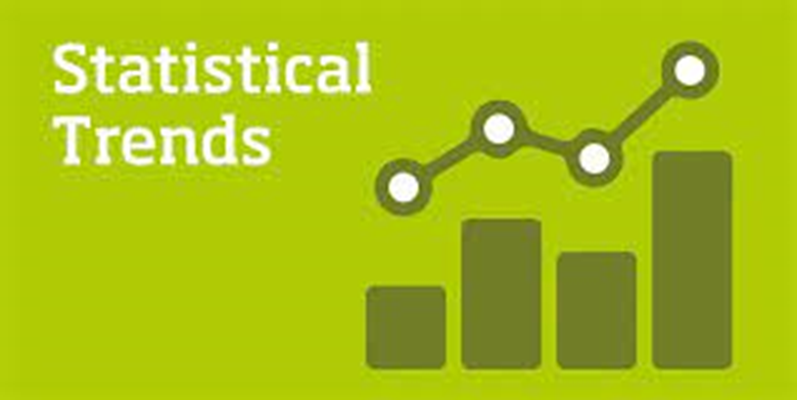
CHAPTER
00
DIGITAL MARKETING IMPLEMENTATION AND PRACTICE
With new technologies emerging and consumer behavior (7ws) changing rapidly,
businesses were eager to stay ahead of the curve
and adopt the latest marketing trends.
Why are digital marketing statistics important?

Slide 11
CHAPTER
00
WHY ARE DIGITAL MARKETING STATISTICS IMPORTANAT?
We need to prove the point of our work with digital marketing statistics, but here are a few other reasons why making data-backed decision in marketing is so important:
Statistics help you prioritize your efforts. If you’re implementing a multi- channel marketing strategy, you’ll want to know how certain platforms will perform compared to others. With statistics to back your choices, you’re able to know what channels might require more resources over others.

Slide 12
CHAPTER
00
WHY ARE DIGITAL MARKETING STATISTICS IMPORTANAT?
Digital marketing statistics help you stay competitive. With these data points, you’re able to know what others are doing—which can help you jump ahead of your competitors.

Slide 13
CHAPTER
00
Why are digital marketing statistics important?
Stay on top of trends. Data reveals patterns and digital marketing trends that can help you to identify strategies and platforms where it might make sense to be an early adopter.
Data can make room for other strategies. When you’re leveraging digital marketing statistics, you have full confidence in what’s going to work.

Slide 14
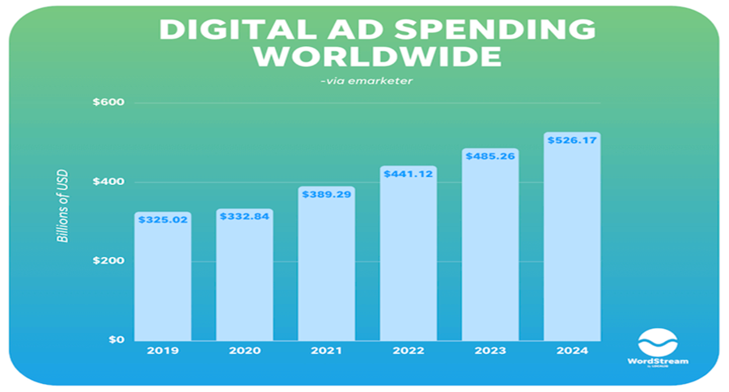
CHAPTER
00
Digital Marketing Industry: Statistics Overview
How big is the online advertising industry?
Digital ad spend worldwide is estimated at $441 billion in 2022 ad projected to reach $485 billion in 2023.
The annual growth rate for digital media is higher than that of offline media.

Slide 15
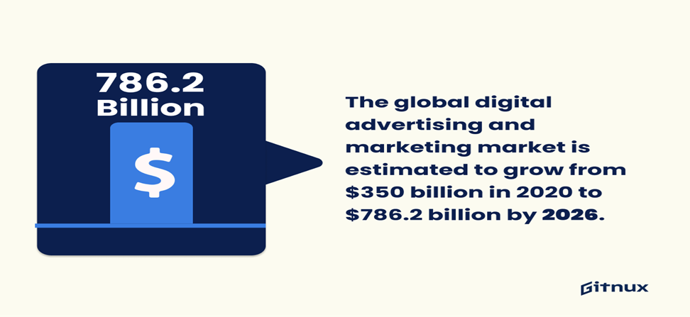
CHAPTER
00
This statistic shows the shift in ad spending from desktop to mobile phones, which is important for digital marketers to understand in order to optimize their campaigns for the most effective results.
The global digital advertising and marketing market is estimated to grow from $350 billion in 2020 to $786.2 billion by 2026, with a compound annual growth rate of 9%.

Slide 16
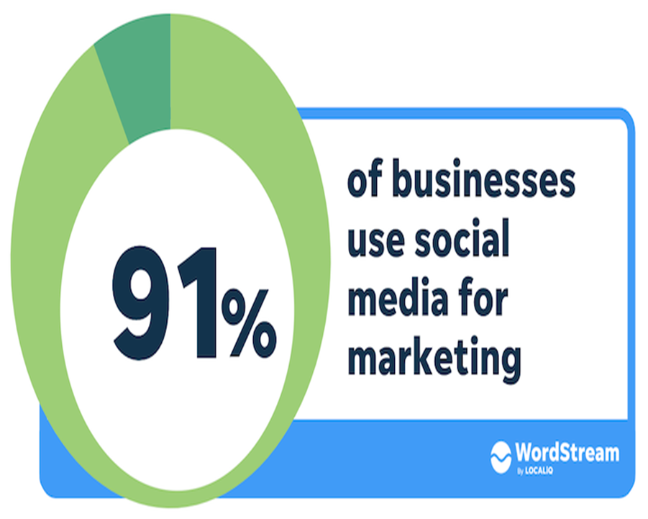
CHAPTER
00
2023 social media marketing statistics
Social media marketing statistics prove just how fast the space is growing,
How big is the social media market?
The social media market size is estimated to be worth $72.2 billion.
What percentage of marketing is done on social media?
How many businesses use social media for marketing?

Slide 17
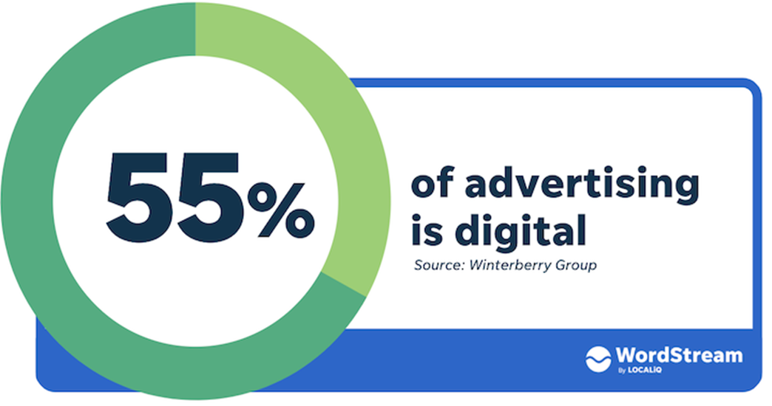
CHAPTER
00
Digital Marketing Industry: Statistics Overview
2023 social media marketing statistics
Is digital marketing in demand in 2023?

Slide 18
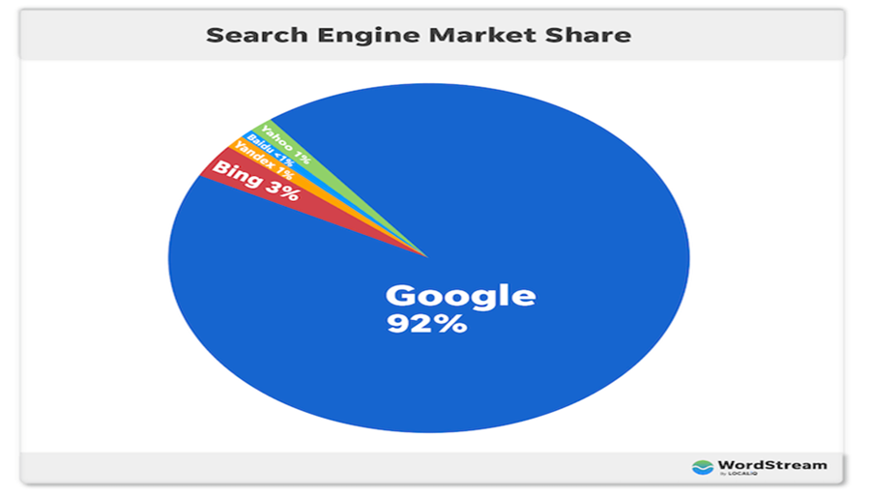
CHAPTER
00
Is digital marketing in demand in 2023?
Google holds 92% of the total worldwide search engine market share.

Slide 19

CHAPTER
00
Digital Marketing Industry: Statistics Overview
In conclusion, the world of digital marketing was evolving at a rapid pace, and businesses were embracing these new trends to stay ahead of the competition and meet the changing needs of consumers.

Slide 20
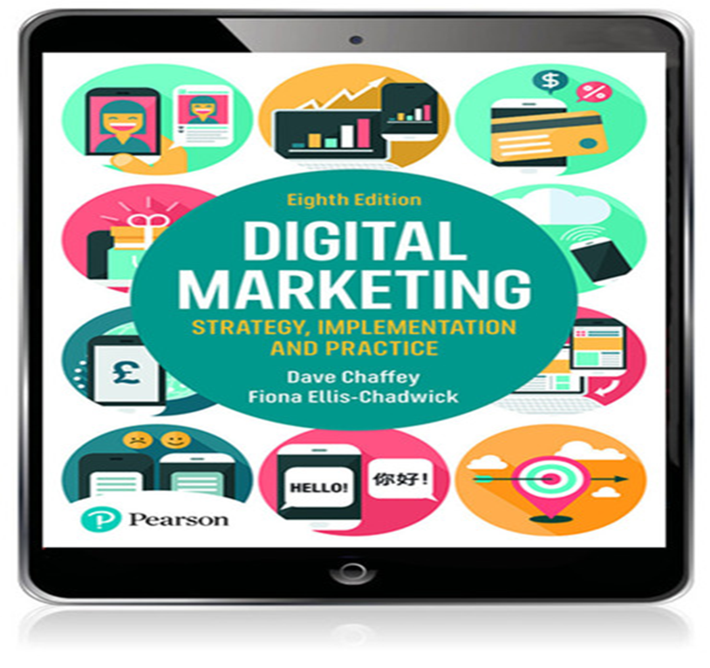

CHAPTER
00
REFERENCES

Slide 21

CHAPTER
00
ASSESSMENT
Weekly Tests

Slide 22

CHAPTER
00
ASSESSMENT
Weekly DISCUSSION SESSION

Slide 23



Thank You

