Slide 1

Research Methods (RSC 701)
Prepared by
Dr. Mahitab ELrafii
Lecture No.2
Research Methods (RSC 701)

Slide 2


Lecture 2
Lecture Content
The lecture 2 includes the following elements:
A simple schematic representation of the research process
Sources of Knowledge
Everyday Experience as Sources of Knowledge
The Scientific Method as a Source of Knowledge
Research Process
Research Topic
How to Choose Research Topics?
How to Select A Research Title?
What is a research proposal?
Purpose of a research proposal
How long is a research proposal?
Abstract and table of contents
Title page
Introduction

Slide 3
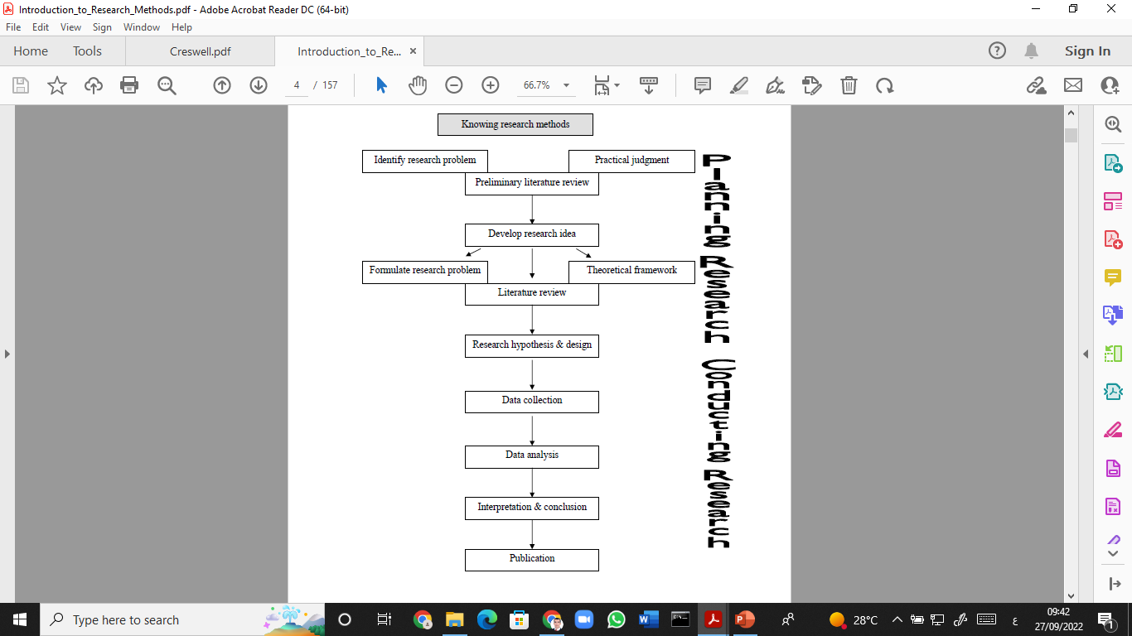
Lecture 2
A simple schematic representation of the research process

Slide 4

Lecture 2
Sources of Knowledge
This lecture deals with the two major approaches of knowing the world:
1- Everyday experience and science. It answers questions like :
what is the difference between common sense knowledge and science?
Are they alike? What are the various forms of knowing?

Slide 5
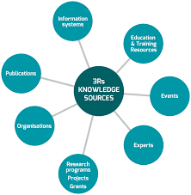
Lecture 2
Everyday Experience as Sources of Knowledge
As we live in this world and interact with our surrounding, we may be confronted with new ideas that may have important impact on our lives.
We get access to this new information through our senses as the speed way of knowing something.
This is what we call sensory knowledge.
Reflecting on your own experiences, do you think your senses provide a perfect means of observation?

Slide 6

Lecture 2
The Scientific Method as a Source of Knowledge
Science is a body of systematized knowledge. In the scientific method, ideas are evaluated and corrected through observing by means of our senses or measuring devices.
In this case, science can be seen as a systematic and controlled extension of common sense - and using reason to compare various theoretical conceptualizations based on experience.

Slide 7

Lecture 2
The Scientific Method as a Source of Knowledge
One of the characteristics of science is a reliance on information that is verifiable through experience.
That is, it must be possible for different people in different places and at different times using the same method to obtain comparable results.
Science and common sense differ in terms of:
• The use of conceptual schemes and theoretical structures.
• The explanations of different observed phenomena.

Slide 8


Lecture 2
The Scientific Method as a Source of Knowledge
The difference between common sense and science revolves around the concepts systematic and controlled. Scientists systematically build theoretical structure, test them for internal consistency, and Theory is the ultimate aim of science. Science only deals with testable ideas.
The scientific method of knowing is the scientific research, and its goal is the discovery of regularities of nature and their representation in theories from which predictions can be made.

Slide 9
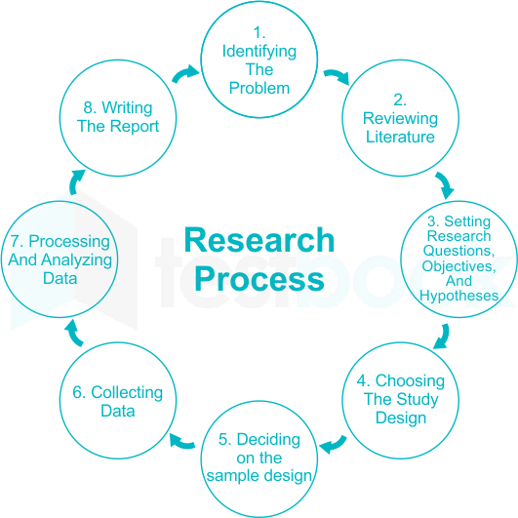
Lecture 2
Research Process
The steps in the scientific method guide researchers in planning, conducting, and interpreting research studies.
Scientific research follows logical steps, which include:
Identifying the problem.
Reviewing literature.
Setting research questions, objectives, and hypotheses.
Choosing the study design.
Deciding on the sample design.
Collecting data.
Processing and analyzing data.
Writing the report.

Slide 10

Lecture 2
Research Process
Identifying the problem.
The first and most important step for identifying a problem is asking a question or identifying a need that arises as a result of curiosity and to which it becomes necessary to find an answer.
Reviewing literature.
A researcher needs to focus on the related studies and techniques for the research but creativity is not required to do the review of existing literature.

Slide 11
Lecture 2
Research Process
Conceptual framework:
After reviewing the related literature a researcher requires attentiveness and dedication for the conceptual understanding.
Formulating a Hypothesis:
Hypotheses are single tentative guesses, good hunches – assumed for use in devising theory or planning experiments intended to be given a direct experimental test when possible”. While formulating hypothesis there is a desire to get the intellectual joy of doing some creative work, it involves creative thinking.

Slide 12
Lecture 2
Research Process
Identifying, Manipulating, and Controlling Variables: Variables are defined as those characteristics which are manipulated, controlled, and observed by the researcher. The study may have extraneous variables. So, the researcher needs to use the imagination skills to identify the most appropriate variables that can help in formulating and structuring the study.
Formulating a Research Design: A research design may be regarded as the blueprint of those procedures which are adapted by the researcher for testing the relationship between the dependent variable and the independent variable.

Slide 13
Lecture 2
Research Process
Constructing Devices for Observation and Measurement: When the research design has been formulated the next step is to construct or collect and choose appropriate tools of research for scientific observation and measurement.
Sample Selection and Data Collection: After deciding the tools for the study the research one must also decide about the participants of the study for which purpose usually a small sample is drawn which represents the population.
Data Analysis and Interpretation: After making observation the data collected are analyzed with the help of various quantitative and qualitative statistical techniques that requires no creativity.

Slide 14

Lecture 2
THE RESEARCH TOPIC
Before considering what literature to use in a project, first identify a topic to study and reflect on whether it is practical and useful to undertake the study.
The topic is the subject or subject matter of a proposed study, such as “Social media Platforms,” “Digital Media,” or “Online Journalism.”
Describe the topic in a few words or in a short phrase.
The topic becomes the central idea to learn about or explore

Slide 15
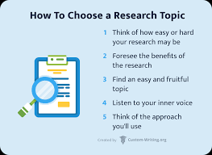
Lecture 2
How to Choose Research Topics?
A choice of your research topic ensures that the entire process of composing, writing, and proofreading will be pleasing.
The tree below illustrates the main steps to pick the best variant.
Follow it and come to an end with a good topic to write about.

Slide 16

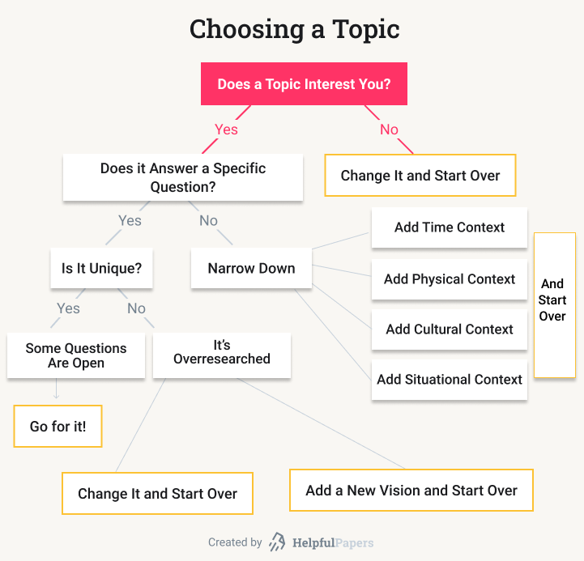
Lecture 2
THE RESEARCH TOPIC

Slide 17
Lecture 2
Interesting Topics to Research in media
Digital media and women's protection from violence
Electronic Journalism and Sports
Digital content industry
Editing of video and photos and its impact on audience

Slide 18

Lecture 2
THE RESEARCH TOPIC
There are several ways that researchers gain some insight into their topics when they are initially planning their research (my assumption is that the topic is chosen by the researcher and not by an adviser or committee member): One way is to draft a brief title to the study.
I am surprised at how often researchers fail to draft a title early in the development of their projects.

Slide 19

Lecture 2
HOW TO SELECT A RESEARCH TOPIC?
The ability to develop a good research topic is an important skill. An instructor may assign you a specific topic, but most often instructors require you to select your own topic of interest. When deciding on a topic, there are a few things that you will need to do:
brainstorm for ideas
choose a topic that will enable you to read and understand the literature

Slide 20

Lecture 2
HOW TO SELECT A RESEARCH TOPIC?
Ensure that the topic is manageable and that material is available
Make a list of keywords
Be flexible
Define your topic as a focused research question
Research and read more about your topic
Formulate a thesis statement

Slide 21

Lecture 2
HOW TO SELECT A RESEARCH TOPIC?
Be aware that selecting a good topic may not be easy. It must be narrow and focused enough to be interesting, yet broad enough to find adequate information.
Before selecting your topic, make sure you know what your final project should look like. Each class or instructor will likely require a different format or style of research project.

Slide 22

Lecture 2
HOW TO SELECT A RESEARCH Title?
The following parameters can be used to help you formulate a suitable research paper title:
The purpose of the research
the type of the research
The methods used
The first aim of a title is to capture the reader’s attention and to draw his or her attention to the research problem being investigated.

Slide 23

Lecture 2
HOW TO SELECT A RESEARCH Title?
the final title you submit to your professor is created after the research is complete so that the title accurately captures what was done.
The title should be developed early in the research process because it can help anchor the focus of the study in much the same way the research problem does.
Referring back to the working title can help you reorient yourself back to the main purpose of the study if you feel yourself drifting off on a tangent while writing.

Slide 24
Lecture 2
HOW TO SELECT A RESEARCH Title?
Effective titles in academic research papers have several characteristics:
Indicate accurately the subject and scope of the study.
Avoid using abbreviations.
Use words that create a positive impression and stimulate reader interest.
Use current nomenclature from the field of study.
Identify key variables, both dependent and independent.
May reveal how the paper will be organized.

Slide 25
Lecture 2
HOW TO SELECT A RESEARCH Title?
Effective titles in academic research papers have several characteristics:
Suggest a relationship between variables which supports the major hypothesis.
Is limited to 10 to 15 substantive words.
Do not include "study of," "analysis of" or similar constructions.
Titles are usually in the form of a phrase, but can also be in the form of a question.

Slide 26
Lecture 2
HOW TO SELECT A RESEARCH Title?
Effective titles in academic research papers have several characteristics:
Use correct grammar and capitalization with all first words and last words capitalized, including the first word of a subtitle. All nouns, pronouns, verbs, adjectives, and adverbs that appear between the first and last words of the title are also capitalized.
In academic papers, rarely is a title followed by an exclamation mark. However, a title or subtitle can be in the form of a question.

Slide 27
Lecture 2
HOW TO SELECT A RESEARCH Title?
the final title you submit to your professor is created after the research is complete so that the title accurately captures what was done.
The title should be developed early in the research process because it can help anchor the focus of the study in much the same way the research problem does.
Referring back to the working title can help you reorient yourself back to the main purpose of the study if you feel yourself drifting off on a tangent while writing.

Slide 28

Lecture 2
HOW TO SELECT A RESEARCH Subtitle?
Examples of why you may include a subtitle in social science research papers:
Explains or provide additional context.
Adds substance to a literary, provocative, or imaginative title.
Qualifies the geographic scope of the research.
Qualifies the temporal scope of the research.
Focuses on investigating the ideas, theories, or work of a particular individual.

Slide 29
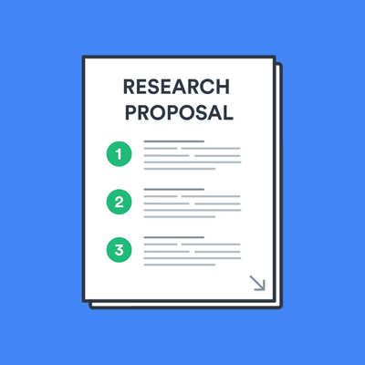
Lecture 2
What is a research proposal?
A research proposal describes what you will investigate, why it’s important, and how you will do the research. The format of a research proposal varies between fields, but most proposals should contain at least these elements:
Cover page
Introduction
Literature review
Research design
Reference list

Slide 30

Lecture 2
What is a research proposal?
Table of contents:
Purpose of a research proposal
Title page
Introduction
Literature review
Research design and methods
Implications and contribution to knowledge

Slide 31
Lecture 2
What is a research proposal?
Table of contents:
Reference list or bibliography
Research schedule
Revisions and Proofreading

Slide 32
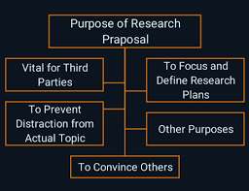

Lecture 2
Purpose of a research proposal
Academics often have to write research proposals to get funding for their projects. As a student, you might have to write a research proposal as part of a grad school application, or you might need to submit one before you start writing your thesis or dissertation.
All research proposals are designed to persuade someone—such as a funding body, educational institution, or supervisor—that your project is worthwhile.

Slide 33
Purpose of a research proposal
Research proposal aims
Relevance:
Convince the reader that your project is interesting, original, and important
Context:
Show that you are familiar with the field, you understand the current state of research on the topic, and your ideas have a strong academic basis

Slide 34

Lecture 2
Purpose of a research proposal
Approach:
Make a case for your methodology, showing that you have carefully thought about the data, tools and procedures you will need to conduct the research
Feasibility:
Confirm that the project is possible within the practical constraints of the programme, institution or funding

Slide 35

Lecture 2
How long is a research proposal?
The length of a research proposal varies dramatically. A bachelor’s or master’s thesis proposal can be just a few pages, while proposals for Ph.D. dissertations and research funding are often very long and detailed.
Although you write it before you begin the research, the proposal’s structure usually looks like a shorter version of a thesis or dissertation (but without the results and discussion sections).

Slide 36
Lecture 2
Title page
Like your dissertation or thesis, the proposal will usually have a title page that includes:
The proposed title of your project
Your name
Your supervisor’s name
The institution and department
Check with the department or funding body to see if there are any specific formatting requirements.

Slide 37
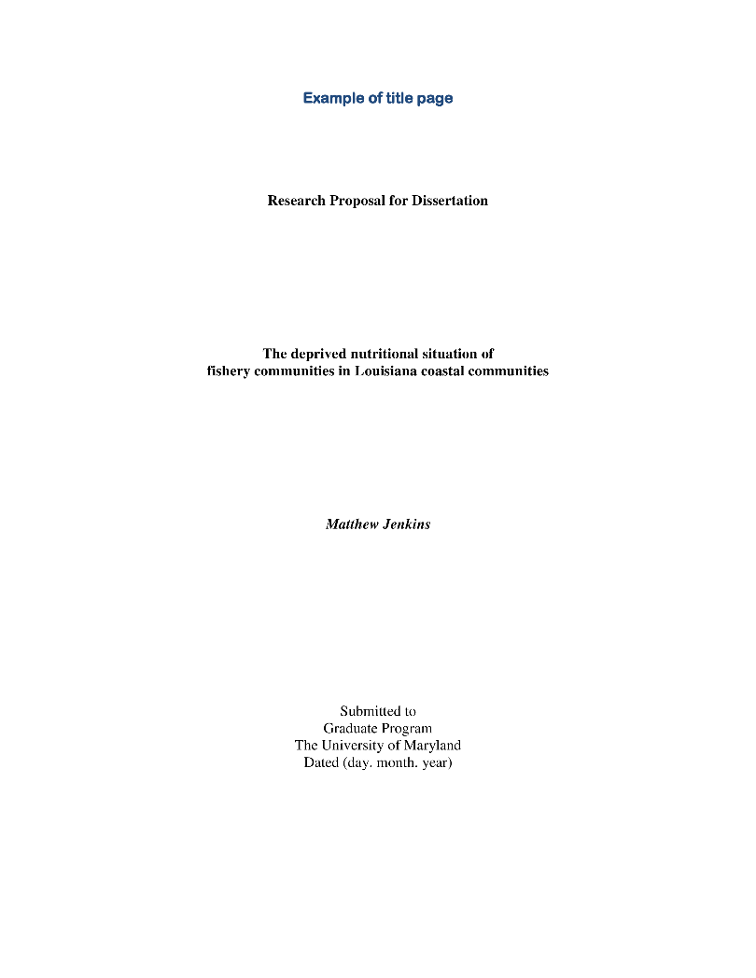
Lecture 2
Title page

Slide 38
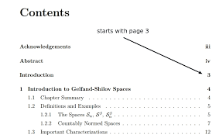
Lecture 2
Abstract and table of contents
If your proposal is very long, you might also have to include an abstract and a table of contents to help the reader navigate the document.

Slide 39

Lecture 2
Introduction
The first part of your proposal is the initial pitch for your project, so make sure it succinctly explains what you want to do and why. It should:
Introduce the topic
Give background and context
Outline your problem statement and research question(s)
Some important questions to guide your introduction include:

Slide 40
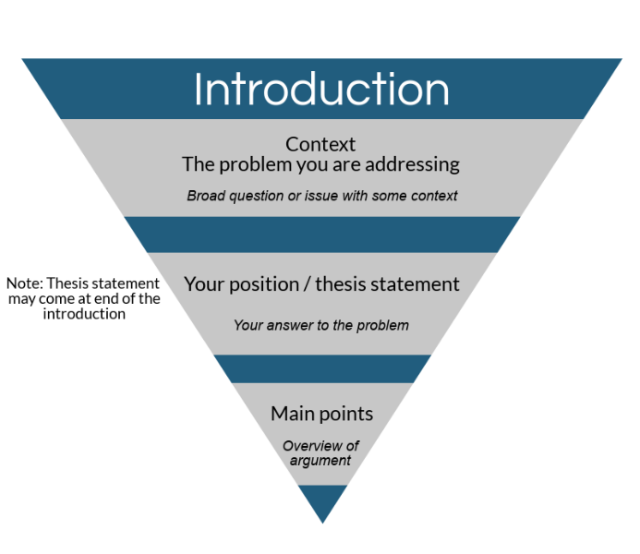
Lecture 2
Introduction
Who has an interest in the topic (e.g. scientists, practitioners, policymakers, particular members of society)?
How much is already known about the problem?
What is missing from current knowledge?
What new insights will your research contribute?
Why is this research worth doing?
If your proposal is very long, you might include separate sections with more detailed information on the background and context, problem statement, aims and objectives, and importance of the research.

Slide 41
Lecture 2
Thank you

