Slide 1




Project Time Management
Lecture 7
PMG 212
Prepared by Dr. Nael Yousry
Presented by Dr. Amira Elfekky
www.midocean.ae

Slide 2


Project Time Management
Prepared by Dr. Nael Yousry
Presented by Dr. Amira Elfekky
PMG 212
Lecture 7

Slide 3
Chapter
07
Agenda
Agenda
Scheduling
Who is the Scheduler
Attributes of Planner/Scheduler
Importance of the Schedule
Scheduling Tools
Critical Path Method
Scheduling Terminology
Relationships (Logic) – 4 Types
www.midocean.ae

Slide 4
Chapter
07
Agenda
Agenda
Scheduling
Who is the Scheduler
Attributes of Planner/Scheduler
Importance of the Schedule
Scheduling Tools
Critical Path Method
Scheduling Terminology
Relationships (Logic) – 4 Types
www.midocean.ae

Slide 5
Chapter
Scheduling
07
If PLANNING is an Art form based on Experience and Knowledge, then SCHEDULING is a Systematic exercise in using applied Logic.
www.midocean.ae

Slide 6

Chapter
Scheduling
07
www.midocean.ae

Slide 7
Chapter
07
Agenda
Agenda
Scheduling
Who is the Scheduler
Attributes of Planner/Scheduler
Importance of the Schedule
Scheduling Tools
Critical Path Method
Scheduling Terminology
Relationships (Logic) – 4 Types
www.midocean.ae

Slide 8
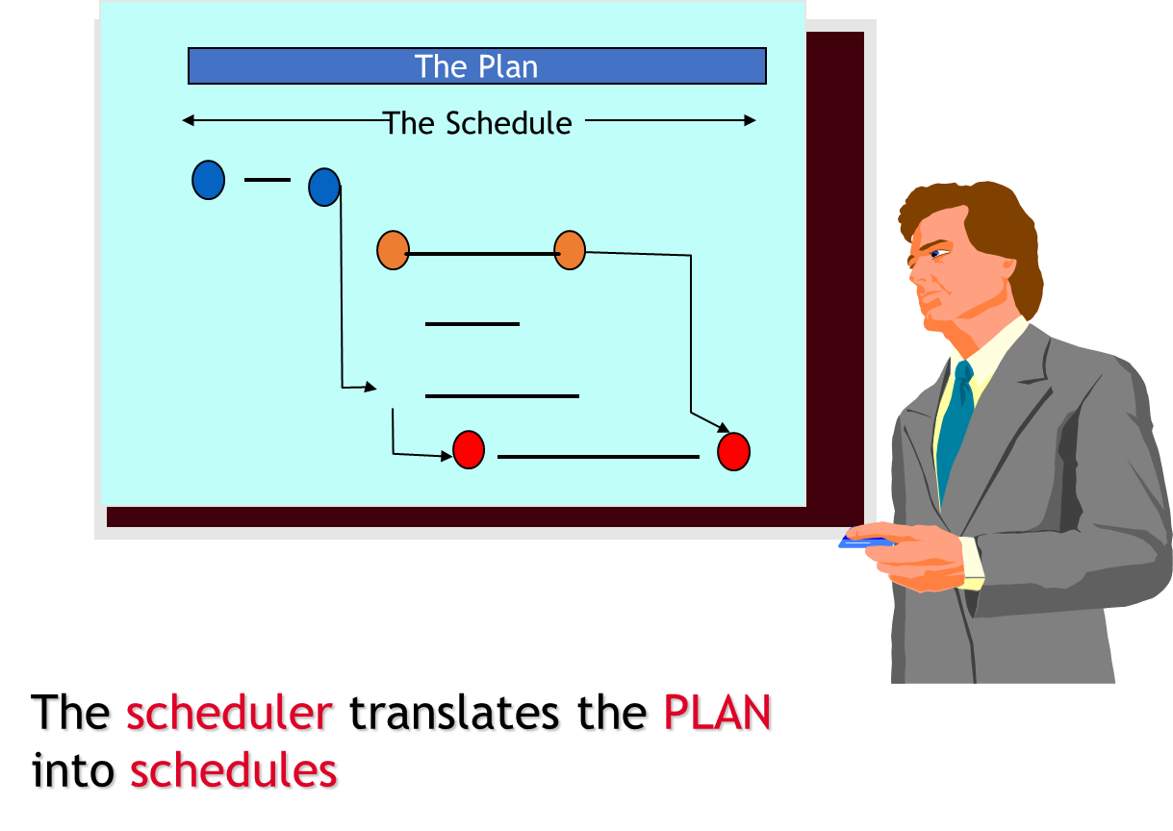
Chapter
Who is the Scheduler
07
www.midocean.ae

Slide 9
Chapter
07
Agenda
Agenda
Scheduling
Who is the Scheduler
Attributes of Planner/Scheduler
Importance of the Schedule
Scheduling Tools
Critical Path Method
Scheduling Terminology
Relationships (Logic) – 4 Types
www.midocean.ae

Slide 10
Chapter
07
Attributes of Planner/Scheduler
Possess PEOPLE skills!
  Exercise humility and salesmanship
  Exercise care when recommending various approaches
  Do not alienate the managing parties
  Ease off when needed
  Emphasize his/her role is to coordinate and integrate ideas and plans into a coherent project schedule.
امتلاك المهارات الشخصية (عدم الاعتماد على البرامج الحاسوبية)
  التحلي بمهارات التواصل بين أقسام المشروع
  العناية الشديدة عند التوصية بإستخدام أساليب مختلفة
  العمل على عدم نفور الأطراف ذات الصلة
  الحد من المشكلات عند الحاجة
  تنسيق ودمج الأفكار والخطط في جدول زمني متماسك
www.midocean.ae

Slide 11
Chapter
07
Agenda
Agenda
Scheduling
Who is the Scheduler
Attributes of Planner/Scheduler
Importance of the Schedule
Scheduling Tools
Critical Path Method
Scheduling Terminology
Relationships (Logic) – 4 Types
www.midocean.ae

Slide 12
Chapter
Importance of the Schedule
07
Depicts يصورthe Scope of work
Improves the probability for the project team to meet its goals
Establishes overall schedule parameters
Aids in determining staffing requirements
www.midocean.ae

Slide 13
Chapter
Importance of the Schedule
07
Resource loading basis
Identifies long lead items
Identifies the phases in the project
www.midocean.ae

Slide 14
Chapter
07
Importance of the Schedule
Standardized scheduling techniques motivates the project team to:
  Think through the entire project
  Predict a realistic project completion
  Recognize impacts of unexpected events
www.midocean.ae

Slide 15
Chapter
Importance of the Schedule
07
Standardized scheduling techniques motivates the project team to:
  Identify claims or time extensions
  Coordinate interfaces and reduce conflicts
  Plan resource requirements and cash flow
  Serve as a record of the project’s progress
  Communication Tool
www.midocean.ae

Slide 16
Chapter
07
Importance of the Schedule
  Tells you where you’ve been.
  Tells you where you are.
  But most importantly, it tells you where are you going!
Must have sufficient detail to control the project
  To much detail is cumbersome to maintain.
  Not enough detail and the analysis of the schedule is difficult.
www.midocean.ae

Slide 17
Chapter
07
Agenda
Agenda
Scheduling
Who is the Scheduler
Attributes of Planner/Scheduler
Importance of the Schedule
Scheduling Tools
Critical Path Method
Scheduling Terminology
Relationships (Logic) – 4 Types
www.midocean.ae

Slide 18
Chapter
07
Scheduling Tools
P6 (Primavera)
Microsoft Project Planner (MSP)
Suretrak (Primavera)
Milestones, etc.. - Bar Chart
TILOS- Linear Scheduling
www.midocean.ae

Slide 19
Chapter
07
Agenda
Agenda
Scheduling
Who is the Scheduler
Attributes of Planner/Scheduler
Importance of the Schedule
Scheduling Tools
Critical Path Method
Scheduling Terminology
Relationships (Logic) – 4 Types
www.midocean.ae

Slide 20
Chapter
07
Scheduling Methodology
www.midocean.ae

Slide 21
Chapter
07
Critical Path Method
Item | Price
A | 100
B | 100
C | 100
D | 100
E | 100
F | 100
Sum | 600
The calculation of the earliest and latest start and finish dates of activities based on their duration's and relationships to other activities
a resource-utilization algorithm for scheduling a set of project activities
www.midocean.ae

Slide 22
Chapter
Activities
07
The Basic element into which a project is subdivided for scheduling a network (CPM)
  Has a definable start and finish
  Consumes resources
  Is assignable
  Is measurable
  Is defined by a Work Package
  Is a Physical Task for Construction
www.midocean.ae

Slide 23
Chapter
07
Agenda
Agenda
Scheduling
Who is the Scheduler
Attributes of Planner/Scheduler
Importance of the Schedule
Scheduling Tools
Critical Path Method
Scheduling Terminology
Relationships (Logic) – 4 Types
www.midocean.ae

Slide 24
Chapter
07
Scheduling Terminology: Work Package
A group or number of Engineering/Construction Deliverables that will enable Procurement or Construction to accomplish a meaningful task. WP is the lowest level of a WBS.
  All of the Data Sheets & Specifications required for a Purchase Order.
  All of the Drawings & Details necessary to Locate, Excavate, Form and Pour a Foundation
  Earthwork
  Foundation
  Cabling
www.midocean.ae

Slide 25
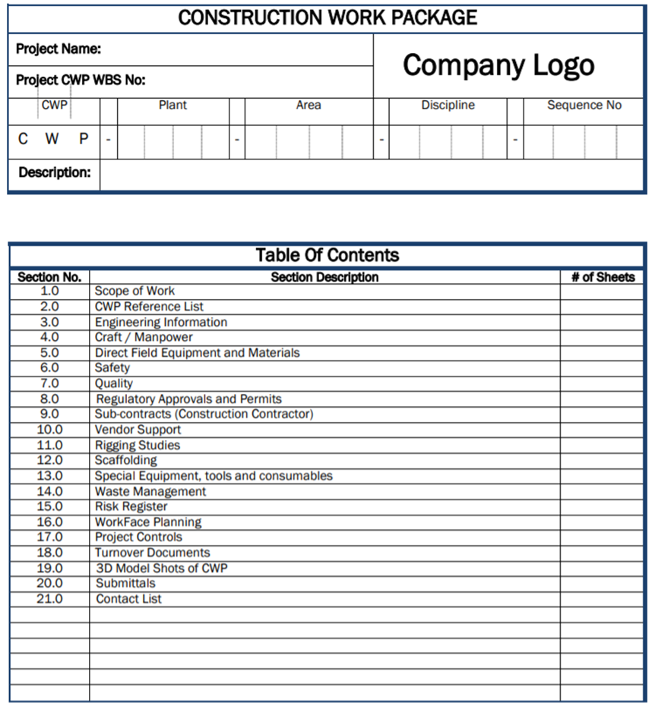
Scheduling Terminology:
Work Package Template
Chapter
07
www.midocean.ae

Slide 26
Chapter
Scheduling Terminology: Milestone
07
Is a GOAL to be achieved.
    Can be either a Start or Finish Achievement
    Is a single point in Time
    Has no duration
    Has no resources
    Has a specific and unique Definition
    It is either YES or NO
www.midocean.ae

Slide 27
Chapter
Scheduling Terminology
07
Predecessor = An activity that must occur before another activity. A predecessor activity controls the start or finish date of its successor(s). An activity can have multiple predecessors, each with a different relationship to it.
Successor = An activity that must occur after another activity. An activity can have multiple successors, each with a different relationship to it.
www.midocean.ae

Slide 28
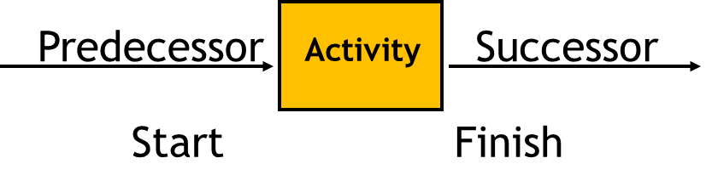
Chapter
Scheduling Terminology
Predecessor and Successor Synonymsمرادفات
07
Dependencies
Prerequisites
Interface requirements
Links
Logic relationships “To” and “From”
التابعين (الاعتماديين)
المتطلبات المسبقة
متطلبات الواجهة/الربط
الروابط
العلاقات المنطقية "إلى" و "من"
www.midocean.ae

Slide 29
Chapter
07
Agenda
Agenda
Scheduling
Who is the Scheduler
Attributes of Planner/Scheduler
Importance of the Schedule
Scheduling Tools
Critical Path Method
Scheduling Terminology
Relationships (Logic) – 4 Types
www.midocean.ae

Slide 30
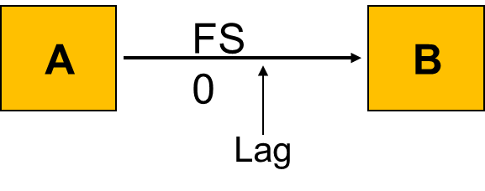
Chapter
07
Relationships (Logic) – 4 Types
  Finish to Start - FS - A relationship in which the predecessor activity must Finish before its successor activity can Start.
www.midocean.ae

Slide 31
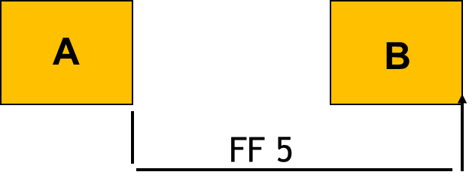
Chapter
07
Relationships (Logic) – 4 Types
  Finish to Finish - FF - A relationship in which the Finish of a successor activity depends on the Finish of its predecessor activity.
www.midocean.ae

Slide 32
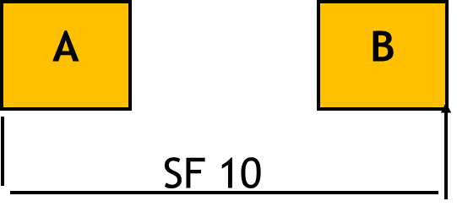
Chapter
07
Relationships (Logic) – 4 Types
  Start to Finish - SF - A relationship in which the Start of the predecessor activity controls the Finish of a successor activity. Not used
www.midocean.ae

Slide 33
Chapter
07
Relationships (Logic) – 4 Types
  Start to Start - SS - A relationship in which the Start of the predecessor activity controls the Start of a successor activity .
A
B
SS 0
www.midocean.ae

Slide 34
Thank You
www.midocean.ae

