Slide 1



Secure Operating Systems (CYB610)
Master of Science in Cybersecurity
Lecture 5
OS and Program Security
Dr. Ibrahim Gomaa
Faculty of Informatics
Midocean University
Lecture-5

Slide 2


Chapter
Topics
05
This chapter covers the following topics and concepts:
Programs security
Controls for Security
Operating System Controls for Security

Slide 3
Chapter
Goals
05
When you complete this chapter, you will be able to:
Know What is “Program security”
Explain the Basic approaches to having secure programs
Illustrate how to control security of programs during their development and maintenance

Slide 4
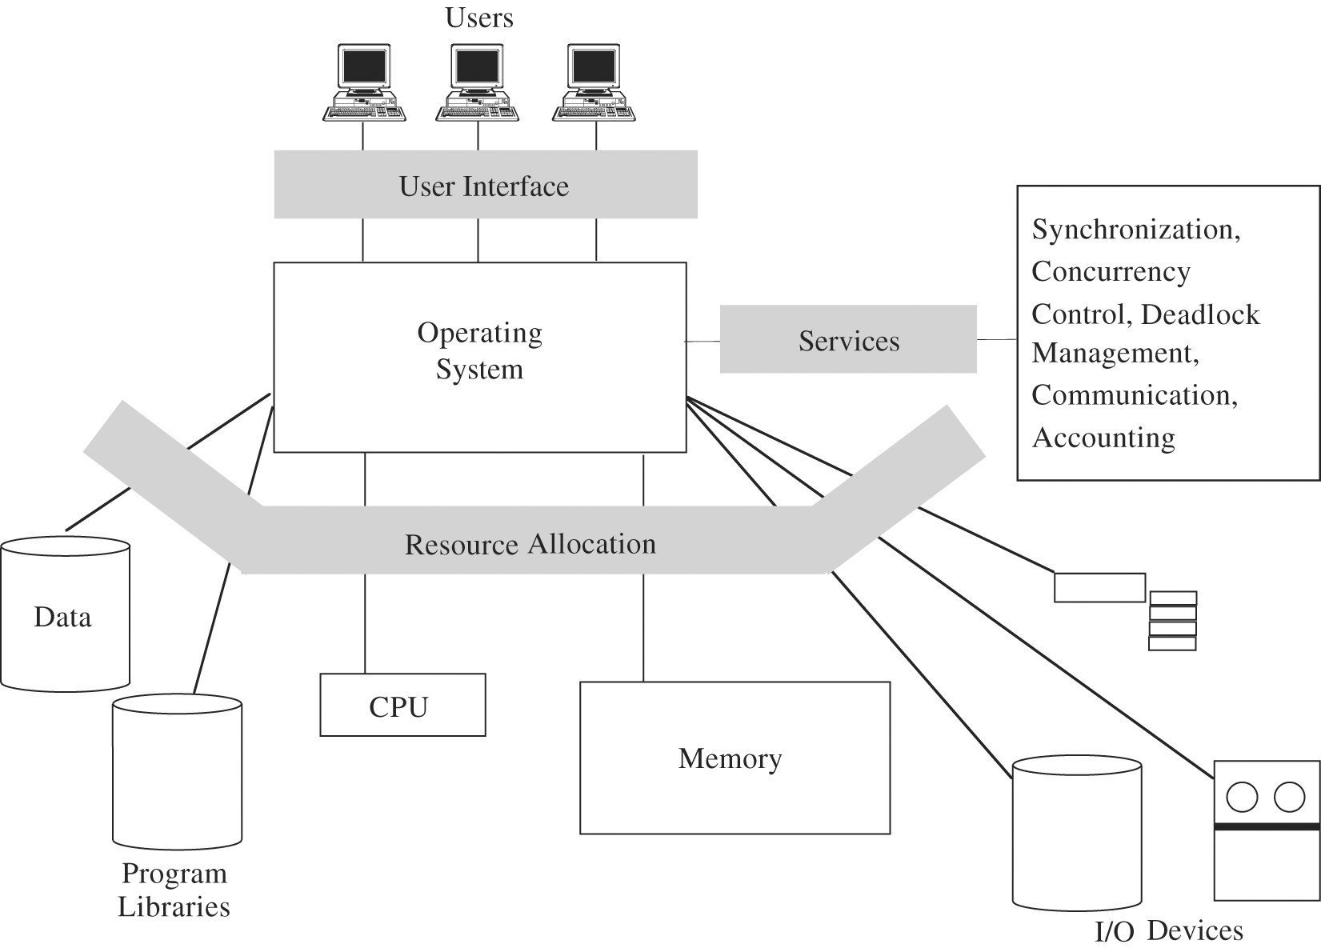
Chapter
05
Overview of an OS Functions

Slide 5
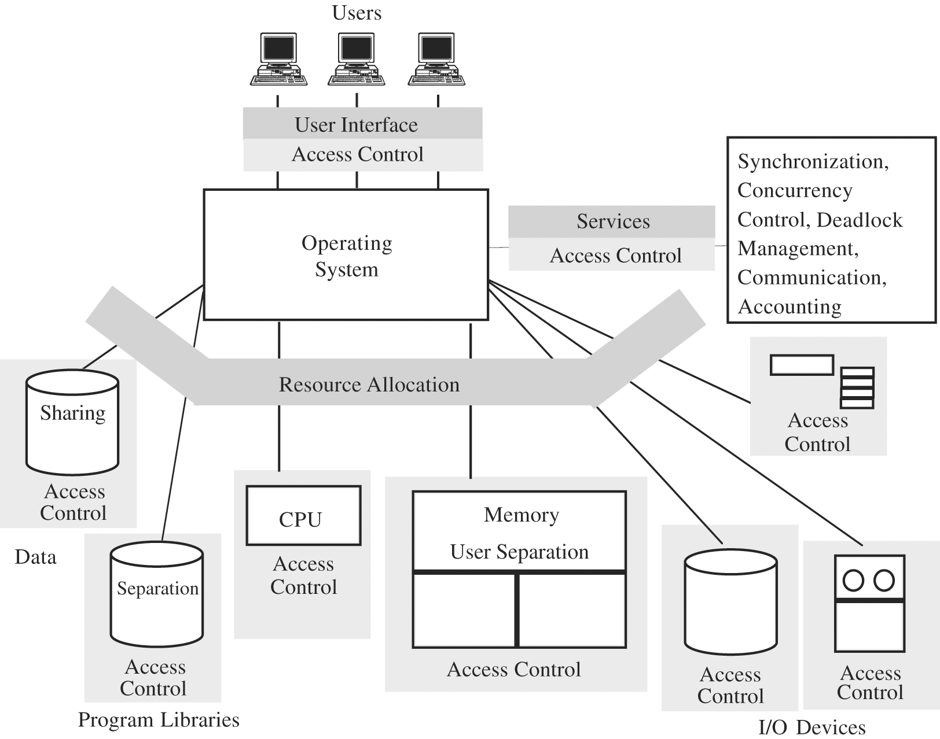
Chapter
05
Security Functions of a Trusted OS

Slide 6
Chapter
Programs security
05
Program is secure if we trust that it provides/enforces:
  Confidentiality
  Integrity
  Availability

Slide 7
Chapter
What is “Program security?”
05
Depends on who you ask
  user - fit for his task
  programmer - passes all “his” tests
  manager - conformance to all specifications
Developmental criteria for program security include:
  Correctness of security & other requirements
  Correctness of implementation
  Correctness of testing

Slide 8
Chapter
Fault tolerance terminology
05
  Error - may lead to a fault
  Fault - cause for deviation from the intended function
  Failure - system malfunction caused by fault
Note:
Faults - seen by insiders (e.g., programmers)
Failures - seen by outsiders (e.g., independent testers, users)
Error/fault/failure example:
  Programmer’s indexing error, leads to buffer overflow fault
  Buffer overflow fault causes system crash (a failure)
Two categories of faults :
Permanent faults
Transient faults – can be much more difficult to diagnose

Slide 9
Chapter
05
Basic approaches to having secure programs
  Judging S/W security by fixing program faults
    Red Team / Tiger Team tries to crack S/W
      If programs withstands the attack => security is good
  Judging S/W security by testing program behavior
    Run tests to compare behavior vs. Requirements.
    Important: If a flaw detected as a failure (an effect), look for the underlying fault (the cause)
    Recall: fault seen by insiders, failure – by outsiders
    If possible, detect faults before they become failures

Slide 10
Chapter
Basic approaches to having secure programs
05
    Any kind of fault/failure can cause a security incident
    we must consider security consequences for all kinds of detected faults/failures
    Even inadvertent faults / failures
        - Inadvertent faults are the biggest source of security vulnerabilities exploited by attackers
    Testing only increases probability of eliminating faults

Slide 11
Chapter
Basic approaches to having secure programs
05
  Judging s/w security by program Security Analysis
    Best approach to judging s/w security
    Analyze what can go wrong
      At every stage of program development!
        From requirement definition to testing
      After deployment
        Configurations / policies / practices

Slide 12
Chapter
Controls for Security
05
  How to control security of programs during their development and maintenance?
  Three types of controls for security (against program flaws):
  Developmental controls
  Operating system controls
  Administrative controls

Slide 13
Chapter
Controls for Security
05
  Overview
  “Better to prevent than to cure”
    Preventing security flaws
      We have seen a lot of possible security flaws
      How to prevent (some of) them?
      Software engineering concentrates on developing and maintaining high-quality s/w
        We’ll take a look at some techniques useful specifically for developing/ maintaining secure s/w

Slide 14
Chapter
Developmental Controls for Security
05
  Nature of s/w development
    Collaborative effort
    Team of developers, each involved in ≥ 1 of stages:
      Requirement specification
        Regular req. specs: “do X”
        Security req. specs: “do X and nothing more”

Slide 15
Chapter
Developmental Controls for Security
05
      Design
      Implementation
      Testing
      Documenting at each stage
      Reviewing at each stage
      Managing system development thru all stages
      Maintaining deployed system (updates, patches, new versions, etc.)
Both product and process contribute to overall quality

Slide 16
Chapter
Developmental Controls for Security
05
  Fundamental principles of S/W engineering
      Modularity
      Encapsulation
      Info hiding

Slide 17
Chapter
Fundamental principles of S/W engineering
05
      Modularity
      Modules should be:
      Single-purpose - logically/functionally
      Small - for a human to grasp
      Simple - for a human to grasp
      Independent – high cohesion, low coupling
        High cohesion – highly focused on (single) purpose
        Low coupling – free from interference from other modules
      Modularity should improve correctness
        Fewer flaws => better security

Slide 18
Chapter
Fundamental principles of s/w engineering
05
      Encapsulation
        Minimizing info sharing with other modules
        => Limited interfaces reduce # of covert channels
        Well documented interfaces
        “Hiding what should be hidden and showing what should be visible.”

Slide 19
Chapter
Fundamental principles of s/w engineering
05
      Information hiding
        Module is a black box
          Well defined function and I/O
        It's easy to know what a module does, but not how it does it.
        Reduces complexity, interactions, covert channels, ...
        => better security

Slide 20
Chapter
Developmental Controls for Security
05
  Many techniques for building a solid software
      Peer reviews
      Hazard analysis
      Testing
      Good design
      Risk prediction & management
      Static analysis
      Configuration management
      Additional developmental controls

Slide 21
Chapter
05
Building a solid software
    Peer Reviews - three types
      Informal Reviews
          No formal process
          May take the form of pair programming or a technical lead reviewing designs and code
          Results may be documented
          Varies in usefulness depending on the reviewers
          Gain consensus on solutions before development
          Main purpose: inexpensive way to get some benefit
      Walk-throughs
          Developer walks team through code/document
          Discover flaws in a single design document
          May vary in practice from quite informal to very formal
          Main purposes: learning, gaining understanding, finding defects
      Inspection
          Formalized and detailed
          Statistical measures used
          Main purpose: finding defects
          Various types of peer reviews can be highly effective

Slide 22
Chapter
05
Building a solid software
    Hazard Analysis
    systematic techniques to expose
    potentially hazardous system states, including security vulnerabilities
    Components of HA
      Hazard lists
      What-if scenarios – identify non-obvious hazards
      System-wide view (not just code)
      Begins Day 1
      Continues throughout SDLC (Software Development Life Cycle)
    Techniques
      HAZOP – Hazard and Operability Studies
      FMEA – Failure Modees and Effects Analysis
      FTA – Fault Tree Analysis

Slide 23
Chapter
Building a solid software
05
  Testing – phases:
    Module/component/unit testing of individual modules
    Integration testing of interacting (sub)system modules
    (System) function testing checking against requirement specs
    (System) performance testing
    (System) acceptance testing – with customer against customer’s
    requirements — on seller’s or customer’s premises
    (System) installation testing after installation on customer’s system
    Regression testing after updates/changes to s/w
  Types of testing
    Black Box testing – testers can’t examine code
    White Box / Clear box testing – testers can examine design and code,
    can see inside modules/system

Slide 24
Chapter
Building a solid software
05
  Good design
    Good design uses:
      Modularity / encapsulation / info hiding
      Fault tolerance
      Consistent failure handling policies
      Design rationale and history
      Design patterns

Slide 25
Chapter
Good Design
05
I. Using modularity / encapsulation / info hiding
II. Using fault tolerance for reliability and security
  System tolerates component failures
  System more reliable than any of its components
    Different than for security, where system is as secure as its weakest component
Fault-tolerant approach:
  Anticipate faults (car: anticipate having a flat tire)
    Active fault detection rather than pasive fault detection
    (e.g., by use of mutual suspicion: active input data checking)
  Use redundancy (car: have a spare tire)
  Isolate damage
  Minimize disruption (car: replace flat tire, continue your trip)

Slide 26
Chapter
Good Design
05
III. Using consistent failure handling policies
  Each failure handled by one of 3 ways:
    Retrying
      Restore previous state, redo service using different “path”
        E.g., use secondary code instead of primary code
    Correcting
      Restore previous state, correct something, run service using the same code as before
    Reporting
      Restore previous state, report failure to error handler, don’t rerun service
Example — How fault-tolerance enhances security
  If security fault destroys important data (availability in CIA), use fault tolerant to revert to backup data set

Slide 27
Chapter
Good Design
05
IV. Using design rationale and history
  Knowing it (including knowing design rationale and history for security mechanisms) helps developers modifying or maintaining system
V. Using design patterns
  Knowing it enables looking for patterns showing what works best in which situation

Slide 28
Chapter
Good Design
05
Value of Good Design
  Easy maintenance
  Understandability
  Reuse
  Correctness
  Better testing
  => translates into (saving) BIG bucks !

Slide 29
Chapter
Building a solid software
05
5) Risk prediction & management
  Predict and manage risks involved in system development and deployment
    Make plans to handle unwelcome events should they occur
  Risk prediction/mgmt are especially important for security
    Because unwelcome and rare events can have security consequences
  Risk prediction/mgmt helps to select proper security controls (e.g., proportional to risk)

Slide 30
Chapter
Building a solid software
05
6) Static analysis
  Before system is up and running, examine its design and code to locate security flaws
    More than peer review
  Examines
    Control flow structure (sequence in which instructions are executed, incl. iterations and loops)
    Data flow structure (trail of data)
    Data structures
  Automated tools available

Slide 31
Chapter
Building a solid software
05
7) Configuration management
  It is a process of controling system modifications during development and maintenance
  Offers security benefits by scrutinizing new/changed code
Problems with system modifications
  One change interefering with other change
    E.g., neutralizing it
  Proliferation of different versions and releases
    Older and newer
    For different platforms
    For different application environments (and/or customers categories)

Slide 32
Chapter
Building a solid software
05
Reasons for software modification
  Corrective changes
    To maintain control of system’s day-to-day functions
  Adaptive changes
    To maintain control over system’s modifications
  Perfective changes
    To perfect existing acceptable system functions
  Preventive changes
    To prevent system’s performance degradation to unacceptable levels

Slide 33
Chapter
05
Building a solid software
8) Additional developmental controls
  8a) Learning from mistakes
    Avoiding such mistakes in the future enhances security
  8b) Proofs of program correctness
    Formal methods to verify pgm correctness
    Logic analyzer shows that:
      initial assertions about inputs...
      ... through implications of pgm statements...
      ... lead to the terminal condition (desired output)
    Problems with practical use of pgm correctness proofs
      Esp. for large pgms/systems
    Most successful for specific types of apps
      E.g. for communication protocols & security policies
      Even with all these developmental controls (1-8) –
still no security guarantees!

Slide 34
Chapter
05
Administrative Controls for Security
1) Standards and guidelines for program development
  Capture experience and wisdom from previous projects
  Facilitate building higher-quality s/w (incl. more secure)
  They include:
    Design Standard & Guidelines – design tools, languages, methodologies
    S&G for documentation, language, and coding style
    Programming S&G - incl. reviews, audits
    Testing S&G
    Configuration mgmt S&G

Slide 35
Chapter
05
Administrative Controls for Security
2) Security audits
  Check compliance with S&G
  Scare potential dishonest programmer from including illegitimate code (e.g., a trapdoor)
3) Separation of duties
  Break sensitive tasks into ≥ 2 pieces to be performed by different people (learned from banks)
  Example 1: modularity
    Different developers for cooperating modules
  Example 2: independent testers
    Rather than developer testing her own code

Slide 36
Chapter
05
Operating System Controls for Security
Developmental controls not always used
OR:
Even if used, not foolproof
=> Need other, complementary controls, incl. OS controls
Such OS controls can protect against some program flaws

Slide 37
Chapter
05
Operating System Controls for Security
Trusted software
– code accurately developed and analyzed so we can trust that it does all and only what specs say.
  Trusted code establishes foundation upon which untrusted code runs
  Trusted code establishes security baseline for the whole system
  In particular, OS can be trusted s/w

Slide 38
Chapter
05
Operating System Controls for Security
Key characteristics determining if OS code is trusted
  1) Functional correctness
    OS code consistent with specs
  2) Enforcement of integrity
    OS keeps integrity of its data and other resources even if presented with flawed or unauthorized commands
  3) Limited privileges
    OS minimizes access to secure data/resources
    Trusted programs must have “need to access” and proper access rights to use resources protected by OS
    Untrusted programs can’t access resources protected by OS
  4) Appropriate confidence level
    OS code examined and rated at appropriate trust level

Slide 39
Chapter
05
Operating System Controls for Security
Similar criteria used to establish if s/w other than OS can be trusted
Ways of increasing security if untrusted programs present:
  Mutual suspicion
  Confinement
  Access log
1) Mutual suspicion between programs
  Distrust other program s – treat them as if they were incorrect or malicious
    program protects its interface data
    With data checks, etc.

Slide 40
Chapter
05
Operating System Controls for Security
2) Confinement
  OS can confine access to resources by suspected program
  Example 1: strict compartmentalization
    program can affect data and other programs only within its compartment
  Example 2: sandbox for untrusted programs
  Can limit spread of viruses

Slide 41
Chapter
05
Operating System Controls for Security
3) Audit log / access log
  Records who/when/how (e.g., for how long) accessed/used which objects
    Events logged: logins/logouts, file accesses, program ecxecutions, device uses, failures, repeated unsuccessful commands (e.g., many repeated failed login attempts can indicate an attack)
  Audit frequently for unusual events, suspicious patterns
  It is a forensic measure not protective measure
    Forensics – investigation to find who broke law, policies, or rules (a posteriori, not a priori)

Slide 42
Chapter
05
Summary
What is “Program security”
Basic approaches to having secure programs
Controls for Security
Developmental Controls for Security
Administrative Controls for Security
Operating System Controls for Security

Slide 43


Thank You

