Slide 1


Slide 2
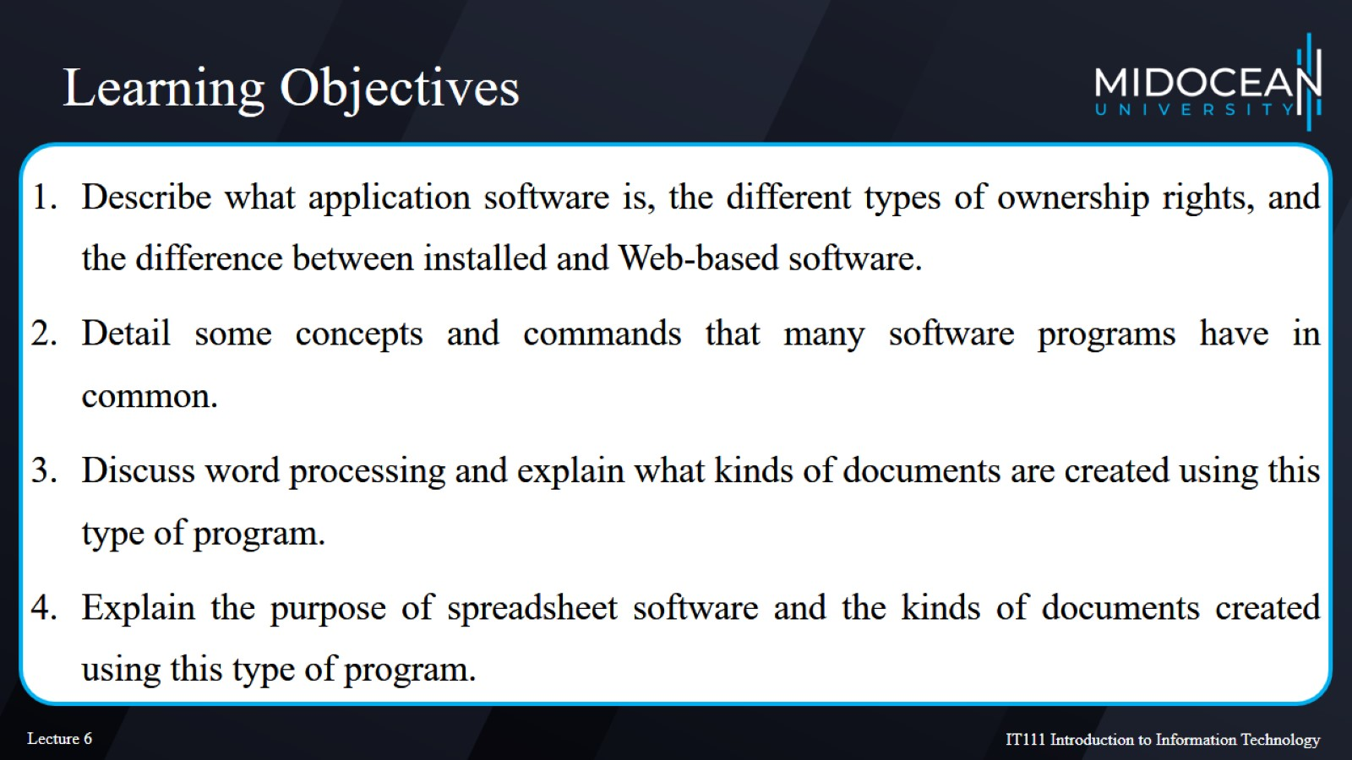
Learning Objectives

Slide 3
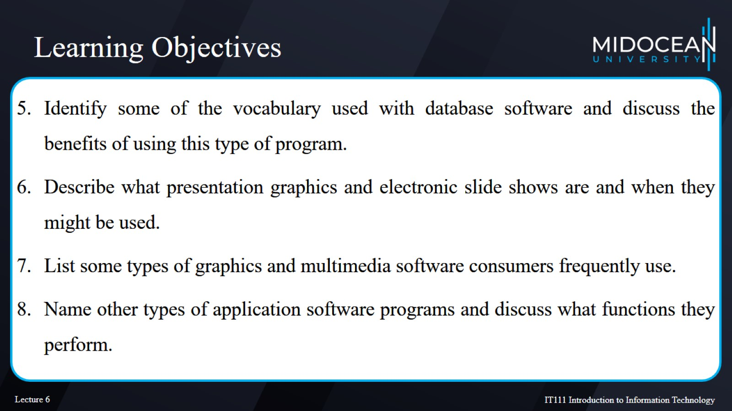
Learning Objectives

Slide 4
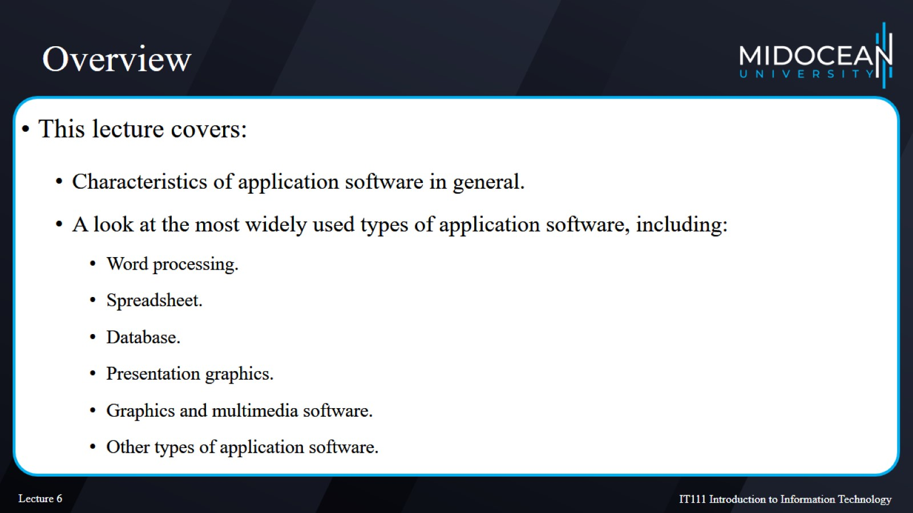
Overview

Slide 5
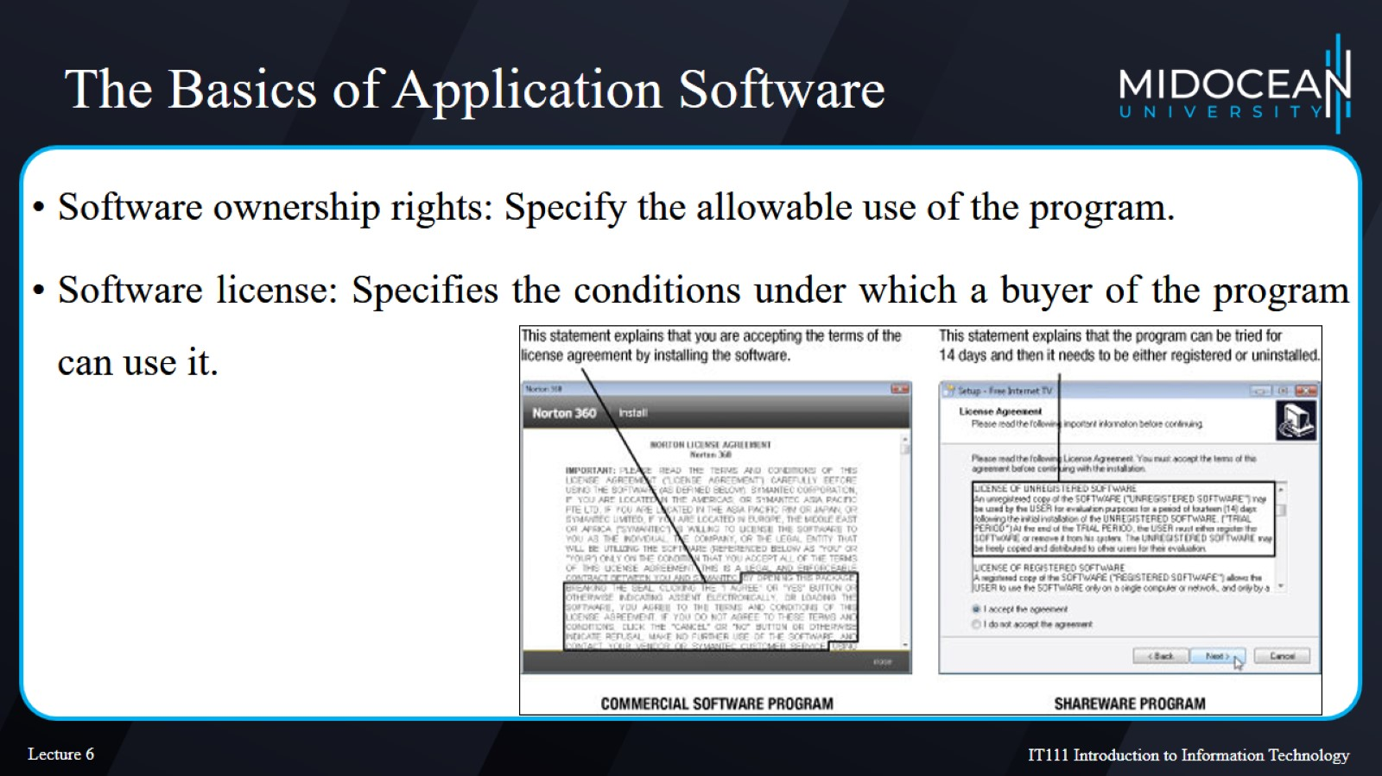
The Basics of Application Software

Slide 6
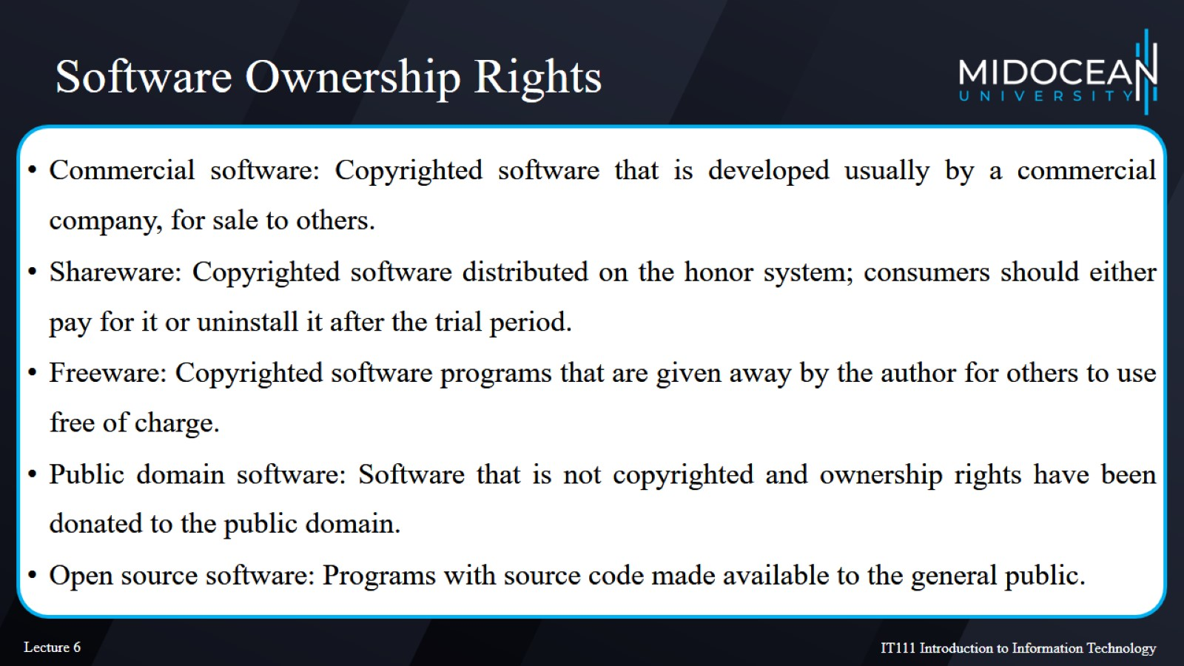
Software Ownership Rights

Slide 7
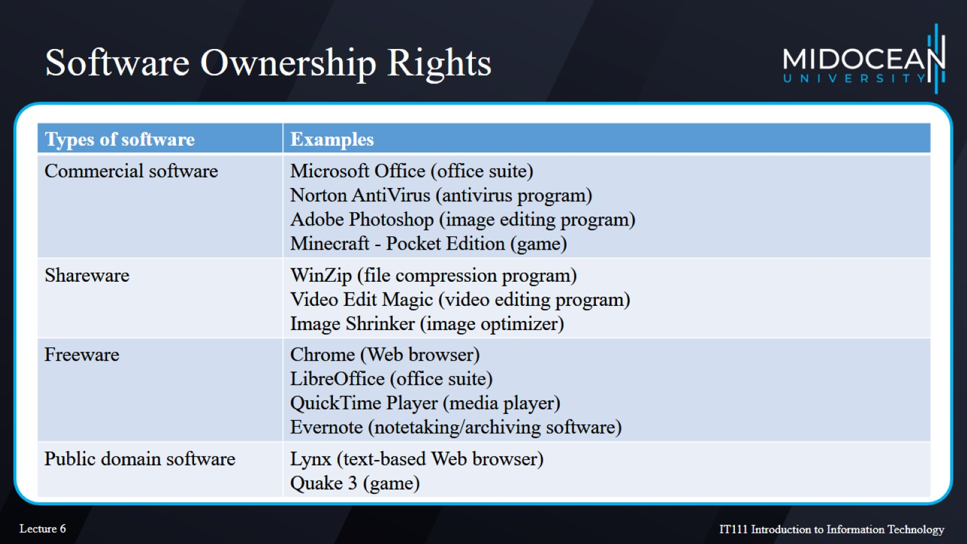
Software Ownership Rights

Slide 8
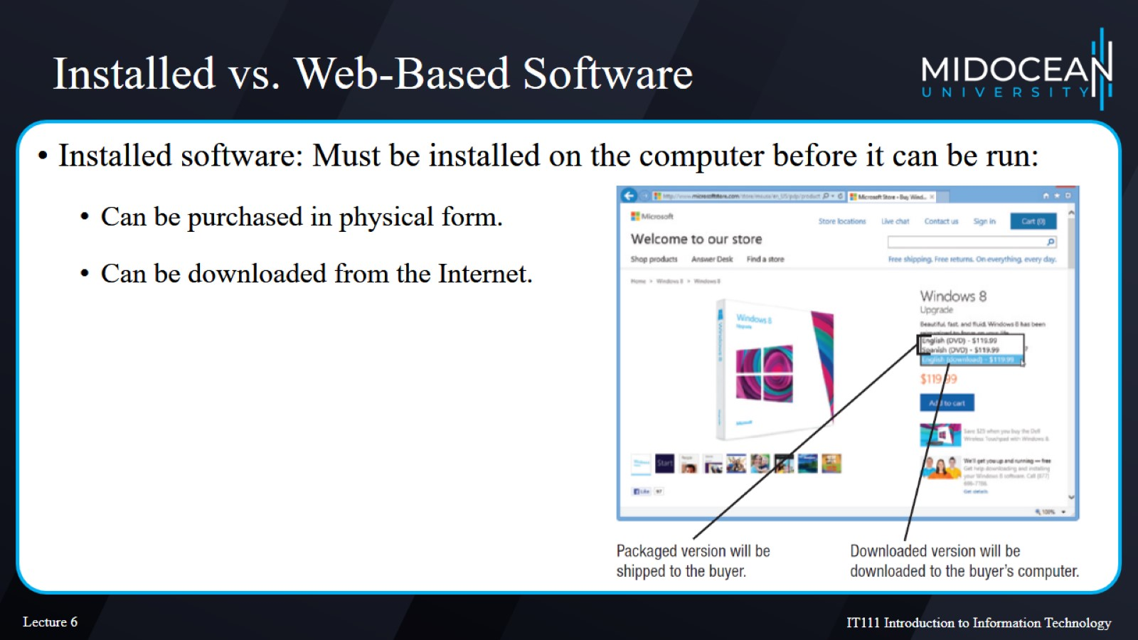
Installed vs. Web-Based Software

Slide 9
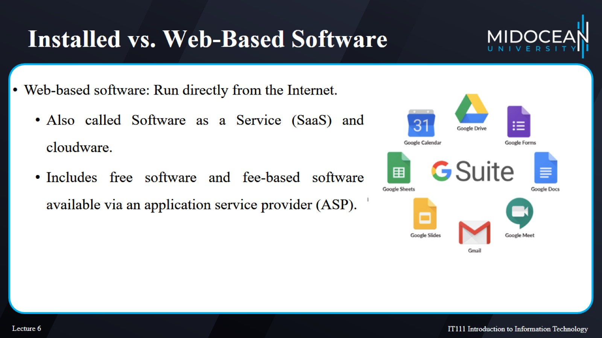
Installed vs. Web-Based Software

Slide 10
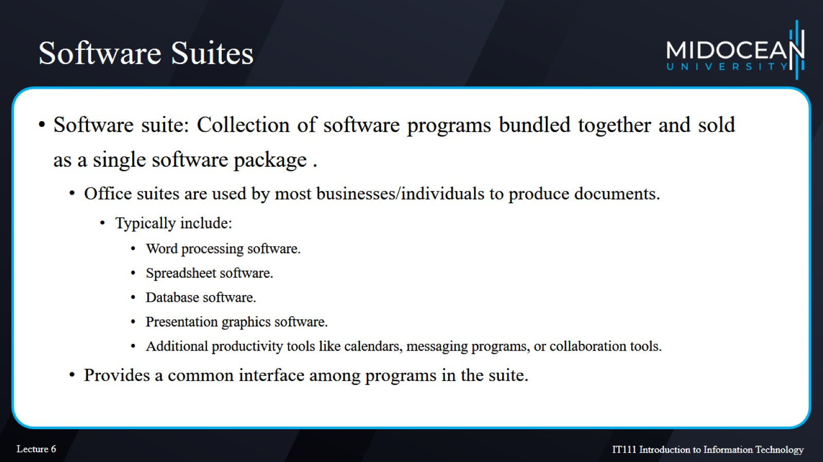
Software Suites

Slide 11
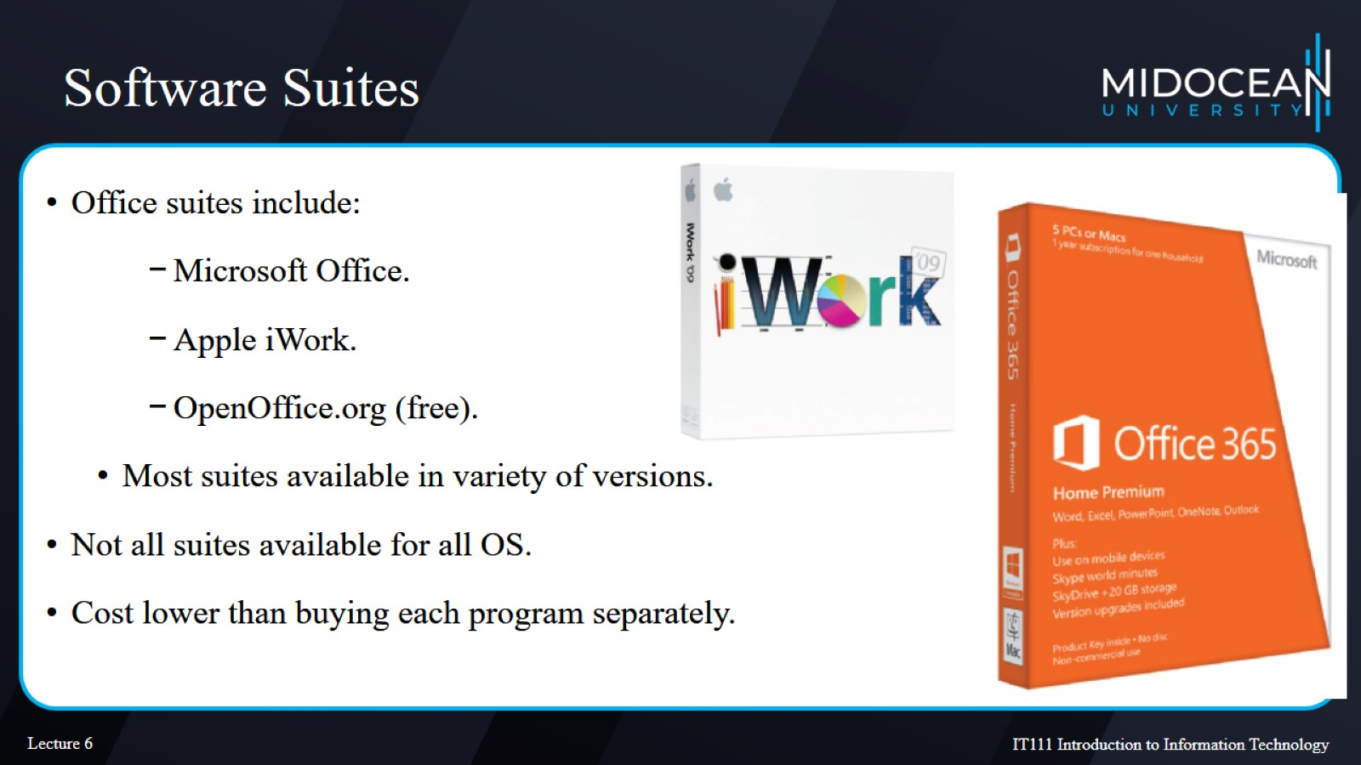
Software Suites

Slide 12
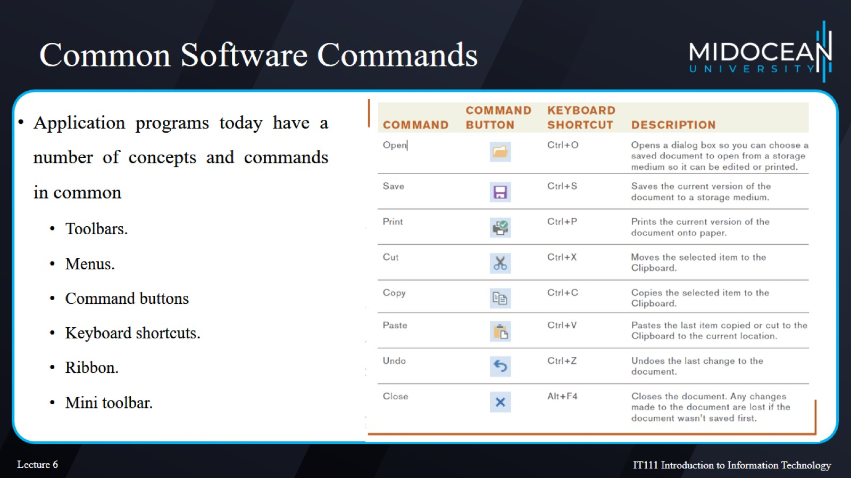
Common Software Commands

Slide 13
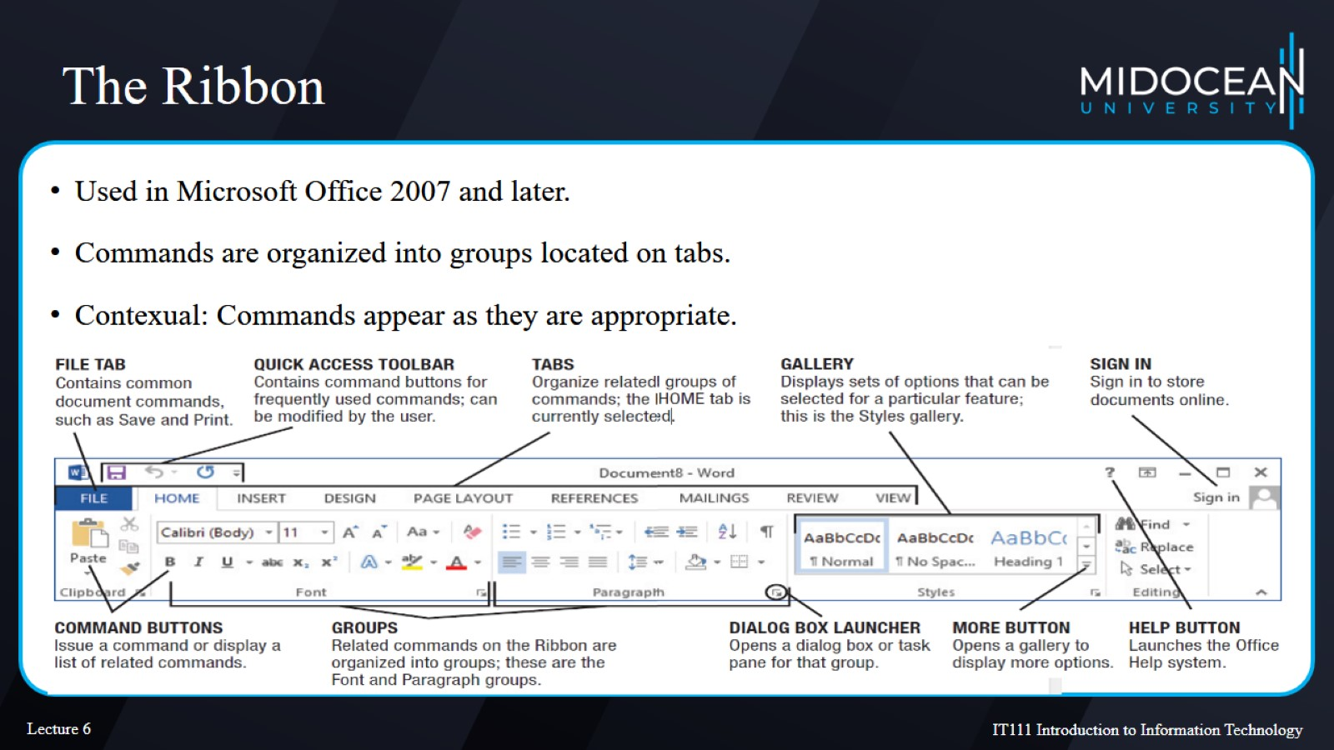
The Ribbon

Slide 14
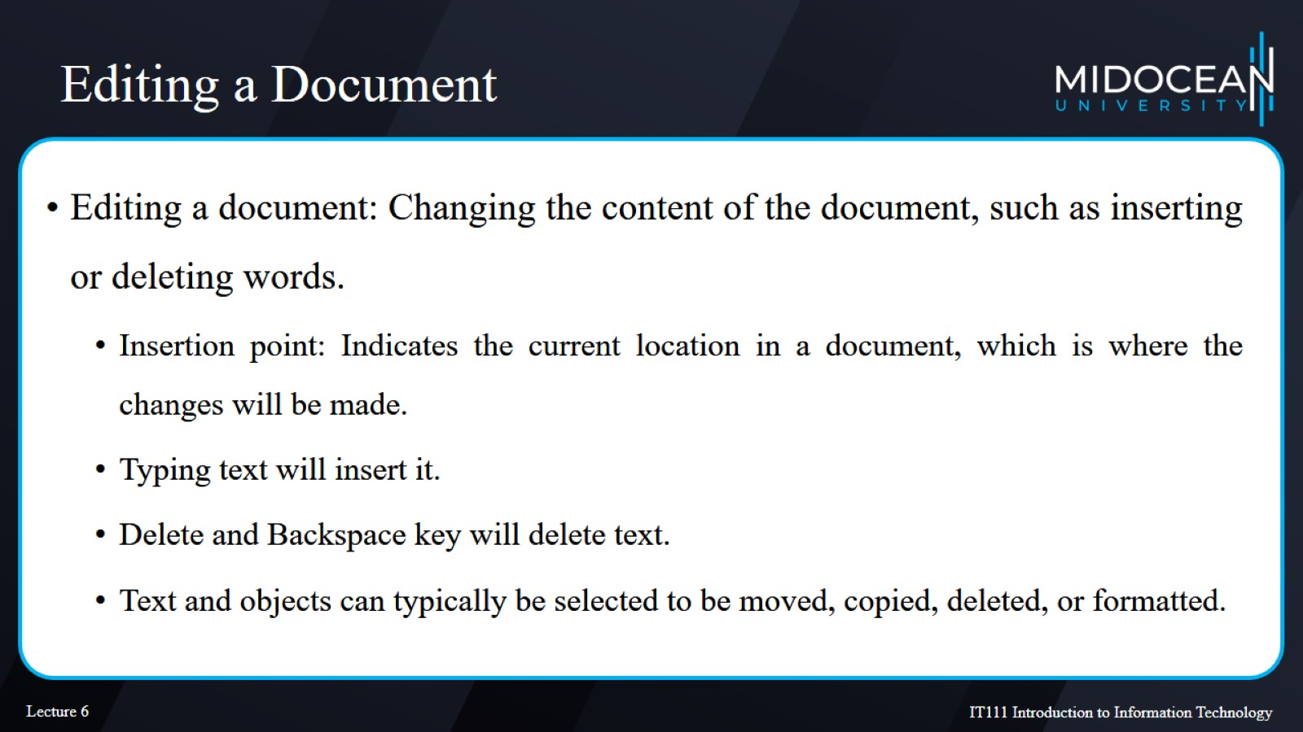
Editing a Document

Slide 15
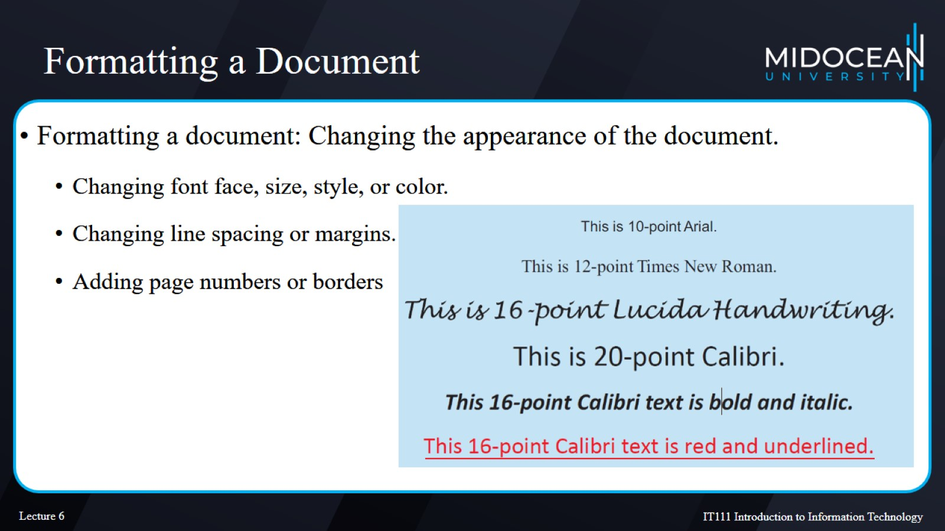
Formatting a Document

Slide 16
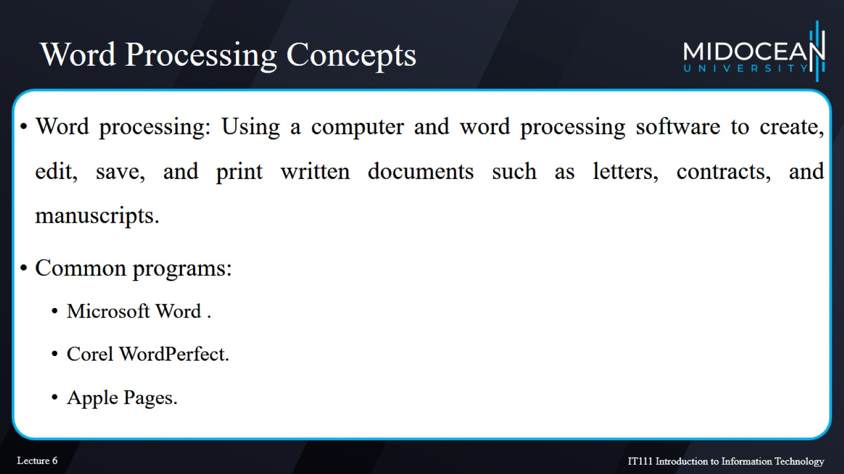
Word Processing Concepts

Slide 17
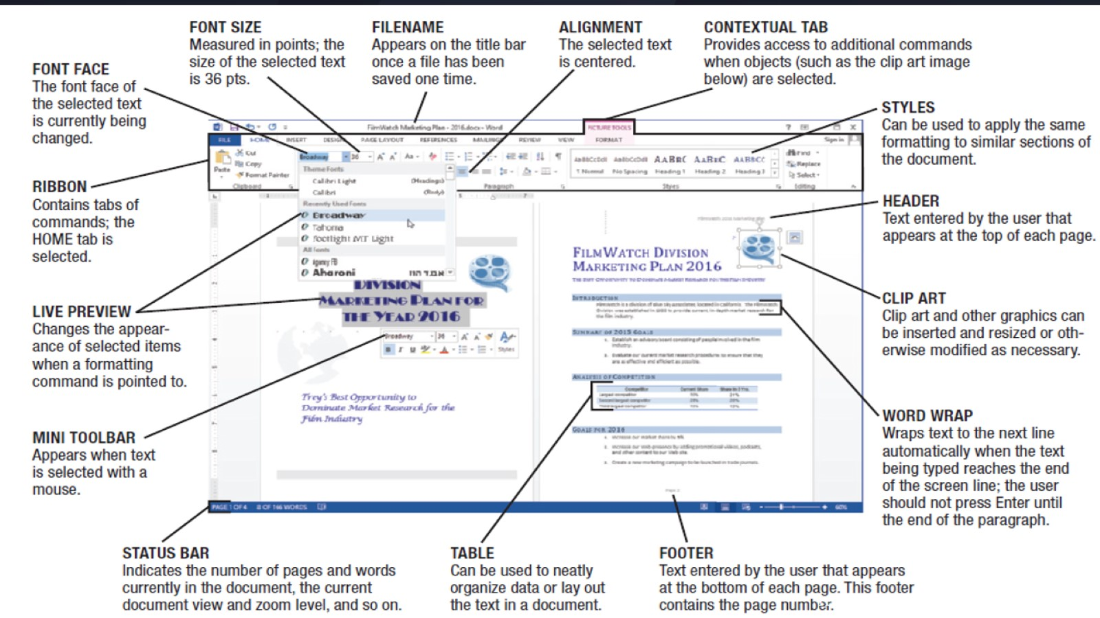
Microsoft Word

Slide 18
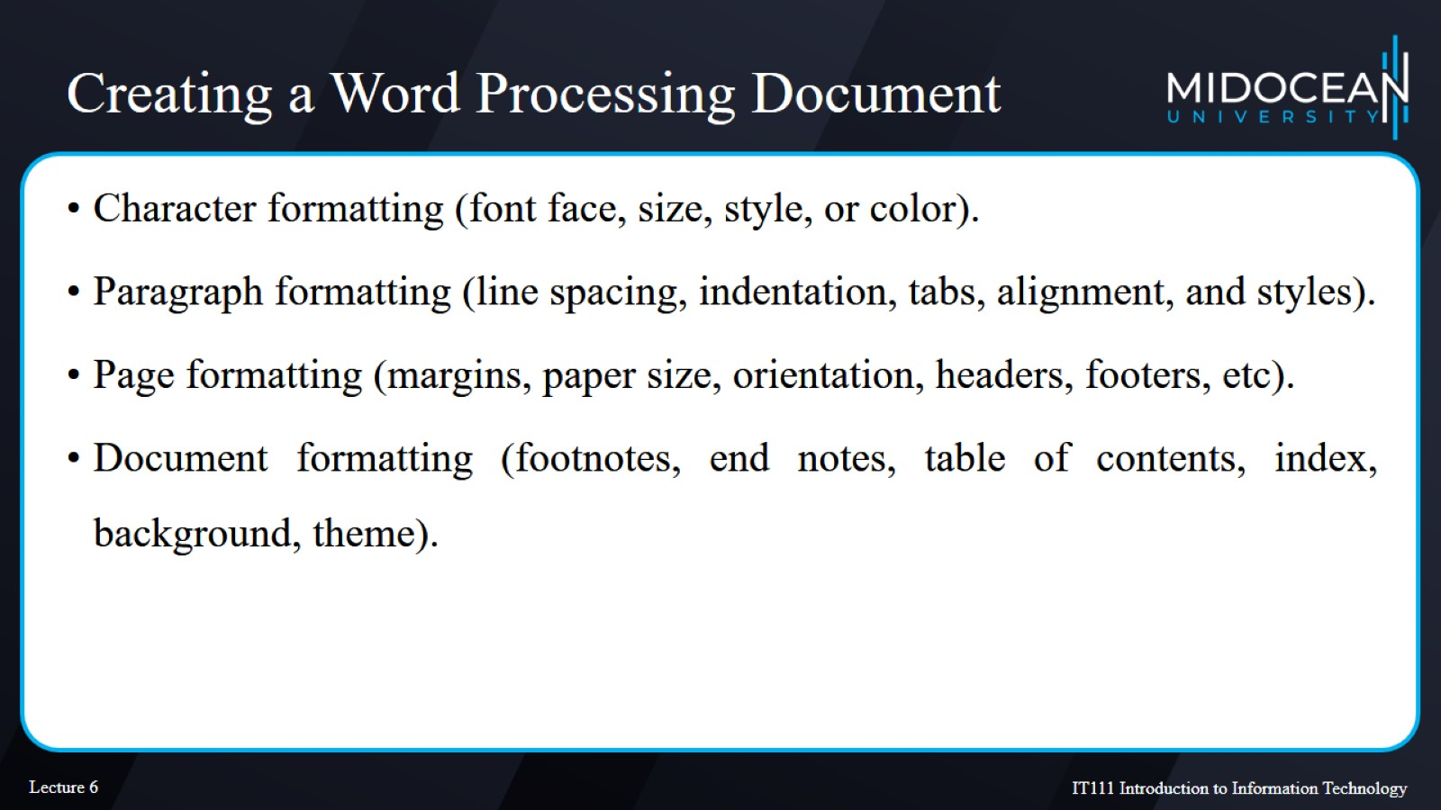
Creating a Word Processing Document

Slide 19
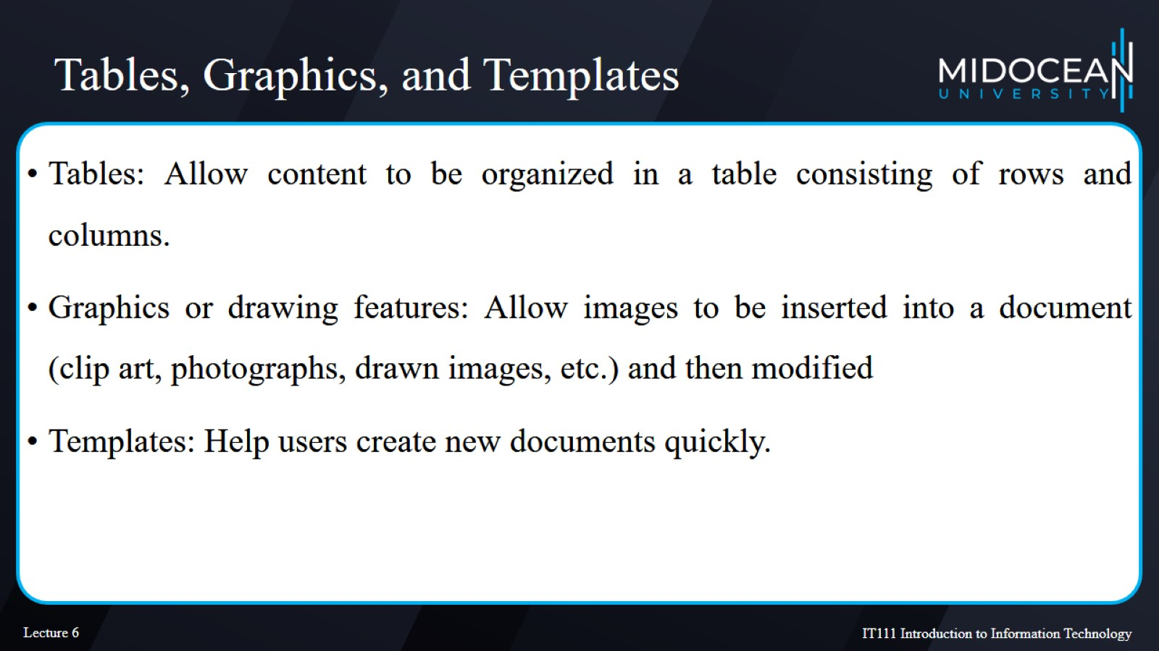
Tables, Graphics, and Templates

Slide 20
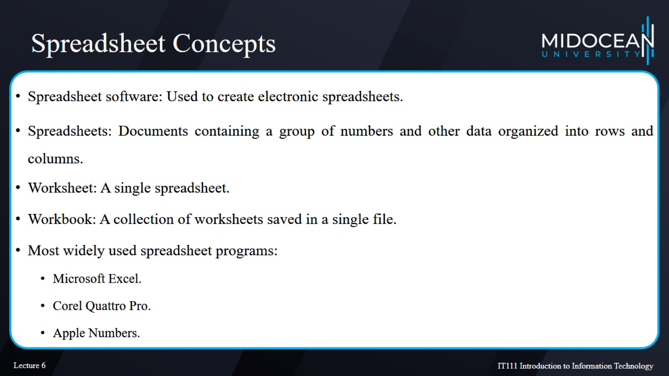
Spreadsheet Concepts

Slide 21
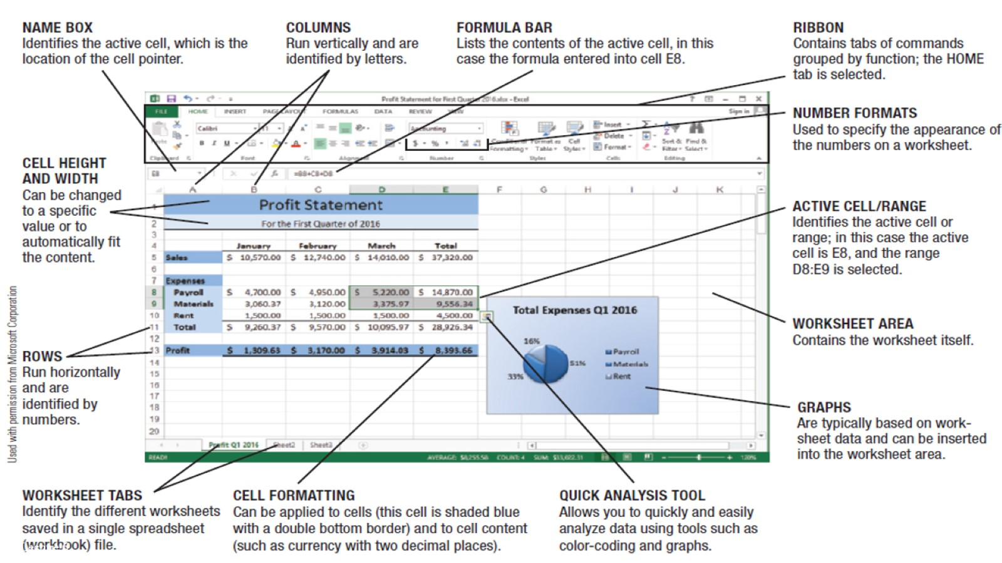
Microsoft Excel

Slide 22
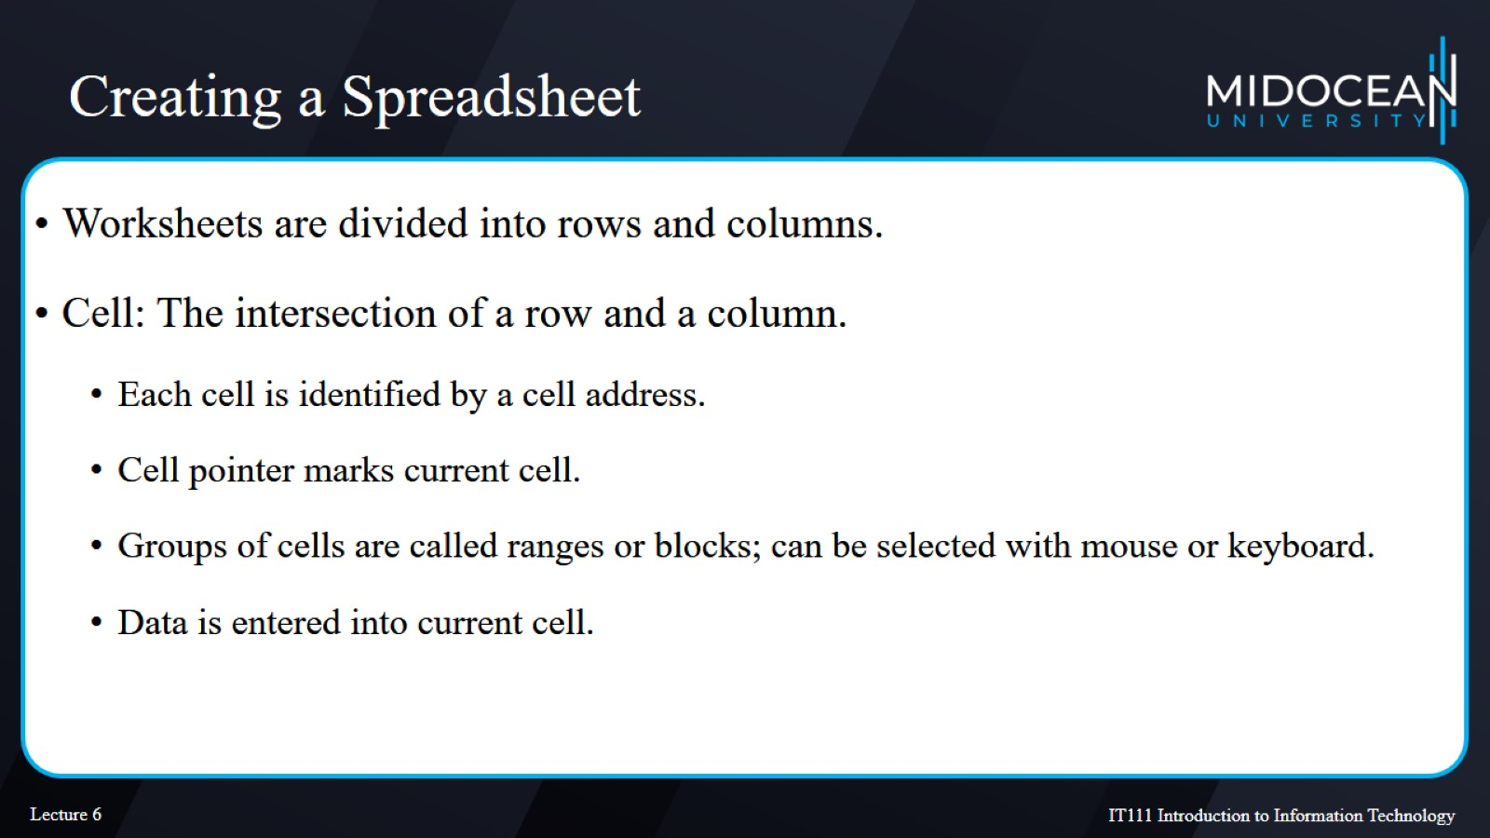
Creating a Spreadsheet

Slide 23
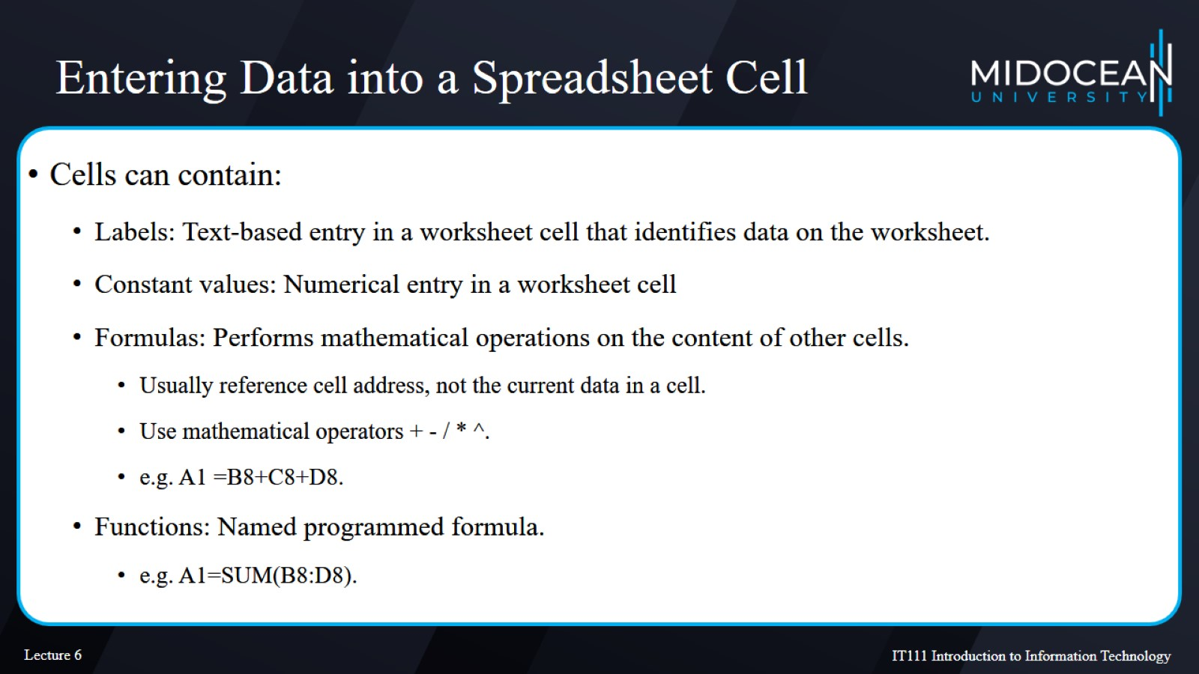
Entering Data into a Spreadsheet Cell

Slide 24
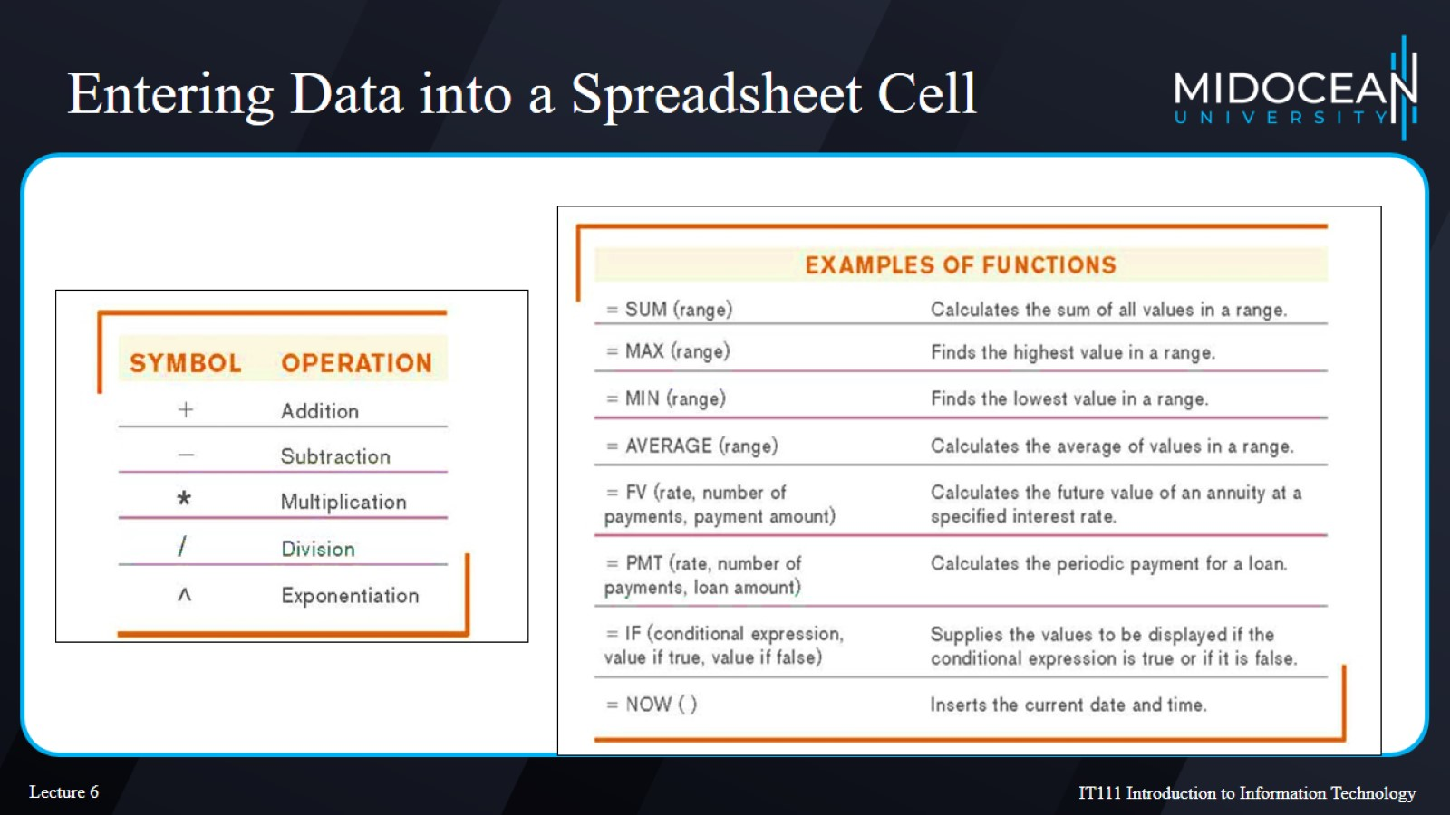
Entering Data into a Spreadsheet Cell

Slide 25
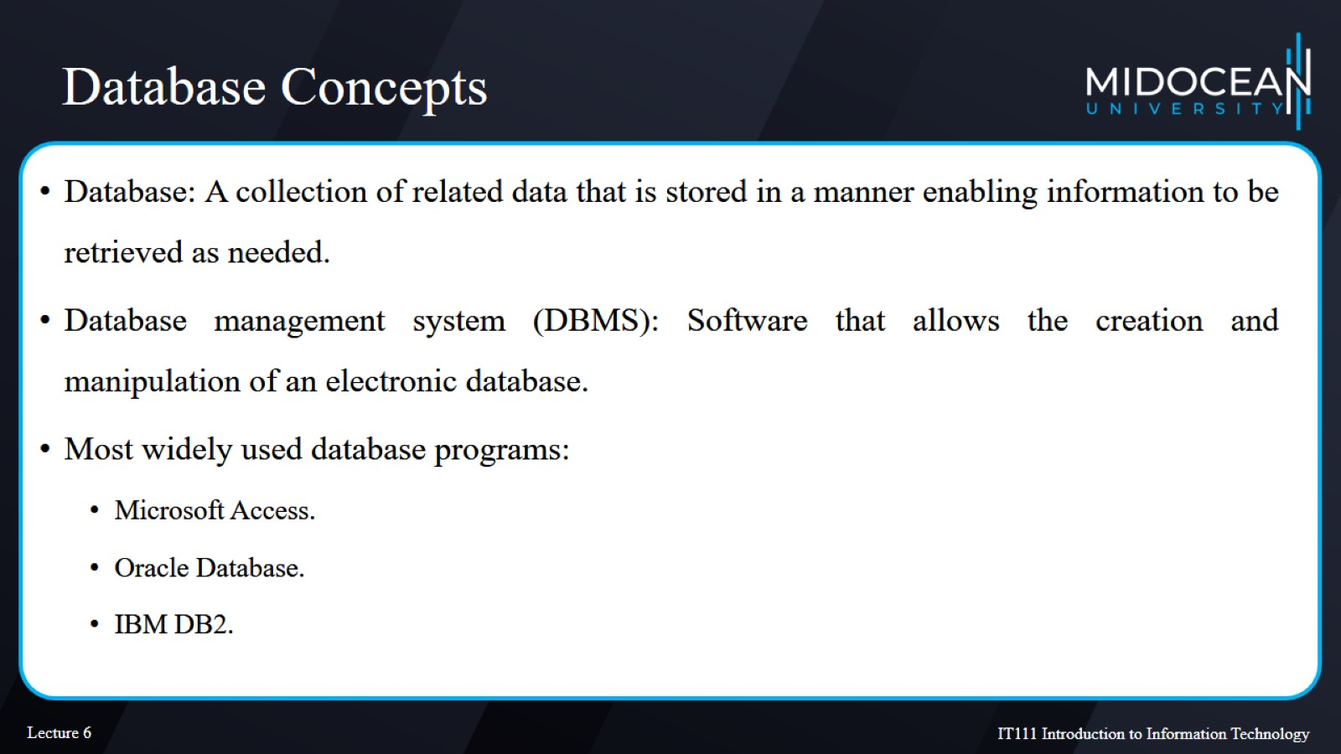
Database Concepts

Slide 26
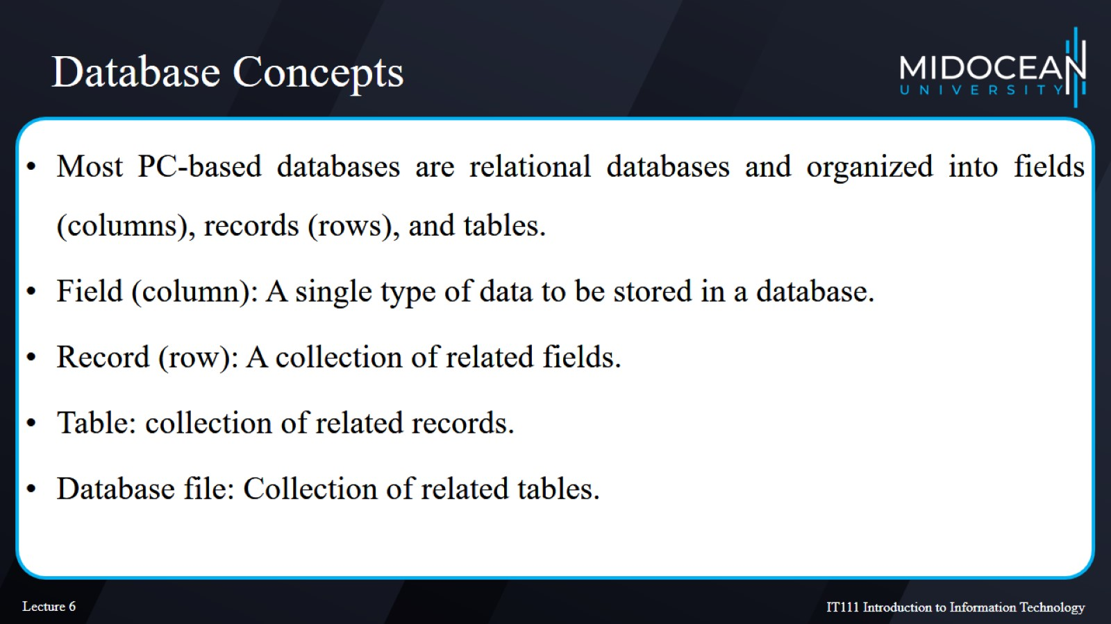
Database Concepts

Slide 27
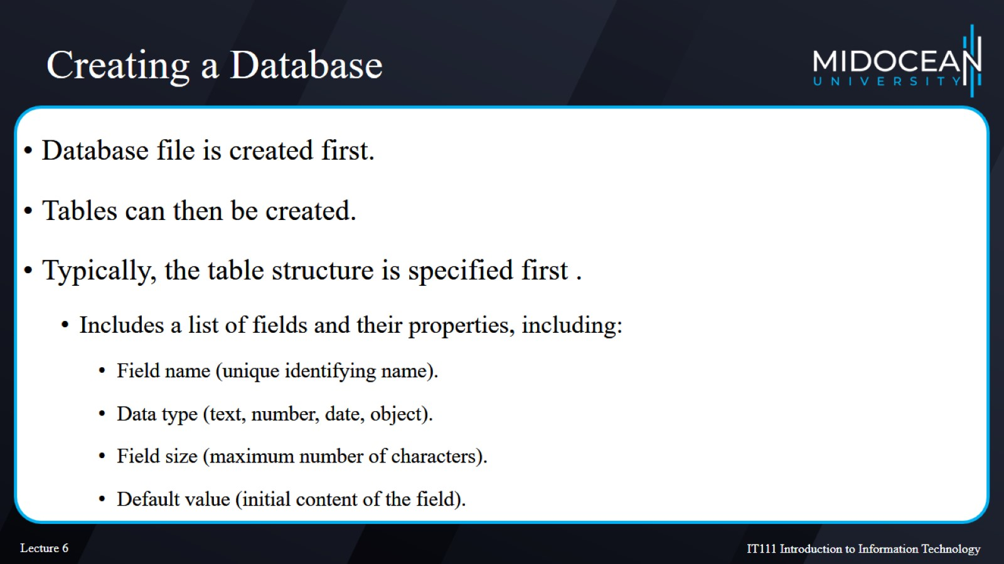
Creating a Database

Slide 28
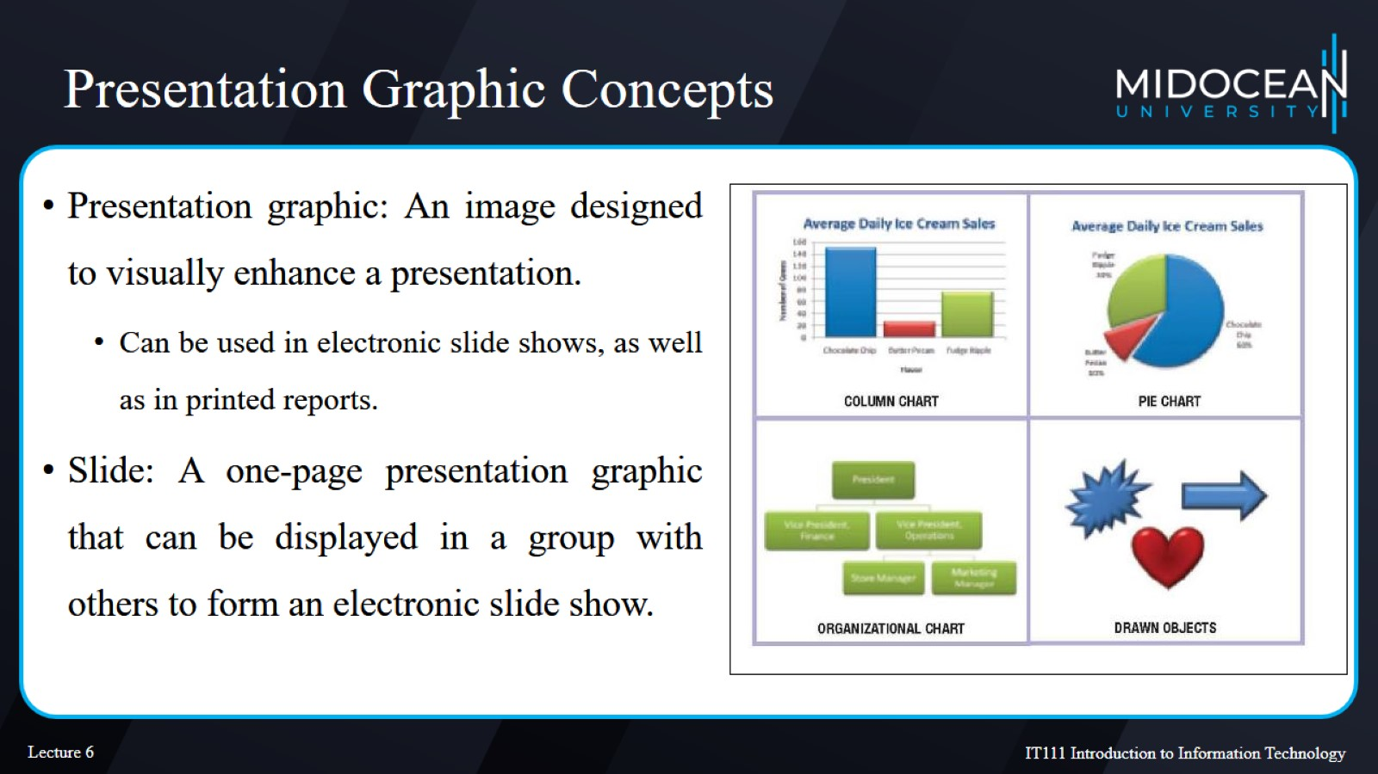
Presentation Graphic Concepts

Slide 29
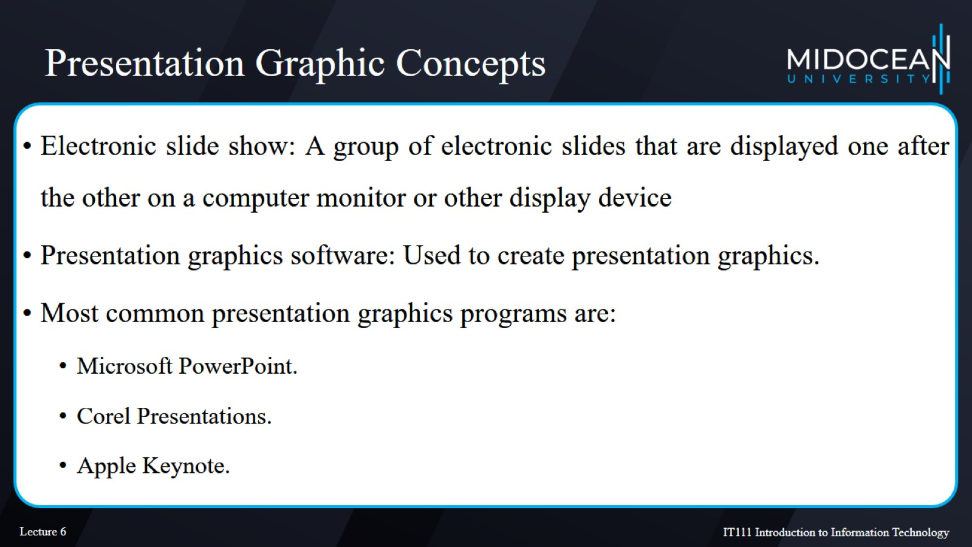
Presentation Graphic Concepts

Slide 30
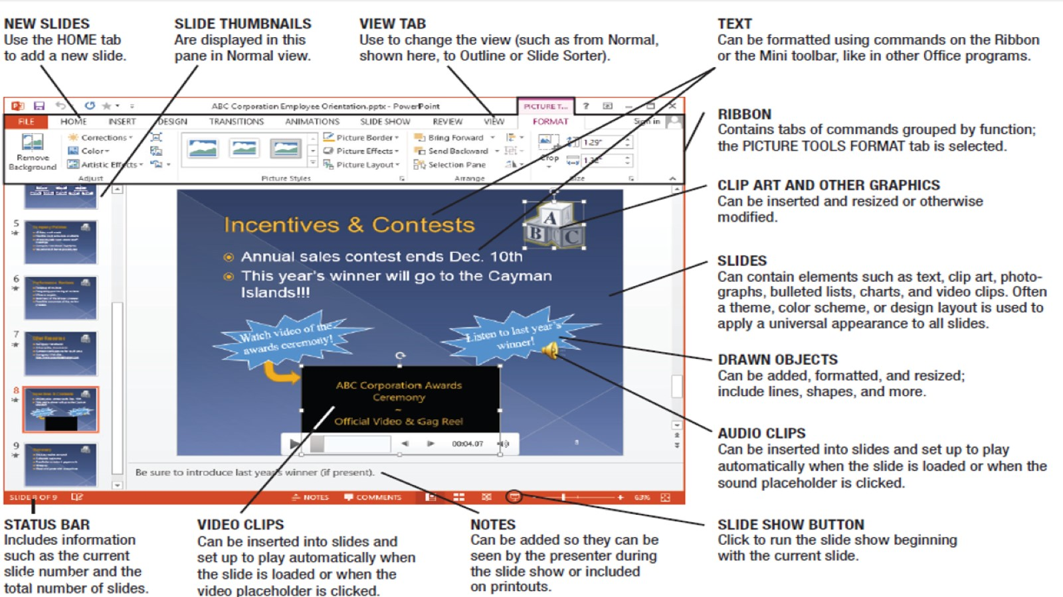
Microsoft PowerPoint

Slide 31
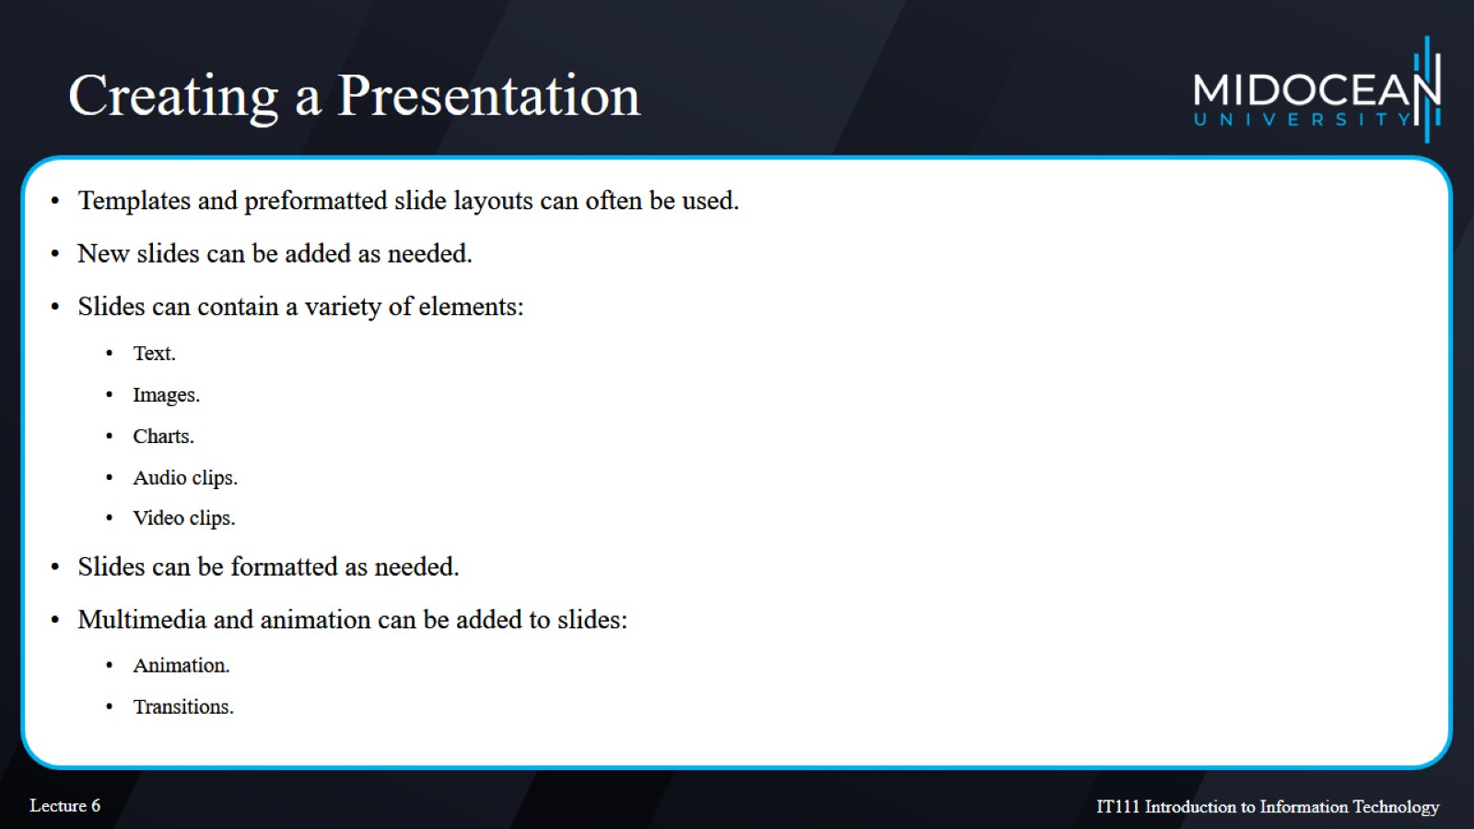
Creating a Presentation

Slide 32
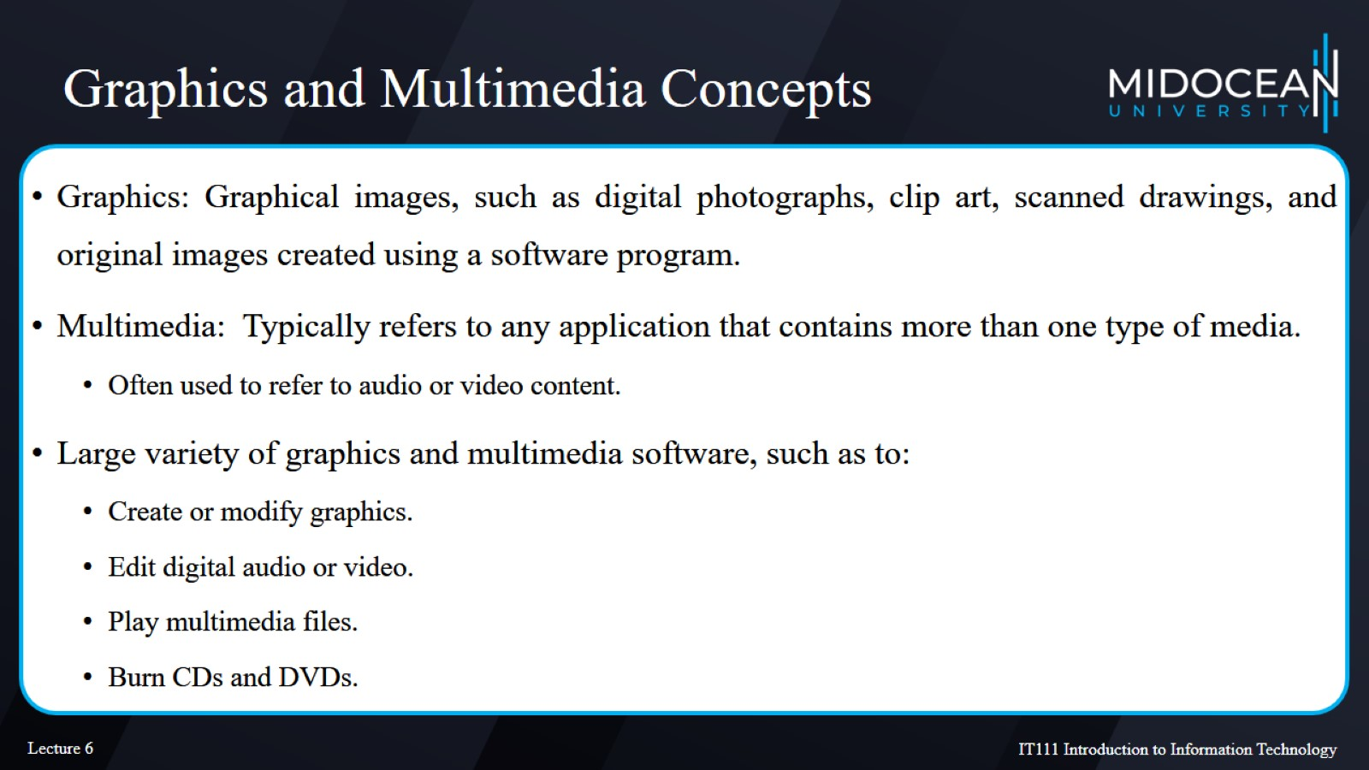
Graphics and Multimedia Concepts

Slide 33
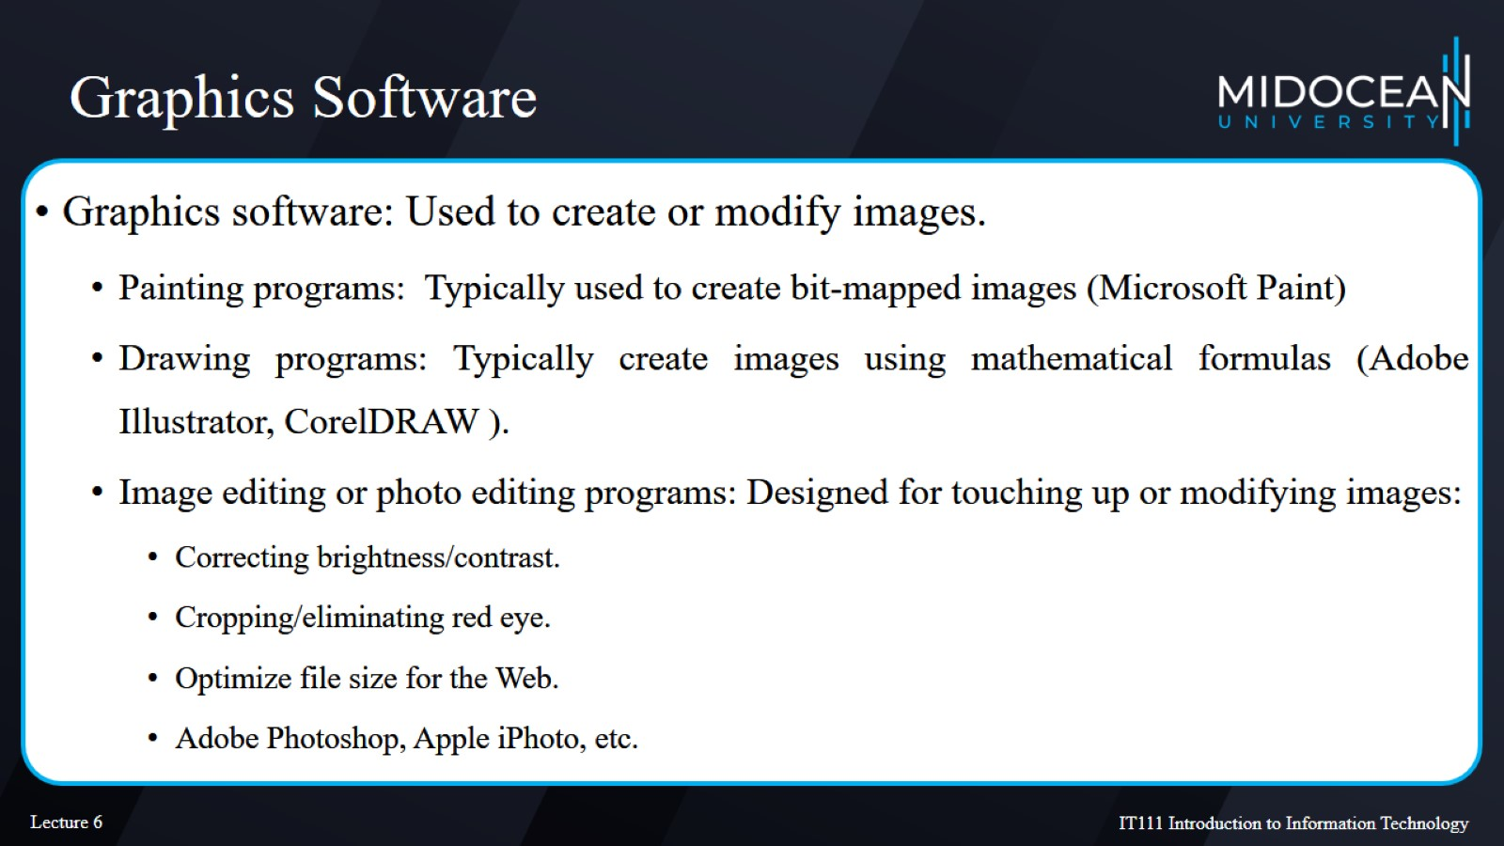
Graphics Software

Slide 34
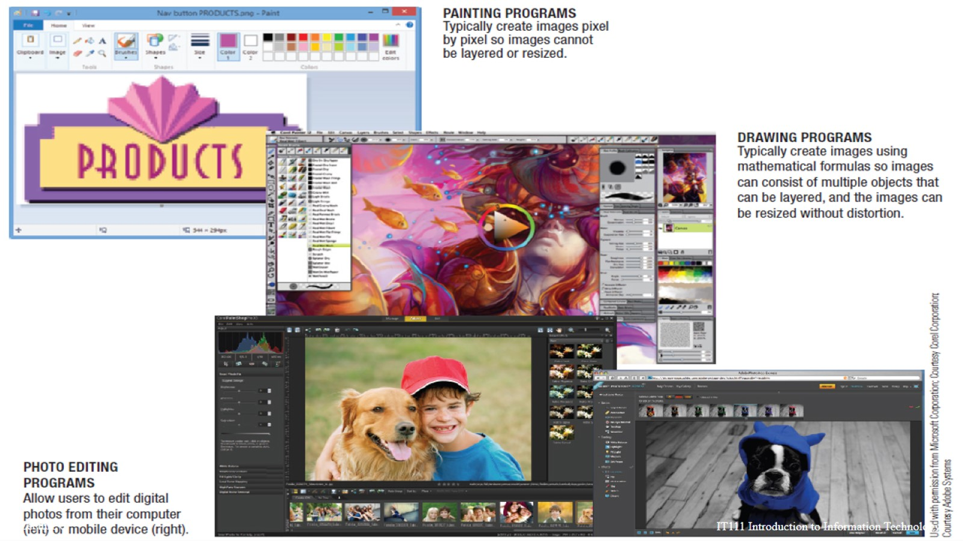
Graphics Software

Slide 35
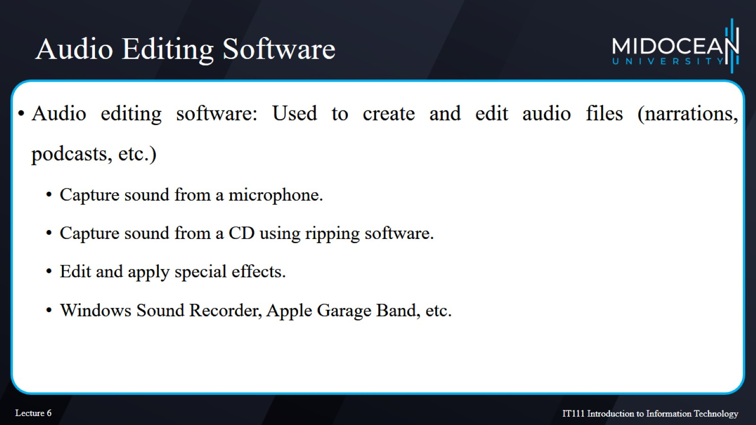
Audio Editing Software

Slide 36
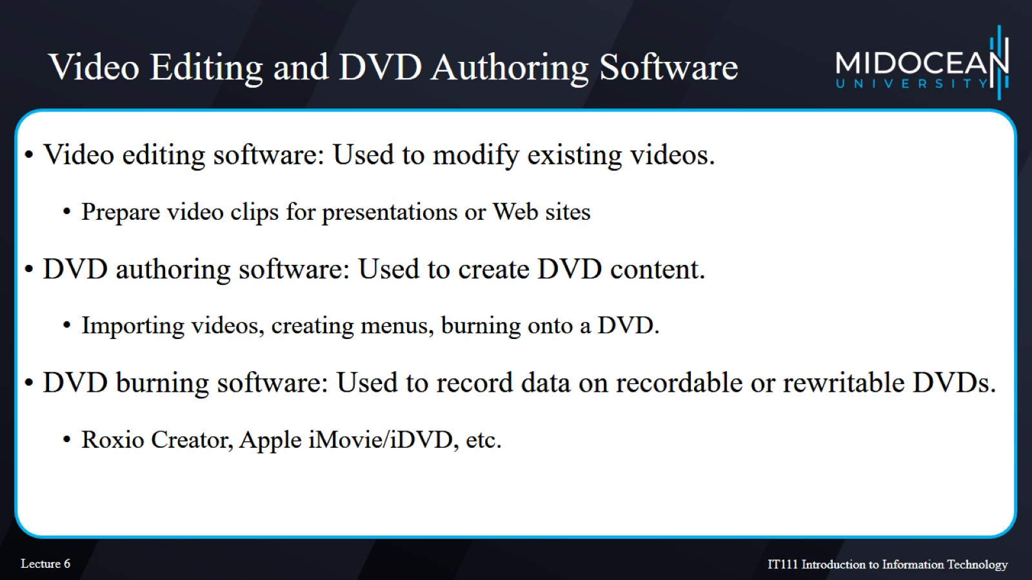
Video Editing and DVD Authoring Software

Slide 37
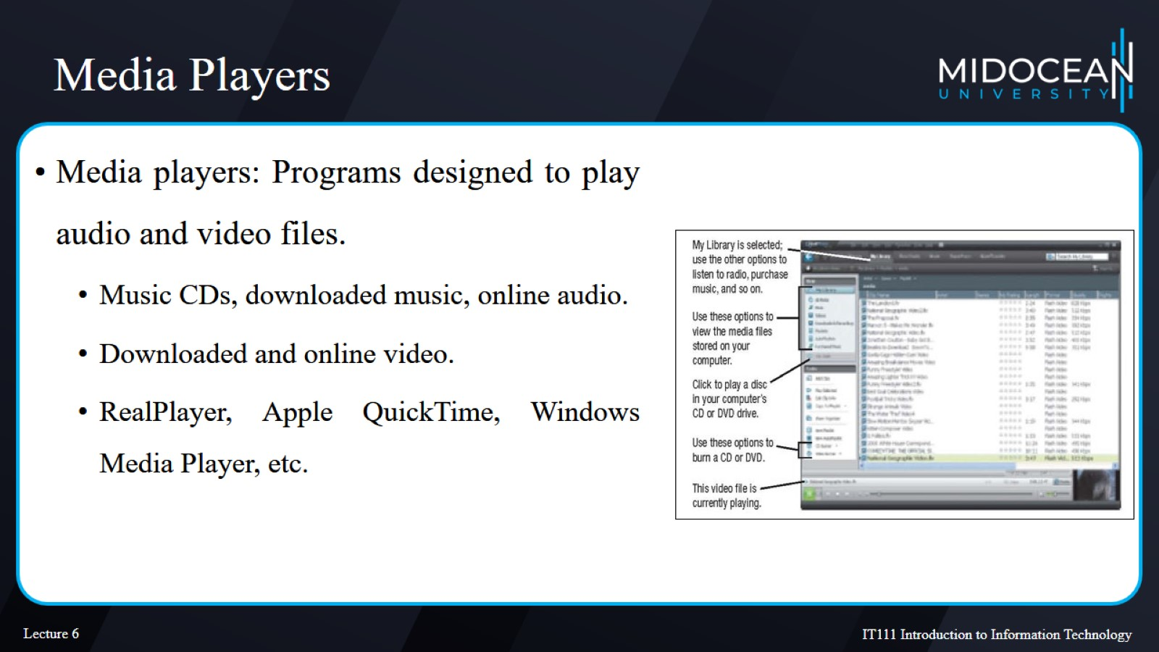
Media Players

Slide 38
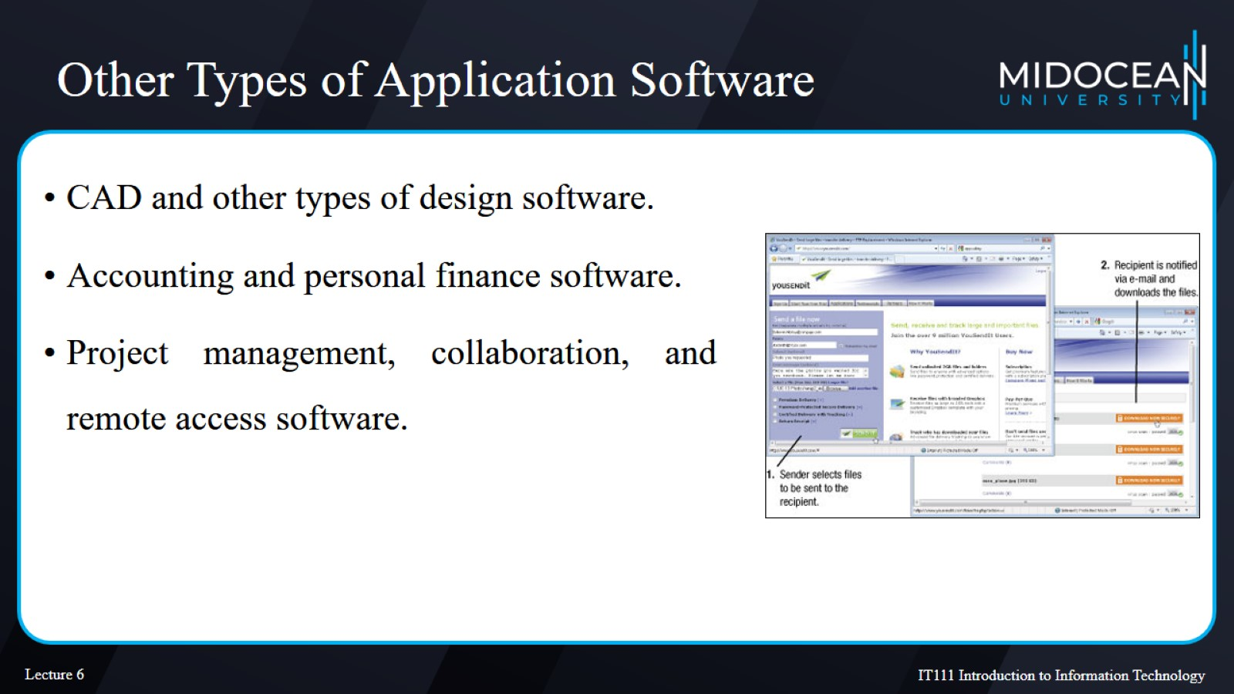
Other Types of Application Software

Slide 39
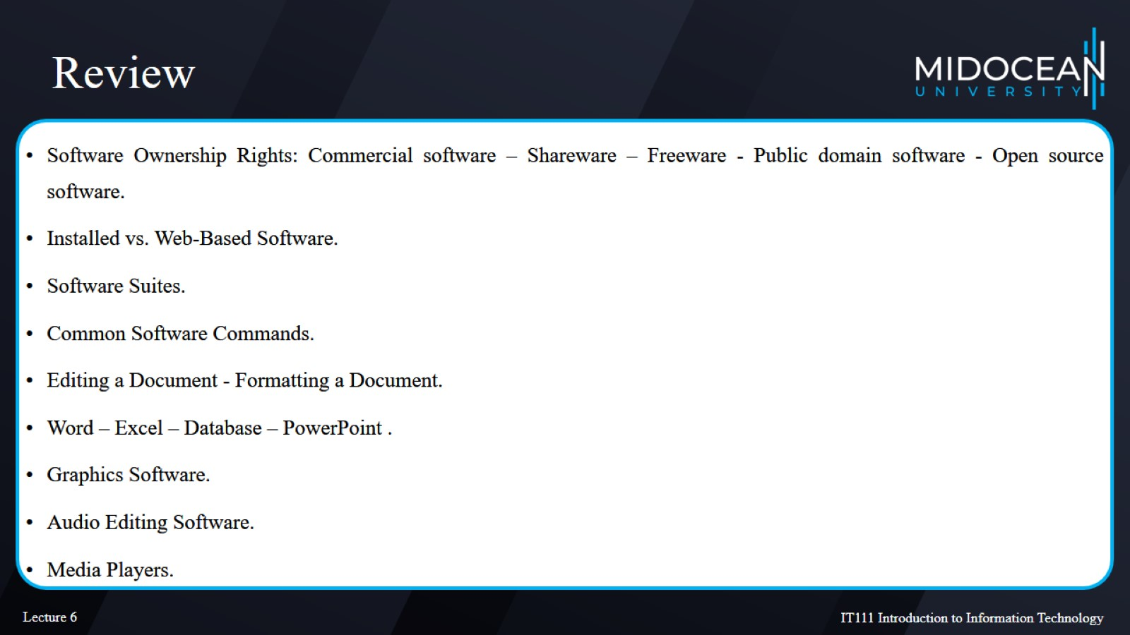
Review

Slide 40
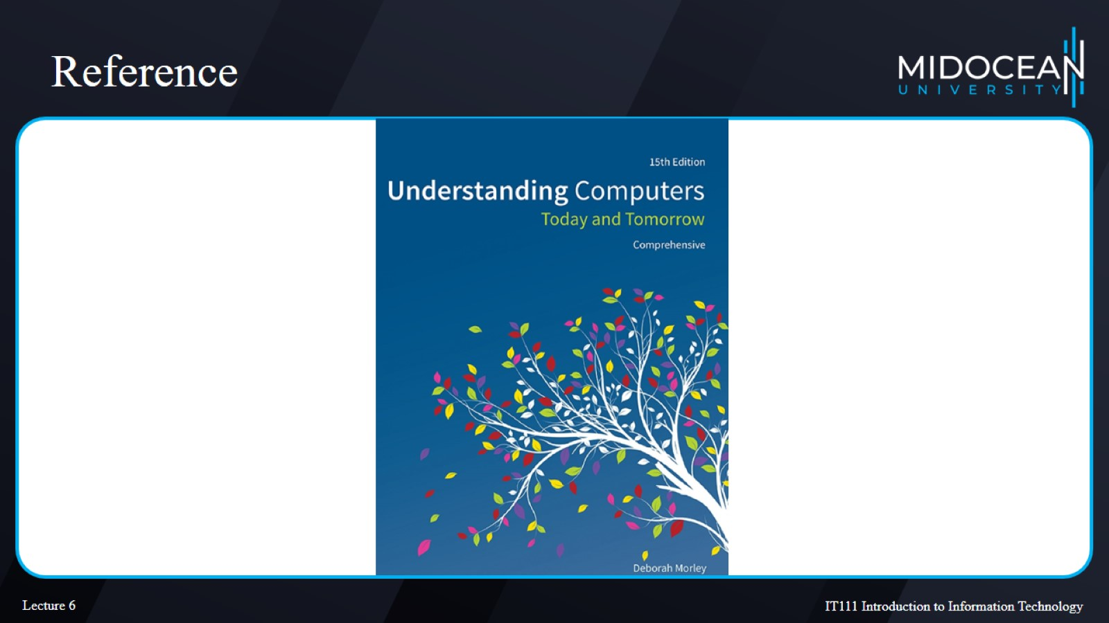
Reference

